Slide 1

Introduction
https://en.wikipedia.org/wiki/AlphaGo

Slide 2
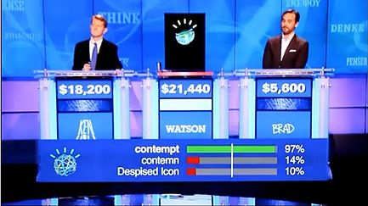
Introduction
https://en.wikipedia.org/wiki/Watson_(computer)

Slide 3
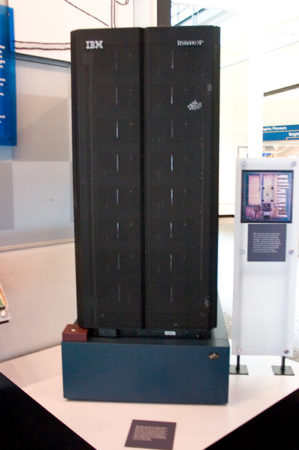
Introduction
https://en.wikipedia.org/wiki/Deep_Blue_(chess_computer)

Slide 4
Introduction
Artificial Intelligence:
Past, Present, and Future

Slide 5
Introduction
“intelligence organizes the world by organizing itself.”
--- Jean Piaget
Real world (reality)
|
Our perception/understanding of reality

Slide 6
Introduction
Intelligence is knowledge based.
Intelligence concerns self-organization and adaptation.
Learning may be viewed as a process of organization, finding patterns, finding structures in the real world.

Slide 7
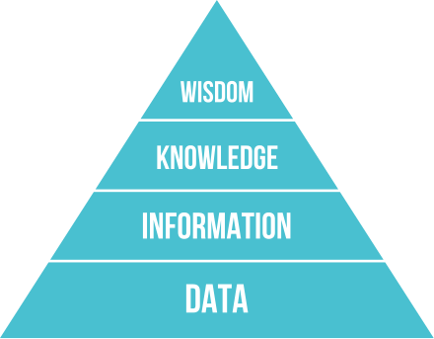
Introduction
Data-information-knowledge-wisdom hierarchy
Increasing degree of intelligence
https://en.wikipedia.org/wiki/DIKW_pyramid

Slide 8
Introduction
Basic questions:
Are we becoming wiser?
Are machine becoming more intelligent?

Slide 9
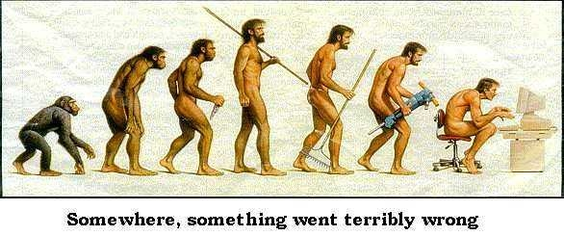
https://sites.google.com/site/sjlewisprojects/Home/the-ascent-of-man

Slide 10
Chapter 1: Introduction
1.0. Objectives of CS 320
1.1. A brief history of Artificial Intelligence (AI)
1.2. Scopes of AI
  1.2.1 Theories of Intelligence
  1.2.2 Artificial Intelligence

Slide 11
1.0. Objectives of CS320
Understand your intelligence through AI.
Apply AI in building smarter systems.

Slide 12
1.0. Objectives of CS320
AI as a way of thinking
AI as a methodology
AI as a tool
AI as a foundation for intelligent systems

Slide 13
1.0. Focus of CS320
Depth vs. breadth
We will adopt a breadth-oriented approach.

Slide 14
1.0. Benefits of taking CS320
to gain some general problem solving skills.
to learn Prolog, which is very different from other programming languages.
to understand better the notion of "intelligence".
to build a rational way of thinking.

Slide 15
1.0. Benefits of taking CS320
The ideas are more useful than the results.
The skills are more important than a solution to a particular problem.

Slide 16
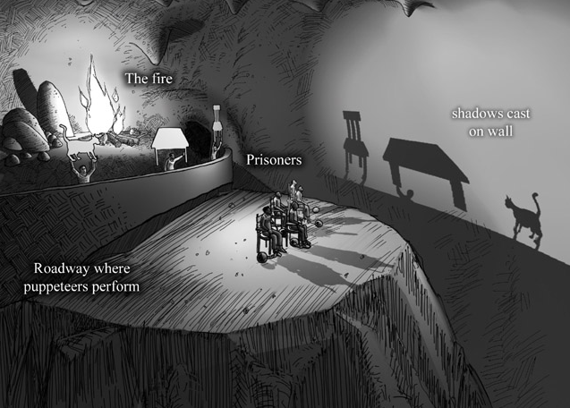
Plato’s Allegory of The Cave

Slide 17
1.1. A brief history of Artificial Intelligence (AI)
From AAAI site:
  http://aitopics.org/misc/brief-history
BG Buchanan (2005), A (Very) Brief History of Artificial Intelligence
  http://www.aaai.org/ojs/index.php/aimagazine/article/view/1848/1746

Slide 18
Dartmouth Conferences
The Dartmouth Summer Research Conference on Artificial Intelligence was the name of a conference now considered the seminal event for artificial intelligence as a field. The conference occurred in 1956. It was organised by John McCarthy (then at Dartmouth College) and formally proposed by McCarthy, Marvin Minsky, Nathaniel Rochester and Claude Shannon. Their proposal is credited with introducing the term 'artificial intelligence'.
Besides the proposal's authors, attendees included Ray Solomonoff, Oliver Selfridge, Trenchard More, Arthur Samuel, Herbert Simon, and Allen Newell.
From Wikepedia
http://

Slide 19
Dartmouth Conferences
The proposal introduction states
We propose that a 2 month, 10 man study of artificial intelligence be carried out during the summer of 1956 at Dartmouth College in Hanover, New Hampshire. The study is to proceed on the basis of the conjecture that every aspect of learning or any other feature of intelligence can in principle be so precisely described that a machine can be made to simulate it. An attempt will be made to find how to make machines use language, form abstractions and concepts, solve kinds of problems now reserved for humans, and improve themselves. We think that a significant advance can be made in one or more of these problems if a carefully selected group of scientists work on it together for a summer.
(McCarthy et al. 1955)
From: http://www-formal.stanford.edu/jmc/history/dartmouth/dartmouth.html
http://

Slide 20
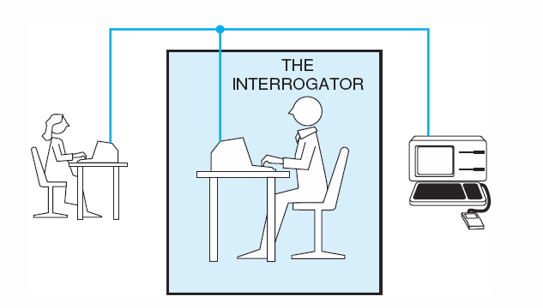
Turing test
Luger: Artificial Intelligence, 6th edition. © Pearson Education Limited, 2009

Slide 21
John Searle: The Chinese Room Argument
Imagine a native English speaker who knows no Chinese locked in a room full of boxes of Chinese symbols (a data base) together with a book of instructions for manipulating the symbols (the program). Imagine that people outside the room send in other Chinese symbols which, unknown to the person in the room, are questions in Chinese (the input). And imagine that by following the instructions in the program the man in the room is able to pass out Chinese symbols which are correct answers to the questions (the output). The program enables the person in the room to pass the Turing Test for understanding Chinese but he does not understand a word of Chinese.
Stanford Encyclopedia of Philosophy
http://

Slide 22
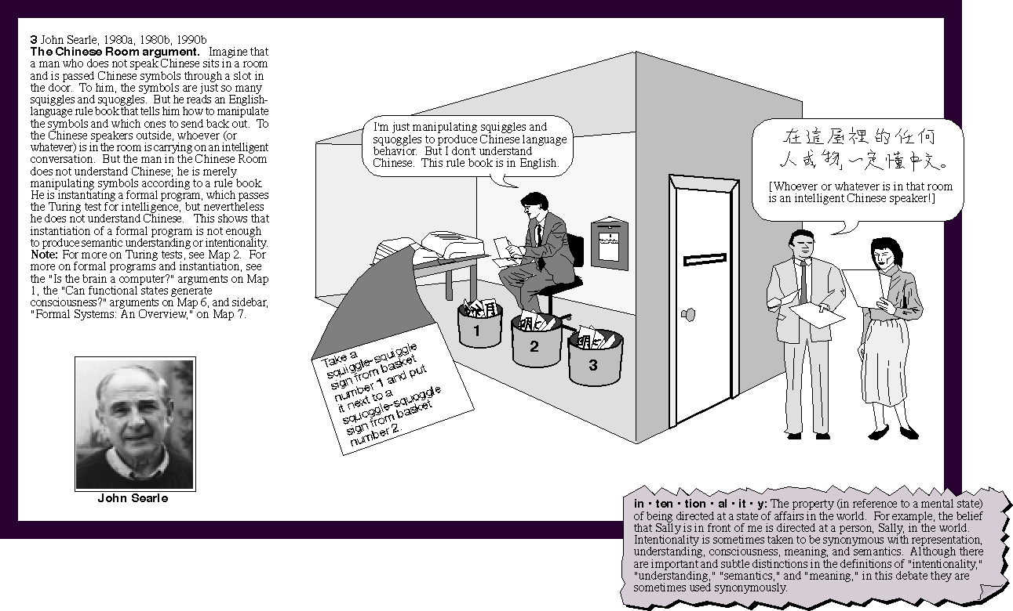
John Searle: The Chinese Room Argument
http://www.macrovu.com/image/CCTimg/CCTMap4ChineseRm.gif

Slide 23
1.2. Scopes of AI
  AI can have two purposes. One is to use the power of computers to augment human thinking, just as we use motors to augment human or horse power. Robotics and expert systems are major branches of that. The other is to use a computer's artificial intelligence to understand how humans think. In a humanoid way. If you test your programs not merely by what they can accomplish, but how they accomplish it, they you're really doing cognitive science; you're using AI to understand the human mind.
  Herbert A.Simon 1994

Slide 24
1.2.1 Theories of Intelligence
(Examples)
Intelligence quotient (IQ)
An intelligence quotient (IQ) is a total score derived from several standardized tests designed to assess human intelligence. The abbreviation "IQ" was coined by the psychologist William Stern for the German term Intelligenzquotient, his term for a scoring method for intelligence tests at University of Breslau he advocated in a 1912 book.
http://en.wikipedia.org/wiki/Intelligence_quotient

Slide 25
1.2.1 Theories of Intelligence
(Examples)
Howard Gardner (Multiple Intelligence)
  Linguistic Intelligence
  Logical-mathematical Intelligence
  Musical Intelligence
  Bodily-kinesthetic Intelligence
  Spatial Intelligence
  Interpersonal Intelligence
  Intrapersonal Intelligence
  A Naturalist Intelligence
  A spiritual Intelligence
  An Existential Intelligence
Gardner, H. Intelligence Reframed, multiple intelligence for the 21 Century, 1999.

Slide 26
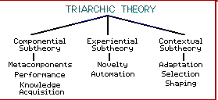
1.2.1 Theories of Intelligence
(Examples)
Robert J. Sternberg: Triarchic theory of intelligence

Slide 27
1.2.1 Theories of Intelligence
(Examples)
Robert J. Sternberg: Triarchic theory of intelligence
  Analytic (componential) Facet or Subtheory
  Creative (experiential Facet or Subtheory
  Practical (contextual) Facet or Subtheory

Slide 28
1.2.2 Artificial Intelligence
Artificial intelligence (AI) may be defined as the branch of CS that is concerned with the automation of intelligent behavior.
- Page 1, textbook

Slide 29
Artificial Intelligence
The collection of problems and methodologies studied by artificial intelligence researchers.

Slide 30
Artificial Intelligence
Simulate intelligence/implement intelligence
Explain natural intelligence

Slide 31
Artificial Intelligence
“The exciting new effort to make computers think ... machine with minds, in the full and literal sense.” (Hauheland, 1985).
-- Think like humans.

Slide 32
Artificial Intelligence
“The study of mental faculties through the use of computational models.” (Charniak and McDermott, 1985)
-- Think like humans.

Slide 33
Artificial Intelligence
“[The automation of] activities that we associate with human, thinking, activities such as decision-making, problem solving, learning ...” (Bellman, 1978).
-- Think and act like humans.

Slide 34
Artificial Intelligence
“The study of computations that make it possible to perceive, reason, and act.” (Winston, 1992)
-- Think and act like humans

Slide 35
Artificial Intelligence
“The art of creating machines that perform functions that require intelligence when performed by People.” (Kurzweil, 1990)
-- Think and act like humans and rationally.

Slide 36
Artificial Intelligence
“A field of study that seeks to explain and emulate intelligent behavior in terms of computational processes.” (Schalkoff, 1990)
-- Act like humans and rationally.

Slide 37
Artificial Intelligence
“The study of how to make computers do things at which, at the moment, people are better.” (Rich and Kight, 1991).
-- Act like humans.

Slide 38
1.2.2 Artificial Intelligence
Systems that think like humans (Cognitive modelling approach )
Systems that think rationally (The law of thought approach)
Systems that act like humans (The Turing test approach)
Systems that act rationally (The rational agent approach)
- Stuart Russell and Peter Norvig: Artificial Intelligence: A Modern Approach

Slide 39
Topics of AI
Simulate intelligence/implement intelligence
  Computer vision and image processing
  Perception and pattern recognition
  Speech recognition and natural language processing
  Robotics

Slide 40
Topics of AI
Simulate intelligence/implement intelligence
  Knowledge representation and reasoning (classical and non-classical logic)
  Learning and adaptation
  Strategies of problem solving (selective search, or heuristic search)

Slide 41
Topics of AI
Simulate intelligence/implement intelligence
  Expert systems
  Theorem proving
  Computer game
  …

Slide 42
Topics of AI
Explain natural intelligence
  Conceptual modeling of brain (e.g., neural nets)
  Explaining Natural Intelligence (NI) through AI
  Foundations of AI
  …

Slide 43
Important Research and Application Areas (textbook)
1 Game Playing
2 Automated Reasoning and Theorem Proving
3 Expert Systems
4 Natural Language Understanding and Semantic Modeling
5 Modeling Human Performance
6 Planning and Robotics
7 Languages and Environments for AI
8 Machine Learning
9 Alternative Representations: Neural Nets and Genetic Algorithms
AI and Philosophy
… …
Luger: Artificial Intelligence, 6th edition. © Pearson Education Limited, 2009

Slide 44
Important Features of Artificial Intelligence (textbook)
The use of computers to do reasoning, pattern recognition, learning, or some other form of inference.
A focus on problems that do not respond to algorithmic solutions. This underlies the reliance on heuristic search as an AI problem-solving technique.
A concern with problem-solving using inexact, missing, or poorly defined information and the use of representational formalisms that enable the programmer to compensate for these problems.
Reasoning about the significant qualitative features of a situation.
An attempt to deal with issues of semantic meaning as well as syntactic form.
Answers that are neither exact nor optimal, but are in some sense “sufficient”. This is a result of the essential reliance on heuristic problem-solving methods in situations where optimal or exact results are either too expensive or not possible.
The use of large amounts of domain-specific knowledge in solving problems. This is the basis of expert systems.
The use of meta-level knowledge to effect more sophisticated control of problem-solving strategies. Although this is a very difficult problem, addressed in relatively few current systems, it is emerging as an essential are of research.
Luger: Artificial Intelligence, 6th edition. © Pearson Education Limited, 2009

Slide 45
Additional Information
Other views of AI

Slide 46
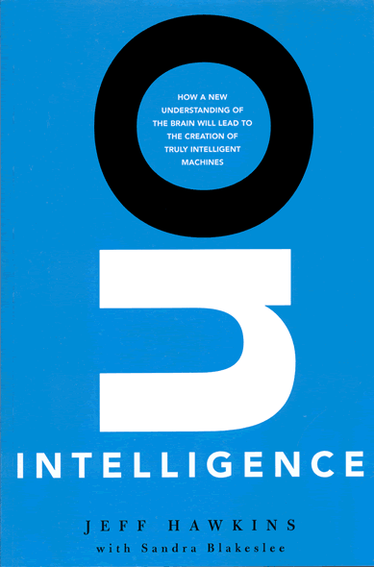
Jeff Hawkins : On Intelligence
Understanding Brain (Natural Intelligence)
as a prerequisite for AI
http://www.onintelligence.org/excerpt.php

Slide 47
Jeff Hawkins : On Intelligence
Can computers be intelligent?
Weren't neural networks supposed to lead to intelligent machines?
Why has it been so hard to figure out how the brain works?
What is intelligence if it isn't defined by behavior?
How does the brain work?
What are the implications of this theory?
Can we build intelligent machines and what will they do?

