Slide 1
Chapter 2: The Predicate Calculus
2.0 Introduction
2.1 The Propositional Calculus
2.2 The Predicate Calculus
2.3 Using Inference Rules to Produce Predicate Calculus Expression
2.4 Application: A Logic-Based Financial Advisor

Slide 2
2.0 Introduction
Logic is a formal language for valid reasoning
  Syntax: rules for forming sentences/formulas
  Semantics: interpretation of sentences/formulas

Slide 3
2.0 Introduction
Predicate logic provide theoretic foundation of programming language PROLOG
  PROLOG program (knowledge): first order logic sentences
  PROLOG interpreter (reasoning/inferences): depth-first search

Slide 4
2.0 Introduction
Logic provides an abstract way of thinking
“ … computing is all about constructing, manipulating, and reasoning about abstractions.”
“ONCE WE HAVE LEARNED HOW TO REASON PRECISELY ABOUT ONE SET OF ABSTRACTIONS, IT TAKES RELATIVELY LITTLE EXTRA EFFORT TO REASON ABOUT ANY OTHERS.”
-- Devlin, Keith. “Why Universities Require Computer Science Students to Take Math.” Communications of the ACM. September 2003: 37-39. http://dl.acm.org/citation.cfm?doid=903893.903917

Slide 5
2.1 The Propositional Calculus
Using symbols (propositional variable) to represent a statement.
A statement is either true or false, but not both.

Slide 6
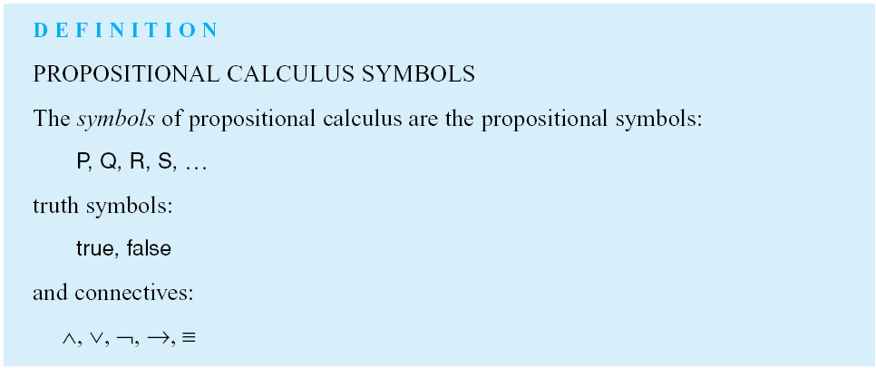
Luger: Artificial Intelligence, 6th edition. © Pearson Education Limited, 2009

Slide 7
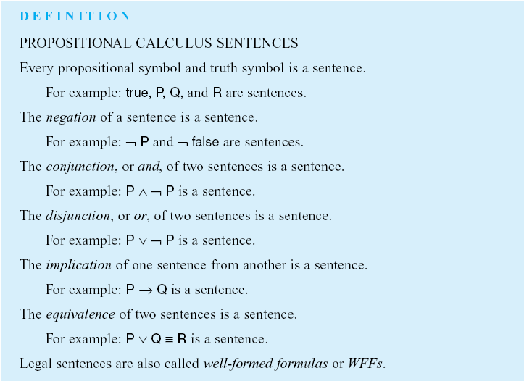

Slide 8
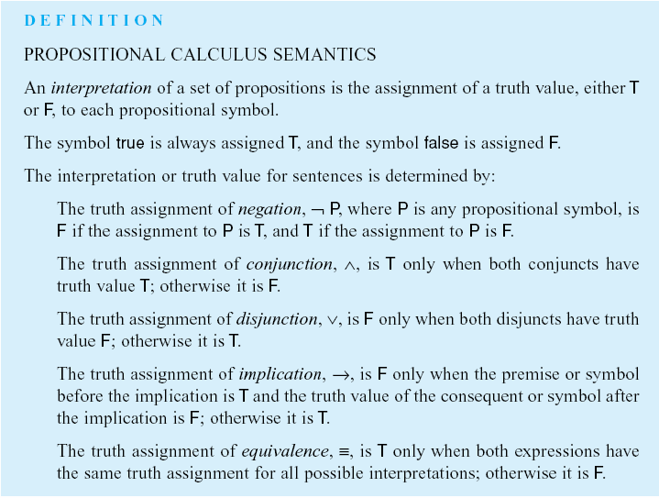
Luger: Artificial Intelligence, 6th edition. © Pearson Education Limited, 2009

Slide 9
Semantics of Propositional logic
Truth table
P | Q | ¬P | P∧Q | P∨Q | P⇒Q | P⇔Q
false | false | true | false | false | true | true
false | true | true | false | true | true | false
true | false | false | false | true | false | false
true | true | false | true | true | true | true
Notes:
Semantics can be defined in other ways as well.

Slide 10
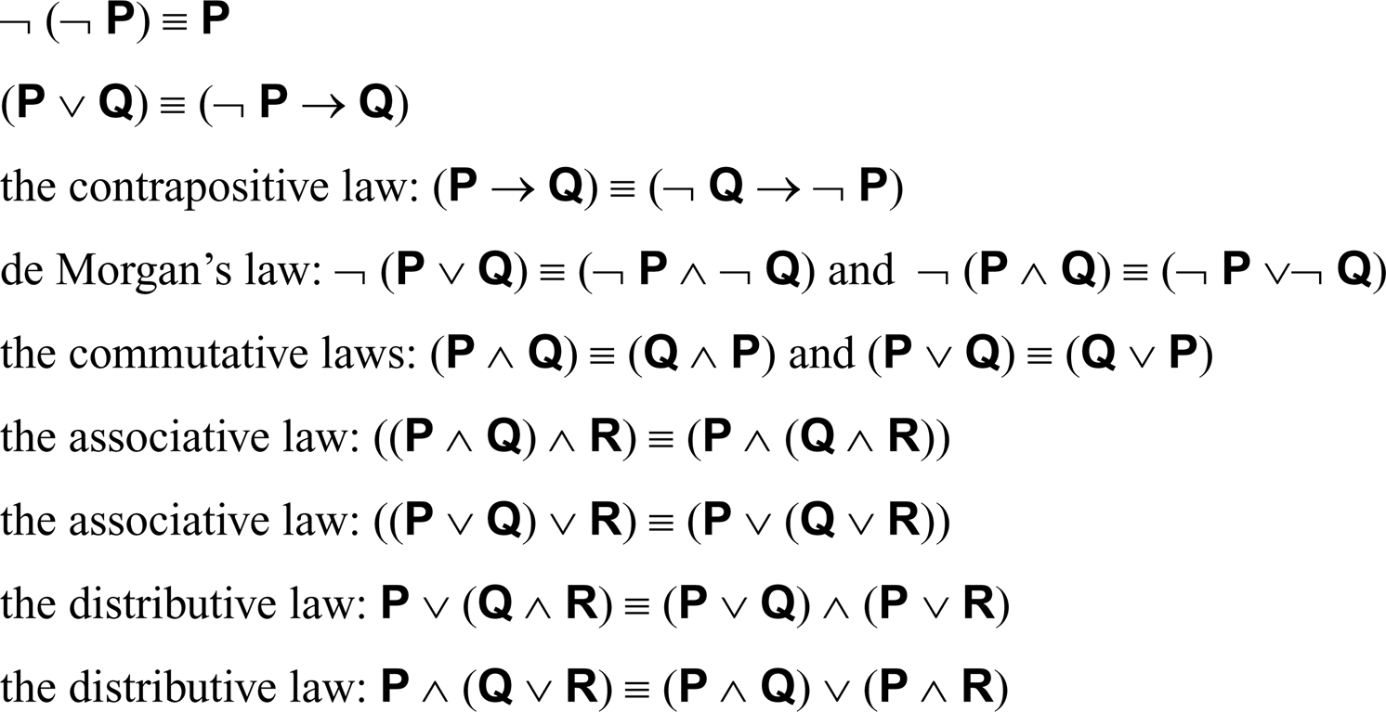
Two logic expressions are equivalent if they have the same
value under all truth value assignments. Examples
For propositional expressions P, Q and R:

Slide 11
2.2 The Predicate Calculus
Extension of propositional logic by adding new vocabularies:
  Variables to present individuals of a domain
  Two new unary logic operators (quantifiers):
    Universal
    Existential
New rules of inferences involving quantifiers

Slide 12
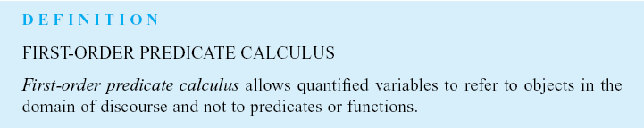
Luger: Artificial Intelligence, 6th edition. © Pearson Education Limited, 2009

Slide 13
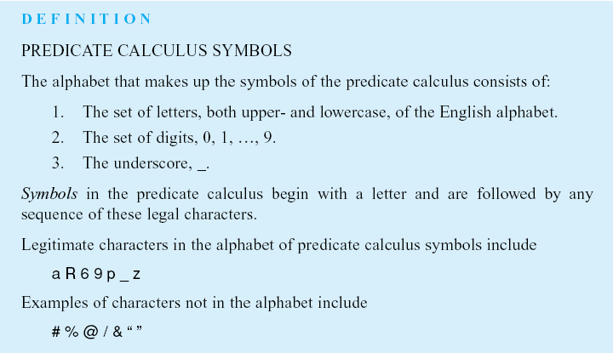
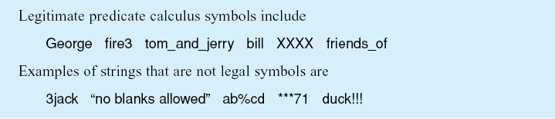
Luger: Artificial Intelligence, 6th edition. © Pearson Education Limited, 2009

Slide 14
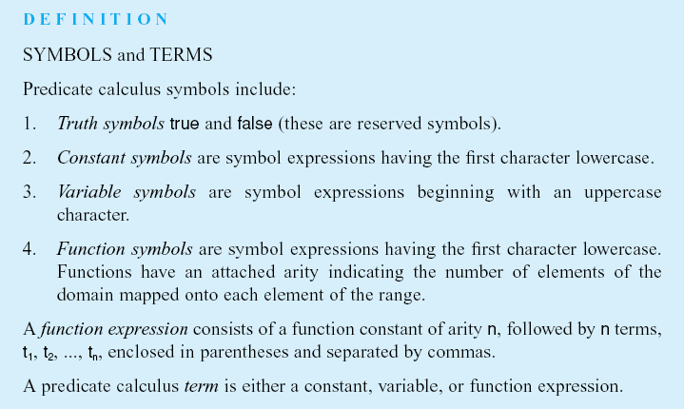
Luger: Artificial Intelligence, 6th edition. © Pearson Education Limited, 2009

Slide 15
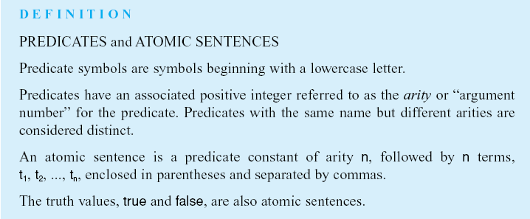
Luger: Artificial Intelligence, 6th edition. © Pearson Education Limited, 2009

Slide 16
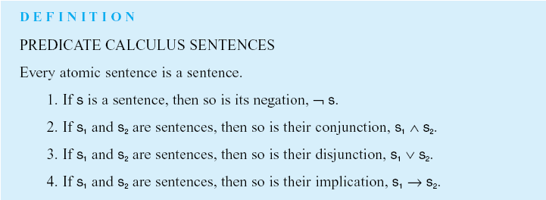
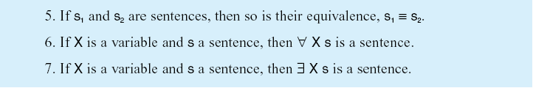
Luger: Artificial Intelligence, 6th edition. © Pearson Education Limited, 2009

Slide 17
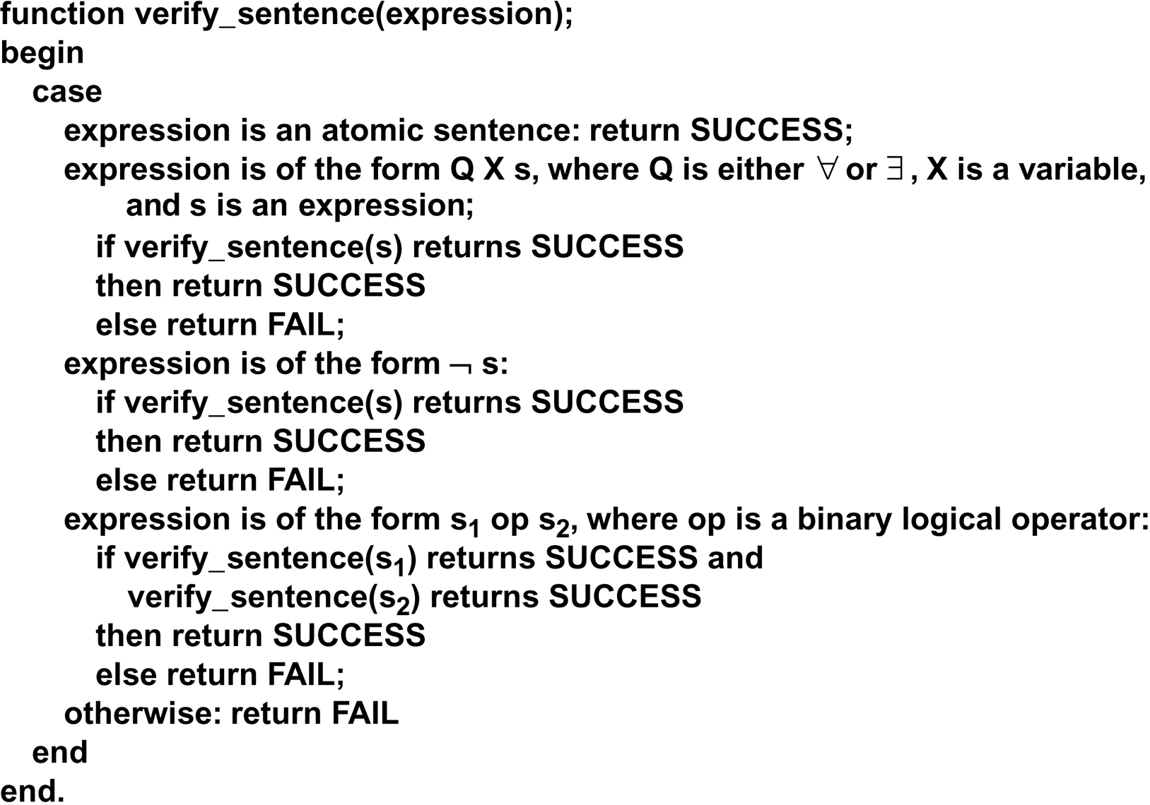
verify_sentence algorithm
Luger: Artificial Intelligence, 6th edition. © Pearson Education Limited, 2009

Slide 18
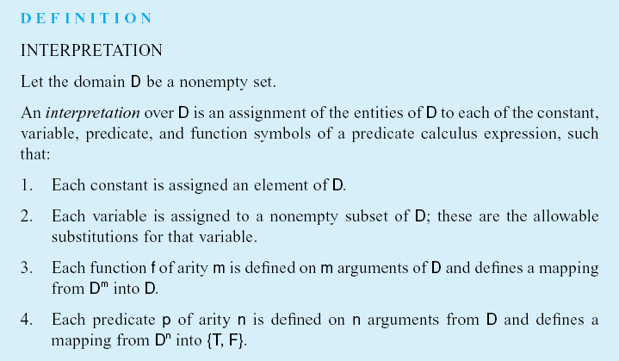
Luger: Artificial Intelligence, 6th edition. © Pearson Education Limited, 2009

Slide 19
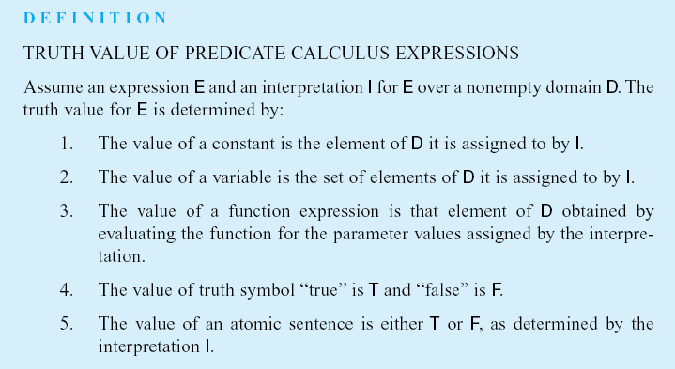
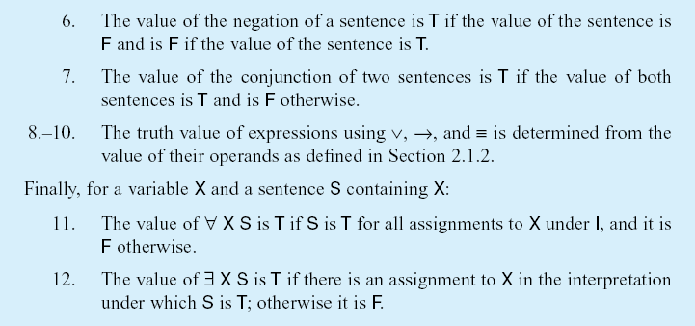
Luger: Artificial Intelligence, 6th edition. © Pearson Education Limited, 2009

Slide 20
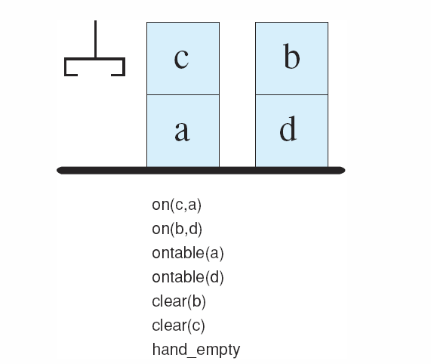
Figure 2.3: A blocks world with its predicate calculate description.
Luger: Artificial Intelligence, 6th edition. © Pearson Education Limited, 2009

Slide 21
2.3 Using Inference Rules to Produce Predicate Calculus Expression
Inference rules (share with propositional logic)
Unification (new)

Slide 22
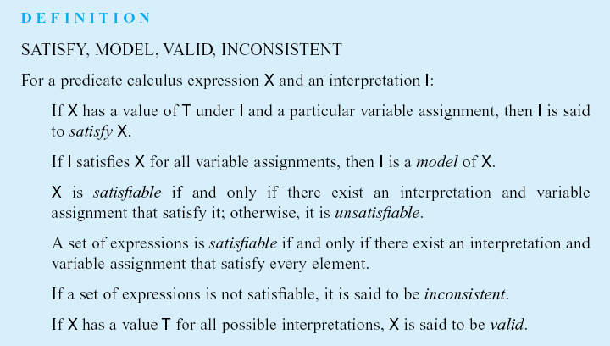
Luger: Artificial Intelligence, 6th edition. © Pearson Education Limited, 2009

Slide 23
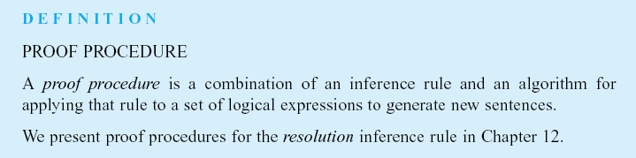
Luger: Artificial Intelligence, 6th edition. © Pearson Education Limited, 2009

Slide 24
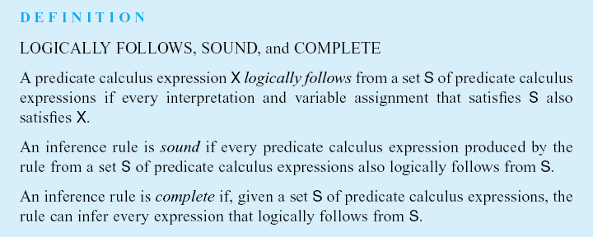
Luger: Artificial Intelligence, 6th edition. © Pearson Education Limited, 2009

Slide 25
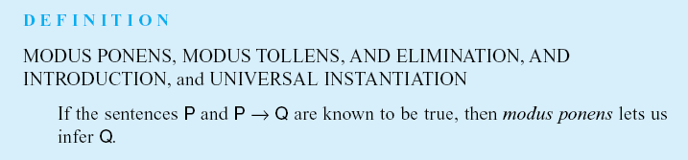
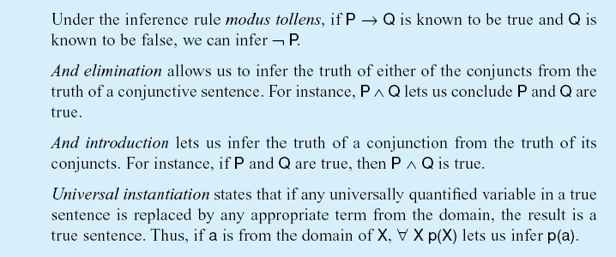
Luger: Artificial Intelligence, 6th edition. © Pearson Education Limited, 2009

Slide 26
Unification: match with substitutions
happy(X) does not mach literately with happy(john)
We need to substitute X by john, or we instantiate X by john
Substitution or binding
  X/Y: X is substituted for Y, Y is bound to X
  john/X: john is substituted for X, X is bound to john (not a variable anymore)

Slide 27
Unification: match with substitutions
X (man(X) -> mortal(X))
man(john)
john/X
man(john) -> mortal(john)
John is a man

Slide 28
Composition of substitutions
If S and S’ are two substitution sets, the composition of S and S’ (written
SS’) is obtained by:
Applying S’ to elements of S
Adding the results to S
Example:
S1: {X/Y. W/Z}
S2: {V/X}
S3: {a/V, f(b)/W}
S3S2:
1: {a/X}
2: {a/X, a/V, f(b)/W}
(S3S2)S1
1: {a/Y, f(b)/Z}
2: {a/Y, f(b)/Z, a/X, a/V, f(b)/W}

Slide 29
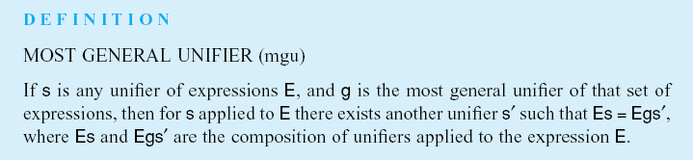
Luger: Artificial Intelligence, 6th edition. © Pearson Education Limited, 2009

Slide 30
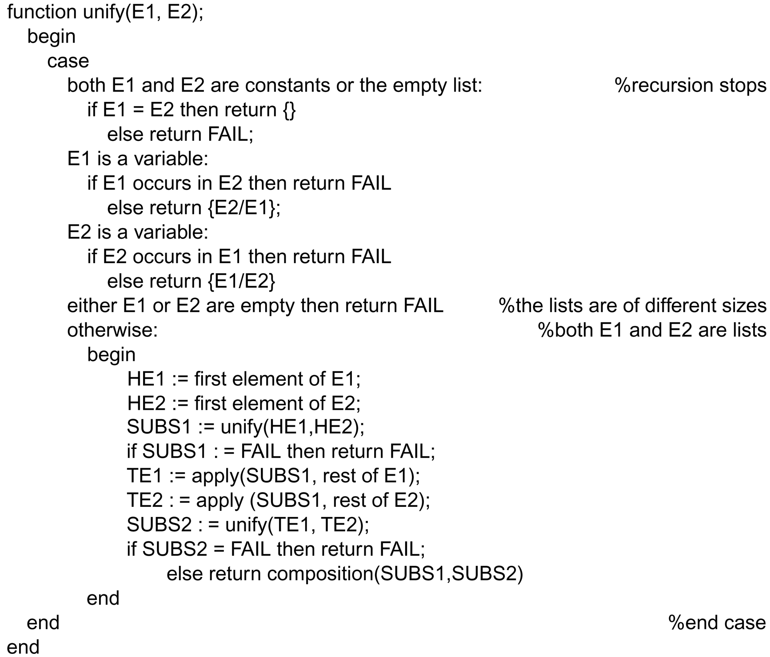
Luger: Artificial Intelligence, 6th edition. © Pearson Education Limited, 2009

Slide 31
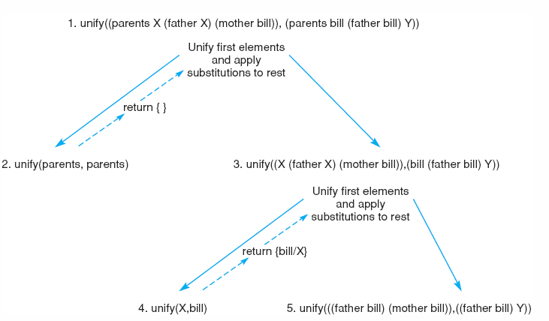
Figure 2.5: Further steps in the unification of (parents X (father X) (mother bill)) and (parents bill (father bill) Y).
Luger: Artificial Intelligence, 6th edition. © Pearson Education Limited, 2009

Slide 32
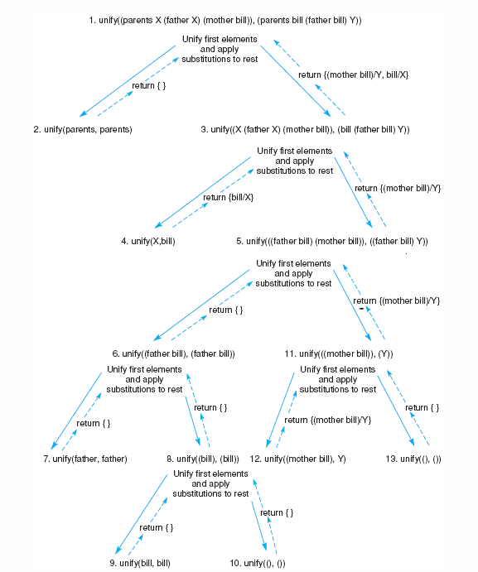
Figure 2.6: Final trace of the unification of (parents X (father X) (mother bill)) and (parents bill (father bill) Y).
Luger: Artificial Intelligence, 6th edition. © Pearson Education Limited, 2009
Notes:
OWEN: Insert fig 2.6

Slide 33
2.4 Application: A Logic-Based Financial Advisor
Representation of financial situations
Rules of financial planning and decision making

Slide 34
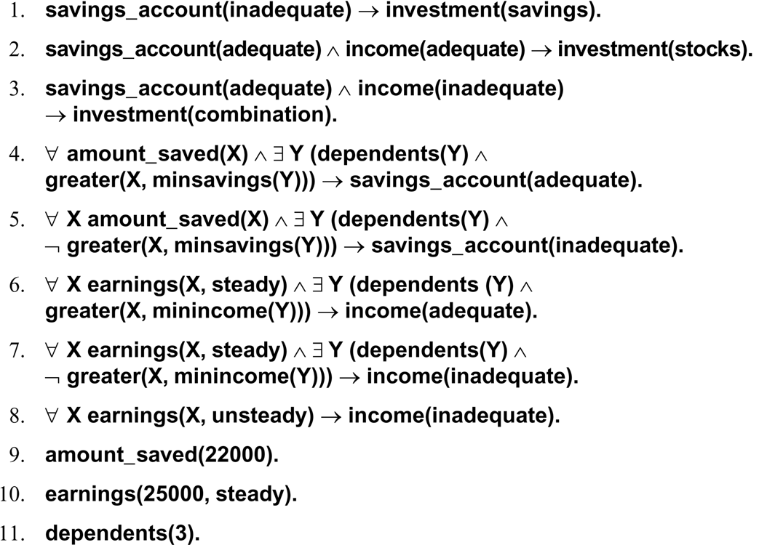
Luger: Artificial Intelligence, 6th edition. © Pearson Education Limited, 2009

