Slide 1
3.3 Using State Space to Represent Reasoning with the Predicate Calculus

Slide 2
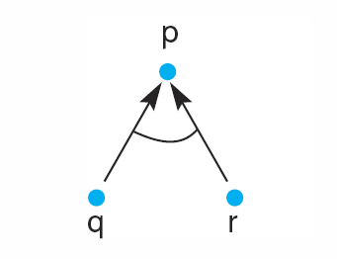
Fig 3.21 And/or graph of the expression q Λ r → p.
2
Luger: Artificial Intelligence, 6th edition. © Pearson Education Limited, 2009
Notes:
2

Slide 3
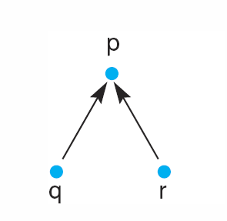
Fig 3.22 And/or graph of the expression q v r → p
3
Luger: Artificial Intelligence, 6th edition. © Pearson Education Limited, 2009
Notes:
3
Insert fig 3.22

Slide 4
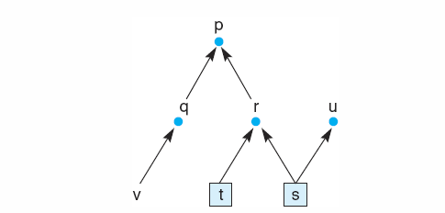
Fig 3.20 State space graph of a set of implications in the propositional calculus.
4
Luger: Artificial Intelligence, 6th edition. © Pearson Education Limited, 2009
Notes:
4

Slide 5
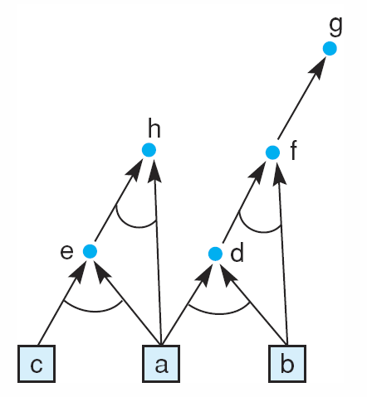
Fig 3.23 And/or graph of a set of propositional calculus expressions.
5
Luger: Artificial Intelligence, 6th edition. © Pearson Education Limited, 2009
Notes:
5

Slide 6
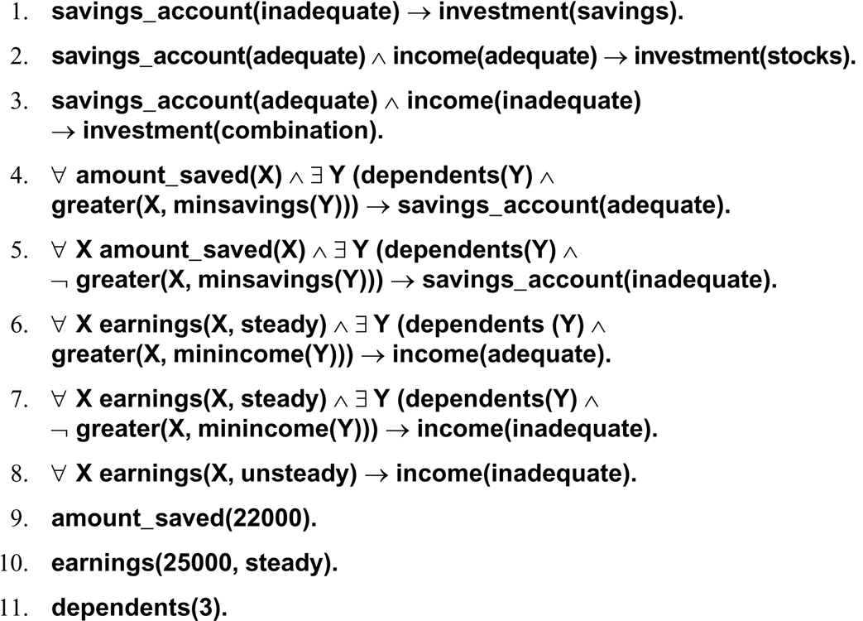
financial advisor
6
Luger: Artificial Intelligence, 6th edition. © Pearson Education Limited, 2009

Slide 7
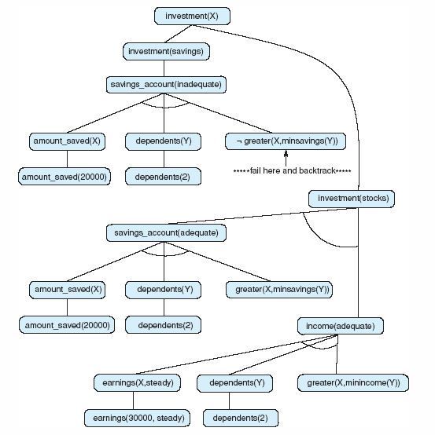
Fig 3.26 And/or graph searched by the financial advisor.
7
Luger: Artificial Intelligence, 6th edition. © Pearson Education Limited, 2009
Notes:
7

Slide 8
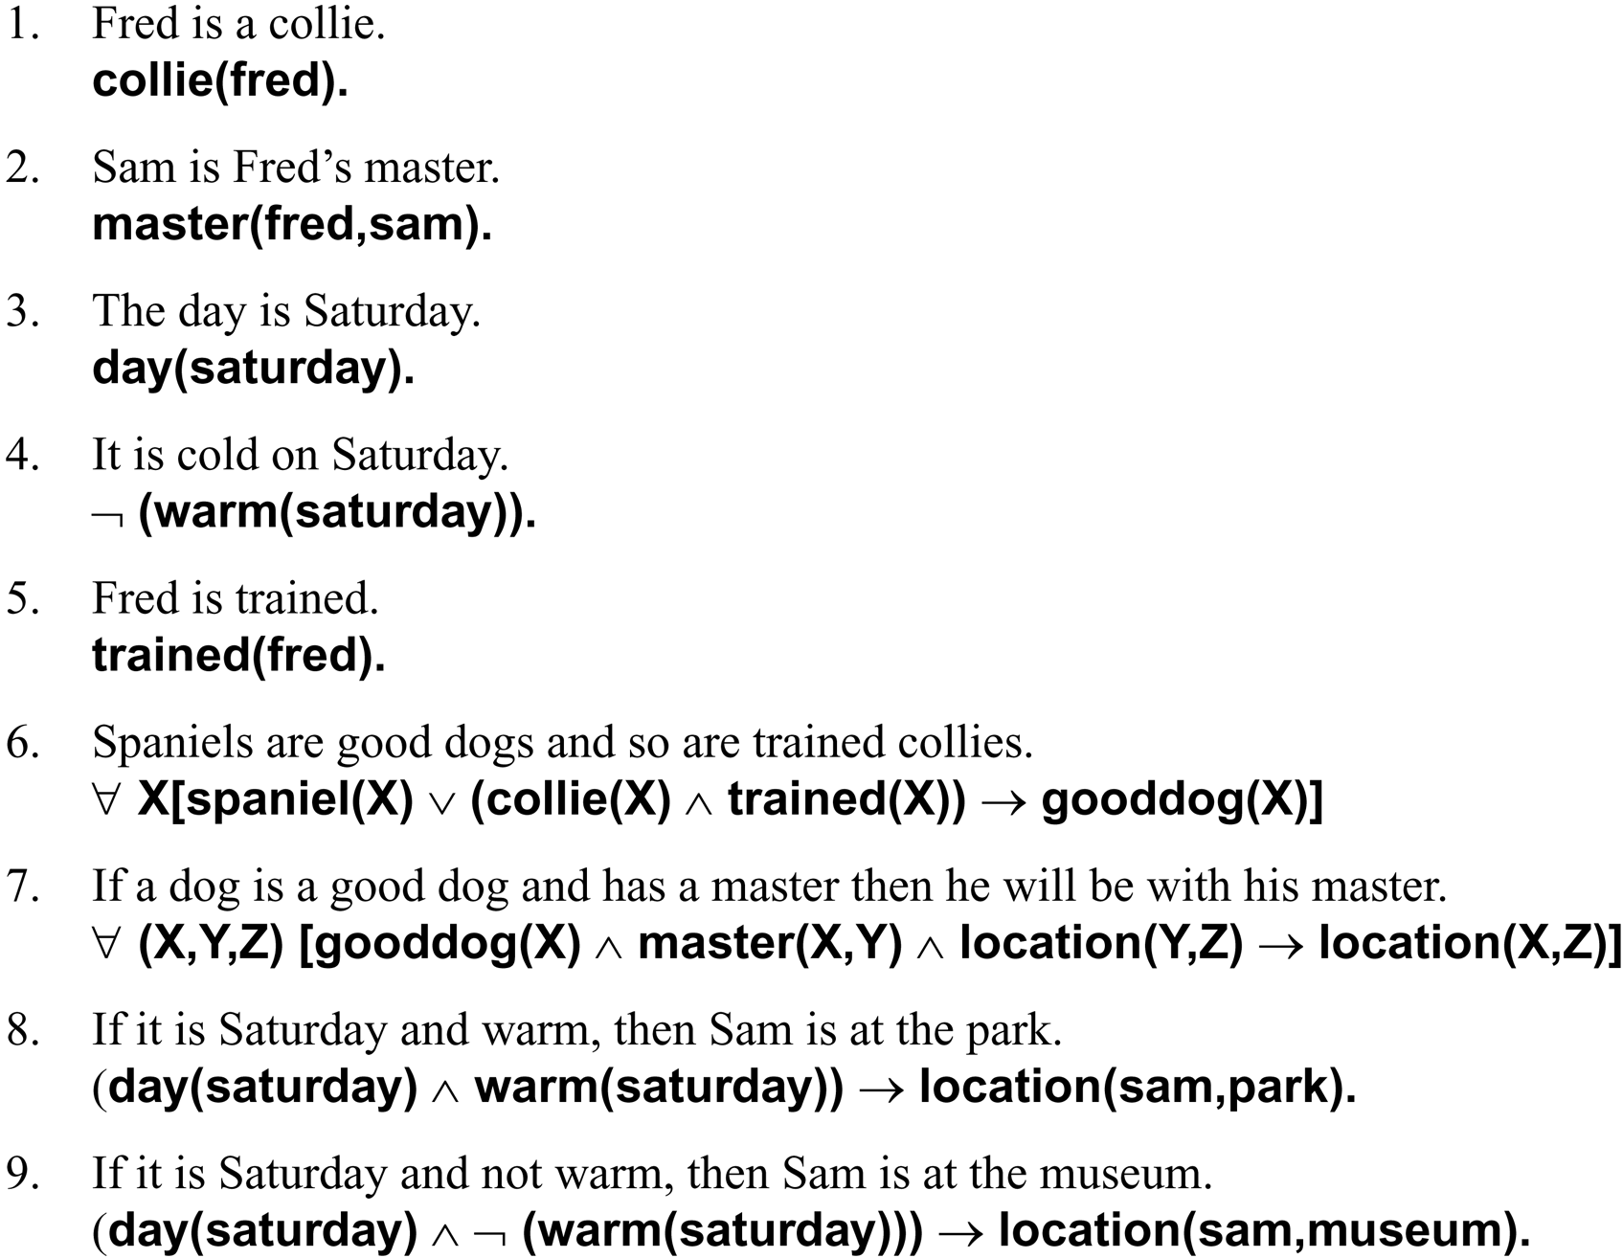
The facts and rules of this example are given as English sentences followed by their predicate calculus equivalents:
8
Luger: Artificial Intelligence, 6th edition. © Pearson Education Limited, 2009

Slide 9
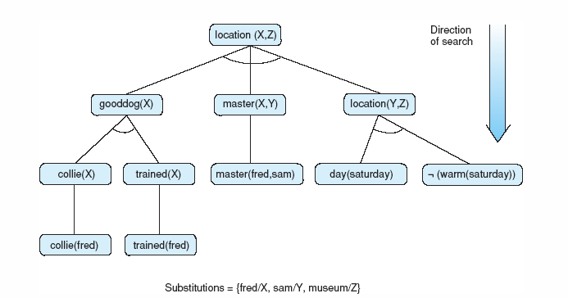
Fig 3.25 The solution subgraph showing that Fred is at the museum.
9
Luger: Artificial Intelligence, 6th edition. © Pearson Education Limited, 2009
Notes:
9

