Slide 1
Chapter 10:
Machine Learning: Symbol-Based
10.0 Introduction
10.1 A Framework for Symbol-Based Learning
10.2 Version Space Search
10.3 ID3 (Decision Tree Induction)
PRISM (Sequential Covering)
10.4 Inductive Bias and Learnability
10.5 Knowledge and Learning
10.6 Unsupervised Learning
10.7 Reinforcement Learning

Slide 2
10.0 Introduction
Machine learning refers to a system capable of the autonomous acquisition and integration of knowledge. This capacity to learn from experience, analytical observation, and other means, results in a system that can continuously self-improve and thereby offer increased efficiency and effectiveness.
--- from http://www.aaai.org/AITopics/pmwiki/pmwiki.php/AITopics/MachineLearning

Slide 3
10.0 Introduction
Machine learning vs human learning
  Human learning offers hints to machine learning.
  Machine learning leads to better understanding of human learning.

Slide 4
10.0 Introduction
Motivation and rewarding
  Evaluation of success
    Results
    Methods
    …
  Rewarding
    Reinforcement
    Reconfirmation
    Achievement
    Exciting
    …

Slide 5
10.0 Introduction
Piaget’s Theory:
“The intelligence organize the world by organizing itself.”

Slide 6
10.0 Introduction
Two basic processes:
  Assimilation – the process through which children acquire information from the environment and incorporate this information into existing knowledge.
  Accommodation – the process through which children revise their existing knowledge in order to satisfy the requirements of the environment.
  - From Spitzer, D. R., Concept Formation and Learning in Early Childhood

Slide 7
10.0 Introduction
Common algorithm types:
Supervised learning - Generates a function that maps inputs to desired outputs. For example, in a classification problem, the learner approximates a function mapping a vector into classes by looking at input-output examples of the function.
Unsupervised learning - Models a set of inputs: like clustering
Semi-supervised learning - Combines both labeled and unlabeled examples to generate an appropriate function or classifier.
Reinforcement learning - Learns how to act given an observation of the world. Every action has some impact in the environment, and the environment provides feedback in the form of rewards that guides the learning algorithm.
Transduction - Tries to predict new outputs based on training inputs, training outputs, and test inputs.
Learning to learn - Learns its own inductive bias based on previous experience.
Pareto-based multi-objective learning - a Pareto-based approach to learning that results in a set of learning models, which typically trade off between performance and complexity.
From: http://en.wikipedia.org/wiki/Machine_learning

Slide 8
10.1 A Framework for Symbol-Based Learning
Learning as search
  From disorder to order (organization)
  From uncertainty to certainty
  From a lack of confidence to confidence
  From worse performance to better performance
  From errors to correct knowledge (i.e., error correction)
  …

Slide 9
10.1 A Framework for Symbol-Based Learning
Multiple criteria
  Performance
  Understanding
  New results
  …
Multiple strategies
  Learning from example
  Learning by doing
  Learning by being told
  Learning from errors
  Learning by observation
  …

Slide 10
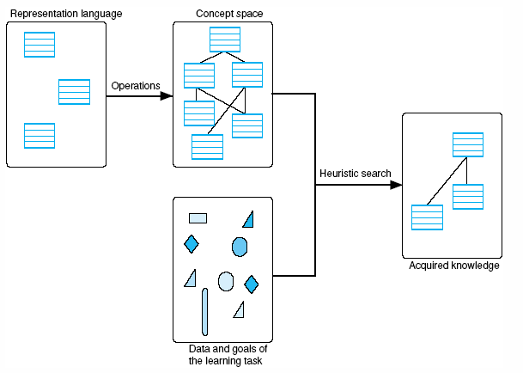
Fig 10.1 A general model of the learning process
Luger: Artificial Intelligence, 6th edition. © Pearson Education Limited, 2009
2

Slide 11
An Illustrative Example:
Partick Winston’s algorithm (learning structural concept, e.g., “arch”)
  Positive examples
  Negative examples
  Near misses

Slide 12
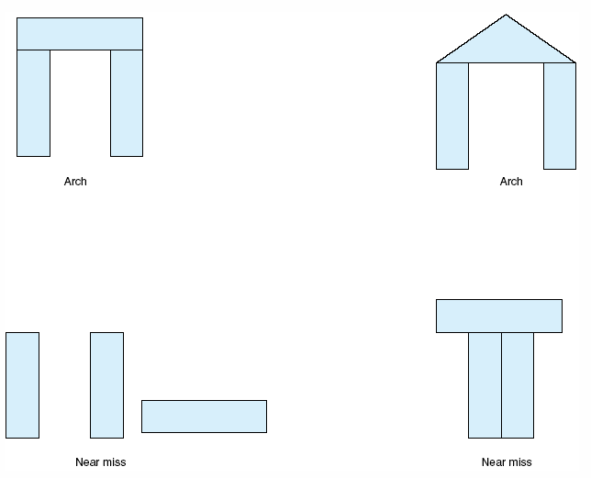
Fig 10.2 Examples and near misses for the concept “arch.”
Luger: Artificial Intelligence, 6th edition. © Pearson Education Limited, 2009
3

Slide 13
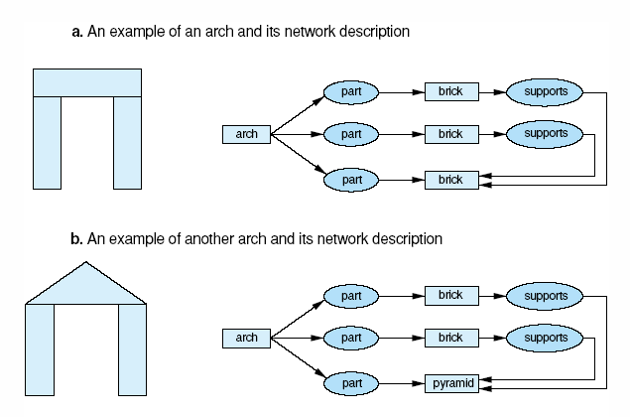
Fig 10.3 generalization of descriptions to include multiple examples.
Luger: Artificial Intelligence, 6th edition. © Pearson Education Limited, 2009
4

Slide 14
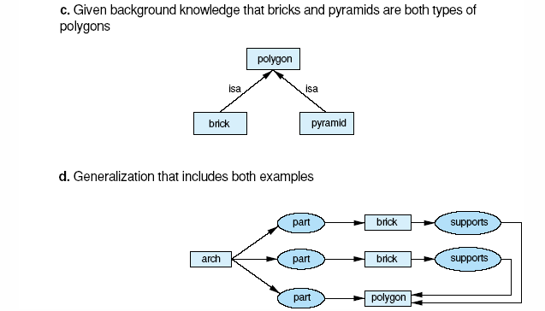
Fig 10.3 generalization of descriptions to include multiple examples (cont’d)
Luger: Artificial Intelligence, 6th edition. © Pearson Education Limited, 2009
5

Slide 15
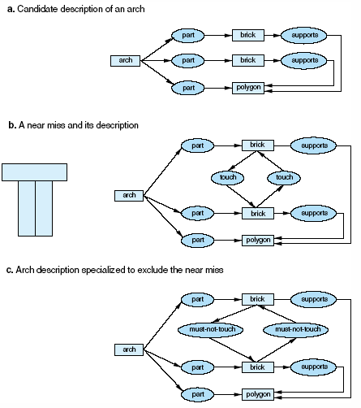
Fig 10.4 Specialization of a description to exclude a near miss. In 10.4c we add constraints to 10.4a so that it can’t match with 10.4b.
Luger: Artificial Intelligence, 6th edition. © Pearson Education Limited, 2009
6

Slide 16
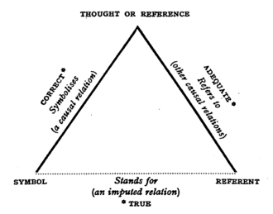
Representation of a concept
Meaning triangle
http://en.wikipedia.org/wiki/The_Meaning_of_Meaning

Slide 17
Representation of a concept
Name of the concept
Intension of the concept: meaning
  A logic formula
  A set of properties/traits
Extension of the concept: instances
  A set of objects

Slide 18
Concept learning
Finding an intension based on an extension (i.e., a set of examples)
Express an concept by a set of known concepts

Slide 19
10.2 Version Space Search
Knowledge representation
  Concept space
Three strategies to search a concept space
  From specific to general
  From general to specific
  A combination of the two

Slide 20
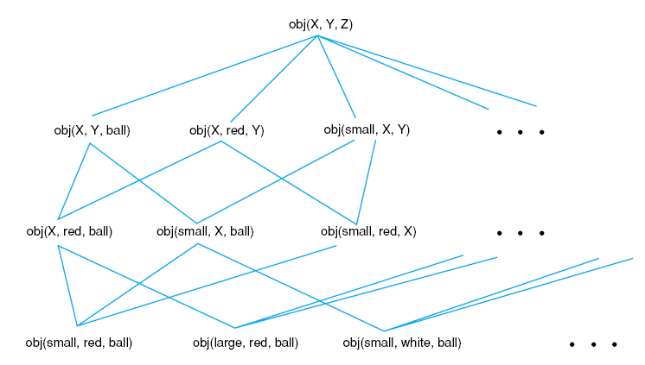
Fig 10.5 A concept space.
Luger: Artificial Intelligence, 6th edition. © Pearson Education Limited, 2009
7

Slide 21
Relationships between concepts
Generalization-specialization relation
  Ancestor and descendent
Most general specialization
  Parent
Most specific generalization
  Child

Slide 22
Version space learning
A single concept in the concept space
  Conjunction of properties

Slide 23
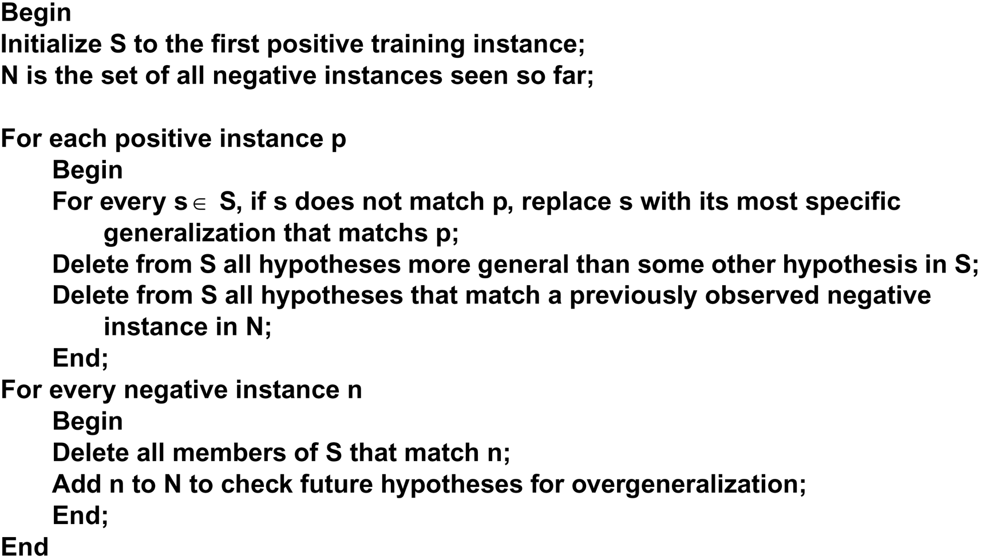
Defining specific to general search, for hypothesis set S as:
Luger: Artificial Intelligence, 6th edition. © Pearson Education Limited, 2009
8

Slide 24
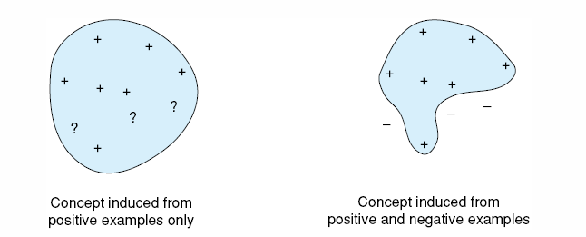
Fig 10.6 The role of negative examples in preventing overgeneralization.
Luger: Artificial Intelligence, 6th edition. © Pearson Education Limited, 2009
10

Slide 25
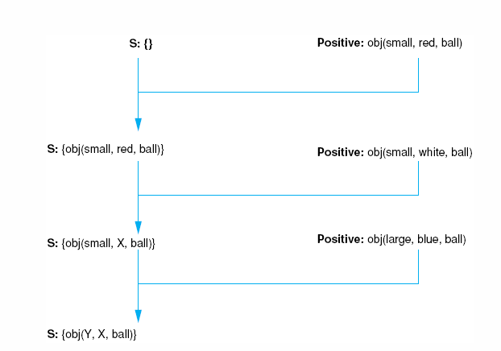
Fig 10.7 Specific to general search of the version space learning the concept “ball.”
Luger: Artificial Intelligence, 6th edition. © Pearson Education Limited, 2009
11

Slide 26
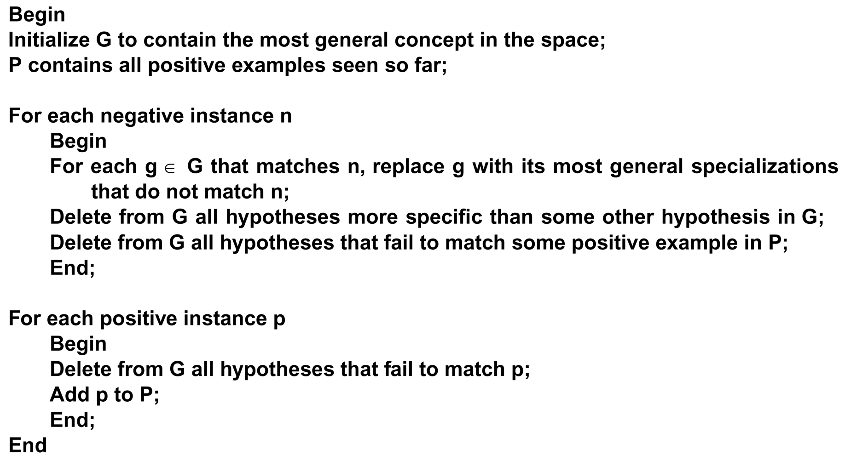
From general to specific.
Luger: Artificial Intelligence, 6th edition. © Pearson Education Limited, 2009
9

Slide 27
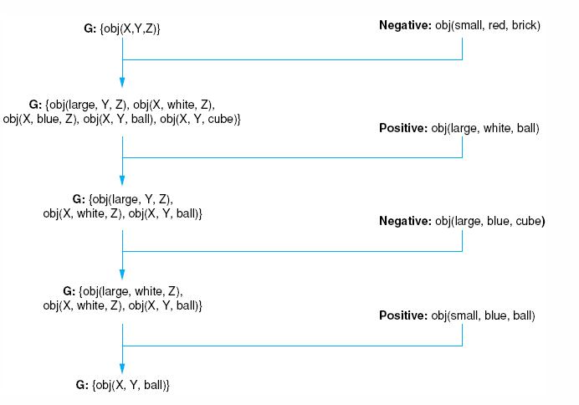
Fig 10.8 General to specific search of the version space learning the concept “ball.”
----------
Luger: Artificial Intelligence, 6th edition. © Pearson Education Limited, 2009
13

Slide 28
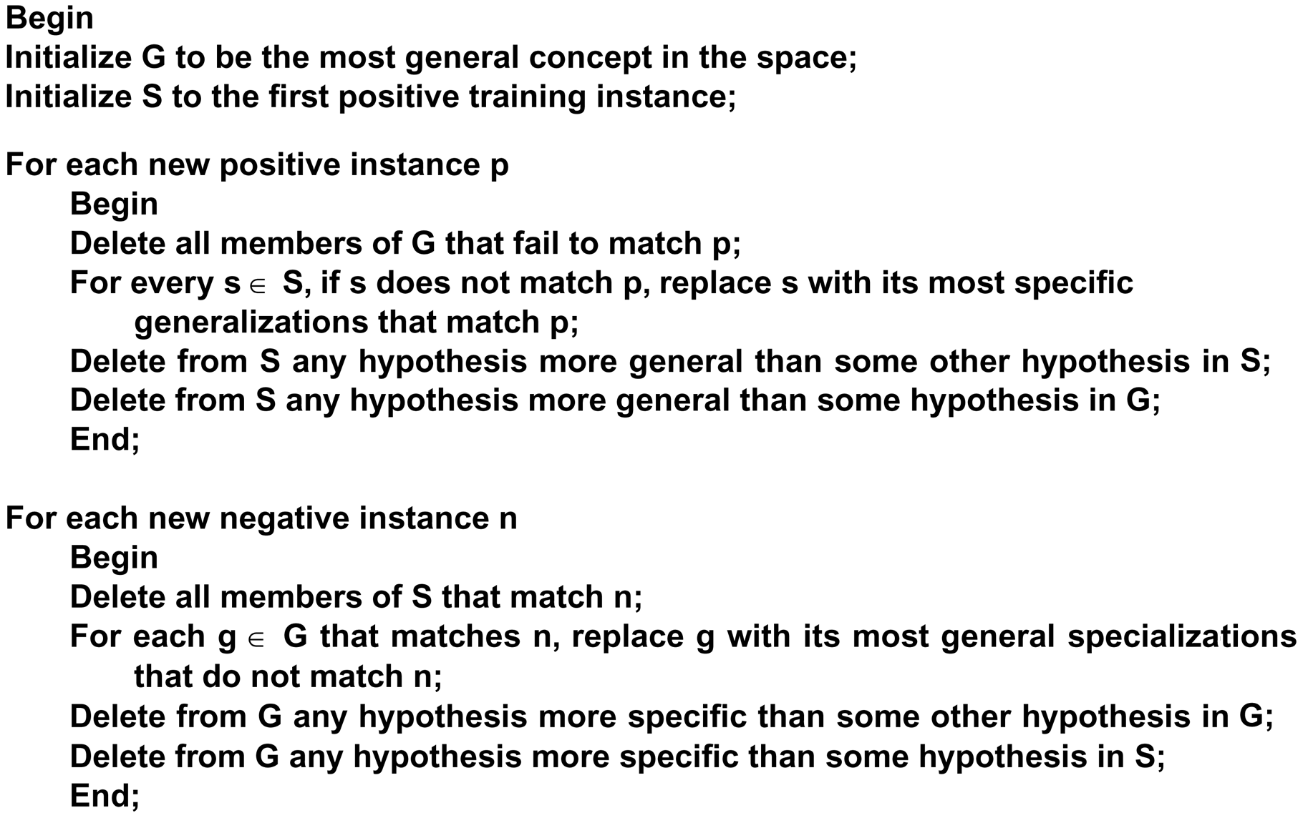
The algorithm specializes G and generalizes S until they converge on the target concept. The algorithm is defined:
------------------------------------------------------------------
Delete from G any hypothesis that is not more
General than some hypothesis in S
Luger: Artificial Intelligence, 6th edition. © Pearson Education Limited, 2009
12

Slide 29
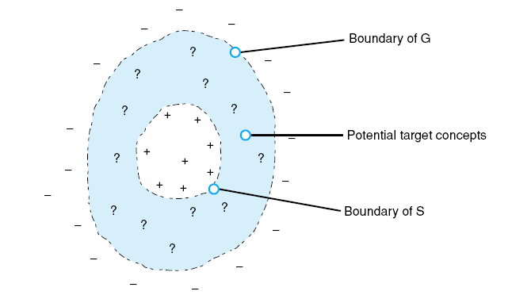
Fig 10.10 Converging boundaries of the G and S sets in the candidate elimination algorithm.
Luger: Artificial Intelligence, 6th edition. © Pearson Education Limited, 2009
15

Slide 30
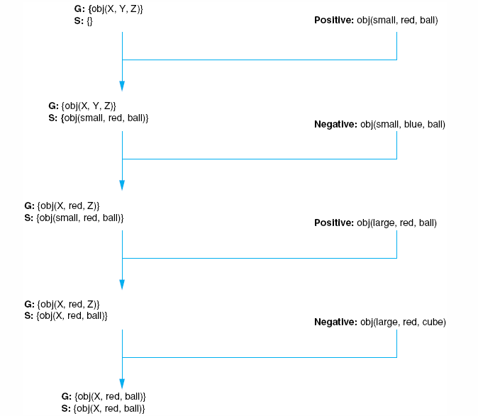
Fig 10.9 The candidate elimination algorithm learning the concept “red ball.”
Luger: Artificial Intelligence, 6th edition. © Pearson Education Limited, 2009
14

