Slide 1
Two types of learning algorithms
Learning a set of rules simultaneously
  Decision tree construction
    ID3
Learn one rule at a time
  Sequential covering
    AQR
    PRISM

Slide 2
10.3.1 The ID3 Decision Tree Induction Algorithm
The state space is the family of all decision trees
Construct a decision top-down based on conditional entropy

Slide 3
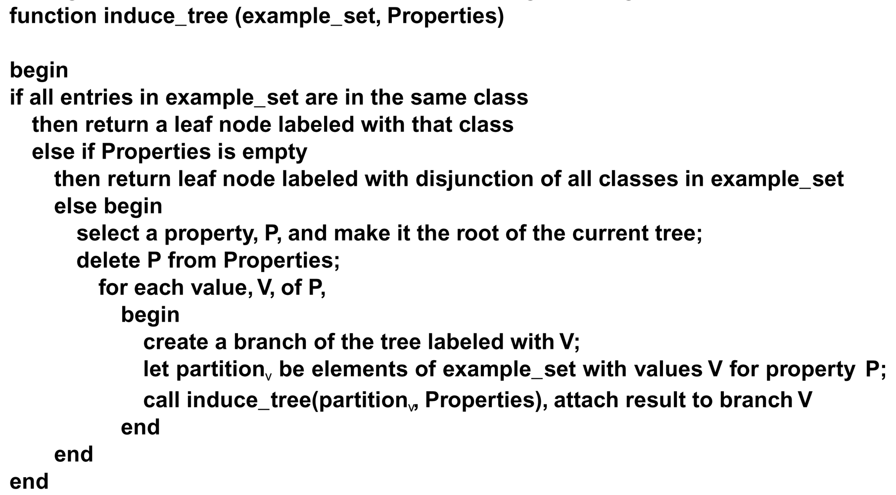
The induction algorithm begins with a sample of correctly classified members of the target categories. ID3 constructs a decision tree according to the algorithm:
Luger: Artificial Intelligence, 6th edition. © Pearson Education Limited, 2009
21

Slide 4
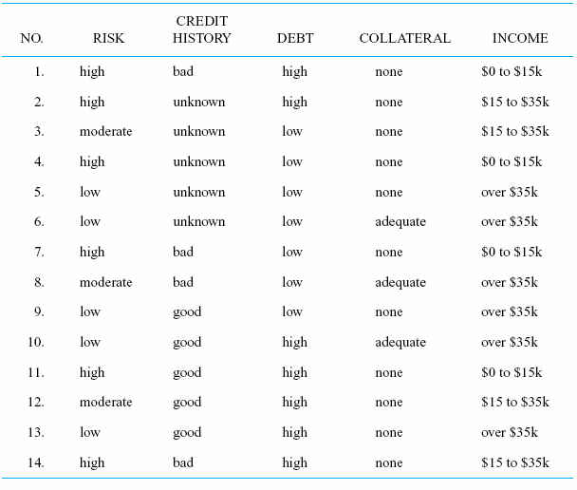
An example
Luger: Artificial Intelligence, 6th edition. © Pearson Education Limited, 2009
18

Slide 5
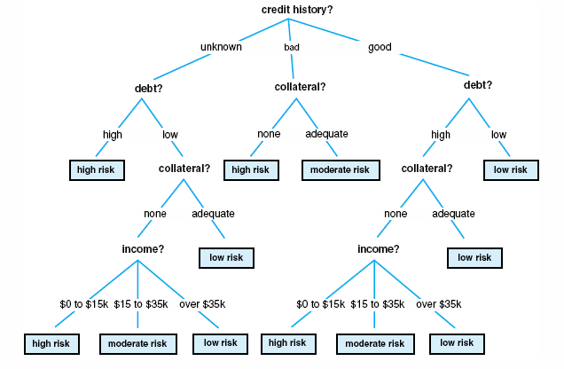
Fig 10.13 A decision tree for credit risk assessment.
Luger: Artificial Intelligence, 6th edition. © Pearson Education Limited, 2009
19

Slide 6
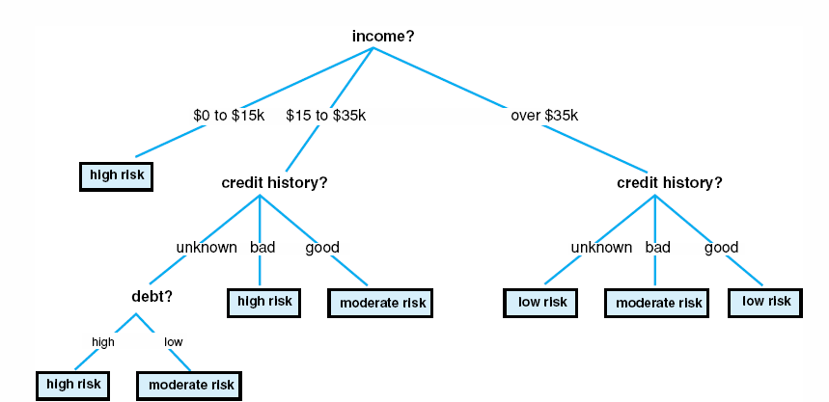
Fig 10.14 a simplified decision tree for credit risk assessment.
Luger: Artificial Intelligence, 6th edition. © Pearson Education Limited, 2009
20

Slide 7
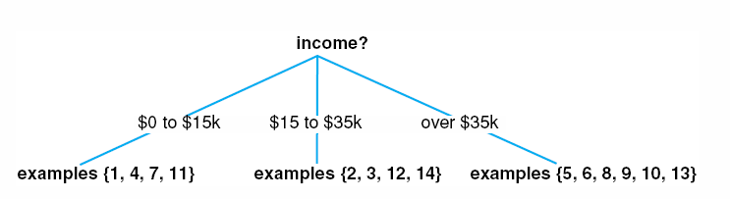
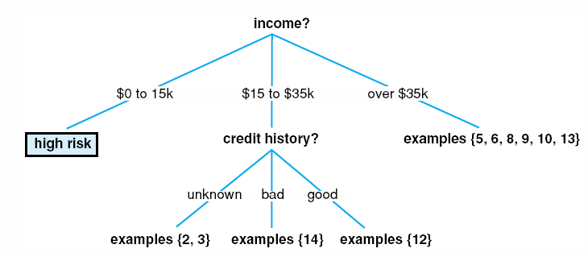
Fig 10.15 A partially constructed decision tree.
Fig 10.16 Another partially constructed decision tree.
Luger: Artificial Intelligence, 6th edition. © Pearson Education Limited, 2009
22

Slide 8
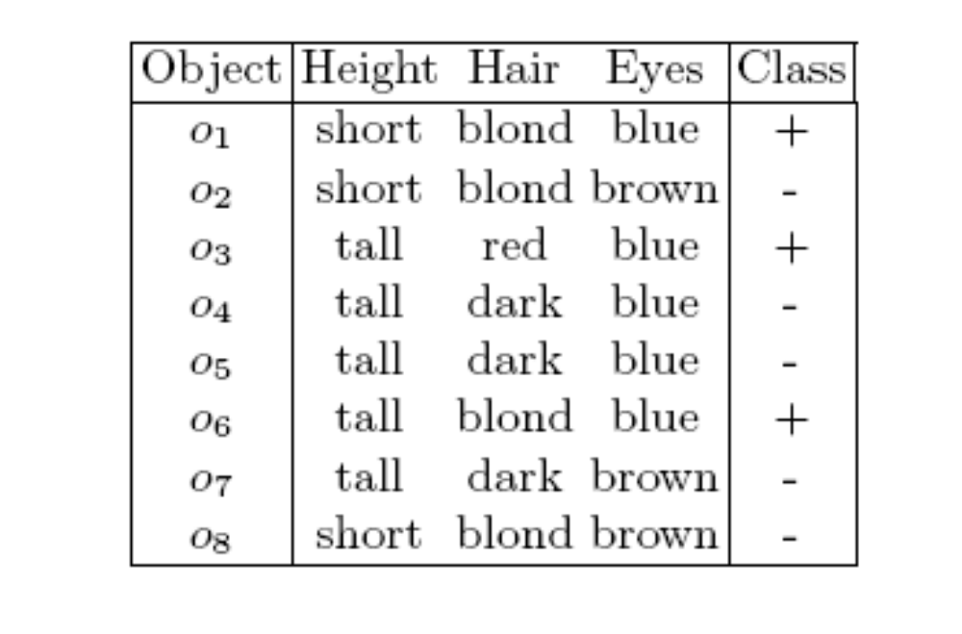
Another example

Slide 9
Decision tree for the example
Hair
dark
blond
red
+
Eyes
-
blue
brown
-
+

Slide 10
10.3.1 Learning one rule at a time
Sequentially learning one rule at a time such that the rule has the following properties:
  Covers some positive examples.
  Does not cover any negative example.

Slide 11
10.3.1 Learning one rule at a time
Search the concept space
  Each concept is a conjunction of some conditions
  E.g., Hair = red AND Eyes = blue

Slide 12
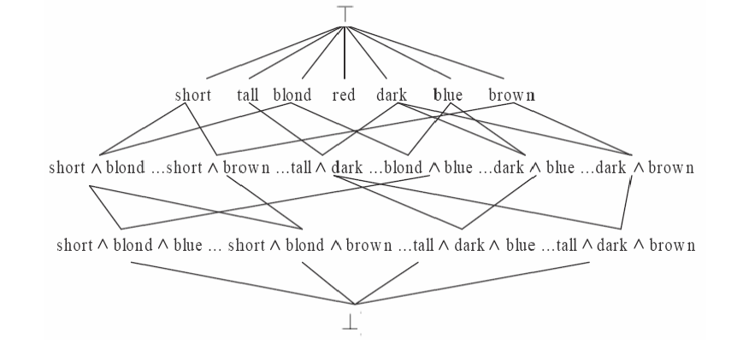
An example of concept space

Slide 13
Learning Propositional Rules: Sequential Covering Algorithms
The algorithm is called a sequential covering algorithm because it sequentially learns a set of rules that together cover the whole set of positive examples.
It has the advantage of reducing the problem of learning a disjunctive set of rules to a sequence of simpler problems, each requiring that a single conjunctive rule be learned.
The final set of rules is sorted so that the most accurate rules are considered first at classification time.
However, because it does not backtrack, this algorithm is not guaranteed to find the smallest or best set of rules ---> Learn-one-rule must be very effective!
From: www.site.uottawa.ca/~nat/Courses/csi5387_2009/New_ML_Lecture_9.ppt

Slide 14
Learn-one-rule
General-to-Specific Search:
Consider the most general rule (hypothesis) which matches every instances in the training set.
Repeat
  Add the attribute that most improves rule performance measured over the training set.
Until the hypothesis reaches an acceptable level of performance.
General-to-Specific Beam Search (CN2):
Rather than considering a single candidate at each search step, keep track of the k best candidates.
From: www.site.uottawa.ca/~nat/Courses/csi5387_2009/New_ML_Lecture_9.ppt

Slide 15
PRISM Learning
This is another example of sequential covering method.

Slide 16
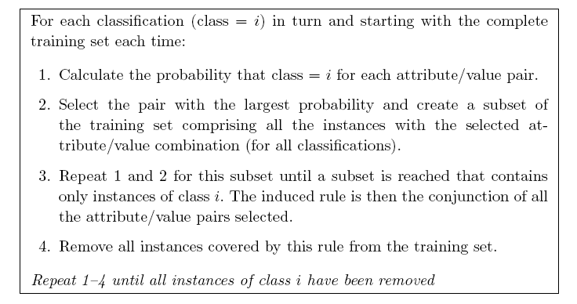
PRISM Learning
From: Max Bramer, Principles of Data Mining

Slide 17
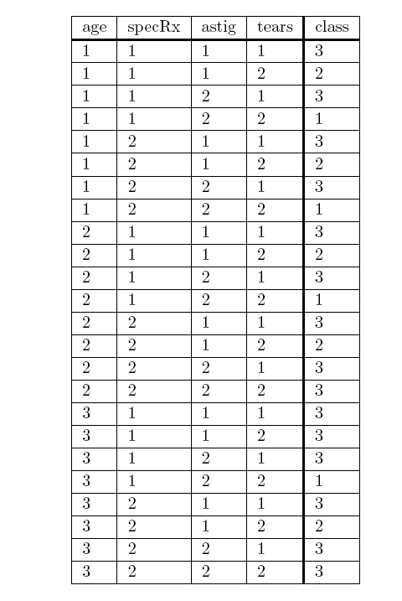
PRISM Learning
From: Max Bramer, Principles of Data Mining

Slide 18
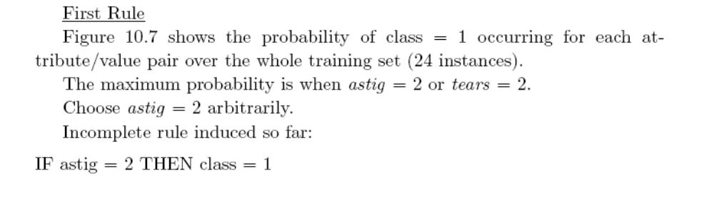
PRISM Learning
From: Max Bramer, Principles of Data Mining

Slide 19
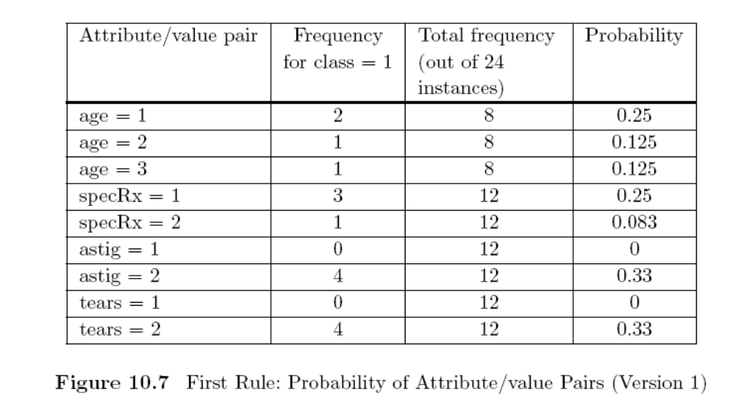
PRISM Learning
From: Max Bramer, Principles of Data Mining

Slide 20
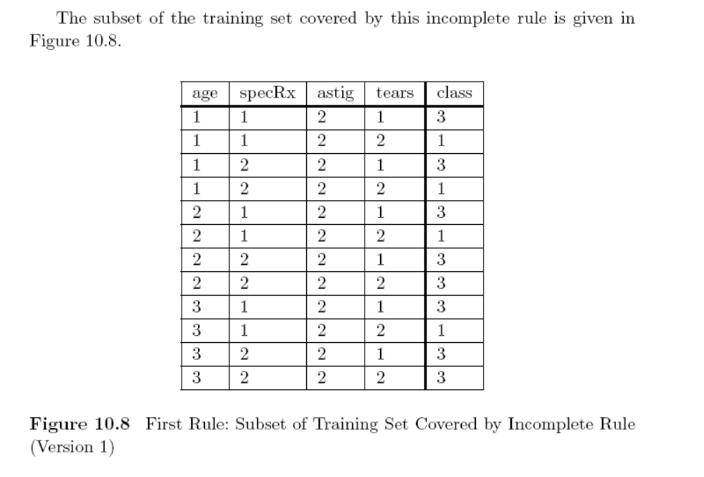
PRISM Learning
From: Max Bramer, Principles of Data Mining

Slide 21
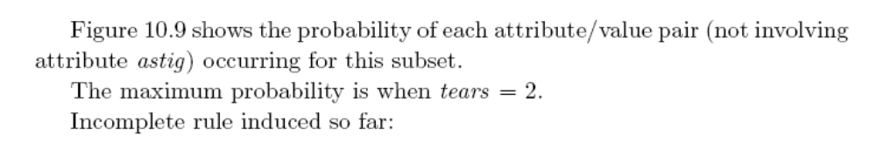
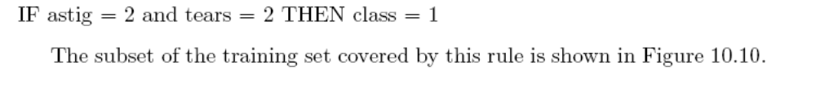
PRISM Learning
From: Max Bramer, Principles of Data Mining

Slide 22
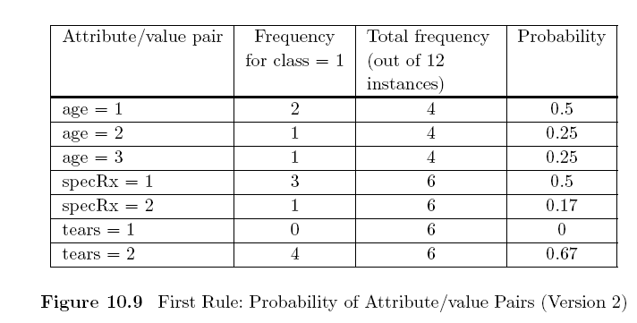
PRISM Learning
From: Max Bramer, Principles of Data Mining

Slide 23
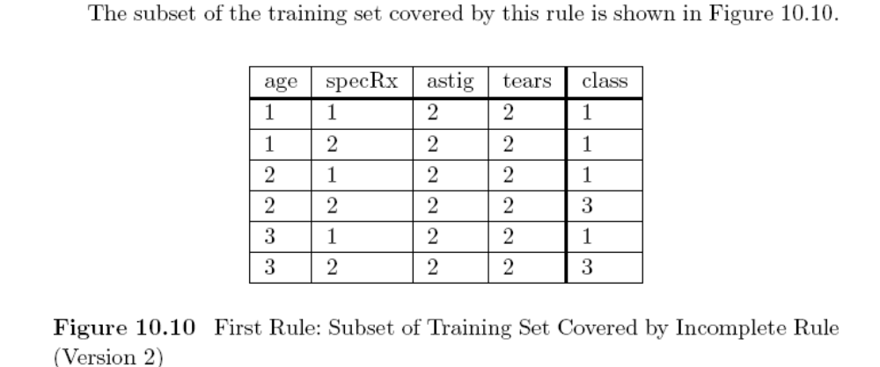
PRISM Learning
From: Max Bramer, Principles of Data Mining

Slide 24
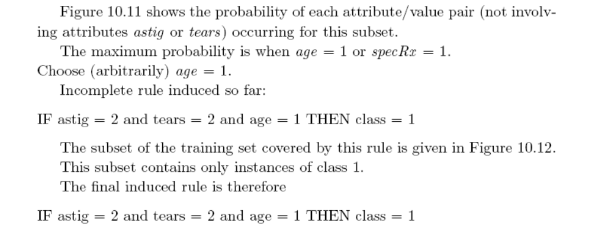
PRISM Learning
From: Max Bramer, Principles of Data Mining

Slide 25
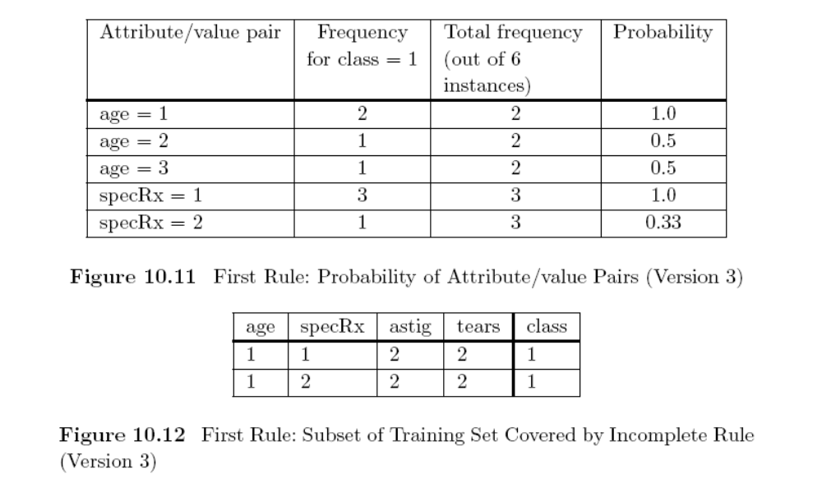
PRISM Learning
From: Max Bramer, Principles of Data Mining

Slide 26
PRISM Learning
Details for other rules can be found at:
http://www.springerlink.com/content/h06g1u08qp82q590/
Note: you must be using a university computer to access the chapter of the book.
From: Max Bramer, Principles of Data Mining

