Slide 1

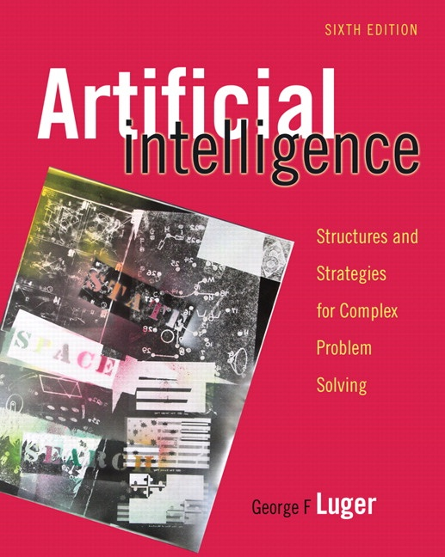
Machine Learning: Connectionist
11.0 Introduction
11.1 Foundations for Connectionist
Networks
11.2 Perceptron Learning
George F Luger
ARTIFICIAL INTELLIGENCE 6th edition
Structures and Strategies for Complex Problem Solving
1

Slide 2
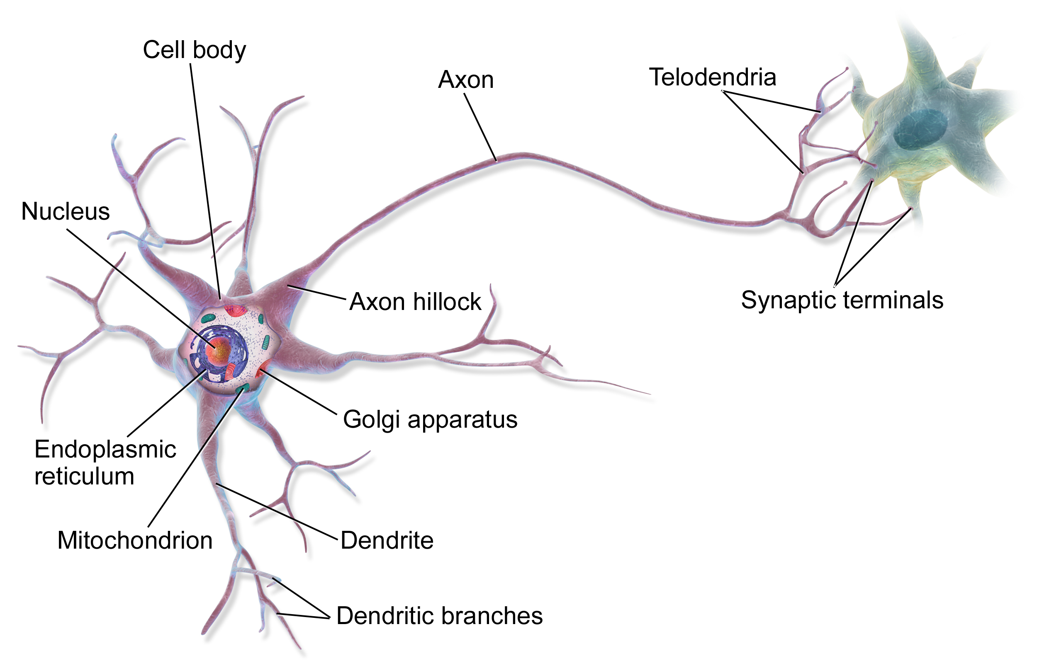
Neuron and Artificial Neuron
https://en.wikipedia.org/wiki/Neuron

Slide 3
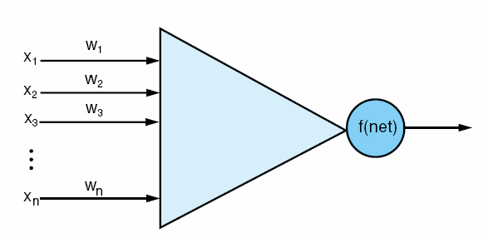
Fig 11.1 An artificial neuron, input vector x_{i}, weights on each input line, and a thresholding function f that determines the neuron’s output value. Compare with the actual neuron in fig 1.2
2

Slide 4
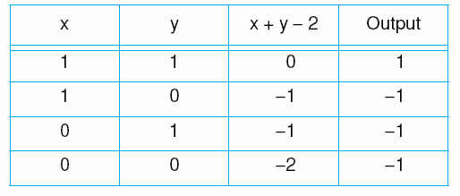
Table 11.1 The McCulloch-Pitts model for logical and.
4

Slide 5
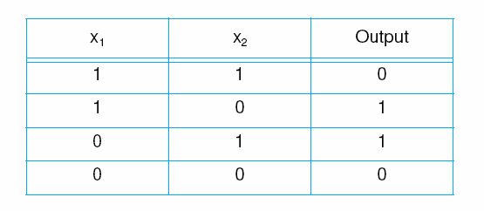
Table 11.2 The truth table for exclusive-or.
5

Slide 6
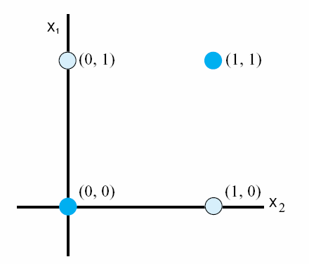
Fig 11.3 The exclusive-or problem. No straight line in two-dimensions can separate the (0, 1) and (1, 0) data points from (0, 0) and (1, 1).
Luger: Artificial Intelligence, 6th edition. © Pearson Education Limited, 2009
6

Slide 7
Two equivalent formulations
Original input vector and weight vector
(x1, x2, …, xn)
(w1, w2, …, wn)
w1x1 + w2x2 + … + wm xn >= t ---> +
w1x1 + w2x2 + … + wm xn < t ---> -
Extended input vector and weight vector
(x1, x2, …, xn, )
(w1, w2, …, wn, -t)
w1x1 + w2x2 + … + wm xn + (-t) 1 >= 0 ---> +
w1x1 + w2x2 + … + wm xn + (-t) 1 < 0 ---> -

Slide 8
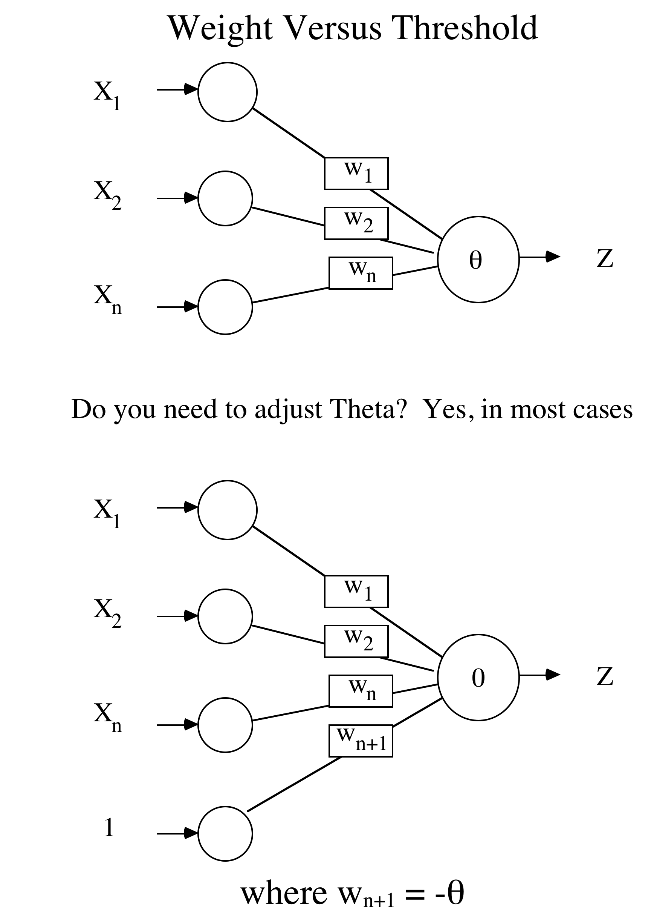
axon.cs.byu.edu/~martinez/classes/478/slides/Perceptron.pptx

Slide 9
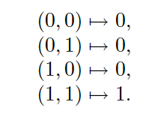
Original input vectors (Logic AND)

Slide 10
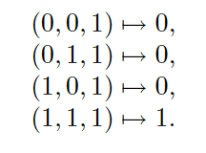
Extended input vectors (Logic AND)

Slide 11
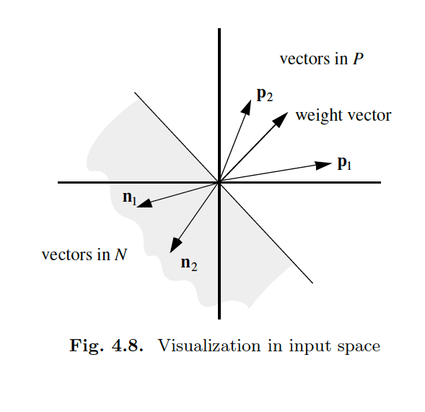
Geometric visualization
R. Rojas, Neural Networks, Springer, Berlin. 1996

Slide 12
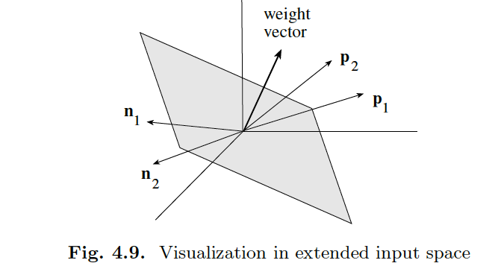
Geometric visualization

Slide 13
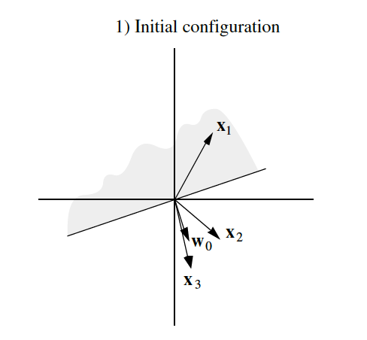
Geometric visualization

Slide 14
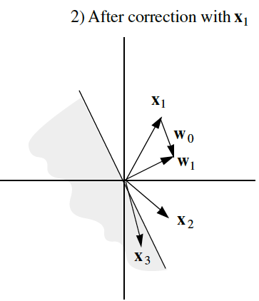
Geometric visualization

Slide 15
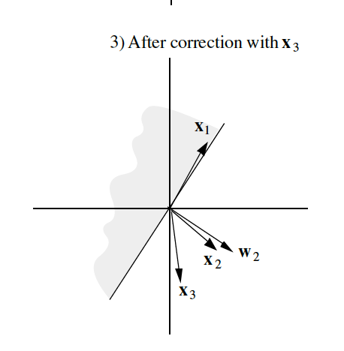
Geometric visualization

Slide 16
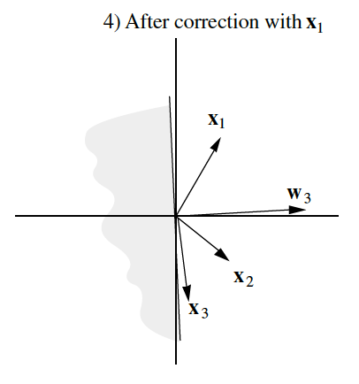
Geometric visualization

Slide 17
Augmented Pattern Vectors
1 0 1 -> 0
1 0 0 -> 1
Augmented Version
1 0 1 1 -> 0
1 0 0 1 -> 1
Treat threshold like any other weight. No special case. Call it a bias since it biases the output up or down.
Since we start with random weights anyways, can ignore the -θ notion, and just think of the bias as an extra available weight. (note the author uses a -1 input)
Always use a bias weight
axon.cs.byu.edu/~martinez/classes/478/slides/Perceptron.pptx
Notes:
Author uses -1 into bias, any real difference (back to being a threshold weight), but since starts random anyway, will make no difference, though the final weight will be negated by comparison

Slide 18
Perceptron Rule Example
Assume a 3 input perceptron
Initial weights all 0
Training set 0 0 1 -> 0
        1 1 1 -> 1
        1 0 1 -> 1
        0 1 1 -> 0
Pattern Target Weight Vector Net Output ΔW
0 0 1 1 0 0 0 0 0
axon.cs.byu.edu/~martinez/classes/478/slides/Perceptron.pptx

Slide 19
Example
Assume a 3 input perceptron
Initial weights all 0
Training set 0 0 1 -> 0
        1 1 1 -> 1
        1 0 1 -> 1
        0 1 1 -> 0
Pattern Target Weight Vector Net Output ΔW
0 0 1 1 0 0 0 0 0 0 0 0 0 0 0
1 1 1 1 1 0 0 0 0
CS 478 - Perceptrons

Slide 20
Example
Assume a 3 input perceptron
Initial weights all 0
Training set 0 0 1 -> 0
        1 1 1 -> 1
        1 0 1 -> 1
        0 1 1 -> 0
Pattern Target Weight Vector Net Output ΔW
0 0 1 1 0 0 0 0 0 0 0 0 0 0 0
1 1 1 1 1 0 0 0 0 0 0 1 1 1 1
1 0 1 1 1 1 1 1 1
axon.cs.byu.edu/~martinez/classes/478/slides/Perceptron.pptx

Slide 21
Example
Assume a 3 input perceptron
Initial weights all 0
Training set 0 0 1 -> 0
        1 1 1 -> 1
        1 0 1 -> 1
        0 1 1 -> 0
Pattern Target Weight Vector Net Output ΔW
0 0 1 1 0 0 0 0 0 0 0 0 0 0 0
1 1 1 1 1 0 0 0 0 0 0 1 1 1 1
1 0 1 1 1 1 1 1 1 3 1 0 0 0 0
0 1 1 1 0 1 1 1 1
axon.cs.byu.edu/~martinez/classes/478/slides/Perceptron.pptx

Slide 22
Example
Assume a 3 input perceptron
Initial weights all 0
Training set 0 0 1 -> 0
        1 1 1 -> 1
        1 0 1 -> 1
        0 1 1 -> 0
Pattern Target Weight Vector Net Output ΔW
0 0 1 1 0 0 0 0 0 0 0 0 0 0 0
1 1 1 1 1 0 0 0 0 0 0 1 1 1 1
1 0 1 1 1 1 1 1 1 3 1 0 0 0 0
0 1 1 1 0 1 1 1 1 3 1 0 -1 -1 -1
0 0 1 1 0 1 0 0 0

Slide 23
Example
Assume a 3 input perceptron
Initial weights all 0
Training set 0 0 1 -> 0
        1 1 1 -> 1
        1 0 1 -> 1
        0 1 1 -> 0
Pattern Target Weight Vector Net Output ΔW
0 0 1 1 0 0 0 0 0 0 0 0 0 0 0
1 1 1 1 1 0 0 0 0 0 0 1 1 1 1
1 0 1 1 1 1 1 1 1 3 1 0 0 0 0
0 1 1 1 0 1 1 1 1 3 1 0 -1 -1 -1
0 0 1 1 0 1 0 0 0 0 0 0 0 0 0
1 1 1 1 1 1 0 0 0 1 1 0 0 0 0
1 0 1 1 1 1 0 0 0 1 1 0 0 0 0
0 1 1 1 0 1 0 0 0 0 0 0 0 0 0

