Slide 1
Chapter 4: Heuristic Search
4.0 Introduction
4.1 Hill-Climbing
4.2 The Best-first Search Algorithm
4.3 Admissibility, Monotonicity, and Informedness
4.4 Using Heuristics in Games
4.5 Complexity Issues

Slide 2
4.0 Introduction
Observations:
  Some moves are more profitable
  Some moves have a high probability to be successful
  Some moves are more flexible
  Some moves leave more doors open
  …
  All choices are NOT equal

Slide 3
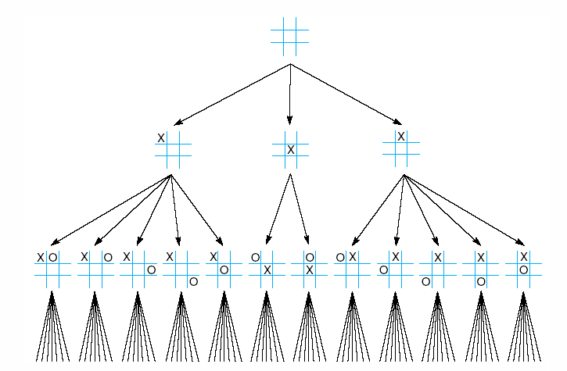
Fig 4.1 First three levels of the tic-tac-toe state space reduced by symmetry
Luger: Artificial Intelligence, 6th edition. © Pearson Education Limited, 2009

Slide 4
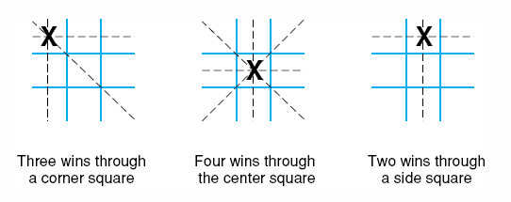
Fig 4.2 The “most wins” heuristic applied to the first children in tic-tac-toe.
Luger: Artificial Intelligence, 6th edition. © Pearson Education Limited, 2009

Slide 5
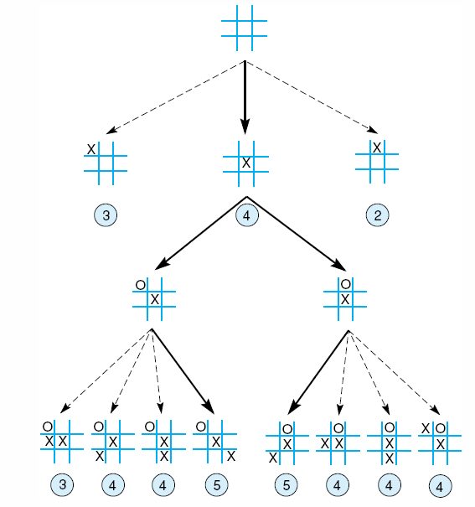
Fig 4.3 Heuristically reduced state space for tic-tac-toe.
Luger: Artificial Intelligence, 6th edition. © Pearson Education Limited, 2009

Slide 6
4.0 Introduction
Moving from BLIND search to intelligent search
Moving from BLIND search to SELECTIVE search
Main ideas: Evaluate before Move
  Fitness
  Heuristic
  …

Slide 7
Heuristics
Polya, 1945:
The study of the methods and rules of discovery and invention.

Slide 8
Heuristics
In state space search, heuristics are formalized as rules for choosing branches in a state space that are most likely to lead to an acceptable solution.

Slide 9
Heuristics
Heuristic is an adjective for experience-based techniques that help in problem solving, learning and discovery.
A heuristic method is particularly used to rapidly come to a solution that is hoped to be close to the best possible answer, or 'optimal solution'.
Heuristics are "rules of thumb", educated guesses, intuitive judgments or simply common sense.
Heuristics as a noun is another name for heuristic methods.
----- From: http://en.wikipedia.org/wiki/Heuristic

Slide 10
Why Heuristics?
A problem may not have an exact solution due to (e.g., ill-defined problem):
  Incomplete information, insufficient information
  Ambiguities
A problem may have an exact solution, but the cost of find it is prohibitive
  Combinatorial explosion of state space
  Brute-force methods (e.g., DFS, BFS) are impractical.

Slide 11
Limitation of Heuristics
Heuristics are informed guesses
Heuristics are fallible
Heuristics are based on experience
Heuristics normally explore local optimization

Slide 12
Heuristics: Examples
If you are having difficulty understanding a problem, try drawing a picture.
If you can't find a solution, try assuming that you have a solution and seeing what you can derive from that ("working backward").
If the problem is abstract, try examining a concrete example.
Try solving a more general problem first (the "inventor's paradox": the more ambitious plan may have more chances of success).
--- Polya's 1945 book, How to Solve It

Slide 13
Heuristics: Examples
Lord E. John P. Browne, former group chief executive officer, British Petroleum:
My first advice to anyone is to become really good at one thing. Don't try to ascent to generality before you've become fabulously successful at one undertaking. Building a strong core, whatever you're doing. And in doing so, make sure to establish principles against which to measure yourself.
Mastering one thing seems to me to be the single most important career move, yet it's very difficult to persuade people to do so.

Slide 14
4.1 Hill-Climbing
Basic idea:
An eager, but blind mountain climber’s strategy
Go uphill along the steepest possible path until you can go no further up.

Slide 15
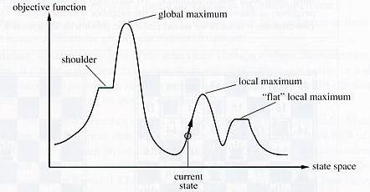
An illustration

Slide 16
Hill-Climbing
Hill climbing attempts to maximize (or minimize) a function f(x), where x are discrete states. These states are typically represented by vertices in a graph, where edges in the graph encode nearness or similarity of a graph. Hill climbing will follow the graph from vertex to vertex, always locally increasing (or decreasing) the value of f, until a local maximum (or local minimum) xm is reached.
Hill climbing can also operate on a continuous space: in that case, the algorithm is called gradient ascent (or gradient descent if the function is minimized)

Slide 17
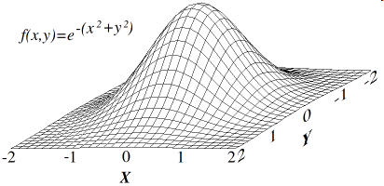
Ideal situation: one maximal point

Slide 18
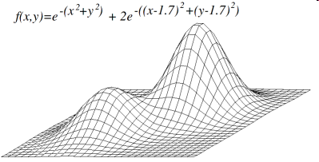
Problem with local maxima

Slide 19
Hill-Climbing and State Space Search
Expand the current state of the search and evaluate its children (fitness function).
The “best” child is selected for further expansion; neither its siblings nor is parent are retained.

Slide 20
4.2 The Best-first Search Algorithm
Use priority queue to keep track of fitness
Use the path information

Slide 21
The Best-first Search Algorithm
OPEN (a priority queue): keeps track the current fringe of the search
CLOSED: records states already visited.
ADDED Step: orders states in the OPEN (i.e., OPEN is a priority queue.).

Slide 22
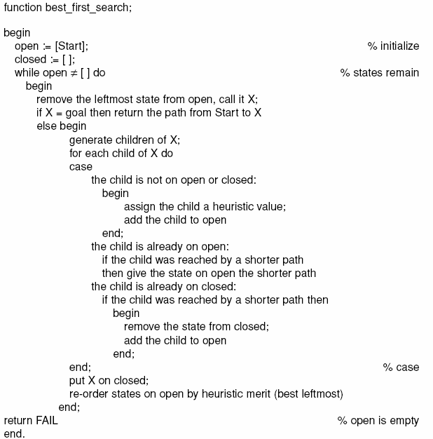
Luger: Artificial Intelligence, 6th edition. © Pearson Education Limited, 2009

Slide 23
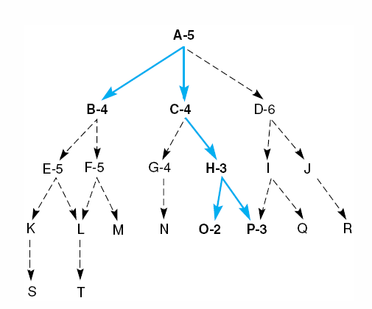
Fig 4.10 Heuristic search of a hypothetical state space.
Luger: Artificial Intelligence, 6th edition. © Pearson Education Limited, 2009

Slide 24
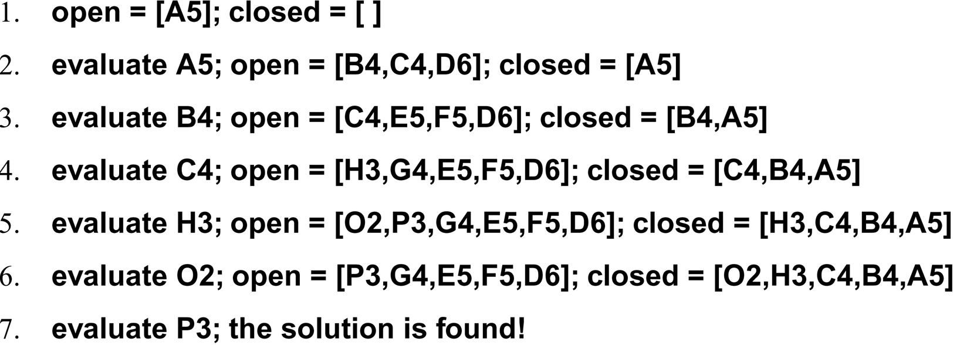
A trace of the execution of best_first_search
Luger: Artificial Intelligence, 6th edition. © Pearson Education Limited, 2009

Slide 25
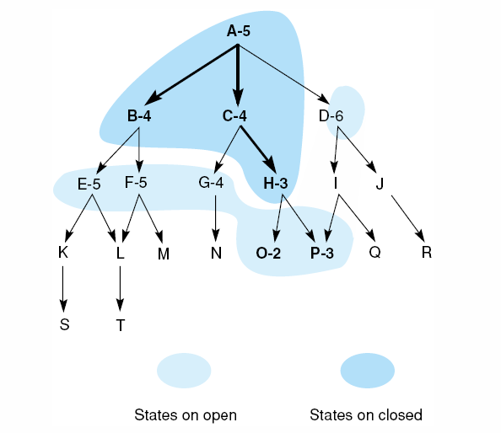
Fig 4.11 Heuristic search of a hypothetical state space with open and closed states highlighted.
Luger: Artificial Intelligence, 6th edition. © Pearson Education Limited, 2009

Slide 26
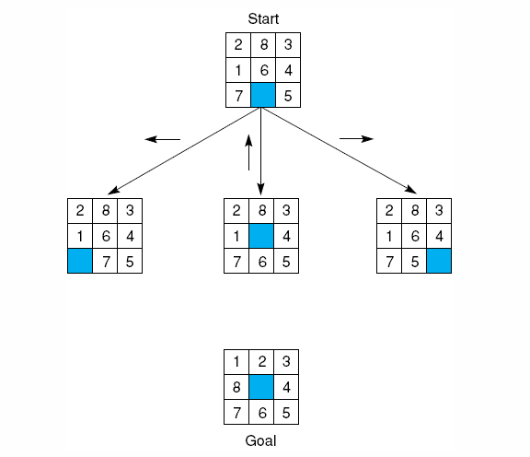
Best-first search: an example
Luger: Artificial Intelligence, 6th edition. © Pearson Education Limited, 2009
Notes:
Insert fig 4.12

Slide 27
Possible evaluation functions
The number of out-of-place tiles
  The state that has the fewest tiles out of place is probably closer to the goal.

Slide 28
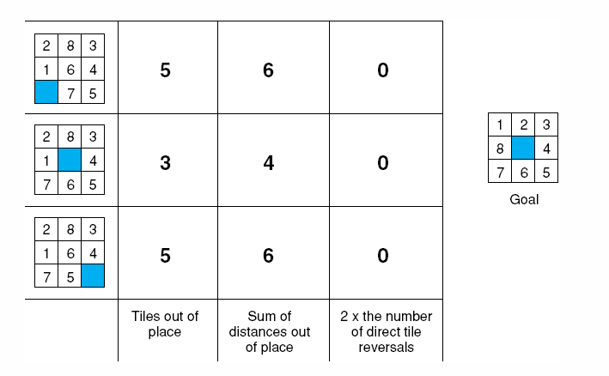
Fig 4.14 Three heuristics applied to states in the 8-puzzle.
Row 1:
Out-of-place tiles: 1, 2, 6, 7, 6
The number: 5
Luger: Artificial Intelligence, 6th edition. © Pearson Education Limited, 2009

Slide 29
Possible evaluation functions
The distance by which a tile is required to move to is right place.
Total distance.

Slide 30
Fig 4.14 Three heuristics applied to states in the 8-puzzle.
For configuration in the first row:
1: 1, 2: 1, 3:0, 4: 0, 5:0, 6:1, 7:1, 9: 2
Total = 1 + 1 + 0 + 0 + 0 + 1 + 1 + 2 = 6.
Luger: Artificial Intelligence, 6th edition. © Pearson Education Limited, 2009

Slide 31
Possible evaluation functions
The number of direct reversals
  Direct reversal: two adjacent tiles must be exchanged to be in the right order of the goal.
  It takes more than two moves to correct a reversal. 2 times # of direct reversal.

Slide 32
Fig 4.14 Three heuristics applied to states in the 8-puzzle.
Luger: Artificial Intelligence, 6th edition. © Pearson Education Limited, 2009

Slide 33
Limitation:
Only consider how far away from the goal state.
Do not consider how far away from the start state.

Slide 34
A better choice:
f(n) = g(n) + h(n)
  g(n): “distance” between the current state and the start state.
  h(n): “distance” between the current state and the goal state.
  f(n): “total distance” between the start state and the goal state.

Slide 35
A better choice: data-driven
f(n) = g(n) + h(n)
  g(n): “distance” between the current state and the start state. = # of steps
  h(n): “distance” between the current state and the goal state. = must be estimated:
    # of out-of-place tiles
    # total distance
    …
  f(n): “total distance” between the start state and the goal state.

Slide 36
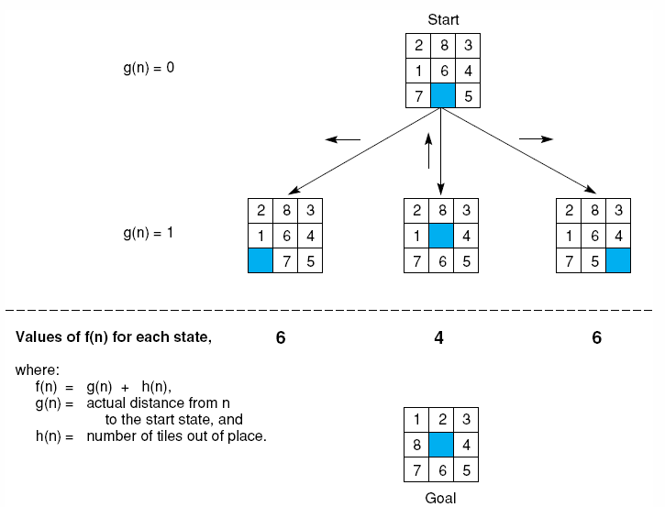
Fig 4.15 The heuristic f applied to states in the 8-puzzle.
Luger: Artificial Intelligence, 6th edition. © Pearson Education Limited, 2009
Notes:
Insert fig 4.15

Slide 37
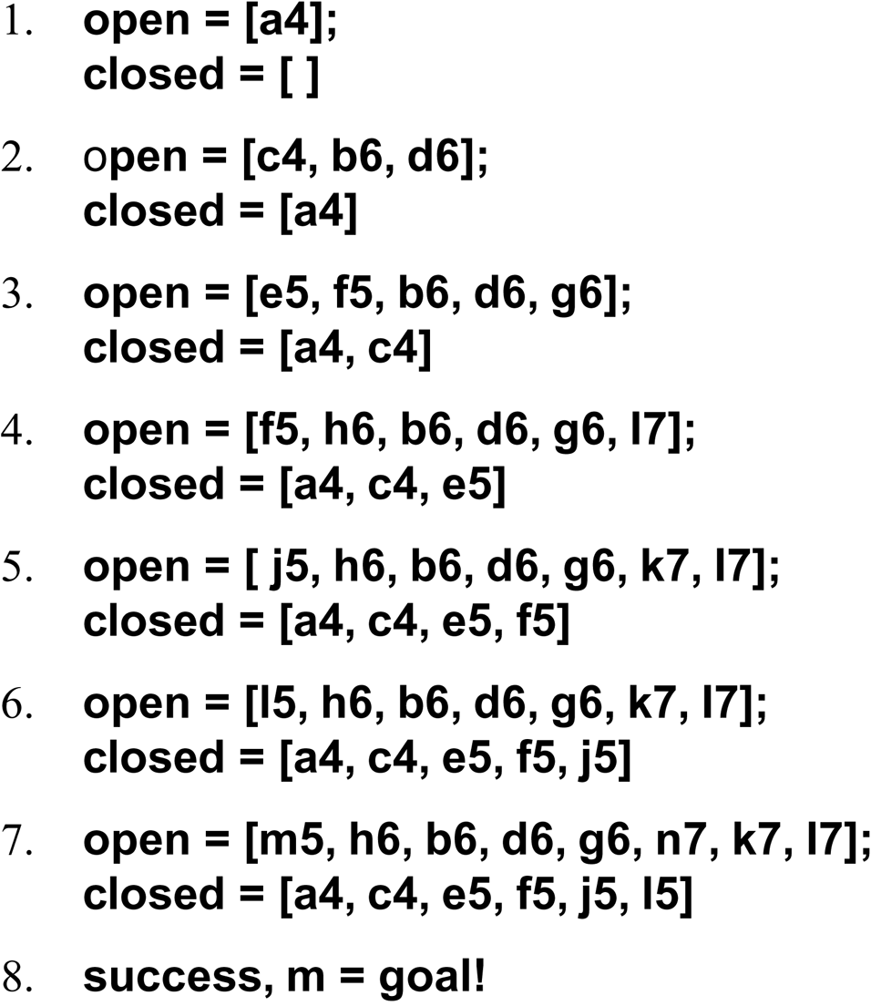
The successive stages of open and closed that generate this graph are:
Luger: Artificial Intelligence, 6th edition. © Pearson Education Limited, 2009

Slide 38
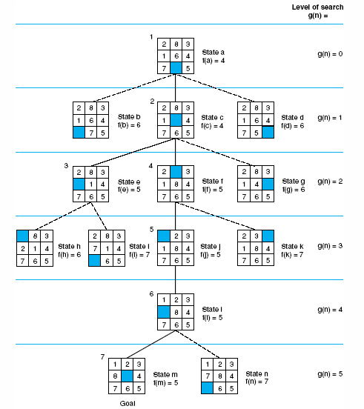
Fig 4.16 State space generated in heuristic search of the 8-puzzle graph.
Luger: Artificial Intelligence, 6th edition. © Pearson Education Limited, 2009
Notes:
Insert fig 4.16

Slide 39
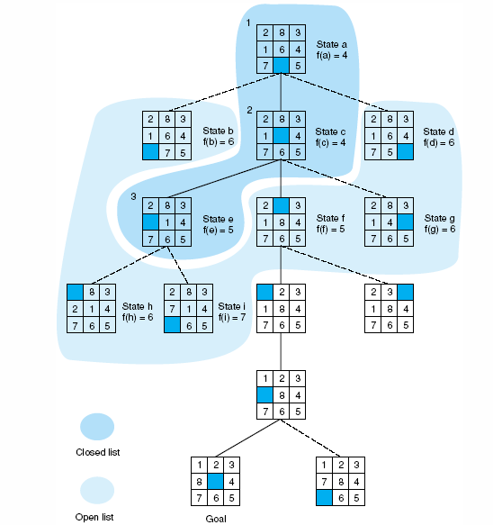
Fig 4.17 Open and closed as they appear after the 3rd iteration of heuristic search
Luger: Artificial Intelligence, 6th edition. © Pearson Education Limited, 2009

