Slide 1
4.4 Using Heuristics in Games
Two-player competitive game
  MAX: the player trying to win, to MAXimize his/her advantage.
  MIN: the player trying to win, to MINimize the MAX’s advantage.
minimax algorithm

Slide 2
Game of nim:
A number of tokens.
Each player divides one pile into two nonempty piles of different sizes.
The player who cannot make the move loses.

Slide 3
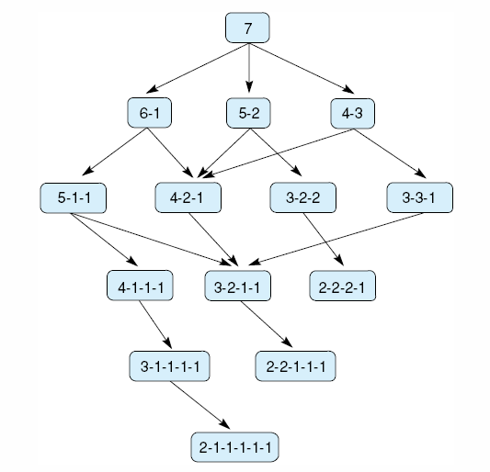
Fig 4.19 State space for a variant of nim. Each state partitions the seven matches into one or more piles.
Luger: Artificial Intelligence, 6th edition. © Pearson Education Limited, 2009

Slide 4
Minmax search:
n-Ply look-ahead: n is the depth of search, i.e., the number of levels.
Forward search:
  At each move, the player search n plies.
  Calculate the value of the nodes in the new ply.
Backward propagation:
  MAX takes the maximum value from its children.
  MIN takes the minimum value from its children.

Slide 5
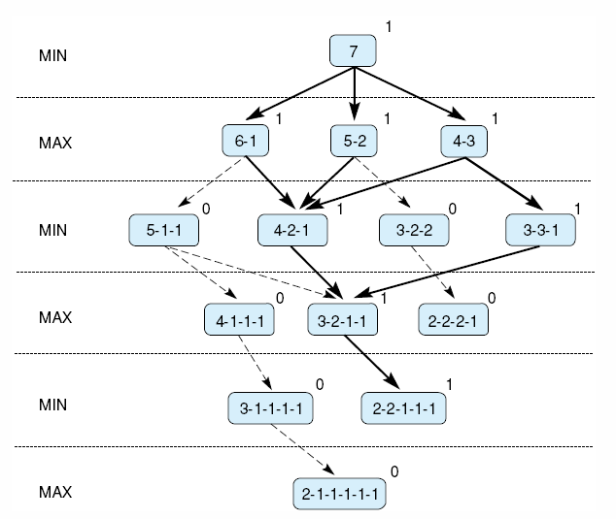
Fig 4.20 Exhaustive minimax for the game of nim. Bold lines indicate forced win for MAX. Each node is marked with its derived value (0 or 1) under minimax.
1: MAX win
0: MIN win
Luger: Artificial Intelligence, 6th edition. © Pearson Education Limited, 2009
Notes:
Insert fig 4.20

Slide 6
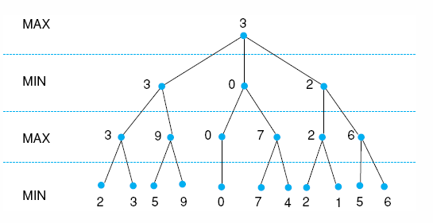
Fig 4.21 Minimax to a hypothetical state space. Leafstates show heuristic values; internal states show backed-up values.
Luger: Artificial Intelligence, 6th edition. © Pearson Education Limited, 2009
Notes:
Insert fig 4.21

Slide 7
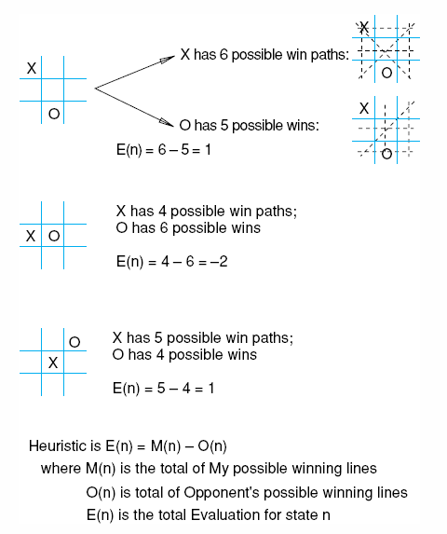
Fig 4.22 Heuristic measuring conflict applied to states of tic-tac-toe.
Luger: Artificial Intelligence, 6th edition. © Pearson Education Limited, 2009

Slide 8
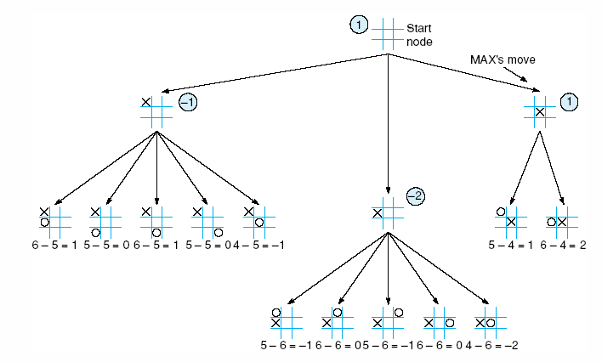
Fig 4.23 Two-ply minimax applied to the opening move of tic-tac-toe, from Nilsson (1971).
Luger: Artificial Intelligence, 6th edition. © Pearson Education Limited, 2009

Slide 9
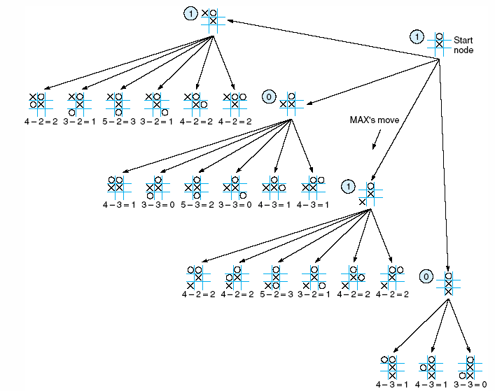
Fig 4.24 Two ply minimax, and one of two possible MAX second moves, from Nilsson (1971).
Luger: Artificial Intelligence, 6th edition. © Pearson Education Limited, 2009

Slide 10
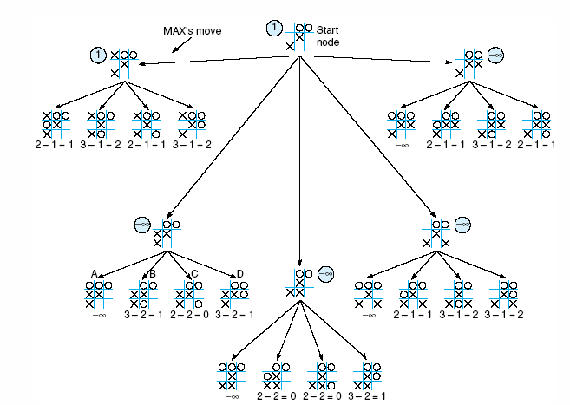
Fig 4.25 Two-ply minimax applied to X’s move near the end of the game, from Nilsson (1971).
Luger: Artificial Intelligence, 6th edition. © Pearson Education Limited, 2009

Slide 11
The alpha-beta pruning
A technique to reduce the search.
  Depth-first search.
  Keep track of current “best” solution.
  Do not search a subtree if the solution it provides is worse than the current “best” solution.
Alpha for MAX node:
alpha value never decrease
Beta for MIN node:
beta value never increase

Slide 12
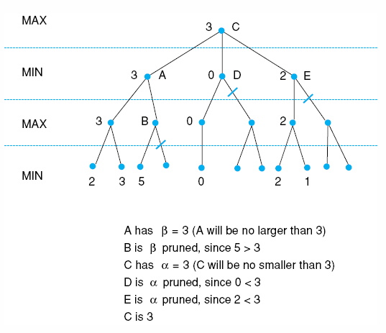
Fig 4.26 Alpha-beta pruning applied to state space of Fig 4.21. States without numbers are not evaluated.
Luger: Artificial Intelligence, 6th edition. © Pearson Education Limited, 2009

Slide 13
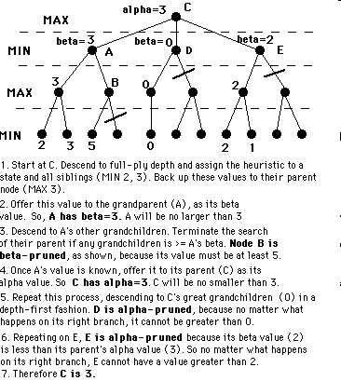
The alpha-beta pruning

Slide 14
4.5 Complexity Issues
Combinatorial explosion.
Find “reasonable”, “good”, “approximate” solution.

Slide 15
The wheat and chessboard problem
When the creator of the game of chess (in some tellings an ancient Indian mathematician, in others a legendary dravida vellalar named Sessa or Sissa) showed his invention to the ruler of the country, the ruler was so pleased that he gave the inventor the right to name his prize for the invention. The man, who was very wise, asked the king this: that for the first square of the chess board, he would receive one grain of wheat (in some tellings, rice), two for the second one, four on the third one, and so forth, doubling the amount each time. The ruler, who was not strong in mathematics, quickly accepted the inventor's offer, even getting offended by his perceived notion that the inventor was asking for such a low price, and ordered the treasurer to count and hand over the wheat to the inventor. However, when the treasurer took more than a week to calculate the amount of wheat, the ruler asked him for a reason for his tardiness. The treasurer then gave him the result of the calculation, and explained that it would be impossible to give the inventor the reward.
The ruler then, to get back at the inventor who tried to outsmart him, told the inventor that in order for him to receive his reward, he was to count every single grain that was given to him, in order to make sure that the ruler was not stealing from him.
http://en.wikipedia.org/wiki/Wheat_and_chessboard_problem

Slide 16
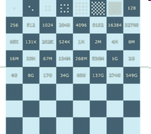
The wheat and chessboard problem
If a chessboard were to have wheat placed upon each square such that one grain were placed on the first square, two on the second, four on the third and so on, doubling the number of grains on each subsequent square, how many grains of wheat would be on the chessboard at the finish?
http://en.wikipedia.org/wiki/Wheat_and_chessboard_problem

Slide 17

The wheat and chessboard problem
which equals 18,446,744,073,709,551,615.
http://en.wikipedia.org/wiki/Wheat_and_chessboard_problem

Slide 18

The wheat and chessboard problem
If it is assumed that a grain of rice occupies a volume of 2 cubic millimetres then the total volume of all the rice on the chess board would be about 36.89 cubic kilometres, i.e.
http://en.wikipedia.org/wiki/Wheat_and_chessboard_problem

Slide 19
Branching factor
Assume that each node, on average, has about B branches:
A depth L:
T = 1 + B^2 + B^3 +… + B^L
T = N(B^L – 1)/(B – 1)

Slide 20
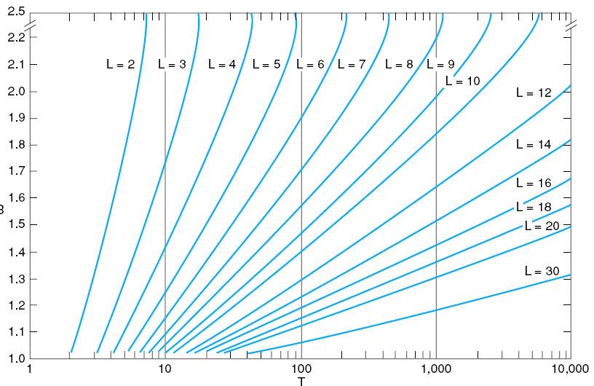
Fig 4.27 Number of nodes generated as a function of branching factor, B, for various lengths, L, of solution paths. The relating equation is T = B(B^{L} – 1)/(B – 1), adapted from Nilsson (1980).
Luger: Artificial Intelligence, 6th edition. © Pearson Education Limited, 2009

Slide 21
Richard Hamming:
Knowledge and productivity are like compound interest
Given two people of approximately the same ability and one person who works ten percent more than the other, the latter will more than twice outproduce the former. The more you know, the more you learn; the more you learn, the more you can do; the more you can do, the more the opportunity - it is very much like compound interest. I don't want to give you a rate, but it is a very high rate.
http://www.cs.virginia.edu/~robins/YouAndYourResearch.html

Slide 22
Richard Hamming:
Knowledge and productivity are like compound interest
Given two people with exactly the same ability, the one person who manages day in and day out to get in one more hour of thinking will be tremendously more productive over a lifetime.
I spent a good deal more of my time for some years trying to work a bit harder and I found, in fact, I could get more work done.
I don't like to say it in front of my wife, but I did sort of neglect her sometimes; I needed to study. You have to neglect things if you intend to get what you want done. There's no question about this. .
http://www.cs.virginia.edu/~robins/YouAndYourResearch.html

Slide 23
Trade-off: cost for computing heuristics and informedness
Time to spend on calculating a fitness function.
The effectiveness of a heuristic.

Slide 24
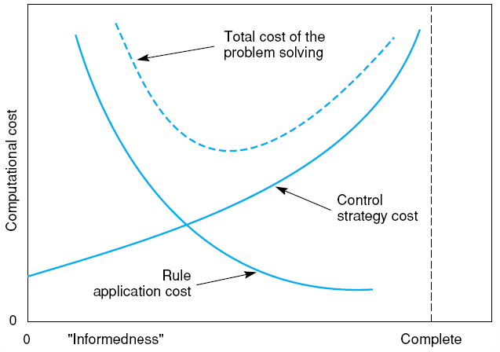
Fig 4.28 Informal plot of cost of searching and cost of computing heuristic evaluation against informedness of heuristic, adapted from Nilsson (1980).
Luger: Artificial Intelligence, 6th edition. © Pearson Education Limited, 2009

