Slide 1
Chapter 3
Describing Syntax and Semantics
1-<number>

Slide 2
Chapter 3 Topics
Introduction
The General Problem of Describing Syntax
Formal Methods of Describing Syntax
Attribute Grammars
Describing the Meanings of Programs: Dynamic Semantics
1-<number>

Slide 3
Introduction
Syntax: the form or structure of the expressions, statements, and program units
Semantics: the meaning of the expressions, statements, and program units
Syntax and semantics provide a language’s definition
  Users of a language definition
    Other language designers
    Implementers
    Programmers (the users of the language)
1-<number>

Slide 4
The General Problem of Describing Syntax: Terminology
A sentence is a string of characters over some alphabet
A language is a set of sentences
A lexeme is the lowest level syntactic unit of a language (e.g., *, sum, begin)
A token is a category of lexemes (e.g., identifier)
1-<number>

Slide 5
Formal Definition of Languages
Recognizers
  A recognition device reads input strings over the alphabet of the language and decides whether the input strings belong to the language
  Example: syntax analysis part of a compiler
  - Detailed discussion of syntax analysis appears in
  Chapter 4
Generators
  A device that generates sentences of a language
  One can determine if the syntax of a particular sentence is syntactically correct by comparing it to the structure of the generator
1-<number>

Slide 6
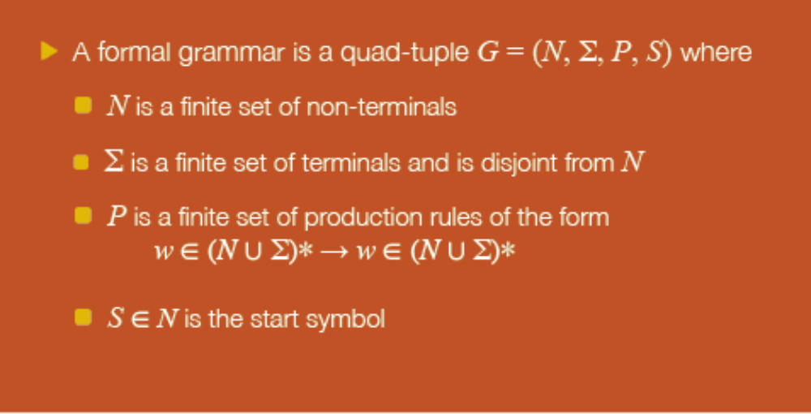
Formal definition
From: http://adammikeal.org/courses/compute/Chomsky%20Presentation.pdf
1-<number>
1-<number>

Slide 7
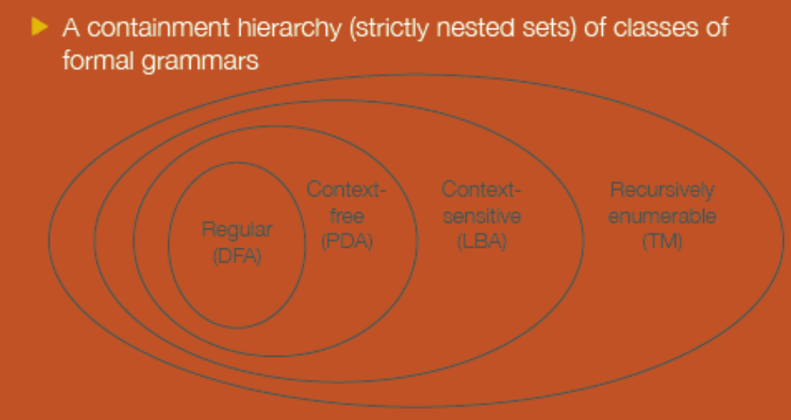
Chomsky Hierarchy
From: http://adammikeal.org/courses/compute/Chomsky%20Presentation.pdf
1-<number>
1-<number>

Slide 8
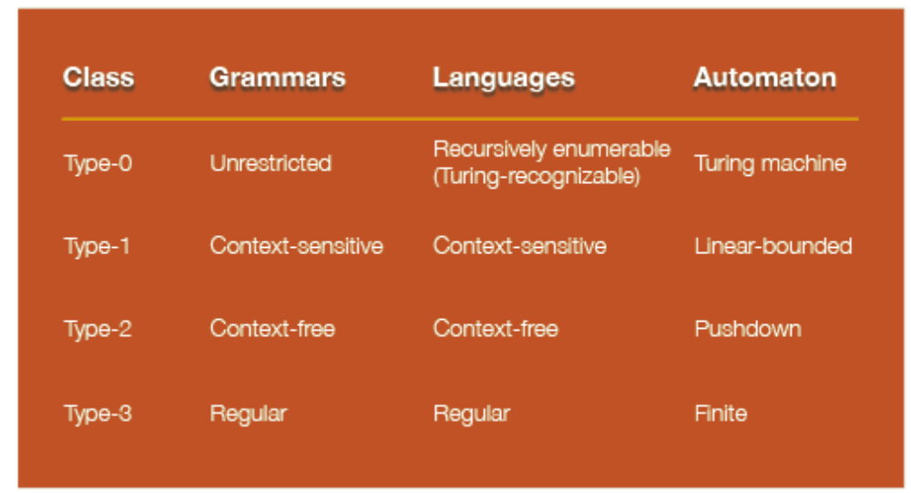
Chomsky Hierarchy
From: http://adammikeal.org/courses/compute/Chomsky%20Presentation.pdf
1-<number>
1-<number>

Slide 9
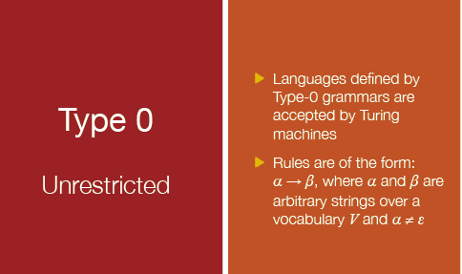
Chomsky Hierarchy
From: http://adammikeal.org/courses/compute/Chomsky%20Presentation.pdf
1-<number>
1-<number>

Slide 10
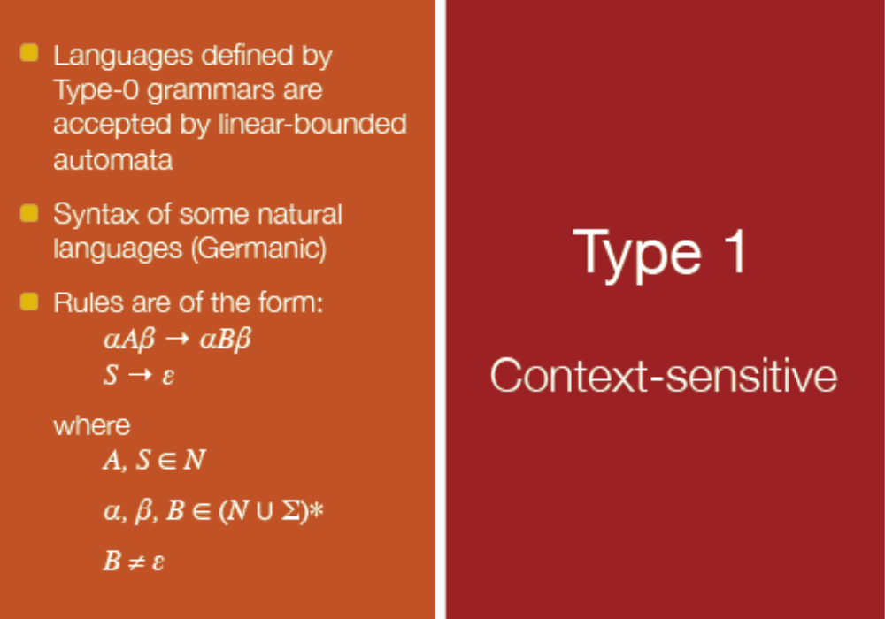
Chomsky Hierarchy
From: http://adammikeal.org/courses/compute/Chomsky%20Presentation.pdf
1-<number>
1-<number>

Slide 11
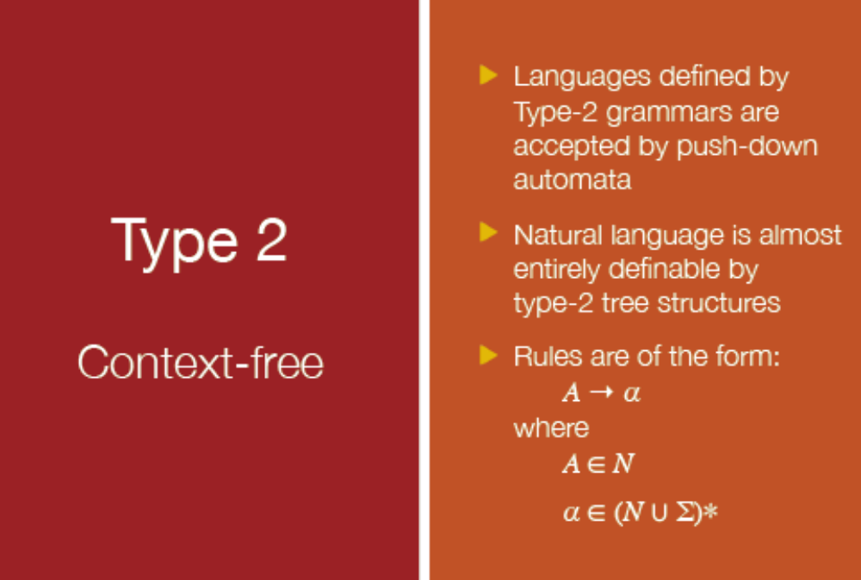
Chomsky Hierarchy
From: http://adammikeal.org/courses/compute/Chomsky%20Presentation.pdf
1-<number>
1-<number>

Slide 12
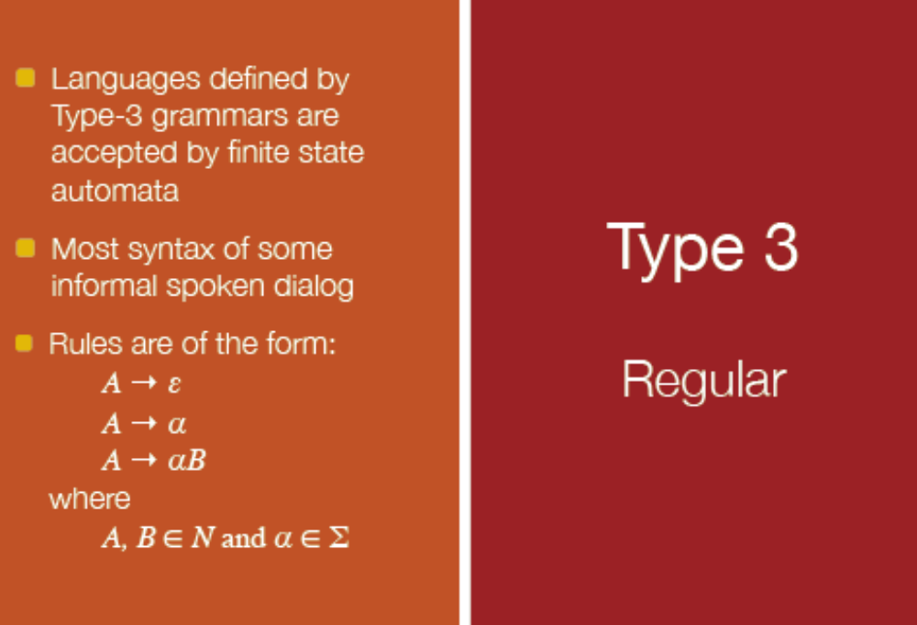
Chomsky Hierarchy
From: http://adammikeal.org/courses/compute/Chomsky%20Presentation.pdf
1-<number>
1-<number>

Slide 13
BNF and Context-Free Grammars
Context-Free Grammars
  Developed by Noam Chomsky in the mid-1950s
  Language generators, meant to describe the syntax of natural languages
  Define a class of languages called context-free languages
Backus-Naur Form (1959)
  Invented by John Backus to describe the syntax of Algol 58
  BNF is equivalent to context-free grammars
1-<number>

Slide 14
BNF Fundamentals
In BNF, abstractions are used to represent classes of syntactic structures--they act like syntactic variables (also called nonterminal symbols, or just terminals)
Terminals are lexemes or tokens
A rule has a left-hand side (LHS), which is a nonterminal, and a right-hand side (RHS), which is a string of terminals and/or nonterminals
1-<number>

Slide 15
BNF Fundamentals (continued)
Nonterminals are often enclosed in angle brackets
  Examples of BNF rules:
  <ident_list> → identifier | identifier, <ident_list>
  <if_stmt> → if <logic_expr> then <stmt>
Grammar: a finite non-empty set of rules
A start symbol is a special element of the nonterminals of a grammar
1-<number>

Slide 16
BNF Rules
An abstraction (or nonterminal symbol) can have more than one RHS
<stmt> → <single_stmt>
| begin <stmt_list> end
1-<number>

Slide 17
Describing Lists
Syntactic lists are described using recursion
<ident_list> → ident
| ident, <ident_list>
A derivation is a repeated application of rules, starting with the start symbol and ending with a sentence (all terminal symbols)
1-<number>

Slide 18
PASCAL Syntax Diagram
<expression> ::= <term> | <term> "+“ <expression>
<term> ::= <factor> | <factor> "*" <term>
<factor> ::= <constant> | <variable> | "(" <expression> ")"
<variable> ::= "x" | "y" | "z"
<constant> ::= <digit> | <digit> <constant>
<digit> ::= "0" | "1" | "2" | "3" | "4" | "5" | "6" | "7" | "8" | "9"
1-<number>

Slide 19
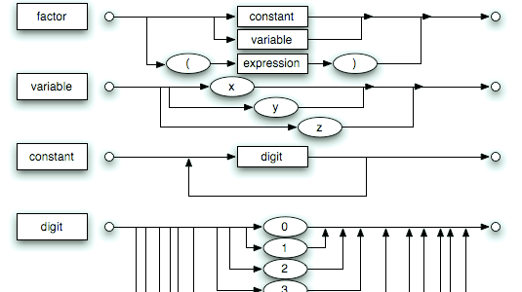
PASCAL Syntax Diagram
1-<number>
From: http://en.wikipedia.org/wiki/Syntax_diagram

Slide 20
An Example Grammar
<program> → <stmts>
<stmts> → <stmt> | <stmt> ; <stmts>
<stmt> → <var> = <expr>
<var> → a | b | c | d
<expr> → <term> + <term> | <term> - <term>
<term> → <var> | const
1-<number>

Slide 21
An Example Derivation
<program> => <stmts> => <stmt>
=> <var> = <expr>
=> a = <expr>
=> a = <term> + <term>
=> a = <var> + <term>
=> a = b + <term>
=> a = b + const
1-<number>

Slide 22
Derivations
Every string of symbols in a derivation is a sentential form
A sentence is a sentential form that has only terminal symbols
A leftmost derivation is one in which the leftmost nonterminal in each sentential form is the one that is expanded
A derivation may be neither leftmost nor rightmost
1-<number>

Slide 23
Parse Tree
A hierarchical representation of a derivation
<program>
<stmts>
<stmt>
<var>
=
<expr>
a
<term>
+
<term>
<var>
const
b
1-<number>

Slide 24
Ambiguity in Grammars
A grammar is ambiguous if and only if it generates a sentential form that has two or more distinct parse trees
1-<number>

Slide 25
An Ambiguous Expression Grammar
<expr> → <expr> <op> <expr> | const
<op> → / | -
<expr>
<expr>
<expr>
<op>
<expr>
<expr>
<op>
<op>
<expr>
<expr>
<op>
<expr>
<expr>
<op>
<expr>
const
-
const
/
const
const
-
const
/
const
1-<number>

Slide 26
An Unambiguous Expression Grammar
If we use the parse tree to indicate precedence levels of the operators, we cannot have ambiguity
<expr> → <expr> - <term> | <term>
<term> → <term> / const| const
<expr>
<expr>
-
<term>
<term>
<term>
/
const
const
const
1-<number>

Slide 27
Associativity of Operators
Operator associativity can also be indicated by a grammar
<expr> -> <expr> + <expr> | const (ambiguous)
<expr> -> <expr> + const | const (unambiguous)
<expr>
<expr>
<expr>
+
const
<expr>
+
const
const
1-<number>

Slide 28
Extended BNF
Optional parts are placed in brackets [ ]
<proc_call> -> ident [(<expr_list>)]
Alternative parts of RHSs are placed inside parentheses and separated via vertical bars
<term> → <term> (+|-) const
Repetitions (0 or more) are placed inside braces { }
<ident> → letter {letter|digit}
1-<number>

Slide 29
BNF and EBNF
BNF
<expr> → <expr> + <term>
| <expr> - <term>
| <term>
<term> → <term> * <factor>
| <term> / <factor>
| <factor>
EBNF
<expr> → <term> {(+ | -) <term>}
<term> → <factor> {(* | /) <factor>}
1-<number>

Slide 30
Recent Variations in EBNF
Alternative RHSs are put on separate lines
Use of a colon instead of =>
Use of _{opt} for optional parts
Use of oneof for choices
1-<number>

Slide 31

The Compilation Process
Regular language (i.e., regular expressions)
Context-free language (i.e., BNF)
1-<number>

Slide 32
Static Semantics
Context-free grammars (CFGs) cannot describe all of the syntax of programming languages
Categories of constructs that are trouble:
- Context-free, but cumbersome (e.g.,
types of operands in expressions)
- Non-context-free (e.g., variables must
be declared before they are used)
1-<number>

Slide 33
Attribute Grammars
Attribute grammars (AGs) have additions to CFGs to carry some semantic info on parse tree nodes
Primary value of AGs:
  Static semantics specification
  Compiler design (static semantics checking)
1-<number>

Slide 34
Attribute Grammars : Definition
Def: An attribute grammar is a context-free grammar G = (S, N, T, P) with the following additions:
  For each grammar symbol x there is a set A(x) of attribute values
  Each rule has a set of functions that define certain attributes of the nonterminals in the rule
  Each rule has a (possibly empty) set of predicates to check for attribute consistency
1-<number>

Slide 35
Attribute Grammars: Definition
Let X₀ → X₁ ... X_{n} be a rule
Functions of the form S(X₀) = f(A(X₁), ... , A(X_{n})) define synthesized attributes
Functions of the form I(X_{j}) = f(A(X₀), ... , A(X_{n})), for i <= j <= n, define inherited attributes
Initially, there are intrinsic attributes on the leaves
1-<number>

Slide 36
Attribute Grammars: An Example
Syntax
  <assign> -> <var> = <expr>
  <expr> -> <var> + <var> | <var>
  <var> A | B | C
actual_type: synthesized for <var> and <expr>
expected_type: inherited for <expr>
1-<number>

Slide 37
Attribute Grammar (continued)
Syntax rule: <expr> → <var>[1] + <var>[2]
Semantic rules:
<expr>.actual_type ← <var>[1].actual_type
Predicate:
<var>[1].actual_type == <var>[2].actual_type
<expr>.expected_type == <expr>.actual_type
Syntax rule: <var> → id
Semantic rule:
<var>.actual_type ← lookup (<var>.string)
1-<number>

Slide 38
Attribute Grammars (continued)
How are attribute values computed?
  If all attributes were inherited, the tree could be decorated in top-down order.
  If all attributes were synthesized, the tree could be decorated in bottom-up order.
  In many cases, both kinds of attributes are used, and it is some combination of top-down and bottom-up that must be used.
1-<number>

Slide 39
Attribute Grammars (continued)
<expr>.expected_type ← inherited from parent
<var>[1].actual_type ← lookup (A)
<var>[2].actual_type ← lookup (B)
<var>[1].actual_type =? <var>[2].actual_type
<expr>.actual_type ← <var>[1].actual_type
<expr>.actual_type =? <expr>.expected_type
1-<number>

Slide 40
Semantics
There is no single widely acceptable notation or formalism for describing semantics
Several needs for a methodology and notation for semantics:
  Programmers need to know what statements mean
  Compiler writers must know exactly what language constructs do
  Correctness proofs would be possible
  Compiler generators would be possible
  Designers could detect ambiguities and inconsistencies
1-<number>

Slide 41
Operational Semantics
Operational Semantics
  Describe the meaning of a program by executing its statements on a machine, either simulated or actual. The change in the state of the machine (memory, registers, etc.) defines the meaning of the statement
To use operational semantics for a high-level language, a virtual machine is needed
1-<number>

Slide 42
Operational Semantics
A hardware pure interpreter would be too expensive
A software pure interpreter also has problems
  The detailed characteristics of the particular computer would make actions difficult to understand
  Such a semantic definition would be machine- dependent
1-<number>

Slide 43
Operational Semantics (continued)
A better alternative: A complete computer simulation
The process:
  Build a translator (translates source code to the machine code of an idealized computer)
  Build a simulator for the idealized computer
Evaluation of operational semantics:
  Good if used informally (language manuals, etc.)
  Extremely complex if used formally (e.g., VDL), it was used for describing semantics of PL/I.
1-<number>

Slide 44
Operational Semantics (continued)
Uses of operational semantics:
- Language manuals and textbooks
- Teaching programming languages
Two different levels of uses of operational semantics:
- Natural operational semantics
- Structural operational semantics
Evaluation
- Good if used informally (language
manuals, etc.)
- Extremely complex if used formally (e.g.,VDL)
1-<number>

Slide 45
Axiomatic Semantics
Based on formal logic (predicate calculus)
Original purpose: formal program verification
Axioms or inference rules are defined for each statement type in the language (to allow transformations of logic expressions into more formal logic expressions)
The logic expressions are called assertions
1-<number>

Slide 46
Axiomatic Semantics (continued)
An assertion before a statement (a precondition) states the relationships and constraints among variables that are true at that point in execution
An assertion following a statement is a postcondition
A weakest precondition is the least restrictive precondition that will guarantee the postcondition
1-<number>

Slide 47
Axiomatic Semantics Form
Pre-, post form: {P} statement {Q}
An example
  a = b + 1 {a > 1}
  One possible precondition: {b > 10}
  Weakest precondition: {b > 0}
1-<number>

Slide 48
Program Proof Process
The postcondition for the entire program is the desired result
  Work back through the program to the first statement. If the precondition on the first statement is the same as the program specification, the program is correct.
1-<number>

Slide 49
Axiomatic Semantics: Assignment
An axiom for assignment statements
(x = E):
{Q_{x->E}} (That is, x is replaced by E.)
x = E
{Q}
1-<number>

Slide 50
Axiomatic Semantics: Assignment
An axiom for assignment statements
(x = E):
{Q_{x->E}}
x = E
{Q}
Example:
{b > 22}
A = b/2 – 1
{A > 10}
b/2 – 1 > 10
b > 22
1-<number>

Slide 51
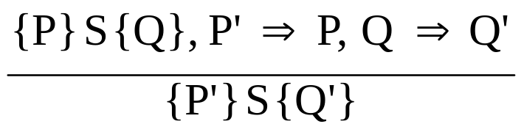
Axiomatic Semantics: Assignment
An axiom for assignment statements
{x > -3}
x = x + 3
{x > 0}
The Rule of Consequence:
1-<number>

Slide 52
Axiomatic Semantics: Inference
The Rule of Consequence:
P’ is stronger than P
Q’ is weaker than Q
1-<number>

Slide 53

Axiomatic Semantics: Sequences
An inference rule for sequences of the form S1; S2
{P1} S1 {P2}
{P2} S2 {P3}
1-<number>

Slide 54
Axiomatic Semantics: Selection
An inference rules for selection
- if B then S1 else S2
{B and P} S1 {Q}, {(not B) and P} S2 {Q}
{P} if B then S1 else S2 {Q}
1-<number>

Slide 55
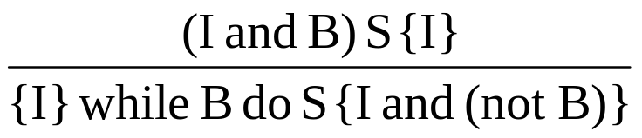
Axiomatic Semantics: Loops
An inference rule for logical pretest loops
{P} while B do S end {Q}
where I is the loop invariant (the inductive hypothesis)
1-<number>

Slide 56
Axiomatic Semantics: Axioms
Characteristics of the loop invariant: I must meet the following conditions:
  P => I -- the loop invariant must be true initially
  {I} B {I} -- evaluation of the Boolean must not change the validity of I
  {I and B} S {I} -- I is not changed by executing the body of the loop
  (I and (not B)) => Q -- if I is true and B is false, Q is implied
  The loop terminates -- can be difficult to prove
1-<number>

Slide 57
Loop Invariant
The loop invariant I is a weakened version of the loop postcondition, and it is also a precondition.
I must be weak enough to be satisfied prior to the beginning of the loop, but when combined with the loop exit condition, it must be strong enough to force the truth of the postcondition
1-<number>

Slide 58
Evaluation of Axiomatic Semantics
Developing axioms or inference rules for all of the statements in a language is difficult
It is a good tool for correctness proofs, and an excellent framework for reasoning about programs, but it is not as useful for language users and compiler writers
Its usefulness in describing the meaning of a programming language is limited for language users or compiler writers
1-<number>

Slide 59
Summary
BNF and context-free grammars are equivalent meta-languages
  Well-suited for describing the syntax of programming languages
An attribute grammar is a descriptive formalism that can describe both the syntax and the semantics of a language
Three primary methods of semantics description
  Operation, axiomatic, denotational
1-<number>

