Slide 1
Chapter 4
Lexical and Syntax Analysis
1-<number>

Slide 2
Chapter 4 Topics
Introduction
Lexical Analysis
The Parsing Problem
Recursive-Descent Parsing
Bottom-Up Parsing
1-<number>

Slide 3
Introduction
Language implementation systems must analyze source code, regardless of the specific implementation approach
Nearly all syntax analysis is based on a formal description of the syntax of the source language (BNF)
1-<number>

Slide 4
Syntax Analysis
The syntax analysis portion of a language processor nearly always consists of two parts:
  A low-level part called a lexical analyzer (mathematically, a finite automaton based on a regular grammar)
  A high-level part called a syntax analyzer, or parser (mathematically, a push-down automaton based on a context-free grammar, or BNF)
1-<number>

Slide 5
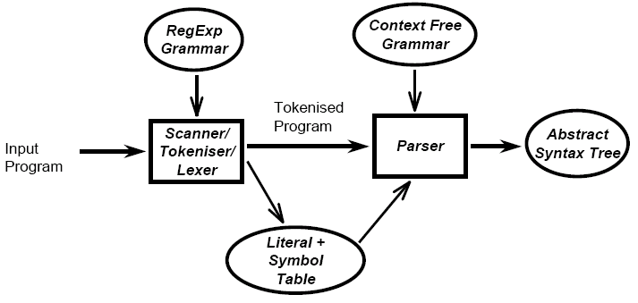
Lexical analyzer and syntax analyzer (parser)
1-<number>

Slide 6
Advantages of Using BNF to Describe Syntax
Provides a clear and concise syntax description
The parser can be based directly on the BNF
Parsers based on BNF are easy to maintain
1-<number>

Slide 7
Reasons to Separate Lexical and Syntax Analysis
Simplicity - less complex approaches can be used for lexical analysis; separating them simplifies the parser
Efficiency - separation allows optimization of the lexical analyzer
Portability - parts of the lexical analyzer may not be portable, but the parser always is portable
1-<number>

Slide 8
Lexical Analysis
A lexical analyzer is a pattern matcher for character strings
A lexical analyzer is a “front-end” for the parser
Identifies substrings of the source program that belong together - lexemes
  Lexemes match a character pattern, which is associated with a lexical category called a token
  sum is a lexeme; its token may be IDENT
1-<number>

Slide 9
Lexical Analysis (continued)
The lexical analyzer is usually a function that is called by the parser when it needs the next token
Three approaches to building a lexical analyzer:
  Write a formal description of the tokens and use a software tool that constructs a table-driven lexical analyzer from such a description
  Design a state diagram that describes the tokens and write a program that implements the state diagram
  Design a state diagram that describes the tokens and hand-construct a table-driven implementation of the state diagram
1-<number>

Slide 10
State Diagram Design
  A naïve state diagram would have a transition from every state on every character in the source language - such a diagram would be very large!
1-<number>

Slide 11
Lexical Analysis (continued)
In many cases, transitions can be combined to simplify the state diagram
  When recognizing an identifier, all uppercase and lowercase letters are equivalent
    Use a character class that includes all letters
  When recognizing an integer literal, all digits are equivalent - use a digit class
1-<number>

Slide 12
Lexical Analysis (continued)
Reserved words and identifiers can be recognized together (rather than having a part of the diagram for each reserved word)
  Use a table lookup to determine whether a possible identifier is in fact a reserved word
1-<number>

Slide 13
Lexical Analysis (continued)
Convenient utility subprograms:
  getChar - gets the next character of input, puts it in nextChar, determines its class and puts the class in charClass
  addChar - puts the character from nextChar into the place the lexeme is being accumulated, lexeme
  lookup - determines whether the string in lexeme is a reserved word (returns a code)
1-<number>

Slide 14
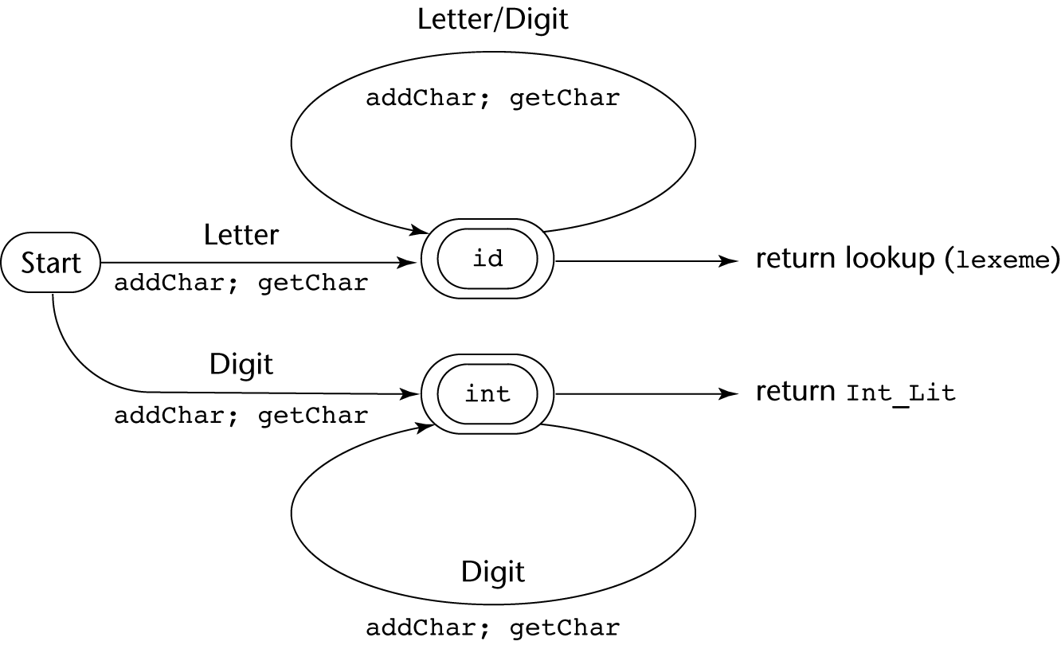
State Diagram
1-<number>

Slide 15
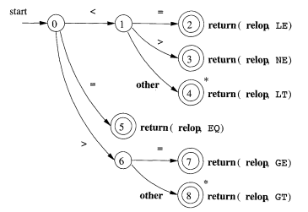
Operator in PASCAL
1-<number>

Slide 16
Lexical Analyzer
Implementation:
→ SHOW front.c (pp. 172-177)
- Following is the output of the lexical analyzer of
front.c when used on (sum + 47) / total
Next token is: 25 Next lexeme is (
Next token is: 11 Next lexeme is sum
Next token is: 21 Next lexeme is +
Next token is: 10 Next lexeme is 47
Next token is: 26 Next lexeme is )
Next token is: 24 Next lexeme is /
Next token is: 11 Next lexeme is total
Next token is: -1 Next lexeme is EOF
1-<number>

Slide 17
The Parsing Problem
Goals of the parser, given an input program:
  Find all syntax errors; for each, produce an appropriate diagnostic message and recover quickly
  Produce the parse tree, or at least a trace of the parse tree, for the program
1-<number>

Slide 18
The Parsing Problem (continued)
Two categories of parsers
  Top down - produce the parse tree, beginning at the root
    Order is that of a leftmost derivation
    Traces or builds the parse tree in preorder
  Bottom up - produce the parse tree, beginning at the leaves
    Order is that of the reverse of a rightmost derivation
Useful parsers look only one token ahead in the input
1-<number>

Slide 19
The Parsing Problem (continued)
Top-down Parsers
  Given a sentential form, xAα , the parser must choose the correct A-rule to get the next sentential form in the leftmost derivation, using only the first token produced by A
The most common top-down parsing algorithms:
  Recursive descent - a coded implementation
  LL parsers - table driven implementation
1-<number>

Slide 20
The Parsing Problem (continued)
Bottom-up parsers
  Given a right sentential form, α, determine what substring of α is the right-hand side of the rule in the grammar that must be reduced to produce the previous sentential form in the right derivation
  The most common bottom-up parsing algorithms are in the LR family
1-<number>

Slide 21
The Parsing Problem (continued)
The Complexity of Parsing
  Parsers that work for any unambiguous grammar are complex and inefficient ( O(n³), where n is the length of the input )
  Compilers use parsers that only work for a subset of all unambiguous grammars, but do it in linear time ( O(n), where n is the length of the input )
1-<number>

Slide 22
Recursive-Descent Parsing
There is a subprogram for each nonterminal in the grammar, which can parse sentences that can be generated by that nonterminal
EBNF is ideally suited for being the basis for a recursive-descent parser, because EBNF minimizes the number of nonterminals
1-<number>

Slide 23
Recursive-Descent Parsing (continued)
A grammar for simple expressions:
<expr> → <term> {(+ | -) <term>}
<term> → <factor> {(* | /) <factor>}
<factor> → id | int_constant | ( <expr> )
1-<number>

Slide 24
Recursive-Descent Parsing (continued)
Assume we have a lexical analyzer named lex, which puts the next token code in nextToken
The coding process when there is only one RHS:
  For each terminal symbol in the RHS, compare it with the next input token; if they match, continue, else there is an error
  For each nonterminal symbol in the RHS, call its associated parsing subprogram
1-<number>

Slide 25
Recursive-Descent Parsing (continued)
/* Function expr
Parses strings in the language
generated by the rule:
<expr> → <term> {(+ | -) <term>}
*/
void expr() {
/* Parse the first term */
term();
/* As long as the next token is + or -, call
lex to get the next token and parse the
next term */
while (nextToken == ADD_OP ||
nextToken == SUB_OP){
lex();
term();
}
}
1-<number>

Slide 26
Recursive-Descent Parsing (continued)
This particular routine does not detect errors
Convention: Every parsing routine leaves the next token in nextToken
1-<number>

Slide 27
Recursive-Descent Parsing (continued)
A nonterminal that has more than one RHS requires an initial process to determine which RHS it is to parse
  The correct RHS is chosen on the basis of the next token of input (the lookahead)
  The next token is compared with the first token that can be generated by each RHS until a match is found
  If no match is found, it is a syntax error
1-<number>

Slide 28
Recursive-Descent Parsing (continued)
/* term
Parses strings in the language generated by the rule:
<term> -> <factor> {(* | /) <factor>)
*/
void term() {
/* Parse the first factor */
factor();
/* As long as the next token is * or /,
next token and parse the next factor */
while (nextToken == MULT_OP || nextToken == DIV_OP) {
lex();
factor();
}
} /* End of function term */
1-<number>

Slide 29
Recursive-Descent Parsing (continued)
/* Function factor
Parses strings in the language
generated by the rule:
<factor> -> id | (<expr>) */
void factor() {
/* Determine which RHS */
if (nextToken) == ID_CODE || nextToken == INT_CODE)
/* For the RHS id, just call lex */
lex();
/* If the RHS is (<expr>) – call lex to pass over the left parenthesis,
call expr, and check for the right parenthesis */
else if (nextToken == LP_CODE) {
lex();
expr();
if (nextToken == RP_CODE)
lex();
else
error();
} /* End of else if (nextToken == ... */
else error(); /* Neither RHS matches */
}
1-<number>

Slide 30
Recursive-Descent Parsing (continued)
- Trace of the lexical and syntax analyzers on (sum + 47) / total
Next token is: 25 Next lexeme is ( Next token is: 11 Next lexeme is total
Enter <expr> Enter <factor>
Enter <term> Next token is: -1 Next lexeme is EOF
Enter <factor> Exit <factor>
Next token is: 11 Next lexeme is sum Exit <term>
Enter <expr> Exit <expr>
Enter <term>
Enter <factor>
Next token is: 21 Next lexeme is +
Exit <factor>
Exit <term>
Next token is: 10 Next lexeme is 47
Enter <term>
Enter <factor>
Next token is: 26 Next lexeme is )
Exit <factor>
Exit <term>
Exit <expr>
Next token is: 24 Next lexeme is /
Exit <factor>
1-<number>

Slide 31
Recursive-Descent Parsing (continued)
The LL Grammar Class
  The Left Recursion Problem
    If a grammar has left recursion, either direct or indirect, it cannot be the basis for a top-down parser
      A grammar can be modified to remove direct left recursion as follows:
      For each nonterminal, A,
      Group the A-rules as A → Aα₁ | … | Aα_{m} | β₁ | β₂ | … | β_{n}
      where none of the β‘s begins with A
      2. Replace the original A-rules with
      A → β₁A’ | β₂A’ | … | β_{n}A’
      A’ → α₁A’ | α₂A’ | … | α_{m}A’ | ε
1-<number>

Slide 32
Recursive-Descent Parsing (continued)
The other characteristic of grammars that disallows top-down parsing is the lack of pairwise disjointness
  The inability to determine the correct RHS on the basis of one token of lookahead
  Def: FIRST(α) = {a | α =>* aβ }
(If α =>* ε, ε is in FIRST(α))
1-<number>

Slide 33
Recursive-Descent Parsing (continued)
Pairwise Disjointness Test:
  For each nonterminal, A, in the grammar that has more than one RHS, for each pair of rules, A → α_{i} and A → α_{j}, it must be true that
FIRST(α_{i}) ⋂ FIRST(α_{j}) = φ
Example:
A → a | bB | cAb
A → a | aB
1-<number>

Slide 34
Recursive-Descent Parsing (continued)
Left factoring can resolve the problem
Replace
<variable> → identifier | identifier [<expression>]
with
<variable> → identifier <new>
<new> → ε | [<expression>]
or
<variable> → identifier [[<expression>]]
(the outer brackets are metasymbols of EBNF)
1-<number>

Slide 35
Bottom-up Parsing
The parsing problem is finding the correct RHS in a right-sentential form to reduce to get the previous right-sentential form in the derivation
1-<number>

Slide 36
Bottom-up Parsing (continued)
Intuition about handles:
  Def: β is the handle of the right sentential form
γ = αβw if and only if S =>*_{rm} αAw =>_{rm} αβw
  Def: β is a phrase of the right sentential form
γ if and only if S =>* γ = α₁Aα₂ =>+ α₁βα₂
  Def: β is a simple phrase of the right sentential form γ if and only if S =>* γ = α₁Aα₂ => α₁βα₂
1-<number>

Slide 37
Bottom-up Parsing (continued)
Intuition about handles (continued):
  The handle of a right sentential form is its leftmost simple phrase
  Given a parse tree, it is now easy to find the handle
  Parsing can be thought of as handle pruning
1-<number>

Slide 38
Bottom-up Parsing (continued)
Shift-Reduce Algorithms
  Reduce is the action of replacing the handle on the top of the parse stack with its corresponding LHS
  Shift is the action of moving the next token to the top of the parse stack
1-<number>

Slide 39
Bottom-up Parsing (continued)
Advantages of LR parsers:
  They will work for nearly all grammars that describe programming languages.
  They work on a larger class of grammars than other bottom-up algorithms, but are as efficient as any other bottom-up parser.
  They can detect syntax errors as soon as it is possible.
  The LR class of grammars is a superset of the class parsable by LL parsers.
1-<number>

Slide 40
Bottom-up Parsing (continued)
LR parsers must be constructed with a tool
Knuth’s insight: A bottom-up parser could use the entire history of the parse, up to the current point, to make parsing decisions
  There are only a finite and relatively small number of different parse situations that could have occurred, so the history could be stored in a parser state, on the parse stack
1-<number>

Slide 41
Bottom-up Parsing (continued)
An LR configuration stores the state of an LR parser
(S₀X₁S₁X₂S₂…X_{m}S_{m}, a_{i}a_{i+1}…a_{n}$)
1-<number>

Slide 42
Bottom-up Parsing (continued)
LR parsers are table driven, where the table has two components, an ACTION table and a GOTO table
  The ACTION table specifies the action of the parser, given the parser state and the next token
    Rows are state names; columns are terminals
  The GOTO table specifies which state to put on top of the parse stack after a reduction action is done
    Rows are state names; columns are nonterminals
1-<number>

Slide 43

Structure of An LR Parser
1-<number>

Slide 44
Bottom-up Parsing (continued)
Initial configuration: (S₀, a₁…a_{n}$)
Parser actions:
  For a Shift, the next symbol of input is pushed onto the stack, along with the state symbol that is part of the Shift specification in the Action table
  For a Reduce, remove the handle from the stack, along with its state symbols. Push the LHS of the rule. Push the state symbol from the GOTO table, using the state symbol just below the new LHS in the stack and the LHS of the new rule as the row and column into the GOTO table
1-<number>

Slide 45
Bottom-up Parsing (continued)
Parser actions (continued):
  For an Accept, the parse is complete and no errors were found.
  For an Error, the parser calls an error-handling routine.
1-<number>

Slide 46
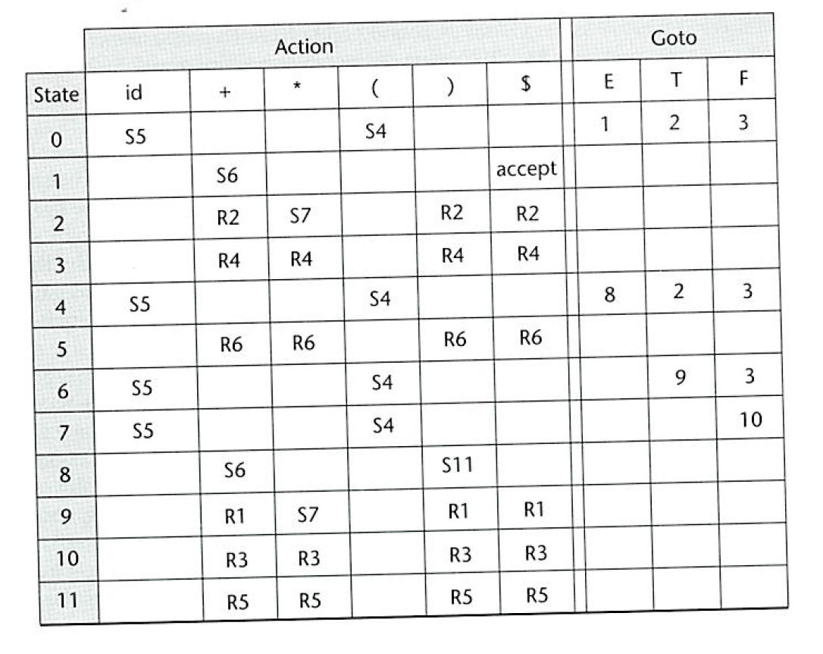
LR Parsing Table
1-<number>

Slide 47
An example
Grammar rules
E --> E + T
E --> T
T --> T * F
T --> F
F --> (E)
F --> id
1-<number>

Slide 48
An example
Right most derivation of id + id * id
E ==> E + T rule (1) E + T is reduced to E
==> E + T * F rule (3) T * F is reduced to T
==> E + T * id rule (6) F --> id, id is reduced to F
==> E + F * id rule (4) T --> F, F is reduced to T
==> E + id * id rule (6) F --> id, id is reduced to F
==> T + id * id rule (2) E --> T, T is reduced to E
==> F + id * id rule (4) T --> F, F is reduced to T
==> id + id * id rule (6) F --> id, id is reduced to F
(The handle of the sentential form is underlined.)
1-<number>

Slide 49
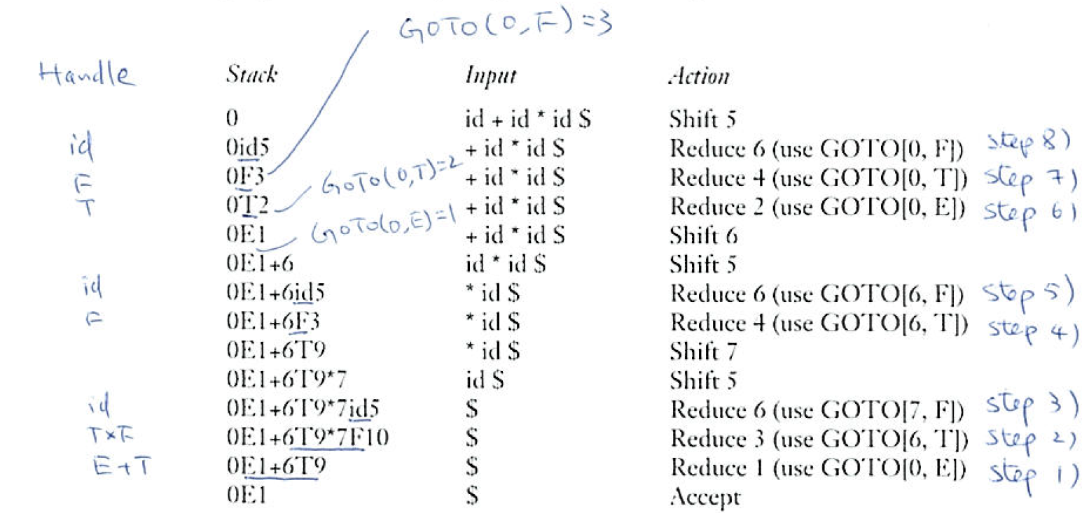
An example
1-<number>

Slide 50
Bottom-up Parsing (continued)
A parser table can be generated from a given grammar with a tool, e.g., yacc or bison
1-<number>

Slide 51
Summary
Syntax analysis is a common part of language implementation
A lexical analyzer is a pattern matcher that isolates small-scale parts of a program
  Detects syntax errors
  Produces a parse tree
A recursive-descent parser is an LL parser
  EBNF
Parsing problem for bottom-up parsers: find the substring of current sentential form
The LR family of shift-reduce parsers is the most common bottom-up parsing approach
1-<number>

