Slide 1
WGST 100-991: Introduction to Women’s and Gender Studies
Week 1: Wednesday, Sept 5/18
Introductory Class

Slide 2
Course Introduction
Syllabus Overview
About Me
About You

Slide 3

Sex and Gender

Slide 4
Introduction: Definition of Sex
Biological characteristics that are considered significant and distinguishing between males and females including the presence of ovaries or testes and external genitalia.

Slide 5
Introduction: Significance of Sex
What if you had been born a different sex? Think about how your life would be altered. Would you have a different job? Different friends?
What would be the same? Perceptions? Activities? Hairstyle?

Slide 6
Introduction: Biological Determination of Sex?
In fact, a surprisingly large proportion of infants are born with chromosomal or anatomical anomalies that make determination of their sex problematic.
Approximately 4 percent of infants have some sex based anomalies which means they do not fit perfectly into the categories of male or female.
Also, about 17 out of every 1000 newborns can be identified as intersexed (a person whose body combines a mixture of male and female physical markers or reproductive organs)

Slide 7
Introduction: Or Assigned Biological Determination of Sex?
When a situation arises that an infant is defined as intersexed the doctor and families seek to identify the dominant features of the infant and then assign the infant a sex (boy or girl).
In short, human decisions and medical interventions can result in the recreation of the sex of the person.

Slide 8
Introduction: Definition of Gender
A system of social properties within society that constitutes people as different in socially significant ways and organizes relations on the basis of the difference.
Also defined as personality traits and behavior patterns, understood to correlate with sex-based differences.

Slide 9
Introduction: Significance of Gender
There are certain social expectations that come with what sex a person is designated.
These social expectations are taught to us from the beginning of our lives until our end.
Those that meet these expectations are generally accepted, those that do not tend to be sanctioned or punished.

Slide 10
Introduction: Determinants of Gender?
But are these social expectations universal, natural, or even desired?
Or are they simply subjective assumptions of how a person should be or portray themselves?

Slide 11
Introduction: Sex and Gender-The Differences
Look at your face in the mirror. You will see your biological aspects such as bone structure and facial features. These can be attributed to your sex.
You will also see your choice in hair colouring, haircut, makeup, and piercings which may be influenced by societal expectations placed upon men and women.

Slide 12
Introduction: Socialization
Definition: The life-long social learning a person undergoes to become a capable member of society.
Primary Socialization: Learning that takes place in the early years of a person’s life that is crucial to the formation of an individual’s personality.
Secondary Socialization: Learning that occurs after childhood, usually involving learning specific roles, norms, attitudes, or beliefs, and sometimes involving self-imposed learning.
Anticipatory Socialization: Learning about and preparing for future roles, built on accumulated learning.

Slide 13
Introduction: Socialization, The Media Example
As Children and Young Adults:
https://www.youtube.com/watch?v=w2bYinZ6RX0

Slide 14
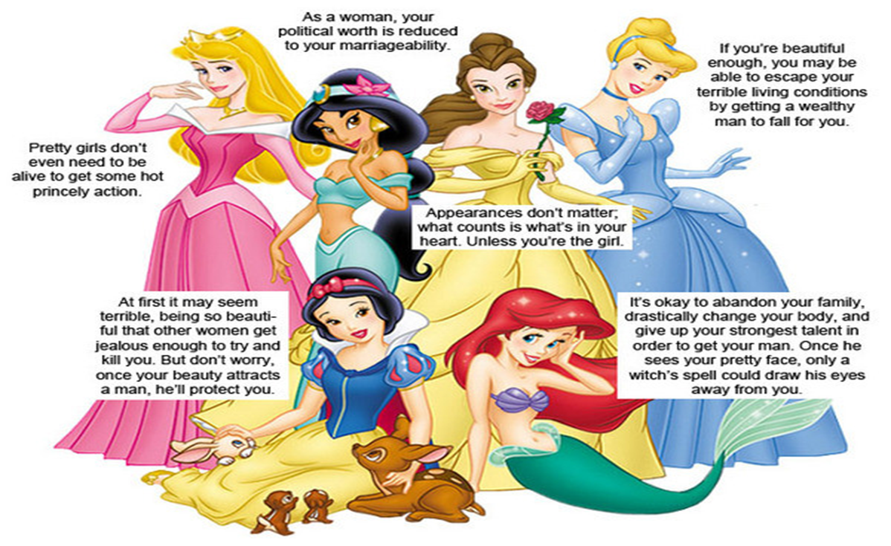
Socialization: The Disney Example

Slide 15
Introduction: Normative Expectations
Normative Expectations: elements that guide our behaviour and assessments of others .
Serves as a tool in which people are ultimately measured in society.
Reinforces the pressure to conform rather than celebrate diversity.
People feel pressure to suppress non-stereotyped activities and characteristics in order to avoid being judged as deviant.

Slide 16
Introduction: Normative Expectations
Gender based normative expectations define cultural standards of masculinity and femininity.
It creates a template on which to assess other people and roles for us to play in order to conform.
Gender roles: a set of behavioural expectations based upon a person’s perceived gender. These roles are thought to influence they ways in which people are supposed to think, feel appear, and behave.
https://www.youtube.com/watch?v=klgeo37QES0
Sex roles: historically accepted idea that men and women behave differently due to their biological capacities in concert with learned behaviour deemed appropriate for their sex.

