Slide 1
WGST 100-991: Introduction to Women’s and Gender Studies
Week 5: Wednesday, Oct. 3/18
Construction of Sex and Gender: The Waves Part III

Slide 2
Third Wave of Feminism
Recognizes that being a woman intersects with other statuses such as class, sexual orientation, and ethnicity.
Thus Feminism must address a broad range of issues.

Slide 3
Third Wave of Feminism
Term created by Rebecca Walker in her article in S. Magazine in 1992.
Catalyst was the Clarence Thomas Supreme Court confirmation hearings.
“To be a feminist is to integrate an ideology of equality and female empowerment into the very fiber of life. It is to search for personal clarity in the midst of systemic destruction, to join in sisterhood with women when often we are divided, to understand power structures with the intention of challenging them.”

Slide 4
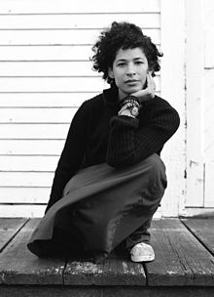
Third Wave of Feminism

Slide 5
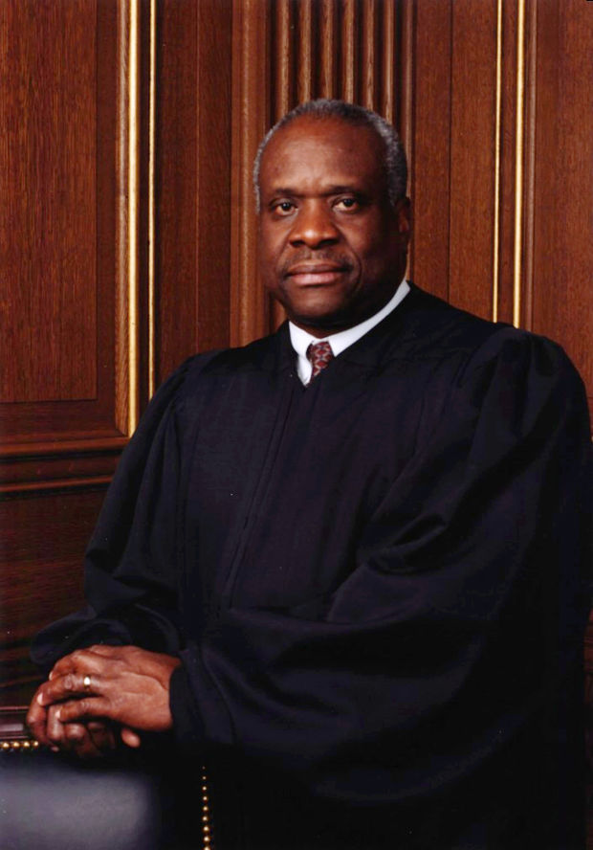
Third Wave of Feminism

Slide 6
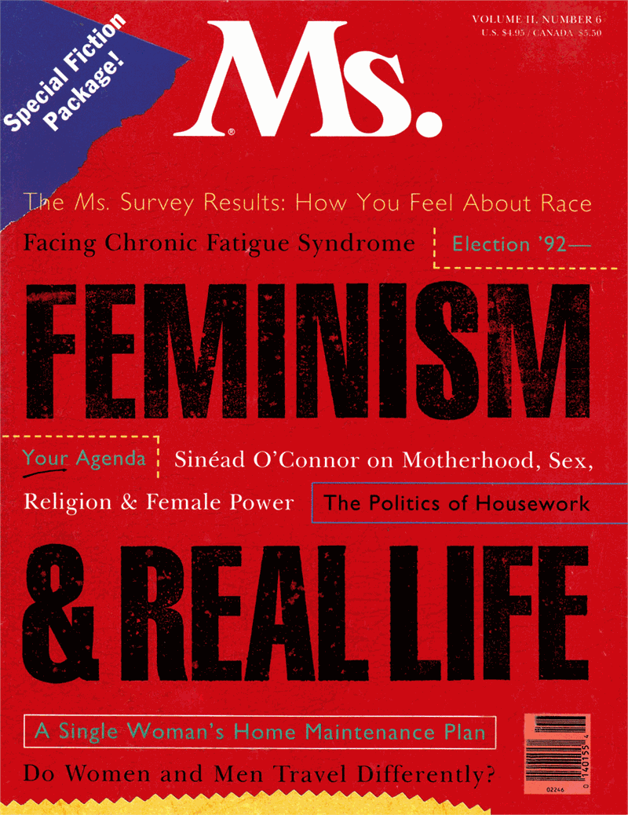
Third Wave of Feminism

Slide 7
Third Wave of Feminism: Gender Violence
a central issue for third-wave feminists.
Organizations such as V-Day have formed with the goal of ending gender violence, and artistic expressions such as Eve Ensler’s The Vagina Monologues have generated awareness and action around issues relating to women's sexuality.
Take Back the Night and Slutwalk.
Transgender violence becomes a topic of discussion for the first time, a response to the “gay bashing” fad in the 1980’s.

Slide 8
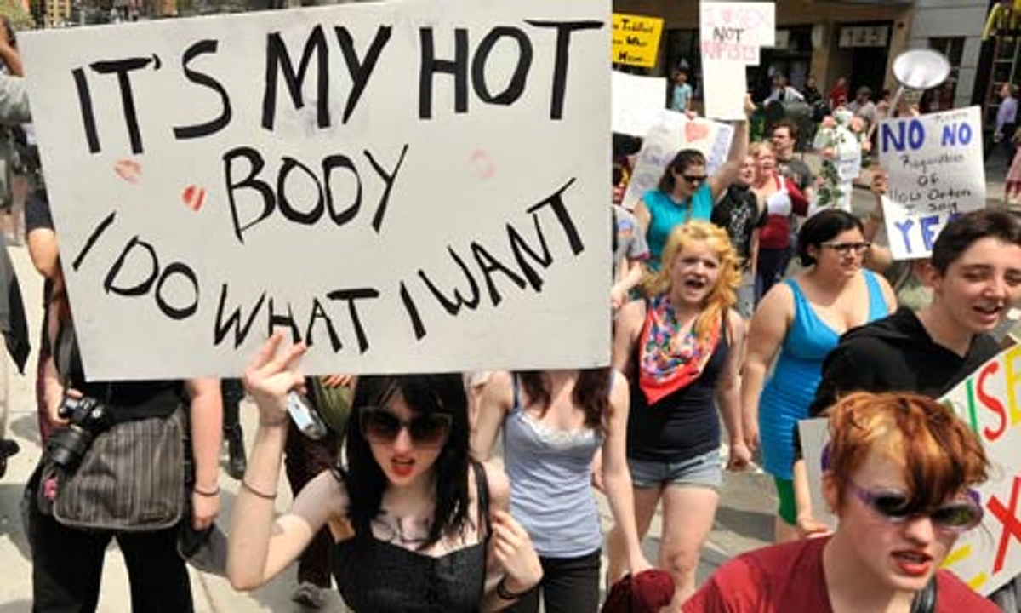
Third Wave of Feminism: Gender Violence

Slide 9
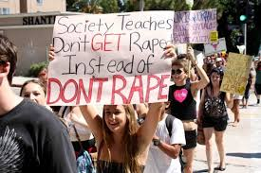
Third Wave of Feminism: Gender Violence

Slide 10
Third Wave of Feminism: Gender Violence: Reclaiming Derogatory Terms
English-speakers continue to use words such as spinster, bitch, whore, and cunt to refer to women in derogatory ways.
But also other negative gender words such as queer, fag, and homo.
Goal to co-opt the words, make it their own and, thus reduce the stigma of them.
This is done through de-constructing them and socializing future generations on the tenor of words.

Slide 11
Third Wave of Feminism: In Canada
Took on the race issues that have permeated Canadian culture.
Canada prides itself on multiculturalism.
However, just because one labels itself multicultural does not wipe clean all racial issues.

Slide 12
Third Wave of Feminism: In Canada (Aboriginal)
Based around the amended 1951 Indian Act.
The status of “Indian” was conferred upon persons whose father was a status Indian.
A native man always passed on his status to his wife and children (whether she was Aboriginal or not), while a native woman who married a non-native lost her own status and could not pass on her status to her children.
the Indian Act was amended to address unequal treatment of native women with Bill C-31 which allowed the return of Native Status to those who had lost it.
Native Women’s Association of Canada.

Slide 13
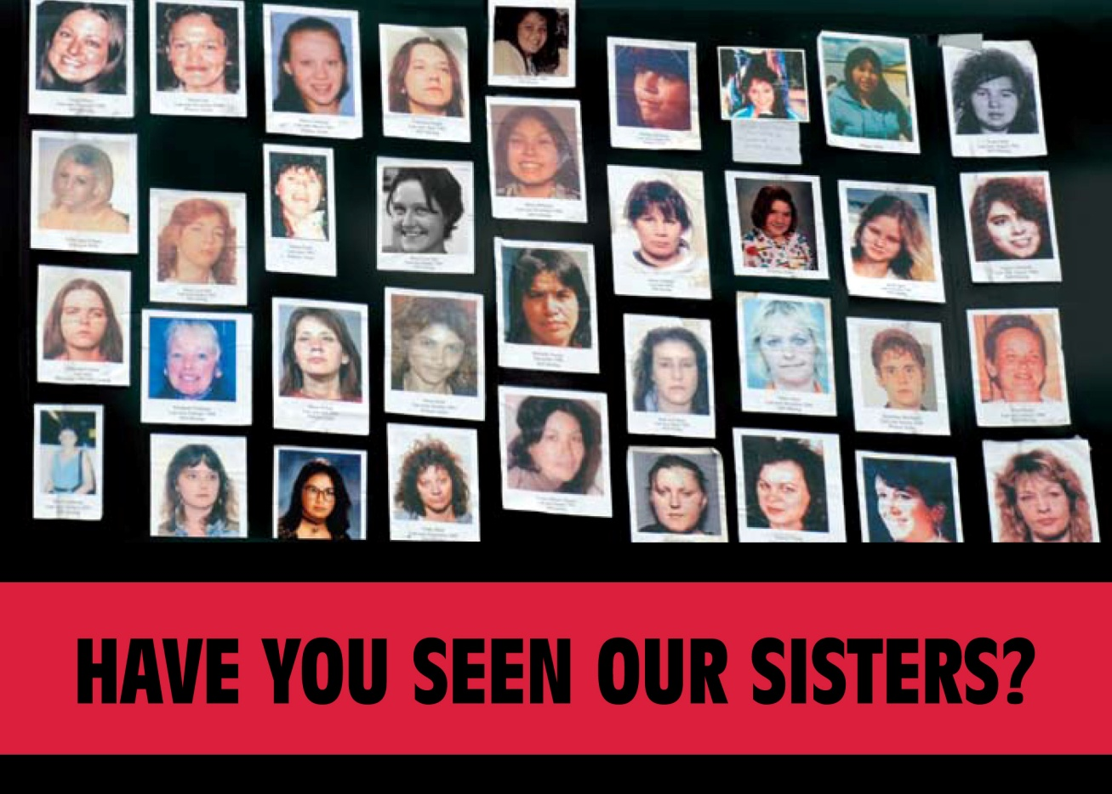
Third Wave of Feminism: In Canada (Aboriginal)

Slide 14
Third Wave of Feminism: In Canada (Black)
The mainstream history of the first and second waves is problematic insofar as their struggles to enable women to leave their homes and partake in the labour force ignored that certain women had always worked to support their families.
Though the “double burden” of work and household labour that would be an important element of feminism in its second wave, had long been present for black women, who were also less likely to be paid fairly.
Canadian Negro Women’s Association in 1951 evolved to the Congress of Black Women.

Slide 15

Third Wave of Feminism: In Canada (Black)

