Slide 1
WGST 100-991: Introduction to Women’s and Gender Studies
Week 5: Friday, Oct. 5/18
Construction of Sex and Gender: The Waves
Gendered Identities: The Culture of Masculinity

Slide 2
Midterm (25%)-Wednesday, Oct 17
Two Sections:
1. Multiple Choice-25 questions worth 1 mark each (25 marks total)
2. Short Answer-7 questions, you pick 5 to answer, worth 5 marks each (25 marks)
You are responsible for all information presented in the lectures up until this point (and including tonight).

Slide 3
The Waves: Recap
First Wave:
-Maternal feminism
-The right to participate in public life
Voting and personhood

Slide 4
The Waves: Recap
Second Wave:
-equal opportunities
-reproductive Freedoms
-solutions to violence

Slide 5
The Waves: Recap
Third Wave:
-Expansion of the term Feminism
-Gendered violence
-Recapturing words (linguistics)

Slide 6
Fourth Wave of Feminism
Term coined by Jennifer Baumgartner in 2008.
Connected through technology as the vehicle of change.
Combines politics, psychology, and spirituality in an overarching vision of change.“

Slide 7
Fourth Wave of Feminism: Technology
Also called “Online Feminism.”
uses Facebook, Twitter, Instagram, YouTube, Tumblr, and other forms of social media to discuss, uplift, and activate gender equality and social justice.
The internet has created a ‘call-out’ culture, in which sexism or misogyny can be ‘called out’ and challenged.
Example: #metoo Movement
https://www.youtube.com/watch?v=8mL1-k1U0aY&t=266s

Slide 8
Fourth Wave of Feminism: Redefining Feminism
The realization that feminism includes individuals who are uncomfortable with the word "feminism" itself, due to the "assumptions of a gender binary and exclusionary subtext: 'for women only.’
Repudiates Radical Feminism because of this.

Slide 9
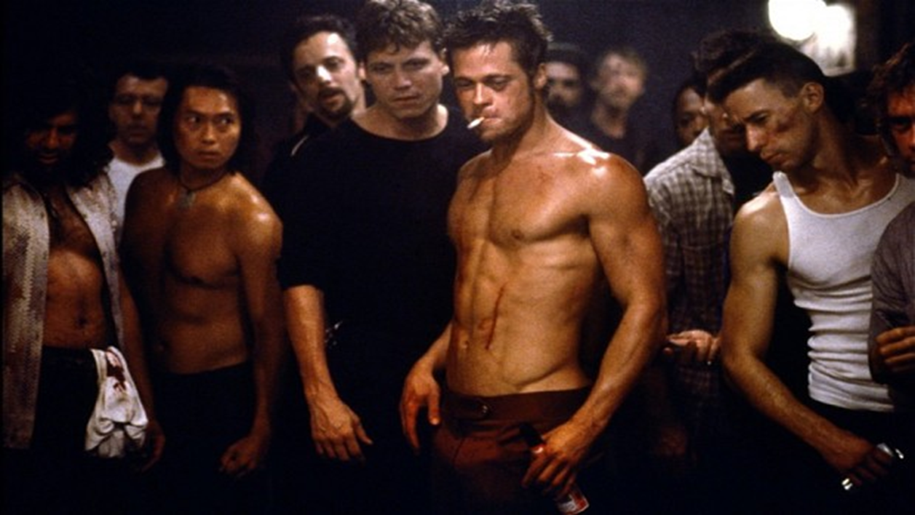
The Culture of Masculinity

Slide 10
Culture of Masculinity: Gender Identity
Gender stereotypes are not mere neutral descriptors of behavior, they can also be prescriptive.
As prescriptive descriptors, stereotypes not only indicate what masculine people are like but also create expectations about what people should be like.
Thus, stereotypes are normative expectations.

Slide 11
Culture of Masculinity: Introduction
Masculinity: term used to describe the qualities of men.
Often described as the “opposite” of femininity and essentially composed of imagined gender differences.
But, their very dichotomy nature also helps shape each other and offers clarity for understanding what is a man.

Slide 12
The Culture of Masculinity
What is the culture of masculinity in Western Society?
Documentary:
Newsom. 2015. The Mask You Live In.
https://www.youtube.com/watch?v=I1OI9B0VSlA

