Slide 1
10.4 Inductive Bias and Learnability
Successful induction:
  Proper use of empirical data (data-driven)
  Proper use of prior knowledge (existing knowledge)
  Proper use of basic assumption about the nature of the concepts being learned (i.e., goal driven)
  Combination of Data-Driven and Goal Driven in learning
Inductive bias, any criteria a learner use

Slide 2
10.4 Inductive Bias and Learnability
Inductive bias, any criteria a learner use to
  constrain the concept space (i.e., construction of state space)
  Select concepts within the space (i.e., search)

Slide 3
Inductive Bias
Needs for inductive bias
  Learning space is large, impossible to search all, use inductive bias to
    have a small space
    search a small portion of the space
  Generalization (inductive learning) is not truth persevering.
    training set is only a subset of all possible instances

Slide 4
Inductive Bias
Examples of inductive bias
  Conjunctive biases
  Limitations on the number of disjuncts
  Feature vectors
  Decision trees
  Horn clauses (a special form of rules)

Slide 5
Inductive Bias
Examples of inductive bias
  Decision trees
    Wider trees (ID3)
    Shorter trees

Slide 6
The theory of learnability
How to quantify the effectiveness of an inductive bias?
How to measure the quality of a learning algorithm?
How to measure the efficiency of a learning algorithm?
…

Slide 7
The theory of learnability
A class of a concept is PAC (probably approximately correct) learnable if an algorithm exists that executes efficiently and has a high probability of finding an approximately correct concept.
  Efficiency (in terms of complexity of the algorithm)
  Effectiveness (in terms of the performance)

Slide 8
10.5 Knowledge and Learning
Similarity-based learning:
  Learning regularity based on the similarity, or common features, of examples.
Explanation-based learning:
  Use prior, domain knowledge to guide generalization
  Construct a model to explain a training example.

Slide 9
Explanation-based learning
Generalizes from explanation of the instance, rather than from the instance itself.
Filters noise
Selects relevant aspects of experience
Organizes training data

Slide 10
Explanation based learning
Given
  A target concept
  A training example
  A domain Theory
  Operationality Criteria
Learn the target concept.

Slide 11
An example
Learning the concept of a “cup”

Slide 12
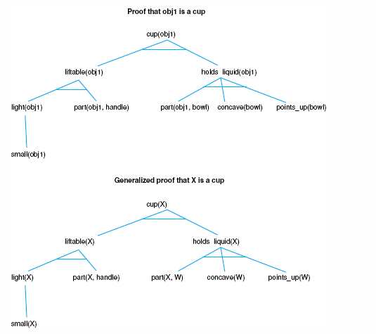
Fig 10.17 Specific and generalized proof that an object, X, is a cup.
Luger: Artificial Intelligence, 6th edition. © Pearson Education Limited, 2009
24

Slide 13
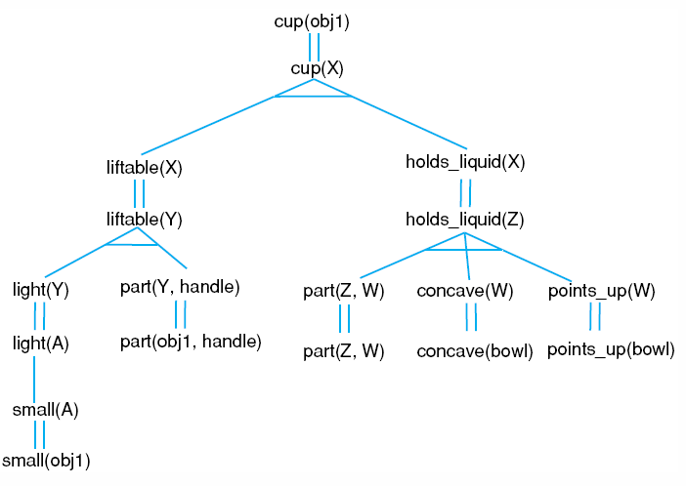
Fig 10.18 An explanation structure of the cup example.
Luger: Artificial Intelligence, 6th edition. © Pearson Education Limited, 2009
25

Slide 14
10.6 Unsupervised Learning
Cluster analysis
  group objects without a teacher
  based on similarity and dissimilarity

Slide 15
Cluster analysis
Basic concepts
  Flat clustering
    K-means
  Hierarchical clustering

Slide 16

Concepts in Clustering
  “Defining distance between points
    Cosine distance
    Overlap distance
  A good clustering is one where
    (Intra-cluster distance) the sum of distances between objects in the same cluster are minimized,
    (Inter-cluster distance) while the distances between different clusters are maximized
    Objective to minimize: F(Intra,Inter)
  Clusters can be evaluated with “internal” as well as “external” measures
    Internal measures are related to the inter/intra cluster distance
    External measures are related to how representative are the current clusters to “true” classes.

Slide 17
Inter/Intra Cluster Distances
Intra-cluster distance
(Sum/Min/Max/Avg) the (absolute/squared) distance between
  All pairs of points in the cluster OR
  Between the centroid and all points in the cluster OR
  Between the “medoid” and all points in the cluster
Inter-cluster distance
Sum the (squared) distance between all pairs of clusters
Where distance between two clusters is defined as:
  distance between their centroids/medoids
    (Spherical clusters)
  Distance between the closest pair of points belonging to the clusters
    (Chain shaped clusters)

Slide 18
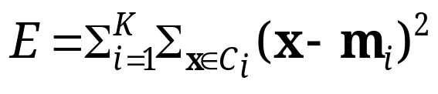
Partitioning Clustering Approach
  a typical clustering analysis approach via partitioning data set iteratively
  construct a partition of a data set to produce several non-empty clusters (usually, the number of clusters given in advance)
  in principle, partitions achieved via minimising the sum of squared distance in each cluster
Given a K, find a partition of K clusters to optimise the chosen partitioning criterion
  global optimal: exhaustively enumerate all partitions
  heuristic method: K-means algorithm
  K-means algorithm (MacQueen’67): each cluster is represented by the centre of the cluster and the algorithm converges to stable centres of clusters.

Slide 19
K-means
Works when we know k, the number of clusters we want to find
Idea:
  Randomly pick k points as the “centroids” of the k clusters
  Loop:
    For each point, put the point in the cluster to whose centroid it is closest
    Recompute the cluster centroids
    Repeat loop (until there is no change in clusters between two consecutive iterations.)
Iterative improvement of the objective function:
Sum of the squared distance from each point to the centroid of its cluster

Slide 20
K-means Example
For simplicity, 1-dimension objects and k=2.
  Numerical difference is used as the distance
Objects: 1, 2, 5, 6,7
K-means:
  Randomly select 5 and 6 as centroids;
  => Two clusters {1,2,5} and {6,7}; meanC1=8/3, meanC2=6.5
  => {1,2}, {5,6,7}; meanC1=1.5, meanC2=6
  => no change.
  Aggregate dissimilarity
    (sum of squares of distanceeach point of each cluster from its cluster center--(intra-cluster distance)
  = 0.5²+ 0.5²+ 1²+ 0²+1² = 2.5
|1-1.5|²

Slide 21
K Means Example
(K=2)
Pick seeds
Reassign clusters
Compute centroids
Reasssign clusters
x
x
x
Compute centroids
x
x
x
Reassign clusters
Converged!
[From Mooney]

Slide 22
10.7 Reinforcement Learning
An unsupervised learning based on feedback from the learner’s environment.
  The learner explore actions that produce the most reward.

