Slide 1
Chapter 14: Automated Reasoning
Proof by searching an AND/OR graph

Slide 2
The general problem solver
The Logic Theorist
  Uses propositional calculus as its representation medium
  Use inference rules:
    substitution,
    replacement, and
    detachment

Slide 3
The general problem solver
substitution
  Substitute every occurrence of a symbol in a proposition that is an axiom or theorem already known to be true.
Replacement
  Replace a connective by an equivalent form
Detachment
  MP rule

Slide 4
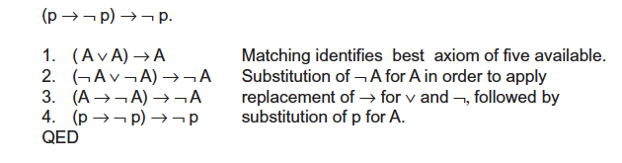
The general problem solver

Slide 5
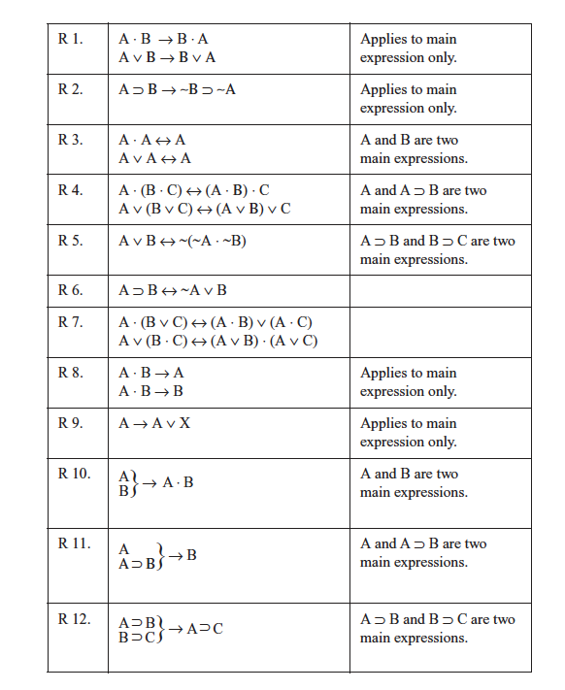
The general problem solver
Table of inference rules

Slide 6
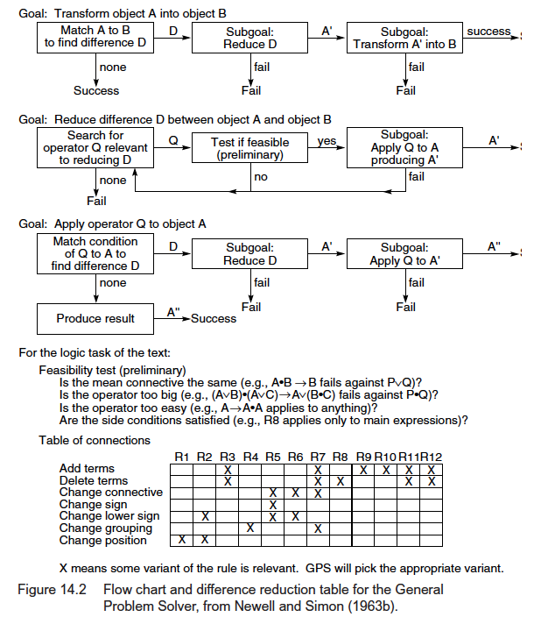
The general problem solver

Slide 7
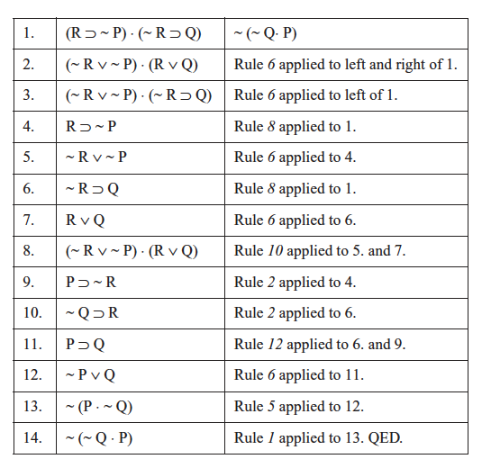
The general problem solver
An example

Slide 8
Binary resolution and PROLOG
Binary Resolution
PROLOG
  PROLOG Program = a set of special type of first order logic expression (Horn clauses)
  PROLOG interpreter = DFS search

Slide 9
Binary resolution rule
Homework: Prove binary resolution rule without using a truth table

Slide 10
Resolution refutation proofs involve the following steps:
Put the premises or axioms into clause form (Section 14.2.2)
Add the negation of what is to be proved, in clause form, into the set of axioms.
Resolve these clauses together, producing new clauses that logically follow from them (Section 14.2.3)
Produce a contradiction by generating the empty clause.
The substitutions used to produce the empty clause are those under which the opposite of the negated goal (what was originally to be proven) is true (Section 12.2.4)
Luger: Artificial Intelligence, 6th edition. © Pearson Education Limited, 2009
5

Slide 11
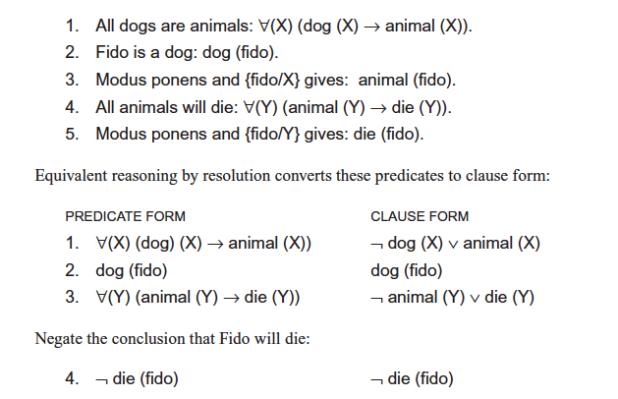
“dead dog” problem.
We wish to prove that “Fido will die” from the statements that “Fido is a dog” and “all dogs are animals” and “all animals will die.” Changing these three premises to predicates and applying modus ponens gives:
Luger: Artificial Intelligence, 6th edition. © Pearson Education Limited, 2009
6

Slide 12
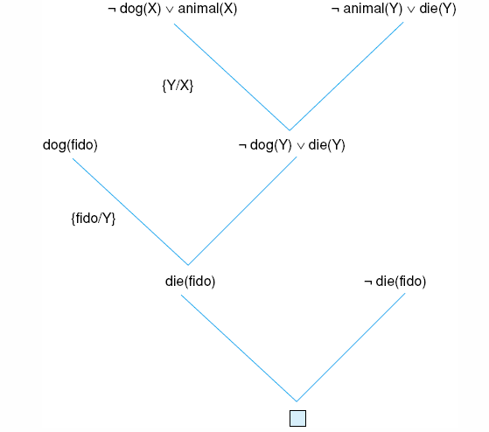
Fig 14.3 Resolution proof for the “dead dog” problem.
Luger: Artificial Intelligence, 6th edition. © Pearson Education Limited, 2009
6

Slide 13

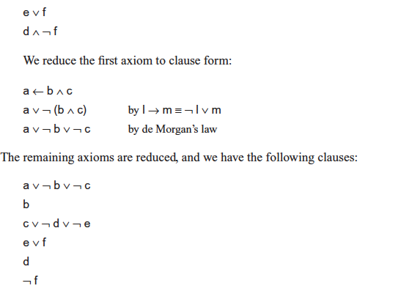
One resolution proof for an example from the propositional calculus.
Luger: Artificial Intelligence, 6th edition. © Pearson Education Limited, 2009
7

Slide 14
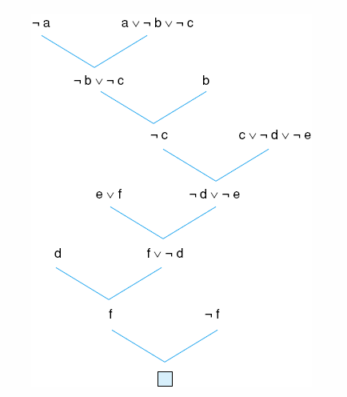
Fig 14.4 One resolution proof for an example from the propositional calculus.
Luger: Artificial Intelligence, 6th edition. © Pearson Education Limited, 2009
7

Slide 15
Two strategies used in binary resolution
Unit preference: The unit preference strategy uses units for resolving whenever they are available.
Linear input form: The linear input form strategy is a direct use of the negated goal and the original axioms: take the negated goal and resolve it with one of the axioms to get a new clause. This result is then resolved with one of the axioms to get another new clause, which is again resolved with one of the axioms. This process continues until the empty clause is produced.

Slide 16
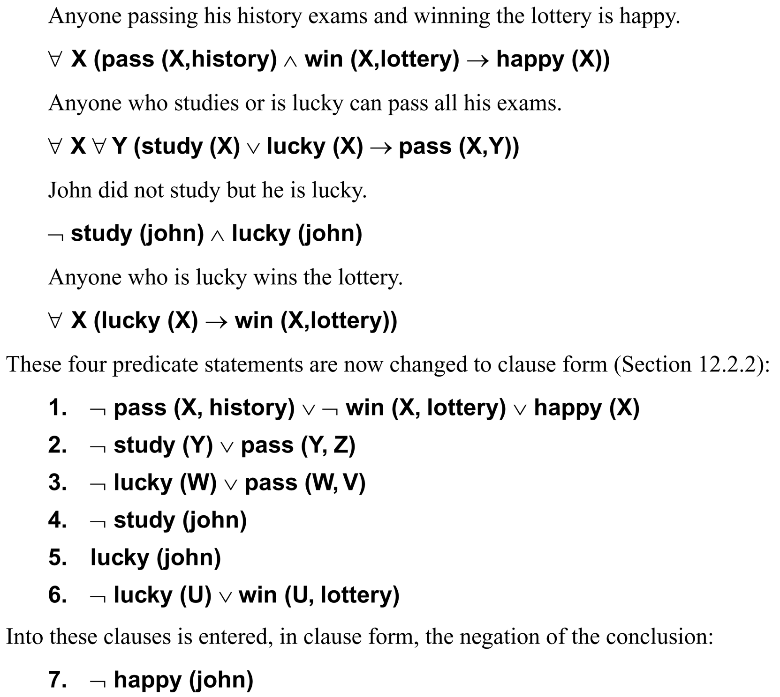
Luger: Artificial Intelligence, 6th edition. © Pearson Education Limited, 2009
8

Slide 17
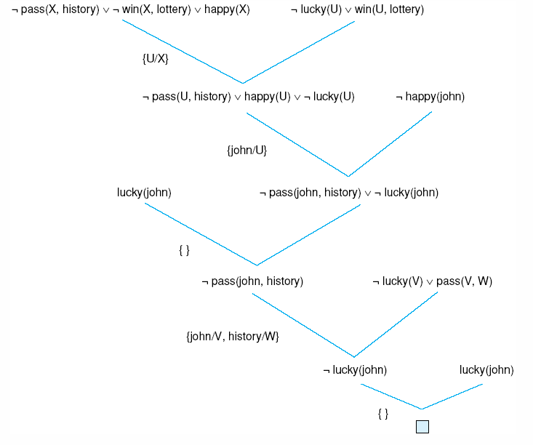
Fig 14.5 One refutation for the “happy student” problem.
Luger: Artificial Intelligence, 6th edition. © Pearson Education Limited, 2009
10

Slide 18
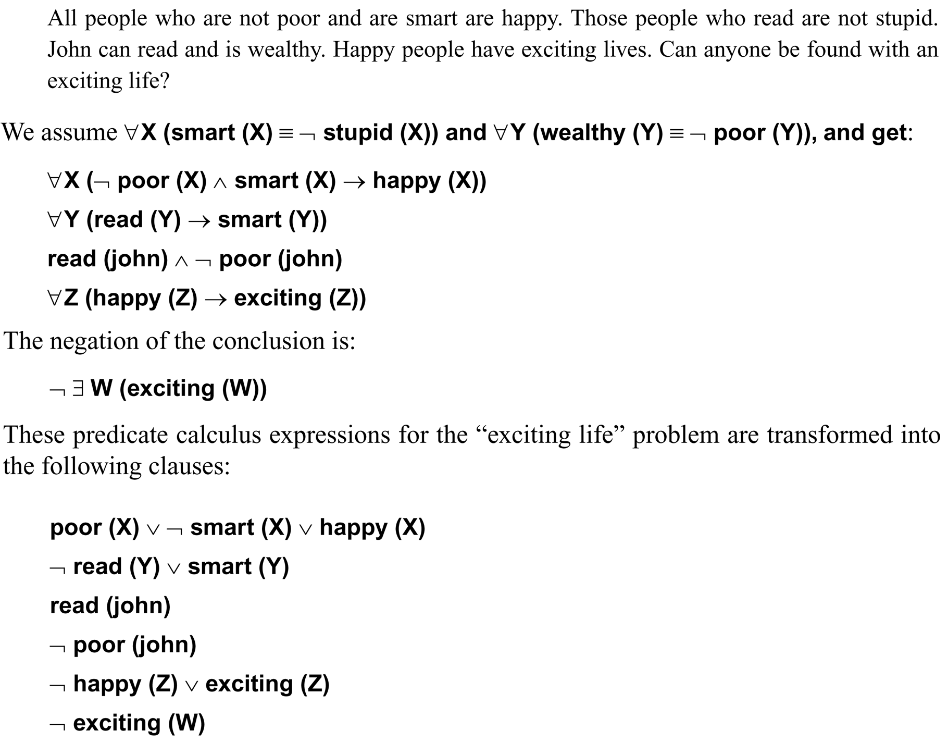
Luger: Artificial Intelligence, 6th edition. © Pearson Education Limited, 2009
9

Slide 19
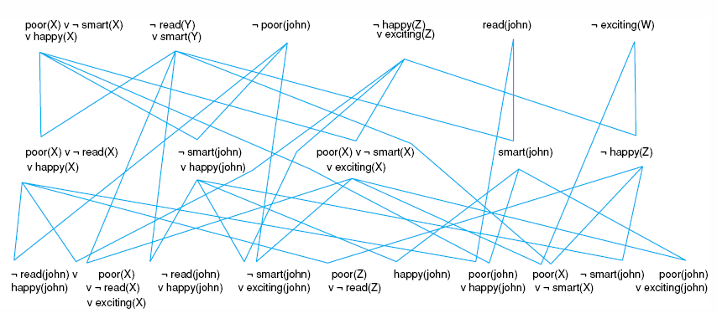
Fig 14.8 Complete state space for the “exciting life” problem generated by breadth-first search (to two levels).
Luger: Artificial Intelligence, 6th edition. © Pearson Education Limited, 2009
14

Slide 20
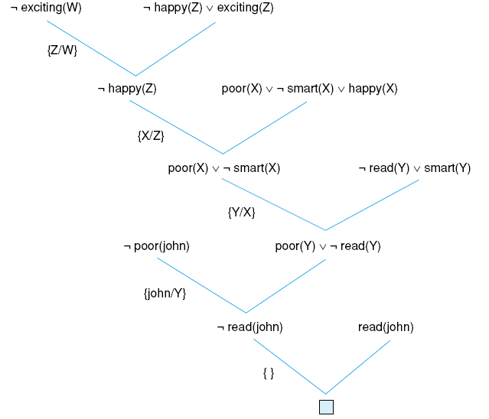
Fig 14.6 Resolution proof for the “exciting life” problem.
Luger: Artificial Intelligence, 6th edition. © Pearson Education Limited, 2009
11

Slide 21
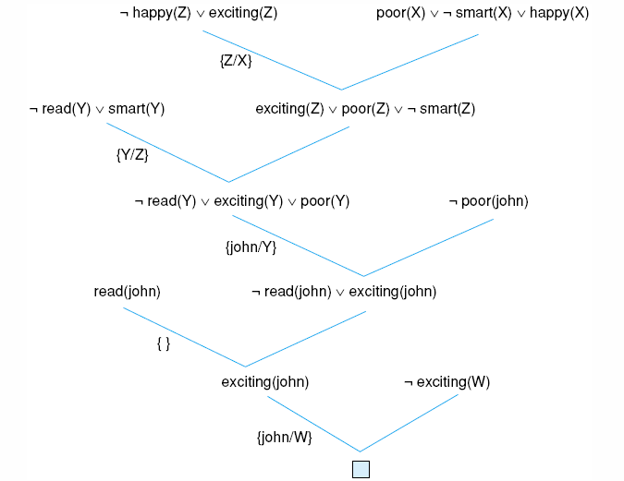
Fig 14.7 another resolution refutation for the example of Fig 14.6.
Luger: Artificial Intelligence, 6th edition. © Pearson Education Limited, 2009
12

Slide 22
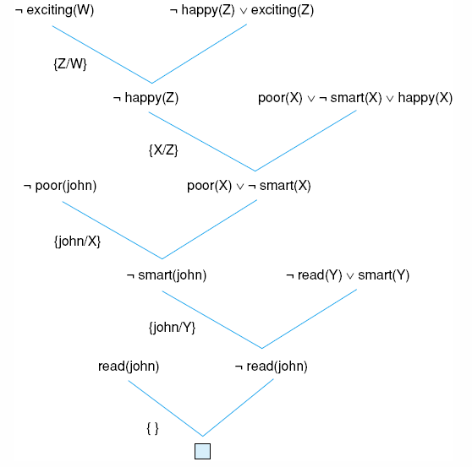
Fig 14.9 Using the unit preference strategy on the “exciting life” problem.
Luger: Artificial Intelligence, 6th edition. © Pearson Education Limited, 2009
14

