Slide 1
4.3. Admissibility, Monotonicity, and Informedness
Properties of fitness/evaluation function
New types of best-first search algorithm
  Algorithm A
  Algorithm A*

Slide 2
Actual cost and estimated cost
f*(n) = g*(n) + h*(n)
  g*(n) = the actual cost of shortest path from the start state to n.
  h*(n) = the actual cost of shortest path from n the goal state.
f(n) = g(n) + h(n)
  g(n) = estimation of g*(n)
  h(h) = estimation of h*(n)
Notes:
Insert def box, pg 148

Slide 3
Actual cost and estimated cost
In general, the path to n may not be the shortest path based on the nodes visited. That is, g(n) >= g*(n)
  One needs to revise the value g(n) during best first search.
  One needs to revise the status of a node visited.
Notes:
Insert def box, pg 148

Slide 4
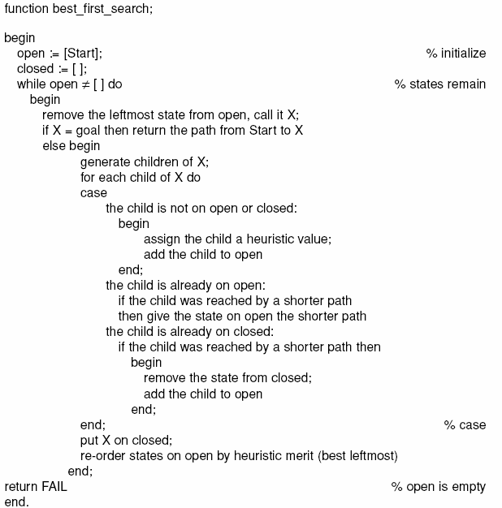
Luger: Artificial Intelligence, 6th edition. © Pearson Education Limited, 2009

Slide 5
Admissibility
A search algorithm is admissible if it is guaranteed to find a minimal path to a solution whenever such a path exists.
Notes:
Insert def box, pg 148

Slide 6
Admissibility
A heuristic is admissible if it never overestimates the cost to the goal from node, i.e., it is always optimistic.
Notes:
Insert def box, pg 148

Slide 7
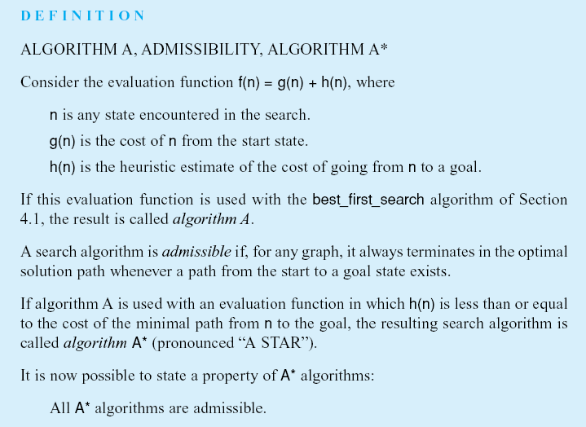
Luger: Artificial Intelligence, 6th edition. © Pearson Education Limited, 2009
Notes:
Insert def box page 146

Slide 8
Admissibility
The breadth-first search algorithm is admissible.
The depth-first search algorithm is in general not admissible.
Notes:
Insert def box, pg 148

Slide 9
Admissibility of Best-first search
Depends on the choice of the evaluation function.
Notes:
Insert def box, pg 148

Slide 10
Breadth-first search
f(n) = g(n) + 0
0 <= h*(n)
BFS is an A* algorithm.
Luger: Artificial Intelligence, 6th edition. © Pearson Education Limited, 2009
Notes:
Insert def box, pg 147

Slide 11
Luger: Artificial Intelligence, 6th edition. © Pearson Education Limited, 2009

Slide 12
Monotonicity
We want to have: g(n) = g*(n)
Notes:
Insert def box, pg 148

Slide 13
Monotonicity
A heuristic that is locally admissible: consistently finds the minimal path to each state that they encounter in the search.
This property is called monotonicity.
Notes:
Insert def box, pg 148

Slide 14
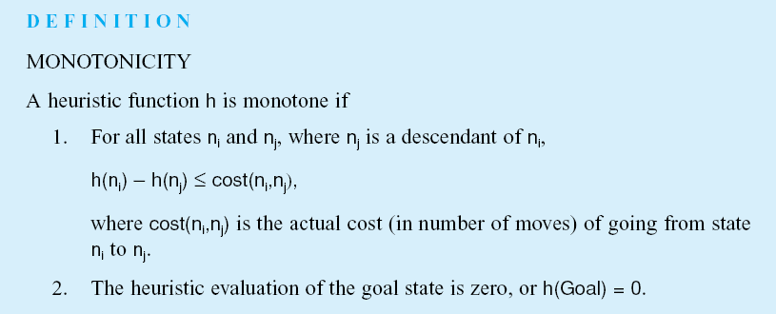
Monotonicity
Luger: Artificial Intelligence, 6th edition. © Pearson Education Limited, 2009
Notes:
Insert def box, pg 147

Slide 15
Monotonicity
A monotone or consistent heuristic function: for nodes ni and nj, nj is a successor of ni:
h(ni) <= h(nj) + cost(ni, nj),
h(g) = 0.
Notes:
Insert def box, pg 147

Slide 16
Monotonicity
A monotone or consistent heuristic function: for nodes ni and nj, nj is a successor of ni:
f(nj) = g(nj) + h(nj)
= (g(ni)+cost(ni,nj)) + h(nj)
= g(ni) + (cost(ni,nj) + h(nj))
>= g(ni) + h(ni)
= f(ni)
That is, f is monotonic increasing.
Notes:
Insert def box, pg 147

Slide 17
Monotonicity => Admissibility
Consider the sequence of nodes that lead to Ng: N0, N1, … Ng
h(N1) – h(N0) <= cost(N1, N0)
h(N2) – h(N1) <= cost(N2, N1)
…
h(Ng) – h(Nn-1) <= cost(Nn,Nn-1)
h(Ng) = 0
--------------------------------------------
h(N0) <= cost(N0, Ng)
That is, a monotone heuristic is admissible.

Slide 18
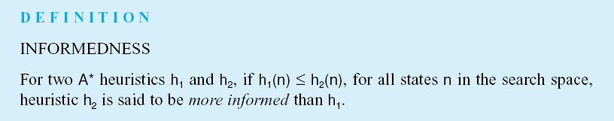
Informedness
Luger: Artificial Intelligence, 6th edition. © Pearson Education Limited, 2009
Notes:
Insert def box, pg 148

Slide 19
Informedness
For A* algorithm, we have
h1(n) <= h*(n)
h2(n) <= h*(n)
h1(n) <= h2(n)
--------------------------------
h*(n) – h1(n) >= h*(n) – h2(n)
h2 is closer to the actual cost h*, it is therefore more informative.
f(n) = g(n) + 0 is the least informed heuristic.
Notes:
Insert def box, pg 148

Slide 20
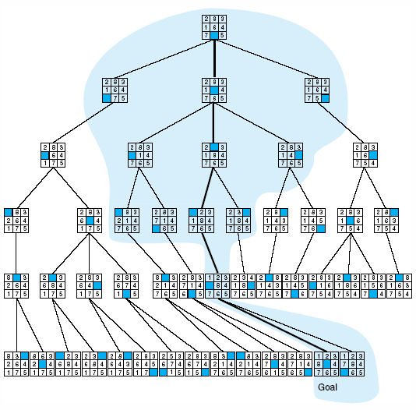
Fig 4.18 Comparison of state space searched using heuristic search with space searched by breadth-first search. The proportion of the graph searched heuristically is shaded. The optimal search selection is in bold. Heuristic used is f(n) = g(n) + h(n) where h(n) is tiles out of place.
Luger: Artificial Intelligence, 6th edition. © Pearson Education Limited, 2009

Slide 21
Dijkstra’s algorithm for shortest path
Best-first search
Dynamic programming
Greedy algorithm
Notes:
Insert def box, pg 148

