Slide 1

Project Title – SWIGGY SALES DASHBOARD
Vaibhav Praful Shendre

Slide 2

PROBLEM STATEMENT
The problem is to analyze Swiggy's sales data using Power BI to uncover trends and provide actionable insights for improving business performance. This aims to optimize delivery operations, tailor marketing strategies, and enhance customer satisfaction..

Slide 3
Project Description Swiggy needs a comprehensive analysis of its sales data using Power BI to visualize trends and gain actionable insights for improving business performance. The goal is to optimize delivery operations, tailor marketing strategies, and enhance customer satisfaction. This analysis will help identify key factors impacting sales and drive strategic decisions, ultimately increasing Swiggy's competitive edge in the market.

Slide 4

WHO ARE THE END USERS?
Business Executives
Marketing Teams
Sales Managers
Regional Managers

Slide 5

Technology Used
Data Analytics Tool: Power BI
Programming Language: Python
Database Management: SQL
Data Source: Swiggy sales data (CSV, Excel)
Visualization Tools: Power BI dashboards and reports
ETL Process: Power BI for data extraction, transformation,
and loading.

Slide 6
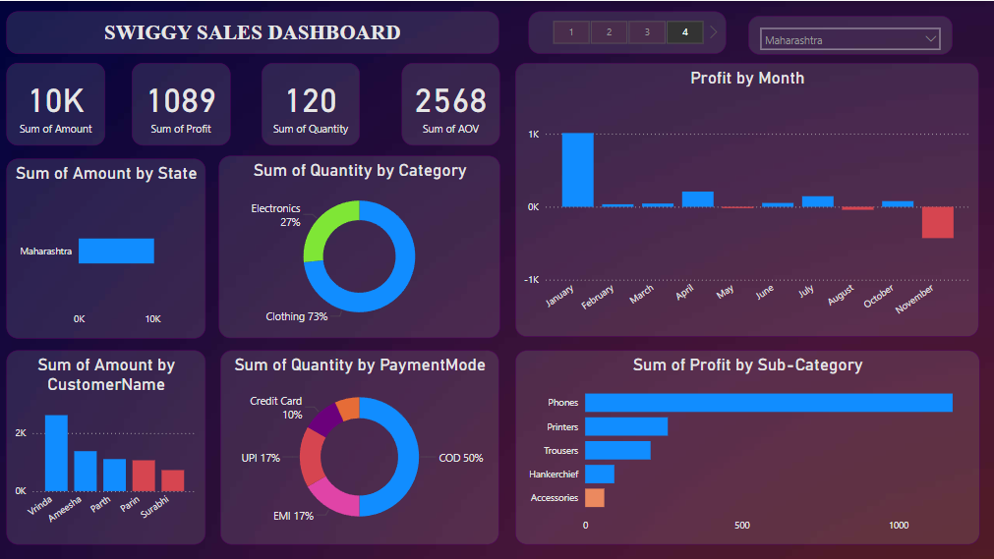
RESULTS
Google Drive: https://drive.google.com/drive/u/0/folders/1VrKyBKAfOcQvoWpaL16zPa2_rMXCNVAU
GitHub: https://github.com/vaibhavshendre26/VOIS_Project/upload

Slide 7
Thank you
Thank you for your time and attention.
If you have any questions or need further information, please feel free to reach out.
Contact Information:
Name: Vaibhav Shendre
Email: vaibhavshendre871@gmail.com
LinkedIn: https: //www.linkedin.com/in/vaibhavshendre26
.
.

