Slide 1


Multimodal Deepfake Detection for Images, Video and Audio
A Hypothesis-Driven Study Under a Group-Disjoint Protocol
Department of Electronics and Computer Engineering
Group members
Vaibhav Shiroorkar
Roll No: 16014024805
Shivansh Gupta
Roll No: 16014023052
Adithya Jithesh
Roll No: 16014024803
Guide: Dr. Tejashree Phatak, Assistant Professor
Notes:
Introduce the project: one system that scores images, videos and the audio inside videos, built from zero and documented as a path from a simple working version to a measured detector. Introduce the three members in the report order (Vaibhav Shiroorkar, Shivansh Gupta, Adithya Jithesh) and the guide, Dr. Tejashree Phatak, Assistant Professor. State the shape of the talk: the problem, the literature, the protocol and method, the data and the encoder shortlist, the rule for the working version, the iteration ladder, the rPPG test, the web demo, the analysis platform built after the freeze with its demonstration, tests and later experiments, the timeline to 30 October, the limitations, the conclusion and the future work. Say at once that the iterations have exploratory results on the development slice, and that the sealed test sets were read once for each frozen iteration on 25 October 2026: only three declared comparisons are confirmatory, and every other sealed number is exploratory. Evidence pointers: docs/IDENTITY.md for the identity fields, docs/DOC_FACTS.md for the wording, docs/PLAN.md for the schedule. The title and the subtitle (Group-Disjoint Protocol) are the decided title of the project and are the same in the paper and the report.

Slide 2
Problem and scope
The problem
Published detectors are measured under different protocols, so their numbers cannot be read side by side.
A score on the training data says little about new data: plain Xception trained on FaceForensics++ c23 reached a mean AUC of 0.945 within the domain and 0.772 over eight other datasets (Yan et al., 2023, their protocol).
Fake covers a swapped, re-enacted or audio-driven face, a generated image (GAN or diffusion), synthesised or converted speech, and audio and video manipulated separately.
What the system returns
A score that the content is fake, calibrated on validation data only.
Which modality carries the evidence.
For a video: a visual score and an audio score, shown separately.
No temporal localisation.
Aim
A documented path: a simple working version, then seven iterations that each follow from a written hypothesis, then integration and freeze. The goal is a result comparable with published detectors on a protocol we define and run ourselves, not the best model.
Notes:
The task is to say whether an image, a video with its audio, or a standalone audio clip is real or generated. The output is a score that the content is fake, temperature-scaled on validation data (a probability only for content like that data; the speech score is read as a ranking score), and a statement of which modality carries the evidence; for a video the visual score and the audio score are shown separately, because the rule for combining them is tested only in the late-fusion iteration (I-6, D-018, D-019). The published literature reports numbers under different protocols, so they cannot be read side by side; DeepfakeBench trained plain detectors on FaceForensics++ c23 and measured a mean AUC of 0.945 within the domain and 0.772 across eight other sets for Xception (Yan et al., 2023, table of R-017, their protocol, not our result). The aim is a documented path with results comparable to published detectors on a protocol we define and run ourselves (D-005, D-025), not the best model. Evidence: docs/DOC_FACTS.md section 2, docs/REQUIREMENTS.md, docs/RESEARCH.md R-017.

Slide 3
Objectives
1. Build the whole system from zero: data, evaluation harness, three detectors, inference library and web page.
2. Fix one protocol before any model: group-disjoint splits, a development slice, sealed test sets behind a guard.
3. Compare pretrained encoders under one rule that prefers the cheaper candidate when the evidence ties.
4. Improve in iterations, each from a written hypothesis with success and failure lines; keep failed runs.
5. Test rPPG as a candidate and adopt it only on evidence.
6. Define comparable as non-inferior to a re-run published detector on the same protocol.
7. Wrap the frozen detectors in a platform that reports one finding per module, with no overall fake score.
8. Produce the software, the paper, the report and this presentation from the same logged evidence.
Notes:
These are the objectives of the project as written in the report, chapter 1 (D-003 to D-006, D-016, D-025, D-041, D-069). The first six describe the detector and its protocol: build everything from zero, fix the protocol before any model, compare encoders under one rule, iterate from written hypotheses, test rPPG as a candidate only, and define comparable as non-inferior. The seventh was added after the freeze: the frozen detectors are wrapped in an analysis platform that reports one finding per module and never a single overall fake probability, and further modules enter only with the status their evidence supports. The last objective is the four deliverables from one body of logged evidence. Evidence: report chapter 1, docs/DECISIONS.md D-069.

Slide 4
Literature and what we take from it
Area | Sources | What they show (own protocol) | What we take
Face datasets | Rossler et al., 2019; Li et al., 2020a; Dolhansky et al., 2020; Li et al., 2025 | FaceForensics++: four methods, three compression levels. Celeb-DF and Celeb-DF++ are hard cross-dataset tests. | FaceForensics++ trains; the Celeb-DF family tests
Visual detectors | Li et al., 2020b; Yan et al., 2023; Dong et al., 2023 | One recipe makes detectors comparable; binary detectors can learn identity cues. | One pipeline; identity-disjoint splits
Frozen features | Ojha et al., 2023; Kornblith et al., 2019 | A linear probe on frozen CLIP features generalised across generators. | Frozen encoder, linear head
Pulse (rPPG) | Ciftci et al., 2020; Hernandez-Ortega et al., 2021; Seibold et al., 2025; Harraq and Aldwairi, 2026; Lin et al., 2023 | High in-dataset accuracy early on; mixed on modern generators; pulse signals can be edited. | Test the signal first
Audio | Wang et al., 2020; Jung et al., 2022; Tak et al., 2022; Muller et al., 2022; Khalid et al., 2021; Chugh et al., 2020; Cai et al., 2022 | ASVspoof 2019 is the standard benchmark; scores drop on In-the-Wild; FakeAVCeleb and LAV-DF carry per-modality labels. | ASVspoof trains; In-the-Wild tests; LAV-DF for fusion
Calibration | Guo et al., 2017 | Temperature scaling repairs the confidence of deep networks. | Temperature scaling, ECE
Numbers inside the cited papers belong to those papers and their protocols; none is a result of this project.
Notes:
Only sources that were opened and read from their primary text are used, and every number inside them is theirs, under their own protocol. Datasets: FaceForensics++ has four manipulation methods at three compression levels, Celeb-DF is the hard cross-dataset test, and Celeb-DF++ adds 22 newer generators (R-001, R-002, R-053). Frozen features: a linear probe on frozen CLIP features generalised across generators when trained on ProGAN (Ojha et al., 2023), which motivates the frozen-encoder working version (D-032). Pulse evidence is mixed, which is why rPPG is a test and not a component (D-006). Audio: ASVspoof 2019 is the standard benchmark, AASIST reports best-seed and three-seed mean numbers that differ, and audio-visual sets with per-modality labels are FakeAVCeleb and LAV-DF (R-012, R-013, R-014, R-024). Evidence: docs/RESEARCH.md, rows R-001 to R-053.

Slide 5
Protocol: group-disjoint splits
Training dataset, e.g. FaceForensics++
Cross-dataset source, e.g. Celeb-DF v2
train
fits the head
validation
threshold, temperature, early stopping
dev_x
development slice: ranks candidates, may be reused
test_x
sealed headline test, touched once per frozen iteration
test_in
in-dataset, sealed, reported but not the headline
dev_x and test_x share no group, identity or file content
Group = source video together with the person identity; a dataset family (Celeb-DF v2 and Celeb-DF++) counts as one source.
Tuning uses train, validation and dev_x only. The two test sets are touched once per frozen iteration, by a guarded command that writes a ledger.
A script proves the splits are disjoint, including content-hash de-duplication across splits.
Notes:
Data is split once, by group: the group is the source video together with the person identity, so no person, video source or recording appears on both sides of a split (D-012, PROTOCOL.md section 1). Binary detectors can learn identity from the labels alone (Dong et al., 2023), so a split by identity is needed for honest numbers. The development slice dev_x is carved out of a cross-dataset source, ranks candidates and may be evaluated repeatedly; test_in and test_x are sealed and are touched once per frozen iteration by a guarded command that refuses the run without the final flag and writes a ledger (D-035, D-041). A script proves group-disjointness, including content-hash de-duplication across splits and across a dataset family (D-026, D-045). Evidence: docs/PROTOCOL.md sections 1 and 7, tests A6 and A9 in docs/EXPERIMENTS.md V-002. This slide is drawn natively and mirrors fig02_splits of the paper and the report, with the same wording, so that the text is large enough to read when projected.

Slide 6
Method: file to calibrated score
Video, visual branch
16 frames (uniform)
Face detector, crop 224
Frozen image encoder
Linear head
Mean over frames
Temperature scaling
Visual score
Audio branch (an audio file, or the audio track of a video)
First 4 s at 16 kHz
Frozen speech encoder
Mean and std over time
Linear head
Temperature scaling
Audio score
shown side by side with the visual score
Image
Face found?
Face crop, or whole image
Frozen image encoder
Linear head
Temperature scaling
Image score
Green boxes hold learned or pretrained weights. The threshold and the temperature are fixed on validation data; scores are calibrated on that data only.
Notes:
The working version uses one frozen pretrained encoder per task and a linear head (D-032). A video gives 16 uniformly spaced frames, a face detector crops the largest face, the frozen image encoder and the linear head score each frame, the clip score is the mean of the frame probabilities and temperature scaling calibrates it (D-024, D-033, D-034). Audio uses the first 4 seconds at 16 kHz through a frozen speech encoder, mean and standard deviation over time and a linear head; an image goes through the face path if a face is found and through the whole-image path otherwise. The threshold and the temperature are fixed on validation data only, and visual and audio scores of a video are shown side by side because no fusion rule is claimed yet (D-040). Evidence: docs/DOC_FACTS.md sections 4 and 5, figure 1 of the paper (same content), src/dfd/infer. This slide is drawn natively and mirrors fig01_pipeline of the paper and the report, with the same wording, so that the text is large enough to read when projected.

Slide 7
Method and the mathematics
Scoring
Head: p = σ(w·z + b) on the frozen feature z = f(x), with σ(u) = 1 / (1 + exp(−u)).
Loss: class-balanced cross-entropy, weights n / (2 n1) for fake and n / (2 n0) for real; the problem is convex.
Clip score: the mean of the frame probabilities.
Calibration: q = σ(ℓ / τ), one τ > 0 fitted on validation data; ranking and AUC do not change.
Threshold: maximises balanced accuracy on validation data, then fixed for every test set.
Evaluation
AUC = P(S1 > S0) + ½ P(S1 = S0): the chance that a random fake outranks a random real example.
Interval: resample groups with replacement, 2,000 resamples, 95 percent percentile interval.
Paired difference Δ = θ(A) − θ(B) on the same resampled groups.
Non-inferior to a re-run baseline: the lower end of the interval of (ours − baseline) is above −δ; δ is fixed beforehand.
Notes:
The head is a logistic regression on standardised features, so the loss is convex and the optimum does not depend on the starting point; the seeds change only the batch order and the stopping point (MATH_NOTES section 10). Class weights n/(2 n1) and n/(2 n0) give the risk under a balanced prior, which matters because FaceForensics++ is 80 percent fake. Temperature scaling divides the logit by one positive number fitted on validation data, so it changes the probabilities but not the ranking or the AUC (Guo et al., 2017). Intervals come from resampling groups, not frames, because frames of one video are dependent; two models are compared on the same resampled groups so the paired interval is narrower than two separate ones. Comparable with a published detector means non-inferior, with delta fixed before the final comparison from the measured seed spread of the baseline (D-025). Evidence: docs/MATH_NOTES.md sections 2, 7, 8, 10; docs/PROTOCOL.md section 6.

Slide 8
Data and splits
Task | Training and validation | Development slice (dev_x) | Sealed tests
Face video frames | FaceForensics++ c23, official train and validation split | Celeb-DF v2: 15 of 59 identity groups | Rest of Celeb-DF v2 (test_x), Celeb-DF++ (test videos of 21 new generators), DFD; FaceForensics++ test (test_in)
Generated images | ProGAN validation set split by class: 14 classes train, 6 validation | Two of the seven CNN-synthesis generator units | Other generator units and the diffusion test set (test_x); ProGAN test set (test_in)
Speech audio | ASVspoof 2019 LA train and dev | In-the-Wild: 12 of 54 speakers | Other In-the-Wild speakers (test_x); ASVspoof 2019 LA eval (test_in)
Audio-visual (fusion) | LAV-DF official train and validation (identity-disjoint) | n/a: official split used | LAV-DF official test
All datasets are research-only; Celeb-DF and Celeb-DF++ forbid publishing derived data, so no frame, crop or per-video score of them appears in any document.
LAV-DF: 136,304 videos, all with audio, labelled per modality (modify_video, modify_audio).
Notes:
Each task has its own training data and its own development slice, and every split is group-disjoint. Visual: FaceForensics++ c23 trains and validates (official split: 3,600 training and 700 validation clips), Celeb-DF v2 supplies the development slice (15 of 59 identity groups; 1,728 clips) and the rest of Celeb-DF v2, Celeb-DF++ and DFD are sealed (D-013, D-035, D-045). Images: the ProGAN validation set is split by class because its images have no identity (D-026); audio: ASVspoof 2019 LA trains and In-the-Wild supplies the development slice (D-035). LAV-DF has 136,304 videos, all with an audio stream, and per-file labels for video and audio manipulation, so it carries the fusion iteration. Evidence: docs/DATA_LOG.md, docs/PROTOCOL.md, docs/DOC_FACTS.md section 3, docs/O007_SWEEP.md section 2.

Slide 9
Encoder shortlist
Task | Encoder | Family | Params | GFLOPs | s per 1,000 | Weights licence
Images, video frames | EfficientNet-B4 | supervised CNN | 17.5 M | 6.1 | 1.73 | research use (ImageNet)
 | Xception | supervised CNN | 20.8 M | 16.7 | 3.32 | research use (ImageNet)
 | DINOv2 small | self-supervised ViT | 22.1 M | 12.2 | 0.94 | Apache-2.0
 | DINOv2 base | self-supervised ViT | 86.6 M | 46.3 | 1.67 | Apache-2.0
 | CLIP ViT-L/14 (OpenAI) | image-text contrastive | 304.0 M | 162.0 | 4.45 | research use (accepted)
 | CLIP ViT-L/14 (LAION) | image-text contrastive | 304.0 M | 162.0 | 4.03 | MIT tag, research use
 | SigLIP base | sigmoid image-text | 92.9 M | 35.4 | 1.44 | Apache-2.0
Speech audio | wav2vec 2.0 base | self-supervised | 94.4 M | 57.5 | 2.04 | Apache-2.0
 | WavLM base plus | self-supervised | 94.4 M | 57.5 | 2.53 | research use (accepted)
 | Whisper small encoder | weakly supervised ASR | 88.2 M | 344.3 | 11.53 | Apache-2.0 / MIT
 | HuBERT base | self-supervised | 94.4 M | 57.5 | 2.04 | Apache-2.0
Both | Small network from scratch | reference, excluded | 0.39 M | n/a | n/a | own code
Parameters from the weight files; GFLOPs per forward pass; s per 1,000 inputs end to end, median of 3 repeats of the cost record (face frames for images). Other cost columns in this deck come from single extraction runs and differ slightly. Inference, fp16, batch 64 (speech 32), RTX 5070. DINOv3 is excluded on purpose (manual access gate).
Notes:
The shortlist was approved before any feature was extracted: criteria first (licence read from the weights' own repository, offline loading, fit in 12 GB, the families differ), then candidates (D-038). Images and video frames: two supervised CNNs, two DINOv2 sizes, two CLIP ViT-L/14 models (OpenAI and LAION) and SigLIP base; audio: wav2vec 2.0 base, WavLM base plus, Whisper small encoder and HuBERT base. A small network from scratch is reported for each task as a reference and is excluded from selection. DINOv3 was excluded on purpose because its weights sit behind a manual access gate. The weights of OpenAI CLIP and of WavLM have conditional licences; they are accepted as research-only and stated as a limitation. Cost values come from the section 7 cost record of 2026-10-25 (data/_results/cost_record.json): inference in fp16 at batch 64 (speech batch 32) on the RTX 5070, FLOPs per forward pass, end-to-end time per 1,000 inputs on real files (face frames for images, 224 px except EfficientNet-B4 320 and Xception 299, speech 4 s clips). Parameter counts are read from the weight files and the model comparison tables (E-001 to E-003): Whisper small encoder 88,154,112, HuBERT base 94,371,712, the from-scratch references 389,633 (images) and 389,057 (speech). Evidence: docs/O007_SWEEP.md section 3.1, docs/DATA_LOG.md encoder weights section, data/_results/*/model_comparison.md. This slide is drawn natively and mirrors fig08_shortlist of the paper and the report, with the same wording, so that the text is large enough to read when projected.

Slide 10
Encoder sweep on the development slice
Exploratory, development slice. AUC on the development slice: mean of three head seeds with the 95 percent group-bootstrap interval. Tie = tied with the leader.
Face frames | Dev AUC [95% CI] | Tie
CLIP-L OpenAI | 0.7464 [0.6721, 0.8306] | yes
SigLIP base | 0.7396 [0.7031, 0.7832] | yes
CLIP-L LAION | 0.7331 [0.6764, 0.7966] | yes
DINOv2 small | 0.6933 [0.6639, 0.7314] | yes
DINOv2 base | 0.6745 [0.6323, 0.7239] | yes
EfficientNet-B4 | 0.6471 [0.5967, 0.6987] | no
Xception | 0.6162 [0.5744, 0.6633] | no
Images | Dev AUC [95% CI] | Tie
CLIP-L OpenAI | 0.9935 [0.9803, 0.9982] | yes
CLIP-L LAION | 0.9563 [0.7760, 0.9975] | no
DINOv2 base | 0.9023 [0.8496, 0.9316] | no
SigLIP base | 0.8657 [0.7591, 0.9166] | no
DINOv2 small | 0.8340 [0.7401, 0.8823] | no
EfficientNet-B4 | 0.6688 [0.6238, 0.7137] | no
Xception | 0.6380 [0.4912, 0.7115] | no
Speech | Dev AUC [95% CI] | Tie
Whisper small | 0.6380 [0.5338, 0.7700] | yes
WavLM base plus | 0.6334 [0.5291, 0.7714] | yes
HuBERT base | 0.6100 [0.5434, 0.7256] | yes
wav2vec 2.0 base | 0.4975 [0.3451, 0.7092] | no
Cheapest in the tie set wins: face frames DINOv2 small (tie of five), images CLIP OpenAI (tie of one), speech HuBERT base (tie of three).
Face frames: EfficientNet-B4 is outside the tie set by the bootstrap (permutation p 0.110); same winner either way.
Speech: verdict inconclusive; the from-scratch reference scores 0.246 (seeds 0.22 to 0.29): a sign-flipped shortcut, not a worse model; development ECE rose after scaling.
Images: both leading CLIP models reach 1.0000 on validation; on the development slice the leader (0.9935) is separated from the others by the paired bootstrap, on only two generator units.
Notes:
The sweep ranked every shortlisted encoder per task on the development slice with the rule fixed beforehand; all values are exploratory (D-041) and are the final results of experiments E-001 (face frames), E-002 (images) and E-003 (speech), recorded in D-049 and in data/_results/T-V, T-I and T-A. Face frames: five of seven candidates form the tie set against the leader, so the cheapest of them, DINOv2 small, wins (0.943 s per 1,000 inputs end to end, 22.1 M parameters); EfficientNet-B4 is outside the tie set by the bootstrap (difference -0.099 [-0.172, -0.023]) but the permutation p-value is 0.110, and the winner would not change. Images: the tie set has one member, CLIP ViT-L/14 (OpenAI), but the development slice has only two generator units, so its interval is not a population interval; per-generator AUC is in the backup (M-004). Speech: the tie set has three members and HuBERT base wins on cost, yet the mechanical verdict is inconclusive (best lower bound 0.534, at or below 0.55), the from-scratch reference is below chance (0.246) and the development ECE rose after temperature scaling for every audio encoder. Evidence: docs/EXPERIMENTS.md E-001 to E-003, docs/DECISIONS.md D-036 and D-049, docs/DOC_FACTS.md section 14.

Slide 11
I-0: the working-version rule
Rule for choosing the encoder
1. Extract features once per candidate with the frozen encoder.
2. Fit a linear head, three seeds.
3. Rank by mean development-slice AUC, paired 95 percent group bootstrap.
4. Tie set: every candidate whose interval against the leader includes zero.
5. Cheapest wins: lowest extraction time per 1,000 inputs, then fewer parameters.
The working version is finished when
a file goes in through the local web page;
the winning encoders score it, calibrated, threshold fixed on validation data;
metrics with intervals exist on validation and development data;
the page shows a real result, with its warnings.
Task | Encoder (winner) | Train AUC | Validation AUC | Dev AUC
Face frames | DINOv2 small | 0.8367 [0.8267, 0.8475] | 0.7985 [0.7731, 0.8269] | 0.6933 [0.6639, 0.7314]
Images | CLIP ViT-L/14 OpenAI | 1.0000 [1.0000, 1.0000] | 1.0000 [1.0000, 1.0000] | 0.9935 [0.9803, 0.9982]
Speech | HuBERT base | 0.9997 [0.9996, 0.9999] | 0.9942 [0.9910, 0.9967] | 0.6100 [0.5434, 0.7256]
Exploratory, development slice. Mean of three head seeds with the 95 percent group-bootstrap interval. The from-scratch reference is excluded from the choice. The development interval of the images rests on 2 generator units; speech is inconclusive.
Notes:
I-0 is the working version and not an improvement: a frozen encoder, a linear head and temperature scaling, chosen by a rule fixed before any feature existed (D-032, D-036, D-040). The rule ranks the candidates of each task by their mean development-slice AUC, builds the tie set of every candidate whose paired 95 percent group-bootstrap interval against the leader includes zero, and lets the cheapest candidate of the tie set win; the from-scratch network is reported but excluded. The table is experiment E-004: the heads of the three winners (face frames DINOv2 small, images CLIP ViT-L/14 OpenAI, speech HuBERT base), mean of three head seeds with the 95 percent group-bootstrap interval, exploratory, development slice; the development values reproduce E-001 to E-003. Train, validation and development AUC are 0.837, 0.799 and 0.693 for face frames, 1.000, 1.000 and 0.994 for images, and 1.000, 0.994 and 0.610 for speech; the shipped head is seed 0 (D-050). The working version is finished when the chain runs from a file through the web page to a calibrated score with metrics and intervals (D-040); the page check and the parity check (maximum difference 0.0019) passed, details in the backup. Evidence: docs/EXPERIMENTS.md E-004, docs/DECISIONS.md D-036, D-040, D-049, D-050.

Slide 12
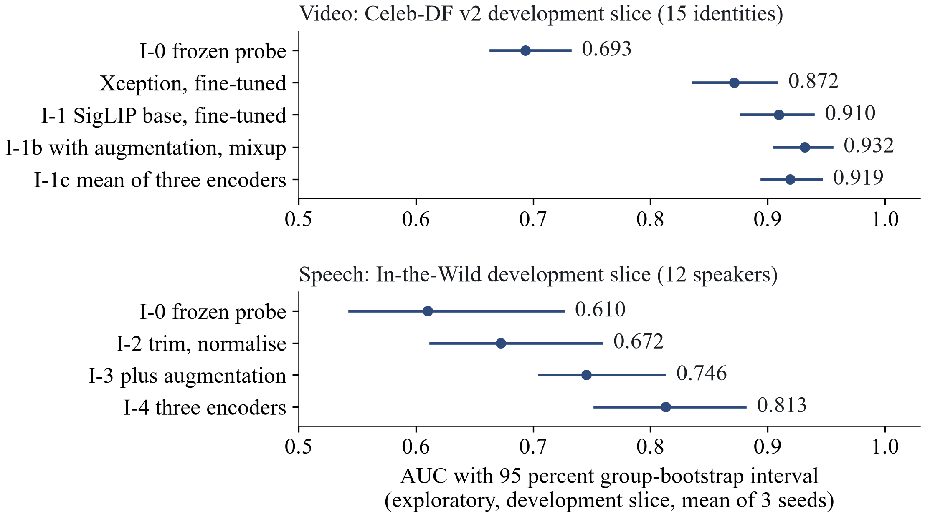
Iteration ladder
I-0
working version
I-1
fine-tuning
I-1b
augment, mixup
I-1c
mean of three
I-2
trim, normalise
I-3
augment
I-4
three encoders
I-5
LAV-DF check
I-6
LAV-DF heads
I-7
rPPG fails
I-8
freeze
Reading it
Green: supported. Orange: limited, or tried and not in the final system. Red: failed.
Fine-tuning: +0.1700 over the probe.
I-1b: slice up, validation down. I-1c: no gain.
Speech: 0.6100 to 0.8130.
Sealed results: see later slides.
Exploratory, development slice, mean of three seeds, 95 percent group-bootstrap interval. The sealed results are on separate slides.
Notes:
After the working version come seven experimental iterations, I-1 to I-7, and a last slot for integration and freeze (D-041, ITERATIONS.md). The lever of each slot was chosen after the diagnostic battery of the preceding step and written, with its hypothesis, success line and failure line, before the run (D-051, D-054 to D-058). I-1 was full fine-tuning of the face encoder (E-005): development AUC 0.7396 to 0.9096 for the same SigLIP encoder, supported. After the first pass, two more video levers were run at the request of the team (D-062 c, D-065): I-1b, augmentation matched to compression, blur and resize plus mixup (E-016), development AUC 0.9315 and validation 0.9705, a trade-off that does not enter the final system; and I-1c, the mean of the logits of three fine-tuned encoders (E-017), development AUC 0.9192, paired difference to I-1 +0.0096 [-0.0020, +0.0231], which does not enter either. The final system stays as defined in D-061. The Xception baseline in the figure is the one at the selected rate 3e-4 (E-013b, D-066). I-2 to I-4 are speech levers (E-007, E-008, E-009): trimming and normalising the clip, augmenting the training clips, and averaging three encoders; the speech development AUC goes from 0.6100 to 0.6723, 0.7455 and 0.8130, each step supported by its mechanical criteria but each on only 12 speakers. I-5 and I-6 are on LAV-DF (E-010 to E-012): the frozen face head is below chance there, so the fusion was not tested; heads trained on LAV-DF give a fused AUC of 0.9935 that a control shows is driven by a production-pipeline cue of the visual head. I-7 is the rPPG check, which failed (E-006). I-8 runs no experiments; it freezes the code and evaluates every frozen iteration once on the sealed tests, which was done on 25 October 2026 (E-014, D-067, D-068); its results are on the sealed-test slides. The figure shows the development-slice results with their 95 percent group-bootstrap intervals; all of them are exploratory (D-041). Evidence: docs/EXPERIMENTS.md E-004 to E-017 and E-013b, docs/DOC_FACTS.md section 15.

Slide 13
I-0 diagnosis
Task | Observations (battery) | Candidate diagnoses
Face frames | Train 0.837, validation 0.799, development 0.693 (gap +0.105). Weakest manipulations on validation: NeuralTextures 0.697, FaceSwap 0.778. Development ECE 0.205 before and 0.222 after temperature scaling. | Bias first: the frozen feature separates even the training data only moderately. Then shift, and calibration under shift. Aggregation is not indicated.
Images | Train and validation 1.000, development 0.994 on 2 generator units (0.999 and 0.983). ECE 0.046 before and 0.005 after. Errors: border artefacts in real images, photorealistic StyleGAN faces. | No bias or variance visible. Shift to other generators cannot be measured with 2 units. Calibration is good.
Speech | Validation 0.994, development 0.610 (gap +0.384). Real In-the-Wild speech scores as fake. ECE 0.329 before and 0.405 after. Errors are short repeat-padded clips with saturated scores. | Shift is dominant. Missing signal or a shortcut (window or padding effect) is a candidate. Calibration worsens under shift.
Exploratory, development slice. Diagnoses only: no lever is chosen here. No sealed set was read for them.
Notes:
The diagnostic battery was run on the working version (experiment E-004, data/_results/I-0/battery.md); every number is exploratory and from the development slice or validation data, and no lever is chosen on this slide. Face frames: the frozen DINOv2 small feature separates even the training data only moderately (train AUC 0.837, train minus validation +0.038), the gap from validation to the development slice is +0.105, and temperature scaling fitted on validation does not transfer (ECE 0.205 to 0.222); aggregation is not indicated because the clip mean is above frame level by about 0.03 and the maximum and top-3 mean are not better. Images: train and validation AUC are 1.000, the development AUC is 0.994 on two generator units (0.999 and 0.983), calibration improves (ECE 0.046 to 0.005), and the errors are border artefacts in some real images and photorealistic StyleGAN faces; with two units a shift to other generators cannot be measured. Speech: the validation to development gap is +0.384 at an in-domain AUC of 0.994, real In-the-Wild speech scores as fake, the trivial recording features reverse sign between the corpora (M-004), calibration worsens (ECE 0.329 to 0.405) and errors concentrate in short repeat-padded clips with saturated scores. Evidence: docs/EXPERIMENTS.md E-004 (diagnostic battery items 1 to 8) and M-004; the choice of the first lever is a later decision.

Slide 14
I-1: fine-tuning the face encoder
AUC | Probe, SigLIP base | Fine-tuned, SigLIP base | Xception baseline, rate 3e-4
Training subset | 0.9245 [0.9093, 0.9388] | 0.9994 [0.9986, 1.0000] | not recorded
Validation | 0.8767 [0.8582, 0.8966] | 0.9899 [0.9809, 0.9967] | 0.9912 [0.9849, 0.9963]
Development slice | 0.7396 [0.7031, 0.7832] | 0.9096 [0.8776, 0.9388] | 0.8716 [0.8364, 0.9076]
What was done
Full fine-tuning, 1,800 steps, learning rate 1e-5, batch 32; three seeds; same recipe for the Xception baseline, whose rate (3e-4) was chosen on validation data.
Higher learning rates collapsed in five of six runs.
Criteria met: validation gain, training AUC at least 0.90, development gain.
What it supports
Gain over the probe: +0.1132 on validation, +0.1700 on the slice.
SigLIP minus Xception on the slice: +0.0380 [+0.0172, +0.0592]. Margin of the non-inferiority test: 0.0100.
Exploratory; 15 identities, one kind of fake. The sealed result is on a later slide.
Notes:
The diagnostic battery of the working version showed bias for the face task: the training AUC of the frozen feature with a linear head was 0.837, so the lever was fine-tuning depth, with the budget fixed beforehand (D-042, D-051). Nine runs of stage 1 (three encoders, three learning rates, one seed) showed that only the lowest rate, 1e-5, works for every encoder; five of the six runs at the higher rates lost most of the signal. Selection on validation data alone gave SigLIP base as the cheapest member of the tie set. Three seeds of SigLIP base reach a validation AUC of 0.9899 [0.9809, 0.9967] and a development AUC of 0.9096 [0.8776, 0.9388], against 0.8767 and 0.7396 for the linear probe of the same encoder; the gains are +0.1132 and +0.1700, larger than the predicted +0.02 to +0.05 and at most +0.03, and the three criteria are met (E-005, supported, exploratory). The baseline is the Xception family re-run with the same recipe and budget (E-013, D-060). In the first pass the grid was 1e-5, 3e-5 and 1e-4 and the selected rate 1e-4 was the edge of the grid: development AUC 0.8750 [0.8435, 0.9089], delta 0.0143. The grid was then extended by one step (E-013b, D-062 a, D-066): 3e-4 gave a validation AUC of 0.9909 against 0.9883 at seed 0 and was selected on validation only; three seeds at 3e-4: validation 0.9912 [0.9849, 0.9963] (seed sd 0.0003), development 0.8716 [0.8364, 0.9076] (seed sd 0.0020). SigLIP minus Xception at 3e-4 is +0.0380 [+0.0172, +0.0592] on the development slice and -0.0013 [-0.0063, +0.0033] on validation. Xception at 3e-4 also gains +0.1783 [+0.1296, +0.2140] over the working version, so most of the gain comes from fine-tuning and not from the encoder. Limits: 15 identity groups, one kind of fake on the slice, the baseline learning rate 3e-4 is again the highest of the grid (a stated limit; no further rate was added), one run was repeated after a data-loader error. The margin of the non-inferiority comparison is now 0.0100, the floor of the rule 2 times the larger seed standard deviation, because both standard deviations are small (D-066); it was 0.0143 in the first pass. Evidence: docs/EXPERIMENTS.md E-005, E-013 and E-013b, docs/DECISIONS.md D-060, D-061 and D-066.

Slide 15
I-1b and I-1c: two more video levers
Face video, 3 seeds | Validation AUC | Development slice AUC | Validation, paired with I-1 | Slice, paired with I-1
I-1, fine-tuned SigLIP base | 0.9899 [0.9809, 0.9967] | 0.9096 [0.8776, 0.9388] | reference | reference
I-1b, augmentation and mixup | 0.9705 [0.9618, 0.9795] | 0.9315 [0.9055, 0.9548] | -0.0194 [-0.0251, -0.0129] | +0.0219 [+0.0090, +0.0382]
I-1c, mean of three encoders | 0.9903 [0.9823, 0.9968] | 0.9192 [0.8948, 0.9457] | +0.0004 [-0.0011, +0.0023] | +0.0096 [-0.0020, +0.0231]
What was done
I-1b: blur, down-up resize and JPEG on the training stream, then mixup; nothing searched.
I-1c: mean of the logits of SigLIP base, DINOv2 base and DINOv2 small, each fine-tuned.
Run on the team's request although the triggers were not met to the letter (gap 0.0803 against about 0.10; correlation 0.89 to 0.91 against below 0.8).
What it shows
I-1b: slice up, validation down by more than the allowed 0.0079: a trade-off; it does not enter.
I-1c: slice interval includes zero; it does not enter.
The final system is unchanged. Exploratory; not tested on the sealed sets.
Notes:
After the first pass over the ladder, two more levers on the face-video task were run at the request of the team (D-062 c, D-063, D-064, D-065). Both triggers were not met to the letter, and this is said here: for I-1b the validation to development gap of I-1 is 0.0803 against about 0.10, for I-1c the score correlation of the three encoders is 0.89 to 0.91 against below 0.8. I-1b (E-016): the fine-tuned SigLIP base trained with blur (sigma 0.1 to 2.0, probability 0.3), a down-and-up resize (scale 0.4 to 1.0, probability 0.5), JPEG (quality 40 to 95, probability 0.5) and mixup (Beta(0.2, 0.2)), all fixed before the run, no parameter searched; the realised rates were 0.307, 0.4975 and 0.503 on 2,000 frames before the runs. Prediction written before: slice AUC up by 0.01 to 0.04, validation flat or down by at most 0.01. Found: slice 0.9315 [0.9055, 0.9548], paired +0.0219 [+0.0090, +0.0382] over I-1; validation 0.9705 [0.9618, 0.9795], paired -0.0194 [-0.0251, -0.0129]. The entry rule needs the slice lower bound above 0 (met) and the validation difference not below -0.0079 (not met), so it does not enter. It is a trade-off, not a failure to act; the train-subset AUC fell from 0.9994 to 0.9913; perturbations and mixup are not separated, and transfer to perturbation types not trained on cannot be tested. I-1c (E-017): the mean of the logits of SigLIP base, DINOv2 base and DINOv2 small, each fine-tuned, three seeds each; the variance formula allows a fall of only 7.6 percent at a correlation of 0.886. Found: slice 0.9192 [0.8948, 0.9457], paired +0.0096 [-0.0020, +0.0231]; validation 0.9903, paired +0.0004 [-0.0011, +0.0023]. The slice lower bound is below zero, so it does not enter. The members are within 0.004 of each other on both splits. The final system stays as defined in D-061. All numbers are exploratory (development slice and validation). Evidence: docs/EXPERIMENTS.md E-016 and E-017; docs/DECISIONS.md D-063 to D-065.

Slide 16
I-2 to I-4: three levers for speech
Step | Validation AUC | Development slice AUC | Change on the slice
I-0: frozen HuBERT head | 0.9942 [0.9910, 0.9967] | 0.6100 [0.5434, 0.7256] | baseline
I-2: trim and normalise | 0.9889 [0.9831, 0.9933] | 0.6723 [0.6126, 0.7584] | +0.0623 [+0.0114, +0.1048]
I-3: plus augmentation | 0.9869 [0.9818, 0.9911] | 0.7455 [0.7052, 0.8121] | +0.0732 [+0.0122, +0.1225]
I-4: three encoders | 0.9964 [0.9943, 0.9982] | 0.8130 [0.7523, 0.8808] | +0.0675 [+0.0300, +0.0929]
Why each lever
I-2: remove level and silence cues that reverse between corpora.
I-3: a head fitted to noisy, filtered, compressed copies cannot rely on those cues.
I-4: averaging weakly correlated scores lowers variance.
Limits
12 speakers: wide intervals; the slice is exploratory.
Calibration stays poor on the slice: a ranking score.
Three encoder passes per clip. The sealed result is on a later slide.
Notes:
The speech task kept a large shift gap after the working version: validation AUC 0.9942, development AUC 0.6100 on 12 speakers, with recording-condition cues that reverse in sign between ASVspoof 2019 and In-the-Wild (M-004). I-2 (E-007, D-054): trim leading and trailing silence and normalise the peak before the 4 second window; a manipulation check written beforehand passed; the development AUC rose to 0.6723 [0.6126, 0.7584], +0.0623 [+0.0114, +0.1048], validation fell by 0.0054; supported. I-3 (E-008, D-055): train the head on the clean clips plus three augmented copies (noise, low-pass, reverberation, MP3 round trip, ranges fixed beforehand); the previous head lost 0.33 AUC on an augmented validation copy and the new head 0.04; development AUC 0.7455 [0.7052, 0.8121], +0.0732 [+0.0122, +0.1225] over the previous head; supported. I-4 (E-009, D-056): average the logits of HuBERT base, WavLM base plus and the Whisper small encoder; mean pairwise correlation 0.534 on the slice; development AUC 0.8130 [0.7523, 0.8808], +0.0675 [+0.0300, +0.0929] over the HuBERT head, validation 0.9964; supported, at the price of three encoder passes. Limits: a slice of 12 speakers, so a gain below about +0.09 cannot be shown by one step; the calibration error on the slice stays high after temperature scaling (0.1670 for the average), so the audio score is a ranking score. All verdicts are exploratory. Evidence: docs/EXPERIMENTS.md E-007, E-008, E-009; docs/DECISIONS.md D-054 to D-056.

Slide 17
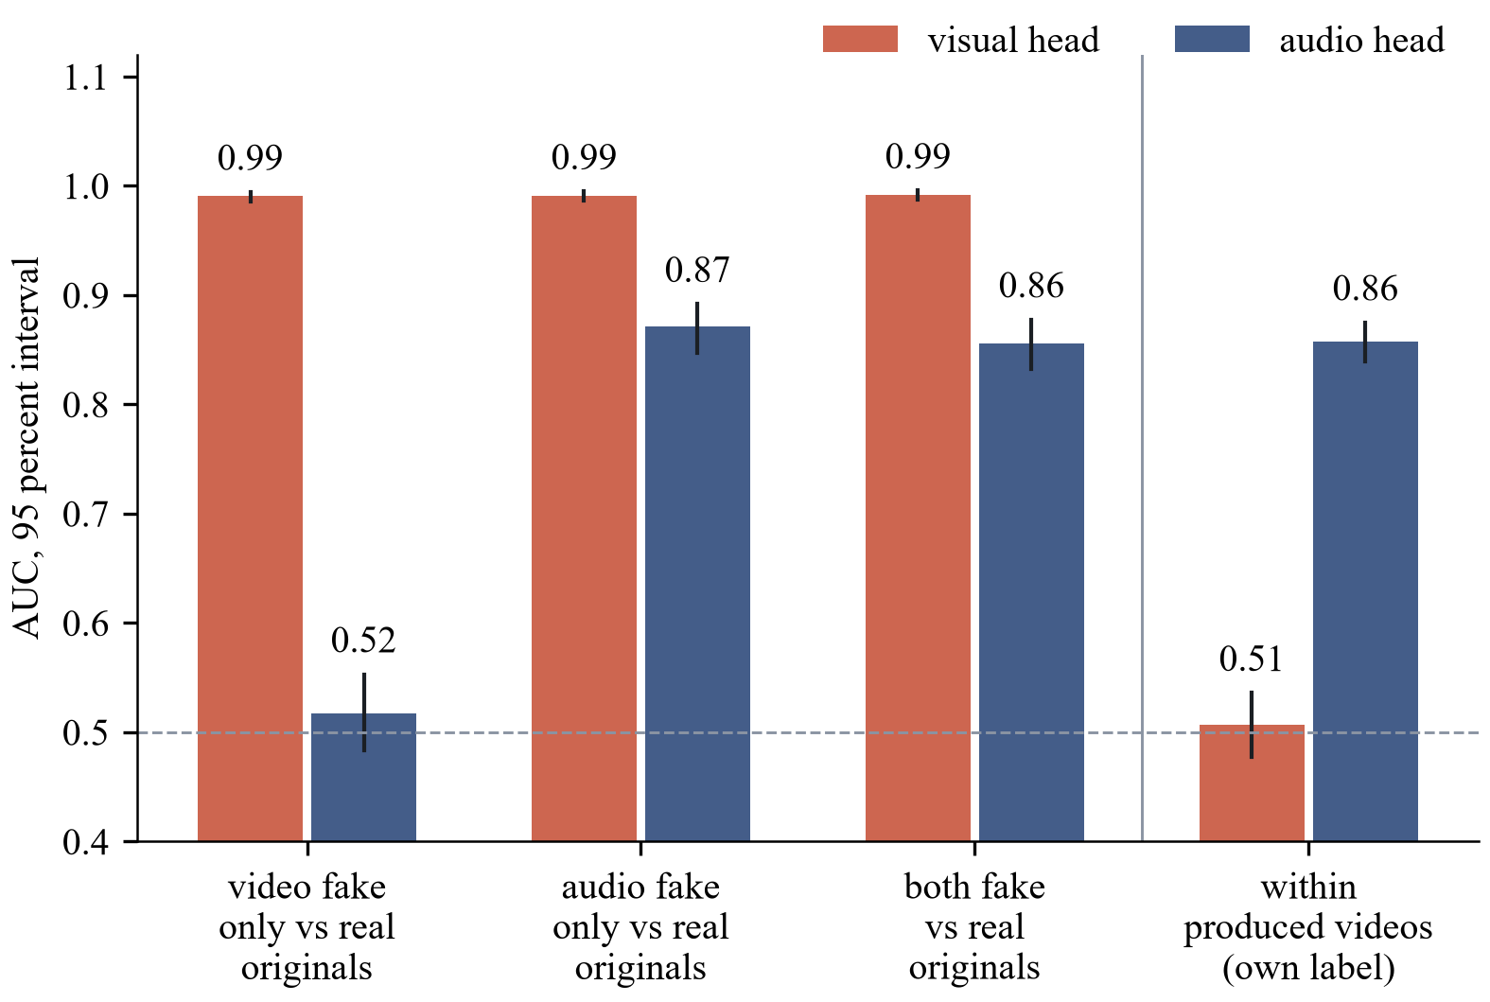
I-5 and I-6: LAV-DF
The control
Frozen face head: 0.3838, below chance.
Visual head: 0.99 against real originals for every fake cell.
Within produced videos: 0.5070, chance.
Produced-only head: 0.5169.
Speech head: 0.8574.
No audio-visual claim.
Exploratory, LAV-DF validation subset of 2,000 videos, 95 percent group-bootstrap interval.
Notes:
LAV-DF is the only data set here in which video and audio are manipulated independently. A fixed subset of 500 videos per cell (real, video fake only, audio fake only, both fake) and split was used, with the source video as the group (D-057). I-5 (E-010): the pre-check written in advance found the frozen face head below chance on LAV-DF, AUC 0.3838 [0.3599, 0.4079] against the video label; the frozen speech average gave 0.6476 [0.6244, 0.6701] against the audio label; the fusion was not tested. I-6 (E-011, D-058): heads trained on LAV-DF pass the pre-check (0.7491 and 0.8604) and the logistic-regression fusion reaches 0.9935 [0.9905, 0.9962] on the fused label, +0.0023 [+0.0009, +0.0040] over the better head; mechanically supported. The post-hoc control (labelled as such, D-059) keeps only the produced videos: the visual head is then at 0.5070 [0.4771, 0.5361] against the video label, while it separates the real originals from audio-only fakes (frames untouched) with 0.9912; the speech head reaches 0.8574 [0.8394, 0.8752] against the audio label within produced videos. The visual head has therefore learned original versus produced, and the fused AUC is an in-data-set result driven by that cue. A follow-up trained the visual head on produced videos only (E-012): 0.5169 [0.4945, 0.5392], not supported; no visual manipulation signal was recovered by this recipe. No audio-visual detection claim is made; the page shows the two scores side by side with a warning and no fused verdict. Evidence: docs/EXPERIMENTS.md E-010 to E-012; docs/DECISIONS.md D-057 to D-059.

Slide 18
rPPG: test the signal first
Contiguous frames, native rate (about 10 s)
Face and skin region
Mean R, G, B per frame
Window normalisation
Projection to one pulse signal
Power spectrum 0.7 to 3 Hz
Peak and SNR
Control: the same clips with time-shuffled frames (pooled, at least 10 shuffles per clip)
Pass, or report: pulse not recoverable
Signal check passes when at least 60 percent of real clips have a peak SNR above the 95th percentile of the shuffled control; if not, the slot reports that the pulse is not recoverable. It did not pass.
Separation, only if it passes: lower interval bound of the AUC above 0.55 on an identity-disjoint split.
Adopt only if the whole paired interval (with minus without) is above zero on the development slice.
Outcome
Signal check: fails, 130 of 432 real clips (0.301 [0.260, 0.346]) against 0.6 required
Separation and added value: not run
Positive control: next slide
Result: pulse not recoverable from these data
Notes:
Remote photoplethysmography is a candidate improvement, not an adopted component (D-006, O-010). The literature is mixed: early work reports high in-dataset accuracy, a 2025 study found a plausible pulse in high-quality face swaps, a 2026 preprint reported a reproduction that fell lower on talking-face fakes under an identity-disjoint split, and pulse signals can be edited on purpose (R-005 to R-010). So the first step is a signal check on contiguous frames with a time-shuffled control pooled across clips (at least ten shuffles per clip); it passes when at least 60 percent of real clips have a peak SNR above the 95th percentile of the control. If it fails, the slot reports exactly that and no separation or fusion experiment is run; if it passes, the adopt decision is taken on the development slice only and needs the whole paired interval above zero. Evidence: docs/ITERATIONS.md section I-7, thresholds written before any run; the signal check was run and failed (E-006): 130 of 432 real clips, 0.301 [0.260, 0.346], above the 95th percentile of the shuffled control (1.118 dB), against the required 0.6; per data set 0.280 for FaceForensics++, 0.288 for Celeb-DF v2 and 0.333 for LAV-DF; median SNR of the real clips -0.222 dB. The slot reports that the pulse signal is not recoverable from these data, and the separation and fusion tests were not run (D-052). The check has no ground-truth pulse, so it does not show that no pulse exists. This slide is drawn natively and mirrors fig05_rppg of the paper and the report, with the same wording, so that the text is large enough to read when projected.

Slide 19
rPPG: positive control
Relative green amplitude | Primary signature | Green only
0 (control) | 0.301 [0.260, 0.346] | 0.301 [0.260, 0.346]
0.002 | 0.343 [0.299, 0.389] | 0.410 [0.364, 0.457]
0.004 | 0.546 [0.499, 0.593] | 0.789 [0.748, 0.825]
0.008 | 0.873 [0.838, 0.901] | 0.958 [0.935, 0.973]
0.016 | 0.972 [0.952, 0.984] | 0.975 [0.955, 0.986]
0.032 | 0.981 [0.964, 0.991] | 0.986 [0.970, 0.994]
It shows
The pipeline recovers a clean 1.2 Hz sinusoid of relative amplitude 0.008 in most clips.
With no injection it reproduces the check: 0.301.
It does not show
That a real pulse exists in these videos, or its amplitude.
That a pulse survives H.264 compression.
Anything about forged videos. The check still fails: 0.301 against 0.6.
Share of the 432 clips in which the injected sinusoid is recovered by the rule of the check; Wilson 95 percent interval. Smallest amplitude with at least 0.60: 0.008 (primary), 0.004 (green only). Exploratory.
Notes:
A failed check is uninformative unless the pipeline is known to recover a pulse that is there (M-005, requested in D-062 d, written before any injected clip was analysed). The exact pipeline of the signal check was run on the same 432 clips after a known 1.2 Hz sinusoid had been injected into the skin pixels at eight relative green amplitudes, with a random phase per clip; the channel weights are R 0.3, G 1.0 and B 0.5 (an implementer's choice, because a modulation common to the three channels is cancelled by the projection), and a green-only signature is the sensitivity run. The control with amplitude 0 reproduces the signal check (0.301, maximum difference 5 millionths of a decibel). The smallest tested amplitude recovered in at least 60 percent of the clips is 0.008 for the primary signature (377 of 432 = 0.873 [0.838, 0.901]; at 0.004 it is 0.546) and 0.004 for green only (0.789). 0.008 is about one grey level at a skin value near 130. What it shows: the pipeline (face track, skin mask, projection, spectral rule, shuffled null) is sensitive to a clean sinusoid of that size and form, so the failure is not caused by an insensitive pipeline for such a modulation. What it does not show: that a real pulse exists in these videos, its amplitude, form or spectrum (not measured, and no source on typical amplitudes was read); that a pulse survives H.264 compression (the injection is made after decoding and is not re-encoded); anything about forged videos. The injected sinusoid is constant in frequency and amplitude, which is easier than a real pulse. The signal-check verdict (0.301 against 0.6) and the conclusion of the iteration are unchanged. All numbers are exploratory. Evidence: docs/EXPERIMENTS.md M-005; docs/DECISIONS.md D-052.

Slide 20
Sealed tests: three comparisons
Test and sealed set | Final system | Working version or baseline | Difference, 95 percent | 98.33 percent interval | Verdict
Video: improvement Celeb-DF family, 7,650 videos | 0.8218 [0.8020, 0.8393] | 0.6238 [0.6015, 0.6486] | +0.1980 [+0.1688, +0.2242] | [+0.1627, +0.2303] | improved, robust
Speech: improvement In-the-Wild, 24,788 clips | 0.9148 [0.8896, 0.9383] | 0.7516 [0.6802, 0.8035] | +0.1633 [+0.1177, +0.2266] | [+0.1085, +0.2481] | improved, robust
Video: against baseline Celeb-DF family, margin 0.0100 | 0.8218 [0.8020, 0.8393] | 0.8042 [0.7841, 0.8223] | +0.0176 [+0.0025, +0.0327] | [-0.0011, +0.0355] | superior at 95 percent; not robust at 98.33 percent; non-inferior at both
What it supports
Video and speech: the lower bounds are above zero at both levels, so both are improved and robust.
Baseline: superior at the 95 percent level only; non-inferior at both levels.
What it does not show
One baseline family at 224 pixels; 344 groups (44 identities); 42 speakers.
Two speech predictions failed upward (0.9148 and 0.7516 found; 0.60 to 0.85 and 0.50 to 0.70 predicted).
Sealed video 0.8218 is below the development 0.9096; speech 0.9148 is above 0.8130.
Notes:
The sealed test sets were read once for each frozen iteration on 25 October 2026, under the final flag, and the ledger holds 74 entries (E-014, D-067, D-068). Values are for seeds 0 to 2 at the level of the clip or the image, with the 95 percent group bootstrap interval of 2,000 resamples. Only three comparisons were declared before the run and are confirmatory (D-062 b). Test 1, face video on the sealed Celeb-DF family (7,650 videos, 344 groups): final system 0.8218 [0.8020, 0.8393] against the working version 0.6238 [0.6015, 0.6486], difference +0.1980 [+0.1688, +0.2242], robustness interval at 98.33 percent [+0.1627, +0.2303]: improved, robust. Test 2, speech on the sealed In-the-Wild set (24,788 clips, 42 speakers): 0.9148 [0.8896, 0.9383] against 0.7516 [0.6802, 0.8035], difference +0.1633 [+0.1177, +0.2266], robustness interval [+0.1085, +0.2481]: improved, robust. Test 3, the final face-video system against the re-run Xception baseline at 3e-4 (0.8042 [0.7841, 0.8223]) on the same set, margin 0.0100: difference +0.0176 [+0.0025, +0.0327], so superior by the declared 95 percent rule; the interval at 98.33 percent, [-0.0011, +0.0355], contains zero, so the superiority is not robust to the Bonferroni level; the lower bound is above -0.0100 at both levels, so the system is non-inferior at both. Use exactly this wording and claim nothing beyond it. The predictions written before the run held for video, including the difference to the baseline; the two speech predictions failed upward (final 0.60 to 0.85, found 0.9148; working version 0.50 to 0.70, found 0.7516). The sealed video value is below the development value (0.8218 against 0.9096) and the sealed speech value is above it (0.9148 against 0.8130); the sets differ, and no experiment explains the difference. Evidence: docs/EXPERIMENTS.md E-014 result block, data/_results/E-014/sealed_block.md.

Slide 21
Sealed staircase (exploratory)
Face video, sealed AUC [95 percent interval] | Working version | Iterations 1 to 4 | Xception, 3e-4
Celeb-DF family (tests 1 and 3) | 0.6238 [0.6015, 0.6486] | 0.8218 [0.8020, 0.8393] | 0.8042 [0.7841, 0.8223]
Celeb-DF v2 test videos alone | 0.6322 [0.6018, 0.6658] | 0.8999 [0.8759, 0.9210] | 0.8527 [0.8237, 0.8777]
DeepFakeDetection | 0.5927 [0.5629, 0.6258] | 0.8797 [0.8566, 0.9041] | 0.8847 [0.8655, 0.9052]
FaceForensics++ test, in-dataset | 0.7946 [0.7667, 0.8243] | 0.9899 [0.9826, 0.9959] | 0.9895 [0.9823, 0.9952]
Speech, sealed AUC [95 percent interval] | Working version | Iteration 2 | Iteration 3 | Iteration 4
In-the-Wild (test 2) | 0.7516 [0.6802, 0.8035] | 0.8125 [0.7361, 0.8560] | 0.8672 [0.8320, 0.8989] | 0.9148 [0.8896, 0.9383]
ASVspoof 2019 test | 0.9684 [0.9564, 0.9777] | 0.9632 [0.9535, 0.9717] | 0.9541 [0.9452, 0.9626] | 0.9835 [0.9798, 0.9872]
Images are the same in every iteration: ProGAN test 1.0000, CNN subset 0.9316, diffusion set 0.9354.
Xception is not lower on DeepFakeDetection (0.8847 against 0.8797, overlapping intervals); no test was declared for these rows.
Exploratory except the rows marked as tests. Celeb-DF++ has no reals of its own, so it has no AUC alone.
Notes:
Each frozen iteration was scored once on every sealed set; apart from the Celeb-DF family row and the In-the-Wild values of iteration 0 and iteration 4, which belong to the three declared tests, every number here is exploratory (E-014). Face video: the model does not change after iteration 1, so iterations 1 to 4 give one value per set. On the sealed Celeb-DF family the working version is at 0.6238, the final system at 0.8218 and Xception at 0.8042; on the Celeb-DF v2 test videos alone 0.6322, 0.8999 and 0.8527; on DeepFakeDetection 0.5927, 0.8797 and 0.8847; on the in-dataset FaceForensics++ test 0.7946, 0.9899 and 0.9895. The Celeb-DF++ videos have no real videos of their own, so Celeb-DF++ alone has one class and no AUC; the family set mixes the Celeb-DF v2 test videos and the Celeb-DF++ fakes against the v2 reals, and on the Celeb-DF++ fakes with the v2 reals the final system is at 0.7105 and Xception at 0.7351. Speech: on In-the-Wild the working version is at 0.7516, iteration 2 at 0.8125, iteration 3 at 0.8672 and iteration 4 at 0.9148; in the training corpus the in-dataset test gives 0.9684, 0.9632, 0.9541 and 0.9835. Images are unchanged in every iteration: ProGAN test 1.0000, CNN subset 0.9316, diffusion set 0.9354. No paired test was declared for any of these rows other than the three, so they are descriptive. Evidence: docs/EXPERIMENTS.md E-014 result block.

Slide 22
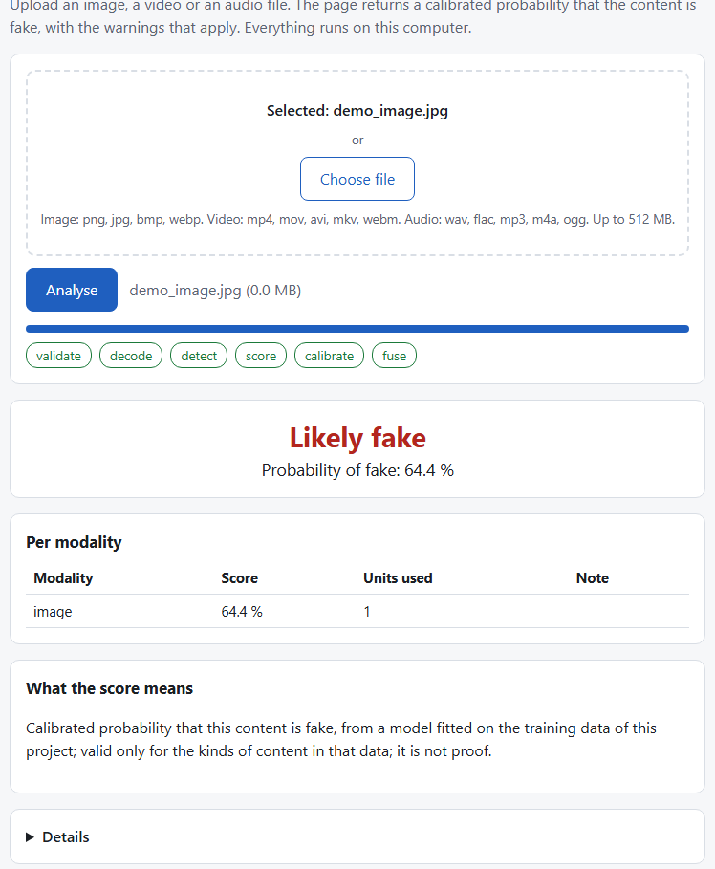
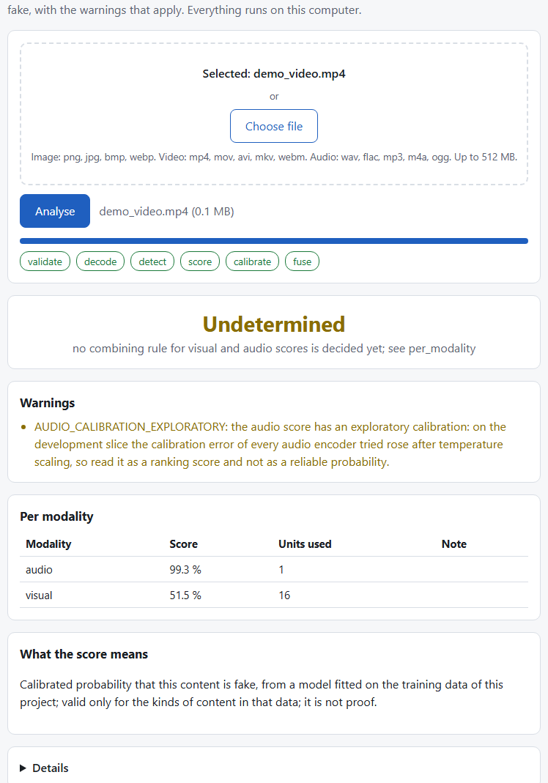
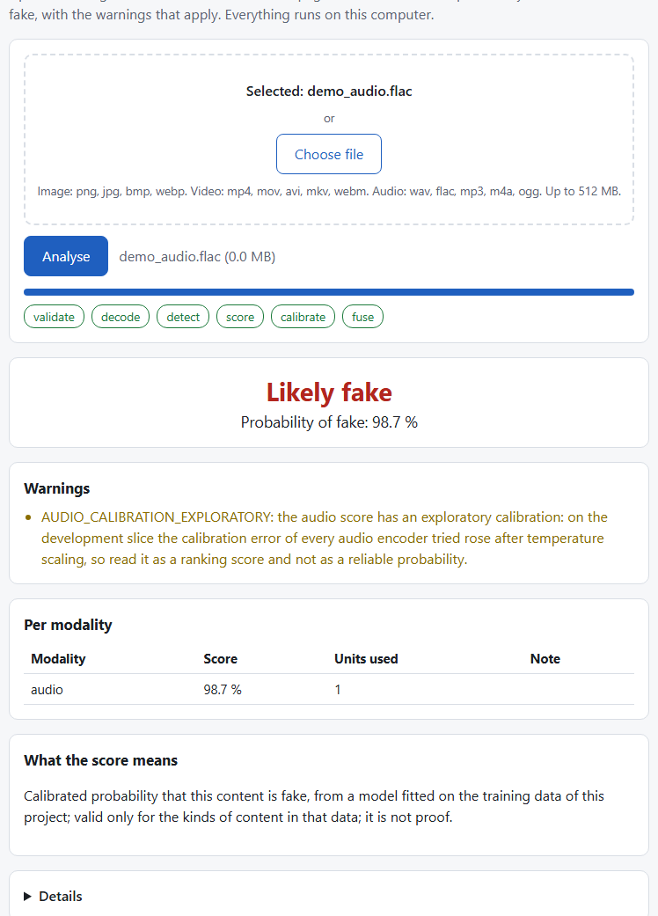
Web demo (real checkpoint)
Real checkpoint
Real adapter with the I-0 checkpoint: no MOCK banner.
The three files are training items: the path works, accuracy is not claimed.
A video shows a visual and an audio score and the verdict Undetermined, as no combining rule is claimed.
The audio score carries an exploratory-calibration warning.
(a) image
(b) video with audio
(c) audio file
Local Flask page on 127.0.0.1; uploads up to 512 MB; files deleted after each request.
A page check with the frozen checkpoint passed on three training files; these screenshots show the working version.
Notes:
The software is a local web page served by Flask on 127.0.0.1 only, with a 512 MB upload limit; uploaded files are deleted after every request (D-043). It calls an inference library with a fixed response structure: a score per modality, a status, warnings, errors, a model block and a fixed sentence that says what the score means (D-027). The three screenshots were taken with the real adapter and the I-0 checkpoint, so there is no MOCK banner: an image, a video with its audio and an audio file, each a training item, so they show that the path works and say nothing about accuracy (E-004, assets/screens/real_image.png, real_video.png, real_audio.png). For the video the visual and the audio score are shown separately and the verdict is undetermined, because no combining rule is claimed; the audio score carries the warning that its calibration is exploratory (D-050). On 25 October the page was also run with the frozen checkpoint on three training files and passed its page check (scripts/freeze/web_freeze_check.py, data/_results/freeze/web_freeze_check.json); the analysis platform on the following slides calls the frozen system for every file. Screenshots against the development stand-in remain in the report as a labelled figure; the real adapter refuses to run without a checkpoint whose metadata and preprocessing identifier match (D-044). The report carries the labelled figure of the page against the development stand-in (fig07_web); this slide shows the real-checkpoint screenshots instead.

Slide 23
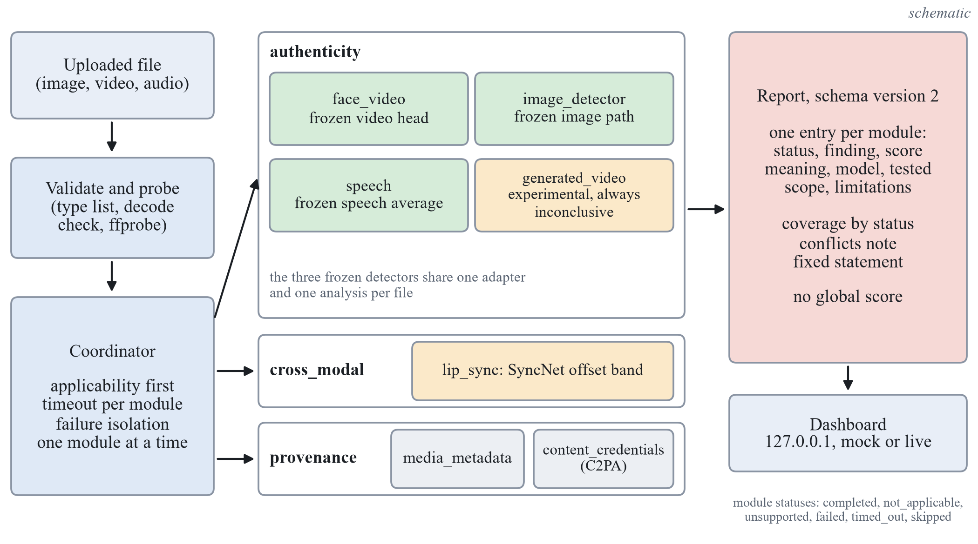
Analysis platform: architecture
Design rules
Each capability is a module: applicability first, then run.
One module at a time, each with a time limit.
Exceptions and timeouts become reported statuses.
Every module appears once, in one of three sections.
No global fake score; no finding means genuine.
Structure of the platform (schematic). The frozen detectors are wrapped, not changed.
Notes:
After the freeze the frozen detectors were placed, unchanged, in a modular analysis platform (src/dfd/platform, D-069). Each capability is a module with an applicability check and a run function; the coordinator runs the modules one at a time because the GPU is shared, gives each a time limit, and turns an exception, a timeout or a result that breaks the contract into a reported failed or timed_out entry. A timed-out thread cannot be killed in Python, so the coordinator sets a cancel flag, discards late results and ignores late cache writes; a second GPU module is skipped while an abandoned one still runs. Every module appears once in report schema version 2.1, in one of three sections: authenticity, cross_modal and provenance; version 2.1 adds a server-written explanation per module (D-076). There is no global fake score and no finding that means genuine. Evidence: src/dfd/platform/coordinator.py and schema.py, paper/figures/fig10_platform.png.

Slide 24
Report contract: statuses and findings
Status | Meaning
completed | ran and returned a valid result
not_applicable | the input lacks what the module needs
unsupported | weights or head not installed here
failed | exception or broken contract
timed_out | no result within its time limit
skipped | not started: time limit or GPU held
Section | Findings allowed
authenticity | indicates_manipulation; no_indication_within_tested_scope; inconclusive
cross_modal | consistent; potential_mismatch; inconclusive
provenance | credentials_valid; credentials_invalid; no_credentials_found; inconclusive
What the report never says
No fused score, overall probability or verdict: the contract checker rejects them.
Fixed statement on every report: a module that found nothing does not show that the media is authentic.
Notes:
The report of schema version 2.1 has one entry per module with its status, finding, score with a sentence on what it means, model, tested scope and limitations (src/dfd/platform/schema.py). Six statuses say whether and why a module ran: completed, not_applicable, unsupported, failed, timed_out and skipped; every status other than completed needs a reason, and failed and timed_out need an error entry. Each section allows its own findings; the strongest negative finding is no indication within the tested scope, never genuine. The contract checker rejects a report that carries a fused score, an overall probability or a verdict, and every report ends with a fixed statement that a module that found nothing does not show that the media is authentic. The report state is failed when nothing completed, partial when any module failed, timed out, was unsupported or was skipped, and ok otherwise.

Slide 25
Implemented capabilities
Module | Section | What it does | Evidence status
face_video | authenticity | fine-tuned SigLIP base on the largest face, 16 frames | sealed Celeb-DF family 0.8218; LAV-DF below 0.5
image_detector | authenticity | face crop: video head; no face: CLIP head | sealed CNN subset 0.9316, diffusion set 0.9354
speech | authenticity | mean logit of three speech encoders, first 4 s | sealed In-the-Wild 0.9148; exploratory calibration
generated_video | authenticity | DINOv2 small, mean embedding, logistic regression | experimental: DF26 0.4957; always inconclusive
lip_sync | cross_modal | SyncNet offset in a band of -6 to +2 frames | weak evidence; not a detector
media_metadata | provenance | container, stream and tag description | descriptive; always inconclusive
content_credentials | provenance | C2PA manifest check with c2pa-python | valid only with an operator trust anchor
Notes:
Seven modules are registered by default (src/dfd/platform/pipeline.py). The three authenticity modules that wrap the frozen detectors quote their sealed results (E-014): face video 0.8218 on the Celeb-DF family and below 0.5 on LAV-DF, the image path 0.9316 on the CNN subset and 0.9354 on the diffusion set, speech 0.9148 on In-the-Wild with an exploratory calibration; a face crop of a still image goes through the video head and is marked as not calibrated for stills. The generated-video module is experimental: its head is at chance on DF26 (0.4957), and a gate with an empty approval table keeps its finding inconclusive (D-072, D-074). The lip-sync module is weak evidence with the band of minus 6 to plus 2 frames (D-073). Media metadata is descriptive and always inconclusive; Content Credentials are valid only relative to a trust anchor that the operator configures, and an untrusted signer is inconclusive.

Slide 26
Demonstration workflow
1 Start
serve 8002 --live, open 127.0.0.1:8002
2 Drop a file
preview, then Analyse
3 Modules run
one at a time, card by card
4 Done or Failed
LIVE ANALYSIS banner or error code
5 Read the groups
no overall score
Inputs of the guide docs/DEMO.md
Face swap and its original video, no audio.
Talking head with speech; a speech audio file.
A still frame of the face swap.
Synthetic clip: no face, 440 Hz tone.
Error cases: a text file, a corrupt video.
Reading the outcome
Done: checks are grouped by what they found; read each on its own.
Inconclusive or experimental: the check ran and makes no finding; it says why.
Not applicable: the input lacks what the module needs.
Failed: the file was rejected with an error code; no report.
Notes:
The demonstration follows the demonstration guide docs/DEMO.md, checked again on 27 October 2026 after the redesign; it shows that the software runs end to end, not the accuracy of any detector. Start: PYTHONPATH=src .venv/Scripts/python.exe -m dfd.platform.dashboard.serve 8002 --live, then open http://127.0.0.1:8002/ ; the first analysis loads the models (about 11 seconds), later ones took about 0.4 to 3 seconds. The page opens on the upload panel; invented MOCK scenarios appear only when chosen from the Demo scenarios menu. The eight inputs are built by scripts/platform/make_demo_inputs.py from non-sealed files only: an FF++ face swap and its original (validation, no audio), a LAV-DF training clip with speech, an ASVspoof development utterance, one frame of the face swap as a still image, a synthetic test pattern with a 440 Hz tone, an unsupported text file and a corrupt video. Observed: the face swap gets indicates manipulation from face_video and the original no indication; speech and lip_sync are not applicable without audio; generated_video is always inconclusive and tagged EXPERIMENTAL; the tone clip gets a speech finding with score 0.0 although it is not speech (documented limitation) while lip_sync reports the audio as not speech-like; the two error cases fail with UNSUPPORTED_MEDIA_TYPE and UNREADABLE_FILE and show no report. Say: each module answers for itself, there is no overall score and no authentic answer, and one clip is not an accuracy measurement.

Slide 27
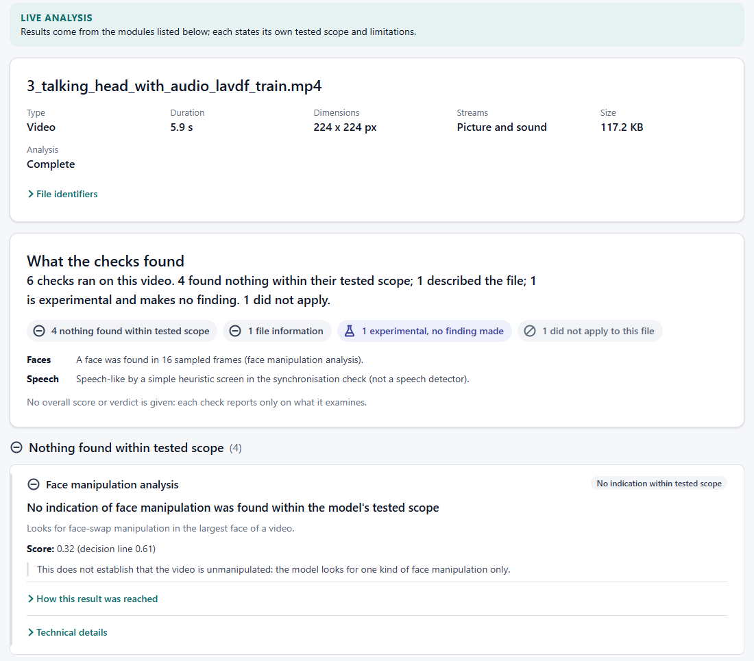
Dashboard and explanations
How explanations are made
Fixed templates on the server, from the module's own fields.
Every sentence names the fields it uses.
Numbers must appear in those fields; tested.
No finding for a check that did not run.
Experimental output is never a headline number.
No overall score; no language model.
Live report, 27 October 2026, before the verdict labels. Screenshot, not a result.
Notes:
The dashboard was redesigned on 27 October 2026 (D-076) for readers who do not know how the models work. It opens on an upload panel; the report starts with the file and a sentence that only counts the checks by what they found, then the checks grouped by meaning, each with a plain headline, one rounded number and what the result does not establish. Identifiers, raw scores, thresholds and evaluation lines stay under Technical details. The experimental generated-video check sits in its own group and shows its score only as an experimental signal. The explanations are written on the server by fixed templates from the fields of each module's result (src/dfd/platform/explain.py); each sentence names its fields, and a validator rejects numbers not in those fields, missing fields, model output from a module that did not run, and wording such as authentic or proves. They describe the stored result; they do not explain how a network reached its score, and no language model writes them. Evidence shown on request: the lip-sync offset curve and the 8 frames the experimental video model saw, both already computed by the modules. Screenshot: demonstration input 3, a real LAV-DF training clip (docs/test_evidence/2026-10-27_redesign), taken before the per-module verdict labels of the slide Verdicts and the Evaluation Lab were added.

Slide 28
Testing (engineering verification)
Level (27 October) | What was run | Recorded outcome
Safe suite | unit and contract tests, GPU hidden; 13 data tests left out | 551 passed, 2 skipped
Opt-in, GPU | wrapper parity on 11 non-sealed files; live face path | 5 passed
Live dashboard | 8 demonstration inputs in Edge, reports checked | 6 media files done; 2 error cases failed as expected
Documentation check | paper, report and slides, project environment | 71 pass, 0 fail
Earlier records | live checks; C2PA cases; reproducibility | 60 checks, 0 failed; 5 of 5; 16 of 16 (not re-run)
Read this as
Behaviour of the software, not detector accuracy. New tests check the explanations against the stored fields and the contrast of the palette.
Notes:
Testing is kept apart from the experiments: a test shows that the software behaves as specified, not how well a detector separates real from fake (docs/TESTING_RECORD.md section 7, logs in docs/test_evidence/2026-10-27_redesign/). On 27 October 2026, after the redesign, in the project environment: the safe suite with CUDA_VISIBLE_DEVICES=-1 (GPU hidden) gave 551 passed and 2 skipped (497 on 26 October before the redesign), the two opt-in tests, with 13 data-dependent tests deselected; the opt-in GPU tests gave 5 passed, including wrapper parity on 11 non-sealed files with the largest difference 0.0019 against a tolerance of 0.02; the documentation check gave 71 pass and 0 fail. The live dashboard was driven in Edge on the 8 demonstration inputs: the six media files finished with all seven modules reported, every report valid and every number shown equal to the stored score; the two error cases failed with UNSUPPORTED_MEDIA_TYPE and UNREADABLE_FILE. Defect found and fixed in that run: after a failed or refused analysis the MOCK scenario of page load stayed on screen next to the failure; the page now hides the report before a new analysis, with a regression test. History, not re-run on this state: live checks 60 with 0 failed, C2PA 5 of 5, generated-video reproducibility 16 of 16, the earlier full suite 508 passed and 2 skipped with the GPU visible, and the clean install 495 passed and 2 skipped.

Slide 29
After the freeze: FakeAVCeleb
Sealed half (5,013 clips, once) | AUC [95 percent interval] | Pre-stated rule
Visual: real against fake video | 0.9552 [0.9442, 0.9657] | supported
Audio: real against fake audio | 0.9263 [0.9149, 0.9366] | supported
Visual score, same real video | 0.5613 [0.5428, 0.5816] | supported (0.40 to 0.60)
Audio score, same real audio | 0.5011 [0.4801, 0.5243] | supported
Limits
Thresholds do not transfer: visual sensitivity 0.480, audio specificity 0.637.
Real audio is interview speech, fake audio clean synthesis.
Development half
Common re-encode: frozen visual AUC 0.9732 to 0.8772.
Codec-matched reals: 0.8856 against 0.8763; codec and method coincide.
Notes:
FakeAVCeleb arrived after the freeze and was split by identity into a development half and a sealed half, 250 identities each, none shared (D-070). The sealed half, 5,013 clips, was scored once by the frozen system with the predictions written before the labels were read (E-015). Visual AUC 0.9552 [0.9442, 0.9657], audio 0.9263 [0.9149, 0.9366], and the two cross-modality controls 0.5613 and 0.5011 inside 0.40 to 0.60: all four pre-stated criteria met; the visual prediction of 0.55 to 0.80 was wrong. The frozen thresholds do not transfer: visual sensitivity 0.480 at specificity 0.996, audio specificity 0.637. On the development half (E-021, E-023) the codec alone separates real from fake video, a common re-encode lowers the frozen visual AUC from 0.9732 to 0.8772, and a codec-matched control did not lower it further (0.8856 against 0.8763); codec and method coincide in this data set, so whether the sealed number is inflated is not estimated.

Slide 30
Generated video and lip sync
Generated-video candidate | DeepAction, development | DF26, held out
Temporal geometry (ReStraV-style) | 0.5073 [0.4608, 0.5542] | 0.5077 [0.4723, 0.5424]
Mean embedding, logistic regression (installed) | 0.8281 [0.7908, 0.8662] | 0.4957 [0.4755, 0.5168]
Seven pixel statistics (control) | 0.7613 [0.7182, 0.8033] | 0.5604 [0.5361, 0.5852]
Lip-sync rule (real clips; Wav2Lip clips) | Real clips flagged | Wav2Lip clips flagged
Tolerance of 2 frames, fresh clips | 15.0 and 13.3 percent | 85 to 93 percent
Band of -6 to +2 frames, disjoint clips | 1.3 percent [0.4, 3.8] | 0 of 160
Real clips from FF++ and LAV-DF: 338 of 440 above the generated-video threshold (pre-registered check).
Generated video stays experimental and always inconclusive; lip sync is weak evidence, not a detector.
Notes:
Generated video (E-018 to E-020): the metadata of DeepAction separated real from generated clips perfectly, so every clip was re-encoded by one recipe; the third recipe made all headers constant, but seven pixel statistics still reach 0.773 [0.729, 0.817], so the clips are not shortcut-free. Of three candidates on frozen DINOv2 small features, only the appearance baseline met the selection rule fixed in advance (0.8281 on DeepAction with each generator left out); on DF26, read once for evaluation only, it reached 0.4957 [0.4755, 0.5168], and 0.4880 on the pre-registered closed-generator subset, so transfer is not supported and the module stays experimental. Lip sync (E-022, E-024, E-025): with a tolerance of 2 frames real clips were flagged in 15.0 and 13.3 percent and Wav2Lip clips in 85 to 93 percent, almost all at minus 3 frames. A band of minus 6 to plus 2 frames, fitted on 230 real clips, flagged 1.3 percent [0.4, 3.8] of 230 disjoint real clips and 0 of 160 Wav2Lip clips: the earlier separation rested on a one-frame margin. The LAV-DF half of those pools was split by file, not by speaker, so this is not evidence of speaker-independent behaviour. E-026 (27 October, pre-registered, nothing fitted): the installed head scored 338 of 440 unmodified real clips from FF++ and LAV-DF above its threshold, 0.7682 [0.7265, 0.8052], against 19 of 100 DeepAction real clips out of fold, so the source-confound hypothesis is supported; which property drives it is not identified.

Slide 31
Modern generators, published numbers
Video head trained on DF26 open generators | Result [95 percent interval]
AUC, open families held out (chosen head) | 0.7453 [0.7174, 0.7710]
AUC, commercial generators, one counted look | 0.7548 [0.7189, 0.7885]
Share of real FF++ and LAV-DF clips flagged | 0.8023 [0.7625, 0.8368]
Speech, equal error rate | Ours | Published
ASVspoof 2019 LA eval (same protocol) | 6.94 percent | 1.13 percent (AASIST)
In-the-Wild (42 of 54 speakers) | 15.8 percent | 33.9 and 7.2 percent, full set
In-domain training moves commercial generators from chance to 0.75, but real clips of other sources still look generated.
Differences are computed only where task, data, protocol and metric match.
Notes:
E-027 (27 October, pre-registered): heads trained only on the six open generators of DF26, as its licence allows, with real clips split by source video and each open family held out in turn. The chosen head, a logistic regression on the mean CLIP ViT-L/14 embedding of 8 frames, reached 0.7453 [0.7174, 0.7710] on held-out families, against 0.4921 for pixel statistics and 0.4995 for the installed head. In one counted look at the four commercial generators it reached 0.7548 [0.7189, 0.7885]; Kling 3.0 was hardest (0.6483), Wan 2.6 easiest (0.8758). Temporal features did not help. But the deployable head flags 0.8023 [0.7625, 0.8368] of real FF++ and LAV-DF clips at its balanced threshold, so the source confound persists and the head is not installed (D-085). Published comparison (docs/PERFORMANCE_BENCHMARK.md): only like-for-like rows get a difference. Speech EER on the official ASVspoof 2019 LA eval, computed afterwards from stored sealed scores (E-030): 6.94 percent against 1.13 for AASIST, 5.81 points worse. In-the-Wild EER 15.8 percent on our 42 sealed speakers; published 33.9 (Muller et al.) and 7.2 (Pascu et al.) are on the full set, so no gap is computed. On DF26 zero-shot our earlier head (0.4957) lies inside the 44.0 to 69.7 range the DF26 authors report for FF++-trained detectors.

Slide 32
Modern generated images
Frozen model, 11,550 images, 21 generators | Result [95 percent interval]
Macro AUC over the 21 generators | 0.7039 [0.6855, 0.7229]
Generated images missed at the frozen threshold (pooled) | 0.7395 [0.7300, 0.7500]
AUC: two GANs / commercial generators | 0.9580 / 0.7351
AUC on PNG real against PNG generated images only | 0.6123 [0.5908, 0.6353]
Images with a face (3,119): AUC | Result [95 percent interval]
Whole-image model (experimental check) | 0.7859 [0.7717, 0.7995]
Face-swap path used by the product today | 0.6020 [0.5836, 0.6202]
Paired difference | +0.1839 [+0.1596, +0.2074]
Inadequate by the line fixed in advance: about three quarters of modern generated images are missed.
Part of the separation is PNG against JPEG; on faces both paths miss most generated images, so the check stays experimental.
Notes:
E-028 (27 October, pre-registered, nothing fitted): the generated-image model of the product, a linear probe on frozen CLIP ViT-L/14 trained on ProGAN images, was scored unchanged on 11,550 images of a test-only subset of Community Forensics-Eval: 5,759 generated by 21 generators and 5,791 real. The subset is the set of cheapest shards, chosen by a written rule before any image was seen; eight generators share one pooled set of 121 RAISE photographs as their real images. Macro AUC over the 21 generators 0.7039 [0.6855, 0.7229]; pooled AUC 0.7973; at the frozen threshold 0.7395 [0.7300, 0.7500] of the generated images are missed and 0.0418 of the real ones flagged. By the line fixed in advance (macro AUC upper bound below 0.75) the model is inadequate for modern generators. It separates the two GANs (0.9580) but is at chance on DeciDiffusionV2 (0.4951) and below chance on kandinsky 2.2 (0.4145), and misses 71 to 95 percent of every commercial generator. Format control: 92.8 percent of the generated images are PNG and 88.1 percent of the real ones JPEG; a score that reads only the format reaches 0.9222; the model's AUC on PNG against PNG only is 0.6123 [0.5908, 0.6353]; re-encoding 380 generated PNG files as JPEG lowered the pooled AUC by 0.059. Images with a face: the product's face detector finds a face in 3,119 of the images. The whole-image model reaches 0.7859 [0.7717, 0.7995] on them, the face-swap path that the product applies to them 0.6020 [0.5836, 0.6202]; paired difference +0.1839 [+0.1596, +0.2074]. But the whole-image model still misses 80.6 percent of the generated faces, so neither is usable. That is why the product shows a whole-image score for images with a face only as an experimental check that makes no finding. Limits: a subset chosen by cost, pooled real images for eight generators, format and size differ between real and generated images, and nothing here says anything about edited images or images shared through social networks. Evidence: docs/EXPERIMENTS.md E-028 (recomputed independently from the stored scores); docs/PERFORMANCE_BENCHMARK.md.

Slide 33
Retraining on recent generators
Head retrained on 125 recent generators | Result [95 percent interval]
Validation AUC, held-out generators | 0.9823 [0.9662, 0.9969]
Macro AUC, 21 evaluation generators (installed head 0.7039) | 0.8839 [0.8732, 0.8942]
Paired gain over the installed head | +0.1800 [+0.1643, +0.1959]
Gain, 18 generators without a related model in training | +0.1675 [+0.1540, +0.1803]
At the head's validation threshold | Share
Real images flagged (all / LAION / COCO) | 0.5213 / 0.5885 / 0.0328
Generated images missed | 0.0545 [0.0495, 0.0596]
Better ranking on unseen generators, but the threshold flags about half of the real images: not usable, not installed.
The evaluation images were scored once, after the heads were frozen; nothing was tuned on them.
Notes:
E-029 (27 October, pre-registered before any feature was extracted): the same kind of head as the installed generated-image model (frozen CLIP ViT-L/14 features, one linear layer) was retrained on 23,807 images of 125 recent generators from the training part of Community Forensics-Small, with a validation split by generator and by real source (31 other generators, COCO and FFHQ real images), three seeds, and the temperature, threshold and choice of encoder taken from validation only (validation AUC 0.9823). The frozen heads were then scored once on the same 11,550 evaluation images of E-028 and paired against the installed head. Macro AUC over 21 generators not in training: 0.8839 (seeds 0.8863, 0.8832, 0.8823; SD 0.0021) against 0.7039; paired gain +0.1800 [+0.1643, +0.1959], each seed's interval above zero, so the hypothesis of improvement is supported. The gain is largest on latent diffusion (+0.32), +0.12 on commercial generators, none on pixel diffusion, and +0.1675 [+0.1540, +0.1803] on the 18 generators without a related model in training. It survives restricting to PNG real against PNG generated images (0.8365 against 0.6123), although JPEG re-encoding of generated PNG files lowers the pooled AUC by 0.073. But the threshold chosen on validation does not transfer: it flags 0.5213 [0.5091, 0.5339] of the real evaluation images (0.5885 of LAION photographs, 0.0328 of COCO photographs), because validation real images came from two sources only. The line fixed in advance for a candidate product check (false-positive rate at most 0.10, JPEG control below 0.10) is not met, so the heads are research artefacts and nothing is installed. The encoder that validation ranked lower reached a higher macro AUC on the evaluation images (0.9142); the rule fixed in advance was applied as written. Three written predictions failed. Limits: a subset of the training data, validation real images from two sources, no edited or socially shared images. Evidence: docs/EXPERIMENTS.md E-029 (recomputed independently from the frozen head files and cached features).

Slide 34
Verdicts and the Evaluation Lab
Per-module verdicts
Evaluation Lab
Module | Flag | No flag
Face video | Possible manipulation | No strong evidence found
Image, face crop | Possible manipulation (weak) | Inconclusive
Image, whole | Possible AI-generated (weak) | Inconclusive
Speech | Possible manipulation (weak) | No strong evidence
Experimental | Experimental signal only | Same label
Safeguards
Re-analyses recorded scores only; runs no model.
Provenance hash and frozen configuration.
Sealed splits only as re-analysis of a logged evaluation, with hash match.
Thresholds never fitted on evaluated rows.
Leakage checks before any metric.
A good lab result is not a product approval.
Each check gives its own verdict and uncertainty; no overall verdict.
A score is a score, not a probability.
Experimental checks never give a finding.
Notes:
Decisions of 27 October 2026 (D-083 to D-087). Each completed module result carries an additive assessment: a verdict label, a tier (detector, limited, experimental, provenance, context), the basis, the raw score with its kind (model output or ranking score), a calibration statement, an uncertainty level and evidence entries tied to stored result files; a unit test checks each entry against its file. There is no report-level verdict and no fused score; the schema still rejects keys such as verdict, overall_score, fused and probability_fake. The scores of the face-video, image and speech detectors were temperature-scaled on each detector's validation split, so they behave like probabilities only for data like that split; the sealed FakeAVCeleb and modern-image measurements show they do not elsewhere, so the text says score. Why the labels are weak: on the sealed FakeAVCeleb half the frozen video threshold had specificity 0.996 but sensitivity 0.480; computed afterwards from the stored sealed scores, the same threshold flagged about 0.11 of the real videos of the Celeb-DF family and 0.14 of those of DFD, so the face-video flag reads Possible manipulation with high uncertainty; audio specificity was 0.637; the generated-image model missed 0.7395 of modern generated images (macro AUC 0.7039), so a low whole-image score is not reassuring. Experimental modules always read Experimental signal observed, no reliable verdict available; Likely AI-generated exists in the vocabulary but no rule reaches it, and a test pins this. The approval table of the generated-video module is empty, so the code refuses a finding from any head file whose hash is not in it. Evaluation Lab (D-086, D-087): a separate dashboard page and an API under /api/evallab. It re-analyses recorded score files only: it runs no model, trains nothing, writes no checkpoint, never reads or writes the approval table or a threshold, and writes nothing to the evaluation ledger. A good lab result is not a product approval. Safeguards: the score file's SHA-256, row count and git state are recorded; the configuration and its hash are frozen before any metric is computed; a final held-out split runs only as a re-analysis of an evaluation already in the ledger, with purpose final re-analysis and a matching SHA-256; thresholds are fitted only on validation rows of the same runs, or given with provenance; leakage checks cover shared groups, duplicate sample ids and duplicate file hashes. Known limit: the lab cannot prove training data excluded the evaluated items when the score file does not record it. Engineering check on 28 October 2026 (software behaviour, not a new result): re-analysis of the frozen final system on the sealed Celeb-DF family reproduced the logged AUC 0.8218; a first look at a sealed split labelled development was refused; the ledger file was byte-identical afterwards. Evidence: docs/DECISIONS.md D-083 to D-088; docs/TESTING_RECORD.md section 10.

Slide 35
Benchmark, limits, unapproved heads
Class A row | Ours | Published / baseline
Speech EER, ASVspoof 2019 LA | 6.94 percent [5.95, 7.82] | AASIST 1.13 percent; RawNet2 5.9 percent
Zero-shot video, DF26 (AUC) | 0.4957, at chance | nine detectors, 44.0 to 69.7
Face video, Celeb-DF family (AUC) | 0.8218 (final system) | re-run Xception 0.8042; paired +0.0176 [+0.0025, +0.0327]
Limitations
No class A row for face video; DFDC never used.
Thresholds do not transfer.
Speech EER is worse than AASIST.
Why experimental heads stay unapproved
Retrained image heads (not installed): flag 0.5213 of real images.
Video head trained on DF26 (not installed): flags 0.8023 of real clips from other sources.
Installed video head: AUC 0.4957 zero-shot, so display only, never a finding.
Notes:
Benchmark audit of 27 October 2026 (docs/PERFORMANCE_BENCHMARK.md sections 9 to 13; E-014, E-020, E-027 to E-030). Four classes: A directly comparable (same data, test items, metric, aggregation, declared training protocol; only class A rows get a difference), B same dataset with a different protocol, C cross-dataset, D contextual only. Speech: official ASVspoof 2019 LA evaluation set, pooled EER computed post hoc from the stored sealed scores (no model run): ours 6.94 percent [5.95, 7.82]; AASIST 1.13 percent, so ours is worse by 5.81 points; RawNet2 under the protocol of Pascu et al. 5.9 percent, ours slightly higher in point estimate and the sign is not established. Zero-shot generated video on DF26: our head AUC 0.4957, at chance; nine published FF++-trained detectors 44.0 to 69.7 pooled AUROC, no intervals published. Our re-run Xception baseline was compared with the final video system on the same sealed tests (Celeb-DF family: final system 0.8218, Xception 0.8042, paired difference +0.0176 [+0.0025, +0.0327], superior by the declared 95 percent rule but not robust at the Bonferroni level, E-014). No class A row exists for the face-video task against any published detector (other subsets, frame counts, training compression, no published intervals), and DFDC was never used. In-the-Wild speech EER 15.8 percent [12.7, 18.8] on 42 sealed speakers is class B. Why the heads stay unapproved: the retrained image heads rank better (macro AUC 0.8839, gain +0.1800) but flag 0.5213 of real evaluation images at the validation threshold (E-029); the generated-video head trained on DF26 open generators reached 0.7548 on unseen closed generators but flags 0.8023 of unmodified real clips from two other sources, a source confound (E-027, D-085); the installed generated-video head is display-only and was at chance zero-shot on DF26, AUC 0.4957 (E-020). The whole-image check on portraits uses the installed generated-image model and is shown only as experimental because it missed 0.7395 of modern generated images (E-028, D-083). The approval table stays empty; promotion needs a new preregistered test with a false-positive line on sources not used for calibration. Evidence: docs/EXPERIMENTS.md, docs/PERFORMANCE_BENCHMARK.md.

Slide 36
Timeline to 30 October
Sat 24
Sun 25
Mon 26
Tue 27
Wed 28
Thu 29
Fri 30
Data, harness, decisions
Encoder sweep
Working version (I-0)
I-1 to I-3
I-4 to I-7 (with rPPG)
Integration and freeze
Assembly, submission
An iteration not finished by Wednesday is reported as not run. Status on 25 October: I-1 to I-7 and the extra iterations I-1b and I-1c have a logged run; the sealed run was made on 25 October. The bars show the original plan.
Notes:
The schedule runs from Saturday 24 October to the submission on Friday 30 October 2026 (D-009, PLAN.md). Saturday was decisions, data and the evaluation harness; Sunday is the encoder sweep and the working-version code path; Monday the working version and its diagnostics; Tuesday I-1 to I-3; Wednesday I-4 to I-7 with the rPPG decision; Thursday integration and freeze with the one-time sealed evaluations (brought forward and made on 25 October, see the sealed-test slides); Friday assembly and submission. Experiments end on Wednesday night, and an iteration that is not finished by then is reported as not run, never as a result. The scope is not cut: each iteration is complete in itself (hypothesis, run, result, decision), so if work stops after any day the story up to the last finished iteration is still valid. Evidence: docs/PLAN.md day-by-day schedule and docs/ITERATIONS.md schedule table. This slide is drawn natively and mirrors fig06_timeline of the paper and the report, with the same wording, so that the text is large enough to read when projected.

Slide 37
Limitations
Small development slices (15 identities, 12 speakers, two generator units): intervals are wide and ties are likely.
The sealed Celeb-DF family set has 344 groups (44 identities, 300 single YouTube videos); the sealed In-the-Wild set has 42 speakers.
Only three sealed comparisons are confirmatory; every other sealed number is exploratory, from one run of each frozen iteration.
One baseline family, Xception at 224 pixels: superior at 95 percent, not robust at 98.33 percent. The margin 0.0100 is a floor from three seeds.
Two speech predictions failed upward and the sealed video value is below its development value; no experiment explains this.
On LAV-DF the fused result is driven by a pipeline cue, repeated on the sealed subset; no audio-visual detection is claimed.
I-1b and I-1c were not tested on the sealed sets; the web page was checked with the frozen checkpoint on three training files only.
Two encoder weights are research-only; the pulse could not be recovered, and the check has no ground truth.
Notes:
These limits are stated with the results. The development slices are small (15 identities, 12 speakers, two generator units), so intervals are wide and ties are likely. The sealed Celeb-DF family set has 344 groups, of which 300 are single YouTube videos, so its fakes vary over 44 identities, and the sealed In-the-Wild set has 42 speakers (D-045, E-014). Only the three declared comparisons are confirmatory; every other sealed number is exploratory and is one run of each frozen iteration with three seeds. The baseline is one family, Xception at 224 pixels, so the superiority at the 95 percent level says nothing about other detectors, and it is not robust at the 98.33 percent level. The margin 0.0100 is the floor of its rule and rests on three seeds. The two speech predictions failed upward and the sealed video value is below its development value; no experiment explains these differences. On LAV-DF the sealed subset repeats the development pattern, and iterations 1b and 1c were not tested on the sealed sets. The web page was checked with the frozen checkpoint on three training files only (scripts/freeze/web_freeze_check.py), which shows the page works and nothing about accuracy. The limits of the work after the freeze are on the next slide. Frozen features may be inadequate for face forgery, the research-only weights of some encoders restrict reuse, cross-dataset numbers quoted from papers use other protocols and are context only, and rPPG could not be recovered from compressed video. Evidence: docs/DOC_FACTS.md section 13, docs/DATA_LOG.md Celeb-DF++ section, docs/EXPERIMENTS.md E-014.

Slide 38
Limitations of the later work
Order of registration: the later registration texts entered version control in one commit with their scripts, so git cannot show they came first.
The re-encoding recipe that passed the header audit was the third tried; pixel statistics still reach about 0.77 to 0.79.
FakeAVCeleb: codec and method coincide, so the sealed AUC may be inflated by an artefact; not estimated.
Lip-sync pools split by file, not speaker, on the LAV-DF side; both sources derive from VoxCeleb2.
Licences: SyncNet weights without a stated licence; FakeAVCeleb request terms not recorded; no redistribution.
The speech module has no speech check of its own: a pure tone gets a speech finding (score 0.0).
Test counts describe the behaviour of the code, not detector accuracy.
Notes:
These limits belong to the work after the freeze and are stated in the report and the paper (docs/RESEARCH_INTEGRITY.md). The registration texts of the later experiments first appear in version control in one commit, together with their scripts, so the order of text and run rests on the project's own statements; this is a gap in the record, not evidence of a different order, and the history is not rewritten. The re-encoding recipe that passed the header audit was the third tried on the same data, and pixel statistics still separate the classes at about 0.77 to 0.79 (E-019). In FakeAVCeleb codec and method coincide completely (E-023), the lip-sync pools were split by file on the LAV-DF side (E-025), and the SyncNet weights have no stated licence while the FakeAVCeleb request terms are not recorded. The speech module wraps the frozen speech detector and has no speech check of its own, so a synthetic 440 Hz tone receives a speech finding with score 0.0 (docs/DEMO.md, docs/TESTING_RECORD.md); no gate was added because it would change a frozen detector's decision with an unevaluated heuristic. Test counts are engineering records, not accuracy.

Slide 39
Conclusion
What the design gives
Group-disjoint protocol; sealed sets read once per frozen iteration; three tests declared beforehand.
What the exploratory runs show
Face development AUC 0.7396 to 0.9096 by fine-tuning.
Speech 0.6100 to 0.8130 on 12 speakers.
LAV-DF fusion driven by a pipeline cue.
What the sealed run adds
Video and speech improved over the working version, at both levels.
Superior to the re-run baseline at 95 percent only.
After the freeze
One finding per module, no global score; generated video experimental.
Claim | Outcome
Working version, development AUC (exploratory) | 0.693; 0.994; 0.610
Fine-tuned SigLIP minus Xception, development slice (exploratory) | +0.0380 [+0.0172, +0.0592]
Two more video levers I-1b and I-1c (exploratory) | 0.9315 and 0.9192; neither enters
Sealed: final against working version, video | +0.1980 [+0.1688, +0.2242]; improved, robust
Sealed: final against working version, speech | +0.1633 [+0.1177, +0.2266]; improved, robust
Sealed: final against re-run baseline (margin 0.0100) | +0.0176 [+0.0025, +0.0327]; superior at 95 percent, not robust at 98.33 percent, non-inferior at both
rPPG: adopt or not | not adopted: signal not recoverable
Only the three sealed rows are confirmatory; every other row is exploratory.
Notes:
This slide states what the evidence supports. The design stands on its own: a group-disjoint protocol with sealed test sets, a rule that prefers the cheaper candidate when evidence ties, a staircase of one sealed evaluation per frozen iteration, and a working-version definition that requires the whole chain to run. The sealed run was made on 25 October 2026 (E-014, D-067, D-068). The three confirmatory tests were declared in advance (D-062 b): the final system against the working version on face video (Celeb-DF family) and on speech (In-the-Wild), and the final system against the re-run published baseline on the Celeb-DF family, the latter judged with delta 0.0100 fixed beforehand (D-025, D-041, D-066); a 98.33 percent interval (Bonferroni over three) is printed beside each as a robustness line. Results: video improved by +0.1980 [+0.1688, +0.2242] (robustness interval [+0.1627, +0.2303]); speech improved by +0.1633 [+0.1177, +0.2266] (robustness interval [+0.1085, +0.2481]); against the baseline +0.0176 [+0.0025, +0.0327], superior at 95 percent, the robustness interval [-0.0011, +0.0355] contains zero so it is not robust to the Bonferroni level, and the system is non-inferior at both levels. Say exactly this and nothing beyond it. Every other comparison is exploratory. After the freeze the detectors were wrapped in the analysis platform, which reports one finding per module and no global score; the later experiments add limits, not claims (E-015, E-020, E-025). Evidence: docs/PROTOCOL.md addendum, docs/EXPERIMENTS.md E-014 result block.

Slide 40
Future work
Detectors
More baseline families and input sizes; more seeds for the margin.
Sealed sets with more identities and speakers.
Explain the speech predictions that failed upward.
Record
Commit each registration on its own before its run.
A hash list of the frozen files; tests from a fresh clone.
Platform
Validate a generated-video head on independent data before it may give a finding.
Lip-sync band on other media, speaker-disjoint pools.
Codec question on data where codec and method differ.
A C2PA trust list; settle the licence questions.
Notes:
Further work follows from the limits (report chapter 5). For the detectors: more baseline families and input sizes, more seeds for the margin, sealed sets with more identities and speakers, and an experiment that explains why the speech predictions failed upward. For the platform: validate a generated-video head on data that played no part in its training or selection before any head may give a finding (DF26 may not be used to select it), measure the lip-sync band on other media with speaker-disjoint pools, and test the codec question on a data set where codec and method are not confounded. For the record: commit each future registration on its own before the run, record a hash list of the frozen files, run the tests from a fresh clone, configure a C2PA trust list if credentials are to be reported as valid, and settle the licence questions before any redistribution. WildDeepfake is a further test when obtained.

Slide 41
References
Cai, Z. et al. (2022). Do you really mean that? Content driven audio-visual deepfake dataset (LAV-DF). DICTA.
Bohacek, M., Farid, H. (2025). Human Action CLIPs: detecting AI-generated human motion. IJCAI workshop.
Chugh, K. et al. (2020). Not made for each other: audio-visual dissonance-based deepfake detection and localization. ACM Multimedia.
Ciftci, U. A., Demir, I., Yin, L. (2020). FakeCatcher: detection of synthetic portrait videos using biological signals. IEEE TPAMI.
Dolhansky, B. et al. (2020). The DeepFake Detection Challenge (DFDC) dataset. arXiv:2006.07397.
Dong, S. et al. (2023). Implicit identity leakage: the stumbling block to improving deepfake detection generalization. CVPR.
Guo, C., Pleiss, G., Sun, Y., Weinberger, K. Q. (2017). On calibration of modern neural networks. ICML, PMLR 70.
Harraq, O., Aldwairi, T. (2026). Physiological signals as a forensic modality for talking-face deepfake detection. arXiv:2607.21776.
Hernandez-Ortega, J. et al. (2021). DeepFakesON-Phys: DeepFakes detection based on heart rate estimation. AAAI Workshops.
Interno, C. et al. (2025). AI-generated video detection via perceptual straightening. NeurIPS.
Jung, J. et al. (2022). AASIST: audio anti-spoofing using integrated spectro-temporal graph attention networks. ICASSP.
Khalid, H. et al. (2021). FakeAVCeleb: a novel audio-video multimodal deepfake dataset. NeurIPS Datasets and Benchmarks.
Kornblith, S., Shlens, J., Le, Q. V. (2019). Do better ImageNet models transfer better? CVPR.
Li, Y. et al. (2020a). Celeb-DF: a large-scale challenging dataset for DeepFake forensics. CVPR.
Li, L. et al. (2020b). Face X-ray for more general face forgery detection. CVPR.
Li, Y. et al. (2025). Celeb-DF++: a large-scale challenging video DeepFake benchmark for generalizable forensics. arXiv:2507.18015.
Lin, Y. et al. (2023). Detection of photoplethysmography manipulation in video forgery. EUSIPCO.
Muller, N. M. et al. (2022). Does audio deepfake detection generalize? Interspeech.
Ojha, U., Li, Y., Lee, Y. J. (2023). Towards universal fake image detectors that generalize across generative models. CVPR.
Rossler, A. et al. (2019). FaceForensics++: learning to detect manipulated facial images. ICCV.
Seibold, C. et al. (2025). High-quality deepfakes have a heart! Frontiers in Imaging 4. doi:10.3389/fimag.2025.1504551.
Shykula, S. et al. (2026). DF26: we cannot tell fake from real anymore. arXiv:2609.07369.
Tak, H. et al. (2022). Automatic speaker verification spoofing and deepfake detection using wav2vec 2.0 and data augmentation. Odyssey.
Wang, X. et al. (2020). ASVspoof 2019: a large-scale public database of synthesized, converted and replayed speech. Computer Speech and Language. doi:10.1016/j.csl.2020.101114.
Yan, Z. et al. (2023). DeepfakeBench: a comprehensive benchmark of deepfake detection. NeurIPS Datasets and Benchmarks.
Notes:
Every source cited on a slide is listed here with the author, the year and the venue (or the arXiv identifier where no venue was verified), in the form used by the paper's bibliography. The entries agree with paper/refs.bib, so the paper and the slides cite the same years and venues. All entries have status READ or PARTIAL in the project's literature matrix; the parts that were read are recorded there, and numbers quoted on the slides come from those parts. The in-text form is author and year, with 2020a and 2020b separating the two Li et al. papers of 2020. Evidence: docs/RESEARCH.md and paper/refs.bib; slides/NEW_REFERENCES.md records how the list was checked.

Slide 42
Backup slides
Contents
Statistics and decision rules: metrics, bootstrap, seed policy, non-inferiority, tie rule
Staircase and confirmatory claims: one sealed evaluation per frozen iteration; three tests; the margin 0.0100; sealed LAV-DF subset
Preprocessing: frames, face crops, audio window
Sweep tables and cost record: full tables per task, cost and fine-tuning fit
I-0 diagnostic battery: metrics, subsets, score distributions, worst errors
Parity check, page check and audio diagnosis
Fine-tuning grid and checkpoint v2; LAV-DF control and software status
Data licences and terms; Celeb-DF++ test balance; Environment (measured)
Notes:
The backup slides hold the details behind the main line: the statistics and decision rules, the staircase of sealed evaluations, the preprocessing, the cost record and the fine-tuning budget, the data licences, the Celeb-DF++ de-duplication and test balance, and the measured environment. Use them to answer why-this-and-not-that questions: each one names the rule, the reason and the evidence file. Nothing on these slides is a result unless it is a logged measurement. The order follows the order of the main slides so that a question can be matched to its detail quickly. Evidence: docs/VIVA_PREP.md lists the likely questions with their answers.

Slide 43
Statistics and decision rules
Metrics
Headline: ROC-AUC on a dataset never used in training, with a 95 percent group-bootstrap interval.
Also EER, balanced accuracy at the validation threshold, log loss, Brier score and ECE (15 equal-width bins) before and after temperature scaling.
Bootstrap: 2,000 resamples, percentile interval, groups resampled with replacement.
Decision rules
Seeds: three for the head of every candidate in the sweep; in fine-tuning, one seed per learning rate and two further seeds for the winner.
Comparable with a published detector: non-inferior, lower end of the paired interval above minus delta; delta fixed beforehand.
Superior only when the whole interval is above zero; an interval that only contains zero is reported as not distinguished.
Encoder choice: the tie set against the leader, then the cheapest wins.
Notes:
Every interval resamples groups, not frames, with 2,000 resamples, a 95 percent percentile interval and a fixed base seed, because the units of independence are source videos and identities (D-024, PROTOCOL.md section 6). Seeds are policy, not decoration: the head of every candidate in the sweep is trained with three seeds, while the fine-tuning budget is one seed per learning rate and two further seeds for the winner only (D-036, D-042). Comparable means non-inferior: the lower end of the paired interval of (ours minus the re-run baseline) is above minus delta, with delta stated before the final comparison and chosen from the measured seed spread of the baseline; an interval that only contains zero is reported as not distinguished (D-025). The tie rule for the encoder sweep is the same idea turned around: if the paired interval against the leader includes zero, the cheaper candidate wins. Evidence: docs/PROTOCOL.md sections 4 to 6, docs/MATH_NOTES.md section 8, docs/DECISIONS.md D-025, D-036, D-042.

Slide 44
Staircase and confirmatory claims
final
frozen, evaluated once
final versus working version
video and speech
...
frozen, evaluated once
I-2
frozen, evaluated once
I-1
frozen, evaluated once
final versus re-run baseline
non-inferiority
I-0
frozen, evaluated once
Development slice: exploratory verdicts. Sealed test sets: one evaluation per frozen iteration, in a ledger of 74 entries; the results are on the sealed-test slides. Three pre-declared tests; non-inferiority margin 0.0100 from the baseline seed spread; 98.33 percent robustness line.
Notes:
Verdicts on the development slice are exploratory: they report sign, size and interval and they choose the next step, never a confirmed performance (D-041). At the freeze each frozen iteration is evaluated once on the sealed test sets, which gives one test score per iteration, a staircase, and each evaluation is written to the ledger; the ledger holds 74 entries after the run of 25 October 2026 (E-014). The confirmatory claims were declared before any final run (D-062 b) and are three tests: the final system against the working version on the sealed Celeb-DF family test (face video) and on the sealed In-the-Wild test (speech), and the final system against the re-run published baseline on the sealed Celeb-DF family test, all as paired group-bootstrap comparisons on sealed data. The declared 95 percent rules are unchanged; a 98.33 percent interval (Bonferroni over three, from the same resamples) is printed beside each as a robustness line, and a verdict that it does not support is written not robust to the Bonferroni level. Every other comparison is labelled exploratory. The baseline was re-run (Xception, three seeds, E-013, then extended to the rate 3e-4 in E-013b) and the margin is delta = 2 times the larger seed standard deviation, with a floor of 0.01: in the first pass 0.0143 (seed sd 0.0010 on validation, 0.0072 on the development slice), for the selected baseline 0.0003 and 0.0020, so the floor applies and delta is 0.0100 (D-060, D-061, D-066). The final system is the face encoder fine-tuned in I-1, the unchanged image head and the three-encoder speech average; neither I-1b nor I-1c entered, and the LAV-DF fusion is not part of it (D-065). Evidence: docs/PROTOCOL.md addendum, ledger/final_ledger.jsonl, docs/ITERATIONS.md. This slide is drawn natively and mirrors fig04_staircase of the paper and the report, with the same wording, so that the text is large enough to read when projected.

Slide 45
Preprocessing
Input | Rule
Video | 16 uniformly spaced frames; YuNet face detector (MIT licence); largest face enlarged by a factor of 1.3; 224 by 224 crops, JPEG quality 95; frames without a face are left out and reported
Image | A face crop if a face is found, otherwise the whole image processed by the encoder's own rule
Audio | First 64,600 samples at 16 kHz, repeat-padded; the Whisper encoder gets its fixed 30 second window with the first 4 seconds first and only those frames pooled
Consistency | One shared package for training, evaluation and inference; a configuration hash is stored in every checkpoint and checked at load
A face-detector comparison on 300 FaceForensics++ validation frames and 300 Celeb-DF development frames found a face in every frame for all three detectors tried.
Notes:
One shared package prepares inputs for training, evaluation and inference, so that the three cannot drift apart; a configuration hash (the preprocess identifier) is stored in every checkpoint and checked at load (D-028, D-044). For video: 16 uniformly spaced frames, the YuNet face detector (MIT licence), the largest face enlarged by 1.3, a 224 by 224 crop and JPEG quality 95; frames without a face are left out and reported. A detector comparison on 300 FaceForensics++ validation frames and 300 Celeb-DF development frames found a face in every frame for three detectors and no geometric reason to re-crop; YuNet takes about 12 ms per frame (M-002). Images use a face crop if a face is found and otherwise the whole image with the encoder's own rule; audio uses the first 64,600 samples at 16 kHz, repeat-padded, and the Whisper encoder gets its fixed 30 second window with only the frames of the first 4 seconds pooled. Evidence: docs/DOC_FACTS.md section 4, docs/DECISIONS.md D-028, D-033, D-034, D-044, docs/EXPERIMENTS.md M-002.

Slide 46
Sweep tables, face frames
Encoder | Val AUC | Dev AUC [95% CI] | Gap | Tie | s per 1,000 | Peak GiB
CLIP ViT-L/14 OpenAI | 0.9046 | 0.7464 [0.6721, 0.8306] | +0.158 | yes | 4.5 | 2.85
SigLIP base | 0.8767 | 0.7396 [0.7031, 0.7832] | +0.137 | yes | 1.4 | 1.30
CLIP ViT-L/14 LAION | 0.8635 | 0.7331 [0.6764, 0.7966] | +0.130 | yes | 4.0 | 2.72
DINOv2 small | 0.7985 | 0.6933 [0.6639, 0.7314] | +0.105 | yes | 0.9 | 0.38
DINOv2 base | 0.8170 | 0.6745 [0.6323, 0.7239] | +0.143 | yes | 1.7 | 0.95
EfficientNet-B4 | 0.7478 | 0.6471 [0.5967, 0.6987] | +0.101 | no | 1.7 | 1.31
Xception | 0.7184 | 0.6162 [0.5744, 0.6633] | +0.102 | no | 3.3 | 1.96
From scratch (excluded) | n/a | 0.5166 [0.5033, 0.5324] | n/a | n/a | n/a | n/a
Exploratory, development slice. Gap = validation minus development AUC. Time and peak memory are one end-to-end extraction run; FLOPs and model-only time are on the cost slide.
Notes:
Full table of experiment E-001: frozen image encoders on face video frames, trained on FaceForensics++ c23, validation FaceForensics++ validation, development slice Celeb-DF v2 (1,728 clips, 15 identity groups), exploratory (D-041, D-049). AUC values are the mean of three head seeds; the interval is the 95 percent group bootstrap with 2,000 resamples; the gap is validation minus development AUC; the tie column is the paired interval against the leader (CLIP ViT-L/14 OpenAI). Cost is one end-to-end extraction run per candidate and the peak memory of that extraction (data/_results/T-V/model_comparison.md); the cost rule picks DINOv2 small, 0.943 s per 1,000 inputs against 1.732 s for EfficientNet-B4. The from-scratch reference is reported and excluded; FLOPs and model-only time are in data/_results/cost_record.json. Evidence: docs/EXPERIMENTS.md E-001, data/_results/T-V/rank.md and model_comparison.md.

Slide 47
Sweep tables, images and speech
Images | Val AUC | Dev AUC [95% CI] | Gap | Tie | s per 1,000 | Peak GiB
CLIP ViT-L/14 OpenAI | 1.0000 | 0.9935 [0.9803, 0.9982] | +0.007 | yes | 4.9 | 2.85
CLIP ViT-L/14 LAION | 1.0000 | 0.9563 [0.7760, 0.9975] | +0.044 | no | 4.5 | 2.72
DINOv2 base | 0.9899 | 0.9023 [0.8496, 0.9316] | +0.088 | no | 2.0 | 0.95
SigLIP base | 0.9975 | 0.8657 [0.7591, 0.9166] | +0.132 | no | 1.8 | 1.30
DINOv2 small | 0.9685 | 0.8340 [0.7401, 0.8823] | +0.135 | no | 1.2 | 0.38
EfficientNet-B4 | 0.8990 | 0.6688 [0.6238, 0.7137] | +0.230 | no | 2.5 | 1.31
Xception | 0.8140 | 0.6380 [0.4912, 0.7115] | +0.176 | no | 2.2 | 1.96
From scratch (excluded) | n/a | 0.5500 [0.5080, 0.5735] | n/a | n/a | n/a | n/a
Speech | Val AUC | Dev AUC [95% CI] | Gap | Tie | s per 1,000 | Peak GiB
Whisper small encoder | 0.9995 | 0.6380 [0.5338, 0.7700] | +0.362 | yes | 11.5 | 1.62
WavLM base plus | 0.9924 | 0.6334 [0.5291, 0.7714] | +0.359 | yes | 2.5 | 2.38
HuBERT base | 0.9942 | 0.6100 [0.5434, 0.7256] | +0.384 | yes | 2.0 | 2.40
wav2vec 2.0 base | 0.9965 | 0.4975 [0.3451, 0.7092] | +0.499 | no | 2.0 | 2.34
From scratch (excluded) | n/a | 0.2458 [0.0706, 0.4404] | n/a | n/a | n/a | n/a
Notes:
Full tables of experiments E-002 (generated images) and E-003 (speech), exploratory, development slice (D-041, D-049). Images: trained on 14 ProGAN classes, validation on the other 6, development slice two CNN-synthesis generator units (5,998 images, 2 groups), so the intervals are not population intervals; per generator, CLIP ViT-L/14 OpenAI scores 0.9988 on StarGAN and 0.9830 on whichfaceisreal, the LAION model 0.9978 and 0.7790 (M-004 c). Speech: trained on ASVspoof 2019 LA train, validation LA dev, development slice In-the-Wild (6,991 clips, 12 speakers); validation AUC is 0.99 to 1.00 for every encoder but the development AUC is 0.50 to 0.64, the verdict is inconclusive, the from-scratch reference is 0.2458 [0.0706, 0.4404] and the label mapping was checked (M-004 a). Time is one end-to-end extraction run per 1,000 inputs (a single run, not the median of 3 repeats used on the encoder-shortlist slide, so the values differ slightly) and the peak memory of the extraction. Evidence: docs/EXPERIMENTS.md E-002, E-003, M-004; data/_results/T-I and T-A (rank.md, model_comparison.md).

Slide 48
Cost record and fine-tuning fit
Candidate | Params | GFLOPs | Model s | End-to-end | Extr. GiB | Tune GiB | Min | Fits | I-1
DINOv2 small | 22.1 M | 12.2 | 0.39 | 0.94 | 0.38 | 2.0 | 1.4 | yes | yes
SigLIP base | 92.9 M | 35.4 | 0.94 | 1.44 | 1.30 | 4.0 | 3.4 | yes | yes
DINOv2 base | 86.6 M | 46.3 | 1.19 | 1.67 | 0.95 | 4.5 | 4.0 | yes | yes
CLIP ViT-L/14 LAION | 304.0 M | 162.0 | 3.61 | 4.03 | 2.72 | 12.2 | 300.0 | no | no
CLIP ViT-L/14 OpenAI | 304.0 M | 162.0 | 4.04 | 4.45 | 2.85 | 13.8 | 457.1 | no | no
EfficientNet-B4 | 17.5 M | 6.1 | 1.24 | 1.73 | 1.31 | 7.3 | 4.2 | yes | no
Xception | 20.8 M | 16.7 | 0.99 | 3.32 | 1.96 | 4.3 | 3.3 | yes | no
HuBERT base (speech) | 94.4 M | 57.5 | 1.90 | 2.04 | 2.40 | n/a | n/a | n/a | n/a
Whisper small enc. (speech) | 88.2 M | 344.3 | 11.14 | 11.53 | 1.62 | n/a | n/a | n/a | n/a
Inference in fp16 at batch 64 (speech 32) on the RTX 5070; GFLOPs per forward pass; Model s and End-to-end s are seconds per 1,000 inputs, end to end on real files (face frames).
Extr. GiB: peak memory of extraction. Tune GiB and Min: fine-tuning peak at batch 32 and minutes per budget. Fits: at most 10 GiB and 10 minutes. I-1: first three of the ranking that fit.
Notes:
Accuracy is never reported alone: every candidate has a cost record generated from the extraction records and the clean step-time run (D-036, D-042; data/_results/T-V/model_comparison.md). The fine-tuning budget of the video task is one pass over 57,600 training frames at batch 32 with a per-run time cap; an encoder enters only if its peak memory at batch 32 is at most 10 GiB and one budget takes at most 10 minutes (D-042). By the clean step-time run this admits DINOv2 small, SigLIP base, DINOv2 base, EfficientNet-B4 and Xception, and excludes the two CLIP ViT-L/14 models (12.2 and 13.8 GiB, 300 and 457 minutes per budget on the 12 GB card); the first three of the ranking that fit are the I-1 candidates, DINOv2 small, SigLIP base and DINOv2 base (D-049). FLOPs and model-only time come from the section 7 cost record of 2026-10-25 (data/_results/cost_record.json): inference in fp16 at batch 64 (speech batch 32) on the RTX 5070, FLOPs per forward pass, times per 1,000 inputs. Evidence: docs/DECISIONS.md D-042, D-049; docs/EXPERIMENTS.md M-003 (superseded by the clean run) and the model comparison tables.

Slide 49
I-0 battery: metrics
Task | Train minus val | Val minus dev | ECE val (before / after) | ECE dev (before / after) | Brier dev (before / after)
Face frames | +0.038 | +0.105 | 0.0325 / 0.0321 | 0.2048 / 0.2217 | 0.2963 / 0.3050
Images | 0.000 | +0.007 | 0.0050 / 0.0012 | 0.0462 / 0.0050 | 0.0334 / 0.0299
Speech | +0.006 | +0.384 | 0.0883 / 0.0078 | 0.3293 / 0.4052 | 0.3699 / 0.4247
Task | Temperature | Threshold | Dev EER | Balanced acc. val / dev | Seed sd (dev) | Bootstrap half-width
Face frames | 0.907 | 0.4774 | 0.3582 | 0.750 / 0.617 | 0.0107 | 0.0338
Images | 0.636 | 0.2073 | 0.0401 | 0.998 / 0.955 | 0.0006 | 0.0089
Speech | 0.486 | 0.1451 | 0.4183 | 0.971 / 0.529 | 0.0026 | 0.0911
Exploratory, development slice. Mean of three head seeds; the threshold is stored in calibrated space and fixed on validation data.
Notes:
Items 2, 3, 4 and 8 of the diagnostic battery for the working version (experiment E-004, data/_results/I-0/battery.md); exploratory, development slice (D-041). The train minus validation gap is small for all three tasks (0.038, 0.000, 0.006), so there is no sign of variance; the validation minus development gap separates the tasks: 0.105 for face frames, 0.007 for images and 0.384 for speech. Temperature scaling fitted on validation lowered the validation ECE for images and speech, but on the development slice it did not help face frames or speech (0.205 to 0.222 and 0.329 to 0.405) and helped images (0.046 to 0.005); all three temperatures are below 1, so validation scores are sharpened and development scores are then over-confident. The seed standard deviation on the development slice (0.0107, 0.0006, 0.0026) is a third or less of the bootstrap half-width (0.0338, 0.0089, 0.0911): the sampling of identities and speakers, not training noise, limits the intervals. Evidence: docs/EXPERIMENTS.md E-004 and the diagnostic battery definition; D-050 for the shipped seed 0 head.

Slide 50
I-0 battery: subsets and errors
Task | AUC by method, generator or speaker | Splits and aggregation | Worst errors (20 per task)
Face frames | Validation: Deepfakes 0.884, Face2Face 0.834, FaceSwap 0.778, NeuralTextures 0.697. Development: one fake label, 0.693. | One face 0.692, two or more 0.762 [0.667, 0.939]; face-height thirds 0.689, 0.696, 0.697. Frame 0.656, clip mean 0.685, median 0.688, top-3 0.663, max 0.662. | False alarms: sharp near-frontal faces, no visible defect. Misses: 6 of 10 from one identity group, 3 from another.
Images | Validation: six classes 1.000. Development: StarGAN 0.999, whichfaceisreal 0.983. | The file extension does not separate the classes in any split. | False alarms: real images with stretched border pixels. Misses: 9 of 10 are photorealistic whichfaceisreal fakes.
Speech | Validation attacks A01 to A05 0.996 to 0.997, A06 0.984. Development per speaker: minimum 0.503, median 0.692, maximum 0.990; pooled 0.610. | No speaker below 0.5. | Short clips (median 1.9 s and 1.2 s), repeat-padded fraction 0.52 and 0.70, scores saturated at 0 or 1.
Notes:
Items 1, 5, 6 and 7 of the diagnostic battery for the working version (experiment E-004, M-004; data/_results/I-0/battery.md); exploratory, development slice, intervals are 95 percent group bootstrap where stated. Face frames: validation AUC by manipulation is 0.884 (Deepfakes), 0.834 (Face2Face), 0.778 (FaceSwap) and 0.697 (NeuralTextures); the development slice has one fake label; the clip mean (0.685) is above frame level (0.656) and the median, top-3 mean and maximum are not better; face size shows no trend and no split by compression was possible because FaceForensics++ c23 is one level and the compression of Celeb-DF is not recorded. Images: all six validation classes are 1.000; per generator CLIP ViT-L/14 OpenAI scores 0.999 on StarGAN and 0.983 on whichfaceisreal. Speech: validation attacks A01 to A05 score 0.996 to 0.997 and A06 0.984; the development AUC per speaker has minimum 0.503, median 0.692 and maximum 0.990, with the pooled value 0.610. Worst errors (10 false alarms and 10 misses per task) were classified by eye from local contact sheets, which are not published because of the dataset licences. Evidence: docs/EXPERIMENTS.md E-004 items 1 to 7.

Slide 51
Parity check and page check
Task | Items scored | Max abs. difference (calibrated score)
Face frames | 2 FaceForensics++ videos (one fake, one real) | 0.0002
Images | 2 ProGAN images | 0.0019
Speech | 3 ASVspoof utterances | 0.0005
All | 7 items, tolerance 0.02 | 0.0019 (pass)
Page check: an image, a video with audio and an audio file (training items) gave results with the source real, no MOCK banner and no page error; the upload folder was empty afterwards.
The checks show that the path works and say nothing about accuracy.
Notes:
The parity check (D-044, experiment E-004) scores seven training items twice: from the stored features and through the real adapter from the raw file, so that any mismatch between training-time and inference-time preprocessing would show. The maximum absolute difference of the calibrated score is 0.0019 (face frames 0.0002, images 0.0019, speech 0.0005) against a tolerance of 0.02, so the check passes; the two dependences named in advance, the JPEG round trip and the colour order, agree. The page check started the page with the real adapter and the I-0 checkpoint and uploaded one image, one video with audio and one audio file, all training items, in a real browser: each gave a result with the source real, no MOCK banner and no page error, the video showed a visual and an audio score separately with the verdict Undetermined, the audio score carried the exploratory-calibration warning, and the upload folder was empty afterwards. These checks show that the path works and say nothing about accuracy. Evidence: docs/EXPERIMENTS.md E-004, data/_results/I-0/parity.json and web_real_check.json, docs/DECISIONS.md D-044 and D-050.

Slide 52
Audio diagnosis (measurement)
Single feature as fake score | ASVspoof train | ASVspoof dev | In-the-Wild dev
Leading silence | 0.416 [0.350, 0.488] | 0.375 [0.299, 0.453] | 0.719 [0.425, 0.933]
Clip duration | 0.479 [0.428, 0.531] | 0.467 [0.393, 0.540] | 0.622 [0.532, 0.670]
RMS energy | 0.572 [0.525, 0.618] | 0.594 [0.537, 0.649] | 0.248 [0.073, 0.546]
Repeat-padded fraction | 0.530 [0.478, 0.581] | 0.543 [0.471, 0.614] | 0.394 [0.348, 0.481]
Labels agree with the source files (0 mismatches): no label inversion.
The from-scratch reference scores 0.99997 in the training domain and 0.219 to 0.286 on In-the-Wild: a data shift, not a label bug.
Leading silence and RMS energy reverse sign between the corpora; with 12 speakers their intervals include 0.5.
Exploratory, development slice; 0.5 means no information.
Notes:
Measurement M-004 (diagnosis, not an experiment) asked why the speech development AUC is so far below validation; it changes no selection (D-049) and reads only training, validation and development data. Label check: the In-the-Wild development features agree with the metadata on every label and speaker, and the ASVspoof train and dev features agree with the protocol files (0 mismatches), so no label inversion; the from-scratch reference reaches 0.99996 to 0.99997 on ASVspoof validation and 0.219 to 0.286 on the development slice, so the below-chance value is a property of the data shift. Trivial features used as the fake score show that the sign of leading silence and of RMS energy reverses between the training corpus and In-the-Wild; with 12 speakers the intervals of these two include 0.5, so the sign is supported but the size is not established, and only duration and the repeat-padded fraction exclude 0.5. Evidence: docs/EXPERIMENTS.md M-004 (a) and (b), scripts/sweep/m004.py, data/_results/M-004/m004.json.

Slide 53
Fine-tuning grid and checkpoint v2
Encoder | Rate 1e-5 | Rate 3e-5 | Rate 1e-4
DINOv2 small | 0.9869 / 0.9031 | 0.7056 / 0.6412 | 0.5871 / 0.5679
SigLIP base | 0.9893 / 0.9210 | 0.9814 / 0.8947 | 0.5186 / 0.5432
DINOv2 base | 0.9918 / 0.9036 | 0.5218 / 0.5379 | 0.5583 / 0.5667
Validation AUC / development slice AUC, seed 0, exploratory.
Checkpoint version 2 and the software status
Per task the checkpoint records how the score is made: linear probe, fine-tuned encoder, or the mean logit of an ensemble of heads.
The hash of every file is kept; the preprocessing identifier is checked against the recorded configuration; the audio preprocessing now includes trimming and normalising.
304 unit tests pass. Parity check on the graphics processor passed: 11 items, largest difference 0.0019, tolerance 0.02.
The web page still runs the checkpoint of the working version; it has not been switched to the frozen system.
Notes:
Stage 1 of the fine-tuning iteration had nine runs, three encoders at three learning rates, one seed each, and the table gives validation and development AUC (E-005). The lowest rate was best for every encoder and five of the six runs at the higher rates lost most of the signal, with no non-finite loss or instability event recorded. The run of DINOv2 base at 1e-4 stopped when a data-loader worker died and was repeated once with the same configuration and seed; the error record is kept. Selection on validation data alone: leader DINOv2 base 0.9918 [0.9847, 0.9974], SigLIP base in the tie set (difference -0.0025 [-0.0068, +0.0009]), cheapest member SigLIP base (203 against 238 seconds of compute). The software status: the version-2 checkpoint format of the frozen system records how each score is made, keeps the hash of every file and checks the preprocessing identifier; 304 unit tests pass; the parity check on the graphics processor passed (11 items, largest difference of the calibrated score 0.0019 against a tolerance of 0.02, data/_results/freeze/parity.json). The web page still runs the checkpoint of the working version; it has not been switched to the frozen system. Evidence: docs/EXPERIMENTS.md E-005; docs/_agents/INTEGRATION.md; data/_results/freeze/parity.json.

Slide 54
LAV-DF control and subset
Head | Own label, all videos | Own label, produced videos only | Real originals against audio-only fakes
Visual head, trained on LAV-DF | 0.7491 [0.7280, 0.7697] | 0.5070 [0.4771, 0.5361] | 0.9912 [0.9864, 0.9951]
Speech head, trained on LAV-DF | 0.8604 [0.8435, 0.8769] | 0.8574 [0.8394, 0.8752] | 0.8711 [0.8474, 0.8920]
Visual head, produced videos only | 0.5342 [0.5163, 0.5530] | 0.5169 [0.4945, 0.5392] | 0.5347 [0.5088, 0.5598]
Frozen face head, trained on FF++ | 0.3838 [0.3599, 0.4079] | not applicable | 0.2876 [0.2568, 0.3174]
Subset: 500 videos per cell and split, source video as the group; the test part was scored once at the freeze.
Fusion weights: visual 4.930, audio 0.813; sum of log-odds 0.9795; best rule minus better head +0.0023 [+0.0009, +0.0040].
Exploratory; the control is post hoc and labelled as such.
Notes:
The LAV-DF subset has 500 videos per cell (real, video fake only, audio fake only, both fake) in each of the training, validation and test splits, with the source video as the group and a fixed seed; only the training part, used to fit the fusion layer, and the validation part were scored, and the test part was sealed and was scored once at the freeze, see the sealed LAV-DF slide (D-057). The heads of E-011 were trained on 10,000 further videos of the official training split that share no source video with the scored parts. The table gives the values of E-011 and the post-hoc control, and the produced-only visual head of E-012. The control keeps only the produced videos, which all went through the data set pipeline, and asks each head for its own label: the visual head 0.5070 [0.4771, 0.5361], the speech head 0.8574 [0.8394, 0.8752]. The visual head separates the real originals from audio-only fakes, whose frames are untouched, with 0.9912 [0.9864, 0.9951]. The produced-only visual head of E-012 reaches 0.5169 [0.4945, 0.5392] within produced videos and 0.5342 over all videos; the difference to the head of E-011 within produced videos is +0.0100 [-0.0159, +0.0372]. The logistic-regression weights fitted for the fusion are 4.930 for the visual head and 0.813 for the speech head, and the sum of the log-odds reaches 0.9795. Limits: the identities of LAV-DF are not in its metadata, the early-stopping epoch of the speech heads was chosen on the validation part, and the check is post hoc. Evidence: docs/EXPERIMENTS.md E-010 to E-012; docs/DECISIONS.md D-057 to D-059.

Slide 55
Sealed LAV-DF subset (exploratory)
Head | Videos scored | Label | AUC [95 percent interval]
Frozen visual head | 2,000 | fake if either is fake | 0.3226 [0.2953, 0.3490]
Frozen speech average | 2,000 | fake if either is fake | 0.6462 [0.6188, 0.6723]
Visual head trained on LAV-DF | 2,000 | fake if either is fake | 0.9921 [0.9880, 0.9956]
Speech heads trained on LAV-DF | 2,000 | fake if either is fake | 0.7344 [0.7133, 0.7549]
Fusion of the two | 2,000 | fake if either is fake | 0.9945 [0.9917, 0.9969]
Visual head, produced videos only recipe | 2,000 | fake if either is fake | 0.5216 [0.5007, 0.5428]
Visual head trained on LAV-DF | 1,500 produced | video label | 0.5032 [0.4746, 0.5320]
Speech heads trained on LAV-DF | 1,500 produced | audio label | 0.8480 [0.8281, 0.8670]
Visual head, produced videos only recipe | 1,500 produced | video label | 0.5203 [0.4973, 0.5429]
The development pattern repeats: 0.99 over the whole subset, chance within the produced videos for both visual recipes, 0.8480 for the audio head.
No audio-visual detection claim. Exploratory, sealed subset of 2,000 videos (1,736 source groups).
Notes:
The sealed subset of LAV-DF has 2,000 videos from 1,736 source groups, and its produced videos number 1,500 from 1,335 groups (E-014). Every row is exploratory. The frozen visual head is below chance on the fused label, 0.3226 [0.2953, 0.3490], and the frozen speech average is at 0.6462 [0.6188, 0.6723]. The head trained on LAV-DF reaches 0.9921 [0.9880, 0.9956] on the whole subset, the speech heads 0.7344 [0.7133, 0.7549] and the fusion 0.9945 [0.9917, 0.9969]. Within the produced videos, where the pipeline cue is constant, the visual head is at 0.5032 [0.4746, 0.5320] against the video label and the head trained on the produced videos only at 0.5203 [0.4973, 0.5429], while the audio head is at 0.8480 [0.8281, 0.8670] against the audio label. On the whole subset the produced-only recipe gives 0.5216 [0.5007, 0.5428]. So the development pattern repeats and the sealed numbers support no claim of audio-visual detection. Evidence: docs/EXPERIMENTS.md E-014 result block, rows I-5 to I-6bp.

Slide 56
Data licences and terms
Data or weights | Terms as recorded | Consequence
FaceForensics++ | Non-commercial research and education only | Used for training; no frames shown
Celeb-DF v2, Celeb-DF++ | Non-commercial research; no publication of derived data | Sealed tests; no frame, crop or per-video score in any document
ASVspoof 2019 LA | ODC-By (README) | Audio training and validation
ProGAN validation and test sets | CC BY-NC-SA 4.0 card tag; LSUN image terms not established | Generated-image training and tests
OpenAI CLIP, WavLM weights | No clean licence statement; conditional | Accepted as research-only; stated as a limitation
Notes:
Every dataset and pretrained weight has its licence, source, version and hash recorded in the data log before use; all datasets are research-only. Celeb-DF, Celeb-DF++ and FakeAVCeleb forbid publishing derived data, so no frame, crop or per-video score of them appears in any document of this project. FaceForensics++ is licensed for non-commercial research and education, ASVspoof 2019 LA is under an open data licence (ODC-By as read from its README), and the ProGAN set carries a CC BY-NC-SA 4.0 card tag while the terms of its LSUN images are not established. The conditional weights licences of OpenAI CLIP and WavLM are accepted as research-only and appear as a limitation. Evidence: docs/DATA_LOG.md sections Downloaded datasets, Keep drop or defer, Encoder weights.

Slide 57
Celeb-DF++ test balance
Celeb-DF++ test videos extracted
5,078
Excluded: development identities
2,079
Excluded: duplicate real videos
150
Sealed test, Celeb-DF++ alone
2,849 fake, 0 real
Pooled family test (sealed) | Real | Fake | Groups
Celeb-DF v2 | 744 | 4,057 | about 44 identities, plus YouTube videos
Celeb-DF++ (new generators) | 0 | 2,849 | 44 identity groups
Pooled family test | 744 | 6,906 | about 44 identity groups on the fake side
Real is 9.7 percent of the pool. The 44 identity groups govern the intervals, and balanced accuracy and the threshold carry more noise than the AUC.
A sample is excluded when its target identity or its celebrity source identity is one of the 15 development identities (1,477 by target, 602 only by source): in a face swap named by two identities the visible face is the source identity.
Notes:
Celeb-DF++ is one family with Celeb-DF v2, so no source video or identity of the development slice may be counted twice. 2,079 Celeb-DF++ samples whose target or source identity is one of the 15 development identities are excluded from the sealed test set, and 150 real videos that are byte-identical to Celeb-DF v2 videos are counted once, under their Celeb-DF v2 group id. The result is a Celeb-DF++ sealed test set of 2,849 fake videos and no real video in 44 identity groups; its AUC is therefore computed only together with the Celeb-DF v2 real videos, and the pooled family test holds 744 real and 6,906 fake videos (89 percent fake). The group bootstrap resamples identities, so the extra fakes add generator coverage but almost no new independent groups: about 44 identity groups govern the intervals, and balanced accuracy and the threshold carry more noise than the AUC. The exclusion rule is by target identity or by celebrity source identity (1,477 by target, 602 only by source), and the source part is required: in a face swap named id_T_id_S the visible face is the source identity, so a sample that shows a development face as the source would otherwise leak it. Evidence: docs/DECISIONS.md D-045, docs/DATA_LOG.md Celeb-DF++ de-duplication update, split celebdf_pp-3f9df077b9eb.

Slide 58
Environment (measured)
Item | Measured value
GPU | NVIDIA GeForce RTX 5070, 12 GB (11.94 GiB seen by PyTorch), compute capability 12.0, driver 595.79
CPU and memory | AMD Ryzen 9 7900X, 12 cores, 24 threads; 31 GB RAM
Operating system | Windows 10 Pro, version 10.0.19045
Python and PyTorch | Python 3.13.15 under uv; PyTorch 2.14.1 with CUDA 13.0 wheels
Web page | Flask 3.1.3, bound to 127.0.0.1
Notes:
Every experiment names its environment, and this one was measured on the machine itself on 24 October 2026 rather than copied from a description. The user described the GPU as an RTX 5070 class card with 8 or 12 GB; the measurement shows 12 GB reported by nvidia-smi, about 11.94 GiB as seen by PyTorch, and about 1 GB already used by desktop applications at idle. The CPU is a Ryzen 9 7900X, not a 7900K as first described. Plans for fine-tuning are made inside the 11 GiB usable, which is why the two large CLIP models do not fit. Evidence: docs/EXPERIMENTS.md, section Environment, Hardware and Software tables (environment label ENV-DESKTOP-GPU).

