Slide 1

DESIGN • VLSI • VERILOG HDL
Design & Verification of an
8-bit RISC-V Inspired Processor
Single-Cycle Architecture • 2-Stage Pipeline with Data Forwarding • Verilog HDL in Xilinx Vivado
Submitted by : Vaibhav Shromani
Branch: Electronics & Communication Engineering
Institute: Maulana Azad National Institute Of Technology
Internship: VLSI Design- Technnglobal Industial Training Program
Github Repository: https://github.com/vaibhavshromani/8_bit_RISC_V
Internship Guide: [Mentor Name]
Duration: [Start] – [End], 2026
01

Slide 2
ROADMAP
Agenda
01
05
Objective
Simulation & Verification
02
06
Instruction Set Architecture
Pipelining & Hazards
03
07
Datapath Architecture
Synthesis in Vivado
04
08
Module-Level Verilog Design
Learnings & Conclusion
RISC-V PROCESSOR — INTERNSHIP PROJECT
02

Slide 3
WHY THIS PROJECT
Project Overview & Objective
What is a RISC Processor?
A Reduced Instruction Set Computer (RISC) processor executes simple, fixed-length instructions in a single clock cycle using a load-store architecture. This project implements a 8-bit 2-stage pipelined RISC processor in Verilog HDL — integrating datapath, control logic, pipelined register, register file, ALU, instruction memory, and data memory into a fully simulated and synthesized digital system..
Project Objective
Design a 8-bit 2-stage pipelined RISC processor (Fetch + Execute/Writeback) in Verilog HDL.
Implement 6 instructions: ADD, SUB, AND, OR, LOAD, STORE with a 4-bit opcode ISA.
Build modular sub-components: PC, Instruction Memory, Control Unit, Register File, ALU, Data Memory Verify
correctness via comprehensive testbench with pass/fail assertions on register and RAM state.
Synthesize and implement on FPGA using Xilinx Vivado; generate RTL schematic and power/timing reports
Document all design decisions, ISA, datapath, and results as required by mentor checklist
03

Slide 4
Processor Specifications
Parameter | Value
Architecture | Custom RISC
Data Width | 8-bit
Instruction Width | 16-bit
Registers | 8 Registers (R0-R7)
Register Width | 8-bit
Instruction Memory | 16 × 16-bit
Data Memory | 32 × 8-bit
Pipeline | 2-Stage
Clocking | Single Clock
HDL | Verilog
Tool Used | Xilinx Vivado

Slide 5
INSTRUCTION SET ARCHITECTURE (ISA)
8-bit Datapath, 16-bit Instruction Word
Custom ISA — 6 instructions across 2 formats
Opcode | Mnemonic | Format | Operation
000 | ADD | R-type | rd = rs1 + rs2
001 | SUB | R-type | rd = rs1 − rs2
010 | AND | R-type | rd = rs1 & rs2
011 | OR | R-type | rd = rs1 | rs2
100 | LOAD | I-type | rd = Mem[base + imm]
101 | STORE | I-type | Mem[base + imm] = rd
R-TYPE (16 bits)
opcode[3] | rd[3] | rs1[3] | rs2[3] | unused[4]
e.g. ADD R3, R1, R2
I-TYPE (16 bits)
opcode[3] | reg[3] | base[3] | imm[7]
e.g. LOAD R1, 0x10
R0 is hardwired to zero (standard RISC convention).
8 × 8-bit registers • 32 × 8-bit data RAM • 16 × 16-bit instruction ROM
RISC-V PROCESSOR — INTERNSHIP PROJECT
04

Slide 6
ARCHITECTURE
Single-Cycle Datapath
Control Unit
decodes opcode → reg_write, mem_write, mem_read, alu_src, mem_to_reg, alu_op
PC
Instruction
Memory
Register
File
ALU
Data
Memory
Write-Back
Mux
4-bit
16×16-bit
8×8-bit
ADD/SUB/AND/OR
32×8-bit
to Reg File
write_back_data
Fetch (PC→IMEM) → Decode (opcode→Control Unit, operands→Register File) → Execute (ALU) → Memory Access (LOAD/STORE) → Write-Back — all completing within one clock cycle.
RISC-V PROCESSOR — INTERNSHIP PROJECT
05

Slide 7
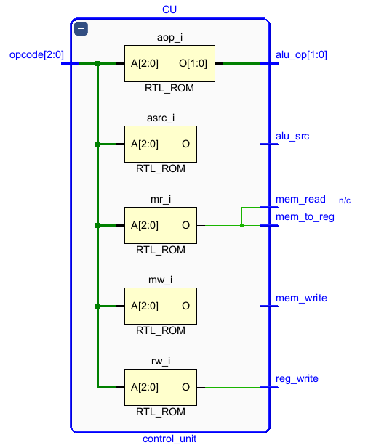
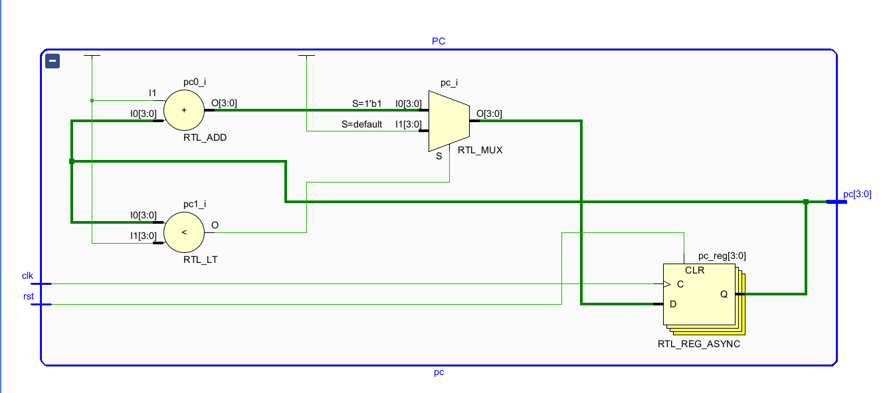
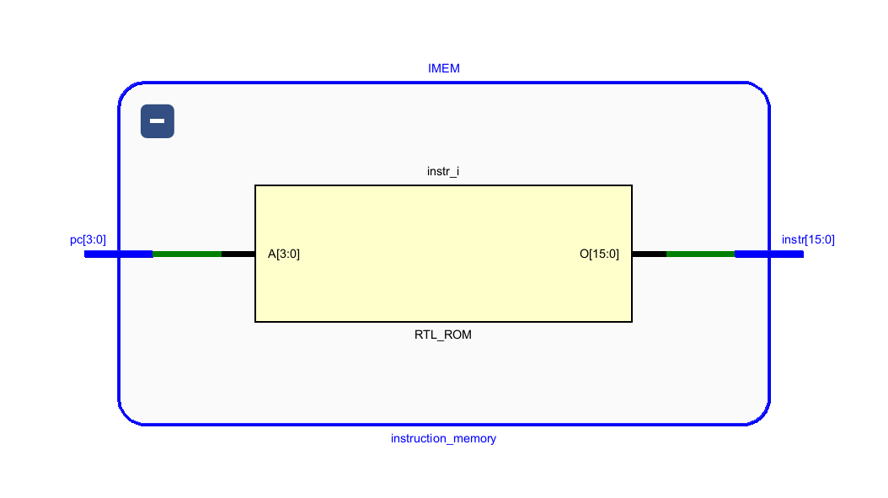
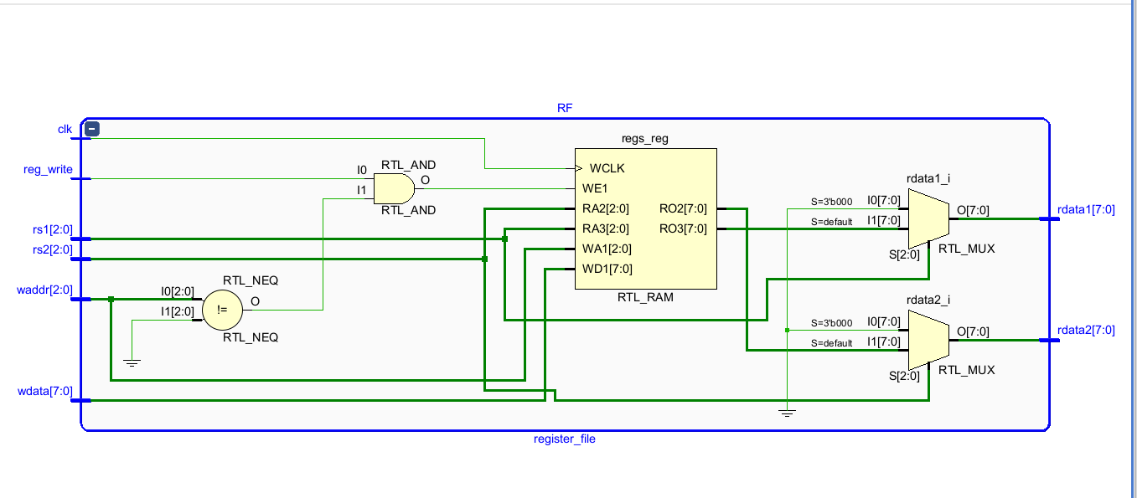
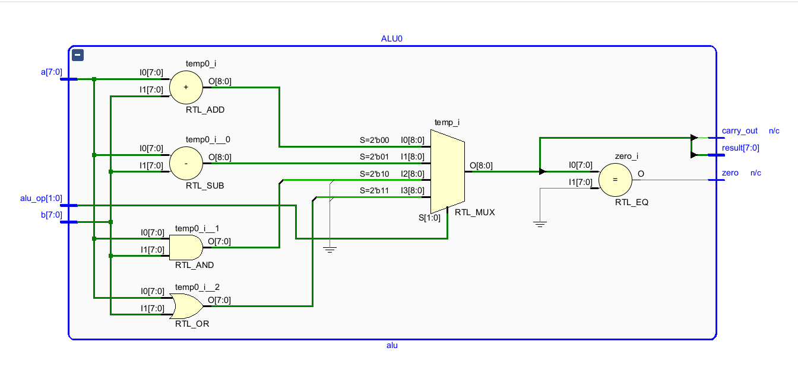
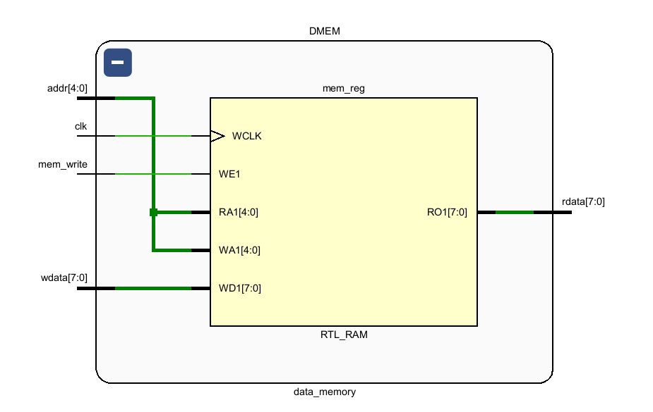
RTL STRUCTURE
Module-Level Breakdown
pc.v
instruction_memory.v
control_unit.v
Program Counter
Instruction ROM
Control Unit
4-bit counter; increments each clock, resets to 0, saturates at 15.
16 × 16-bit words, preloaded with the sample program, word-addressed by PC.
Combinational decoder: opcode → 5 control signals + 2-bit alu_op.
register_file.v
alu.v
data_memory.v
Register File
ALU
Data Memory
8 × 8-bit regs, 2 combinational read ports, 1 synchronous write port. R0 = 0.
9-bit internal adder catches carry-out; supports ADD / SUB / AND / OR.
32 × 8-bit RAM, combinational read + synchronous write, preloaded test data.
RISC-V PROCESSOR — INTERNSHIP PROJECT
06

Slide 8
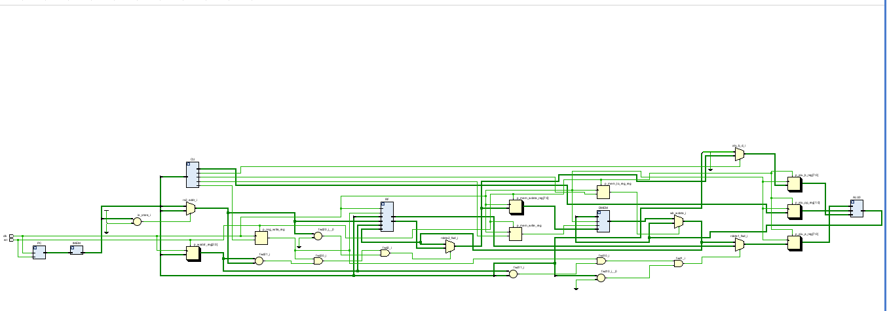
RTL Schematic - Xilinix Vivado

Slide 9
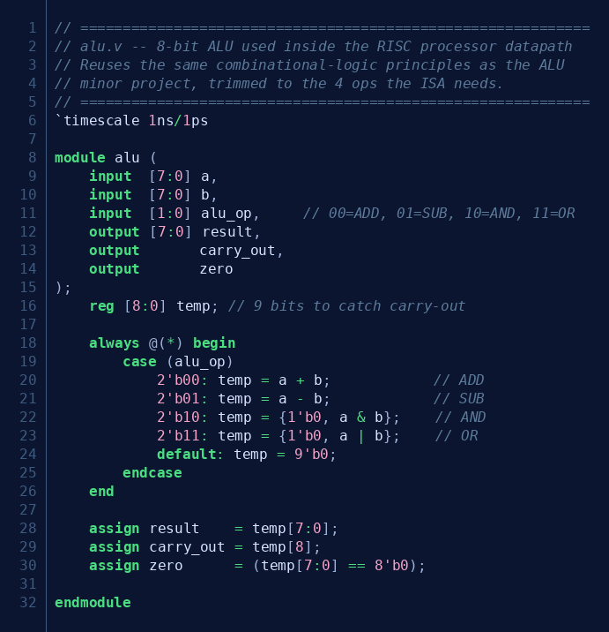
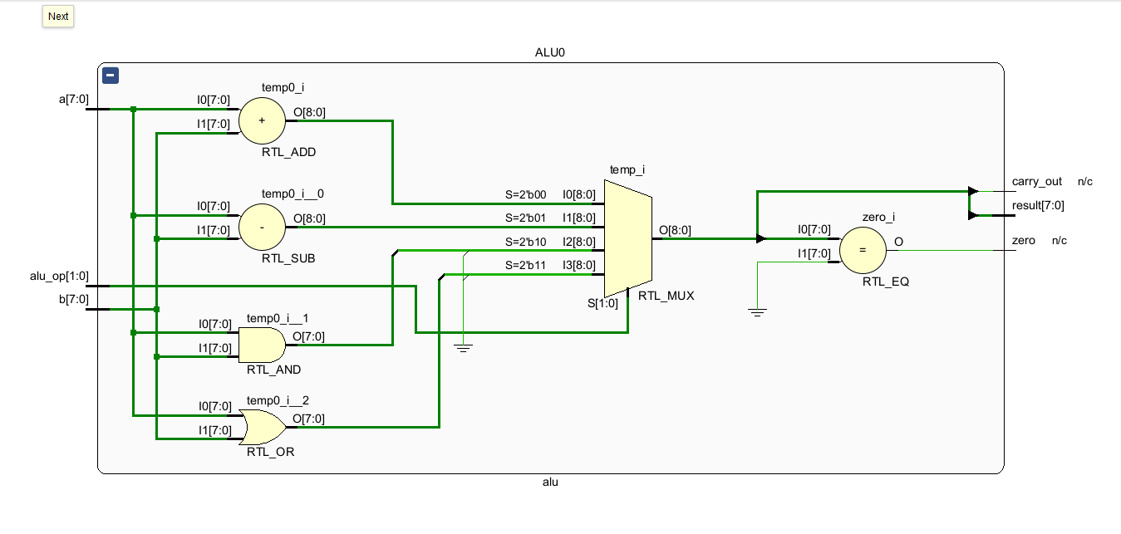
RTL CODE SPOTLIGHT
alu.v — Combinational Logic Core
9-bit internal `temp` register — the extra MSB captures carry-out from ADD without any separate adder hardware.
Reuses the same combinational case-statement style as the earlier 8-bit ALU minor project, trimmed to the 4 ops this ISA needs.
`zero` flag is derived combinationally for potential branch/comparison extensions.
Purely combinational (`always @(*)`) — fits entirely within the single-cycle datapath with no extra latency.
Design notes
RISC-V PROCESSOR — INTERNSHIP PROJECT
07

Slide 10
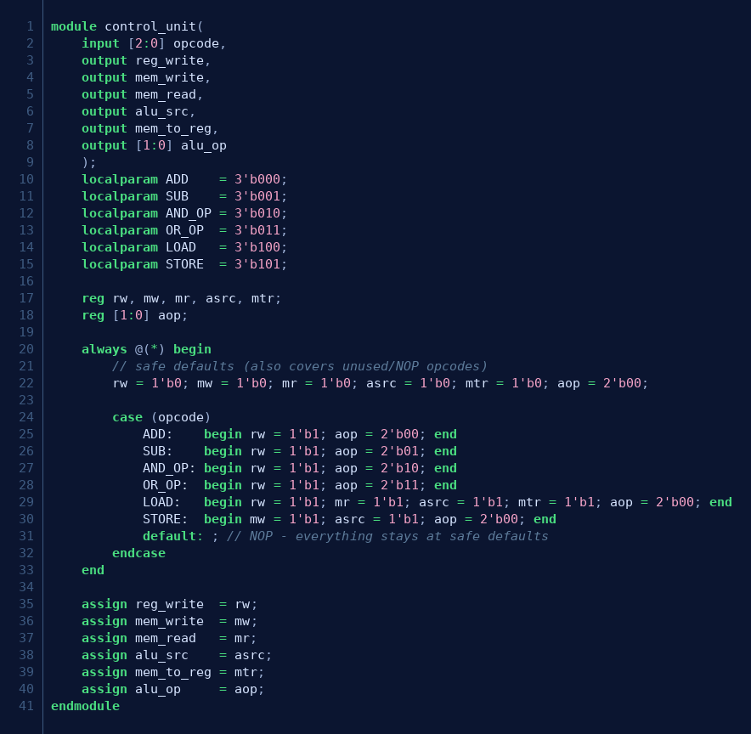
RTL CODE SPOTLIGHT
Pure combinational decoder — one `case` on the 3-bit opcode drives all five control signals plus `alu_op`.
Safe defaults at the top of the always-block mean any unused opcode (5–7) quietly decodes as a harmless NOP.
LOAD asserts `mem_read`, `alu_src` (base+offset addressing) and `mem_to_reg` together — three signals, one decode.
STORE is the only instruction that needs `mem_write` instead of `reg_write`.
control_unit.v — Instruction Decode
Design notes
RISC-V PROCESSOR — INTERNSHIP PROJECT
08

Slide 11
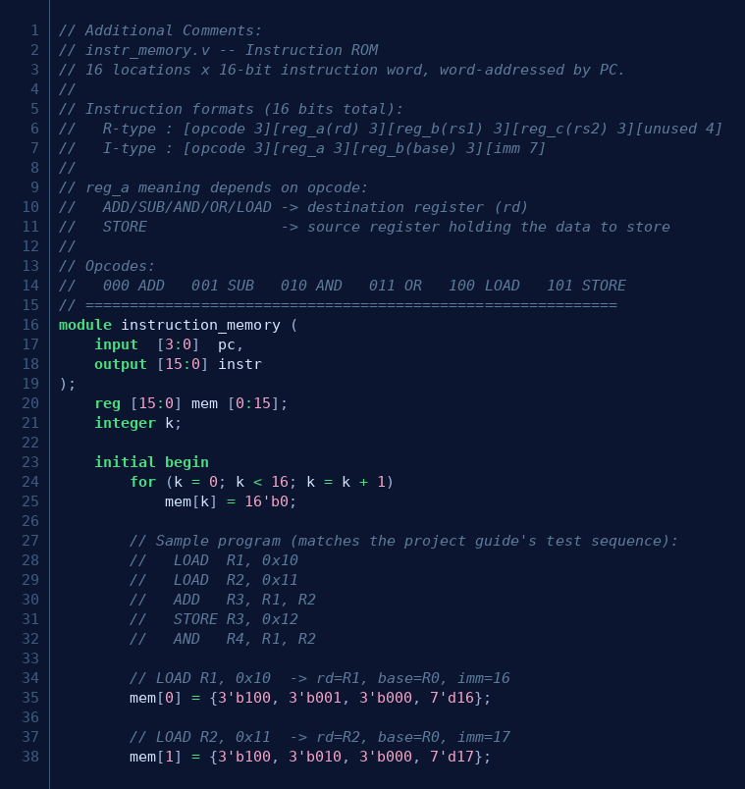
TEST PROGRAM
Sample Program Loaded into Instruction ROM
Program walk-through
LOAD R1, 0x10
R1 ← Mem[16] = 5
LOAD R2, 0x11
R2 ← Mem[17] = 10
ADD R3, R1, R2
R3 ← 5 + 10 = 15
STORE R3, 0x12
Mem[18] ← 15
AND R4, R1, R2
R4 ← 5 & 10 = 0
This exact 5-instruction sequence is used to verify both the single-cycle and the pipelined designs, so their results can be compared directly.
RISC-V PROCESSOR — INTERNSHIP PROJECT
09

Slide 12
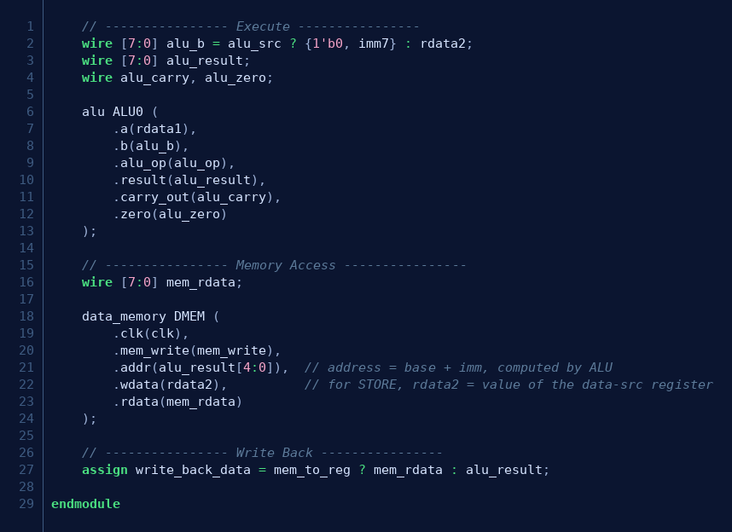
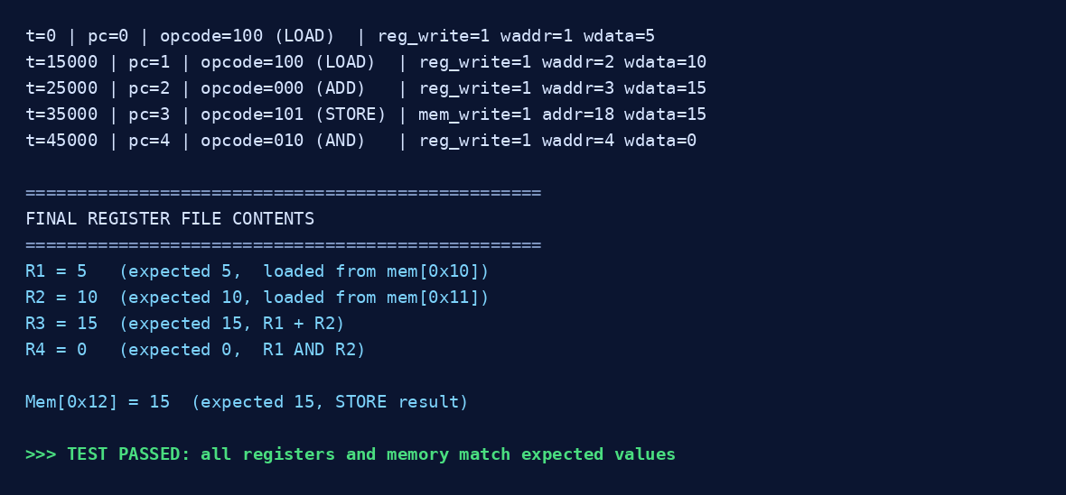
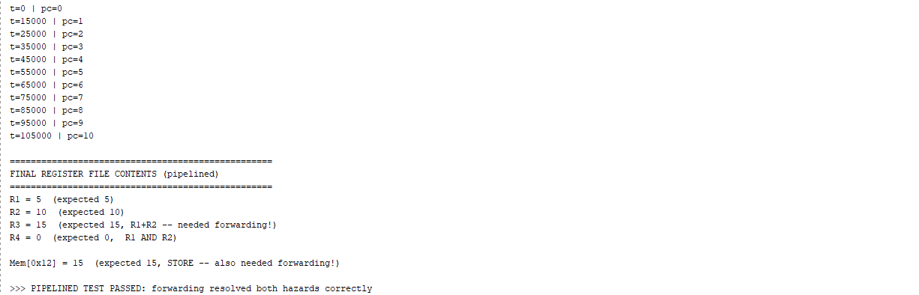
VERIFICATION — SINGLE-CYCLE
risc_top.v Wiring & Simulation Pass
Execute → Memory → Write-Back wiring inside risc_top.v
RISC-V PROCESSOR — INTERNSHIP PROJECT
10

Slide 13
Control Signal Truth Table
reg_write→ 1 if the instruction writes a result back to the register file
mem_write → 1 for STORE (writes ALU-computed address/data into data memory)
mem_read→ 1 for LOAD (data memory is combinationally readable in this design)
alu_src → 0 = ALU operand B comes from register file (R-type)
1 = ALU operand B comes from immediate (LOAD/STORE address calculation)
mem_to_reg→ 0= write-back from ALU result
1= write-back from memory (LOAD only)
alu_op → selects ALU operation: - `00` = ADD ,`01` = SUB ,`10` = AND ,`11` = OR ,LOAD/STORE always use ADD (base + immediate)
Opcode | Instr | reg_write | mem_write | mem_read | alu_src | mem_to_reg | alu_op
000 | ADD | 1 | 0 | 0 | 0 | 0 | 00
001 | SUB | 1 | 0 | 0 | 0 | 0 | 01
010 | AND | 1 | 0 | 0 | 0 | 0 | 10
011 | OR | 1 | 0 | 0 | 0 | 0 | 11
100 | LOAD | 1 | 0 | 1 | 1 | 1 | 00
101 | STORE | 0 | 1 | 0 | 1 | 0 | 00
RISC-V PROCESSOR — INTERNSHIP PROJECT
10

Slide 14
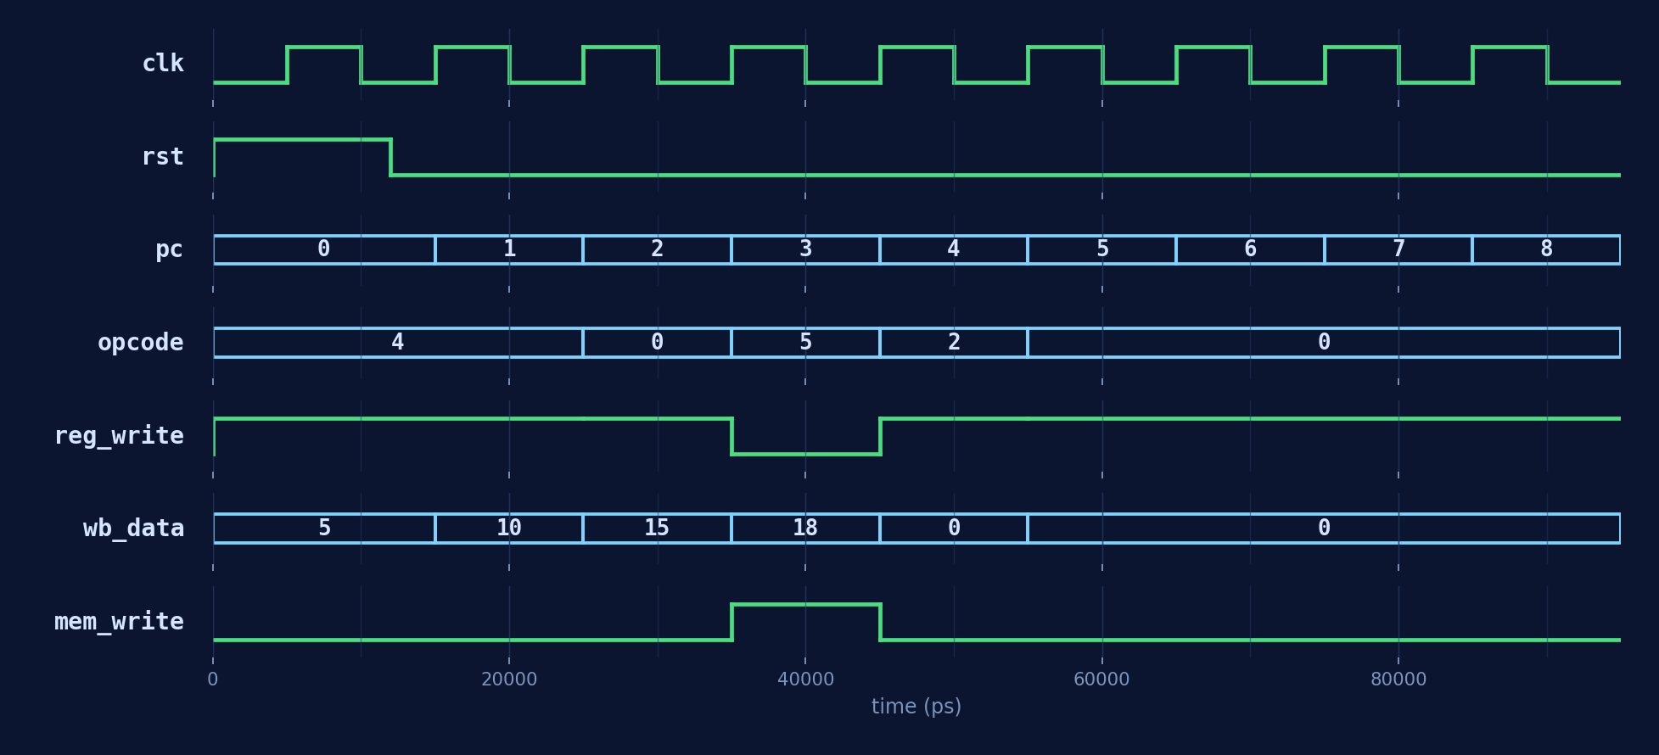
VERIFICATION — SINGLE-CYCLE
Simulation Waveform (Icarus Verilog)
PASS — PC advances 0→8 across five instructions; each LOAD / ADD / AND drives reg_write with the correct write-back value, and STORE asserts mem_write for exactly one cycle.
RISC-V PROCESSOR — INTERNSHIP PROJECT
11

Slide 15
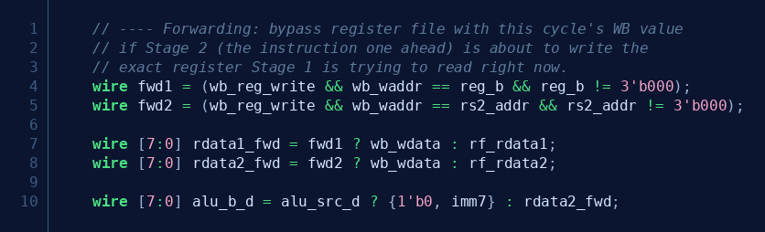
GOING FURTHER
From Single-Cycle to a 2-Stage Pipeline
Splitting the datapath into Stage 1 (Fetch + Decode) and Stage 2 (Execute + Memory + Write-Back) lets a second instruction start before the first finishes — but creates a data hazard.
The Hazard
The Fix — Forwarding
ADD R3,R1,R2 (Stage 1: reading R1,R2)
STORE R3,0x12 (Stage 1, one cycle later)
Since this ISA has no branches, instead of stalling, the write-back value is bypassed directly into Stage 1's register reads the moment it's available — same cycle, no bubble.
STORE needs R3 — but ADD's result is still finishing in Stage 2 of the SAME cycle. The register file hasn't been written yet.
risc_top_pipelined.v — forwarding mux logic
RISC-V PROCESSOR — INTERNSHIP PROJECT
12

Slide 16
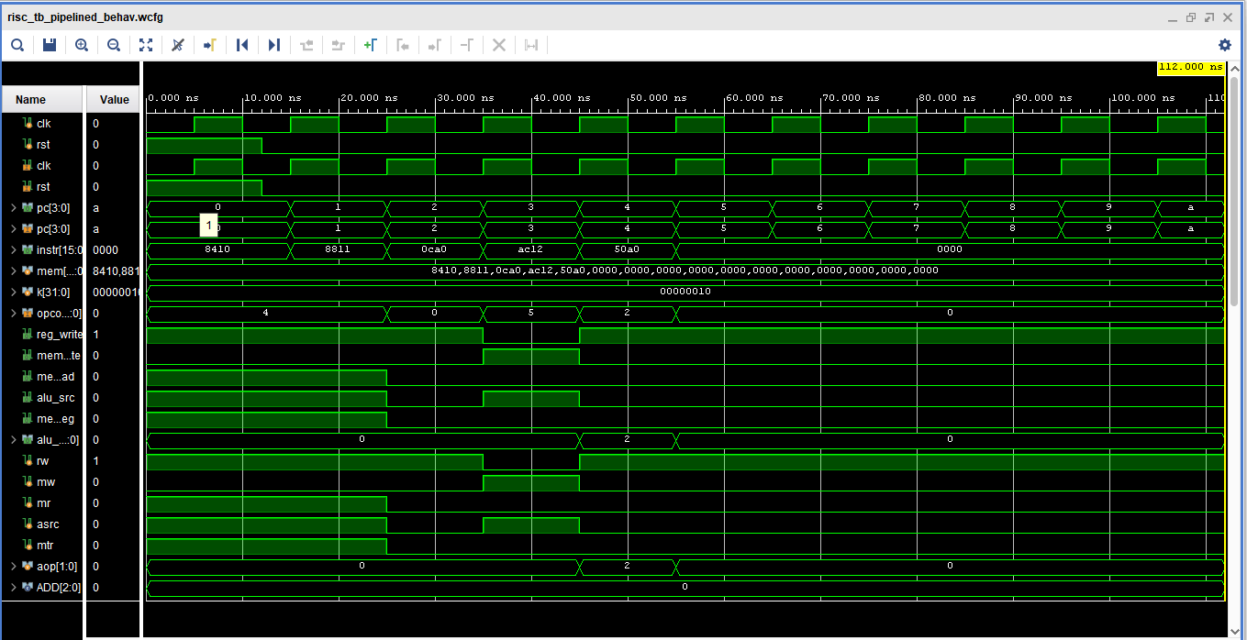
VERIFICATION — PIPELINED
Forwarding Resolves Both Hazards
PASS
Write-back now lands one cycle after each instruction enters the pipeline (wb_waddr/wb_wdata trail pc by one step) — yet R3 = 15 and Mem[0x12] = 15 still come out correct, proving the forwarding paths caught both the ADD→STORE and the LOAD→ADD hazards.
13

Slide 17
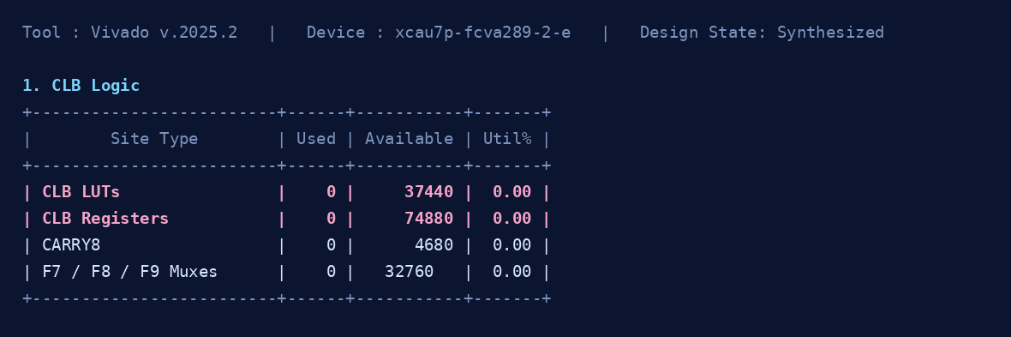
IMPLEMENTATION
Synthesis in Vivado — A Key Lesson
risc_top_pipelined_utilization_synth.rpt • Target: xcau7p-fcva289-2-e
Why does it report 0 LUTs?
Takeaway
risc_top / risc_top_pipelined expose only clk and rst — there are no output ports carrying results off-chip. With nothing observable at the boundary, Vivado's synthesis optimizer treats the entire datapath as logic with no effect on any output and trims it away entirely.
Functional correctness in simulation does not guarantee a meaningful synthesis result — testbench-only designs need real I/O boundaries before utilization numbers mean anything.
Fix: add observable output ports (e.g. expose a register/ALU result, or instantiate inside a wrapper that drives LEDs/registers), then re-run synthesis to see the true LUT/FF/CARRY8 count.
RISC-V PROCESSOR — INTERNSHIP PROJECT
14

Slide 18
REFLECTION
Key Learnings & Challenges
Datapath integration
Forwarding vs Stalling
Wiring six independently-correct modules together surfaces bugs that unit tests never see — bus-width mismatches and signal-name typos in particular.
Because this ISA has no branches or multi-cycle ops, forwarding alone was enough — a stall/bubble mechanism would only be needed for a longer pipeline.
Hazard Awareness
Simulation ≠ synthesis
Pipelining isn't just "split the logic in half" — every shared resource (the register file) becomes a place where timing assumptions can silently break.
A self-checking testbench passing in Icarus Verilog says nothing about what survives synthesis optimization — the 0-LUT report was the clearest proof of that.
RISC-V PROCESSOR — INTERNSHIP PROJECT
15

Slide 19
Mentor Deliverable Checklist
✓
ISA document: instruction formats, opcode table, register file specification. Slide 5
✓
Execution cycle count per instruction (for performance analysis). Slide 13
✓
Block diagram: full datapath with all modules and signal connections labeled. Slide 6, 7
✓
Final report: design decisions, challenges faced, results, and future scope. Slides 3–18
✓
Verilog source: all component modules + top-level integration file (risc_top.v). Slides 6–11
✓
RTL schematic generated from Vivado or Quartus. Slide 8
✓
Testbench: instruction program covering ADD, SUB, AND, OR, LOAD, STORE. Slides 9–12
✓
Optimization report: LUT count, timing analysis .(power & implementation) Slides 12,17
✓
Simulation waveforms: PC progression, register updates, memory access. Slide8-11
✓
Pipeline enhancement (2-stage: Fetch + Execute) — bonus improvement. Slides 15
✓
Control signal truth table: one row per instruction. Slide 13 (ISA table)
✓
GitHub repository with code, testbench, and README
https://github.com/vaibhavshromani/8_bit_RISC_V
RISC-V PROCESSOR — INTERNSHIP PROJECT
15

Slide 20
WRAP-UP
Conclusion & Future Scope
Conclusion
Future Scope
Designed a working 8-bit processor from scratch around a custom 16-bit ISA — 6 instructions, 2 instruction formats.
Verified both a single-cycle and a 2-stage pipelined implementation with self-checking Verilog testbenches in Icarus Verilog.
Confirmed data-forwarding correctly resolves RAW hazards introduced by pipelining, with identical final state in both versions.
Carried the design through Vivado synthesis and learned to interpret (and explain) a utilization report.
Add branch / jump instructions, which would require real hazard detection (stalls), not just forwarding.
Extend the pipeline to 5 stages (IF/ID/EX/MEM/WB) for a closer match to classic RISC architectures.
Expose proper top-level I/O so Vivado synthesis reports meaningful LUT / FF / timing numbers.
Target an FPGA board for a live hardware demo of program execution.
RISC-V PROCESSOR — INTERNSHIP PROJECT
16

Slide 21
Thank You
Vaibhav Shromani
Electronics & Communication Engineering
Maulana Azad National Institute Of Technology, Bhopal
VLSI Domain – Major Project
TechnGlobal Industrial Training Program | May-June 2026
TECHNGLOBAL PRIVATE LIMITED | info@technglobal.in | www.technglobal.in

