Slide 1
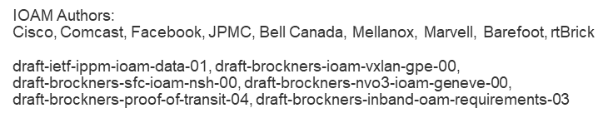
In-situ OAM @ IETF
November 8, 2017

Slide 2


How to send OAM information in packet networks?
“On-Board Unit”
Speed control by police car
In-band OAM
OAM traffic embedded in the data traffic but not part of the payload of the packet
OAM “effected by data traffic”
Example: IPv4 route recording
Out-of-band OAM
OAM traffic is sent as dedicated traffic, independent from the data traffic (“probe traffic”)
OAM “not effected by data traffic”
Examples: Ethernet CFM (802.1ag), Ping, Traceroute
Notes:
Note the difference to transport OAM (SDH/SONET):
In SONET/SDH there is a constant flow of frames
OAM is a bit-stream/data between the data encoding sublayer and the physical media and present in every frame, but not part of the data payload
This mode of OAM transport is often referred to as “out of band”, because OAM has it’s own “channel” – but still resides side by side with the payload data (if present)

Slide 3
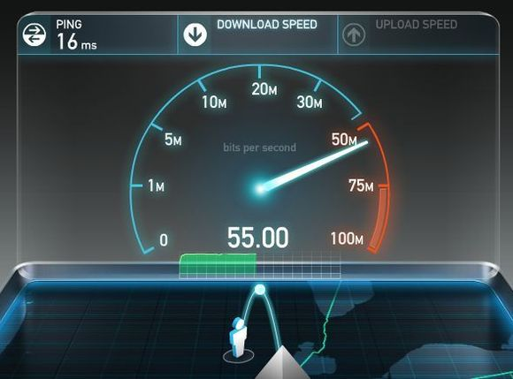
In-situ OAM - Motivation
Multipath Forwarding – debug ECMP networks
Service/Path Verification – prove that traffic follows a pre-defined path
Service/Quality Assurance – Prove traffic SLAs, as opposed to probe-traffic SLAs; Overlay/Underlay
Derive Traffic Matrix
Custom/Service Level Telemetry
“Most large ISP's prioritize Speedtest traffic and I would even go as far to say they probably route it faster as well to keep ping times low.”
Source: https://www.reddit.com/r/AskTechnology/comments/2i1nxc/ can_i_trust_my_speedtestnet_results_when_my_isp/

Slide 4
What if you could collect operational meta-data within your traffic?
Example use-cases...
Path Tracing for ECMP networks
Service/Path Verification
Derive Traffic Matrix
SLA proof: Delay, Jitter, Loss
Custom data: Geo-Location,..
Meta-data required...
Node-ID, ingress i/f, egress i/f
Proof of Transit (random, cumulative)
Node-ID
Sequence numbers, Timestamps
Custom meta-data

Slide 5

In-Band OAM (iOAM) in a Nutshell
Gather telemetry and OAM information along the path within the data packet, (hence “in-band OAM”) as part of an existing/additional header
No extra probe-traffic (as with ping, trace, IPSLA)
Transport options
IPv6: Native v6 HbyH extension header or double-encap
VXLAN-GPE: Embedded telemetry protocol header
NSH: Type-2 Meta-Data ... additional encapsulations being considered/WIP (incl. SRv6, IPv4, MPLS)
Deployment
Domain-ingress, domain-egress, and select devices within a domaininsert/remove/update the extension header
Information export via IPFIX/Flexible-Netflow/publish into Kafka
Fast-path implementation
Ingress/Egress I/F, ..
Generic customer data
Sequence number
Timestamp, Delay,..
Proof of Transit
Node-ID,..
Hdr
OAM
Payload
iOAM domain

Slide 6



Update SCV meta-data
Insert SCV meta-data
B
3
6
SCV Verifier
IPFIX
4
Update SCV meta-data
A
Hdr
2
D
Payload
1
5
Hdr
Hdr
Payload
C
Hdr
r=45/c=39
Hdr
Update SCV meta-data
r=45/c=17
B
6
SCV meta-data
r=45/c=0
C
4
Path-tracing data
C
4
A
1
A
1
Payload
A
1
Payload
Payload

Slide 7
In-Band OAM: Information carried
Per node scope
Hop-by-Hop information processing
Device_Hop_L
Node_ID
Ingress Interface ID
Egress Interface ID
Time-Stamp
Application Meta Data
Set of nodes scope
Hop-by-Hop information processing
Service Chain Validation (Random, Cumulative)
Edge to Edge scope
Edge-to-Edge information processing
Sequence Number

Slide 8
Tracing Option
Bit 0 | 0 1 2 3 4 5 6 7 8 9 0 1 2 3 4 5 6 7 8 9 0 1 2 3 4 5 6 7 8 9 0 1 +-+-+-+-+-+-+-+-+-+-+-+-+-+-+-+-+-+-+-+-+-+-+-+-+-+-+-+-+-+-+-+-+ | Hop_Lim | node_id | +-+-+-+-+-+-+-+-+-+-+-+-+-+-+-+-+-+-+-+-+-+-+-+-+-+-+-+-+-+-+-+-+
Bit 1 | 0 1 2 3 4 5 6 7 8 9 0 1 2 3 4 5 6 7 8 9 0 1 2 3 4 5 6 7 8 9 0 1 +-+-+-+-+-+-+-+-+-+-+-+-+-+-+-+-+-+-+-+-+-+-+-+-+-+-+-+-+-+-+-+-+ | ingress_if_id | egress_if_id | +-+-+-+-+-+-+-+-+-+-+-+-+-+-+-+-+-+-+-+-+-+-+-+-+-+-+-+-+-+-+-+-+
Bit 2 | 0 1 2 3 4 5 6 7 8 9 0 1 2 3 4 5 6 7 8 9 0 1 2 3 4 5 6 7 8 9 0 1 +-+-+-+-+-+-+-+-+-+-+-+-+-+-+-+-+-+-+-+-+-+-+-+-+-+-+-+-+-+-+-+-+ | timestamp seconds | +-+-+-+-+-+-+-+-+-+-+-+-+-+-+-+-+-+-+-+-+-+-+-+-+-+-+-+-+-+-+-+-+
Bit 3 | 0 1 2 3 4 5 6 7 8 9 0 1 2 3 4 5 6 7 8 9 0 1 2 3 4 5 6 7 8 9 0 1 +-+-+-+-+-+-+-+-+-+-+-+-+-+-+-+-+-+-+-+-+-+-+-+-+-+-+-+-+-+-+-+-+ | timestamp nanoseconds | +-+-+-+-+-+-+-+-+-+-+-+-+-+-+-+-+-+-+-+-+-+-+-+-+-+-+-+-+-+-+-+-+
Bit 4 | 0 1 2 3 4 5 6 7 8 9 0 1 2 3 4 5 6 7 8 9 0 1 2 3 4 5 6 7 8 9 0 1 +-+-+-+-+-+-+-+-+-+-+-+-+-+-+-+-+-+-+-+-+-+-+-+-+-+-+-+-+-+-+-+-+ | transit delay | +-+-+-+-+-+-+-+-+-+-+-+-+-+-+-+-+-+-+-+-+-+-+-+-+-+-+-+-+-+-+-+-+
Bit 5 | 0 1 2 3 4 5 6 7 8 9 0 1 2 3 4 5 6 7 8 9 0 1 2 3 4 5 6 7 8 9 0 1 +-+-+-+-+-+-+-+-+-+-+-+-+-+-+-+-+-+-+-+-+-+-+-+-+-+-+-+-+-+-+-+-+ | application data | +-+-+-+-+-+-+-+-+-+-+-+-+-+-+-+-+-+-+-+-+-+-+-+-+-+-+-+-+-+-+-+-+
Bit 15 | Long format of data elements
0 1 2 3
0 1 2 3 4 5 6 7 8 9 0 1 2 3 4 5 6 7 8 9 0 1 2 3 4 5 6 7 8 9 0 1
+-+-+-+-+-+-+-+-+-+-+-+-+-+-+-+-+-+-+-+-+-+-+-+-+-+-+-+-+-+-+-+-+
| Option Type | Opt Data Len | Elements-left | Reserved1 |
+-+-+-+-+-+-+-+-+-+-+-+-+-+-+-+-+-+-+-+-+-+-+-+-+-+-+-+-+-+-+-+-+
| OAM-Trace-Type | Reserved2 |
+-+-+-+-+-+-+-+-+-+-+-+-+-+-+-+-+-+-+-+-+-+-+-+-+-+-+-+-+-+-+-+-+<-+
| | |
| Node data List [0] | |
| | |
+-+-+-+-+-+-+-+-+-+-+-+-+-+-+-+-+-+-+-+-+-+-+-+-+-+-+-+-+-+-+-+-+ D
| | a
| Node data List [1] | t
| | a
+-+-+-+-+-+-+-+-+-+-+-+-+-+-+-+-+-+-+-+-+-+-+-+-+-+-+-+-+-+-+-+-+
. . . S
+-+-+-+-+-+-+-+-+-+-+-+-+-+-+-+-+-+-+-+-+-+-+-+-+-+-+-+-+-+-+-+-+ p
| | a
| Node data List [n-1] | c
| | e
+-+-+-+-+-+-+-+-+-+-+-+-+-+-+-+-+-+-+-+-+-+-+-+-+-+-+-+-+-+-+-+-+ |
| | |
| Node data List [n] | |
| | |
+-+-+-+-+-+-+-+-+-+-+-+-+-+-+-+-+-+-+-+-+-+-+-+-+-+-+-+-+-+-+-+-+<-+

Slide 9
Proof-of-Transit Option
0 1 2 3
0 1 2 3 4 5 6 7 8 9 0 1 2 3 4 5 6 7 8 9 0 1 2 3 4 5 6 7 8 9 0 1
+-+-+-+-+-+-+-+-+-+-+-+-+-+-+-+-+-+-+-+-+-+-+-+-+-+-+-+-+-+-+-+-+
| Option Type | Opt Data Len | POT type = 0 | reserved |
+-+-+-+-+-+-+-+-+-+-+-+-+-+-+-+-+-+-+-+-+-+-+-+-+-+-+-+-+-+-+-+-+<-+
| Random | |
+-+-+-+-+-+-+-+-+-+-+-+-+-+-+-+-+-+-+-+-+-+-+-+-+-+-+-+-+-+-+-+-+ P
| Random(contd) | O
+-+-+-+-+-+-+-+-+-+-+-+-+-+-+-+-+-+-+-+-+-+-+-+-+-+-+-+-+-+-+-+-+ T
| Cumulative | |
+-+-+-+-+-+-+-+-+-+-+-+-+-+-+-+-+-+-+-+-+-+-+-+-+-+-+-+-+-+-+-+-+ |
| Cumulative (contd) | |
+-+-+-+-+-+-+-+-+-+-+-+-+-+-+-+-+-+-+-+-+-+-+-+-+-+-+-+-+-+-+-+-+<-+

Slide 10
Edge-to-Edge Option
0 1 2 3
0 1 2 3 4 5 6 7 8 9 0 1 2 3 4 5 6 7 8 9 0 1 2 3 4 5 6 7 8 9 0 1
+-+-+-+-+-+-+-+-+-+-+-+-+-+-+-+-+-+-+-+-+-+-+-+-+-+-+-+-+-+-+-+-+
| Option Type | Opt Data Len | IOAM-E2E-Type | reserved |
+-+-+-+-+-+-+-+-+-+-+-+-+-+-+-+-+-+-+-+-+-+-+-+-+-+-+-+-+-+-+-+-+
| E2E Option data format determined by IOAM-E2E-Type |
+-+-+-+-+-+-+-+-+-+-+-+-+-+-+-+-+-+-+-+-+-+-+-+-+-+-+-+-+-+-+-+-+
Option Type: 000xxxxxx 8-bit identifier of the type of option.
Opt Data Len: 8-bit unsigned integer. Length of the Option Data field of this option, in octets.
iOAM-E2E-Type: 8-bit identifier of a particular iOAM E2E variant.
0: E2E option data is 64-bit Per Packet Counter (PPC) used to identify packet loss and reordering.
Reserved: 8-bit. (Reserved Octet) Reserved octet for future use.g

Slide 11
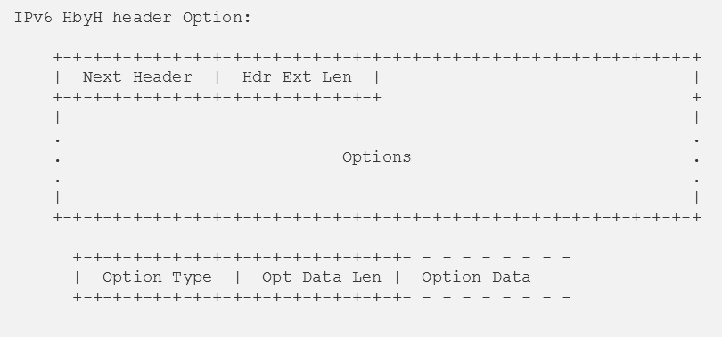
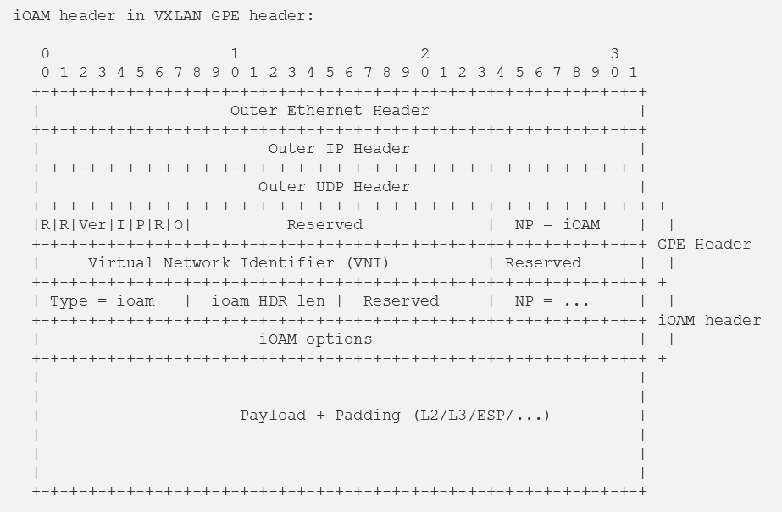
Transport Options – IPv6, VXLAN-GPE, SRv6, NSH...
IPv6: v6 HbyH extension header
VXLAN-GPE: Embedded telemetry protocol header; Combines with NSH etc.
SRv6: In-Band OAM TLV in v6 SR-header SRH (proof-of-transit only)
NSH: Type-2 Meta-Data (proof-of-transit only)
... more to come: MPLS, IPv4,...

Slide 12







Running Code: Experimental OpenSource Implementation
Open source experimental Implementation
FD.io/VPP (see fd.io) – encapsulations: IPv6, VXLAN-GPE, NSH
OpenDaylight Control App (proof of transit / tracing)
Chipset vendors supporting IOAM
Demo Videos: Google+ In-Band OAM group Youtube In-Band OAM channel

Slide 13
Demos at IETF BnB

Slide 14









Visualization & Analytics
iOAM event control
Elasticsearch Logstash Kafka
iOAM visualization
Apache Kafka
OpenDaylight – iOAM6/SCV app
pmacct
Data Export IPFIX, kafka
Control Telemetry/ OAM data
iOAM6: encap
iOAM6: Transit
iOAM6: Decap & Verify
Path Verified
2
VPP
4
Host 2
VPP
Node B
VPP
Host 1
Node A
1
3
Node C Verifier
VPP
Node D
Host 3
Hdr
Hdr
Hdr
Hdr
Payload
r=45/c=0
r=45/c=17
Payload
D
3
A
1
A
1
Payload
Payload

Slide 15
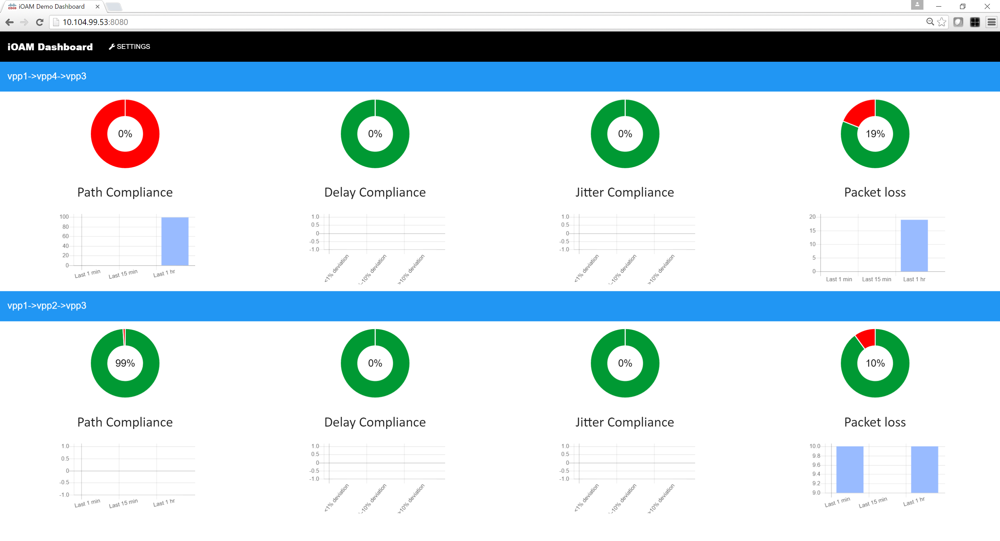
Use-cases
M-anycast Smart service selection – combining SRv6 and in-situ OAM
In-situ OAM based active network probing
VXLAN-GPE Overlay-Underlay Tracing and SLA Check
2
1
S1
0
5
3
C
C1
0
4
2
S2
1
6
B
B
A
A
A
4
3
S3
VXLAN-GPE
Server
B
Measure transit delays, server loads, choose optimal service for client and steer connection using SRv6
UDP probe configured among all edge nodes (0,1,5,6). Server collects summarized probe info from all edge nodes
A
D
C

Slide 16
What is happening at IETF100?
Data draft adopted in IPPM wg
Transport -00 for NSH, VXLAN-GPE, GENEVE
IETF 100 hackathon
VPP and p4 implementation interop
IOAM on barefoot ASIC

