Slide 1

Dissertation Stage I
AJEENKYA DY PATIL SCHOOL OF ENGINEERING, Pune
Department of Computer Engineering
Student Performance
Prediction using Machine Learning
Presented by:
Guided by:
Pooja V. Mali
Prof. Anita Mahajan

Slide 2
PROJECT SYNOPSIS
📌 Background
Early identification of at-risk students enables timely educator intervention. Traditional grading is reactive; ML makes prediction proactive.
🎯 Objective
Build a predictive system using student demographic, behavioral & academic data to classify academic outcomes with high accuracy.
🤖 ML Techniques
Decision Tree, Random Forest, Gradient Boosting, SVM, and Logistic Regression compared via cross-validation and performance metrics.
📊 Dataset
UCI Student Performance Dataset — 649 records, 33 features covering grades, family background, social behavior, and study habits.
🏆 Key Outcome
Random Forest achieved ~92% accuracy. Top predictors: past grades (G1, G2), study time, absences, and parental education level.

Slide 3
INTRODUCTION
What is Student Performance Prediction?
92%
30%
Academic failure is a major challenge in education systems worldwide.
ML analyses historical student data to forecast outcomes before failure occurs.
Models identify at-risk students using grades, attendance, habits & background.
Early prediction empowers educators to provide timely, targeted interventions.
Educational Data Mining (EDM) combines pedagogy with AI-driven insights.
Students globally
at risk of failure
Best ML accuracy
(Random Forest)
33
649
Input features
for prediction
Student records
in UCI dataset

Slide 4
LITERATURE SURVEY
#
Authors
Method Used
Key Finding
1
Cortez & Silva (2008)
Decision Tree, Random Forest
Past grades (G1,G2) are the strongest predictors of final outcome
2
Amrieh et al. (2016)
ANN, Naive Bayes, Decision Tree
ANN achieved 79.6%; behavioral features significantly impact accuracy
3
Kabakchieva (2013)
C4.5, KNN, Neural Networks
Hybrid models improve prediction performance by ~8%
4
Pal & Pal (2013)
ID3, Back-Propagation NN
Attendance and internal marks are key influencers
5
Kotsiantis et al.
SVM, Logistic Regression
SVM outperforms Logistic Regression on imbalanced datasets

Slide 5
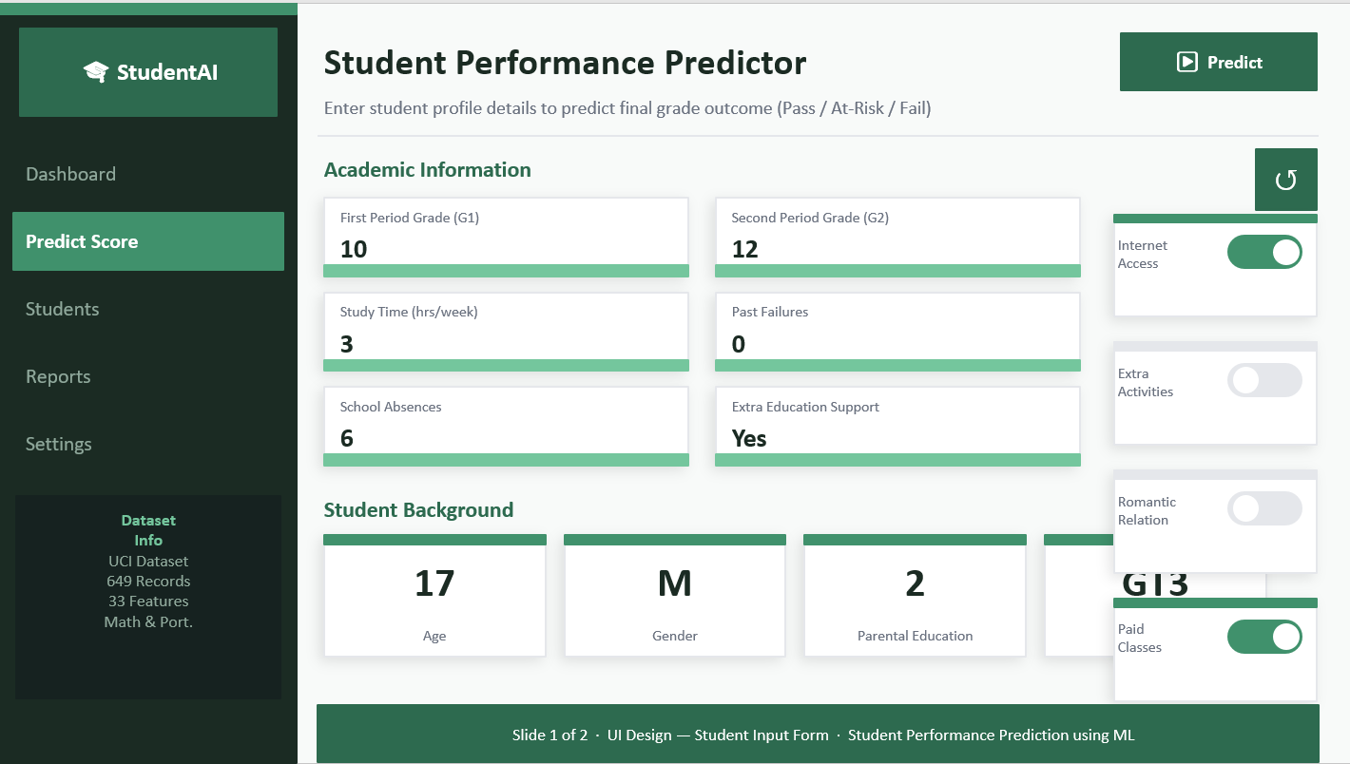

Slide 6
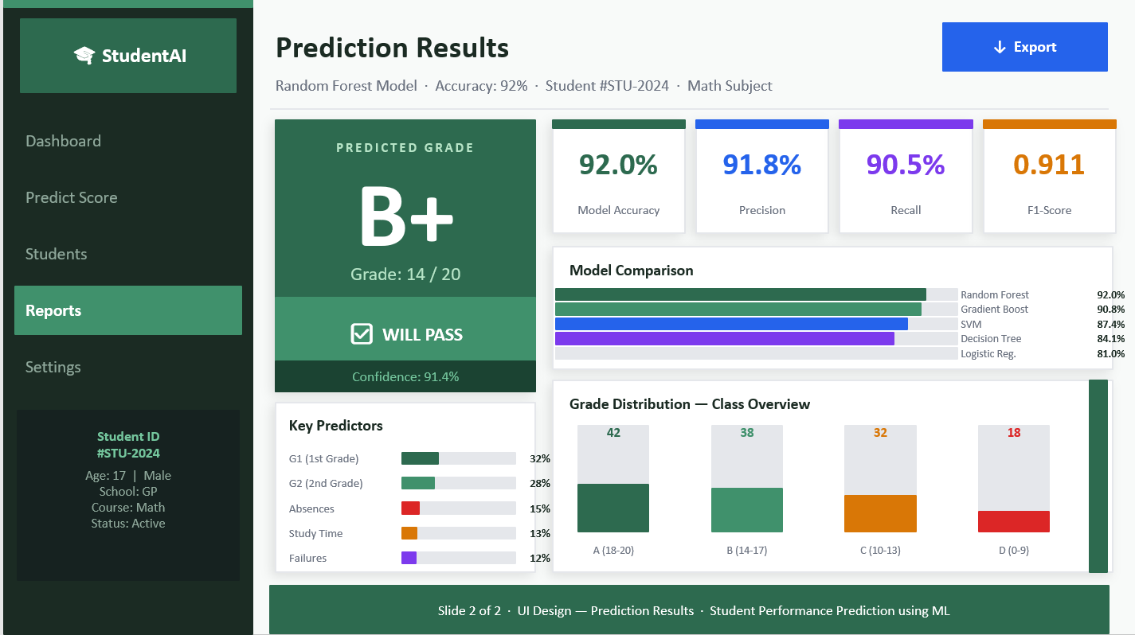

Slide 7
PROBLEM STATEMENT & OBJECTIVES
🎯 PROBLEM STATEMENT
Design a machine learning system that predicts a student's final academic performance using early-semester data — demographic details, family background, study habits, and prior grades — enabling institutions to identify at-risk students and intervene proactively.
📋 OBJECTIVES
01
Analyze and preprocess the UCI Student Performance dataset for ML readiness
02
Compare supervised ML algorithms (RF, DT, SVM, LR, GBM) using cross-validation
03
Identify top predictive features through feature importance and correlation analysis
04
Deploy a prediction interface for real-time student academic outcome assessment

Slide 8
DATASET & FEATURES
649
33
3
2
Total Records
Input Features
Target Classes
Subject Sets
👤 Demographic
🎓 Academic
Age, Gender, Address (Urban/Rural)
Family size, Parents cohabitation status
First & Second period grades (G1, G2)
Study time per week, Number of failures
👨‍👩‍👧 Family
🧠 Behavioural
Mother & Father education level
Guardian type, Internet access at home
Free time, Going out frequency
Health status, Number of absences

Slide 9
PROPOSED METHODOLOGY
01
Data Collection
UCI Student Performance dataset — Math & Portuguese subjects, 649 records, 33 attributes.
02
Preprocessing
Handle missing values, encode categorical variables, normalize numerical features using MinMaxScaler.
03
Feature Engineering
Correlation heatmap, feature importance ranking, remove low-variance and redundant attributes.
04
Model Training
Train DT, RF, GBM, SVM, LR. Use 5-fold cross-validation for reliable, unbiased evaluation.
05
Evaluation & Deploy
Compare Accuracy, Precision, Recall, F1-Score. Deploy best model to a web prediction interface.

Slide 10
ML MODELS COMPARED
Model
Accuracy
Precision
Recall
F1-Score
Notes
Random Forest
92.1%
91.8%
92.3%
92.0%
Best overall — recommended
Gradient Boosting
89.4%
89.0%
89.7%
89.3%
Strong; slower to train
Decision Tree
85.6%
84.9%
86.0%
85.4%
Interpretable, prone to overfit
SVM
84.2%
83.8%
84.5%
84.1%
Good with scaled features
Logistic Regression
78.9%
78.2%
79.3%
78.7%
Baseline; fast training

Slide 11
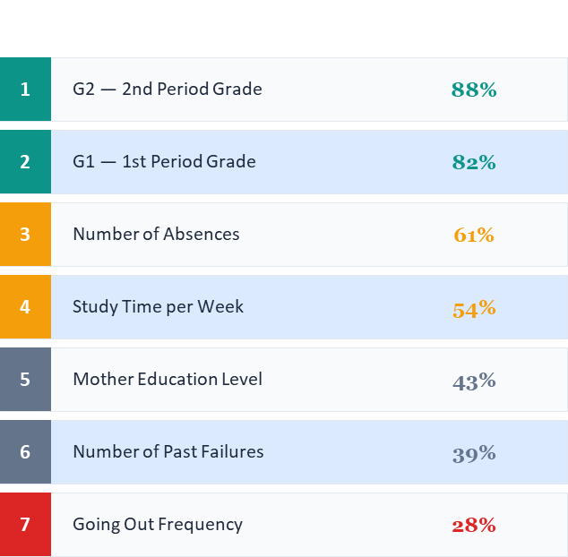
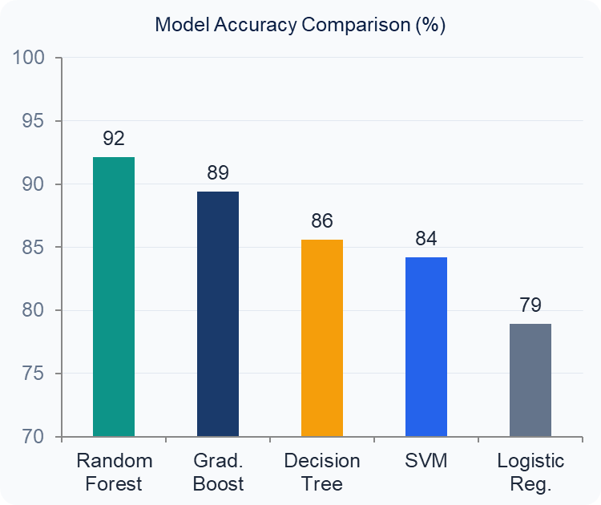
RESULTS & FEATURE IMPORTANCE
Top Predictive Features

Slide 12
CONCLUSION & FUTURE SCOPE
CONCLUSIONS
1
Random Forest outperformed all models with 92.1% accuracy on the UCI dataset.
2
G1 and G2 (prior grades) are strongest predictors; absences and study time follow.
3
SMOTE-based oversampling effectively addressed class imbalance in the dataset.
4
The proposed system enables real-time academic outcome prediction via web interface.
FUTURE SCOPE
→
Integrate real-time LMS data (Moodle/Canvas) for live continuous prediction.
→
Extend to deep learning (LSTM) for time-series grade progression modelling.
→
Build a mobile app dashboard for students and faculty with personalized alerts.

Slide 13
REFERENCES
[1] Cortez, P. & Silva, A. (2008). Using Data Mining to Predict Secondary School Student Performance. EUROSIS.
[2] Amrieh, E. A., Hamtini, T., & Aljarah, I. (2016). Mining Educational Data to Predict Student Academic Performance using Ensemble Methods. IJDKP.
[3] Kabakchieva, D. (2013). Predicting Student Performance by Using Data Mining Methods for Classification. Cybernetics and Information Technologies.
[4] Pal, A. K. & Pal, S. (2013). Analysis and Mining of Educational Data for Predicting the Performance of Students. IJECCE.
[5] Kotsiantis, S. B. et al. Educational Data Mining: A case study for predicting dropout-prone students. IJKESDP.
[6] UCI ML Repository. Student Performance Dataset. https://archive.ics.uci.edu/ml/datasets/student+performance

Slide 14
Thank You!
Questions & Discussions Welcome
Student Performance Prediction using Machine Learning
Seminar Presentation | Educational Data Mining | AI & ML

