Slide 1
S&P GLOBAL & CRISIL CAMPUS HACKATHON 2026
Real-Time AI Risk Signal Engine & Tactical Index Rebalancer
From unstructured news & social text to structured risk signals, and a sentiment-tilted index (Module A)
Vaibhav
IIIT Delhi · vaibhav24597@iiitd.ac.in

Slide 2
PROBLEM & APPROACH
Too much text, too little structure
Market-moving information arrives as headlines and posts. Analysts can't read it all, and keyword alerts are noisy and not comparable across companies. Goal: turn the stream into explainable numbers a portfolio can act on.
1 Read
2 Score
3 Act - Module A
News: GDELT live API + Kaggle financial news
Social: Kaggle stock tweets
Synthetic sample so the demo always runs offline
Clean, dedupe, link to 15 S&P 100 tickers
Sentiment -1..1 (FinBERT)
Event type 10 classes (rules)
Impact 1..10 (explainable formula)
One JSON signal per company per document
Decayed, impact-weighted sentiment per stock
Tilt equal weights: w = w0 · e^(k·s)
Bounds 2-15%, max 3 pts change / day
Backtest vs equal weight & S&P 500
Vaibhav · IIIT Delhi · S&P Global & Crisil Campus Hackathon 2026
2 / 7

Slide 3
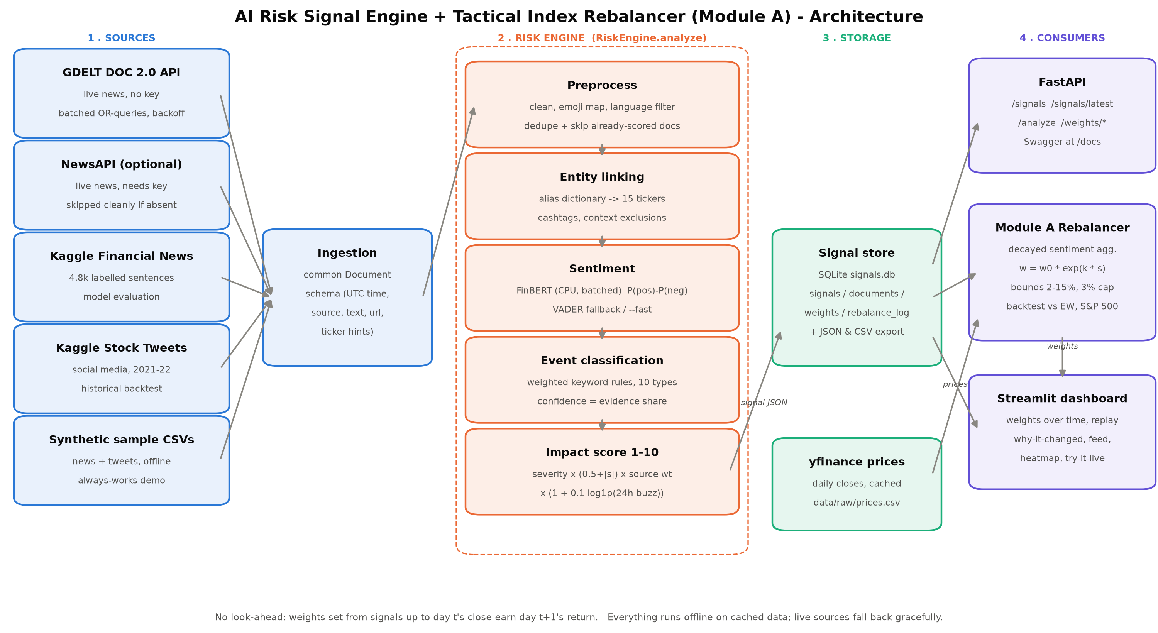
ARCHITECTURE
System design and data flow
Vaibhav · IIIT Delhi · S&P Global & Crisil Campus Hackathon 2026
3 / 7

Slide 4
KEY MODULES & WHY
Implementation highlights
FinBERT sentiment
Rule-based events
Explainable impact
Finance-tuned BERT on CPU, batched; score = P(pos) − P(neg). Cached so no text is scored twice. VADER fallback (--fast).
Weighted regex per class (credit rating, takeover, antitrust, CEO resigns…). Auditable; confidence = share of evidence.
severity[event] × (0.5+|s|) × source weight × (1+0.1·ln(1+24h buzz)), clipped 1-10. All weights in config.yaml.
Bounded rebalancer
No look-ahead
Serving
Exact solver: bisection keeps Σw = 1 with 2-15% bounds and a 3-pt turnover cap. Each change logged with its headlines.
Signals up to 4pm NY on day t set weights that earn day t+1's return. Enforced by a unit test (169 tests).
SQLite + JSON/CSV export · FastAPI (/signals, /analyze, /weights) · Streamlit dashboard · live GDELT polling.
Vaibhav · IIIT Delhi · S&P Global & Crisil Campus Hackathon 2026
4 / 7

Slide 5
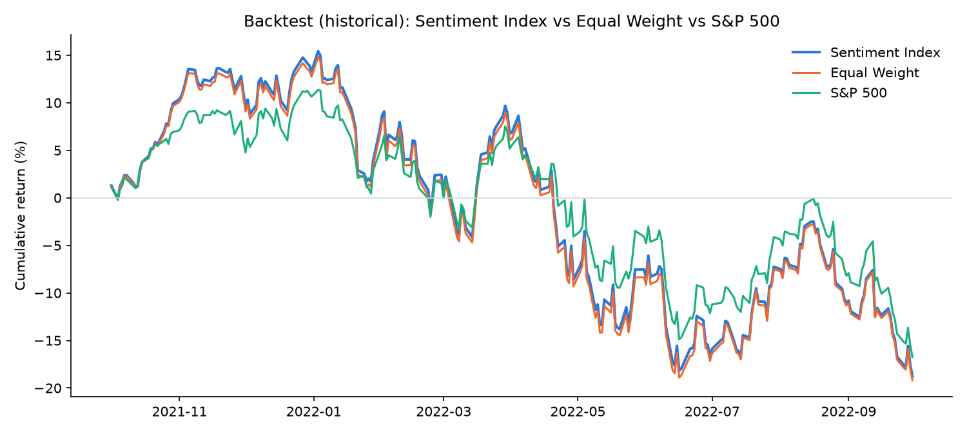
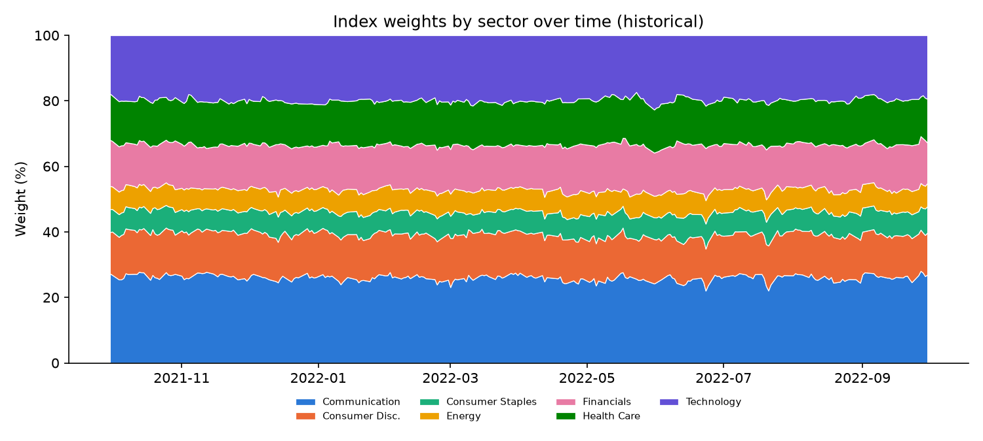
OUTPUTS & METRICS
Key results
Sentiment model (labelled financial news)
Model | Accuracy | Macro-F1
FinBERT | 88.9% | 0.882
VADER baseline | 54.4% | 0.489
n = 4,838 sentences (Kaggle / Financial PhraseBank)
Backtest (Kaggle tweets, Sep 2021 – Sep 2022)
Strategy | Return | Sharpe | Max DD
Sentiment Index | -18.8% | -0.65 | -29.6%
Equal Weight | -19.2% | -0.66 | -29.6%
S&P 500 | -16.8% | -0.73 | -25.2%
Avg daily turnover 2.3%; no transaction costs. Illustrative only.
Vaibhav · IIIT Delhi · S&P Global & Crisil Campus Hackathon 2026
5 / 7

Slide 6
DOMAIN IMPACT
Why it matters
Faster reaction
Explainable by design
A headline becomes a scored, company-tagged signal in well under a second on a laptop CPU, and live mode refreshes every 15 minutes.
Class probabilities, matched event keywords, the impact formula and the headlines behind every weight change are all visible. That fits risk and index governance.
Controlled risk
Reusable engine
Weight bounds, a turnover cap and decay to neutral stop the index from chasing one headline.
The same API feed can drive watch-lists, credit early-warning, or stress-testing scenarios (Module B), not just this index.
499 signals from 3 sources currently in data/signals.json, all served by FastAPI and the dashboard.
Vaibhav · IIIT Delhi · S&P Global & Crisil Campus Hackathon 2026
6 / 7

Slide 7
HONEST SCOPE
Limitations & next steps
Limitations
Next steps
One sentiment per document: two companies in a headline share it
Dictionary entity linking; ambiguous names need exclusion lists
Keyword event rules miss unusual phrasing (falls to “Other”)
FinBERT is trained on news; weaker on slang-heavy tweets
Backtest: one year of tweets, no transaction costs
GDELT throttling: a live poll takes 2-4 minutes
Entity-level (aspect) sentiment
Fine-tune FinBERT on labelled finance tweets
Zero-shot classifier as a second opinion on events
Transaction-cost and liquidity-aware rebalancing
Longer, multi-source history (news archives)
Module B: feed signals into stress-testing scenarios
Vaibhav · IIIT Delhi · S&P Global & Crisil Campus Hackathon 2026
7 / 7

