Slide 1
Master Thesis Kick-Off Talk
Data Modelling and Time Series Classification in Building Automation Systems
Vaibhav Swaminathan
EBC Kick-Off Talk, 06.09.2023
Notes:
<number>

Slide 2
Outline
Motivation
Challenges
Idea (Introduction to thesis topic)
Approach
Problem Statement
Notes on Evaluation
Conclusion

Slide 3
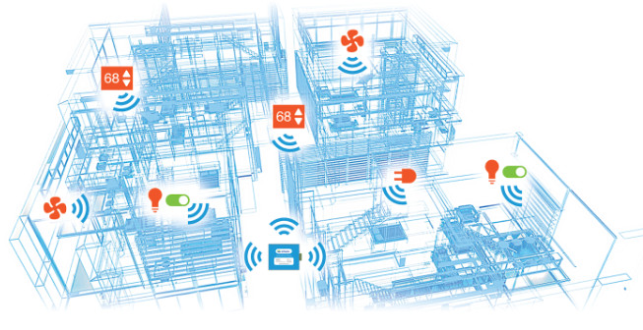
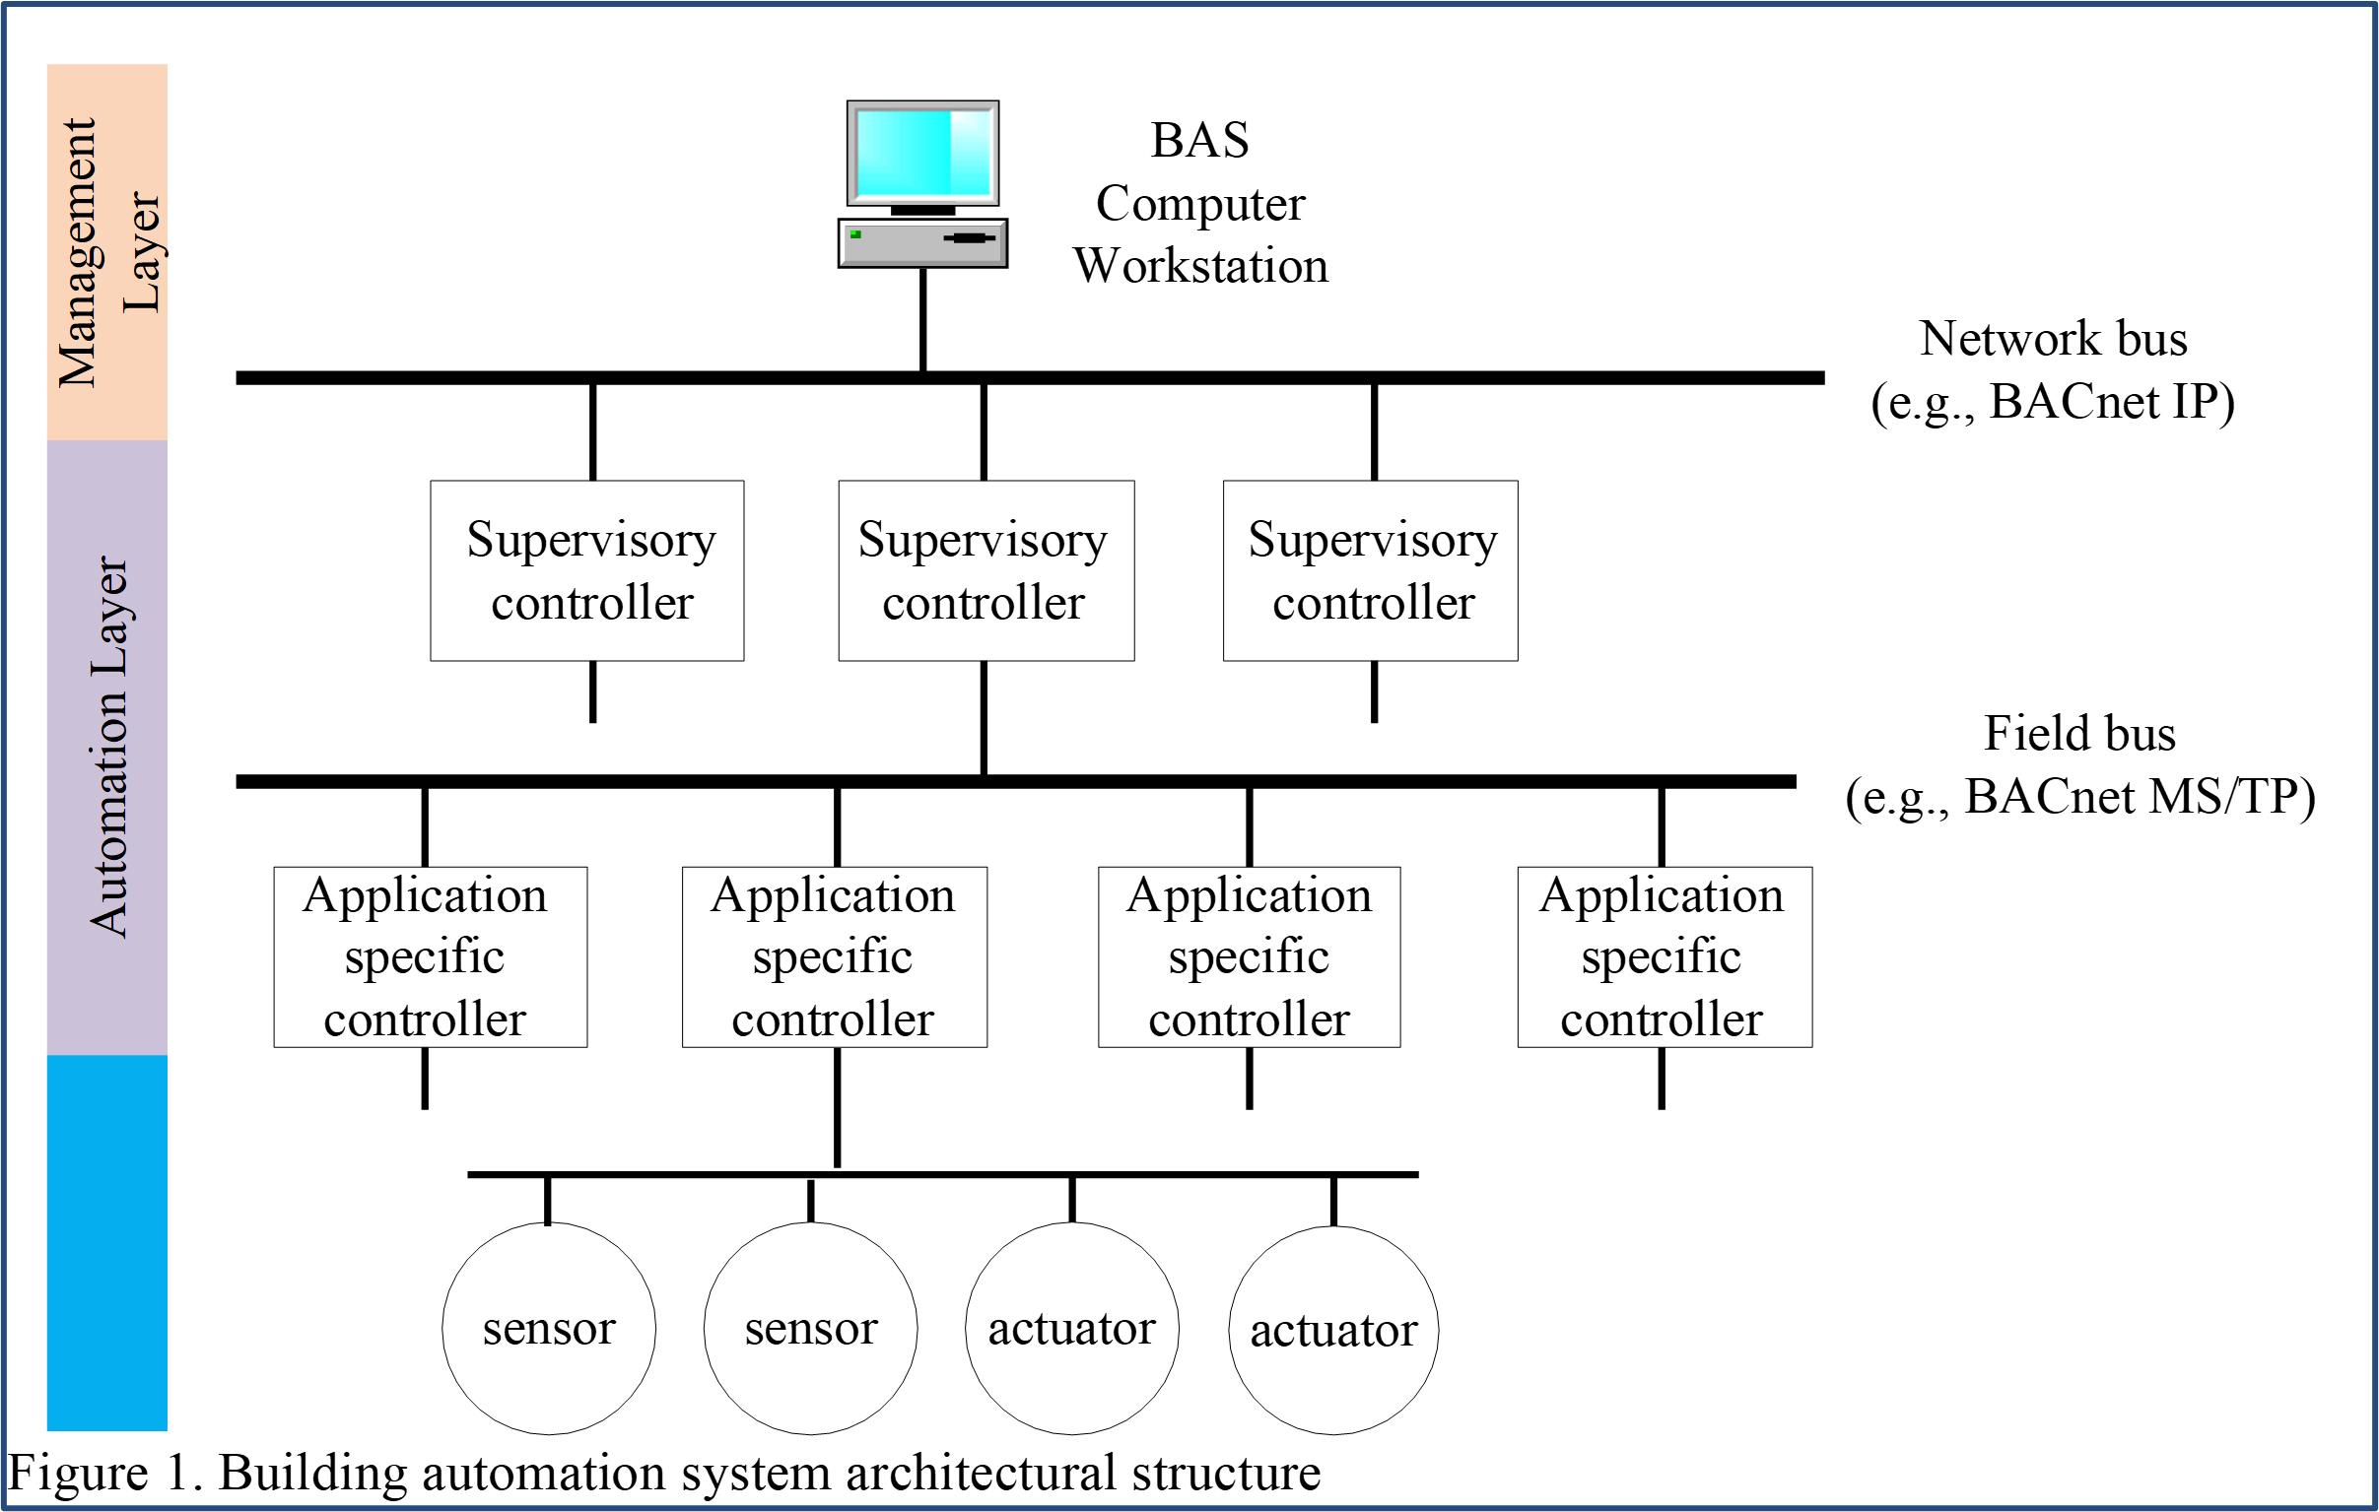
Motivation 1 : Obtain semantic knowledge of buildings
Source: https://www.powerwisesystems.com/blog/monitoring-new-construction-and-existing-buildings/
Source: https://www.bcxa.org/blog/integrating-building-automation-systems.html
Installation of sensors and actuators in buildings
Integration of sensor and actuator datapoints into BAS
These two processes are carried out independently of each other
Problematic since BAS point integration requires knowledge of building topology

Slide 4
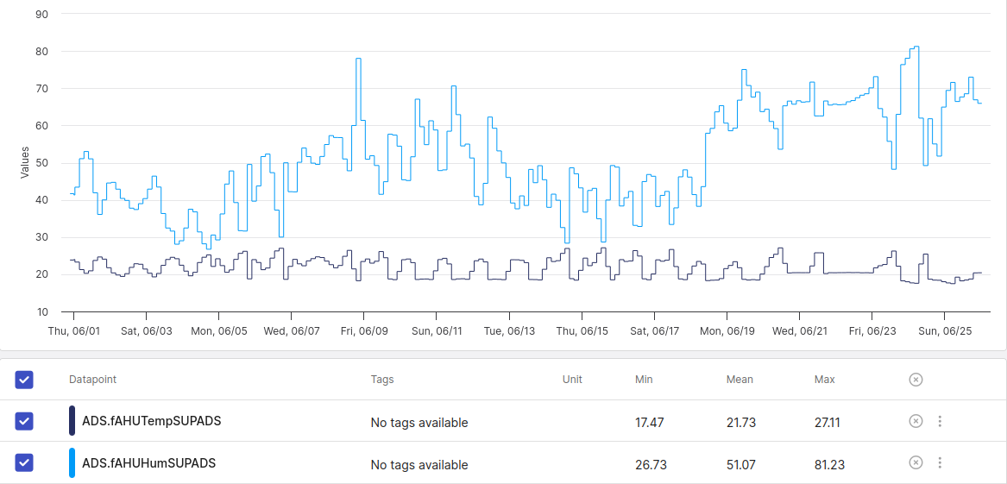
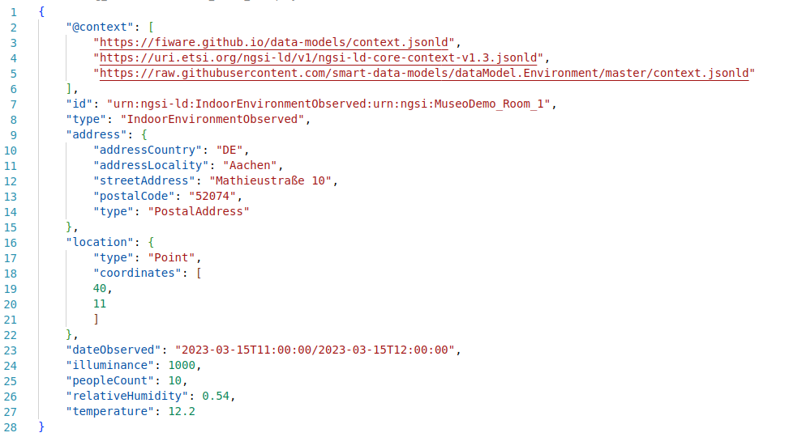
Motivation 2 : Structuring BAS datapoints
Source: Aedifion EBC Dashboard
Source: Smart Data Models (https://github.com/smart-data-models)
Without a data model:
Datapoints do not have hierarchical structure.
Data silos are created but lack relational or semantic knowledge.
With a data model:
Data points have hierarchical structure
Relationships between datapoints can be represented
Common format for data exchange

Slide 5
From motivation to challenges
Summarizing our motivation:
Detect building topology and semantic metadata (eg: location, sensor type, measured metric) of building datapoints
Structure datapoints with a data model to encode above-mentioned metadata
Existing work in this area:
Automated BAS point type detection
Supervised approaches using datapoint labels and time series data _{[1],[2]}
Unsupervised clustering _{[3]}
Methods using numerical time series only _{[4],[5]}
Metadata schemas for buildings _{[6], [7]}

Slide 6
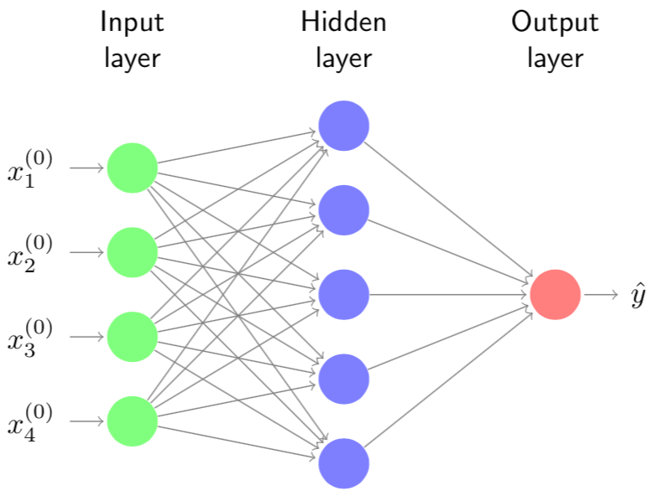
Challenges
Following challenges exist in the literature:
1. Limited availability / poor quality of datapoint labels
2. Unsupervised time series classification is a hard problem
Feature engineering is key to distinguish different point types
3. Erroneous time series data
Outliers, missing data, noise, stuck-at-zero
“main ahu 2700 rm 2703 dmpr pos”
(Datapoint label with useful semantic information)
“A04_VSS”, “NAE01FCB.Device10.AV 1”
(Datapoint label with limited semantic information)
Supervised setting:
classification error computable between
ŷ and y
Unsupervised setting:
y not available. Classification error cannot be backpropagated

Slide 7

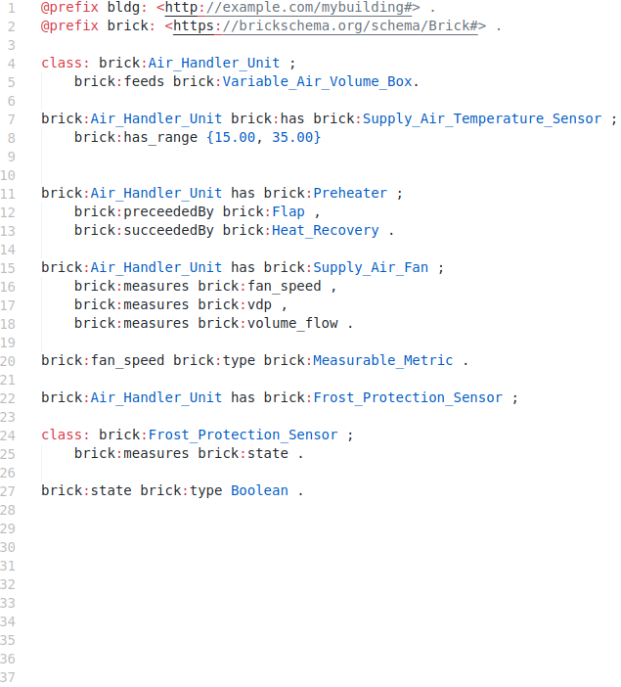
Idea
On a high-level, different BES consist of a constant set of components
General relational and semantic information of BES sub-systems remains unchanged
May contain valuable knowledge of building systems and their components
Use generic semantic information of building systems to enhance time series classification
Figure: Example data model for a Air Handling Unit

Slide 8
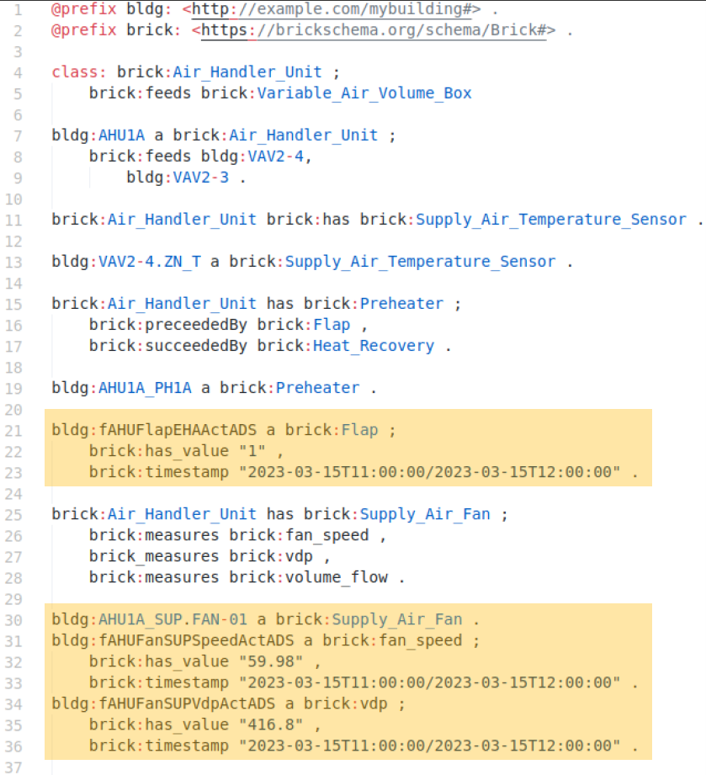
Idea
Associate datapoints with their data model representations

Slide 9
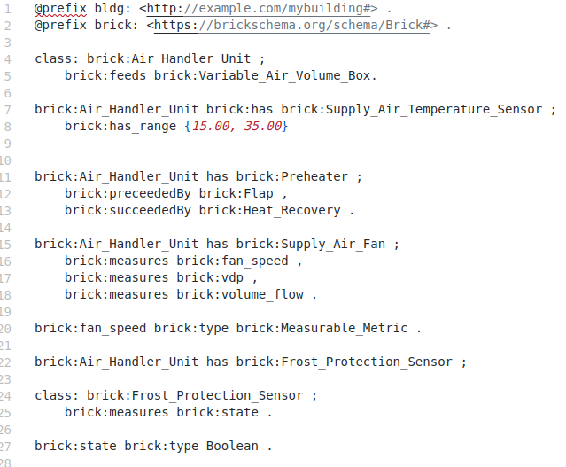
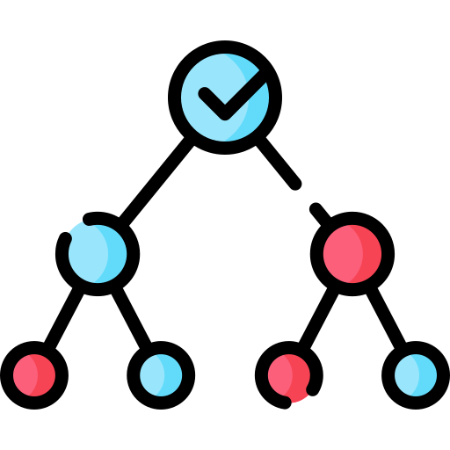
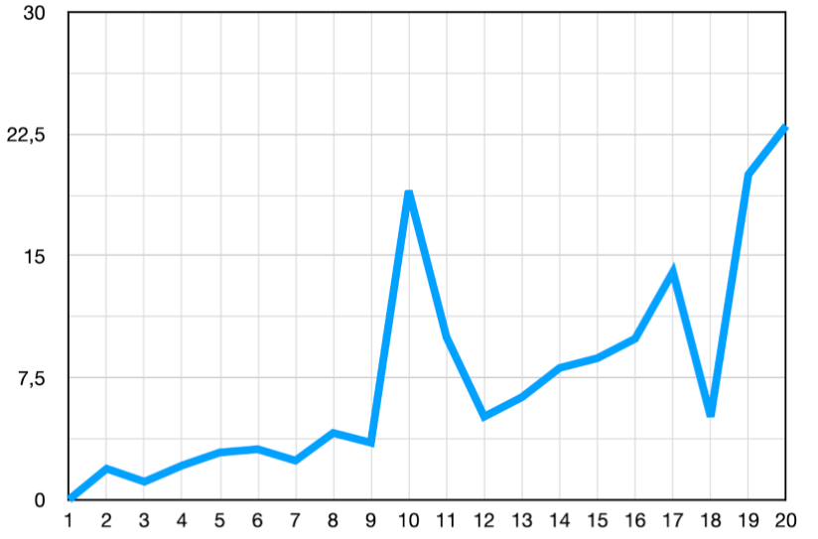
Approach
Extract logical features
Embed classified datapoints to generate physical data model
Generic Data Model
Extract statistical / time / frequency domain features
Source: https://christophm.github.io/interpretable-ml-book/tree.html
Rule-Based Classifier
(eg. Decision Tree, Random Forest
Time Series Data
Specific Data Model

Slide 10
Problem Statement
Development of a generic data model for BES datapoints
Unsupervised time series classification of BES datapoints
Utilizing generic data model logic as features for time series classification of BES datapoints
Assigning classified datapoints to our generic data model to obtain a specific data model

Slide 11
Problem Statement
Development of a generic data model for BES datapoints
Tradeoff between generalizability and sophistication
Unsupervised time series classification of BES datapoints
Computing discriminative features for time series classification
Choice of classifier
Utilizing generic data model logic as features for time series classification of BES datapoints
How do we convert semantic information from a data model into features utilizable by a time series classifier?
Assigning classified datapoints to our generic data model to obtain a specific data model
Ensure serializability (eg: FIWARE NGSI-V2 format)

Slide 12
References
F. Leonardi, H. Reeve, T. Wagner, Z. Xiong, and J. Park, “Assisted point mapping to enable cost-effective deployment of intelligent building applications,” in Proc. Int. High Perform. Buildings Conf. West Lafayette, IN, USA: Purdue Univ., 2016, Paper 193. [Online]. Available: http://docs.lib.purdue.edu/ihpbc/193
Johannes Fütterer, Maksymilian Kochanski, Dirk Müller, “Application of selected supervised learning methods for time series classification in Building Automation and Control Systems”, Energy Procedia, Volume 122, 2017, Pages 943-948, ISSN 1876-6102, https://doi.org/10.1016/j.egypro.2017.07.428.
Gerrit Bode, Thomas Schreiber, Marc Baranski, Dirk Müller, “A time series clustering approach for Building Automation and Control Systems”, Applied Energy, Volume 238, 2019, Pages 1337-1345, ISSN 0306-2619, https://doi.org/10.1016/j.apenergy.2019.01.196.
Noah Mertens and Andreas Wilde, “Automated Classification of Datapoint Types in Building Automation Systems Using Time Series”, IFIP Advances in Information and Communication Technology, pages 495–505, Cham, 2023, Springer Nature Switzerland
Long Chen, H. Burak Gunay, Zixiao Shi, Weiming Shen, and Xiaoping Li, “A Metadata Inference Method for Building Automation Systems With Limited Semantic Information”, IEEE Transactions on Automation Science and Engineering, 17(4):2107–2119, October 2020
B. Balaji, A. Bhattacharya, G. Fierro, J. Gao, J. Gluck, D. Hong, A. Johansen, J. Koh, J. Ploennigs, Y. Agarwal, M. Berges, D. Culler, R. Gupta, M.B. Kjærgaard, M. Srivastava, and K. Whitehouse. 2016. Brick: Towards a Unified Metadata Schema For Buildings. In Proceedings of the 3rd ACM International Conference on Systems for Energy-Efficient Built Environments (BuildSys '16). Association for Computing Machinery, New York, NY, USA, 41–50. https://doi.org/10.1145/2993422.2993577
Project Haystack, https://project-haystack.org/

Slide 13
Your very important remark goes here
Your very important message goes here

