Slide 1

Vehicle Log System for Maintenance and Accounting of Military Vehicles
Under the Guidance of
Mr. S. M. Rathod

Slide 2
Group Members :
Shubham Madankar (2015BCS011)
Pravin Lambture (2016BTECS00205)
Vaibhav Thombare (2016BTECS00210)

Slide 3
Problem Statement :
To design and implement a digitalized system for
the maintenance and accounting of Military vehicles using web and android platform.

Slide 4
Objective:
To study android app development ,web development and Raspberry pi configuration.
To gather Raspberry pi sensor data and store it into MYSQL database and generate notification accordingly.
Suggestion for maintenance according to threshold value.

Slide 5
Software Requirements:
● Front End :
1) XML
2) CSS, Bootstrap, AJAX
3) Material Design
● Back End:
1) Android(Java)
2) JS,PHP, MYSQL ,Python

Slide 6
Tools :
Android studio
Raspberry pi
Sensors (PIR-motion sensor, MQ-2,
Temperature Sensor- DS18B20)

Slide 7



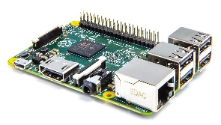


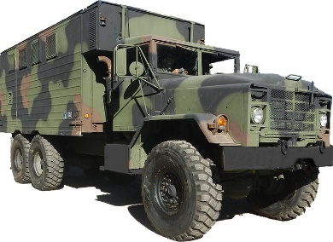

Working Principle:
Authentication
Android User
Main Server
Notification
User
Entry for logbook & cardBook
Register
Get Confirmation
If issues alert the system
Maintained by
Authenticated User
Info about nearby workshop
Sensor Data
Admin
Near by Unit-Workshop
Vehicle having Raspberry pi

Slide 8
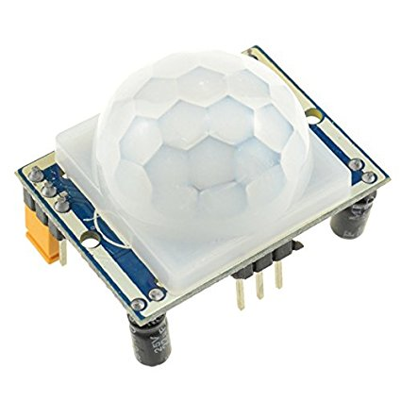
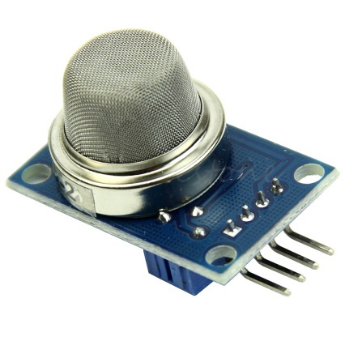
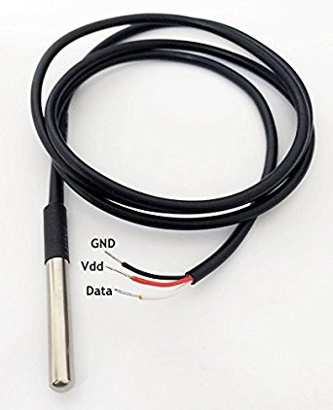
Connected Sensors To Raspberry pi
PIR motion Sensor
MQ-2 Gas Sensor
DS18B20(Temp)
Raspberry pi

Slide 9
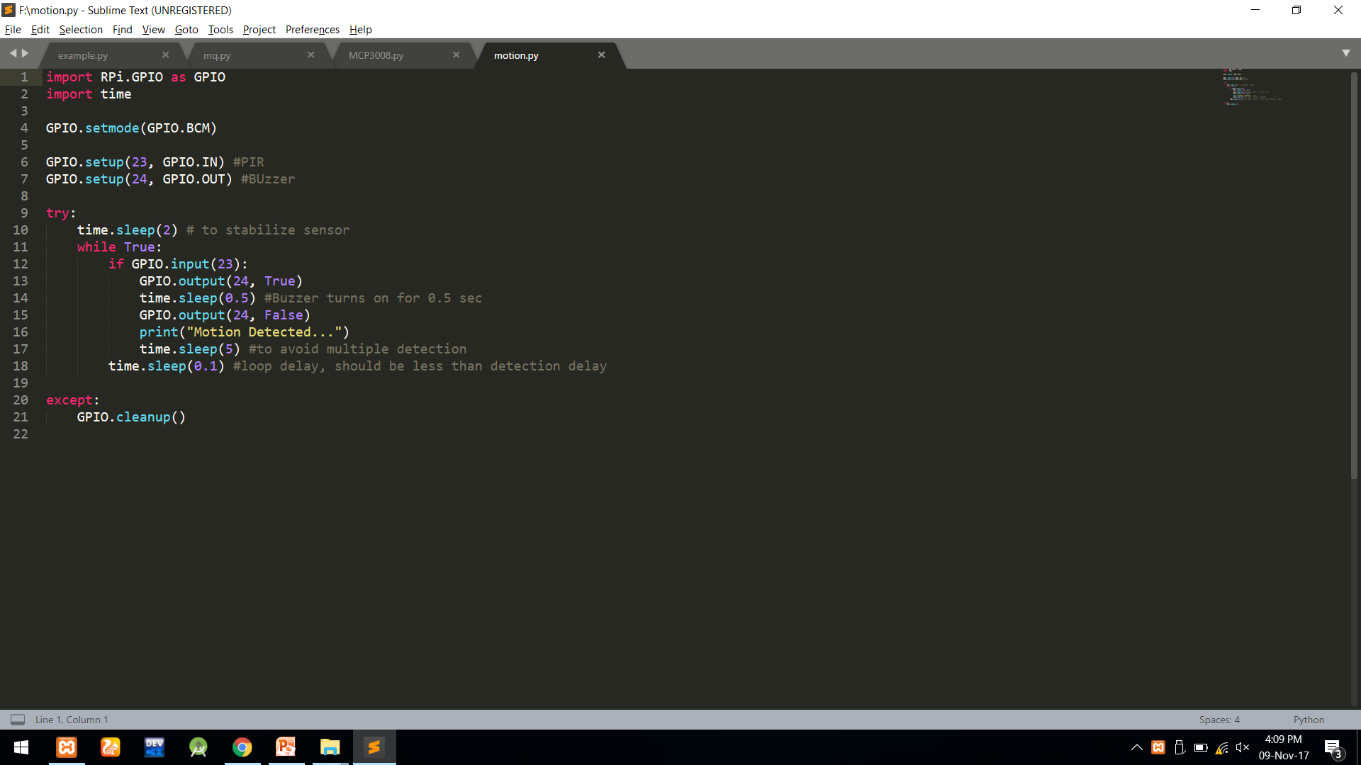

Slide 10
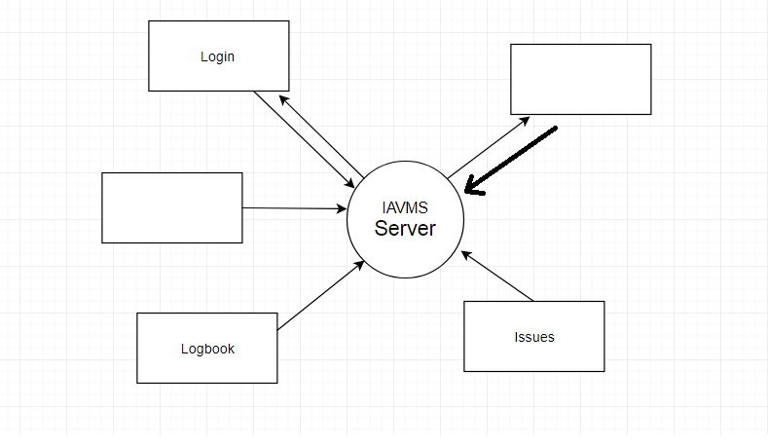
Android App Working :
Notification
Cardiary

Slide 11
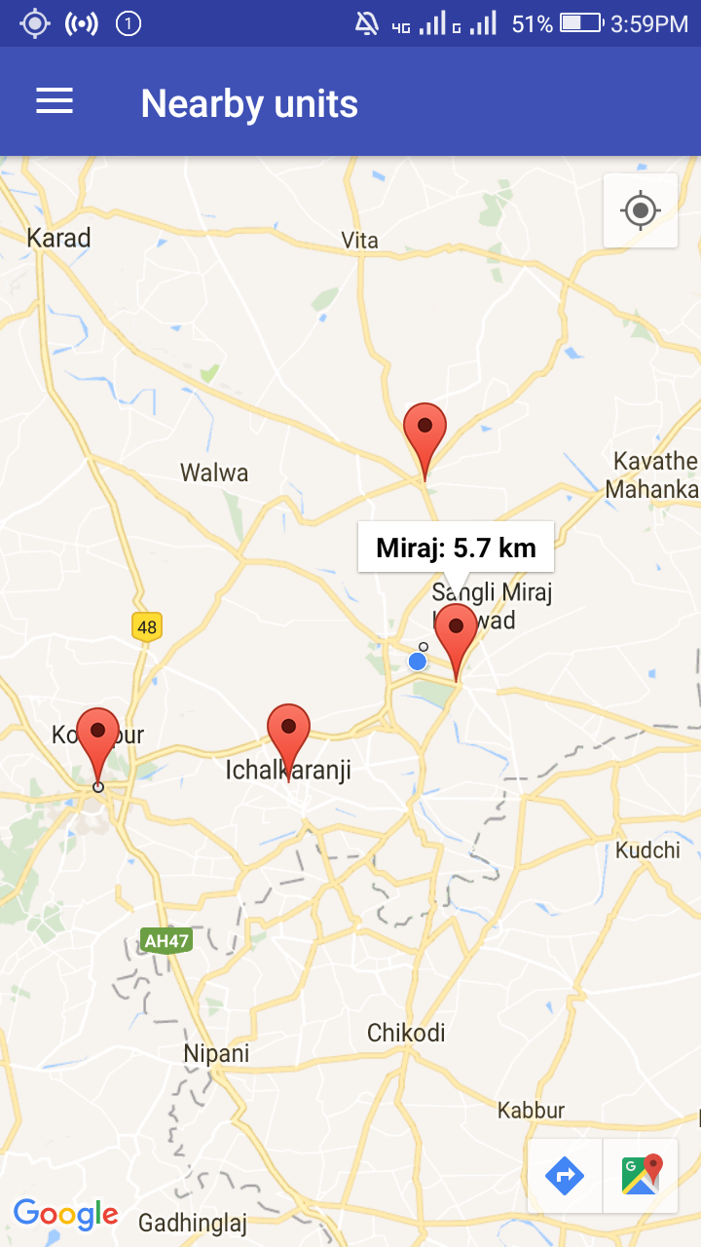
Sample Of Near By Units

Slide 12
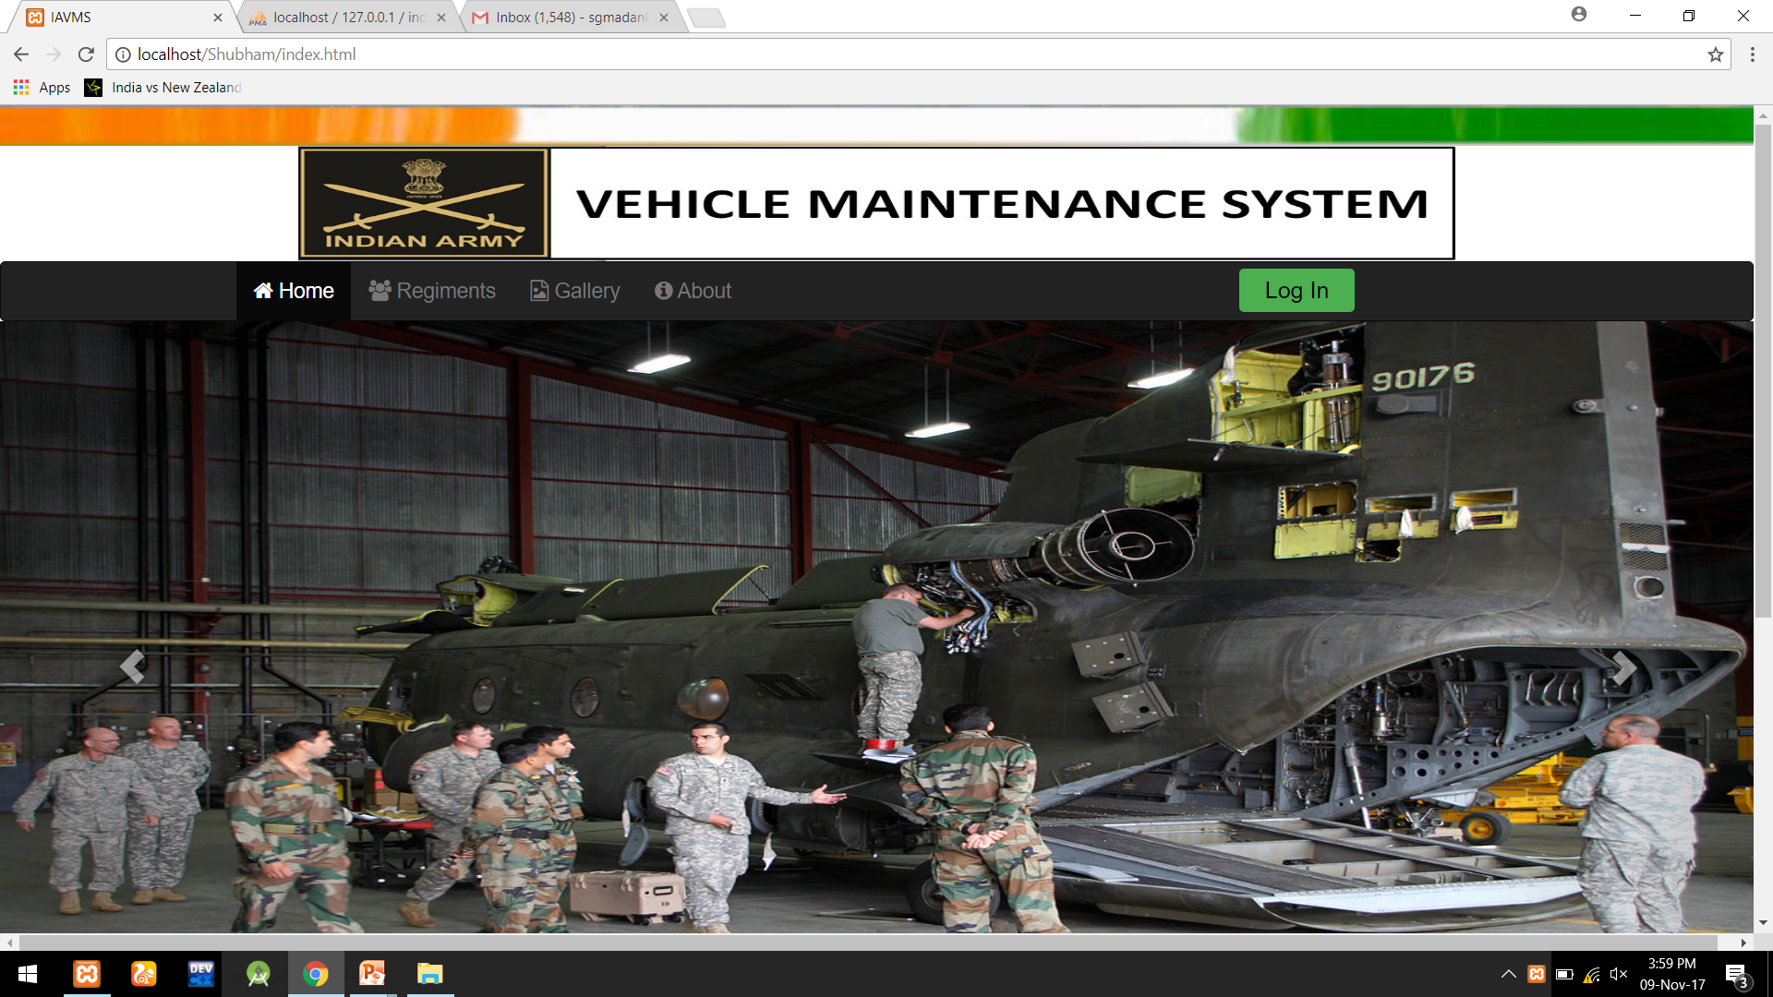
ADMIN WEBSITE HOME PAGE

Slide 13
Future Scope:
Add sensor data eg. Fuel , Tire Air pressure, etc.
Automatically check engine performance.

Slide 14
Outcomes :
Reduces paper work and save manpower.
Automatic monitoring.
Proper and accurate account.
Saves cost and resources.
Extends Vehicle life.

Slide 15
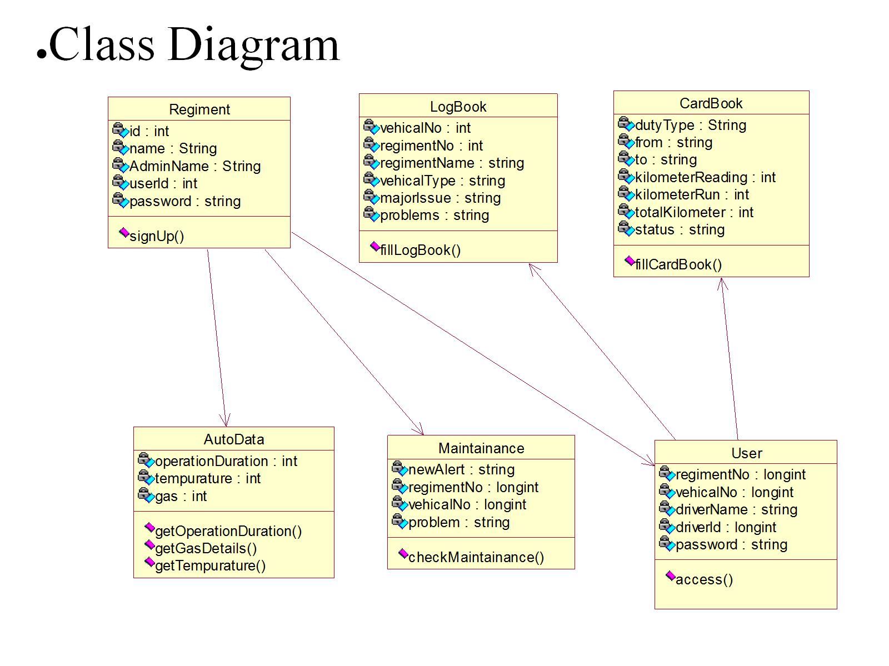
UML Diagrams:

Slide 16
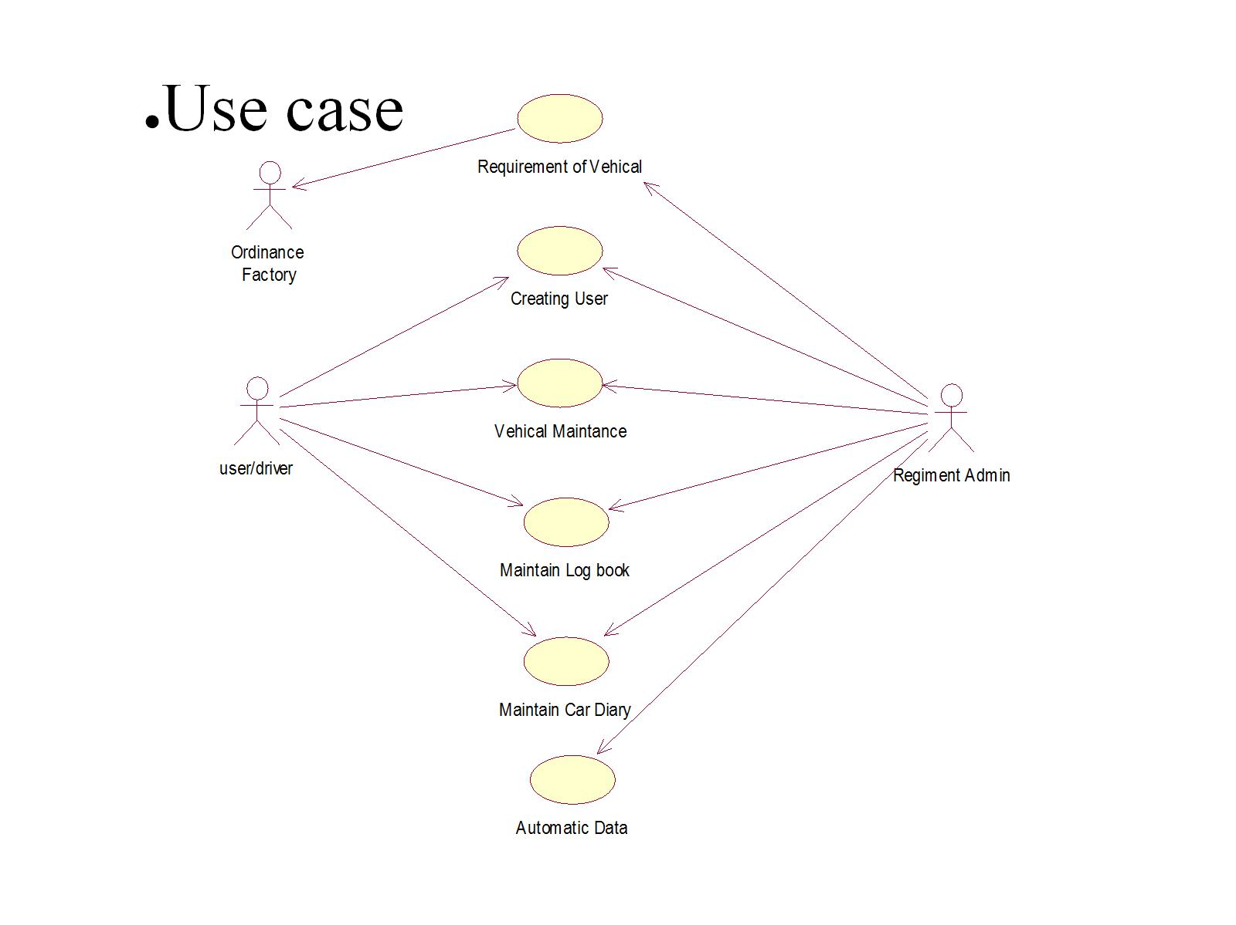

Slide 17
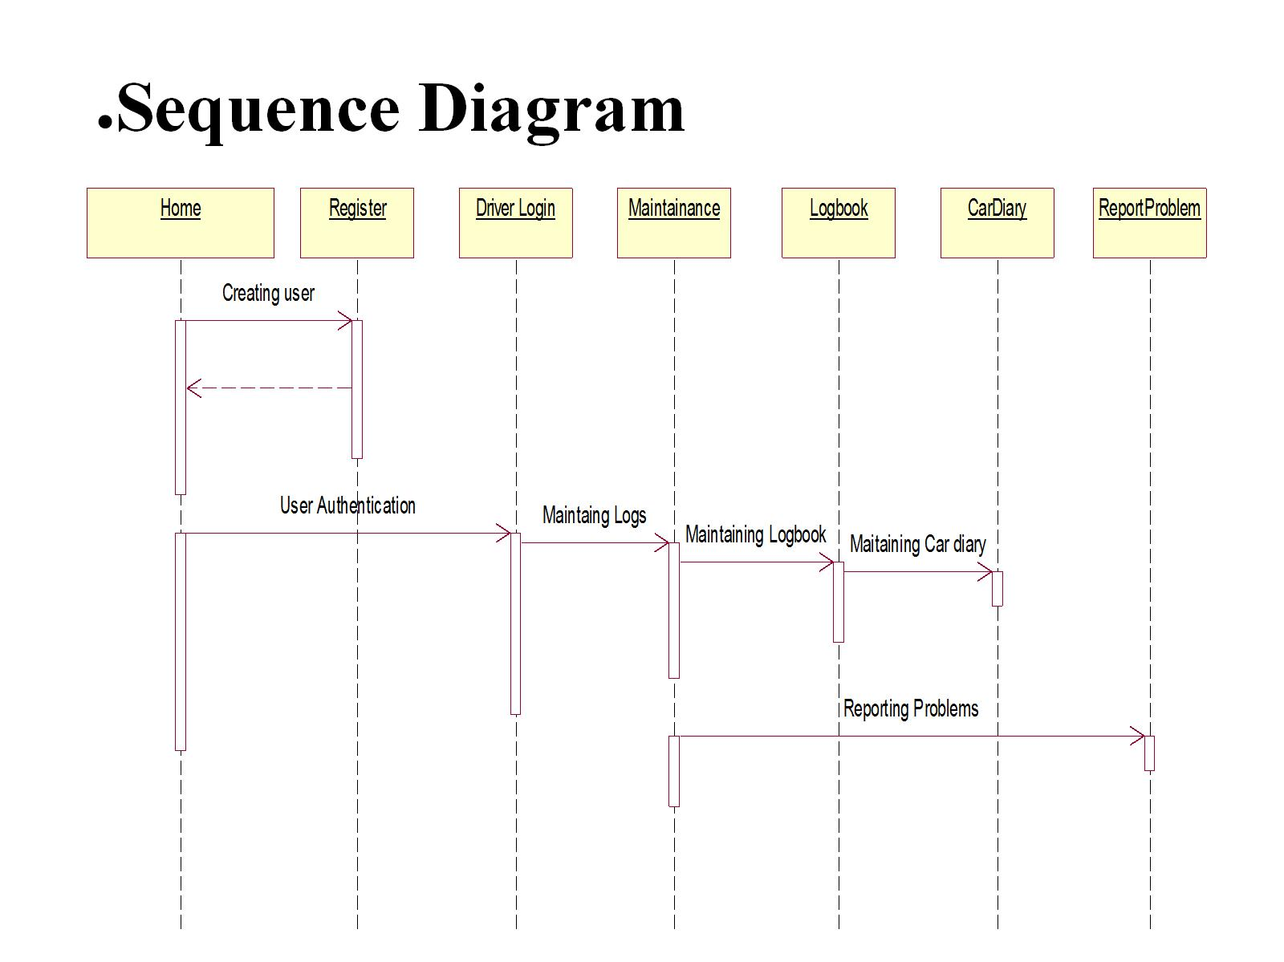

Slide 18
References:
Confederation of Indian Industry . 2017. Army Design Bureau –Future scope and Problem statements
http://defenceaviationpost.com/wp-content/uploads/2017-2/01/compendium-of-prob-defn.pdf
http://joinindianarmy.nic.in/index.htm

Slide 19
Thank You…

