Slide 1
Stock Market Prediction

Slide 2
Abstract
This project is on stock market prediction of Bharti Airtel for the next day.
We have used two features for our project
Rival Performance
Self Performance

Slide 3
Rival Performance
This feature vector is calculated by taking the mean of three big rivals.
Tata Communications
Idea Cellular
Reliance Communications
One notable thing here is that other big telecom operators like Vodafone are not registered with Bombay stock exchange so they are not taken into consideration.

Slide 4
Self Performance
This feature vector has been calculated by using the k-mean algorithm by forming four clusters of the past 52 days.

Slide 5
K-Mean
This algorithm belongs to unsupervised learning.
In unsupervised learning the output is not provided in the data set.
The algorithm itself learns the output by the training examples given.

Slide 6
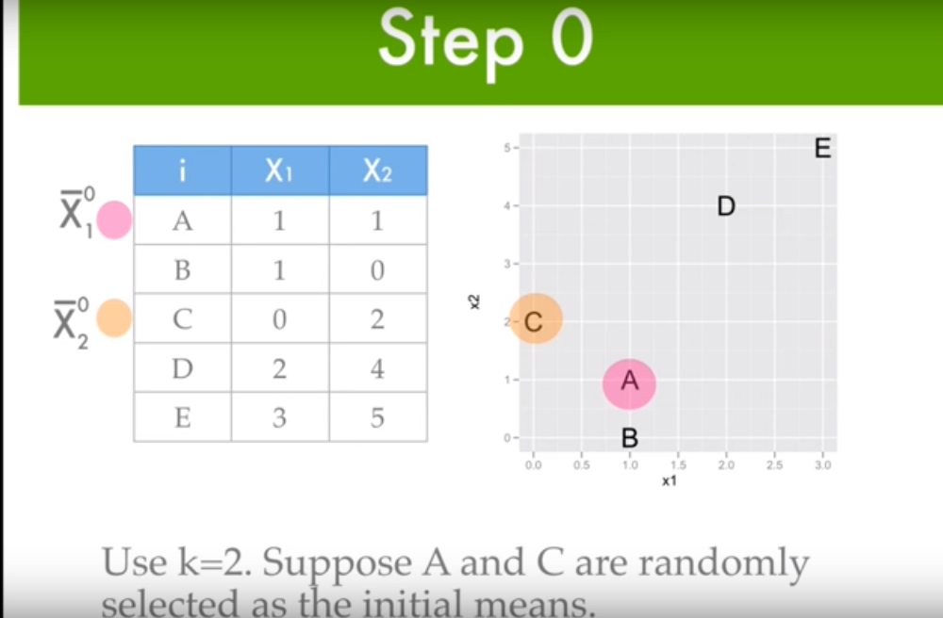
WORKING OF K-Mean

Slide 7
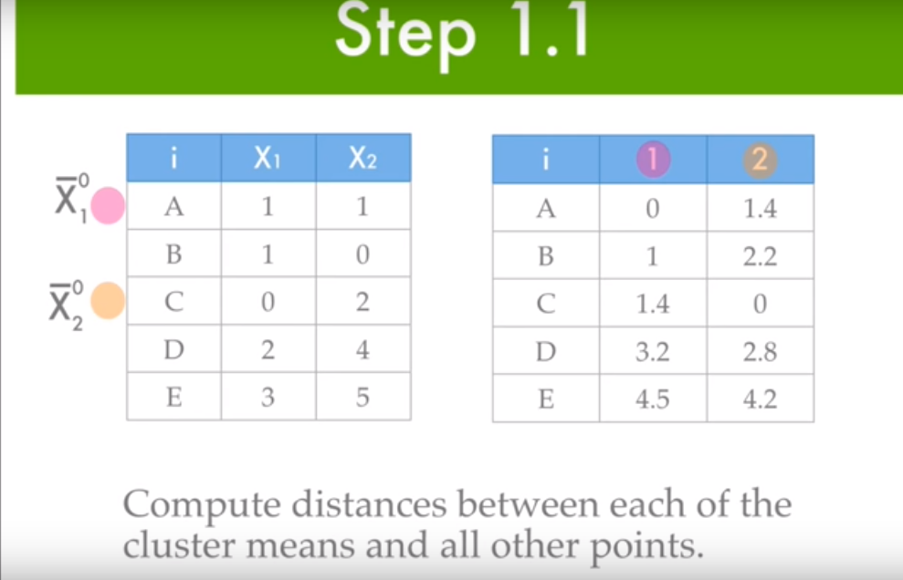
WORKING OF K-Mean

Slide 8
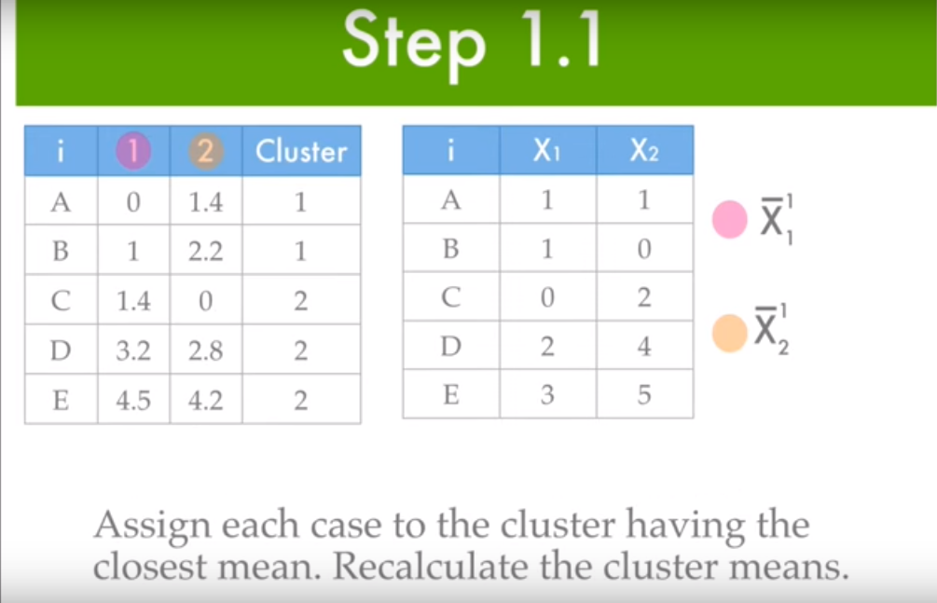
WORKING OF K-Mean

Slide 9
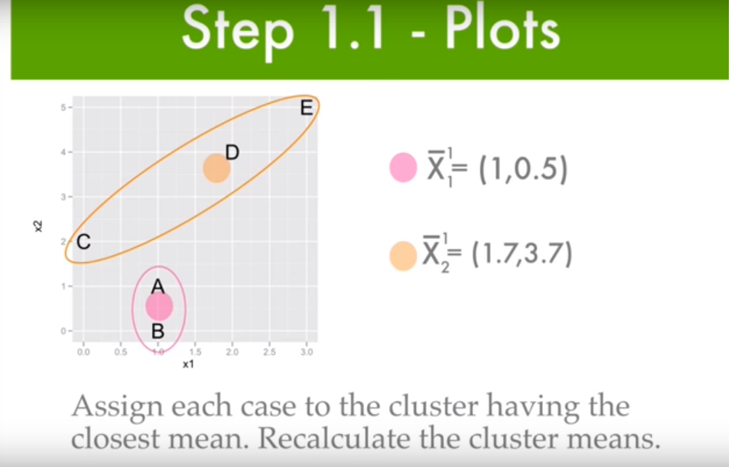
WORKING OF K-Mean

Slide 10
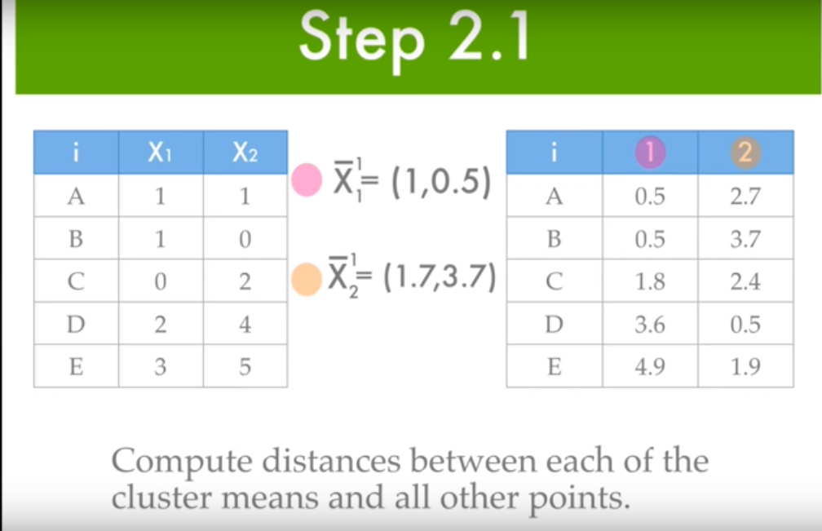
WORKING OF K-Mean

Slide 11
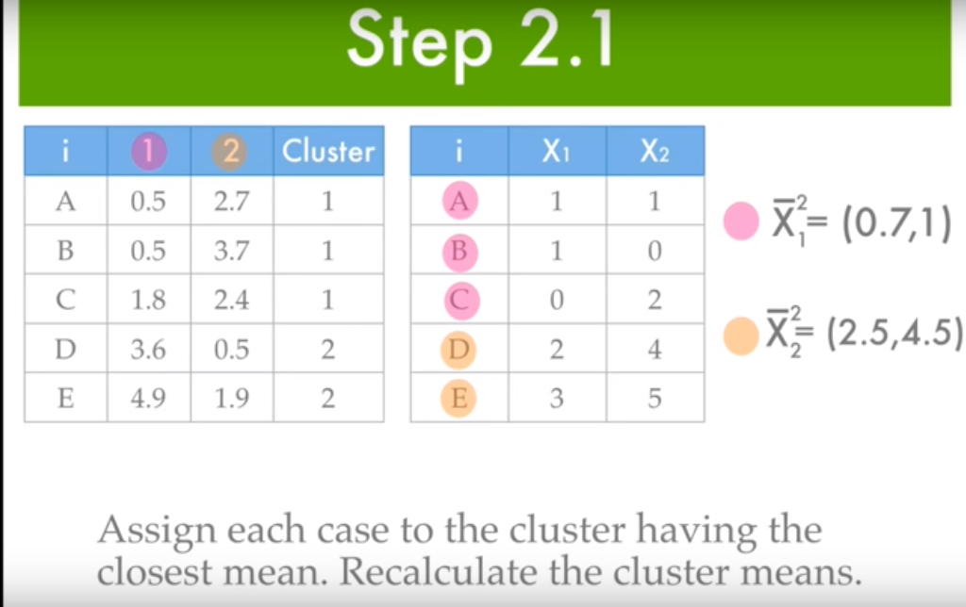
WORKING OF K-Mean

Slide 12
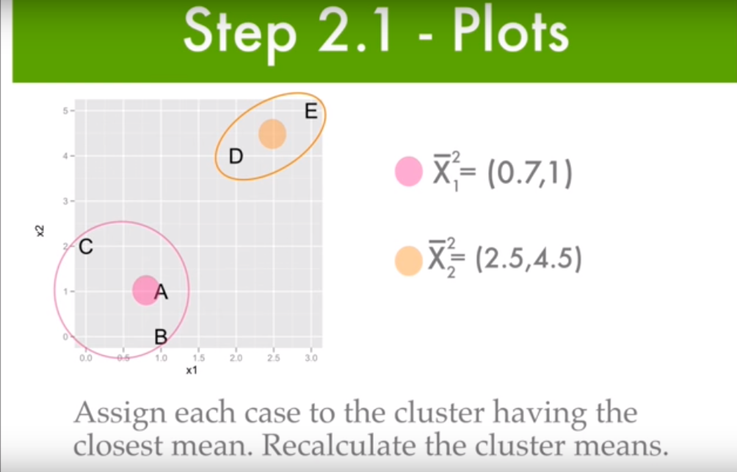
WORKING OF K-Mean

Slide 13
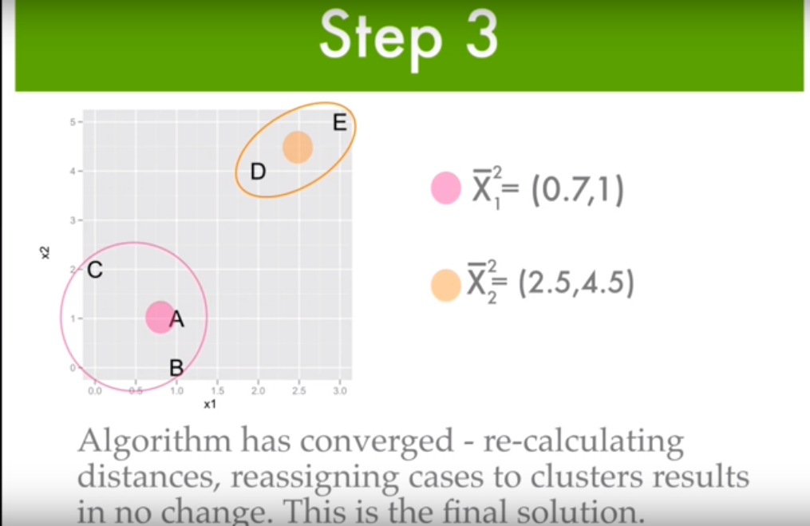
WORKING OF K-Mean

Slide 14
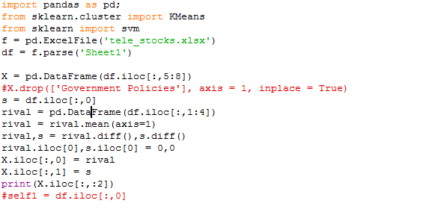

Slide 15
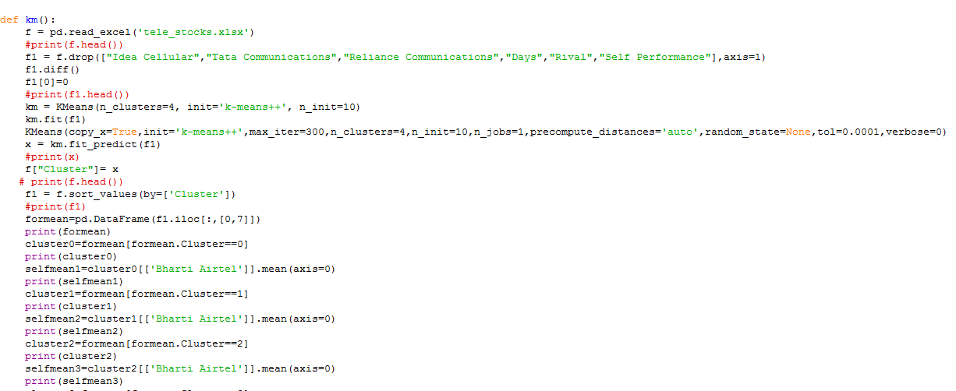

Slide 16
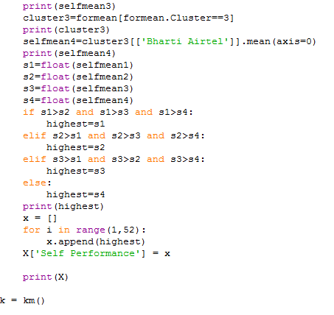

Slide 17
Support Vector Machine
After our feature matrix is ready we move to the prediction step. Here we use the best algorithm for ‘complex non-linear decision boundary’ as quoted by Andrew NG, the support vector machine.
SVM is a large margin classifier i.e. it chooses the best decision boundary at an equal distance from the data points of the classes involved.

Slide 18
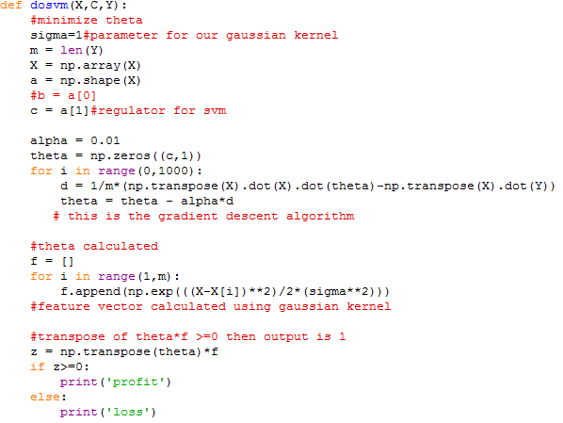

Slide 19
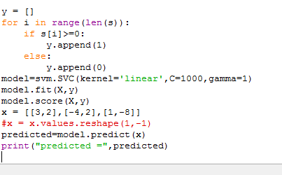
SVM

Slide 20
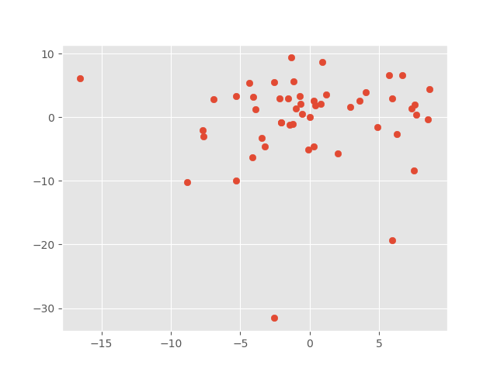

Slide 21
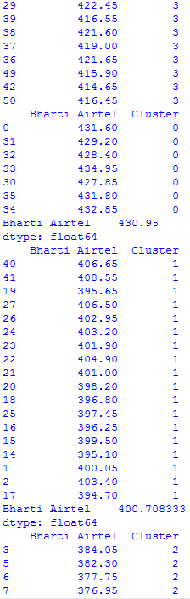
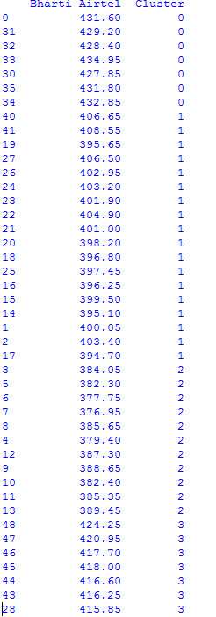
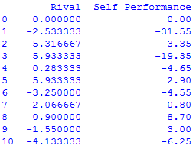
Output

Slide 22
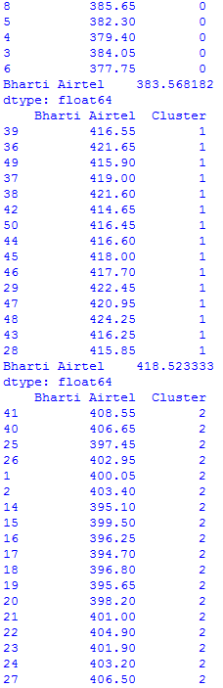
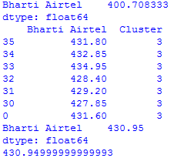

Slide 24
Future Scope
We have not used subjective features like government policies. We will find a way to quantize them and make our predictions more accurate.
Our dataset is a manually made excel sheet. We will do web scraping and store that data from the web into our dataset.

Slide 25
THANK YOU

