Slide 1
Web & Social Media Analytics
BY VAIBHAV BHARAT UJAGARE

Slide 2
INDEX
Problem Statement
Objective And Agenda
Key Insights
Methodology
  Data Pre-processing
  EDA(Exploratory Data Analysis)
  Text Analytics
  Visualization And Storytelling
  Building a sentiment classification engine
Conclusions
Appendix

Slide 3
Problem statement
The product based company want to launch their product into the market.
They want to understand the competitors and preferences of their customers so that they can design their strategies accordingly.
They want to maximize their market share and also want to increase their brand value in the market.

Slide 4
OBJECTIVE AND AGENDA
Find out how market trend is going on
Finding the Top competitors
Finding the Strength and weaknesses of competitors
Finding the market share of competitors
Finding the users preferences

Slide 5
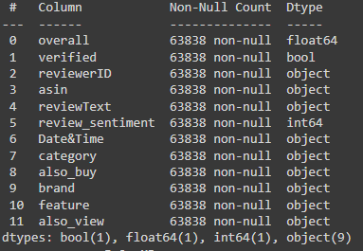
Key insights
After cleaning the data set ‘also_view’, ‘brand’ and ‘also_buy’ are the most important columns for finding the more insights from the data.
‘reviewText’ column play the most important role in the data because this column is used for the sentimental analysis.
‘review_sentiment’ is the target variable in the data.

Slide 6
methodology
Data Pre-processing:
  In this step we did some basic operations like going through the data and understand the attributes of the data present in the data set.
EDA(Exploratory Data Analysis):
  In this step we do the following operations:
    Checking datatypes of the columns or changing the datatypes as per the column description
    Checking the first few entries of the data to get an idea about what kind of analysis can we do.
    Checking the null values percentage row-wise and column-wise
    Removing the null values or replacing the null values if required.
    Keeping only important attributes for further analysis.

Slide 7
Text Analytics:
  In this step we do some following operations:
    We have clean the review text by using the lexical processing method.
    We remove all the stop words from the review text.
    We have create the word cloud based on the positive and negative reviews.
    We also create features based word cloud.
Visualization And Storytelling:
  In this step we do some following operations:
    We have create a tableau dashboard from the features which we had extracted from the previous steps.
Building a sentiment classification engine:
  In this step we do some following operations:
    We have use Naive Bayes text classification algorithm to classify the text
    We have convert the textual data into numeric format

Slide 8
conclusions

Slide 9
Important features to include
(followings are the important features company should consider to look out these parameter)
Screen Size
Battery Life
Camera
Looks

Slide 10
Important features to improve
(followings are the important features company should consider to improve for better brand value )
Performance
Quality
Camera
Sound Quality
Price

Slide 11
Thank you

