Slide 1




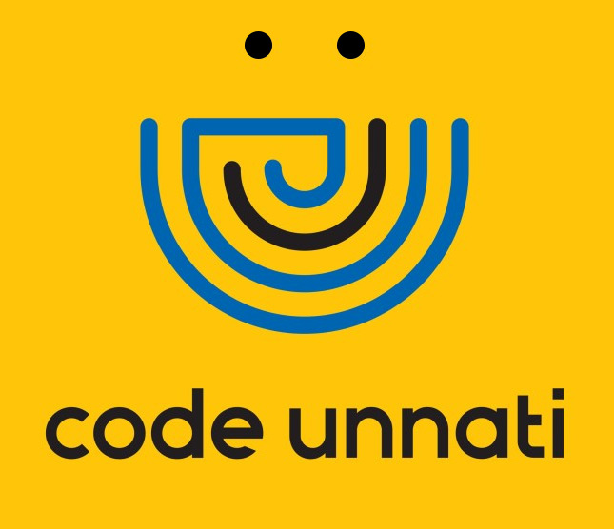
CodeTrust AI – Trust & Verify AI-Generated Code
Team ID -Team_13706
Team Leader Name - Kruparani Tomar
Team Member 1- Shabbir Shaikh
Team Member 2- Anjali Tripathi
Team Member 3 – Samarth Parmar
Team Member 4 – Sahil Shaikh
Under the mentorship of,
Mentor Name : Hiren Modha
Notes:
Slide Duration: 5 min
Objective: To get an insight about Design Thinking
Procedure:
Explanation:
Introduce the topic "Design Thinking"
Design thinking is a creative approach to problem-solving that puts people at the center.
It starts with understanding the needs of those who will use what you're designing.
Then, it involves brainstorming ideas, prototyping solutions, and testing them to see what works best.
It's about being open-minded, collaborative, and willing to try new things to come up with innovative solutions that really fit people's needs.
Learning outcome: Students will be introduced to the topic Design Thinking.

Slide 2
Project overview - Introduction
CodeTrust AI is an intelligent security platform designed specifically to analyze AI-generated code.
It automatically detects security vulnerabilities, identifies hallucinated or unreliable logic, and provides secure patch recommendations with clear explanations.
The platform acts as a trust layer between AI code generation tools and software deployment pipelines.
CodeTrust AI integrates into developer workflows and CI/CD pipelines to ensure that AI-generated code is verified before reaching production.
By combining vulnerability detection, hallucination-aware analysis, and explainable security fixes, CodeTrust AI helps developers build secure software without slowing down innovation.
Notes:
Total duration: 5mins
Learning Objective: In this slide, the trainer will explain the students what they will learn and be able to apply in the real life situations.
Procedure: Discuss the above as the outcome of the session
Learning outcome: Students will understand the learning outcome in this slide.

Slide 3
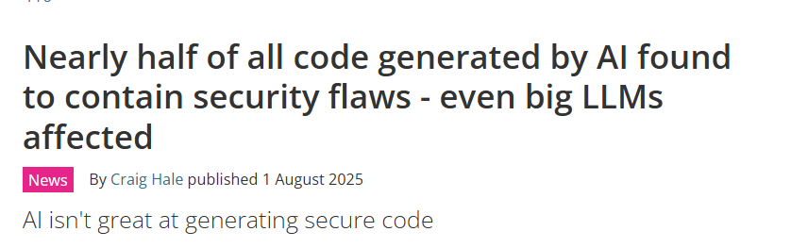
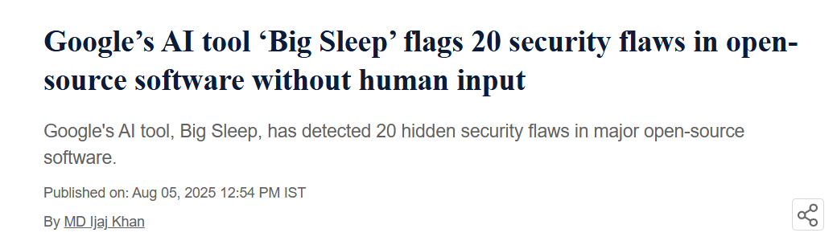
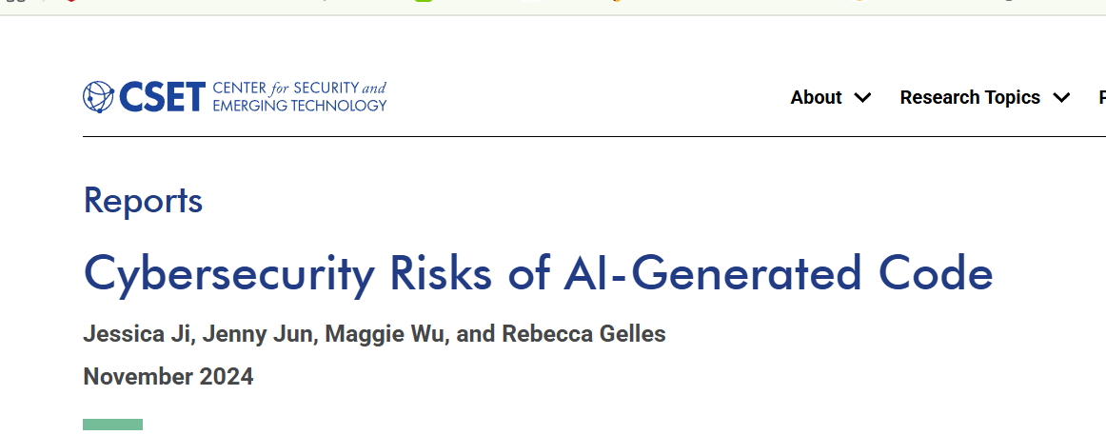
Problem Statement
AI-powered coding tools are rapidly being adopted by developers to accelerate software development.
However, AI-generated code often contains hidden security vulnerabilities, unsafe logic, and hallucinated APIs.
Most existing security scanners are designed for human-written code and fail to evaluate AI-specific risks.
As a result, developers unknowingly deploy insecure AI-generated code into production systems, leading to security breaches, compliance risks, and increased remediation costs.
There is currently a lack of specialized tools that can automatically detect vulnerabilities in AI-generated code and provide secure, explainable fixes.
Notes:
Total duration: 5mins
Learning Objective: In this slide, the trainer will explain the students what they will learn and be able to apply in the real life situations.
Procedure: Discuss the above as the outcome of the session
Learning outcome: Students will understand the learning outcome in this slide.

Slide 4

Project Objectives
To identify security vulnerabilities in AI-generated code.
To detect hallucinated APIs, unsafe logic, and insecure coding patterns.
To provide explainable risk analysis and secure patch recommendations.
To help developers verify AI-generated code before deployment.
To improve trust, security, and reliability in AI-assisted software development
Video Link:-
https://youtu.be/Q6-LZUxMPIc
Notes:
Slide duration: 5 min
Objective: To know the content of the lesson.
Procedure:
Tell students what they are going to learn today.
Discuss each topics given in the slide.
Learning Outcome: Students will get to know the content of today's lesson.

Slide 5
End User
Software Developers using AI coding assistants
Startup Engineering Teams
Enterprise Development Teams
DevSecOps Engineers
Cybersecurity Teams
Government and Regulated Organizations
AI-powered SaaS Product Developers
Notes:
Total duration: 5mins
Learning Objective: In this slide, the trainer will explain the students what they will learn and be able to apply in the real life situations.
Procedure: Discuss the above as the outcome of the session
Learning outcome: Students will understand the learning outcome in this slide.

Slide 6
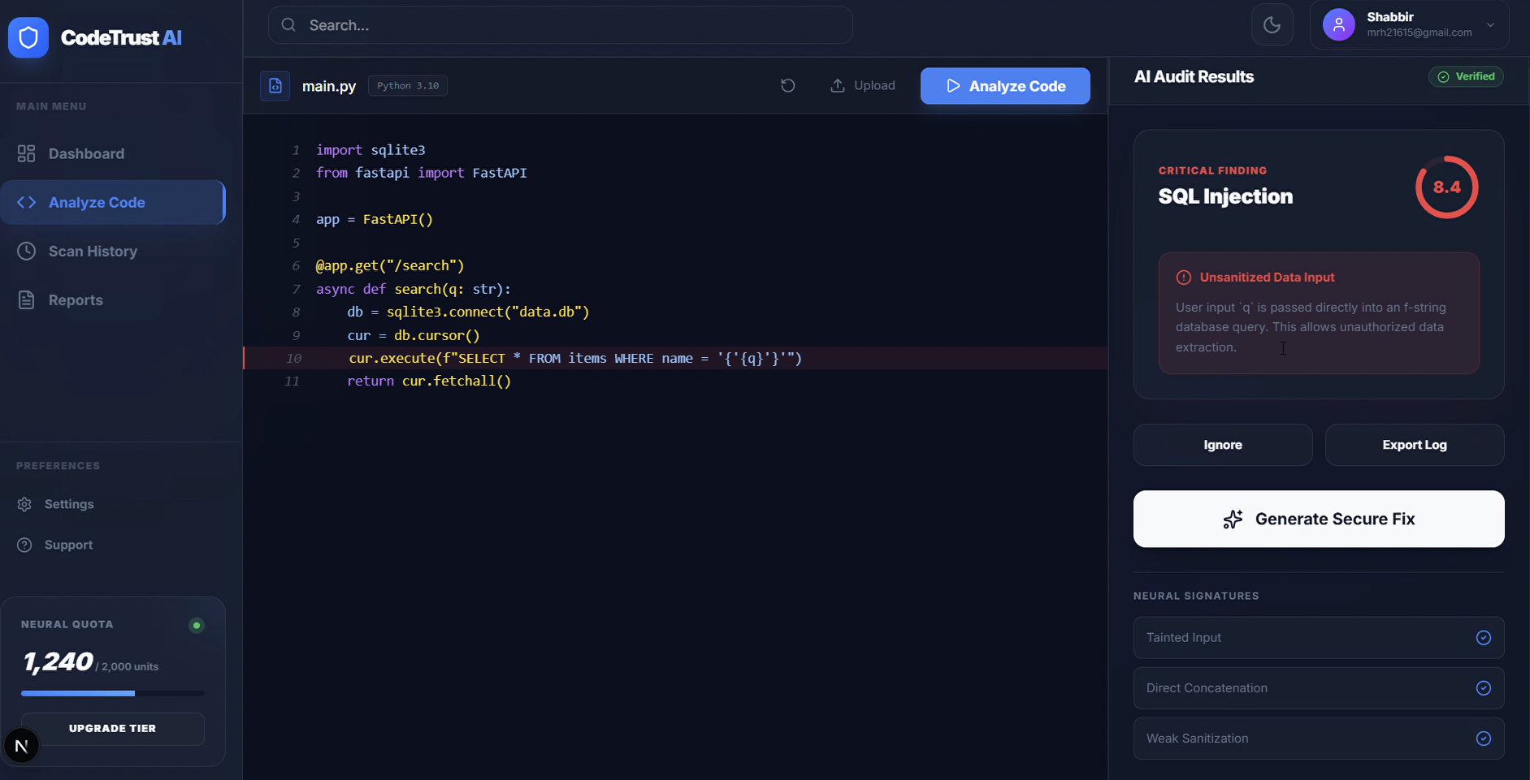
Wow factor
First-of-its-kind platform focused specifically on AI-generated code security
Detects AI hallucinations, not just traditional vulnerabilities
Provides explainable secure patches, not only alerts
Works as a trust layer for AI coding tools
Real-time analysis integrated into developer workflows* Bridges the gap between AI speed and software security
Notes:
Total duration: 5mins
Learning Objective: In this slide, the trainer will explain the students what they will learn and be able to apply in the real life situations.
Procedure: Discuss the above as the outcome of the session
Learning outcome: Students will understand the learning outcome in this slide.

Slide 7
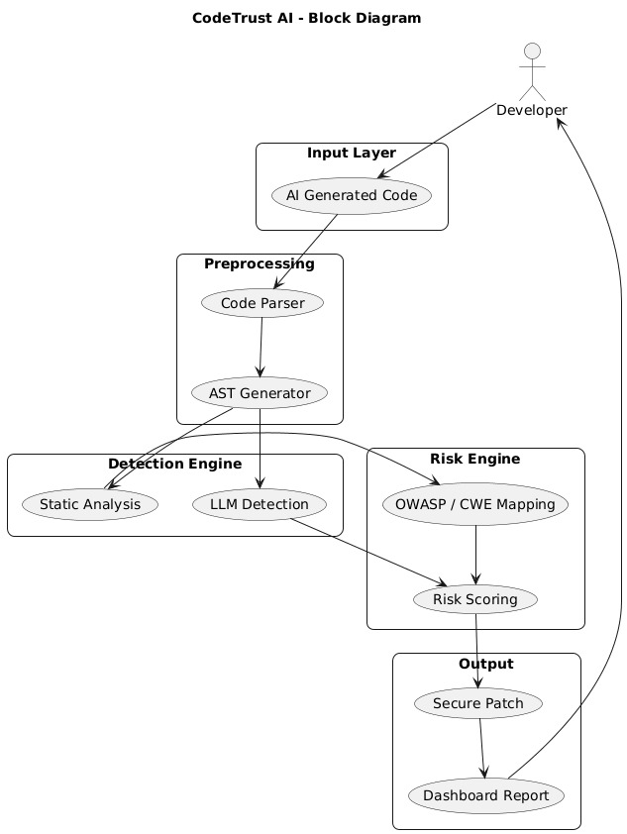
Modelling
Notes:
Total duration: 5mins
Learning Objective: In this slide, the trainer will explain the students what they will learn and be able to apply in the real life situations.
Procedure: Discuss the above as the outcome of the session
Learning outcome: Students will understand the learning outcome in this slide.

Slide 8
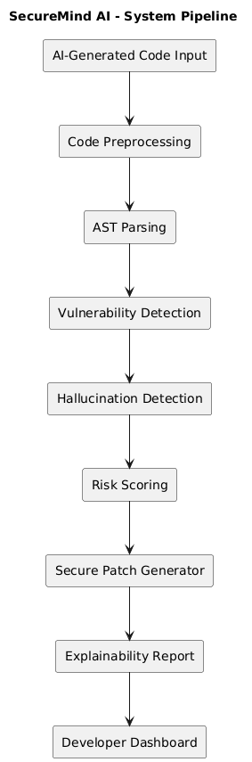
Result / Outcomes
Successful detection of common vulnerabilities such as SQL Injection, XSS, and insecure logic.
Identification of hallucinated APIs and unsafe AI assumptions.
Generation of secure, OWASP-compliant patch recommendations.
Reduced manual code review effort.
Improved security confidence for AI-generated code. Working prototype demonstrating real-time AI code verification.
Notes:
Total duration: 5mins
Learning Objective: In this slide, the trainer will explain the students what they will learn and be able to apply in the real life situations.
Procedure: Discuss the above as the outcome of the session
Learning outcome: Students will understand the learning outcome in this slide.

Slide 9
Future Perspective
IDE extensions for VS Code and JetBrains
Real-time scanning during AI code generation
Multi-language code support
Enterprise compliance and audit reporting
Blockchain-based tamper-proof security reports
Integration with popular AI coding platforms
AI governance and policy enforcement features
Notes:
Total duration: 5mins
Learning Objective: In this slide, the trainer will explain the students what they will learn and be able to apply in the real life situations.
Procedure: Discuss the above as the outcome of the session
Learning outcome: Students will understand the learning outcome in this slide.

Slide 10

Conclusion
CodeTrust AI addresses a critical gap in modern software development by securing AI-generated code. As AI coding tools become mainstream, security risks increase silently. CodeTrust AI ensures that innovation does not compromise security by providing automated vulnerability detection, hallucination-aware analysis, and explainable secure fixes. The platform strengthens developer trust in AI-generated code and promotes responsible AI adoption in real-world software systems.
Source
https://www.freepik.com/
Notes:
Slide duration: 5 min
Objective: To get clarity about the lesson is well received among students.
Procedure:
Ask: What did you learn from the lesson?
What is your takeaways from the lesson?
How this lesson is going to help you in your personal and professional life.
How are you going to implement this lesson?

Slide 11
Thank You
Notes:
Time: 25 to 30 Sec

