Slide 1


The Lehman Brothers Collapse
A case study in Financial Risk Management — exploring how leverage, liquidity, and governance failures brought down a 158-year-old institution.
FRM CASE STUDY
ASSESSMENT INCLUDED

Slide 2
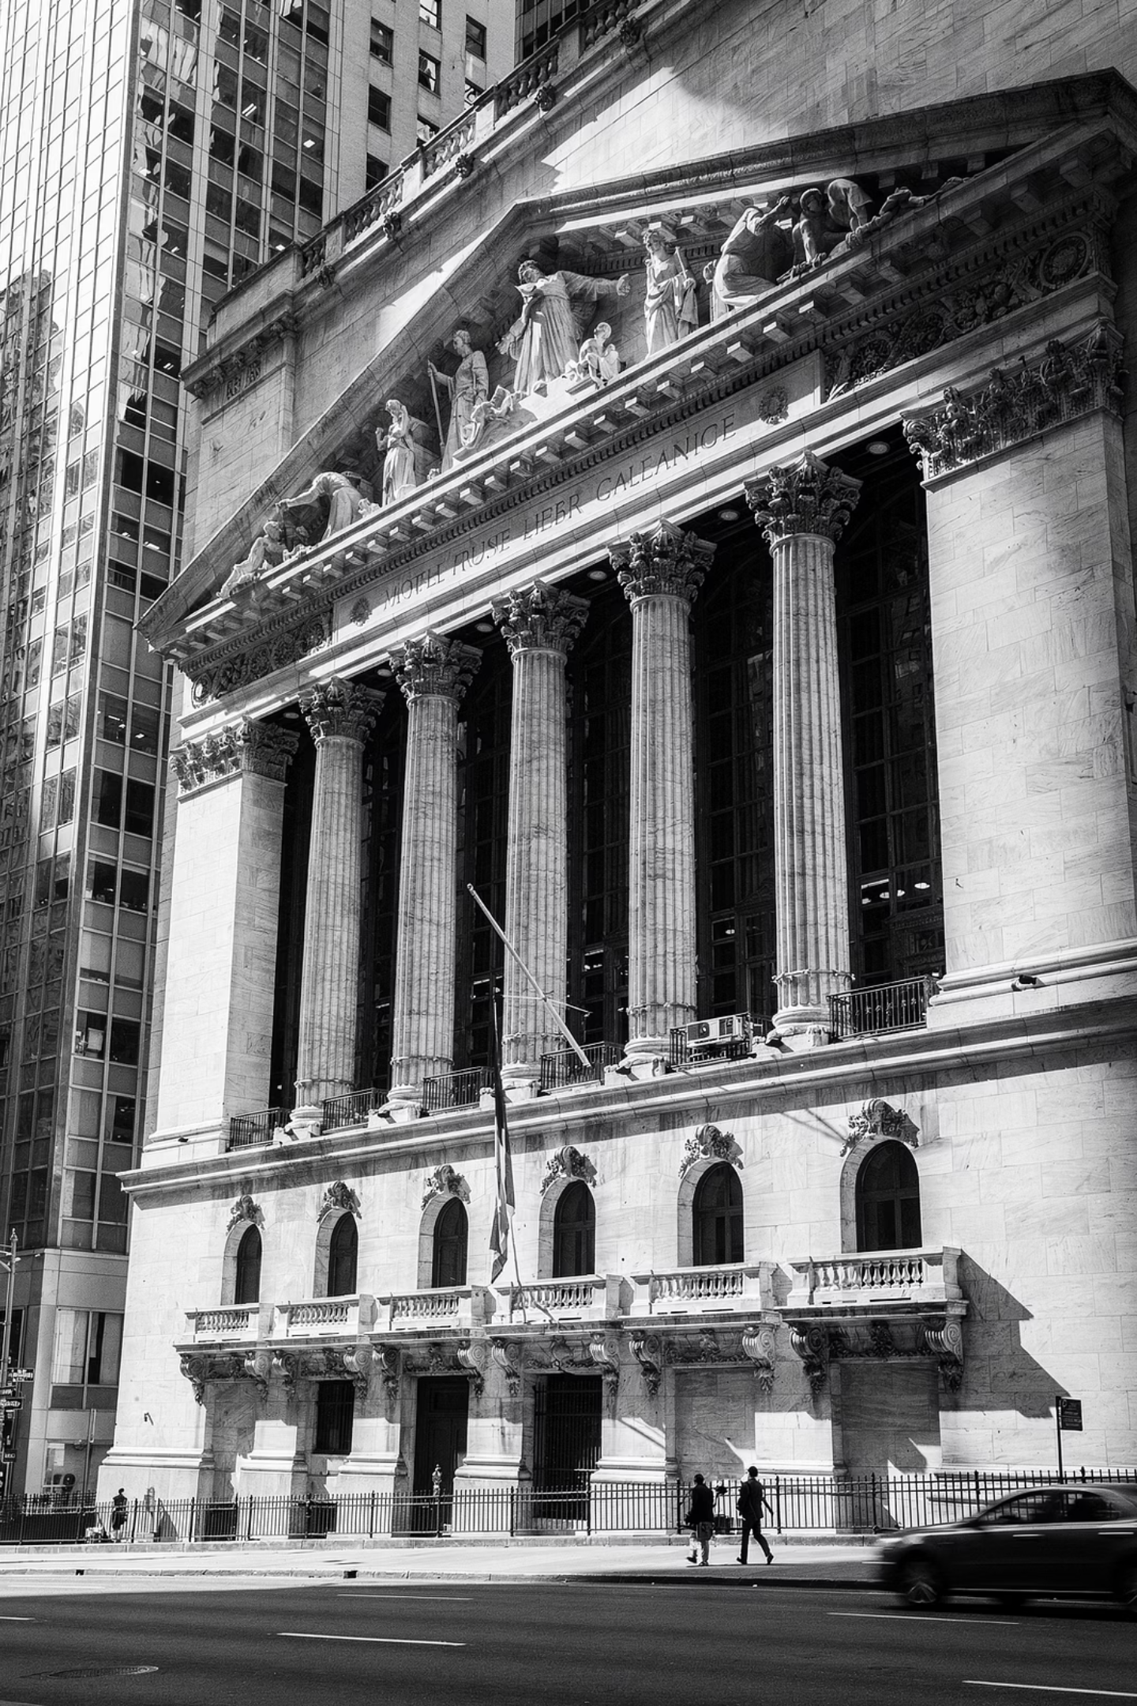

Case Introduction
"In September 2008, Lehman Brothers — a 158-year-old investment bank — filed for bankruptcy. At the time, it was the fourth-largest investment bank in the United States."
The question is not whether markets were volatile. Markets are always volatile.
The central question: Why did Lehman fail?

Slide 3
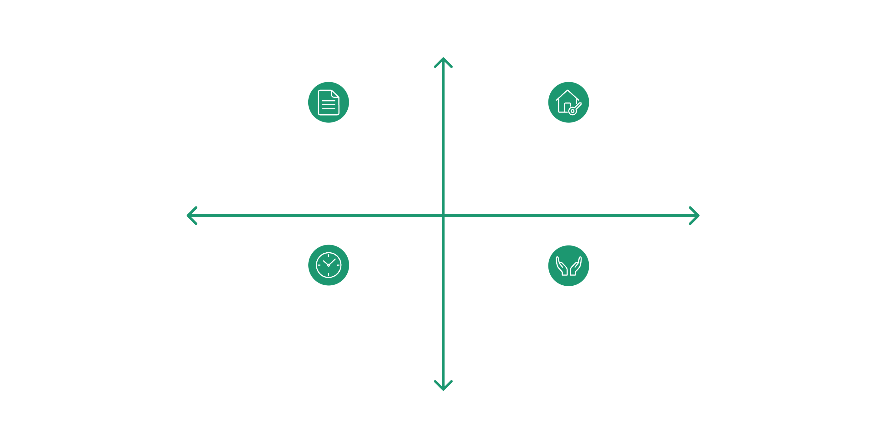




Business Model
Lehman operated heavily in mortgage-backed securities. It borrowed short-term funds from the repo market and invested in long-term, illiquid mortgage assets.
The Maturity Mismatch
This created a critical structural vulnerability at the heart of its balance sheet.
Short-term liabilities.Long-term assets.
Funding that could vanish overnight — tied to assets that could not be sold quickly.
High Long-Term Assets
Concentrated MBS Holdings
Illiquid Mortgage Assets
Low Short-Term Liabilities
High Short-Term Liabilities
Overnight Repo Borrowing
Short-Term Funding Reliance
Low Long-Term Assets

Slide 4

Leverage
30:1
4th
Leverage Ratio
Largest US Bank
For every $1 of equity, Lehman held over $30 of assets.
Lehman's scale made its leverage systemically dangerous.
Good Times
Bad Times
High leverage magnifies returns — a small gain on assets produces outsized equity returns.
High leverage equally magnifies losses — a small decline in asset value can wipe out equity entirely.

Slide 5
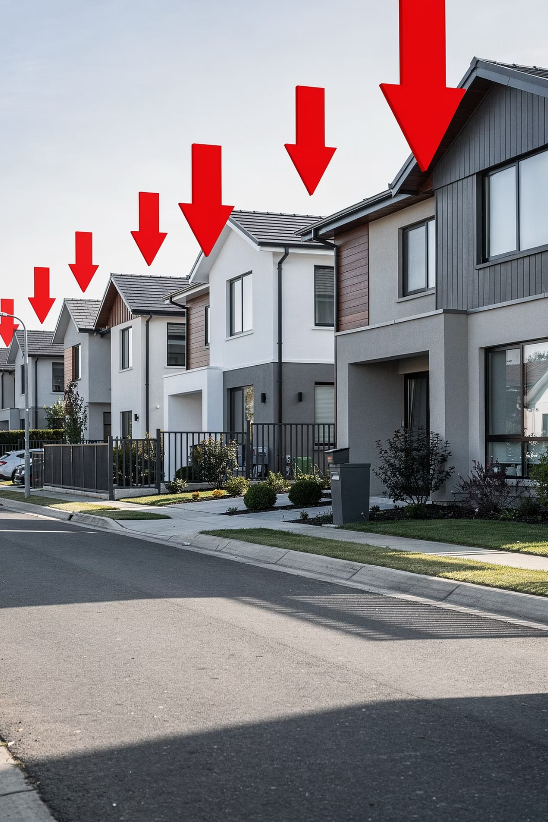
Market Risk
When housing prices began declining, the value of mortgage-backed securities fell. That directly exposed Lehman to market risk — the risk that asset values move against a firm's positions.
Key Insight
Market risk alone does not cause collapse.
It was the combination of risks that proved fatal.
Losses mounted on the balance sheet as the housing market deteriorated through 2007 and into 2008.

Slide 6

Liquidity Risk
"Lehman did not suddenly become insolvent overnight. It became illiquid. And illiquidity kills faster than insolvency."
Confidence Erodes
Funding Withdrawn
Collapse
Counterparties began to lose confidence in Lehman's balance sheet as losses mounted.
Short-term lenders refused to roll over funding — the repo market dried up almost overnight.
Without short-term funding, Lehman could not operate — despite holding long-term assets.

Slide 7


Risk Management Failure
The firm had models. It had VaR calculations. It had internal controls. Yet three critical failures occurred:
Excessive Leverage
1
Leverage exceeded the firm's capacity to absorb losses under stress scenarios.
Tail Risk Underestimated
2
Models failed to account for extreme, low-probability but high-impact events.
Liquidity Dependency
3
Over-reliance on short-term funding with no adequate contingency plan.
This was not a failure of mathematics. It was a failure of risk alignment.

Slide 8
Teaching Transition
Lehman demonstrates that risk exists in layers — and that each layer interacts with the others:
Market Risk
Liquidity Risk
Governance Failure
Triggered losses as housing prices declined and MBS values fell.
Accelerated collapse as short-term funding was withdrawn by counterparties.
Amplified exposure by allowing excessive leverage and poor risk alignment.
"This is why Financial Risk Management is not optional — it is structural."

