Slide 1
A NEW ENCRYPTION ALGORITHM TO SECURELY SEND DATA USING QR CODES
SAURABH KUMAR OJHA 17BCE0773
VAIBHAV VERMA 17BCE0326

Slide 2
What is QR Code?
QR code (abbreviated from Quick Response Code) is the trademark for a type of matrix barcode (or two-dimensional barcode).
A barcode is a machine-readable optical label that contains information about the item to which it is attached.
The Quick Response system became popular due to its fast readability and greater storage capacity compared to standard UPC barcodes.
A QR code consists of black squares arranged in a square grid on a white background, which can be read by an imaging device such as a camera.

Slide 3
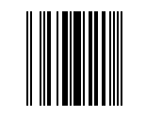

Difference between Upc barcode and QR codes
UPC BARCODE
QR CODE

Slide 4
INTRODUCTION:
In this presentation we propose a new encryption algorithm that uses encrypted QR codes for exchanging the data securely between two communicating users.
The algorithm uses a private key upon which both parties must agree.
The algorithm first encodes the data to be sent in a QR code and then encrypts the QR code using the private key.
The transmitted QR code cannot be tampered with unless the private key is used for decryption.

Slide 5
UNDERSTANDING THE ENCRYPTION PROCESS:
The working of the algorithm can be summarised as follows:
The two users agree on a private key text.
The users then generate the QR codes for the private key (KeyQR).
The sender then generates the QR code for the data he wants to send to the receiver (DataQR).
The sender then encrypts the DataQR using the KeyQR and generates a transmission QR code (transmissionQR).
The transmissionQR is then transmitted through the channel to the receiver.
The receiver decrypts the transmissionQR with the help of the KeyQR to obtain the DataQR.
The receiver decodes the DataQR to obtain the data sent by the sender.

Slide 6
HOW IS THE QR CODE ENCRYPTED:
The QR code is encrypted using a simple yet a very effective process.
The KeyQR and the DataQR are Xor’ed Bitwise to generate the transmission QR.
Thus the transmissionQR can be summarised into a formula as follows:
transmissionQR = KeyQR ⊕ DataQR
where the symbol ⊕ denotes the bitwise XOR operation.

Slide 7
WHY XOR?
XOR operation has a unique property of reversibility.
Since the XOR operation is performed bitwise, it is extremely fast and thus makes the encryption and decryption algorithm very fast.
This property of XOR makes it very useful in the encryption and decryption algorithm.

Slide 8
PROOF 1:
PROOF OF RECOVARABILITY:
DataQR can be generated from transmissionQR and KeyQR and Vice Versa.

Slide 9
Let ‘D’ denote the DataQR , ‘K’ denote the KeyQR, ‘T’ denote the transmissionQR.
STEP 1: AT THE SENDER’S SIDE:
TransmissionQR is generated by DataQR and KeyQR by bitwise Xor of the two.
Thus, T = D⊕K
STEP 2: AT THE RECEIVER’S SIDE:
DataQR is generated back by Xor between the transmissionQR and the KeyQR.
Let G denote the generatedQR at the receiver’s end.
Thus, G = T ⊕K
Also, T = D⊕K (From the sender’s Side)
Hence, G = (D⊕K) ⊕K.
G = D ⊕(K ⊕K) (XOR operations are associative)
G = D ⊕(0) (XOR of an element with itself gives 0)
G = D (XOR of an element with 0 gives the element)
This proves our hypothesis that DataQR can be generated from transmissionQR and KeyQR and vice versa.

Slide 10
PROOF 2:
PROOF OF UNIQUENESS:
There can be only one private key that can Decrypt the transmissionQR to regenerate DataQR.

Slide 11
Proof by contradiction:
Let K1 be the first KeyQR that decrypts the transmissionQR to generate DataQR.
Thus, T ⊕ K1 = D
Take an XOR of T on both the sides we have,
T ⊕ (T ⊕ K1) = D ⊕ T
(T ⊕ T) ⊕ K1 = D ⊕ T
0 ⊕ K1 = D ⊕ T
K1 = D ⊕ T -(i)
Let K2 be the second KeyQR that decrypts the transmissionQR to generate DataQR.
Thus, T ⊕ K2 = D
Take an XOR of T on both the sides we have,
T ⊕ (T ⊕ K2) = D ⊕ T
(T ⊕ T) ⊕ K2 = D ⊕ T
0 ⊕ K2 = D ⊕ T
K2 = D ⊕ T -(ii)
But (i) and (ii) contradicts our assumption that K1 and K2 are different keys.
Thus by the method of contradiction we have proved that K1 and K2 are the same keys and thus there can be only one key that can decrypt the transmissionQR to generate the DataQR.

Slide 12
How to apply the algorithm to a QR code?

Slide 13
Since QR code is an image and image is a collection of pixels, we can manipulate the each pixel individually to generate the transmissionQR and the DataQR respectively.
A QR code is a collection of black and white pixels and we can use the binary form of this image to denote black by 0 and white by 1.
This will ensure that the bitwise XOR can be applied to each pixel individually to generate the transmissionQR and the DataQR code respectively.

Slide 14




A pictorial Representation Of Pixel Wise Xor:
Black(0) XOR White(1) gives White(1):
White(1) XOR Black(0) gives White(1):
Black(0) XOR Black(0) gives Black(0):
White(1) XOR White(1) gives Black(0):

Slide 15
Why is this algorithm failsafe?

Slide 16
Consider a transmissionQR code of size 128*128 pixels while it is generated.
In order to forge a KeyQR code to decrypt the message consider the brute force method of generating the KeyQR.
Each pixel in the forged KeyQR will have 2 choices: It can either be black or white.
Thus for 128*128 pixels we have 2(128*128) choices.
Any modern day computer would take more than the life of universe to generate and check all the combinations to find out the correct KeyQR.
Thus the security of our algorithm is time bound.

Slide 17
Example:
Let users Agree on the following private keyQR:

Slide 18
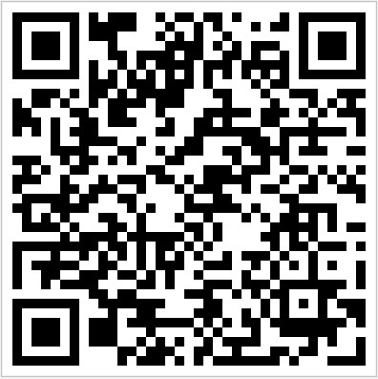
The data to be encoded in DataQR be say “username:abc@abc.com password:abcdefghi” the DataQR generated be:

Slide 19
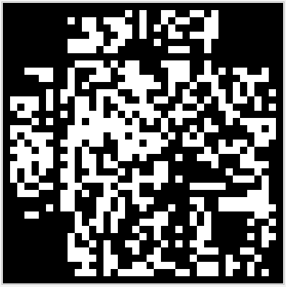
THE TRANSMITTEDQR IS AS FOLLOWS:

Slide 20
RETRIEVED QR IS AS FOLLOWS:

