Slide 1
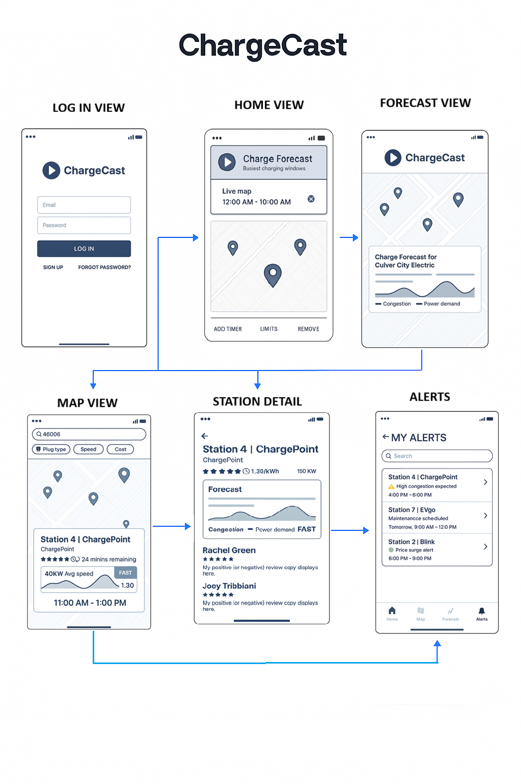
ChargeCast Wireframes
Login Screen:
Users enter credentials or sign up.
Home View
Displays a live map of nearby charging stations.
Includes a “Charge Forecast” widget showing busiest charging windows.
Forecast Detail
Offers a deeper look into predicted demand and pricing trends.
Includes a graph of congestion and power demand over time.
Map View
Interactive map with filters by plug type, speed, and cost.
Highlights selected station with real-time info.
Station Detail
Detailed view of a specific station: plug types, pricing, wattage.
Forecast panel shows expected demand and optimal charging times.
Includes user reviews and ratings.
Alerts Screen
Users can set custom alerts for malfunction, availability, or congestion.
Alerts are shown with time windows and thresholds.

Slide 2
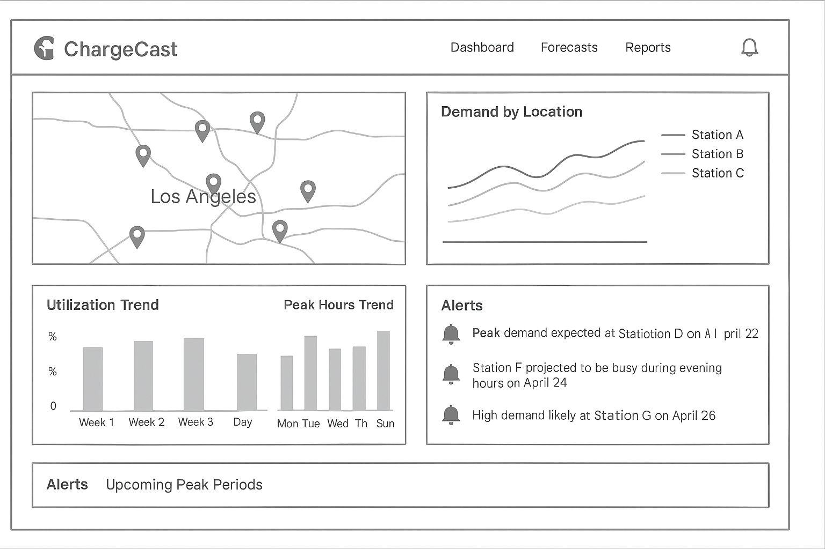
ChargeCast Forecast Dashboard
ChargeCast dashboard purpose is to provide real-time analytics and forecasting tool for EV charging station performance and planning.
Geographic Coverage
Identifies high-density zones and coverage gaps
Demand by Location
Tracks usage over time for different station
Reveals seasonal and daily patterns
Utilization Trend
Weekly usage rates
Supports maintenance scheduling
Highlights busiest days (Mon–Sun)
Aids in staffing and energy load balancing
Real-Time Alerts:
Upcoming Peak Periods
Malfunction notifications
Grid overloads
Future demand prediction

