Slide 1
CS 354 MINOR PROJECT
Customer Segmentation
Purnadip Chakrabarti (190002048)
Vaibhav Chandra (190001065)

Slide 2
INDEX
Problem Statement
Data Exploration, Analysis and Processing
K-Means Algorithm for Clustering
Improvement in K-Means using K-Means++
Evaluation Techniques: Inertia and Dunn Index
Insights on Final Clustered Data
Conclusion

Slide 3
Problem Statement
Modern businesses have very large database for transactions from the customers.
This data can be used to target different categories of customers with different marketing strategies based on the purchasing habits of that category.
However, manual analysis of billions of data points is not practically possible
Here comes the scope of machine learning to cluster the data into different categories
This is the popular problem of customer segmentation which we solved using “Unsupervised Learning”
Customer Segmentation

Slide 4
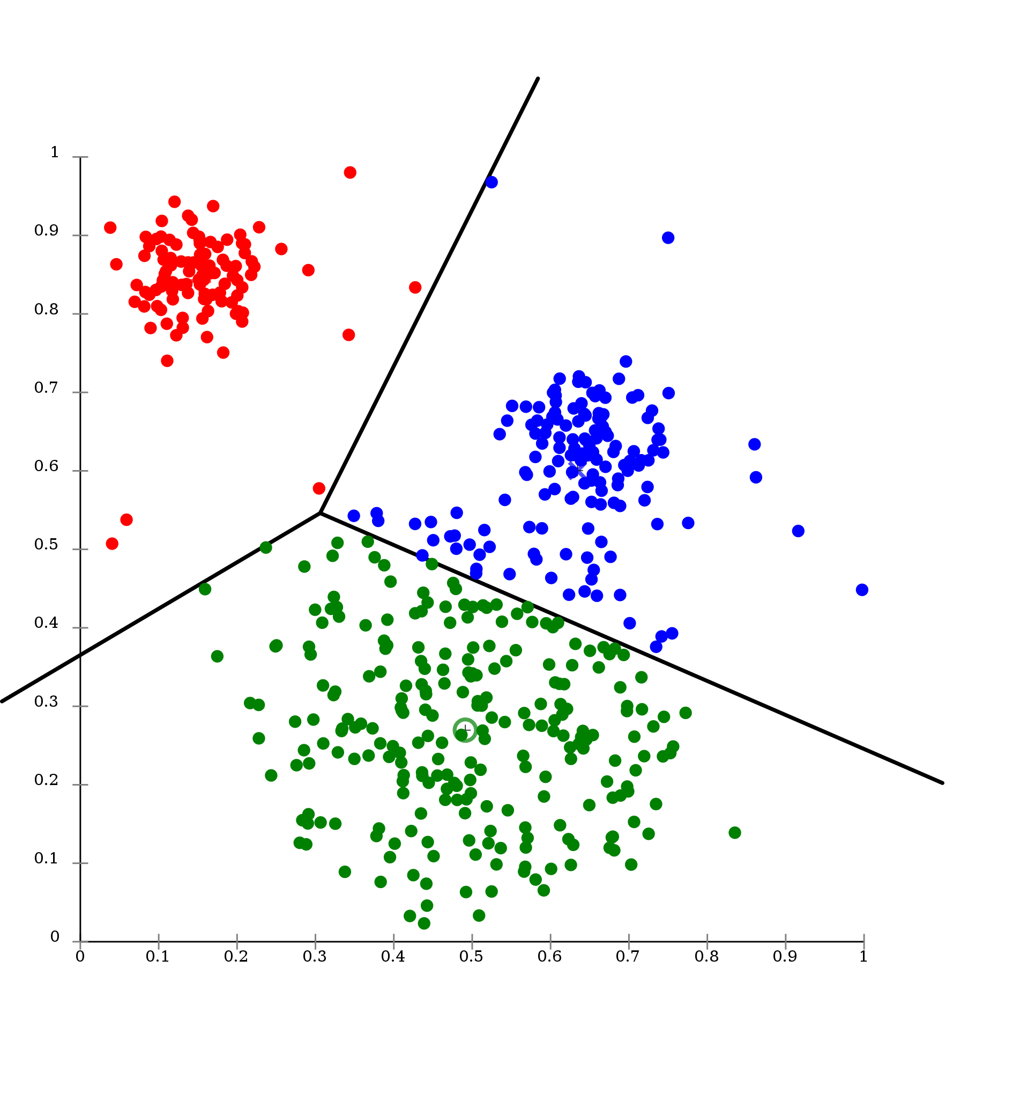
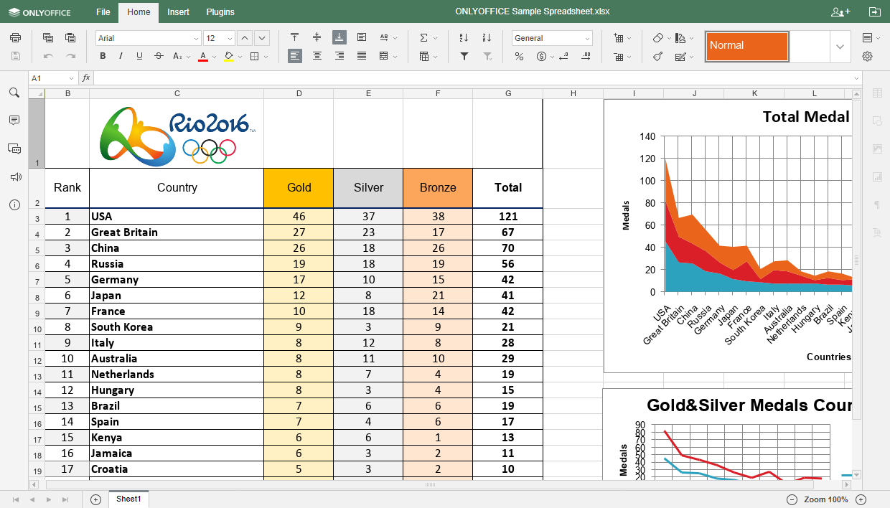

Problem Statement (Contd.)
Input: Data comprising of transactions done by customers
Output: All customers clustered into some category
Paradigm: Unsupervised Learning

Slide 5
Data Exploration, Analysis and Processing
Data Link: https://drive.google.com/file/d/136XGsdeK6-mPUb31xtToyara1amrTjIE/view?usp=sharing
(Taken From Kaggle)

Slide 6
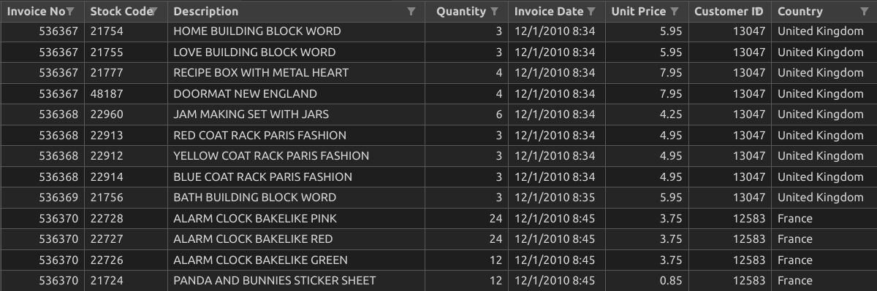
First Sight at Data
(First few rows)
Number of Rows: 5,41,909 Number of Columns: 8

Slide 7
Features of the data
The features of the data are as follows:
Invoice No
Stock Code
Description
Quantity
Invoice Date
Unit Price
Customer ID
Country
A Customer purchases one or more times at a store and for each such purchase one Invoice is generated which has a corresponding Invoice number and Invoice Date.
Each such purchase comprises of multiple products and each product has an associated Stock Code
Each row of the the data corresponds to a product in a single purchase by a customer

Slide 8
Initial Processing
Dropping all rows with any NULL values
Dropping duplicate rows
Mapping countries to indices and storing indices in the data instead of countries
Dropping all rows which correspond to cancelled transactions (Denoted by invoice numbers starting with ‘C’)
Number of data points (rows) left: 3,92,856

Slide 9
Further Strategy for Data Processing
Our final data should have features related to each customer in a row
However, the current data has features of a product of a single transaction in a row
We have to convert this data into our desired form so that we can apply clustering algorithm on the processed data

Slide 10
Further Strategy for Data Processing (Continued)
Cluster the products into categories and for each invoice / bill, include the expenditure in each category
For each invoice, include the information for total expenditure
Now, each row of the table will have details of a particular invoice which includes total expenditure and product category wise expenditure
Now, for a single customer, we will have one or more invoices
So, we will sum total expenditure and category wise expenditures for all invoices
Finally, each row of the table will have details of a particular customer which includes total expenditure and product wise expenditure
PRODUCTS
INVOICES
CUSTOMERS

Slide 11
Product Categorization
Take Product Description and extract nouns using Natural Language Toolkit
Perform lemmatization on the nouns to get the roots
Find the frequency of each root in the whole dataset and pick the most popular roots (185 in our case)
For each Product, find the frequency for each of the popular roots. This way, we will have 185 features for each product
Similarly, divide all the prices into some ranges (6 in our case) and for each product find the price range in which it lies
In total we had 193 features for each product.
Then run a clustering analysis to find the optimal number of product categories

Slide 12
7
is the
Optimal number of Product Categories
( Explanation in upcoming slides )

Slide 13
Next Step
Following our plan, we calculated expenditures for each of the 5 product categories for each invoice
We then calculated expenditures for each of the 5 product categories for each customer
We also added some columns for min, max, mean expenditure and frequency of visiting the store
This formed 12 features for each customer and we then applied clustering algorithm on it to compute the categories

Slide 14
6
is the
Optimal number of Customer Categories
( Explanation in upcoming slides )

Slide 15
K-Means Algorithm
An unsupervised learning algorithm to cluster data into K categories

Slide 16
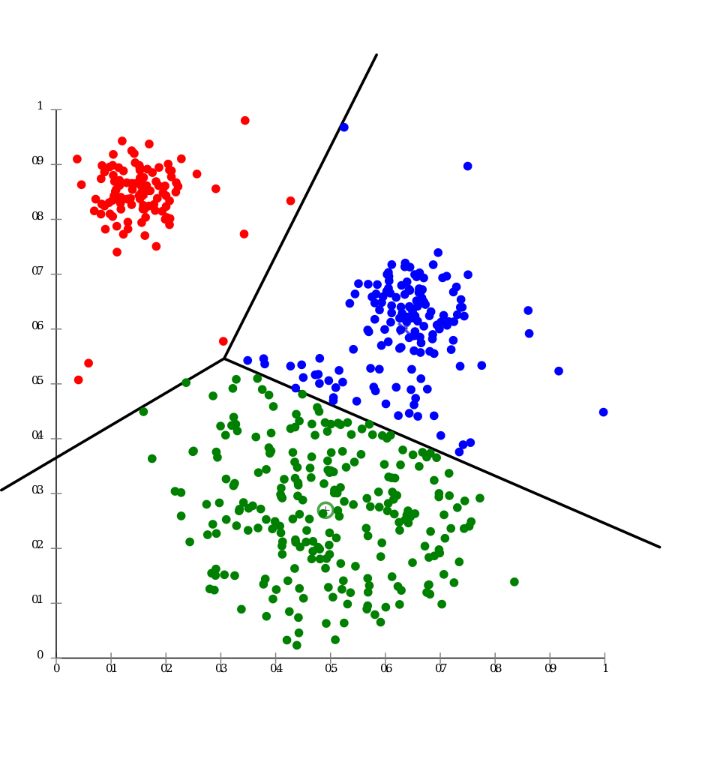
K-Means Algorithm
Select the number K to decide the number of clusters
Select K points / centroids
Assign each data point to its closest centroid which will form the predefined K clusters
Calculate the centroid of all points assigned to a cluster and make it the new center
Repeat step-3 and in case of some new reassignment, repeat step 4 else FINISH

Slide 17
In Step-2 of above algorithm, we had to choose K centroids randomly.
However, there is a better method which gives a better initialisation and hence a better clustering.

Slide 18
Improvement in K-Means using K-Means++
An initialisation method for better results in clustering using K-Means algorithm

Slide 19
K-Means++ Algorithm
Input K for making K centroids
Pick up the first centroid randomly among the existing data points
Pick the next centroid as the data point which is at maximum distance from already assigned data points
Repeat step 3 until we get K centers
FINISH

Slide 20
Evaluation Techniques
Methods to select optimal K for K-Means and K-Means++
Inertia and Dunn Index

Slide 21
Inertia

Slide 22
Inertia
Inertia is the sum of squared distances between all the data points and their corresponding cluster centers
Clustering is considered to be good if inertia is very low and the number of clusters are also low
With more number of clusters, inertia also decreases. But more number of clusters doesn’t give practical solutions.
So, we draw a graph of inertia vs K which comes out to be an elbow graph. The rate of change of inertia wrt K decreases gradually. So, we choose the value of K at the point where this rate slows down

Slide 23
Dunn Index

Slide 24
Dunn Index
It is the ratio of lowest inter cluster distance to the highest intra cluster distance
Clustering is considered to be good if the Dunn Index is higher
Ideally it should be close to 1.0
Inertia and Dunn Index generally are in inverse relationship. So we have to choose an optimal K such that it has lower inertia and higher Dunn Index.
We applied the same theory to choose 7 clusters for product categorization and 6 clusters for customer categorization

Slide 25
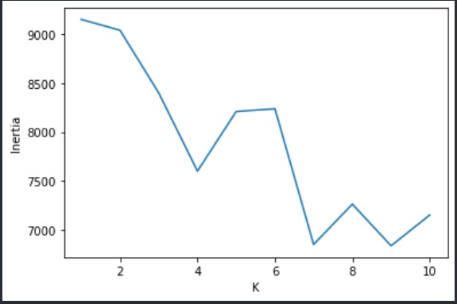
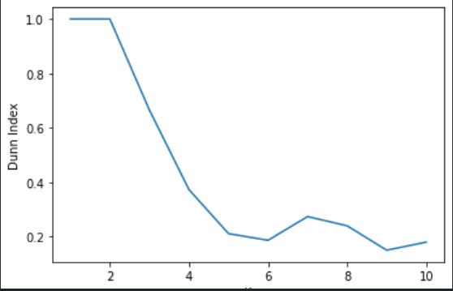
Product Categorization
Inertia
Dunn Index

Slide 26
Number of Products per cluster
0 : 622
1 : 97
2 : 1076
3 : 510
4 : 404
5 : 925
6 : 31
Total = 3665

Slide 27
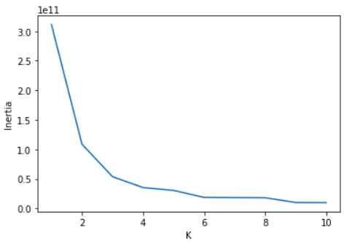
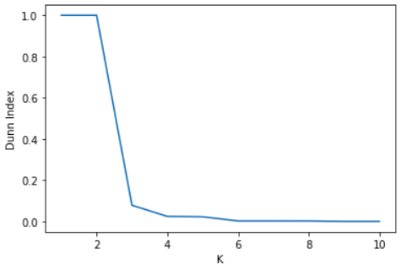
Customer Categorization
Inertia
Dunn Index

Slide 28
Number of Customers per cluster
0 : 1887
1 : 4
2 : 3
3 : 27
4 : 209
5 : 2197
Total = 4327

Slide 29
Insights on Final Clustered Data
Targeting different categories of customers with different product categories

Slide 30
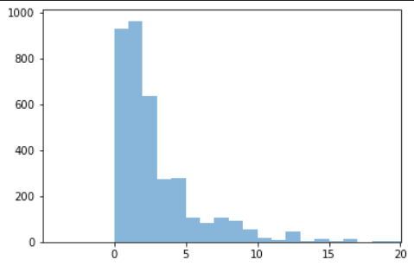
Price Ranges
0-1
1-2
2-3
3-5
5-10
>10

Slide 31
Customer Category Distribution for different Product Categories

Slide 32
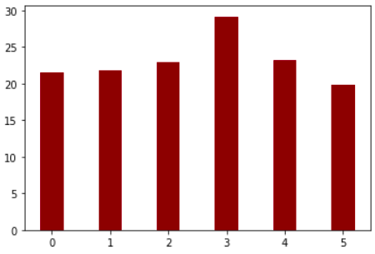
Customer Category Distribution for Product Category - 1

Slide 33
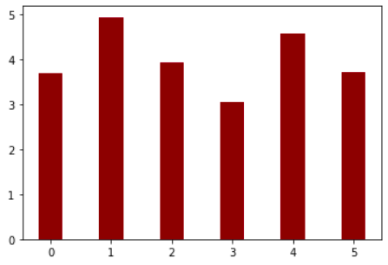
Customer Category Distribution for Product Category - 2

Slide 34
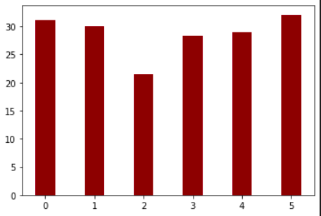
Customer Category Distribution for Product Category - 3

Slide 35
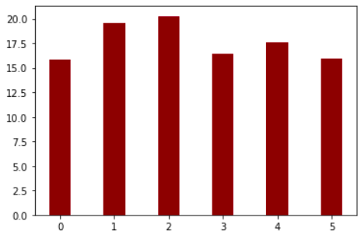
Customer Category Distribution for Product Category - 4

Slide 36
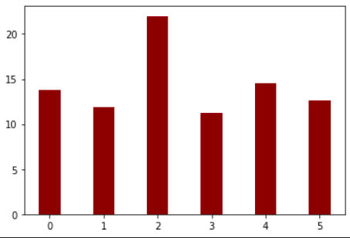
Customer Category Distribution for Product Category - 5

Slide 37
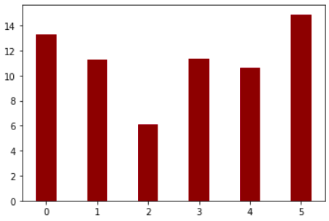
Customer Category Distribution for Product Category - 6

Slide 38
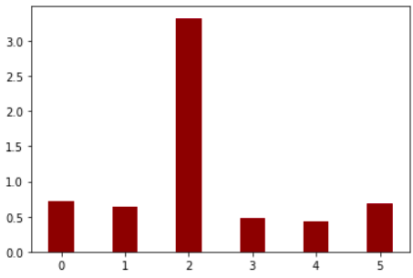
Customer Category Distribution for Product Category - 7

Slide 39
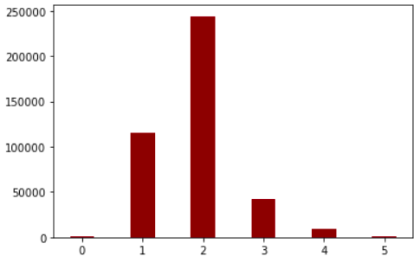
Customer Category Distribution for Total Expenditure

Slide 40
Word Clouds for different Customer Categories

Slide 41
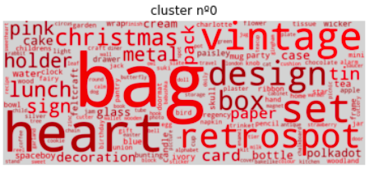
Word cloud for Customer Category - 1

Slide 42
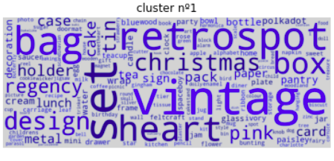
Word cloud for Customer Category - 2

Slide 43
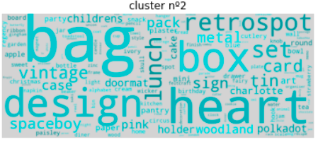
Word cloud for Customer Category - 3

Slide 44
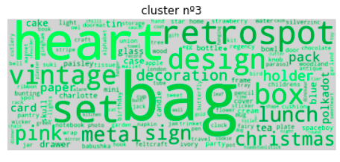
Word cloud for Customer Category - 4

Slide 45
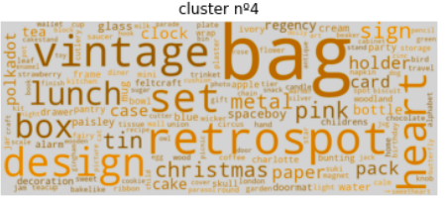
Word cloud for Customer Category - 5

Slide 46
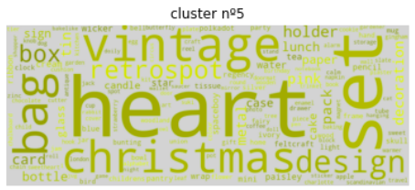
Word cloud for Customer Category - 6

Slide 47
THANK YOU

