Slide 1

Employee Attrition Prediction for HR

Slide 2
Agenda
Objective
Tools & Technology
Methodology / Workflow
Implementation
Conclusion

Slide 3

Objective
To analyze employee data and identify factors affecting attrition.
To build a predictive model that estimates the probability of an employee leaving.
To help organizations take proactive actions to improve retention.
To support HR teams with data-driven insights for better decision-making.
To reduce employee turnover by identifying high-risk individuals early.

Slide 4
Tools & Technology
Programming Language : Python – for data analysis, model building, and evaluation.
Data Analysis : Pandas, NumPy
Data Visualization : Matplotlib, Seaborn, Plotly
Machine Learning : Logistic Regression, Decision Tree, SVM, Gradient Boosting, Random Forest
Environment : Jupyter Notebook, VS Code

Slide 5
Workflow
Data Collection
Data Processing
Exploratory Data
Analysis
Model Training
Model
Deployment

Slide 6
Methodology
Problem Understanding
Identify the goal: Predict whether an employee will leave the company.
Understand HR-related factors influencing attrition.
Data Collection
Use the Employee Attrition dataset containing demographics, job-related, and performance-related features.
Data Preprocessing
Handle missing values
Encode categorical variables
Exploratory Data Analysis (EDA)
Identify patterns and correlations
Visualize attrition trends by job role, salary, age, overtime, etc.
Detect key drivers of attrition
Model Training
Train Multiple Models
Evaluate using F1-Score, Precision, Recall, AUC
Model Deployment
Save the trained model using Joblib
Ready to integrate into applications

Slide 7
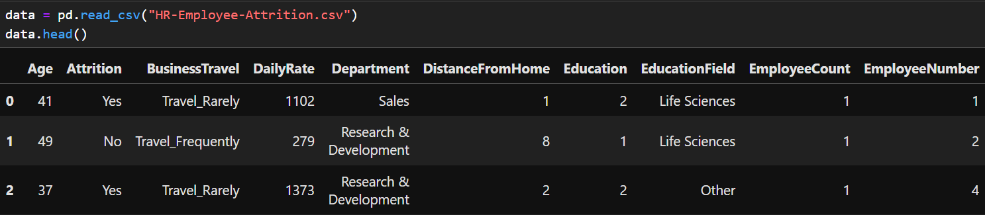
Implementation
Data Collection
Data Preprocessing

Slide 8
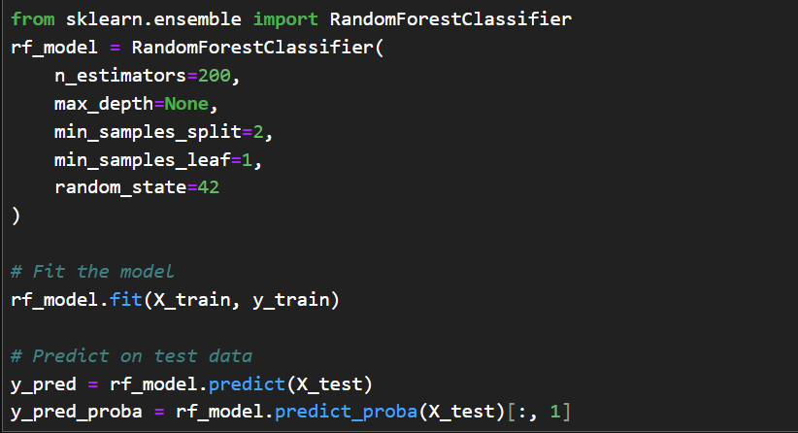
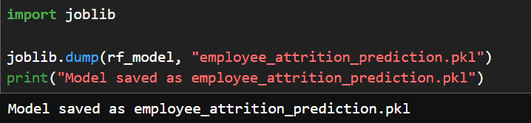
Model Training
Model Deployment

Slide 9

Conclusion
The project successfully developed a reliable Machine Learning model to predict employee attrition using HR and performance-related data.
After evaluating multiple models, Random Forest emerged as the best performer, giving the highest F1-score and consistent results across cross-validation.
The model provides actionable insights by identifying key factors influencing attrition, helping organizations take proactive retention measures.
Predicting attrition probability helps HR teams prioritize high-risk employees and implement targeted interventions.
Overall, the solution supports data-driven decision-making, reduces turnover risk, and contributes to improved organizational stability and employee satisfaction.

Slide 10

Summary
This project focuses on predicting employee attrition using machine learning to help organizations identify employees at risk of leaving. After performing data preprocessing, handling imbalance, and conducting detailed exploratory analysis, multiple models were trained and evaluated.
Random Forest achieved the best performance with the highest and most stable F1-score, making it the final chosen model.
Overall, the project provides a data-driven approach to understand attrition drivers and support strategic HR decision-making.

Slide 11
Thank you
vaibhavvst8@gmail.com

