Slide 1

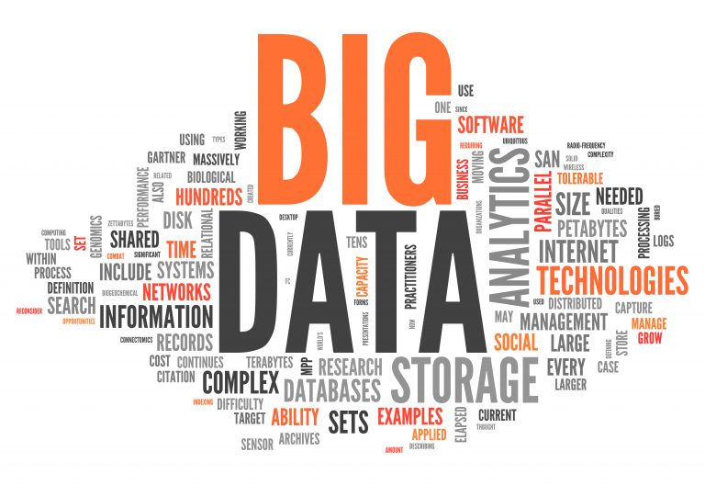
Big Data and Hadoop

Slide 2

Big Data

Slide 3

What is Big Data
According to Gartner
Big Data is high-volume, high-velocity and/or high-variety information assets that demand cost-effective, innovative forms of information processing that enable enhanced insight, decision making, and process automation.

Slide 4

What is Big Data
Big Data has to deal with large and complex datasets that can be structured, semi-structured, or unstructured and will typically not fit into memory to be processed.

Slide 5
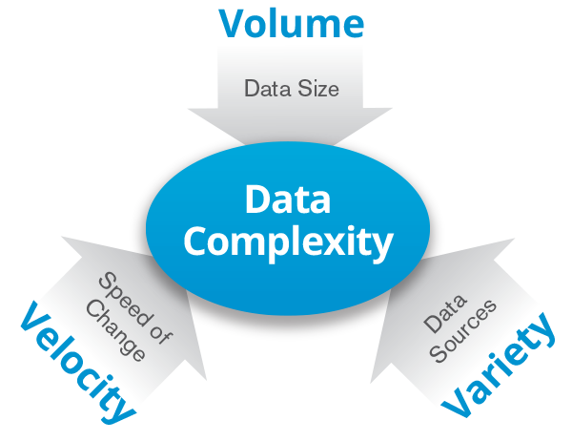
5 V’s of Big Data
The developers typically would mention the 5Vs model of Big Data, which are velocity, volume, variety, value and .

Slide 6
5 V’s of Big Data
Velocity refers to the low latency, real-time speed at which the analytics need to be applied.
A typical example of this would be to perform analytics on a continuous stream of data originating from a social networking site or aggregation of disparate sources of data.

Slide 7
5 V’s of Big Data
Volume refers to the size of the dataset. It may be in KB, MB, GB, TB, or PB based on the type of the application that generates or receives the data.
Variety refers to the various types of the data that can exist, for example, text, audio, video, and photos.

Slide 8
5 V’s of Big Data
Value
Value refers to the benefits that big data can provide, and it relates directly to what organizations can do with that collected data. Being able to pull value from big data is a requirement, as the value of big data increases significantly depending on the insights that can be gained from it.

Slide 9
5 V’s of Big Data
Veracity
Veracity refers to the quality, accuracy, integrity and credibility of data. Gathered data could have missing pieces, might be inaccurate or might not be able to provide real, valuable insight. Veracity, overall, refers to the level of trust there is in the collected data.

Slide 10
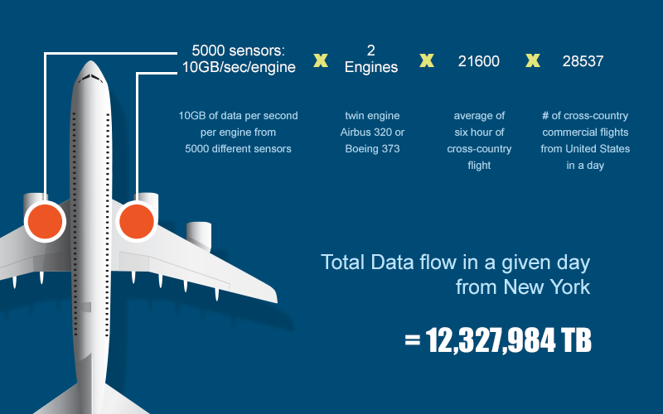
Big Data Examples

Slide 11
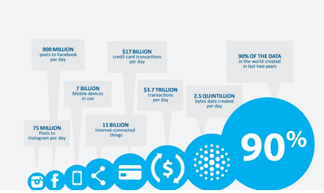
Big Data Examples

Slide 12
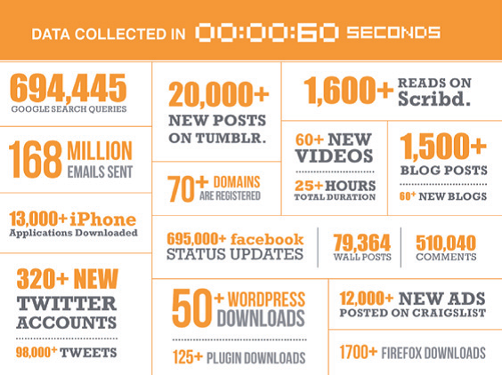
Big Data Examples

Slide 13
Data Generated per day
https://explodingtopics.com/blog/data-generated-per-day

Slide 14
What is Big Data Analysis
Big data analytics is the process of examining large data sets containing a variety of data types -- i.e., big data -- to uncover hidden patterns, unknown correlations, market trends, customer preferences and other useful business information.
Source - http://searchbusinessanalytics.techtarget.com/definition/big-data-analytics

Slide 15
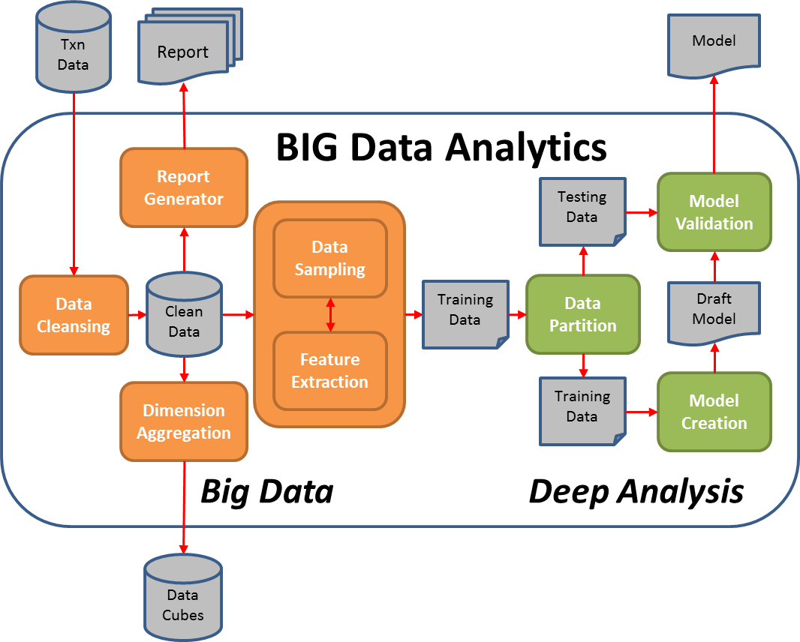
What is Big Data Analysis

Slide 16
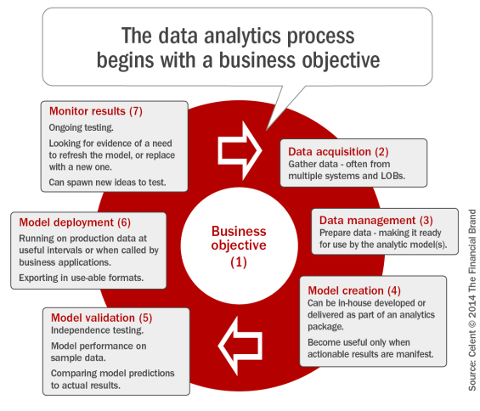
What is Big Data Analysis

Slide 17
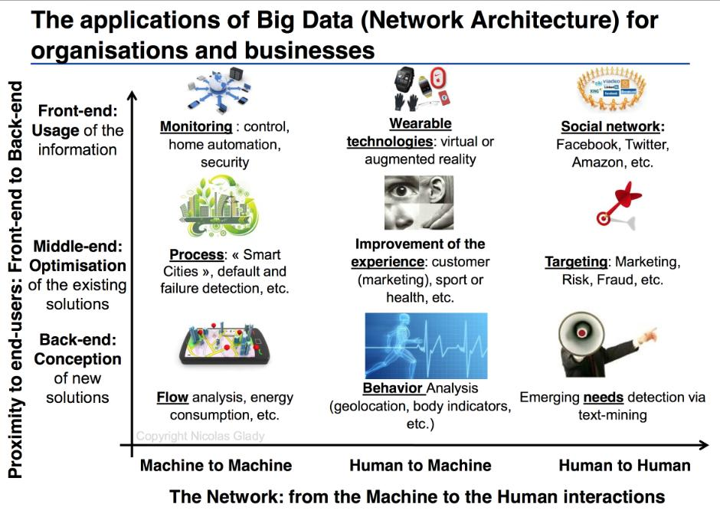
Applications of Big Data

Slide 18
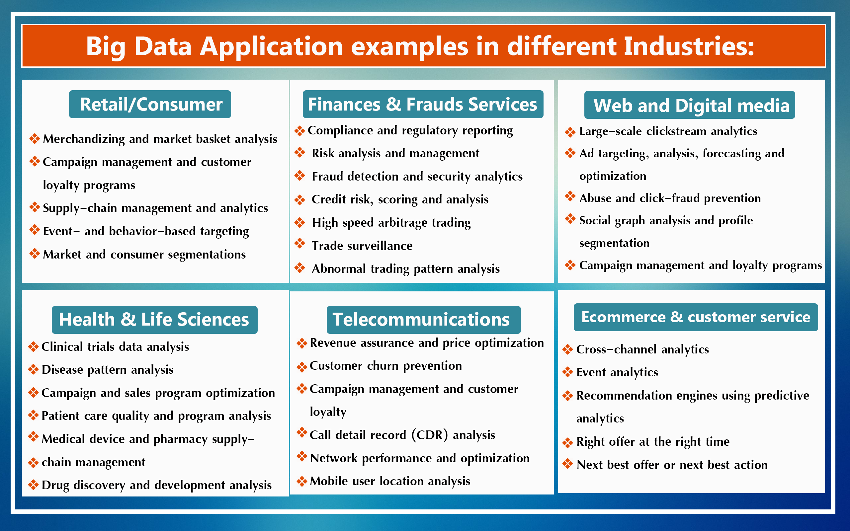
Applications of Big Data

Slide 19
Big Data Analysis - Examples
Some corporates are using big data to reduce risks and costs, identify opportunities, and improve the accuracy of forecasts.
They're using data to identify risky customers, monitor suppliers, thwart fraud, pinpoint revenue leaks, and inform new or more efficient business models.
A recent partnership between The Weather Company and IBM will allow companies to better manage the impact of weather on business performance. According to The Weather Company, weather has an economic impact of half a trillion dollars annually in the US alone.

Slide 20
Big Data Analysis - Examples
The weather data is being collected from more than 100,000 weather sensors and aircraft, as well as millions of smartphones, buildings, and moving vehicles.
That data is combined with data from other sources to yield 2.2 billion unique forecast points, and an average of more than 10 billion forecasts on an active weather day.
Retailers can use the data to adjust staffing and supply chain strategies.
Energy companies can use it to improve supply and demand forecasting.
Insurance companies can use it to warn policy holders of severe weather conditions, so they can minimize the possibility of car damage in the event of a hail storm.

Slide 21
Big Data Analysis - Examples
Pratt & Whitney, a unit of United Technologies Corp., is attempting to reduce unplanned aircraft engine maintenance.
According to AirInsight.com, today's engines collect about 100 parameters in multiple snapshots while a plane is in flight.
By comparison, a new-generation engine is able to collect about 5,000 parameters continuously in flight.
The process generates about 2 petabytes of data.
Using the data, Pratt & Whitney and its partner IBM are trying to enable proactive maintenance.

Slide 22
Big Data Analysis - Examples
Burberry Group plc and personalized shopping. Burberry is using radio frequency identification (RFID) tags in its stores to create a richer shopping experience. When a customer walks by a display screen with an item in hand, the RFID tag triggers a video showing how the item was made and offering up other products complementary to it. With the customer's permission, RFID tags can also help create a customer profile by keeping tabs on what he or she has tried on.

Slide 23
Big Data Analysis - Examples
CVS Health and the call center. CVS launched a call center pilot program that Laney likened to Match.com. Using technology from Mattersight, CVS began experimenting with "predictive behavior routing" by segmenting customers into about six behavior groups.
The drugstore chain is also scoring call center agents so that it can match agents with the kinds of customers they'll best engage with.
The pilot reduced call time and improved the performance of the calls themselves, according to Laney, and was so successful, it was taken to full production.

Slide 24
Big Data Analysis - Examples
Westpac Banking Corp. and the 360-degree view of the customer. For the last few years, the Australian bank has been using technology from SAS Institute to build a 360-degree view of the customer program called "KnowMe."
The program is built on, in part, capturing and centralizing customer activity such as ATM usage and call center interaction from its 12 million customers.

Slide 25
Big Data Analysis - Examples
Based on behavioral analysis, Westpac is matching customers with new programs or offerings.
In nine months, the program enabled Westpac to grow its customer engagement from 1% to 25%, according to Laney.

Slide 26
How companies use Big Data
Netflix
Netflix began as a DVD mailing service and developed algorithms to help it to predict viewers’ preferences and habits. Now it delivers films over the internet and can easily collect information about when movies are watched, how often films might be stopped and restarted, where they might be abandoned, and how users rate films.

Slide 27
How companies use Big Data
Netflix
This allows Netflix to predict which films will be popular with which customers. It is also being used by Netflix to produce its own TV series, with much greater assurance that these will be hits.

Slide 28
How companies use Big Data
Amazon
The world’s leading e-retailer collects huge amounts of information about customers’ preferences and habits which allow it to market very accurately to each customer. For example, it routinely makes recommendations to customers based on products previously purchased.

Slide 29
How companies use Big Data
Airlines
Airlines know where you’ve flown, preferred seats, cabin class, when you fly, how often you search for a flight before booking, how susceptible you are to price reductions, probably which airline you might book with instead, whether you are returning with them but didn’t fly out with them, whether car hire was purchased last time.

Slide 30
How companies use Big Data
Airlines
What class of hotel you might book through their site, which routes are growing in popularity, seasonality of routes. They also know the profitability of each customer so that, for example, if a flight is cancelled they can help the most valuable customers first.

Slide 31
How companies use Big Data
This information allows airlines to design new routes and timings, match routes to planes and also to make individualised offers to each potential passenger.

Slide 32
Challanges of Big Data
Storage
With vast amounts of data generated daily, the greatest challenge is storage (especially when the data is in different formats) within legacy systems.
Unstructured data cannot be stored in traditional databases.

Slide 33
Challanges of Big Data
Processing
Processing big data refers to the reading, transforming, extraction, and formatting of useful information from raw information. The input and output of information in unified formats continue to present difficulties.

Slide 34
Challanges of Big Data
Security
Security is a big concern for organizations.
The value of the data may be critical for the organization.
Non-encrypted information is at risk of theft or damage by cyber-criminals.
Therefore, data security professionals must balance access to data against maintaining strict security protocols.

Slide 35
Challanges of Big Data
Finding and Fixing Data Quality Issues
Many organizations are probably dealing with challenges related to poor data quality.
The incomplete or irrelevant data is the major issue.
Such data affects the outcome of the data analytics process.

Slide 36
Challanges of Big Data
Finding and Fixing Data Quality Issues
The following are the approaches to fixing data problems:
Correct information in the original database.
Identifying the original data source is necessary to resolve any data inaccuracies.
You must use highly accurate methods of determining the valid data.

Slide 37
Challanges of Big Data
Scaling Big Data Systems
As the velocity and/or volume of the data increases with the time, it becomes necessary for the organization to process the data faster to get accurate and timely results.
Then only organizations can achieve benefits from the data analysis.
However for this they need to scale their systems to mach the requirements.

Slide 38
Challanges of Big Data
Scaling Big Data Systems
Database sharding, memory caching, making use of the cloud and separating read-only and write-active databases are all effective scaling methods.

Slide 39
Big Data Technologies
Big data technology is a set of software-utility.
This technology is primarily designed to analyze, process and extract information from a large data set and a huge set of extremely complex structures.
This is very difficult for traditional data processing software to deal with.

Slide 40
Big Data Technologies
Operational Big Data Technologies
This type of big data technology mainly includes the basic day-to-day data that people used to process.
Typically, the operational-big data includes daily basis data such as online transactions, social media platforms, and the data from any particular organization or a firm, which is usually needed for analysis using the software based on big data technologies.

Slide 41
Big Data Technologies
Operational Big Data Technologies
The data can also be referred to as raw data used as the input for several Analytical Big Data Technologies.
Examples - Twitter, Instagram or Facebook posts, Purchases on Amazon, Flipkart etc, Food orders on Swiggy, Zomato etc. Orders received by an organization.

Slide 42
Big Data Technologies
Analytical Big Data Technologies
Analytical Big Data is mostly referred to as an advanced version of Big Data Technologies.
This type of big data technology is more complex when compared with operational-big data.
Example - Weather forcasting data, Stock market data,

Slide 43
Big Data Technologies
Analytical Big Data Technologies
Analytical big data is mainly used when performance criteria are in use, and important real-time business decisions are made based on reports created by analyzing operational-real data.
This means that the actual investigation of big data that is important for business decisions falls under this type of big data technology.

Slide 44
Big Data Technologies
Top Big Data Technologies are divided into four Sections:
Data Storage
Data Mining
Data Analytics
Data Visualization

Slide 45
Big Data Technologies
Data Storage
The top leading technologies under Data Storage are:
Hadoop: Hadoop is one of the best technologies for handling Big Data. This technology is used to store and process big datasets. This software is created using JAVA.

Slide 46
Big Data Technologies
Data Storage
MongoDB: MongoDB is another important component of big data technologies. It is a document database and is often called a No SQL database program.

Slide 47
Big Data Technologies
Data Storage
RainStor: RainStor is a popular database management system designed to manage and analyze organizations' Big Data requirements. It uses strategies that help manage storing and handling huge amounts of data.

Slide 48
Big Data Technologies
Data Storage
RainStor: RainStor is a popular database management system designed to manage and analyze organizations' Big Data requirements. It uses strategies that help manage storing and handling huge amounts of data.

Slide 49
Big Data Technologies
Hunk: Hunk is a software from Splunk that provides analytics for big data stored in Hadoop.
Cassandra: Apache Cassandra is a highly scalable NoSQL database designed to handle large amounts of data across many servers.
There is no point of failure in this software.

Slide 50
Big Data Technologies
Data Analytics
Big Data Technologies that come under Data Analytics
Apache Kafka: Apache Kafka is an event streaming platform that is used for streaming applications.
Splunk: Splunk is a platform for searching, monitoring, and analyzing generated data, such as log files and event data.

Slide 51
Big Data Technologies
The best operational analytics software under data mining includes:
KNIME: KNIME is an open-source data analytics and integration platform that allows users to design data workflows.
Spark: Apache Spark is an open-source system that provides quick data processing.

Slide 52
Big Data Technologies
The best operational analytics software under data mining includes:
R-Language: R is a programming language designed for statistical computing and graphics. It is used for data analysis and modeling.
Blockchain: Blockchain is a digital ledger technology. It records and verifies transactions across a network of computers.

Slide 53
Big Data Technologies
Data Mining
The top leading software under data mining include:
Presto: Presto is a NoSQL database designed for SQL queries on big datasets. It allows querying data from where it is sourced, including Hive, Hadoop, Cassandra, relational databases, etc.

Slide 54
Big Data Technologies
Data Mining
RapidMiner: RapidMiner is a data science platform that provides an environment for machine learning and predictive model analysis.
ElasticSearch: Elasticsearch is a distributed analytics engine that is commonly used for full-text search and data analytics.

Slide 55
Big Data Technologies
Data Visualization
The best operational analytics software under data visualization are:
Plotly: Plotly is a Python graphing library and online tool for creating interactive, quality graphs and dashboards.
Tableau: It is a powerful data visualization tool. It allows users to create shared interactive dashboards.

Slide 56
Hadoop
Apache Hadoop is an open source Java framework for processing and querying vast amounts of data on large clusters of commodity hardware.
Hadoop is a top level Apache project, initiated and led by Yahoo! and Doug Cutting.

Slide 57
Hadoop
It relies on an active community of contributors from all over the world for its success.
With a significant technology investment by Yahoo!, Apache Hadoop has become an enterprise-ready cloud computing technology.

Slide 58
Hadoop
It is becoming the industry de facto framework for Big Data processing.
Hadoop changes the economics and the dynamics of large-scale computing.
Its impact can be boiled down to four salient characteristics.

Slide 59
Hadoop
Hadoop enables scalable, cost-effective, flexible, fault-tolerant solutions.
Hadoop was started with Doug Cutting and Mike Cafarella in the year 2002 when they both started to work on Apache Nutch project.
Apache Nutch project was the process of building a search engine system that can index 1 billion pages.

Slide 60
Hadoop
After a lot of research on Nutch, they concluded that such a system will cost around half a million dollars in hardware, and along with a monthly running cost of $30, 000 approximately, which is very expensive.
Thus they realized that this solution is not a feasible one.

Slide 61
Hadoop
In 2003, they came across a paper that described the architecture of Google’s distributed file system, called GFS (Google File System) which was published by Google, for storing the large data sets.
They sensed that this paper can solve their problem of storing very large files which were being generated because of web crawling and indexing processes.

Slide 62
Hadoop
In 2004, Google published one more paper on the technique MapReduce, which was the solution of processing those large datasets. Now this paper was another half solution for Doug Cutting and Mike Cafarella for their Nutch project.
These both techniques (GFS & MapReduce) were just on white paper at Google.
Google didn’t implement these two techniques.

Slide 63
Hadoop
So, together with Mike Cafarella, he started implementing Google’s techniques (GFS & MapReduce) as open-source in the Apache Nutch project.
So in 2006, Doug Cutting joined Yahoo along with Nutch project. He wanted to provide the world with an open-source, reliable, scalable computing framework, with the help of Yahoo.

Slide 64
Hadoop
So at Yahoo first, he separates the distributed computing parts from Nutch and formed a new project Hadoop.
He gave name Hadoop as it was the name of a yellow toy elephant belonging to the Doug Cutting’s son.

Slide 65
Hadoop
In 2007, Yahoo successfully tested Hadoop on a 1000 node cluster and start using it.
In January of 2008, Yahoo released Hadoop as an open source project to ASF(Apache Software Foundation).
And in July of 2008, Apache Software Foundation successfully tested a 4000 node cluster with Hadoop.

Slide 66
Hadoop
In 2009, Hadoop was successfully tested to sort a PB (PetaByte) of data in less than 17 hours for handling billions of searches and indexing millions of web pages.
Doug Cutting left the Yahoo and joined Cloudera to fulfill the challenge of spreading Hadoop to other industries.

Slide 67
Hadoop
In December of 2011, Apache Software Foundation released Apache Hadoop version 1.0.
And later in Aug 2013, Version 2.0.6 was available.
And currently, we have Apache Hadoop version 3.0 which released in December 2017.

Slide 68

Hadoop Distributions
The Apache® Hadoop® project develops open-source software for reliable, scalable, distributed computing.
The Apache Hadoop software library is a framework that allows for the distributed processing of large data sets across clusters of computers using simple programming models.
It is designed to scale up from single servers to thousands of machines, each offering local computation and storage.
Rather than rely on hardware to deliver high-availability, the library itself is designed to detect and handle failures at the application layer, so delivering a highly-available service on top of a cluster of computers, each of which may be prone to failures.

Slide 69

Hadoop Distributions
CDH (Cloudera Distributed Hadoop) is Cloudera’s open source platform distribution, which includes Apache Hadoop and is built specifically to meet enterprise demands.

Slide 70

Hadoop Distributions
The company employed contributors to the open source software project Apache Hadoop.
The Hortonworks Data Platform (HDP) product, first released in June 2012,included Apache Hadoop and was used for storing, processing, and analyzing large volumes of data.
The platform was designed to deal with data from many sources and formats. The platform included Hadoop technology such as the Hadoop Distributed File System, MapReduce, Pig, Hive, HBase, ZooKeeper, and additional components.

Slide 71
Hadoop Distributions
Amazon Elastic MapReduce is a part of Amazon Web Services (AWS), and it exists since the initial times of Hadoop.
AWS has a simple-to-utilize and well-arranged data analytic stand built on influential HDFS structural design.
AWS is one of the highest ranking vendors with the uppermost market distributions across the globe.

Slide 72
Hadoop Distributions
Based on the current Hadoop distribution strategy of the vendors, Microsoft is an IT business not prominent for free foundation software solutions, still trying to make this platform work on Windows.
It is offered as community cloud manufactured goods—Microsoft Azure’s HDInsight mainly built to work with Azure.

Slide 73
Hadoop Distributions
IBM InfoSphere Insights
IBM InfoSphere is one of the top Hadoop distributions, because it offers excellent advantages in a single package. The company strongly supports its distributions as it is now running a dedicated Apache System ML project. It provides an open source software development with efficient machine learning ability. With each processing of data, your software tools gain power and produce better results in the future.

Slide 74

Questions…..Please?

Slide 75


Slide 76
More Resources
http://hadoop.apache.org/
https://www.mapr.com/products/apache-hadoop
http://hortonworks.com/apache/hadoop/
http://www.cloudera.com/
http://bigdata-madesimple.com/top-20-big-data-jobs-and-their-responsibilities/
http://www.dqindia.com/5-reasons-why-a-big-data-career-so-hot-in-2015-and-beyond/
http://www.tomsitpro.com/articles/big-data-certifications,2-706-2.html

