Slide 1


Spock Unit Testing
By Imran Mir

Slide 2
Highlights
Introduction to Unit Testing
Mock, Stub
Introduction to Spock

Slide 3
Unit Testing
Unit testing is a software development process in which the smallest testable parts of an application, called units, are individually and independently scrutinized for proper operation.

Slide 4
What do we test ?
What a program is supposed to do
==
What the program actually does

Slide 5

Motivation ?
People are not perfect
We make errors in design and code
And we need to deliver high quality software consistently

Slide 6
contd..
Testing is an investment
Over the time as tests build, the early investment in writing the test cases pays dividends later as the size of the application grows

Slide 7
A way of thinking
Design and code are creative
Testing is destructive. The primary aim is to break the software
Most often unit testing is done by the same developer who writes the code
Needs split personality: when you start testing, become paranoid and malicious

Slide 8
Surprisingly hard to do
People don't like finding out that they make mistakes

Slide 9
Unit Tests execute a unit of software with the intent of finding bugs and errors
Good Unit Tests have high probability of finding bugs and errors
Successful Unit Tests detect bugs and errors

Slide 10
Unit Testing is the integral part of software development

Slide 11
Understanding Unit testing
Unit testing is a method by which individual units of source code are tested to determine if they are fit for use
A unit is the smallest testable part of an application
Each test case is independent from the others: substitutes like method stubs, mock objects, can be used to assist testing a module in isolation.
A unit test provides a strict, written contract that the piece of code must satisfy
It tests individual methods or blocks of code without considering for surrounding infrastructure

Slide 12
Disadvantages of writing Unit tests
Test cases -written to suit programmer’s implementation (not necessarily specification)
The actual database or external file is never tested directly by TDD
It is highly reliant on Refactoring and Programmer skills

Slide 13
Advantages Of Unit Testing
Facilitates change
Simplifies Integration
Serves as documentation
Evolve designs
Are index of the Quality of a Software

Slide 14
Why we need Mocking ?
To isolate a piece of code under test from its dependencies
If real objects are impractical to incorporate
In short mocks simulate the behaviour of real objects

Slide 15
Stubbing
We simulate a complex execution by replacing the actual behaviour with a dummy behaviour

Slide 16
Spock
Testing and specification framework for Java and Groovy applications
Beautiful and highly expressive specification language
One of the big reasons Groovy is becoming popular

Slide 17
Specification
spock.lang.Specification
Gives a number of useful methods for writing specifications

Slide 18
Fixture Methods
def setup() {} // run before every feature method
def cleanup() {} // run after every feature method
def setupSpec() {} // run before the first feature method
def cleanupSpec() {} // run after the last feature method

Slide 19
Feature Methods
def "pushing an element on the stack"() {
// blocks go here
}

Slide 20

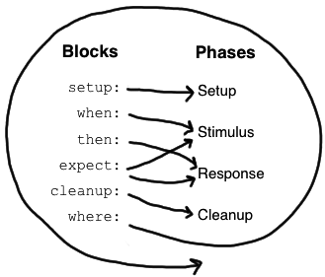

Slide 21
Specification
as
Documentation

Slide 22
Living Documentation
def “our newly bought kettle makes tea”(){
setup: “Need some tea leaves"
// code goes here
and: “and some water"
// code goes here
and: “and the kettle"
// code goes here
when: “contents are boiled” // code goes here
then: “we taste some delicious tea” // compare the result

Slide 23
contd..
given: “plane water"
// ...
when: “lemon juice is added"
// ...
then: “you get a lemonade"

Slide 24
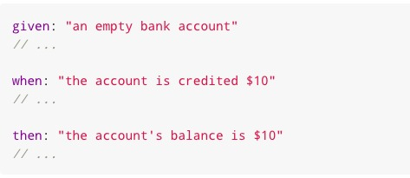
..contd.

Slide 25
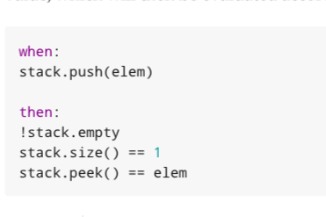
Enough of theory

Slide 26
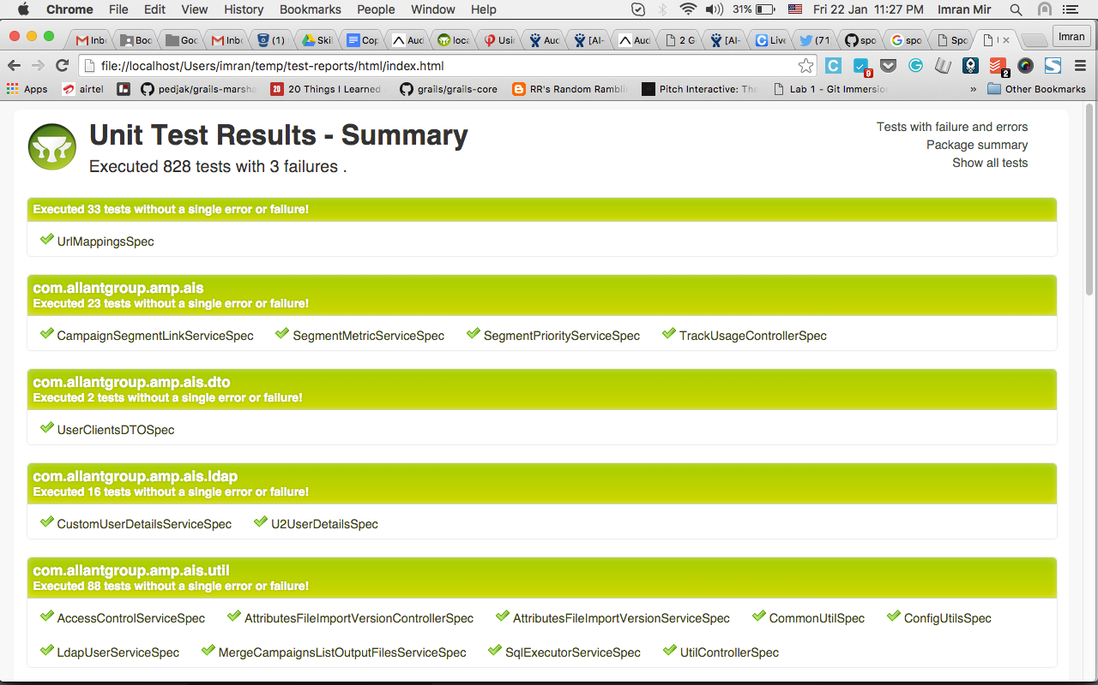
Test Report

Slide 27
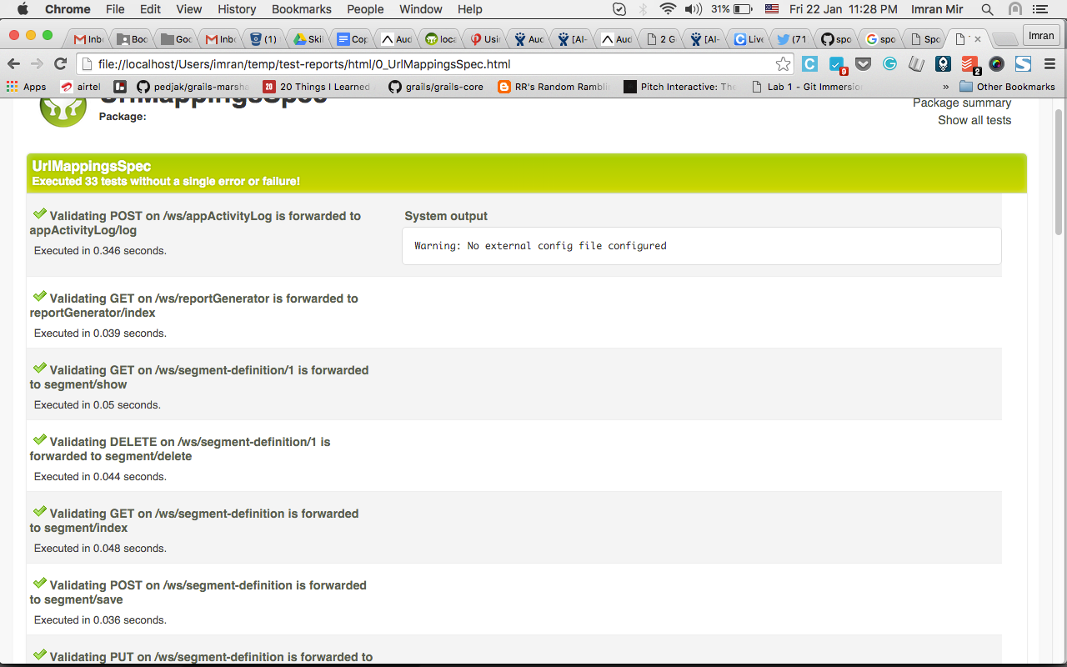
..cont.

Slide 28
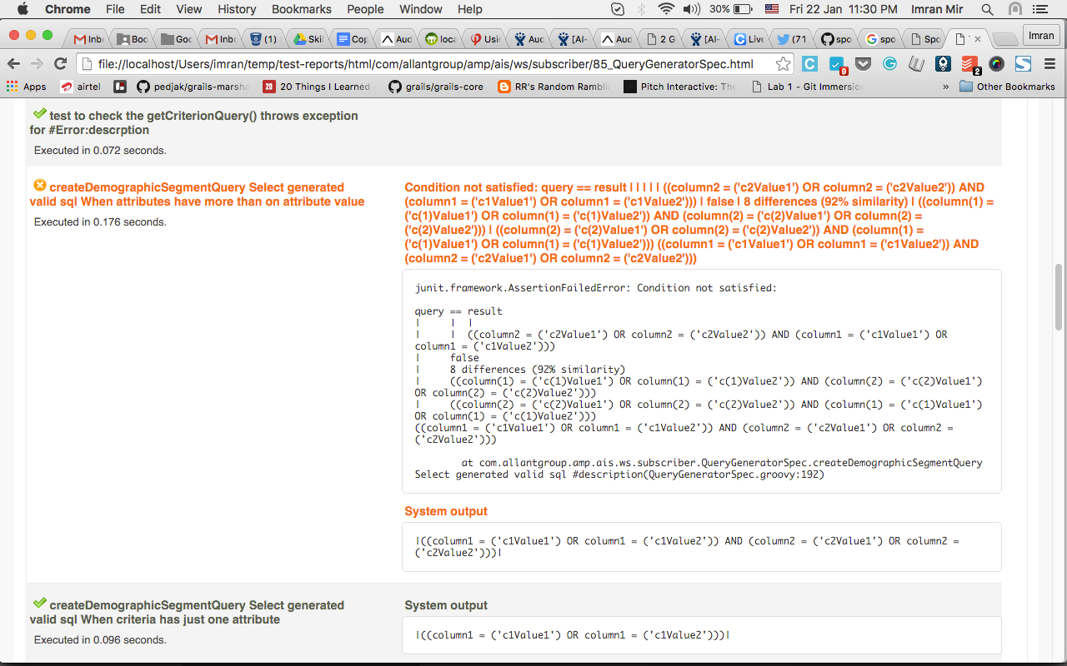
When something goes wrong

Slide 29
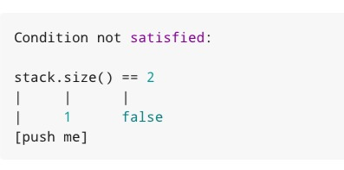
Let us try to read the failures

Slide 30
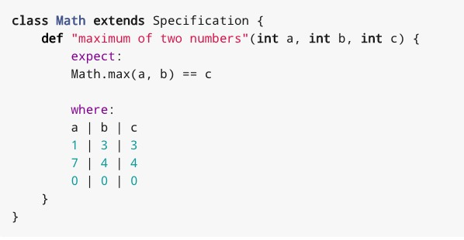
Using Data Tables

Slide 31
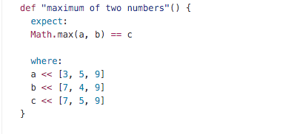

Slide 32
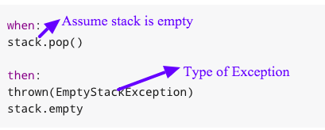

Slide 33
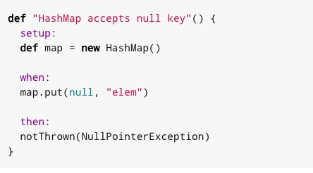
Spot the difference here

Slide 34


A special mention for @Unroll

Slide 35
Few Extensions
@Ignore
@IgnoreRest

Slide 36
Mocks
Mocks have not behaviour
Calling methods on them is allowed but has no effect other than returning the default value for the method’s return type (false, 0, or null)
A mock object is only equal to itself, has a unique hash code, and a string representation that includes the name of the type it represents
This default behavior is overridable by stubbing the methods

Slide 37
Mock Example
class Transaction {
def emailService
void cancelSale(Product product, User user) { String productName = product.name user.balance += (product.price - calculateDiscount(product, user)) user.cancelPurchase(product) emailService.sendCancellationEmail(user, productName) }
def "Email is send when a sale is cancelled"(){ given: "A product" Product product = new Product(name: 'p1', price: 100) and: "A customer" User user = new User() and: "A sale" Transaction transaction = new Transaction() and: "An email service mock" def emailService = Mock(EmailService) transaction.emailService = emailService when: "Cancel save is called" transaction.cancelSale(product, user) then: "Validate email service is called" 1 * emailService.sendCancellationEmail(user, _ as String) }

Slide 38
Stub
Stubbing is the act of making collaborators respond to method calls in a certain way
When stubbing a method, you don’t care if and how many times the method is going to be called; you just want it to return some value, or perform some side effect

Slide 39
Stub example
Boolean encyryptPassword(String pwd) { String encryptedPassword = passwordEncrypterService.encrypt(pwd) return encryptedPassword }
def "Valid password is encrypted" ( ) { given: "A user" User user = new User() and: "A passwordEncrypterMock" def passwordEncrypterService = Mock(PasswordEncrypterService) passwordEncrypterService.encrypt(_ as String) >> "drowssap" user.passwordEncrypterService = passwordEncrypterService passwordEncrypterService.encrypt(_ as String) >> "drowssap" when: "encryptPassword is called" String encryptedPwd = user.encyryptPassword("password") then: encryptedPwd == "drowssap" }

Slide 40

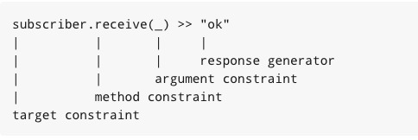
Understanding Stub syntax

Slide 41


..cont.

Slide 42
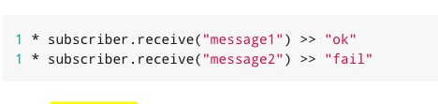
Combining Mocking and Stubbing

Slide 43
Spy
A spy is always based on a real object
Method calls on a spy are automatically delegated to the real object
After creating a spy, you can listen in on the conversation between the caller and the real object underlying the spy
Think twice before using this feature. It might be better to change the design of the code under specification

Slide 44
List<String>getSortedInterestedInCategories(){ List<String> interestedInCategories = getInterestedInCategories() interestedInCategories.sort() } List<String>getInterestedInCategories(){ //assumed to be a very complex method sleep(10000) }
def "SortedInterestedInCategories can be retrieved"(){ given: "A user spy" def user = Spy(User) user.getInterestedInCategories() >> ["z","x","a","s"] when: def sortedCategories = user.getSortedInterestedInCategories() then: sortedCategories == ["a","s","x","z"] }

Slide 45
Questions ?

