Slide 1

The local retailer doesn't lack products or customers.
Going digital is not one task. It's a chain of disconnected tasks. He has to learn and manage several separate systems.
1
Product photo
2
Marketplace listing
3
Multiple marketplaces
4
Regional-language CRM
5
WhatsApp customer campaign
6
Payment link / QR
7
Growth scenario before spending
One owner → the digital team of a big retailer

Slide 2

DUKAANQUEST
One guided workflow from physical shop to digital growth.
PRODUCTS
CUSTOMERS
GROWTH
AI product intelligence
Regional-language CRM
Marketplace listing
Master product record
WhatsApp campaign
Decision simulator
Photo studio
Consent & approval
Quests & progress
Create once → Sell everywhere → Retain → Reach → Simulate

Slide 3
ONE PRODUCT. ONE WORKFLOW. MULTIPLE GROWTH CHANNELS.
One product. One workflow. Multiple growth channels.
Phone photo
tech: Input
Gemini understands
tech: AI
Master product
tech: Single record
Marketplace-ready listing
tech: Amazon SP-API Sandbox
Customer segment
tech: Regional record
Regional campaign
tech: Sarvam + n8n
WhatsApp send
tech: Consent gate
What-if simulation
tech: Deterministic math
Merchant decision
tech: Next action
Every stage is a real, working or verified sandbox workflow in the prototype

Slide 4

THE GAME IS NOT DECORATION
The game makes digital growth understandable.
Traditional workflow
DukaanQuest guided journey
Learn each marketplace tool separately
One guided journey, not six separate logins
Photoshop / shoots, then copy-paste fields
AI reads the product, writes the listing
Type in every listing by hand
One master record sent to every marketplace
Send WhatsApp by hand, one customer at a time
Segment, translate, approve, dispatch in one flow
Run the next numbers in a spreadsheet
Simulate the profit before you spend a rupee
Visible progress and XP — your digital team in view
The quest system is a visual learning & progression layer for a non-technical merchant.
Photo → List once → Reach customers → Simulate → Grow

Slide 5
TECH STACK & ARCHITECTURE
Verified integrations, each solving one merchant problem.
FRONTEND
React · Vite · HTML5 Canvas
BACKEND
Node.js · Express
ORCHESTRATION
Gemini · Sarvam · n8n · Amazon SP-API · Paytm
LOCAL
Marketplace adapters · deterministic simulator
Master product & customer data
read → transform → campaign
AI & rules engines
Gemini reads · Sarvam translates · rules score
Marketplace / CRM / sim outputs
listing · campaign · scenario
LIVE / SANDBOX / STAGED / FALLBACK shown on every integration card

Slide 6
DATA FLOW — WHAT HAPPENS TO A REAL INPUT
User input → orchestrator → AI + rules engines → merchant decision
Merchant
product + customer inputs
Backend orchestrator
API + rules engine
AI + rules engines
Gemini · Sarvam · ads/billing
Marketplace engine
Readiness → listing → sandbox
Amazon SP-API · Flipkart · Meesho · Myntra · Nykaa
CRM engine
Segment → translate → approve → dispatch
n8n · Meta WhatsApp Cloud API
Simulation engine
Scenario profit & payback
deterministic rules
Merchant decision → business progress
One guided journey: digital town, quests, XP | live controls, verified sandbox + staged fallbacks

Slide 7
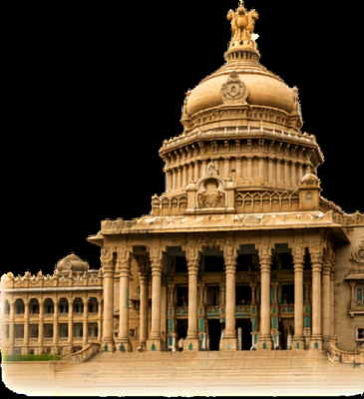


THE WORKING PROTOTYPE
This is the actual product, not a mock.
Digital Town
isometric shop + quest progress
AI Studio
photo → listing title + compliance
Catalog
master product → marketplace payload
WhatsApp CRM
What-If sim
campaign send + consent gate
profit / margin / payback
TODAY
Prototype connects the merchant growth workflow.
Verified sandbox + staged fallbacks, no production claims.
NEXT
Deeper marketplace integrations · billing/inventory · production onboarding · broader multilingual support · richer merchant intelligence.

