Slide 1

SMART INDIA HACKATHON 2026
TITLE PAGE
Problem Statement ID: SIH26153
Problem Statement Title: AI-based Network Attack Forecasting from Network Traffic Data
Theme: Blockchain & Cybersecurity (Organization: NTRO)
PS Category: Software
Team ID: <fill from portal>
Team Name: <registered name>
Notes:
Title slide. One-liner if asked: 'We forecast network attacks before they complete — and show you why.' Fill Team ID / Team Name from the portal before exporting to PDF.

Slide 2
CyberForecaster — forecasting the attack, not just flagging it
Your Team Name
Proposed Solution
• A temporal attack forecaster: reads 10 x 30-second network-state windows (18 flow features) and forecasts attack probability for each of the next 5 windows (2.5 min ahead), plus the coming MITRE ATT&CK stage
• Working prototype today: FastAPI + Next.js console, fully offline on one laptop — historical attack scenarios AND a live packet sensor (Npcap/scapy) feed the same trained model
• Every warning is explained: per-feature attribution (Integrated Gradients) + transparent ATT&CK stage rules
How it addresses the problem
• Implements the PS's world-model requirement directly — P(S t+1 | S t) learned from telemetry and rolled forward K=5 steps; not a static per-flow classifier
• Beats the required logistic baseline ~2x on PR-AUC (0.656 vs 0.333) on identical features and split
• Explainability (PS asks for SHAP/attention): every prediction ships with feature attribution and an independent rule-based stage cross-check
Innovation and uniqueness
• Forecast, don't just detect: probability trajectory + kill-chain stage trajectory = analyst decision support while the attack is still unfolding
• Two engines by design: transparent rules catch instant signatures (recon scan flagged in one window); the LSTM forecasts sustained progression — both verified live over real Wi-Fi
• 57K parameters · 0.23 MB · 2.6 ms CPU inference → edge-deployable, offline, flow-metadata only (no payloads — privacy-preserving)
Notes:
The demo answers 'does it work' before the jury can ask: we will SHOW this live. Numbers: threshold 0.561 (validation 5% FPR budget), precision 0.88, FPR 0.006 on an unseen attack family. IBM 2025 stats on the impact slide.

Slide 3
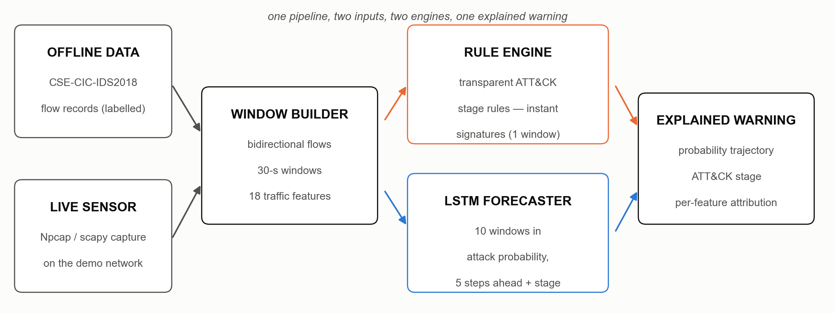
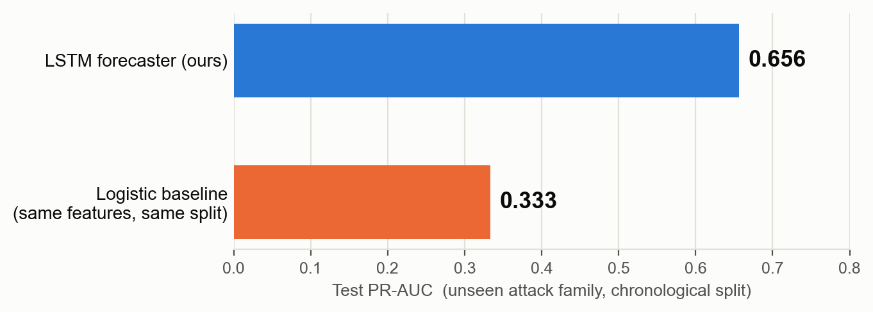
TECHNICAL APPROACH
Your Team Name
Technologies to be used
• Python · PyTorch (2-layer LSTM, multi-task heads) · scapy/Npcap live capture · FastAPI backend · Next.js + TypeScript console · CSE-CIC-IDS2018 benchmark (~6,200 windows, 1,486 attack)
Methodology and process for implementation
• Flow records → 30-s windows x 18 features → chronological 70/15/15 split with boundary purge (no leakage; test split = an attack family absent from training)
• log1p + standardize fitted on train only — one shared transform for baseline, LSTM and the live sensor
• 2-layer LSTM (hidden 64): 5 progression logits + 6-stage head; alert threshold from a 5% false-positive budget on validation
• Independent rule engine (6 ATT&CK rules) validated against labelled windows; Integrated Gradients attribution on every prediction
Notes:
Architecture: two inputs (offline dataset + live packets) → one window builder → two engines (orange rules = instant signatures; blue LSTM = 5-step forecast) → one explained warning. Chart: PR-AUC on the test split which is an UNSEEN attack family — measures transfer, not memorization. Same features/split for both models, so the gap isolates temporal modeling. The live demo runs this exact pipeline on real packets.

Slide 4
FEASIBILITY AND VIABILITY
Your Team Name
Analysis of the feasibility of the idea
• Already built and verified end-to-end: offline benchmark + live sensor demo; in rehearsal a real attack over Wi-Fi crossed the alert threshold during a sustained UDP sweep while benign traffic stayed LOW
• 0.23 MB model, 2.6 ms CPU inference, fully offline — runs on a commodity laptop, no cloud dependency
Potential challenges and risks
• Benchmark ↔ production traffic shift (benchmark flows are long-lived aggregates; production sees short transactions)
• Class imbalance and rare attack families (~24% of windows contain attack)
• False alarms erode analyst trust; no system can warn before the first attack packet exists
Strategies for overcoming these challenges
• Live input conditioned to the model's validated training domain + rule engine on raw features; NetFlow/IPFIX named as the production input
• PR-AUC focus, chronological split, high-precision operating point (FPR 0.6%); cross-family test split measures transfer honestly
• Every alert explained (attribution + rules); positioned as decision support, not auto-blocking; limitations stated up front
• Scale path: windowing at each sensor/tap, one shared 0.23 MB model centrally or at the edge
Notes:
Feasibility is proven, not claimed — the prototype exists and was rehearsed over real Wi-Fi on Aug 30 (attack forecast climbed 0.03 → 0.905 HIGH → 0.988 across four sustained windows; benign worst 0.014). Honesty is the strategy: we state the no-pre-onset-warning limit ourselves.

Slide 5
IMPACT AND BENEFITS
Your Team Name
Potential impact on the target audience
• SOC analysts, CERTs and agencies (NTRO context), critical-infrastructure operators — anyone with flow telemetry and alert fatigue
• Early, explained warnings redirect analyst attention to the right flows while an attack is still unfolding
Benefits of the solution
• Economic: breaches average US$4.44M and ~241 days to identify and contain (IBM 2025); early warning + explanation shortens both; security AI/automation is associated with ~$1.9M lower breach costs
• Social: protects critical infrastructure and public services; metadata-only analysis preserves privacy (no packet payloads)
• Analyst welfare: explained, high-precision warnings instead of black-box alert floods
• Environmental: software-only, 57K-parameter model — no new hardware; edge deployment minimises data movement
• Scalable and globally comparable: trained/evaluated on the international benchmark dataset; the architecture (sensor → windows → model) is network-agnostic — any organization exporting flow data can deploy it
Notes:
IBM Cost of a Data Breach 2025 figures — verify at ibm.com/reports/data-breach before submitting. The 241-day identify+contain number is the product thesis in one stat: every day earlier is the entire value proposition.

Slide 6
RESEARCH AND REFERENCES
Your Team Name
Research and references
• CSE-CIC-IDS2018 dataset — Canadian Institute for Cybersecurity, UNB: https://www.unb.ca/cic/datasets/ids-2018.html
• MITRE ATT&CK framework: https://attack.mitre.org
• Sundararajan, Taly & Yan (2017), 'Axiomatic Attribution for Deep Networks' (Integrated Gradients), ICML
• Hochreiter & Schmidhuber (1997), 'Long Short-Term Memory', Neural Computation
• IBM Security, 'Cost of a Data Breach Report 2025': https://www.ibm.com/reports/data-breach
• Open-source stack: Python, PyTorch, scapy, FastAPI, Next.js
• Project repository (working prototype + code): <add GitHub link before submission>
Notes:
All benchmark numbers are reproducible from the repository (models/metrics_*.json). The demo video for the portal should follow docs/DEMO_RUNBOOK.md's 7-minute arc.

