Slide 1


Bank of Baroda Hackathon - 2022
Technology Partner
Your Team Name : Decoders.
Your team bio :
A Team built of enthusiastic girls students, who are very dedicated to accomplish any task.
Date: 20-09-2022

Slide 2
Problem Statement? Virtual Avatar, Virtual Assistant and Alternate Authentication.
Why did you decide to solve this Problem statement?
There comes many hurdles and panic situations among customers while doing transactions in online banking so in order to ease the customers there needs to be a voice assistant guiding them in the every step that they take while transacting or doing some or the other banking work through e-banking.
Also, there are many customers with disability so a virtual assistant with voice and text both can be a boon to those disable people. The process of working online with the bank will become super easy to them.
Additionally, there are many more benefits of using a virtual assistant instead of a chat-bot.
The alternate authentication system besides the login id and password can be a QR code system that will be connected to respective customer’s bank application just like WhatsApp Web. Also we can use a OTP system while logging through Website just as the same we do for an App Login

Slide 3
User Segment & Pain Points
Which user /advertiser segment would be early adopter of your product & why?
It is not like that these features that we will be introducing are inhibited to a particular flock of people.
The entire humankind will be benefitted because of these features.
As the interface will be clean and easy to use, everyone including the old people and even the disable people will be able to use the new Bank of Baroda Website as well as the Application smoothly without any hassle and bustle.
The voice assistant and the text which will be displaying on the screen will be very much helpful to the blind as well as to the deaf people.

Slide 4
Pre-Requisite
What are the alternatives/competitive products for the problem you are solving?
The existing alternatives are AI powered chatbots. These Chatbots use artificial intelligence to mimic human interactions through a chat interface, allowing customers to obtain the information they want using simple, natural conversational language. For example:
1. State Bank of India (SBI) deployed its AI-based financial chatbot named SBI Intelligent Assistant (SIA) in 2017 which is capable of understanding and resolving the banking needs of customers without human intervention.
2. HDFC Bank’s EVA (Electronic Virtual Assistant)
3. ICICI Bank deployed its AI-powered chatbot iPal in 2017.
The main issue with these assistants is that they all are chat-bots and not the real time virtual assistants. However they are still in the budding stage.

Slide 5
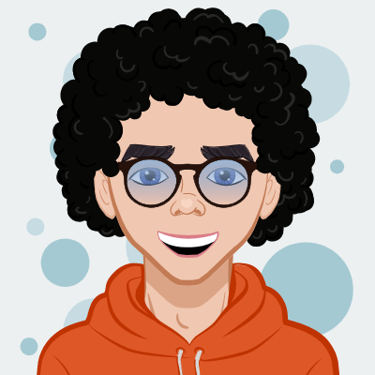
Azure tools or resources
Azure tools or resources which are likely to be used by you for the prototype, if your idea gets selected: 1. In the making of voice assistant, we will need Azure Cognitive Services like vision, speech, language and decision. 2. Various Azure APIs 3. Azure Artificial Intelligence for developers.
Hi!!! I am BOB. Virtual Assistant, designed by the Team Decoders for the Bank of Baroda.
I am capable of handling various functions and I am going to automate the e-banking system of the bank.

Slide 6
Any Supporting Functional Documents
Present your solution, talk about methodology, architecture & scalability:
Methodology:
1. BOB(Bank of Baroda voice assistant) is an AI based virtual assistant that is going to automate E-banking system of Bank of Baroda.
2. Bob will consist features like Checking the internet speed of user , Display the credit score along with the account balance.
3. For now, the features are limited if the idea get selected, we will add new and unique features into the assistant.
4. Our main focus is to reduce the stress of the users which is often created while debiting large amount of transacting money.
5. For the scalability we are adding two step verification process using QR code and OTP systems.
Architecture:
Voice Assistant will be designed using:
Python and its libraries
Databases and API’s
Generate text script with TextSynth.
Converting the response text to speech with FlowTron.
Creating talking head with LipGan.
For checking Internet service speed:
JavaScript libraries. Eg. Underscore.js, Jquery etc. with be used.
Other technologies like Google Analytics, Amazon Web Services, Babel will be used.
………………………………………………………………………………………………………………

Slide 7
Key Differentiators & Adoption Plan
How is your solution better than alternatives and how do you plan to build adoption?
As we already mentioned the existing products which are a competition to our BOB Assistant, it will be clear to you that BOB is more advanced than those products as they are just mere chat-bots and our BOB is a real time voice assistant which takes input from the user of bank and returns an answer to the user’s query along with the text beside it.
Since, the text too is displayed with the voice, it is beneficial for disable people.
Also, we are planning to make the voice assistant more featuristic by adding the Multilingual feature in it. Atleast there will be two prominent languages which preferrably be English and Hindi.
Besides that, we are going to add the feature of checking internet connection of the user and the condition of Bank Servers at that particular time when an user needs to do a heavy transaction online. If the connection of the user is poor then the voice assistant will alert the user regarding the issue and same goes with the bank servers incase they are down.
The virtual assistant of SBI bank is still in the prototyping stage and they have not actually deployed the assistant SIA in there application nor on there website.

Slide 8
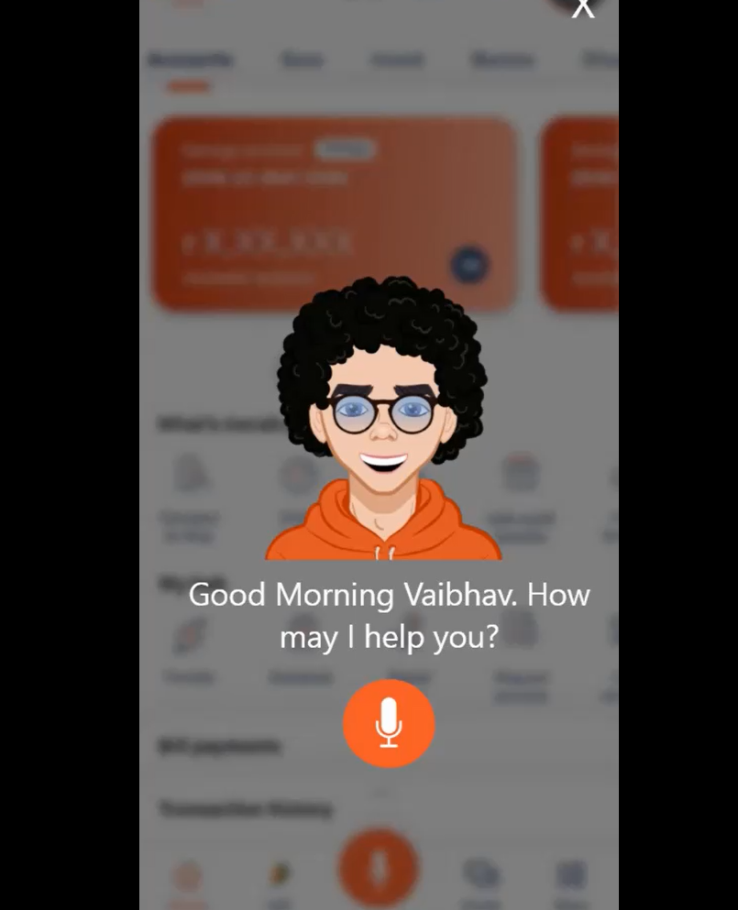
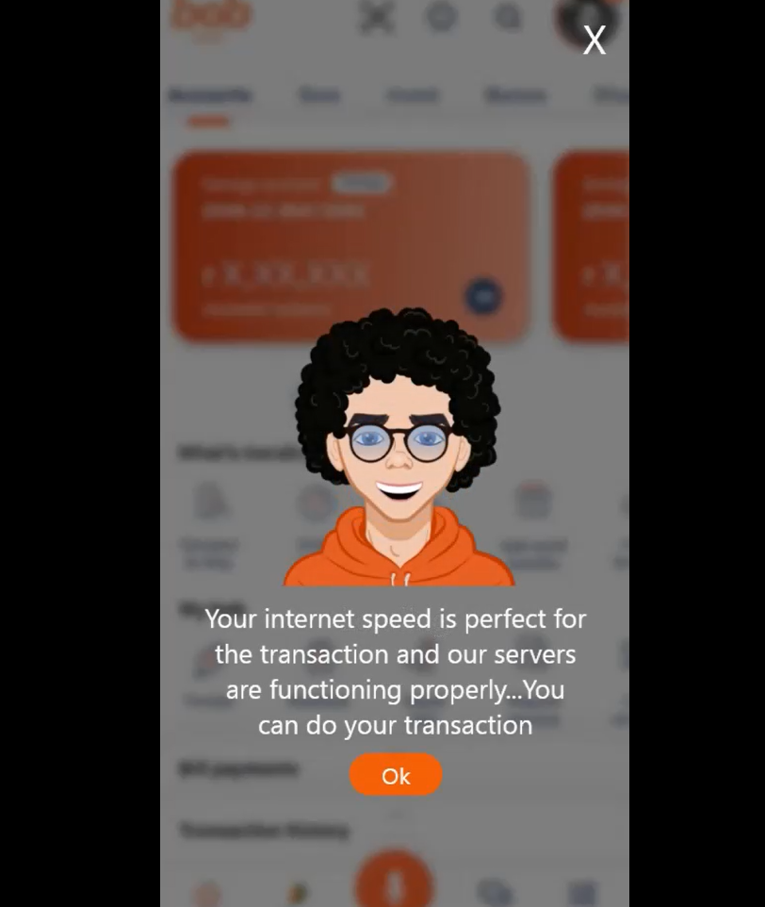
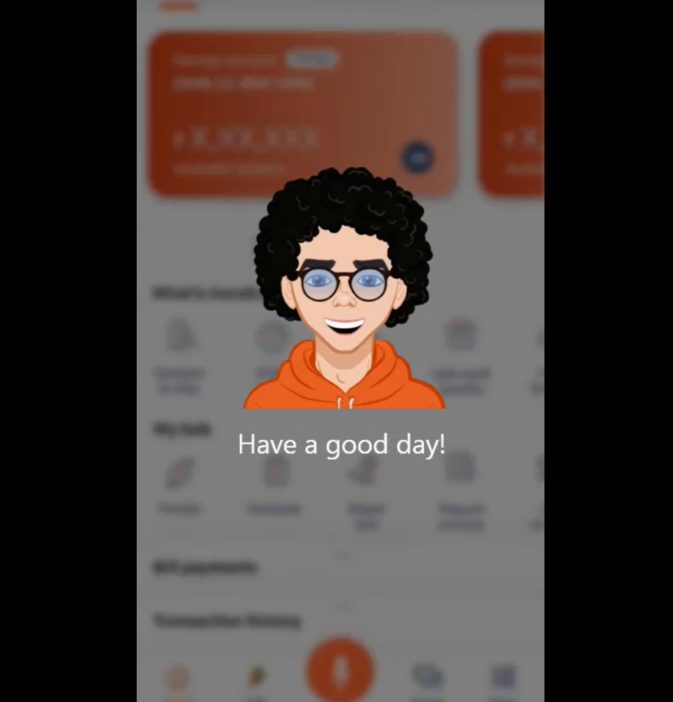
Google Drive link showing the entire web & app prototype created by our team:
https://drive.google.com/drive/folders/1PaZcdOsMQickERMsTh1dLkzZNsYeeH2A
Here are some screenshots from the prototype which we built for both the website and the application of BOB:
Do check out the above mentioned drive link. There you’ll get to see the entire prototype built by us for the web as well as for the app of Bank of Baroda.

Slide 9
Thank You!!!
Team member names:
Vaibhavi Kadam
Anupam Kumari
Anushka Mandrawliya
Gauri Patil

