Slide 1
Hadoop Introduction
What you will be able to do after these presentations –
Understand how Hadoop works
Know the Hadoop ecosystem
Know what is HDFS
Find your way around Linux
How to make Sql Server and Hadoop talk
Have working knowledge of Hive, Sqoop, Impala, Pig
Be comfortable with Cloudera Manager

Slide 2
Why are we looking at Hadoop?
More Questions -
Bigger question – what is Big Data? – Discussion on traditional data processing, RDBMS, structured and unstructured data.
Is Crimson into Big Data?
What’s big data useful for?
How are we handling Big Data right now?

Slide 3
Introduction to Linux Commands
The linux command prompt
Basic linux commands
Editing Files
Redirecting Output
Chaining multiple commands together

Slide 4
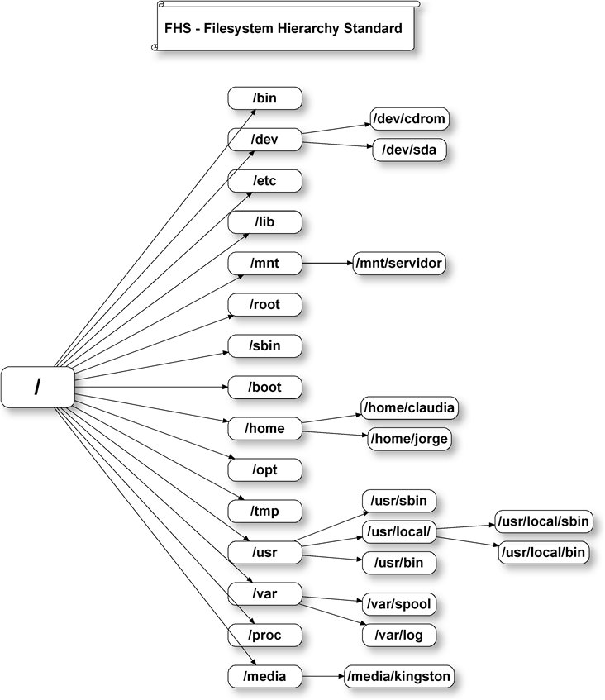
Linux File System

Slide 5
Linux Filesystem …
The forward slash is the root of all files in Linux
/bin – contains executables (ls, cd)
/sbin – contains all superuser binaries (ifconfig)
/home – user’s files
Special directories
  . : current directory
  .. : parent directory
  ~ : home directory

Slide 6
Common Linux commands
ls – list all files and directories in the current folder
cp and mv – copy and move files
cat – display file contents
chmod – change file permissions
pwd – print current working directory
sudo – Execute as super user

Slide 7
Hadoop Introduction
Framework for data intensive distributed computing (storage and computation API). In detail, later.
Created by Doug Cutting of Yahoo based on Google papers on MapReduce and Google File System
Licensed under the Apache v2 license

Slide 8
Google and Open Source Comparison
Google File System – Hadoop Distributed FS
Map-Reduce – Hadoop Map-Reduce
Sawzall – Pig, Hive, JAQL
Big Table – Hadoop HBase, Cassandra
Chubby – Zookeeper

Slide 9
Hadoop (computation and storage)
Distributed Storage – HDFS overview (more by Ganesh)
Distributed Computation – Map Reduce
Computation goes to Data
Batch processing architecture and not real time (but can be used for real-time as well)

Slide 10
Map Reduce Goals
Process large data sets
Cope with hardware failure
High Throughput

Slide 11
What is Map Reduce (conceptual overview)
Programming model for processing large datasets
Highly scalable and designed to work parallel on a large cluster of commodity hardware
Parallel programming model meant for large clusters. User implements Map() and Reduce()
Parallel computing framework
  Libraries take care of EVERYTHING else
    Parallelization
    Fault Tolerance
    Data Distribution
    Load Balancing

Slide 12
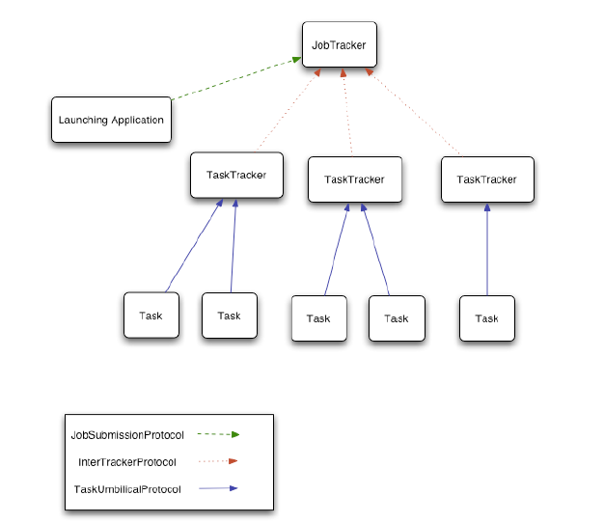
Map Reduce (daemons)

Slide 13
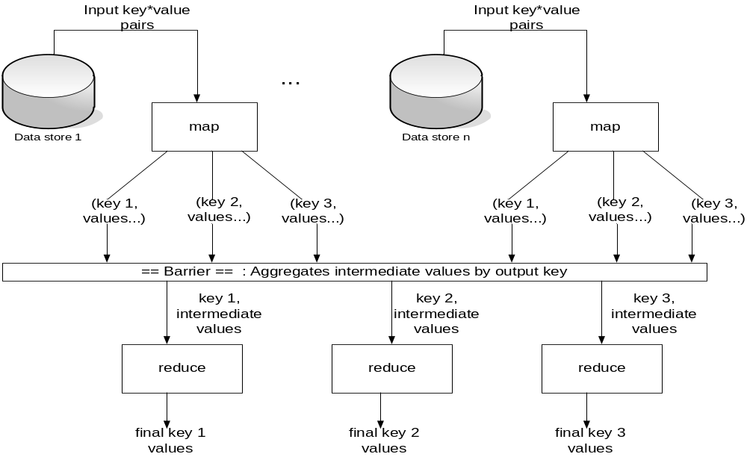
Map Reduce (diagrammatic)
Most simple example to get MR – Word Count!
Counting words in a large set of documents

Slide 14
Map Reduce (pseudo code)
Goes to white board and explains
map(key, value):
// key: document name; value: text of document
for each word w in value:
emit(w, 1)
reduce(key, values):
// key: a word; values: an iterator over counts
result = 0
for each count v in values:
result += v
emit(key,result)

Slide 15
Combiners / Shufflers
Often a map task will produce many pairs of the form (k,v1), (k,v2), … for the same key k
  E.g., popular words in Word Count
Can save network time by pre-aggregating at mapper
  combine(k1, list(v1)) → v2
  Usually same as reduce function

Slide 16
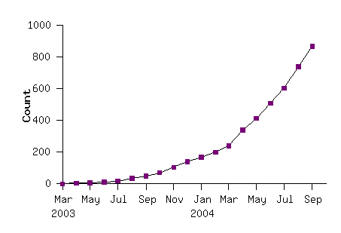
Some Stats
Example Usages – distributed grep, sort, term vector/host, document clustering, web access log stats, machine learning, complex graph analysis, inverted index construction, statistics…..unending list

Slide 17
Important Config Files you should know about!
Hadoop is all about configurations. Why?
Hadoop-env.sh
Core-site.xml (mapreduce and hdfs)
Mapred-site.xml
Hdfs-site.xml

Slide 18
Know your Daemons!
The first things to check when something goes wrong (and something about Hadoop ports)-
2287 TaskTracker
2149 JobTracker
1938 DataNode
2085 SecondaryNameNode
2349 Jps
1788 NameNode

Slide 19
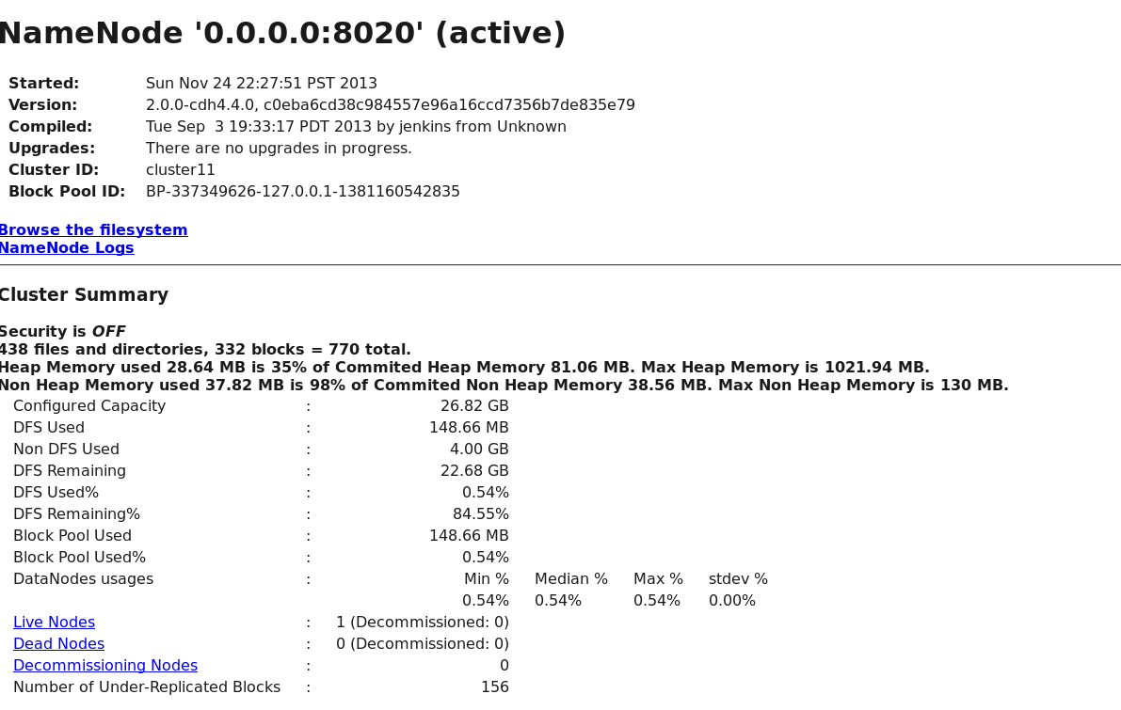
Important Web Interfaces(demo)
http://localhost:50070/ - NameNode Web UI

Slide 20
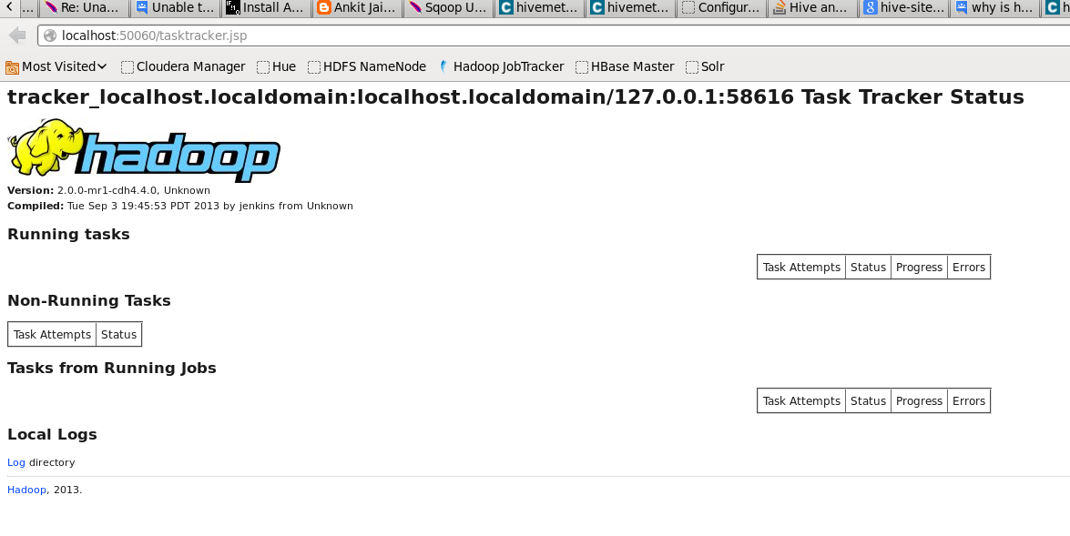
Important UI contd..
http://localhost:50030/ - JobTracker Web UI

Slide 21
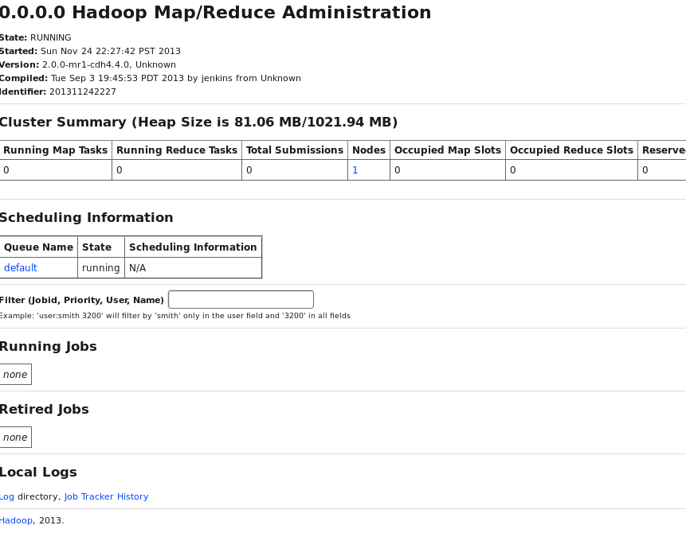
Important UI contd…
http://localhost:50060/ - MapRed Admin

Slide 22
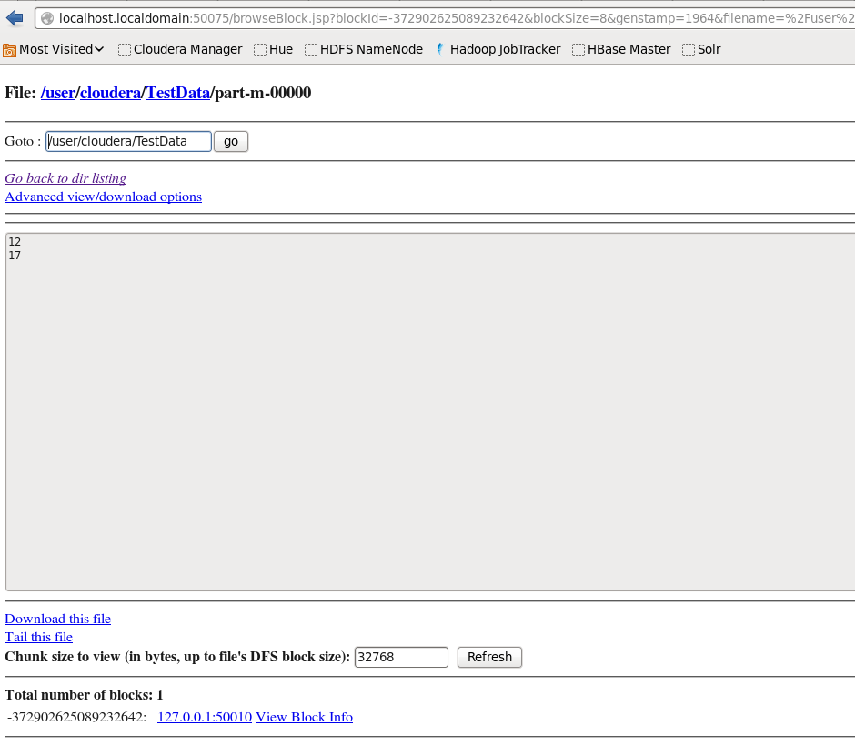
Browsing the File System(which one?)
Browse Hdfs from Web UI
http://localhost.localdomain:50075/browseDirectory.jsp?namenodeInfoPort=50070&dir=/&nnaddr=localhost.localdomain:8020

Slide 23
HDFS Basic Features
HDFS is a distributed file system
Highly Fault Tolerant
High throughput
Suitable for applications with large data sets
Streaming access to file system data
Can be built out of commodity hardware

Slide 24
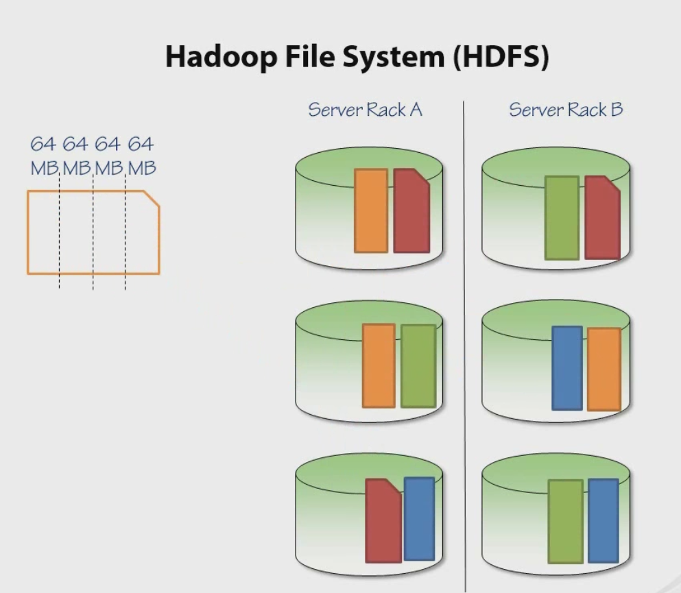

Slide 25
Fault tolerance
Failure is the norm rather than exception
A HDFS instance may consist of thousands of server machines, each storing part of the file system’s data.
Since we have huge number of components and that each component has non-trivial probability of failure means that there is always some component that is non-functional.
Detection of faults and quick, automatic recovery from them is a core architectural goal of HDFS.

Slide 26
Data Characteristics
Streaming data access
Batch processing rather than interactive user access.
Large data sets and files: gigabytes to terabytes size
Scale to hundreds of nodes in a cluster
Write-once-read-many: a file once created, written and closed need not be changed – this assumption simplifies coherency
A map-reduce application or web-crawler application fits perfectly with this model.

Slide 27
File system Namespace
Hierarchical file system with directories and files
Create, remove, move, rename etc.
Namenode maintains the file system
Any meta information changes to the file system recorded by the Namenode.
An application can specify the number of replicas of the file needed: replication factor of the file. This information is stored in the Namenode.

Slide 28
Hive
DataWarehousing tool built on top of Hadoop
Enables easy ETL (Extract/Transform/Load) processing
A mechanism to impose structure on a variety of data formats
Query execution via MapReduce

Slide 29
Hive Tables
  Analogous to tables in relational DBs.
  Each table has corresponding directory in HDFS.
  Example
    Page view table name – pvs
    HDFS directory
      /wh/pvs
  CREATE TABLE t1(ds string, ctry float)

Slide 30
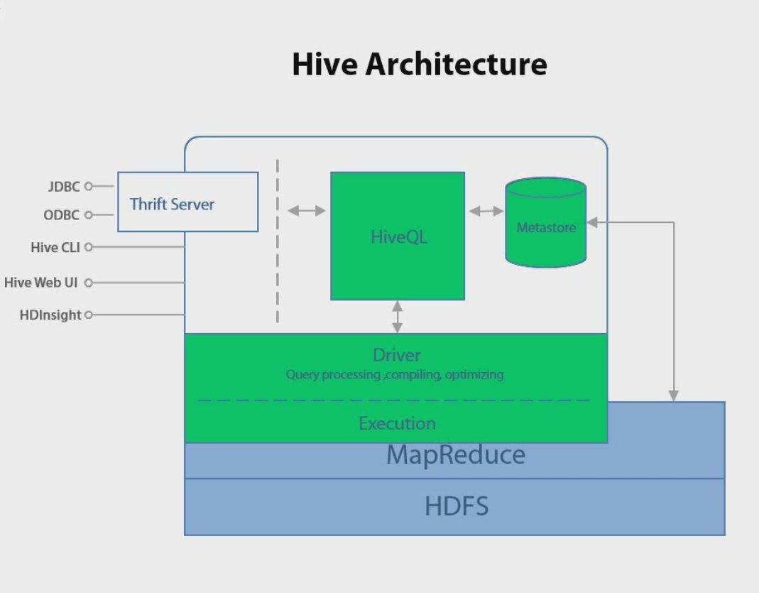
Hive Architecture

Slide 31
Impala and Big Query
Big Query is google's database service based on the Dremel. Big Query is hosted by Google (not free! – about 35$ / TB data processing)
Impala is open source database inspired by the Dremel paper. Impala is part of the Cloudera Hadoop distribution.
Where Impala lives right now?

Slide 32
What’s Impala
Massive parallel processing (MPP) database engine, developed by Cloudera (NOT MR based!)
Integrated into Hadoop stack on the same level as MapReduce, and not above it (as Hive and Pig)
Pig
Hive
Impala
Map Reduce
HDFS

Slide 33


Bypassing MR!
There are folks who do have MPP databases on top of HDFS. One of the popular ones is –
Jethrodata have their proprietary format which enable full indexing of the data together with columnar efficiency. In cases of high selectivity queries this approach has serious advantages.

Slide 34
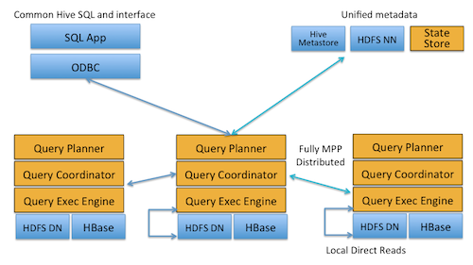
Impala Architecture
Implemented in C++ and not Java!

Slide 35
LLVM code generation
What is LLVM?
Helps in generating custom code for each query
LLVM enables us to compile in fraction of seconds into native code
LLVM enable us to enjoy new CPU capabilities like SSE(single instruction, multiple data) in a portable way

Slide 36
Impala-Hive Connection
Impala shares metastore with Hive, which enables very simple adoption
Impala is the only open source MPP engine
Today we do not have any other means to run hundreds of CPU cores in one query efficiently without expensive license.
Hive give us the same but not efficiently.

Slide 37
Hive versus Impala
Impala does not support DDL. Have to use Hive for this
Hive can have UDFs while Impala cannot
Hive is not as efficient as Impala! (MR versus Indexing)

Slide 38
Impala Performance
Impala is called the Real time querying engine for Hadoop
Impala, on our last POC, processed both 3k and 2 million records in 3 seconds!

Slide 39
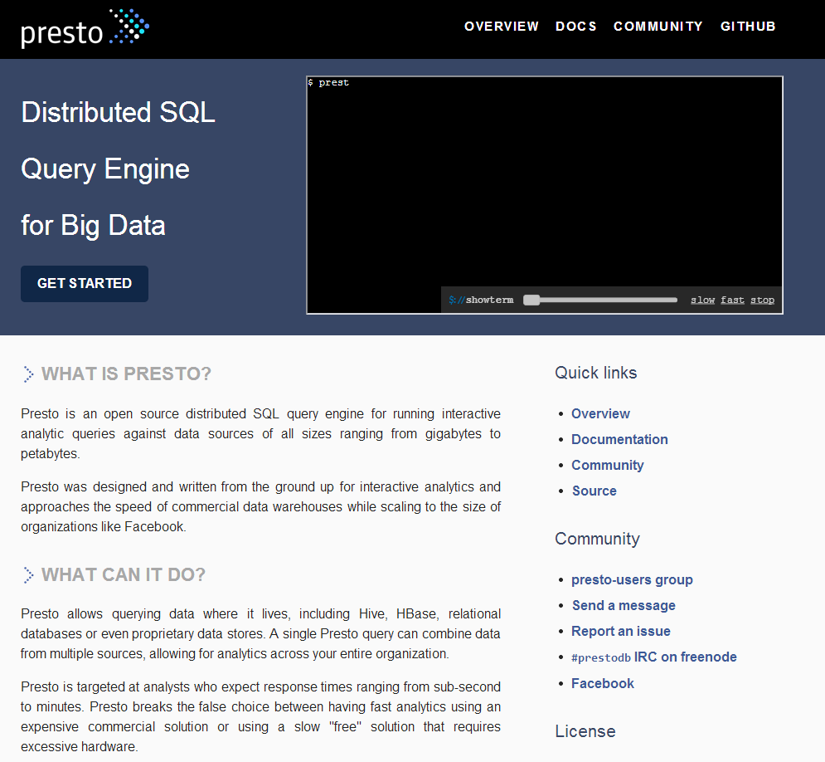
Presto!
Facebook’s New querying engine to query across various data stores! - http://prestodb.io/

Slide 40
(Hadoop) Pig Dataflow Language

Slide 41
Apache Pig
Apache Pig is a platform for analyzing large data sets that consists of a high-level language for expressing data analysis programs, coupled with infrastructure for evaluating these programs.
Pig's infrastructure layer consists of
  a compiler that produces sequences of Map-Reduce programs,
  Pig's language layer currently consists of a textual language called Pig Latin, which has the following key properties:
    Ease of programming. It is trivial to achieve parallel execution of simple, "embarrassingly parallel" data analysis tasks. Complex tasks comprised of multiple interrelated data transformations are explicitly encoded as data flow sequences, making them easy to write, understand, and maintain.
    Optimization opportunities. The way in which tasks are encoded permits the system to optimize their execution automatically, allowing the user to focus on semantics rather than efficiency.
    Extensibility. Users can create their own functions to do special-purpose processing.

Slide 42
Running Pig
You can execute Pig Latin statements:
  Using grunt shell or command line
    $ pig ... - Connecting to ...
    grunt> A = load 'data';
    grunt> B = ... ;
  In local mode or hadoop mapreduce mode
    $ pig myscript.pig
    Command Line - batch, local mode mode
    $ pig -x local myscript.pig

Slide 43
Program/flow organization
A LOAD statement reads data from the file system.
A series of "transformation" statements process the data.
A STORE statement writes output to the file system; or, a DUMP statement displays output to the screen.

Slide 44
Interpretation
In general, Pig processes Pig Latin statements as follows:
  First, Pig validates the syntax and semantics of all statements.
  Next, if Pig encounters a DUMP or STORE, Pig will execute the statements.
  A = LOAD 'student' USING PigStorage() AS (name:chararray, age:int, gpa:float);
  B = FOREACH A GENERATE name;
  DUMP B;
  (John)
  (Mary)
  (Bill)
  (Joe)
Store operator will store it in a file

Slide 45
Simple Examples(Demo)
A = LOAD 'input' AS (x, y, z);
B = FILTER A BY x > 5;
DUMP B;
C = FOREACH B GENERATE y, z;
STORE C INTO 'output';
-----------------------------------------------------------------------------
A = LOAD 'input' AS (x, y, z);
B = FILTER A BY x > 5;
STORE B INTO 'output1';
C = FOREACH B GENERATE y, z;
STORE C INTO 'output2'

Slide 46
Why Cloudera(CDH) and not Apache?
Easy to handle and has good support. Learning curve smoothened. Excellent learning resource.
Fixes the inconsistencies in Apache Open Source projects
Makes sense for a non-Java firm like us
Free upto 50 nodes !
We are familiar with it :D

Slide 47
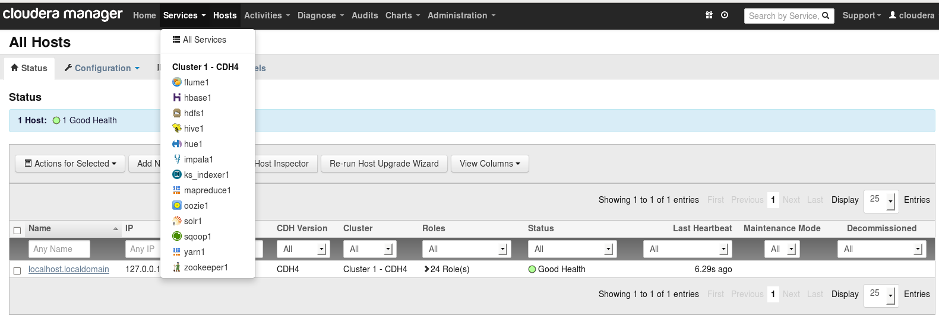
Cloudera Manager (CM 4)
One stop for all tasks related to cluster (demo) management!

Slide 48
Limitations of Hadoop
No built-in optimization for SQL
Steep learning curve
Designed only for LAN (something talk hdfs protocols)
Great for offline batch processing but not so much for Real Time. Scalability is important, not latency!

Slide 49
Is it worth learning?
Was Sql worth learning?
What the industry is moving towards and are we ready for it?
What’s next? Some talk on the much needed mathematics and science.

Slide 50
Whom to go to?
Glad you asked !
Hadoop User Group, Chennai - https://groups.google.com/forum/#!forum/chennaihug
IRC
#hadoop channel/group on IRC’s freenode server
Stackoverflow.com
You can also mail us at
RanganaG@advisory.com and VaibhavK@advisory.com
Best Resource for Sqoop/hive/Impala/Cluster Setup on VM
https://fogbugz.devid.local/default.asp?W2302

Slide 51

Questions?

