Slide 1
Psych plots with discrete categorization

Slide 2
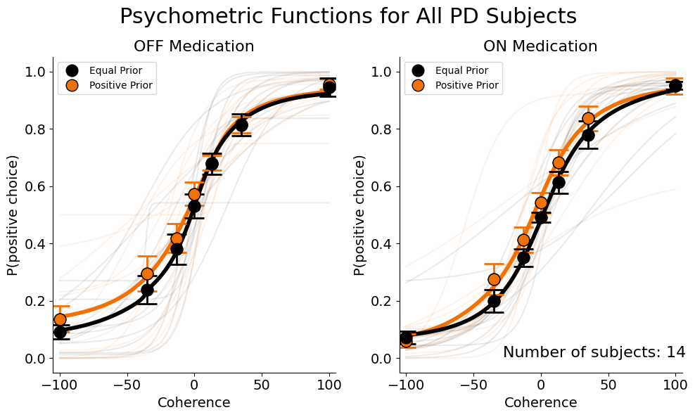

Slide 3
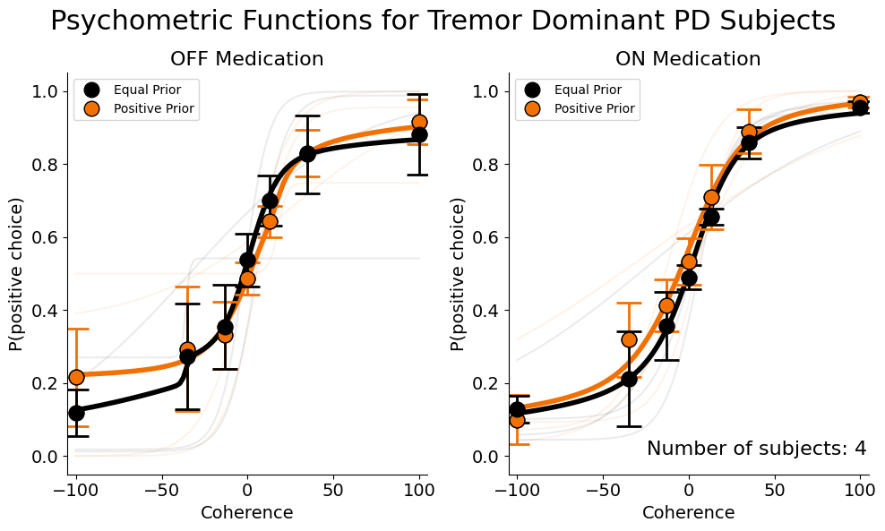

Slide 4
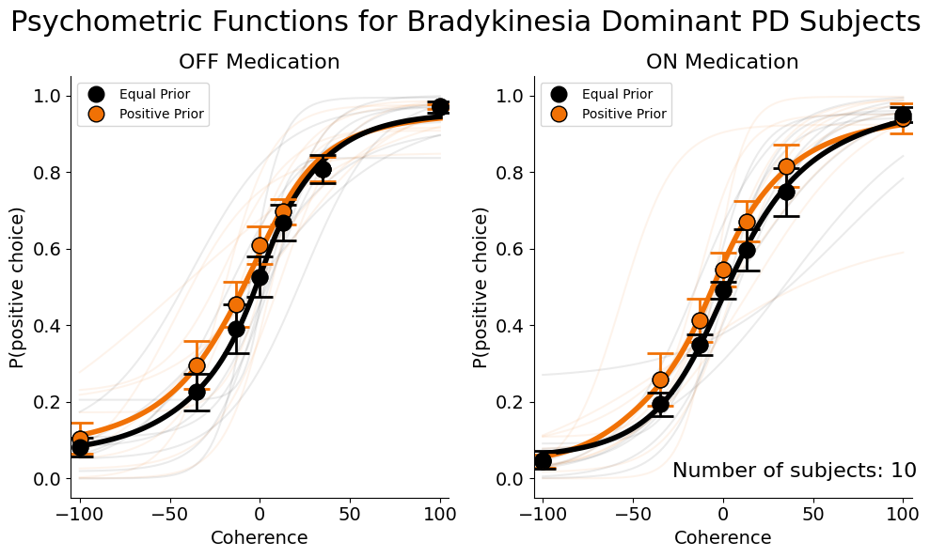

Slide 5
Psychometric Parameters Fit for correlational analysis
Alpha -> Threshold
Beta -> Sensitivity

Slide 6
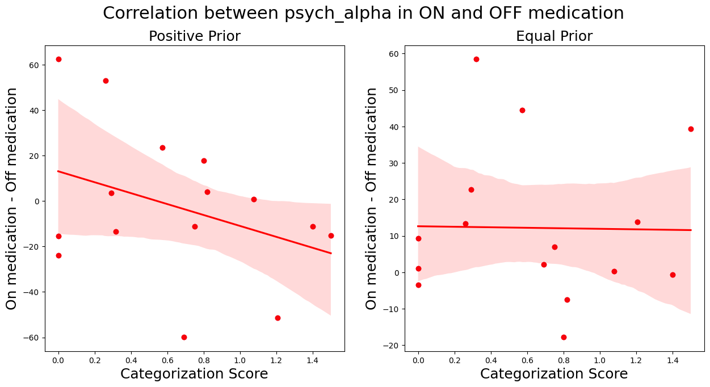

Slide 7
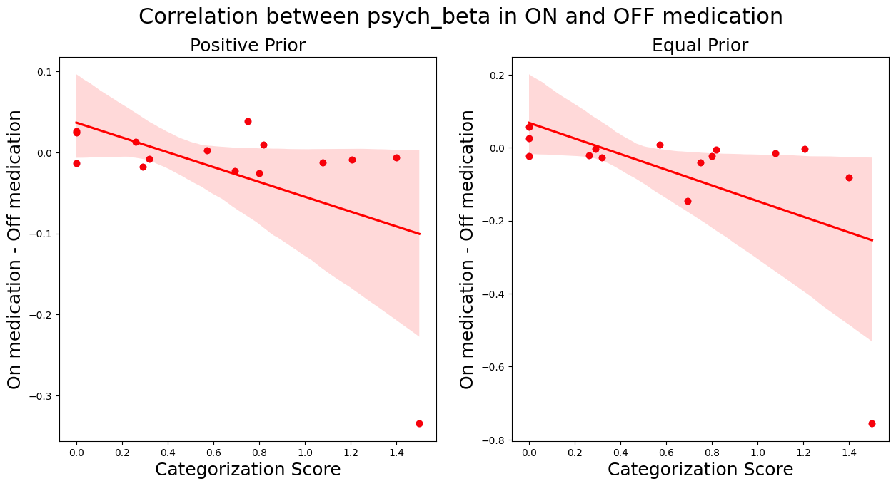
p-value = 0.047
p-value = 0.017

