Slide 1
Psych plots with discrete categorization

Slide 2
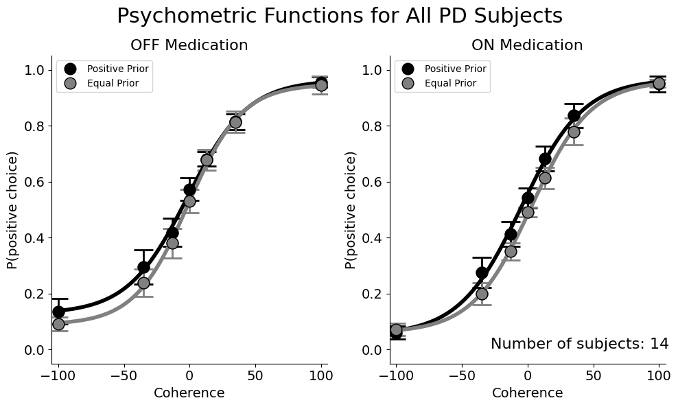

Slide 3
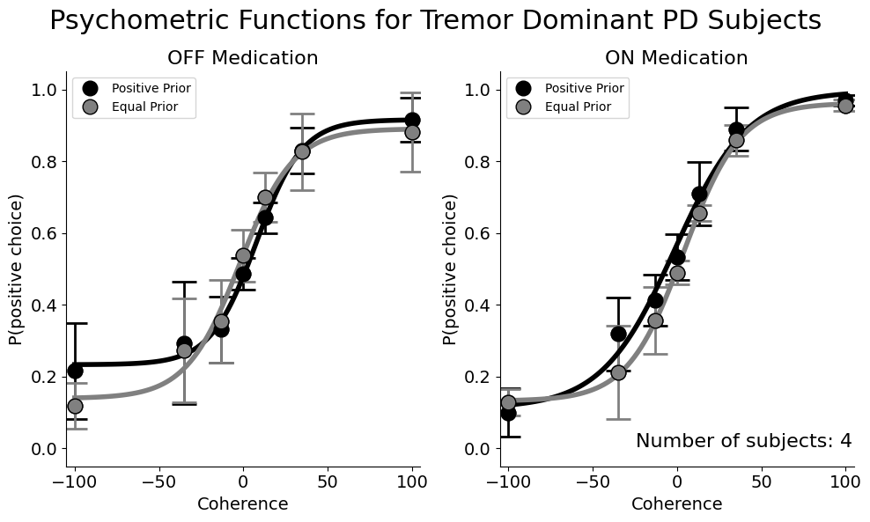

Slide 4
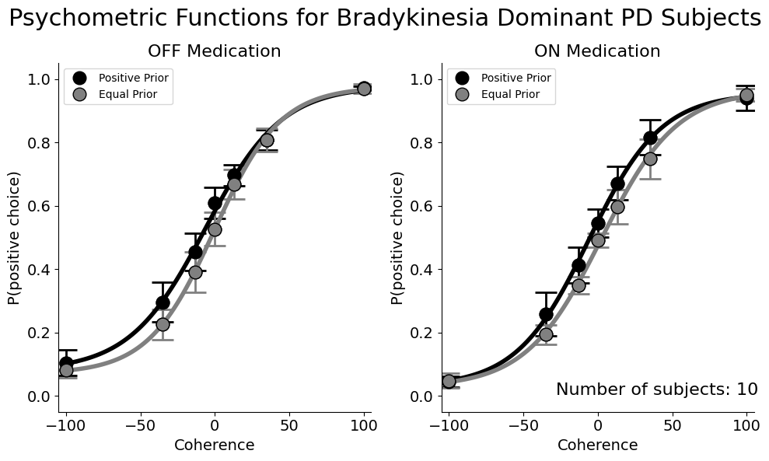

Slide 5
Psychometric Parameters Fit for correlational analysis
Alpha -> Threshold
Beta -> Sensitivity

Slide 6
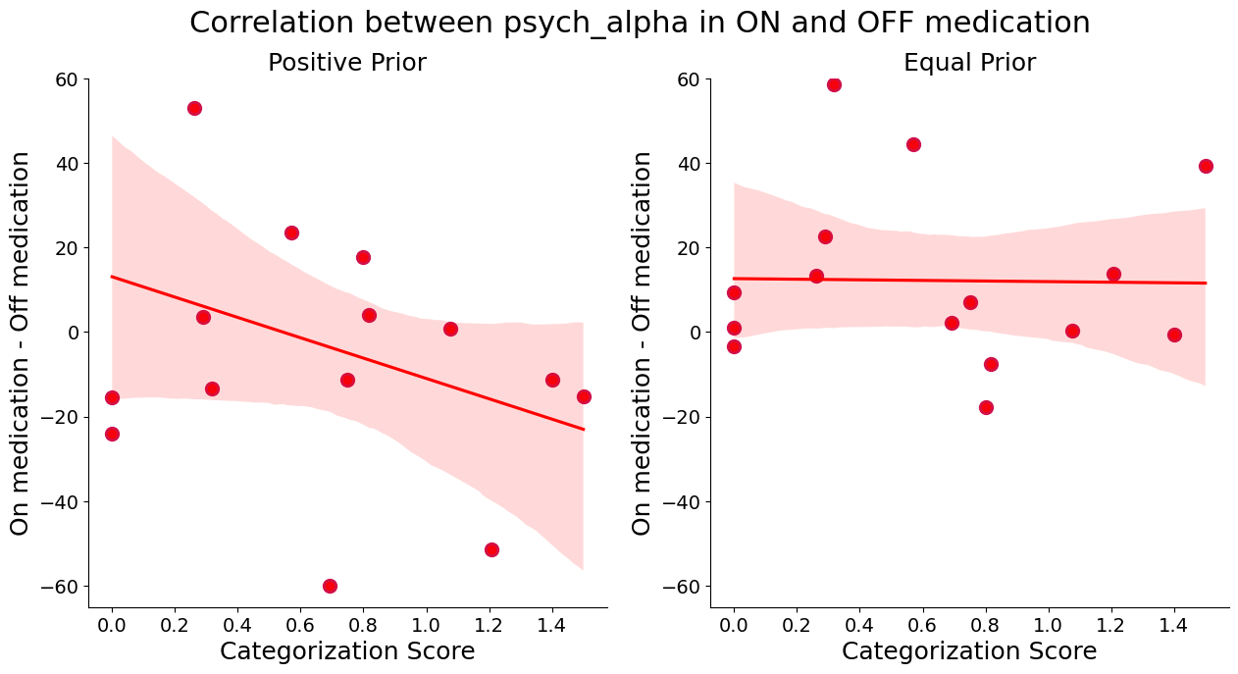

Slide 7
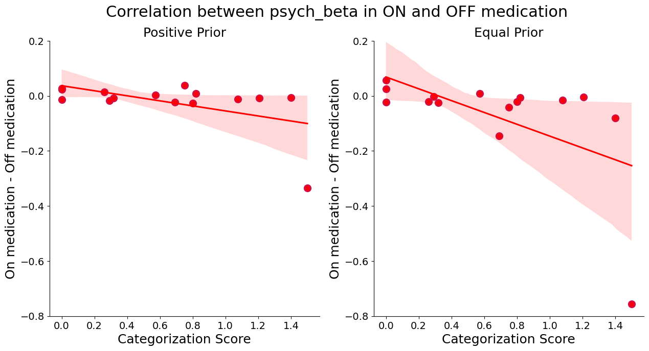
p-value = 0.047
p-value = 0.017

Slide 8
Interpretation
Preliminary interpretation:
PD patients show a minor improvement in bias implementation with dopamine medication. When we perform the same analysis with dividing subjects into Bradykinesia-dominant and tremor dominant group, we see minor improvement in the bias implementation for both subjects. However, when we fit the psychometric function to the data and look at the changes in the threshold and sensitivity of orientation detection, we can see that tremor dominant patients (category scores above ~0.8) show improved threshold in favor of the more probable direction however, when we look at the sensitivity of the decisions, the tremor dominant patients have reduced sensitivity to the orientation discrimination after medication compared to the bradykinetic dominant patients which showed improved sensitivity. Although, none on these trends are significant yet, we hope with collection of additional subjects the statistically significant results can be achieved.

