Slide 1
ASM Healthy Controls

Slide 2
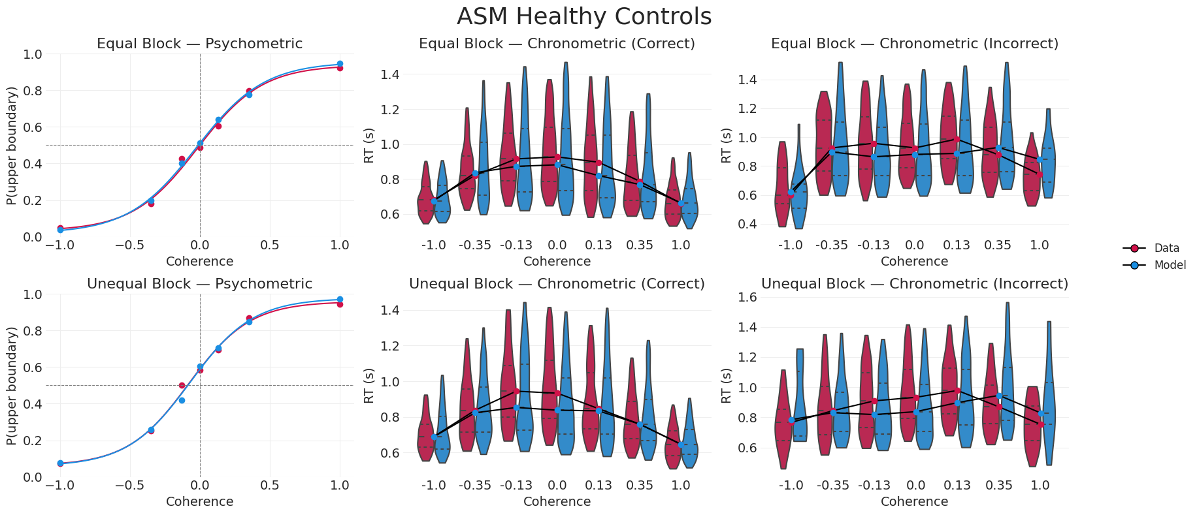
ASM Healthy Controls - Behavior Fit

Slide 3
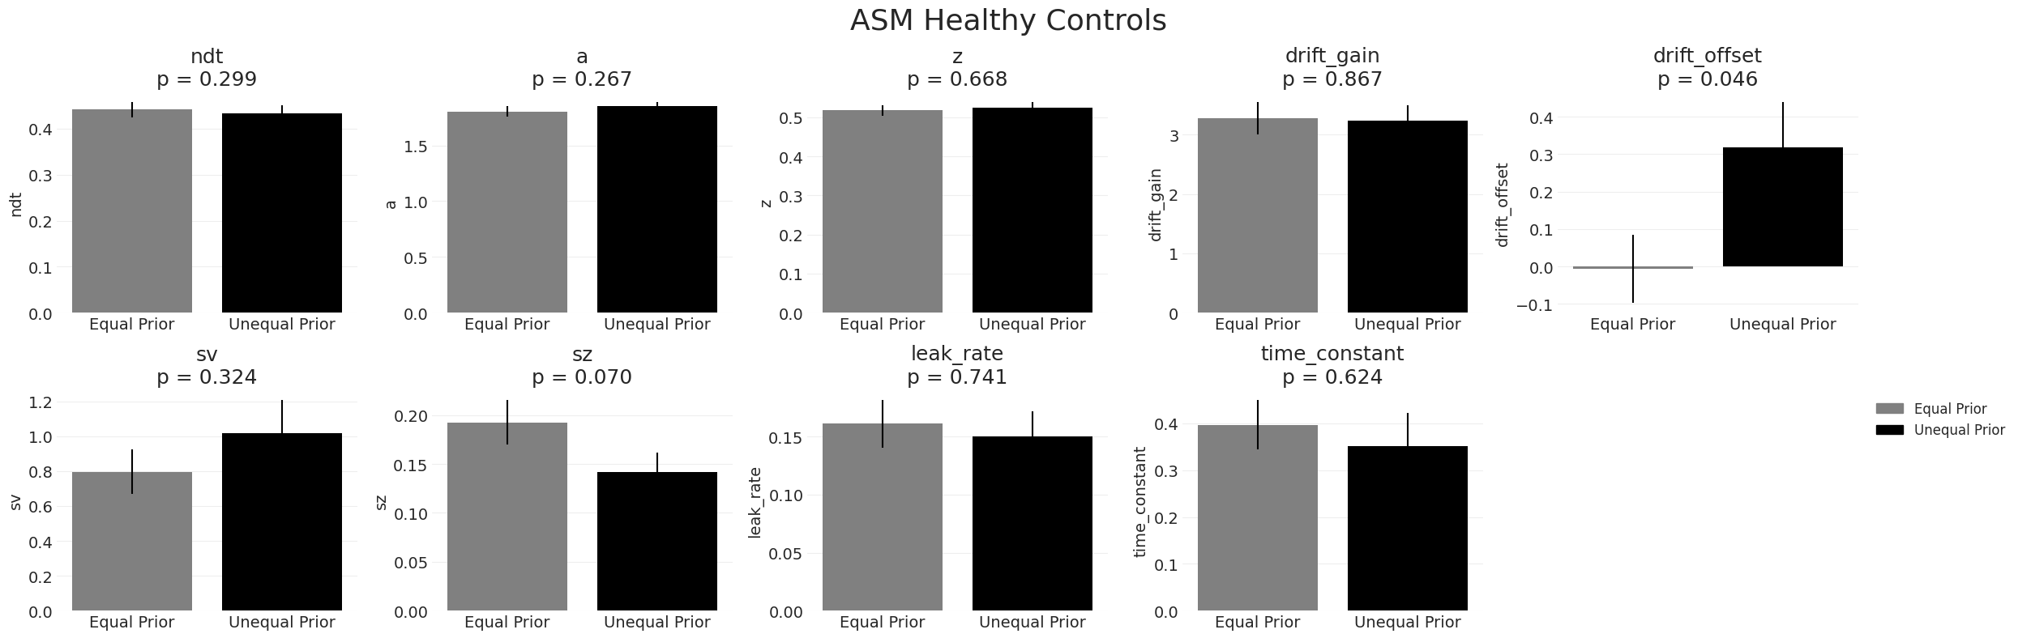
ASM Healthy Controls - Parameter Comparison

Slide 4
Tremor-Dominant PD Off Meds

Slide 5
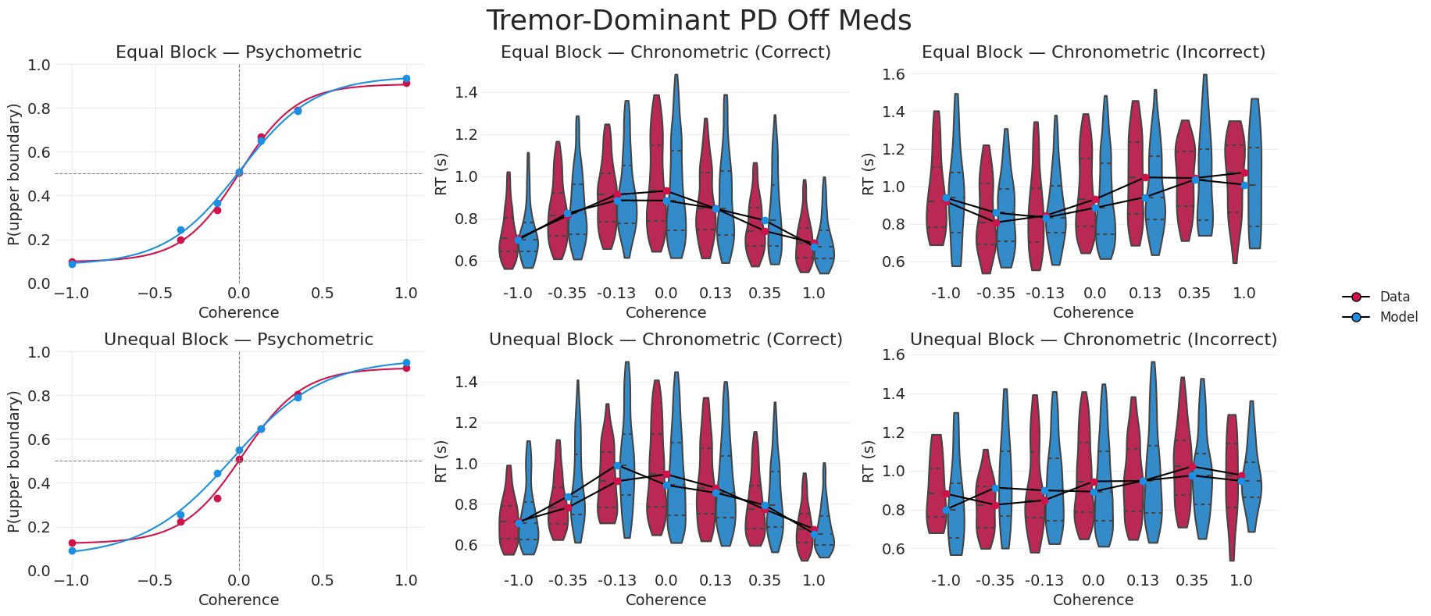
Tremor-Dominant PD Off Meds - Behavior Fit

Slide 6
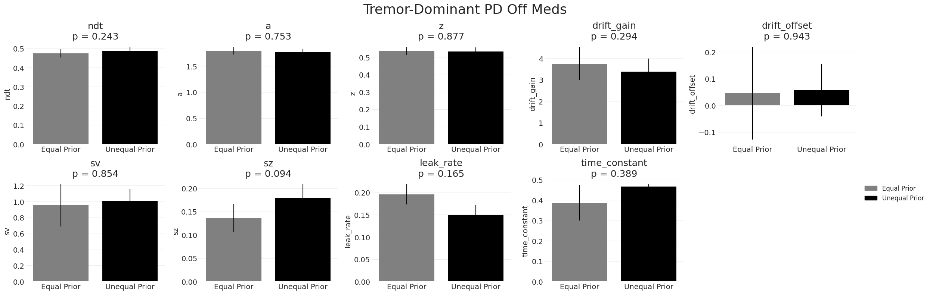
Tremor-Dominant PD Off Meds - Parameter Comparison

Slide 7
Tremor-Dominant PD On Meds

Slide 8
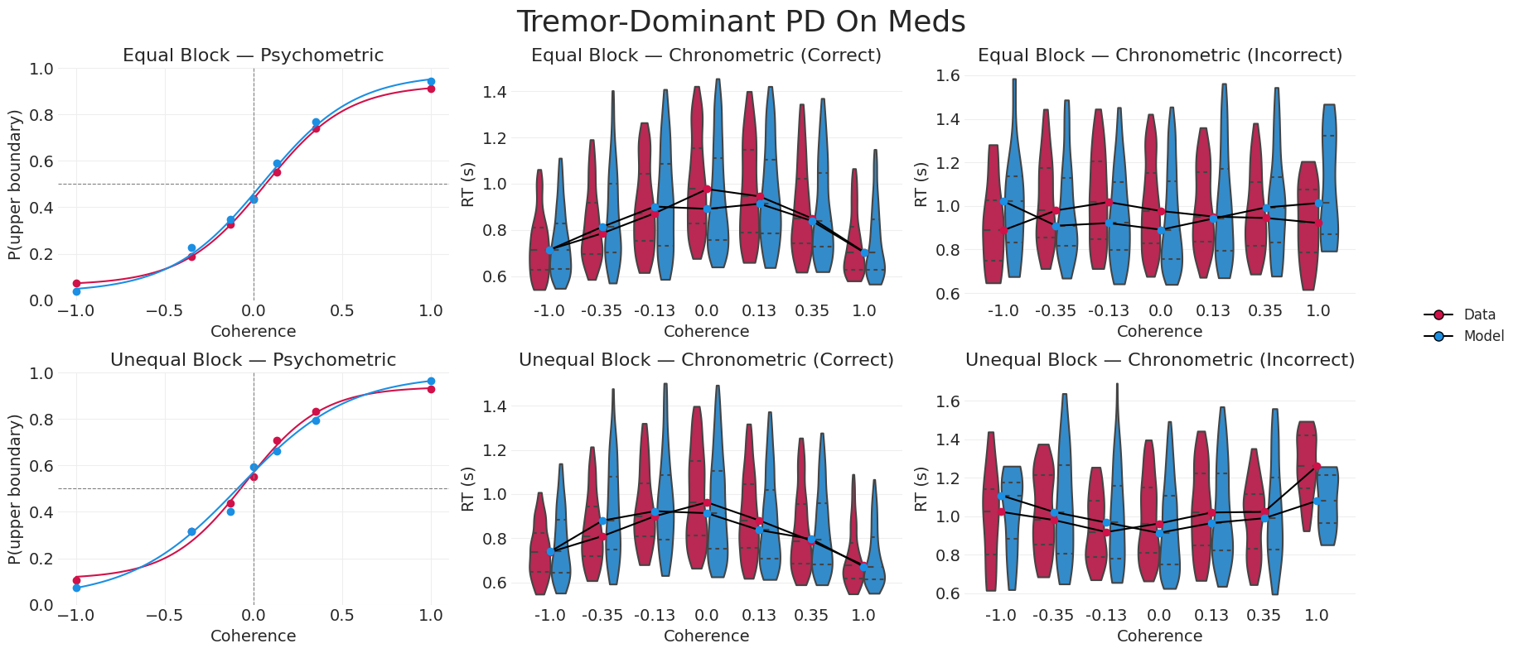
Tremor-Dominant PD On Meds - Behavior Fit

Slide 9
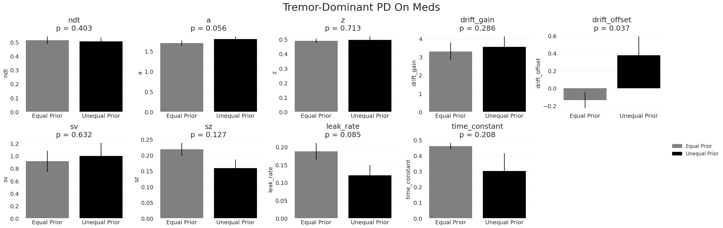
Tremor-Dominant PD On Meds - Parameter Comparison

Slide 10
Bradykinetic PD Off Meds

Slide 11
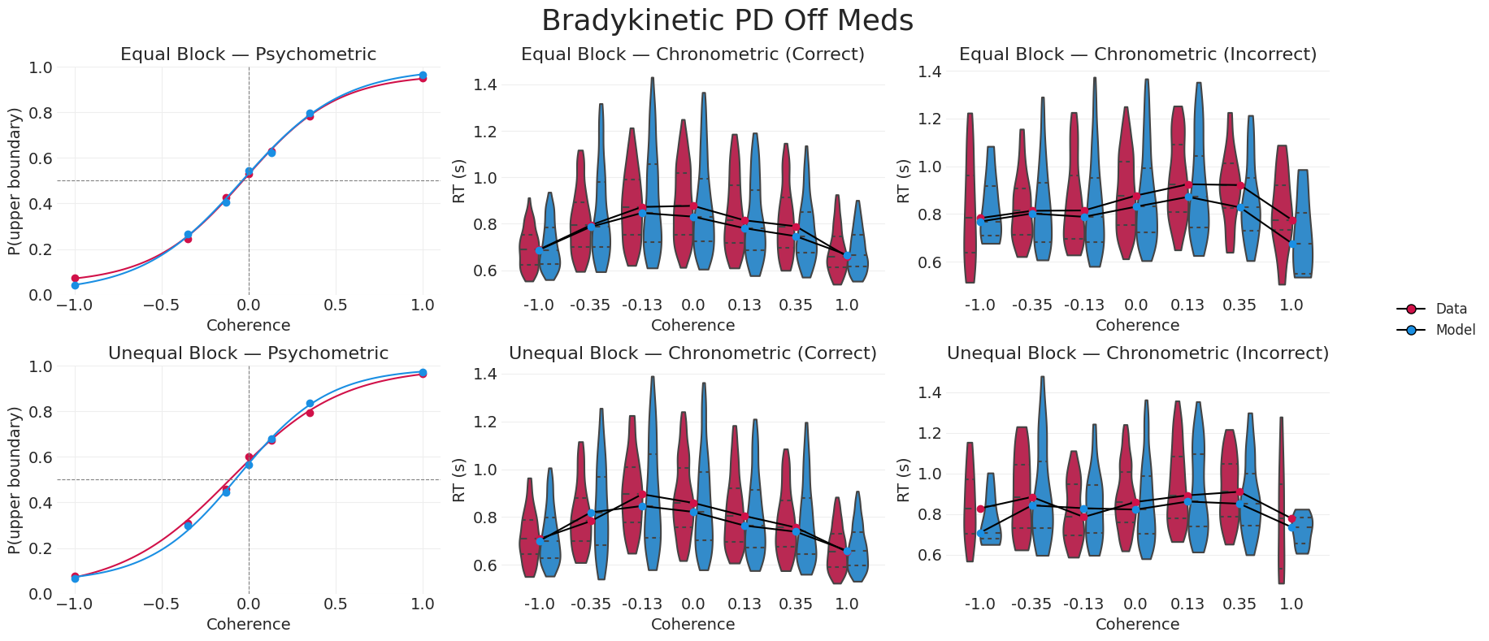
Bradykinetic PD Off Meds - Behavior Fit

Slide 12
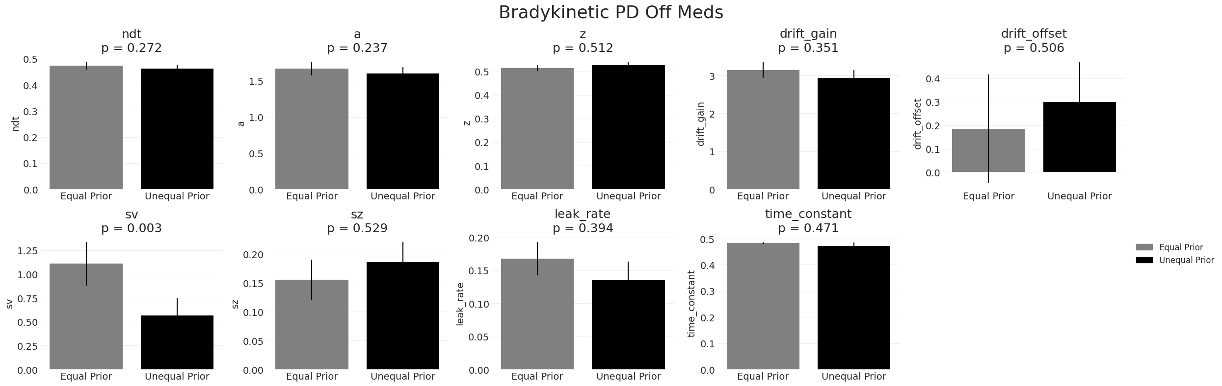
Bradykinetic PD Off Meds - Parameter Comparison

Slide 13
Bradykinetic PD On Meds

Slide 14
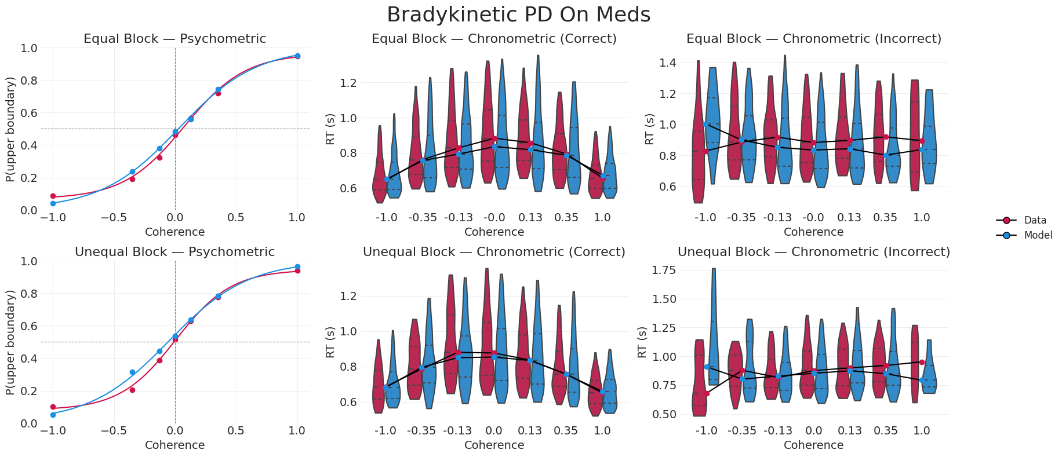
Bradykinetic PD On Meds - Behavior Fit

Slide 15
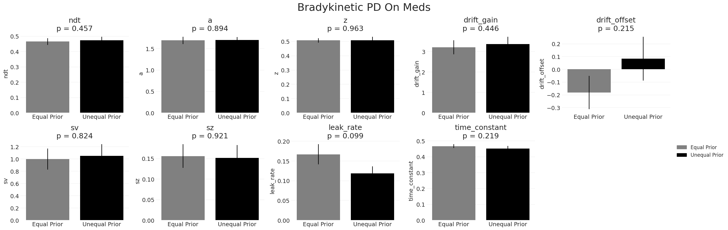
Bradykinetic PD On Meds - Parameter Comparison

