Slide 1
dPCA updates: Whole-Trial Trajectories Projected onto dPCs aligned at different periods
07/02/2025

Slide 2
Target Onset-Aligned dPCA

Slide 3
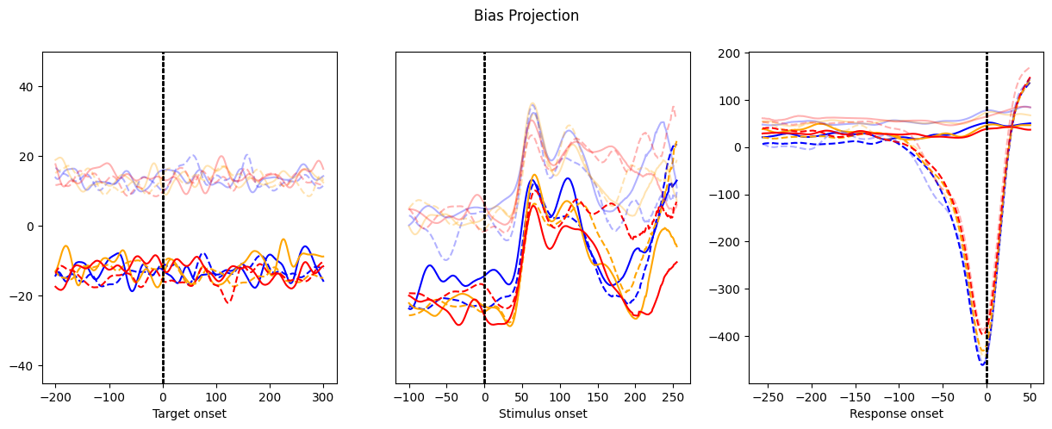
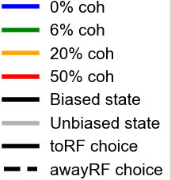
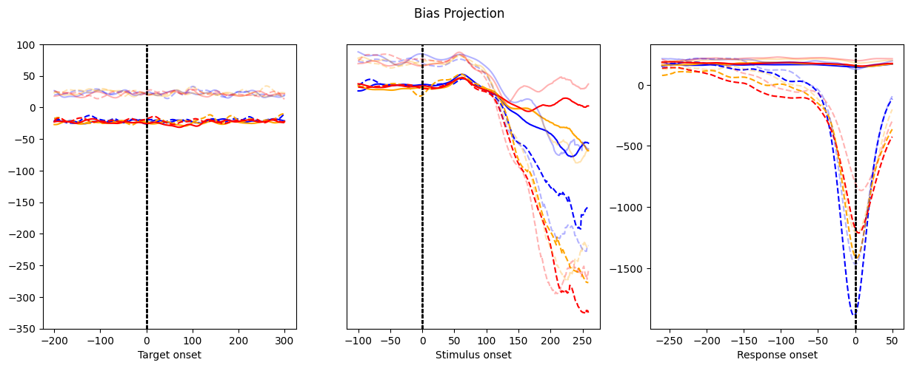
Observation:
toRF prior:
Bias axis persisted before stimulus onset, decerased and start to encode stimuluschoice information before response
Only toRF choices have separation between biased/unbiased near response
awayRF prior:
Bias axis persisted before stimulus onset, vanished and instead encode choice information before response
Only awayRF choices have separation between biased/unbiased near response
toRF prior
awayRF prior

Slide 4
Stimulus Onset-Aligned dPCA

Slide 5
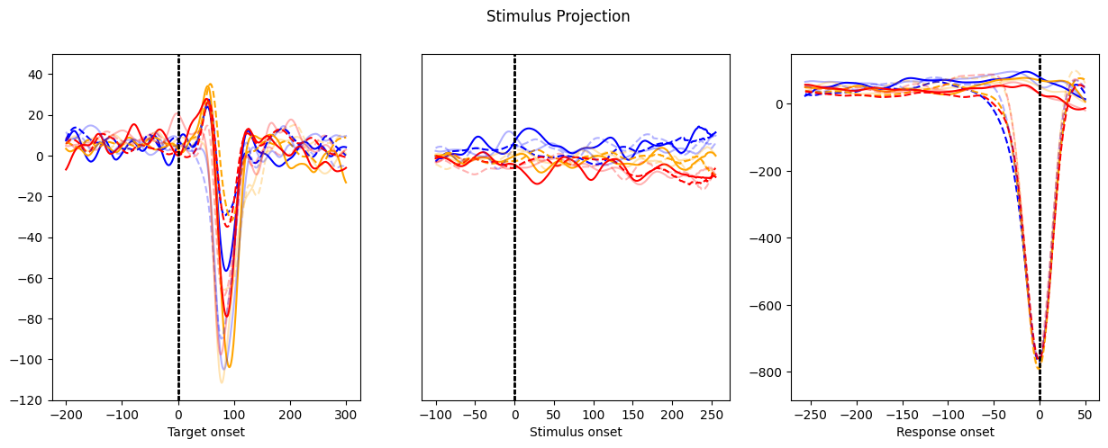
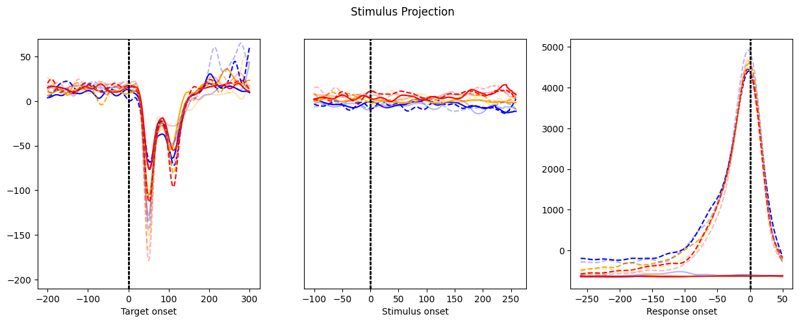
Observation:
Stimulus information is not present before stimulus onset.
After stimulus onset, clear separation emerges between coherences, indicating onset of stimulus encoding.
Then coherence separation collapsed before saccade.
toRF prior
awayRF prior

Slide 6
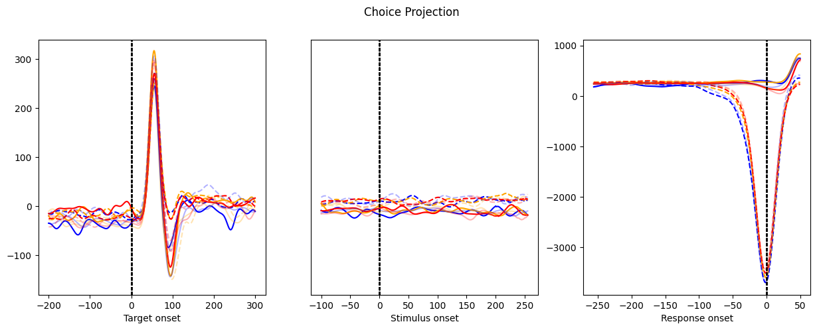
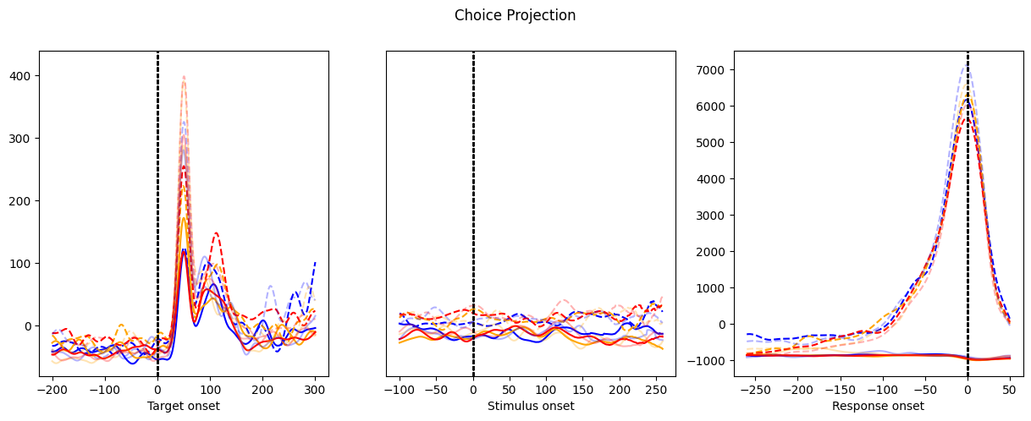
Observation:
Choice information is present weakly before stimulus onset.
After stimulus onset, clear separation emerges between choices and grows until saccade.
toRF prior
awayRF prior

Slide 7
Response Onset-Aligned dPCA

Slide 8
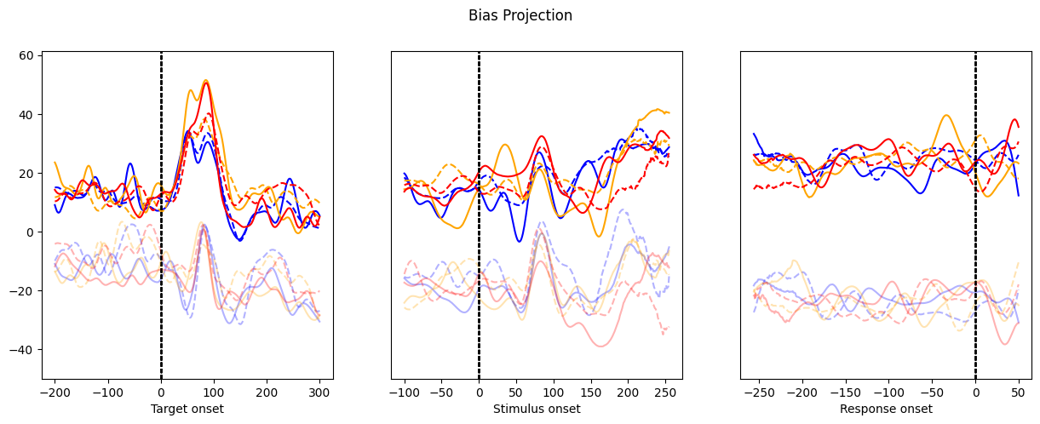
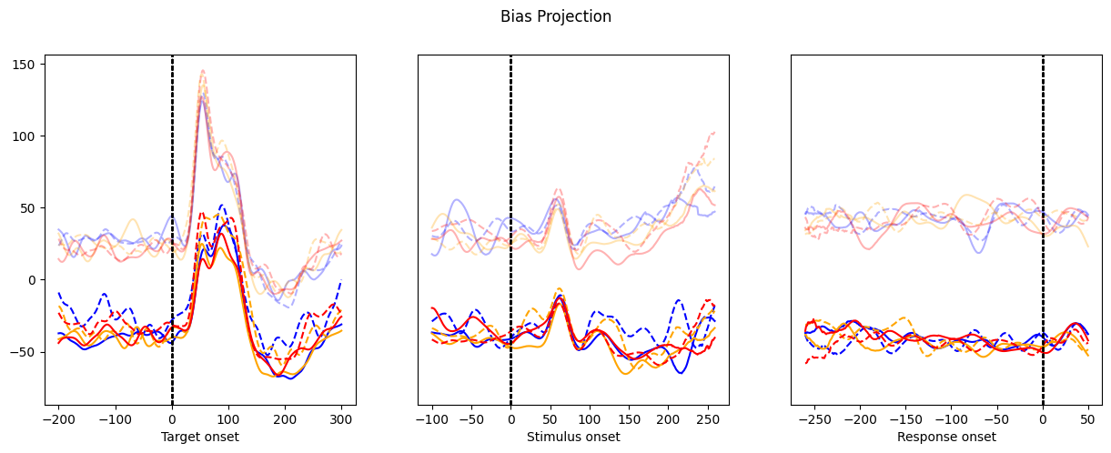
Observation:
Bias axis in response-onset aligned duration encodes bias information throughout the trial
toRF prior
awayRF prior

Slide 9
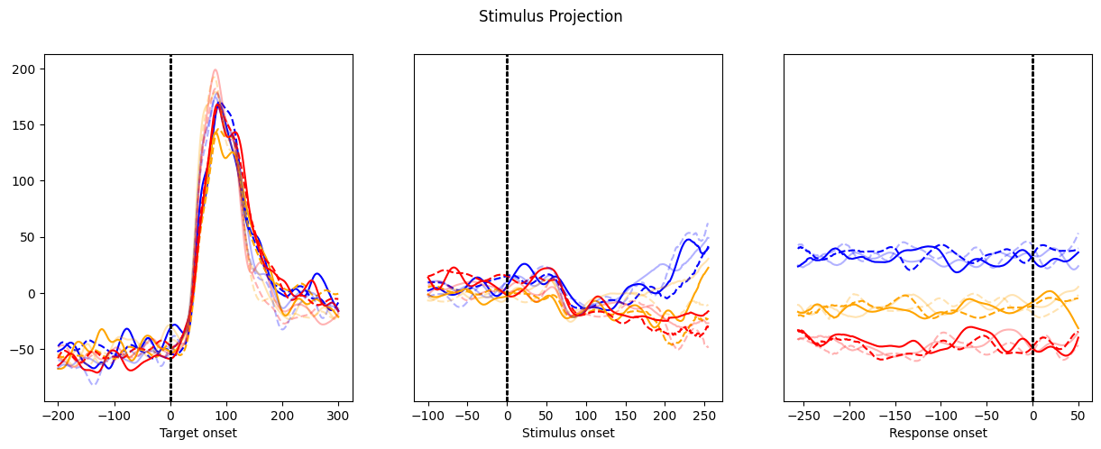
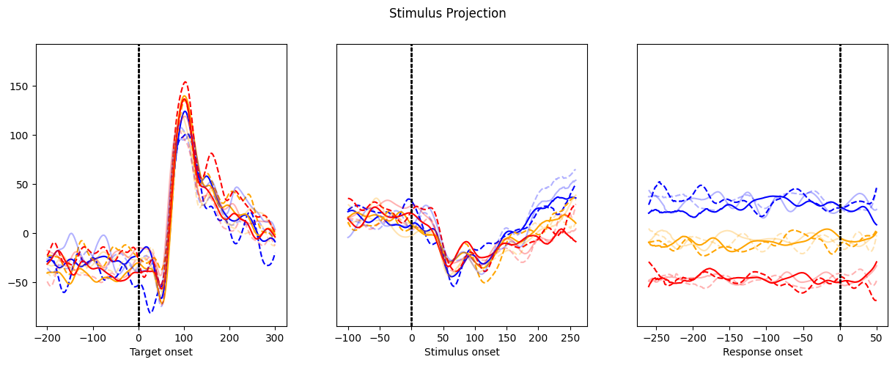
Observation:
Stimulus axis in response-onset aligned duration encodes stimulus information ~150ms after GP on, and the separation across coherences grows and persists until saccade.
toRF prior
awayRF prior

Slide 10
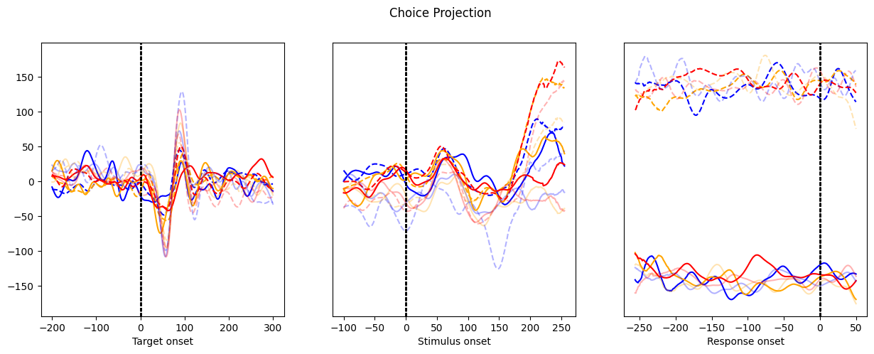
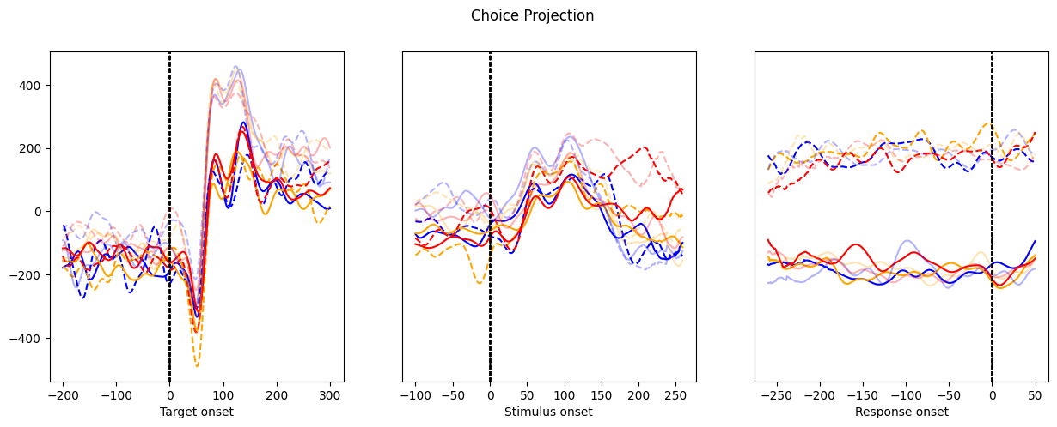
Observation:
No choice encoding before stimulus onset, differences between choices emerges ~150ms after GP on, the separation grows and persists until saccade.
toRF prior
awayRF prior

