Slide 1
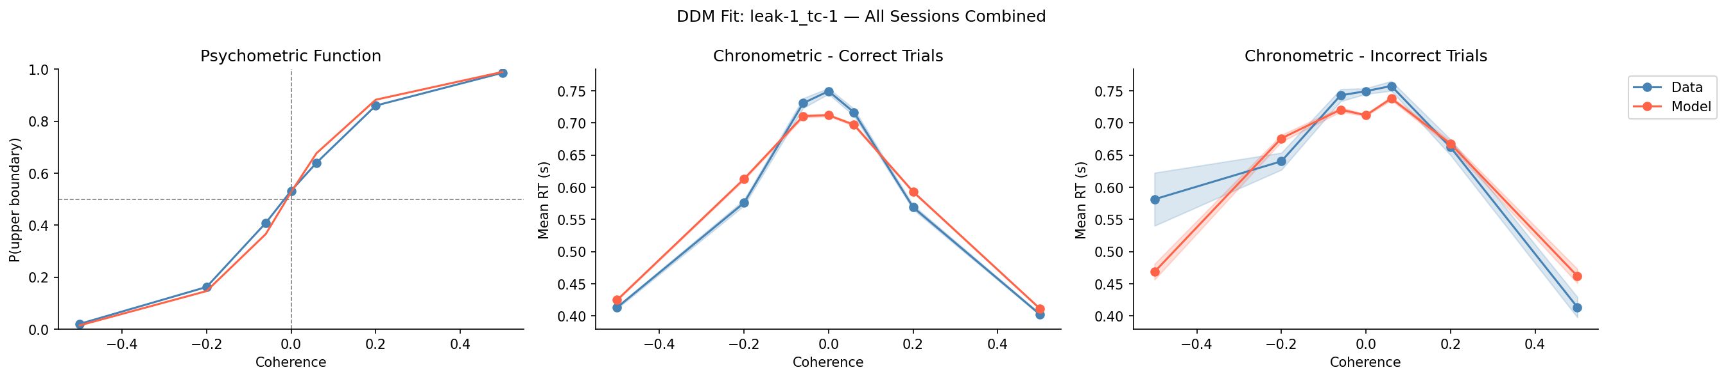
leak-1_tc-1 — All Sessions Combined

Slide 2
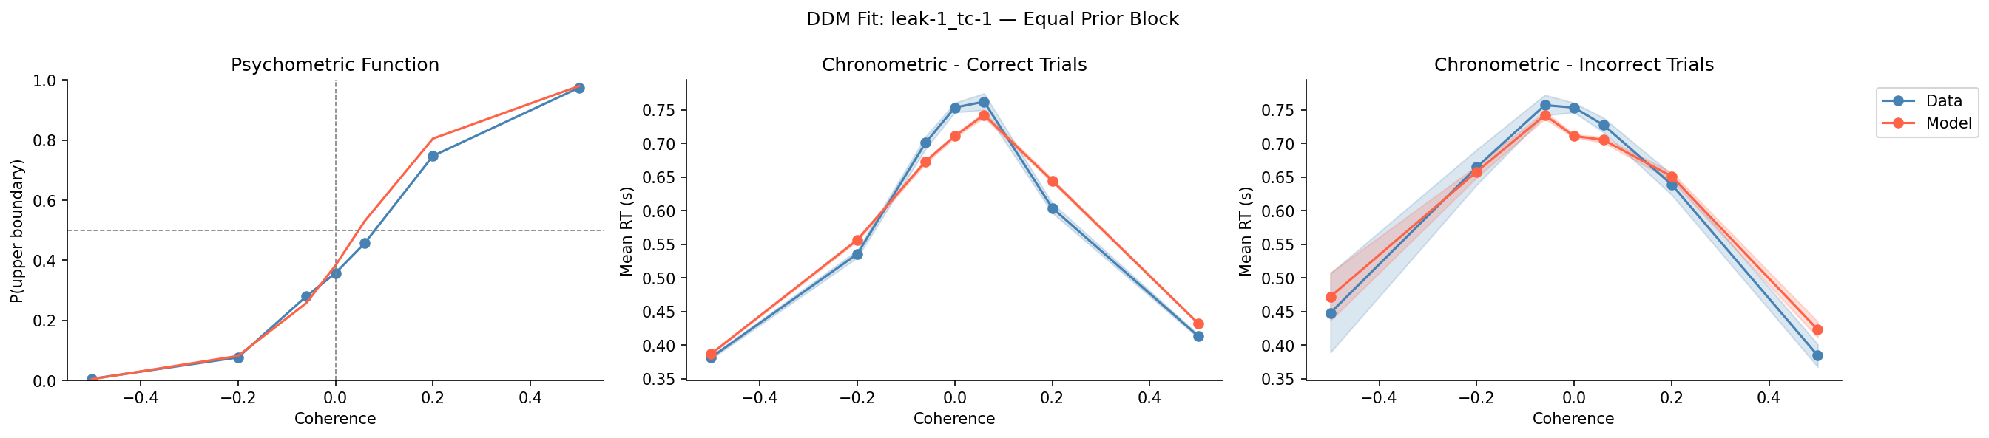
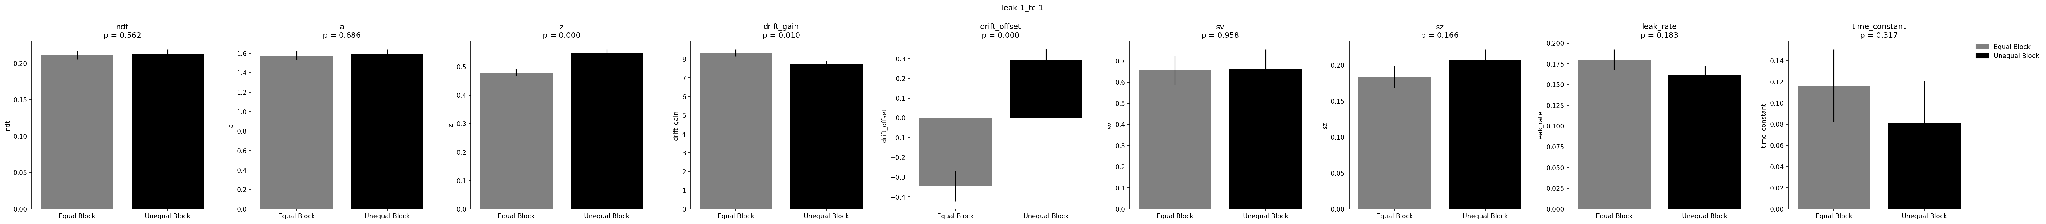
leak-1_tc-1 — Equal Block + Parameters

Slide 3
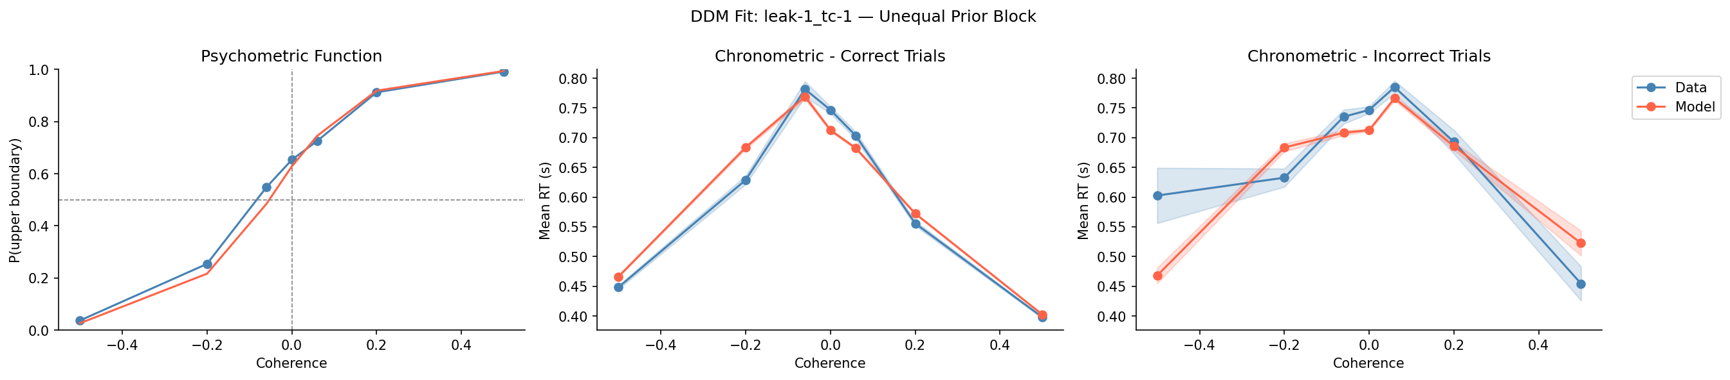
leak-1_tc-1 — Unequal Block + Parameters

Slide 4
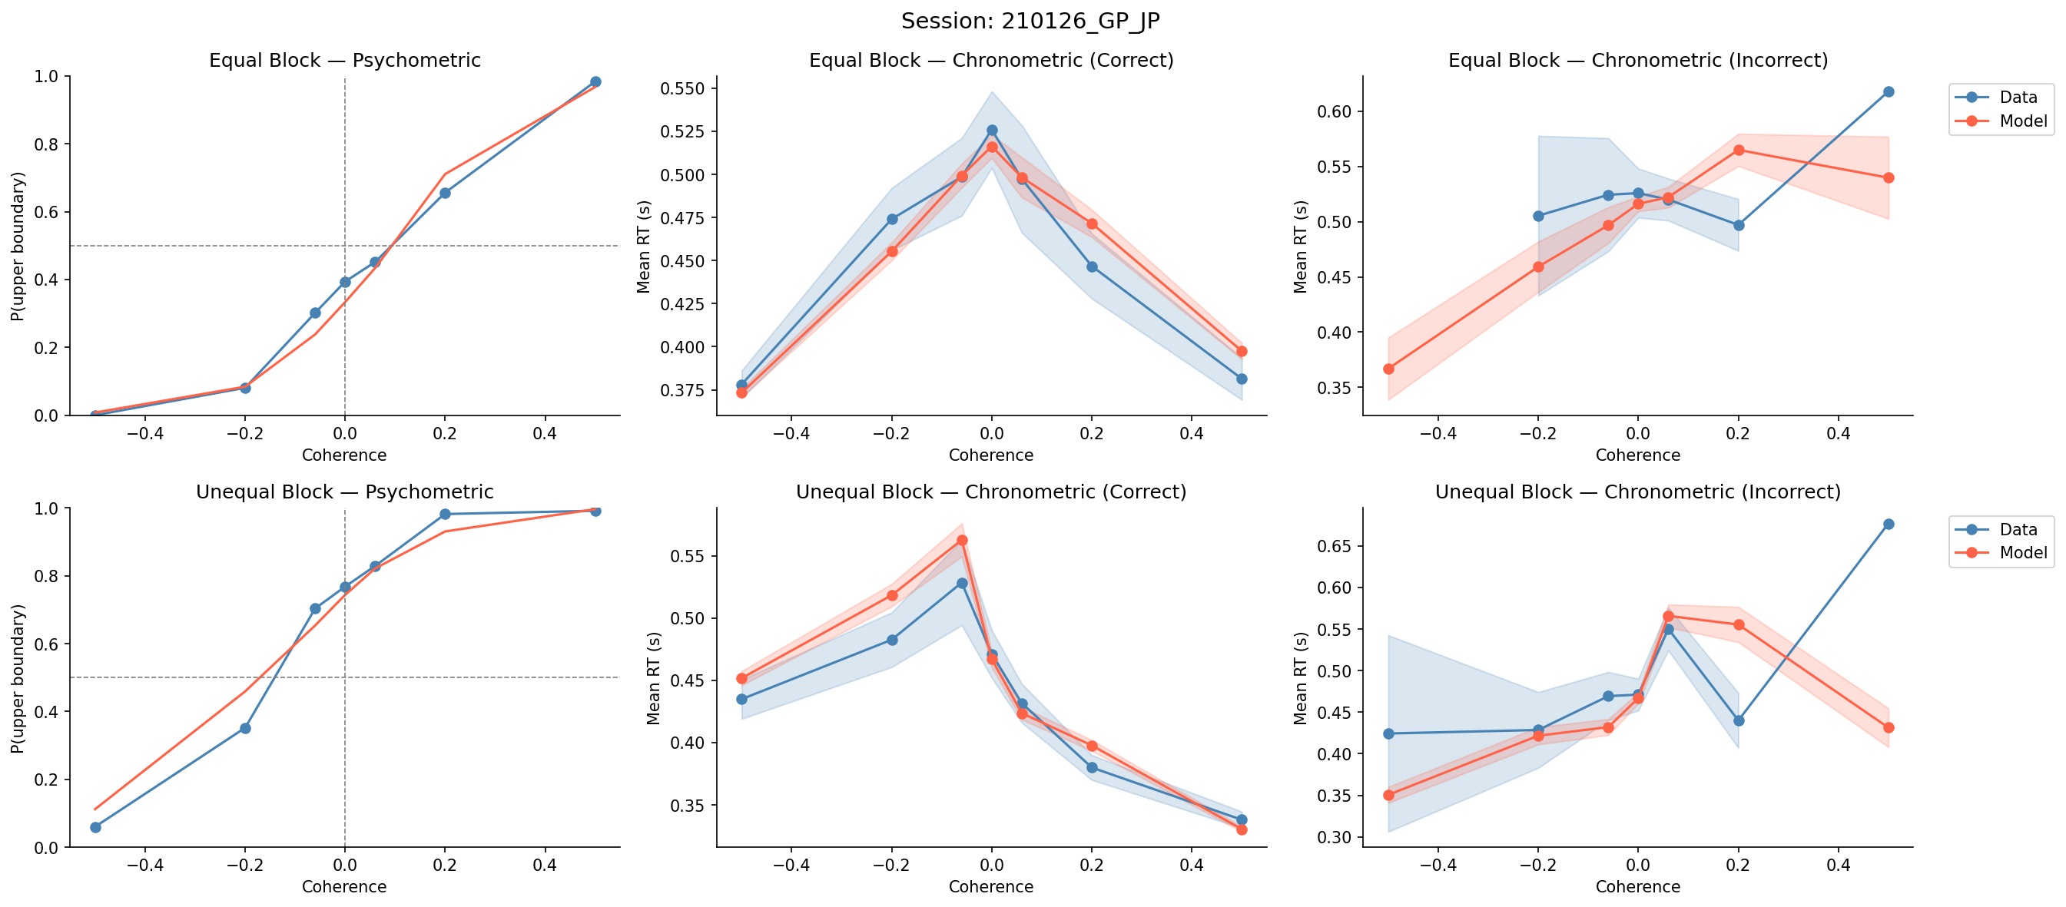
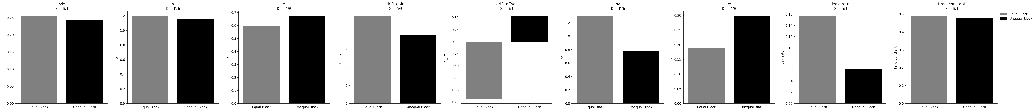
Session: 210126_GP_JP

Slide 5
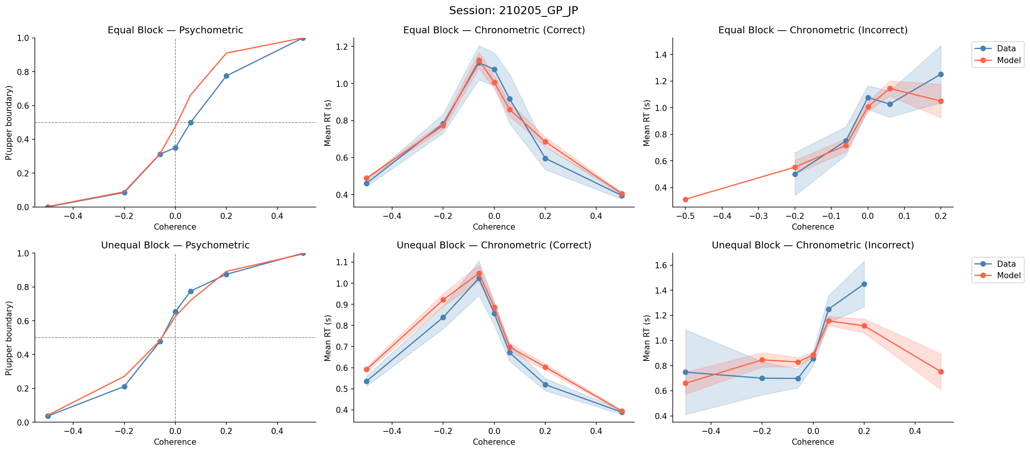
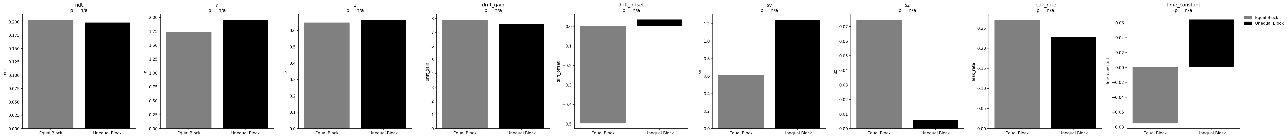
Session: 210205_GP_JP

Slide 6
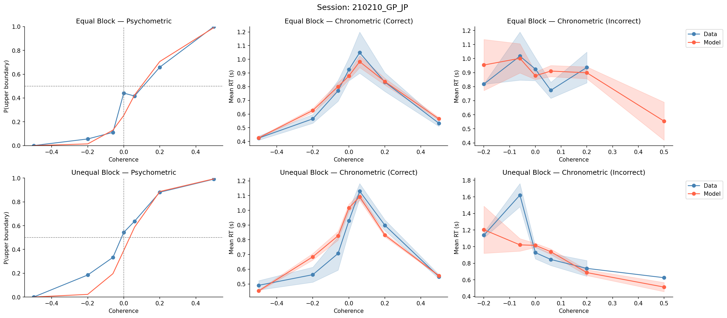
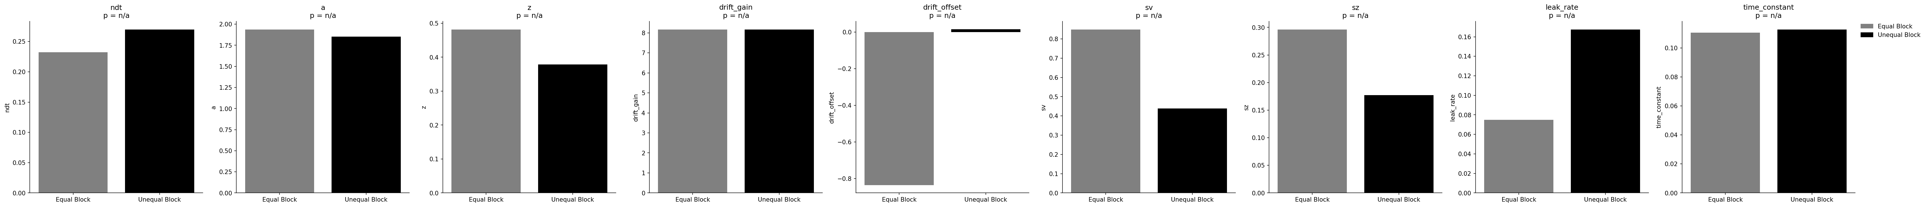
Session: 210210_GP_JP

Slide 7
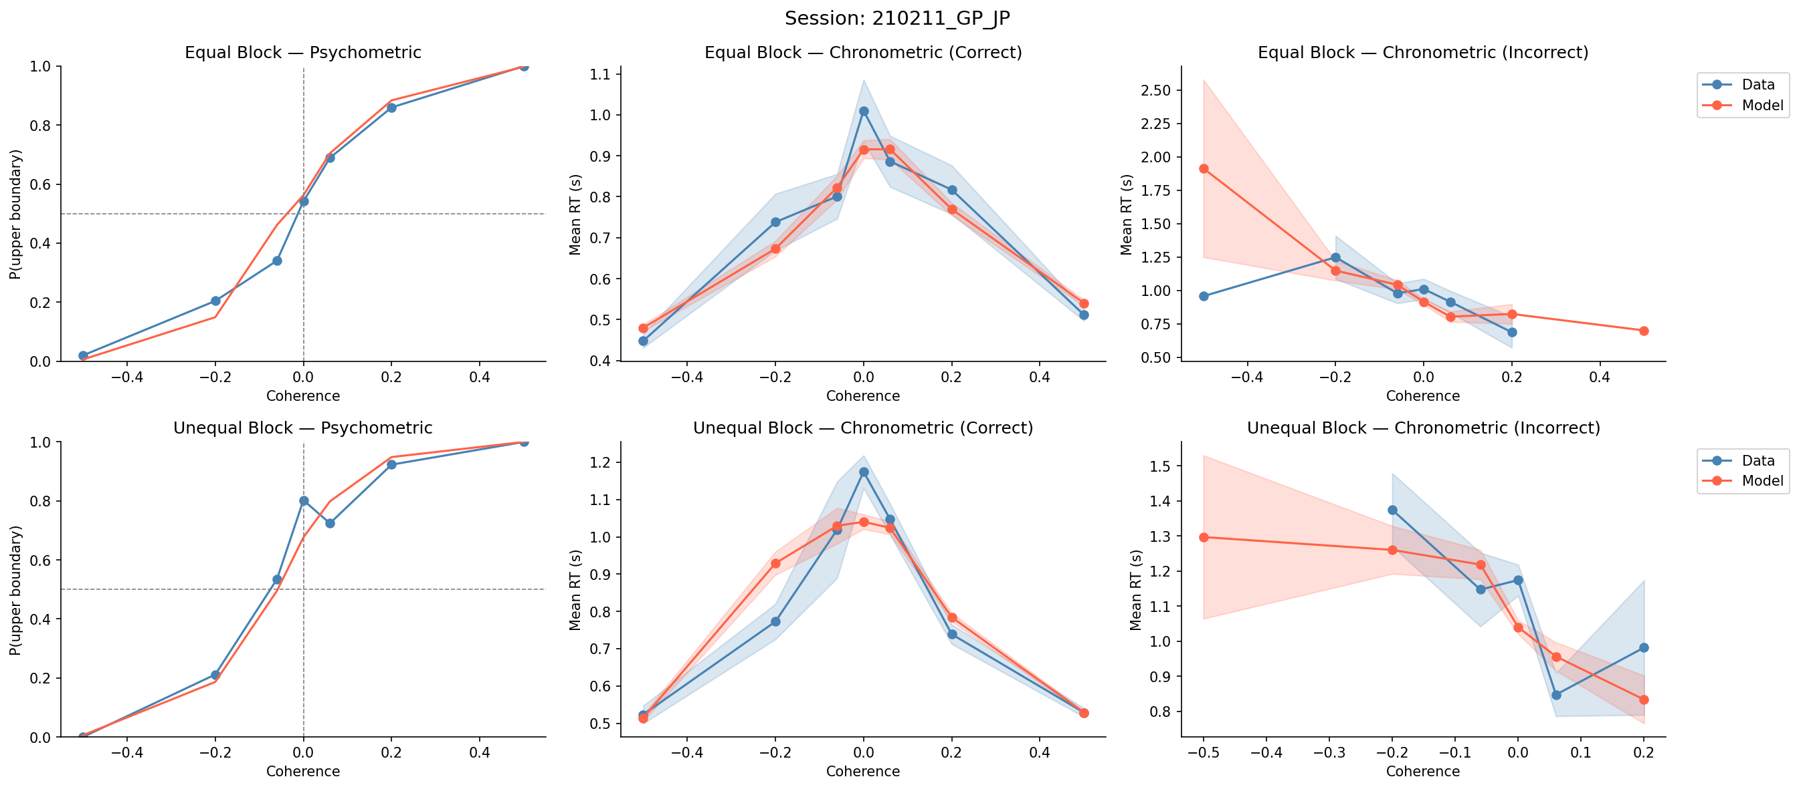
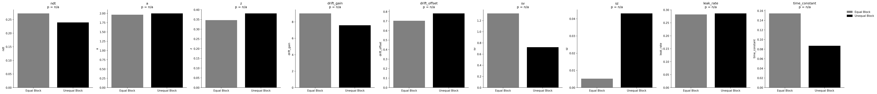
Session: 210211_GP_JP

Slide 8
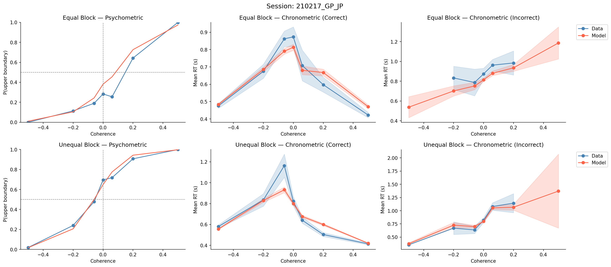
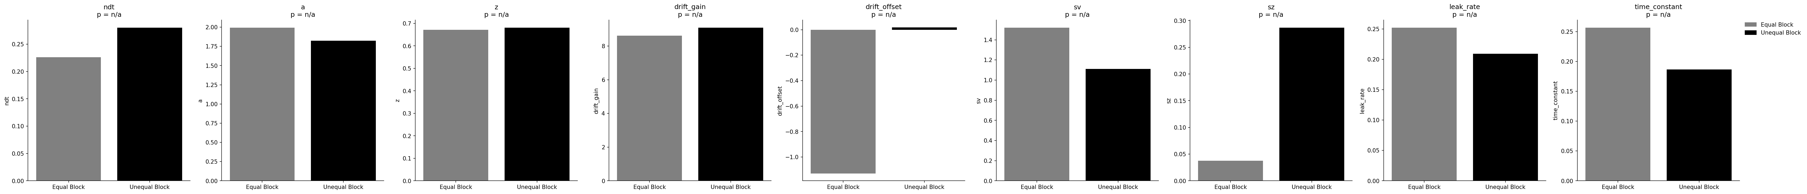
Session: 210217_GP_JP

Slide 9
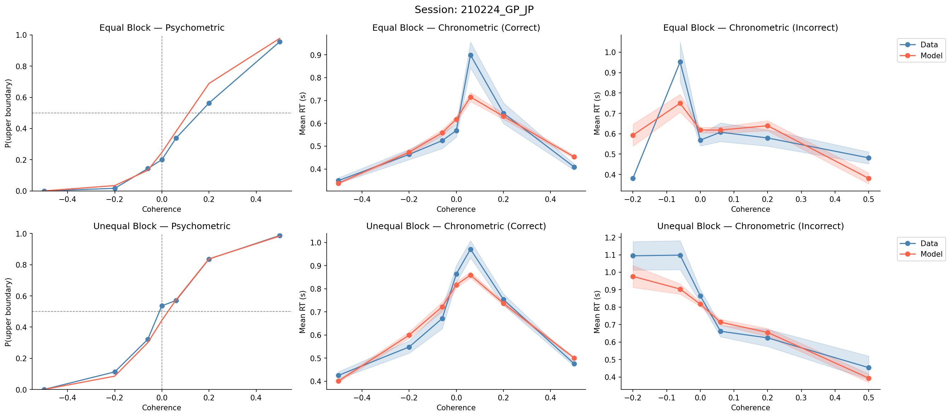
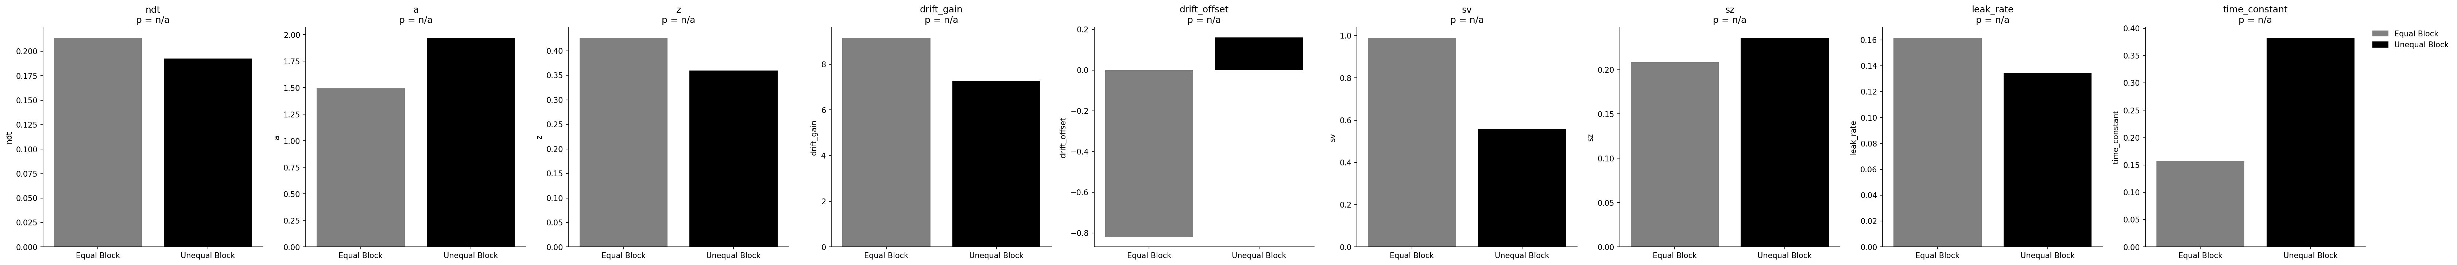
Session: 210224_GP_JP

Slide 10
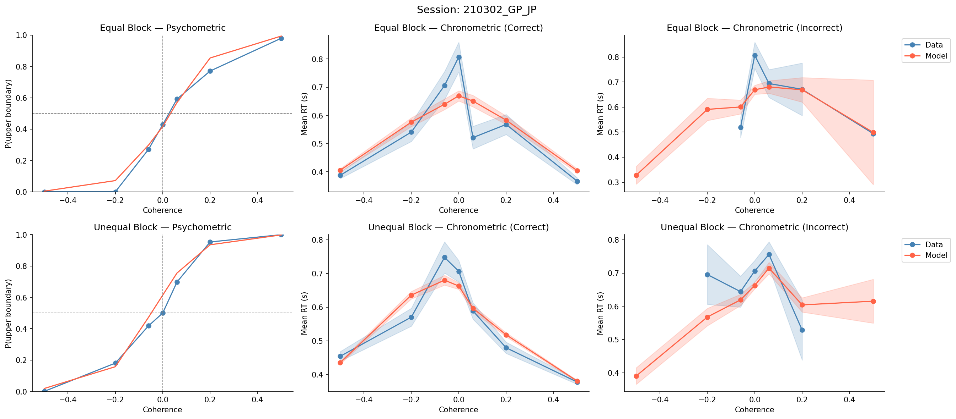
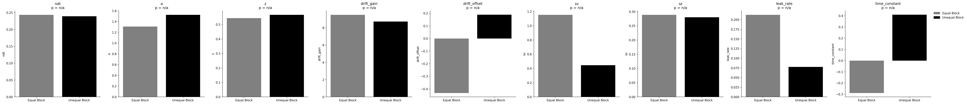
Session: 210302_GP_JP

Slide 11
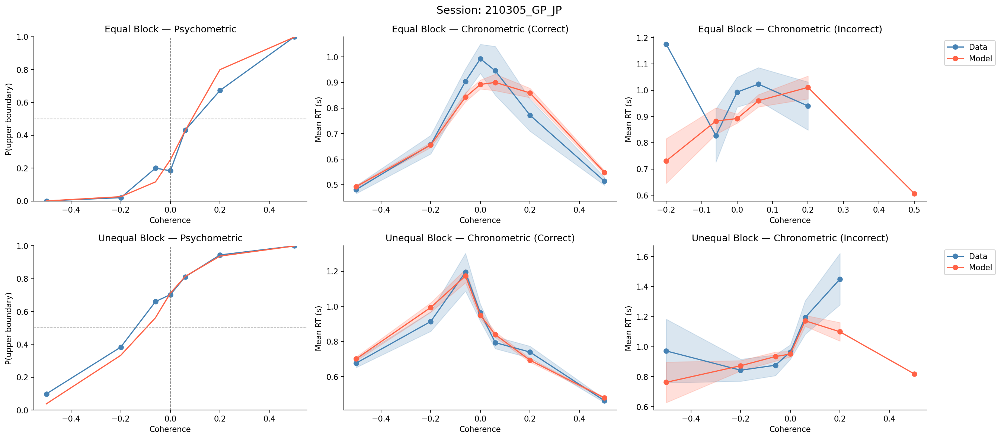
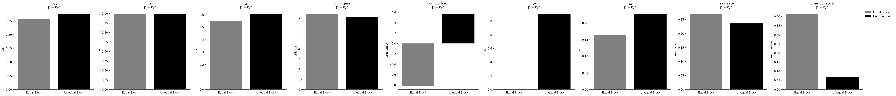
Session: 210305_GP_JP

Slide 12
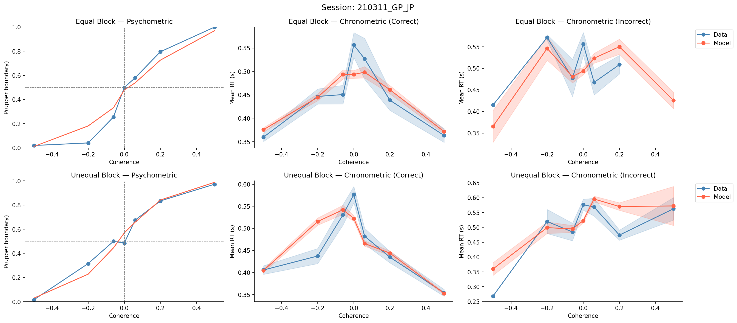
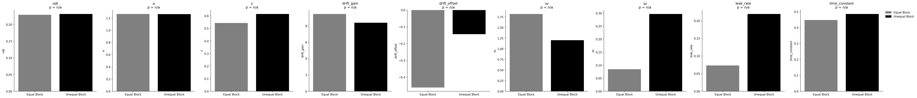
Session: 210311_GP_JP

Slide 13
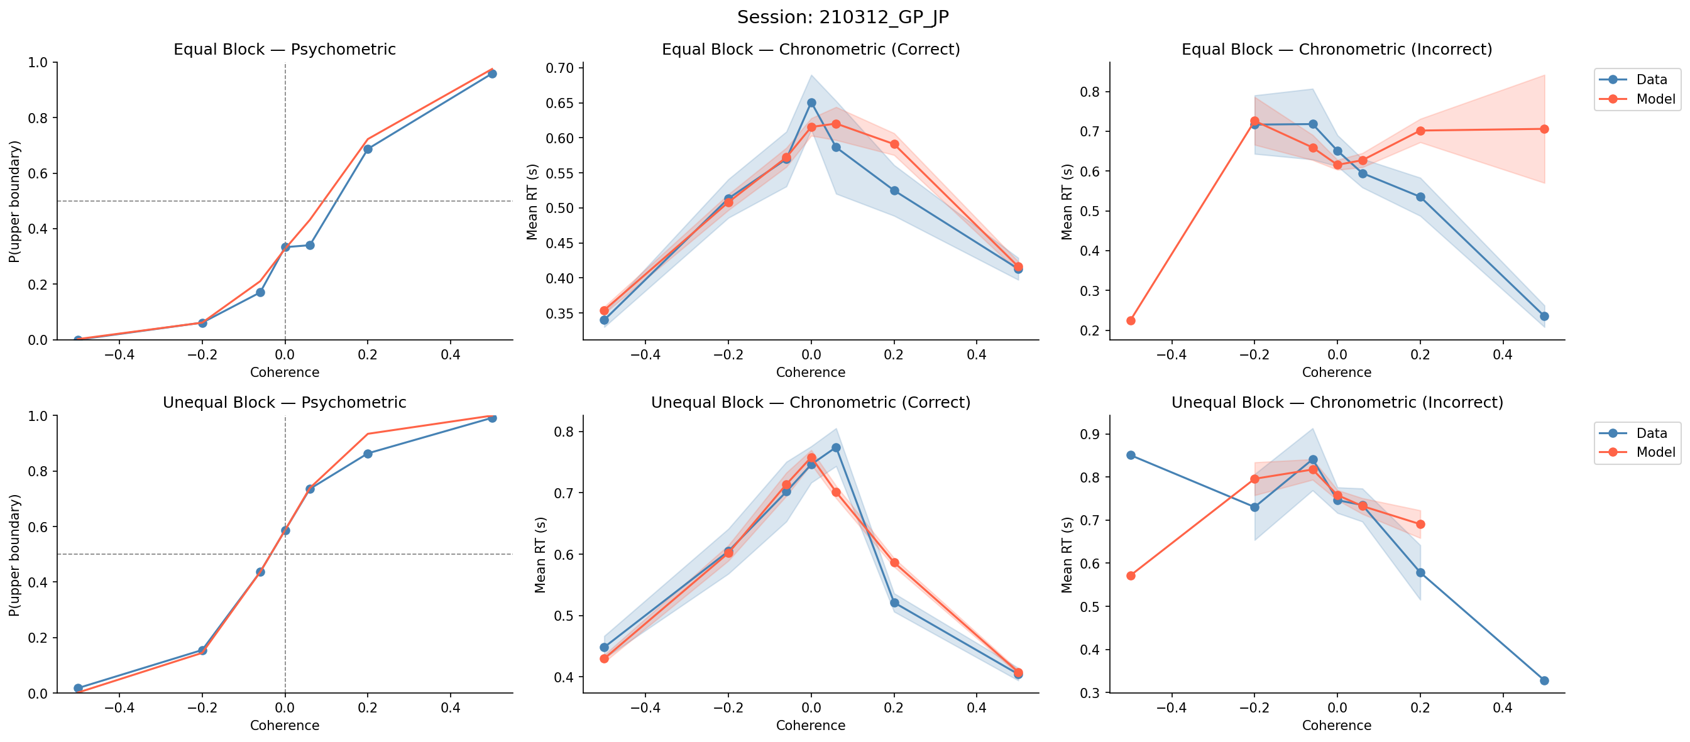
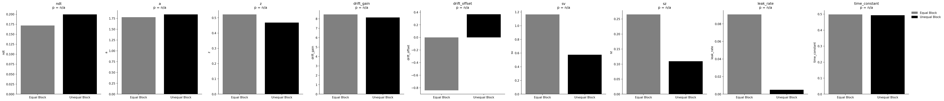
Session: 210312_GP_JP

Slide 14
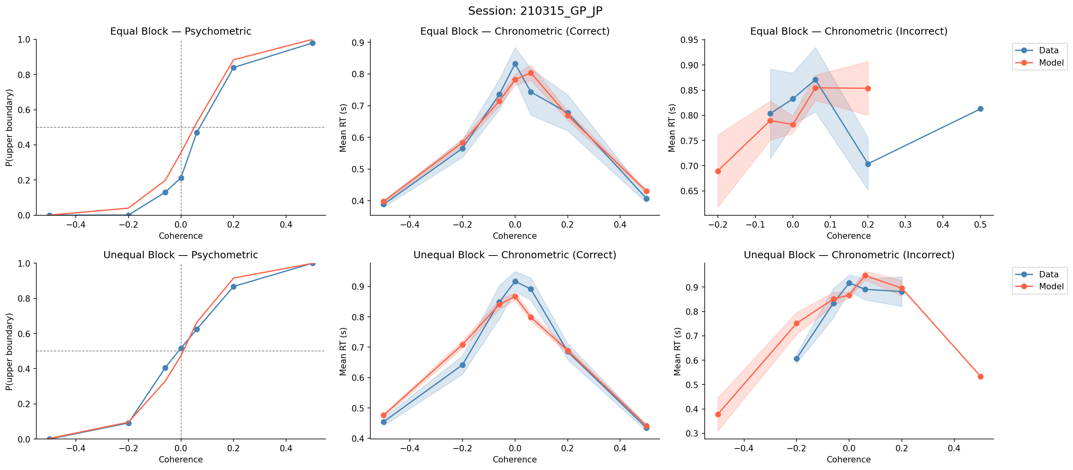
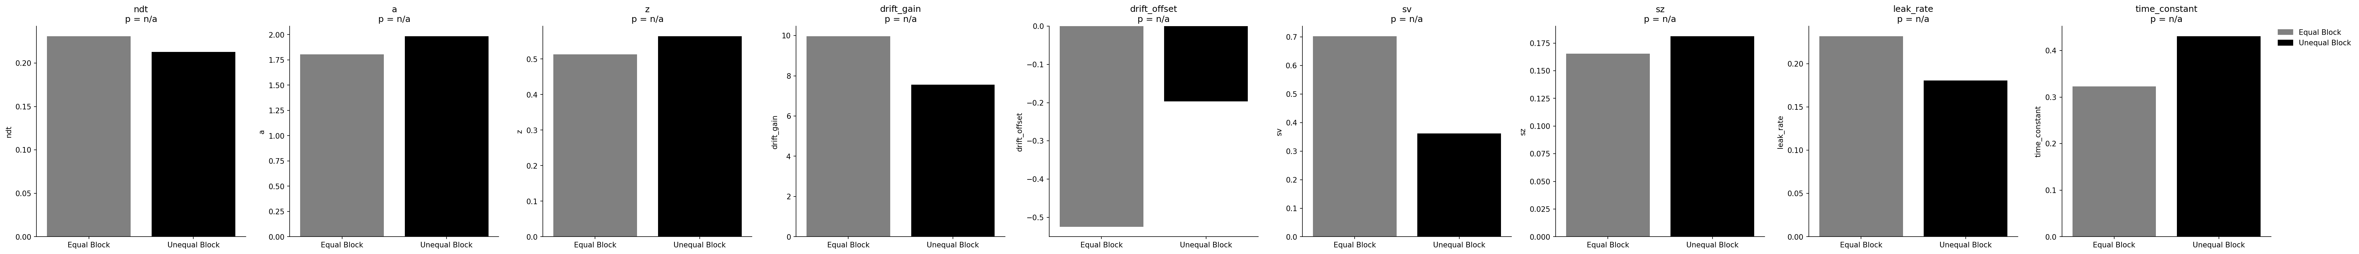
Session: 210315_GP_JP

Slide 15
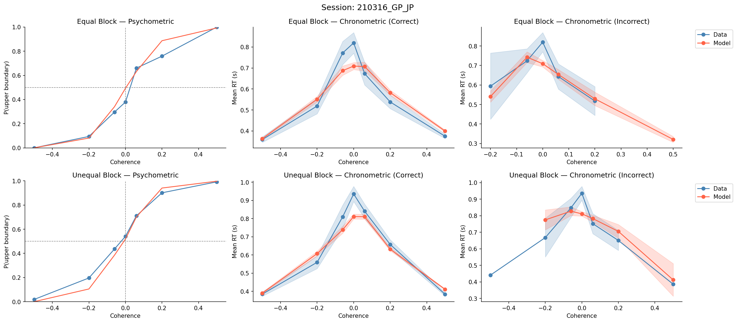
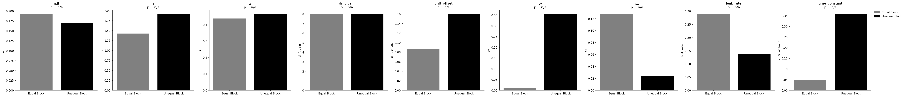
Session: 210316_GP_JP

Slide 16
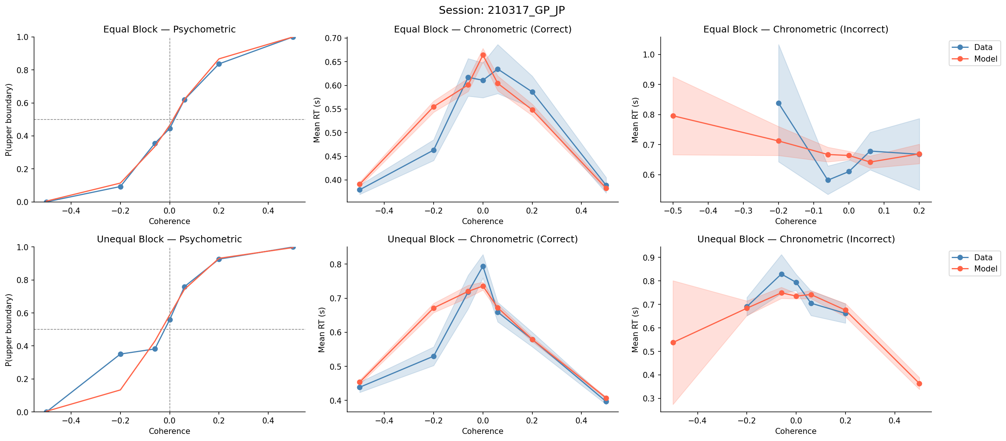
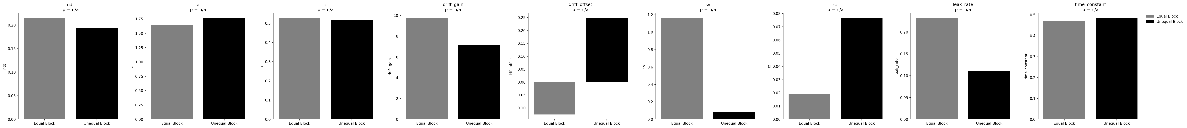
Session: 210317_GP_JP

Slide 17
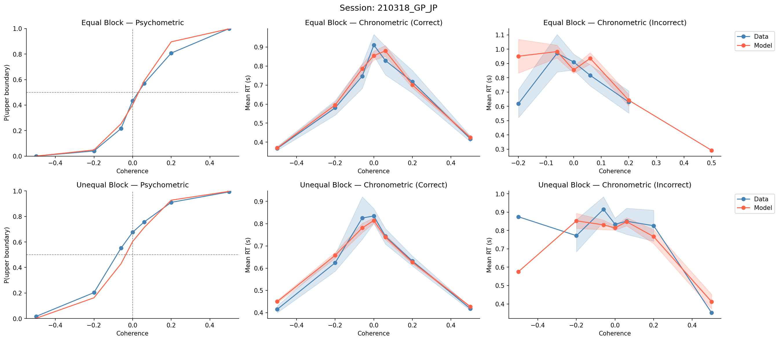
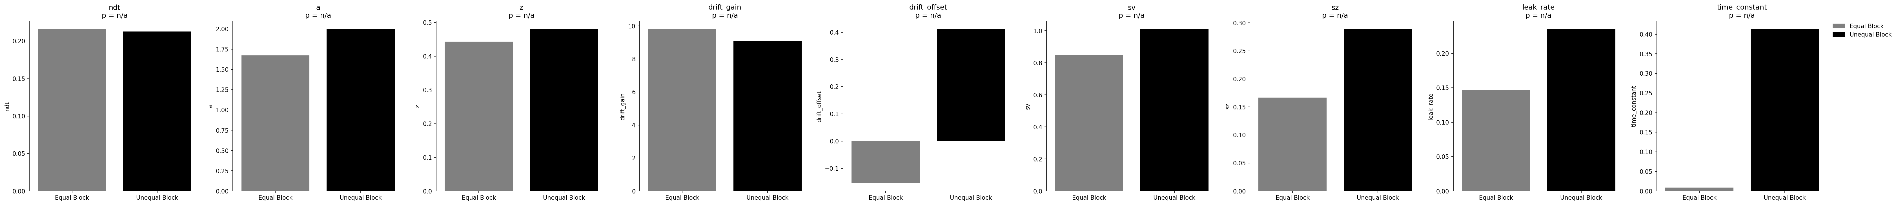
Session: 210318_GP_JP

Slide 18
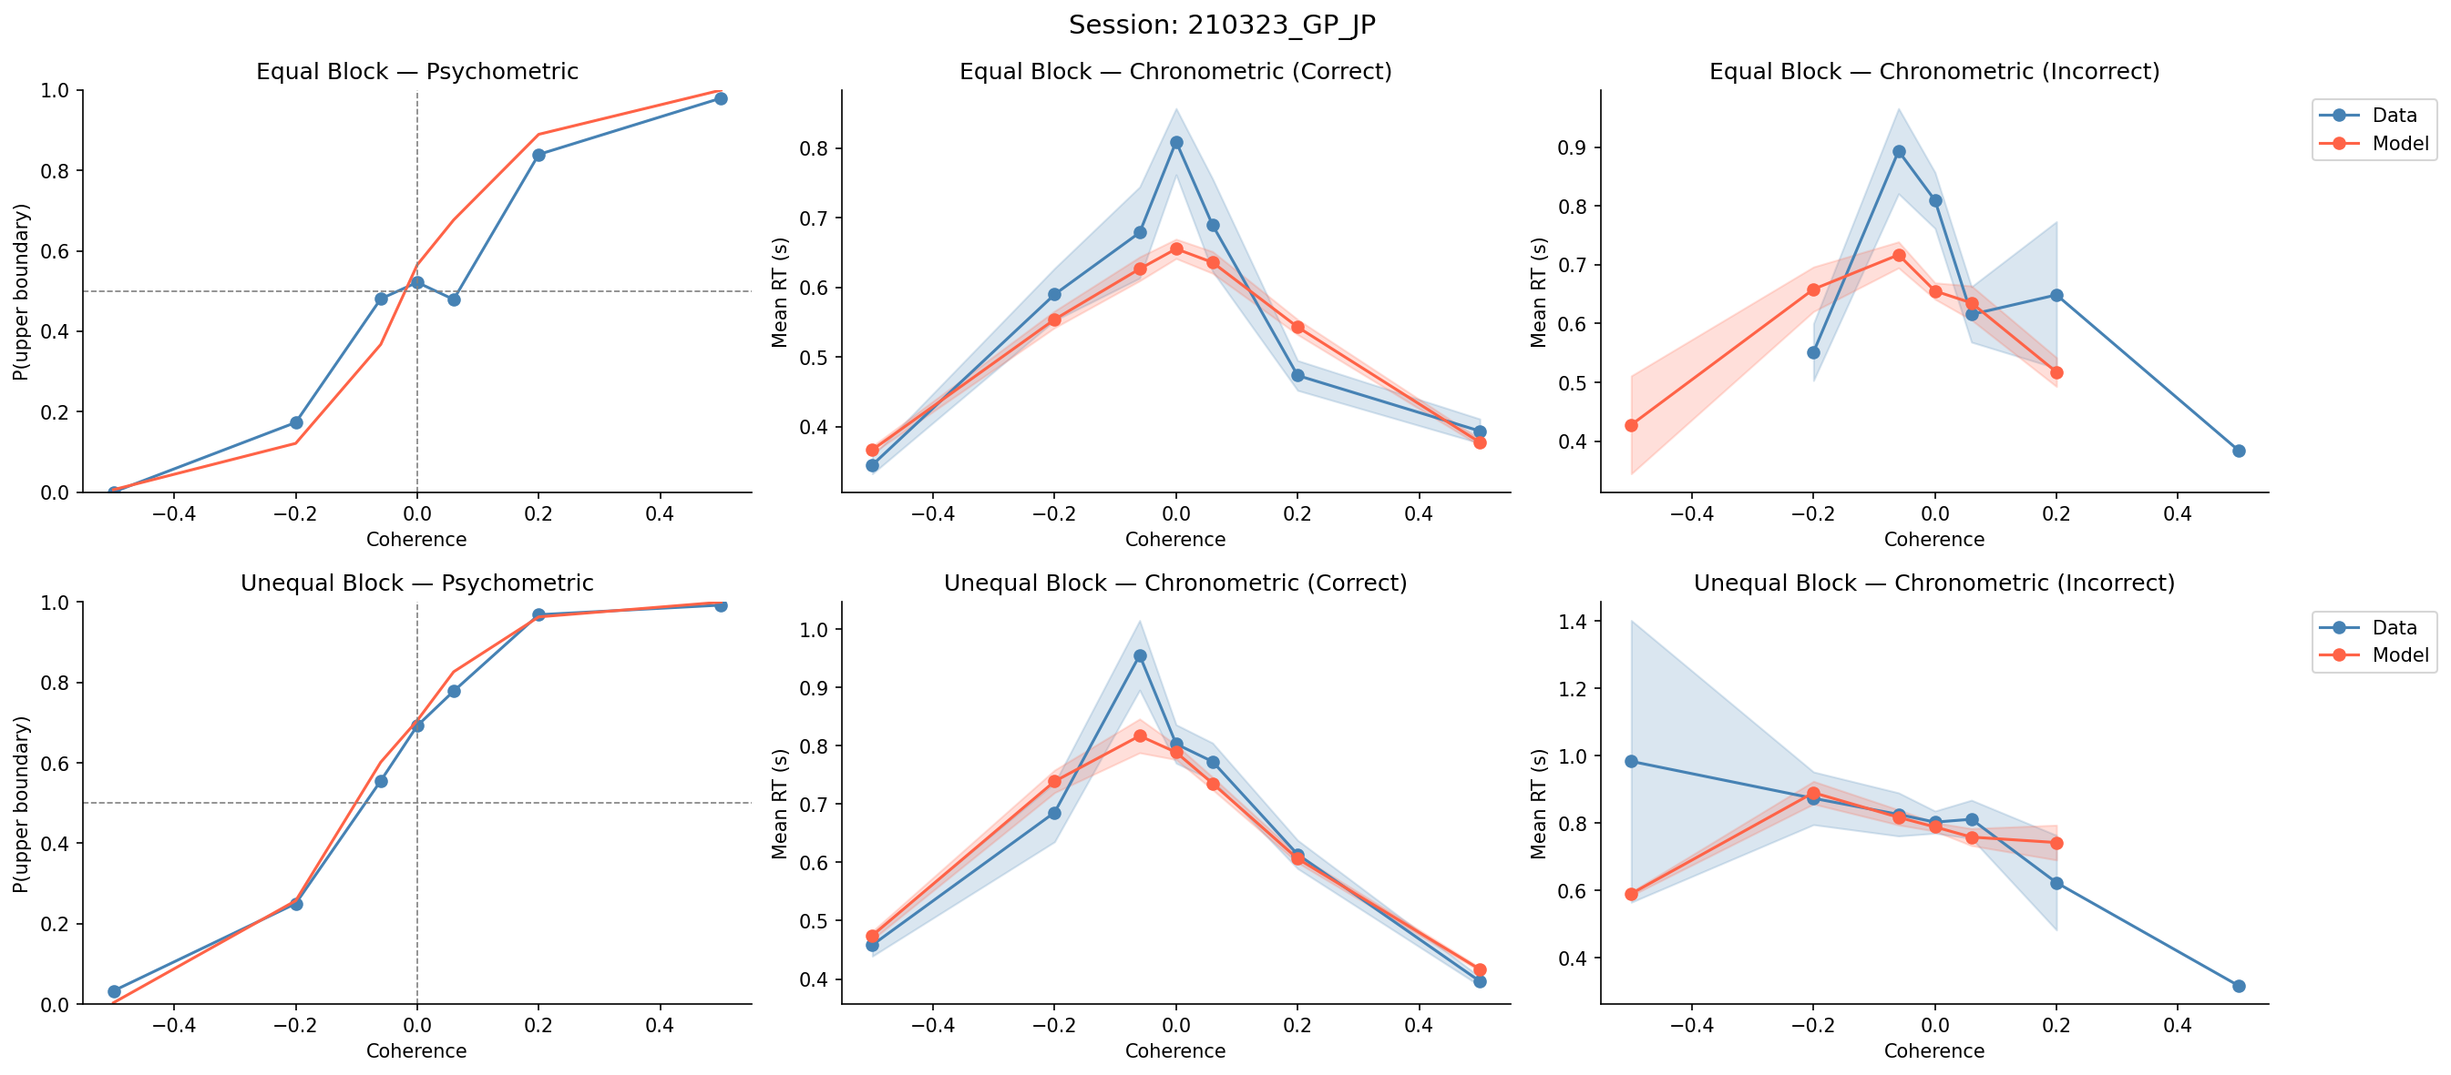
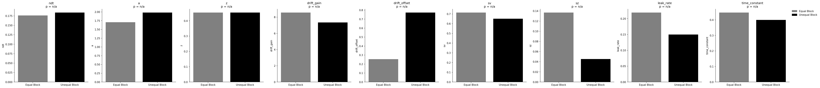
Session: 210323_GP_JP

Slide 19
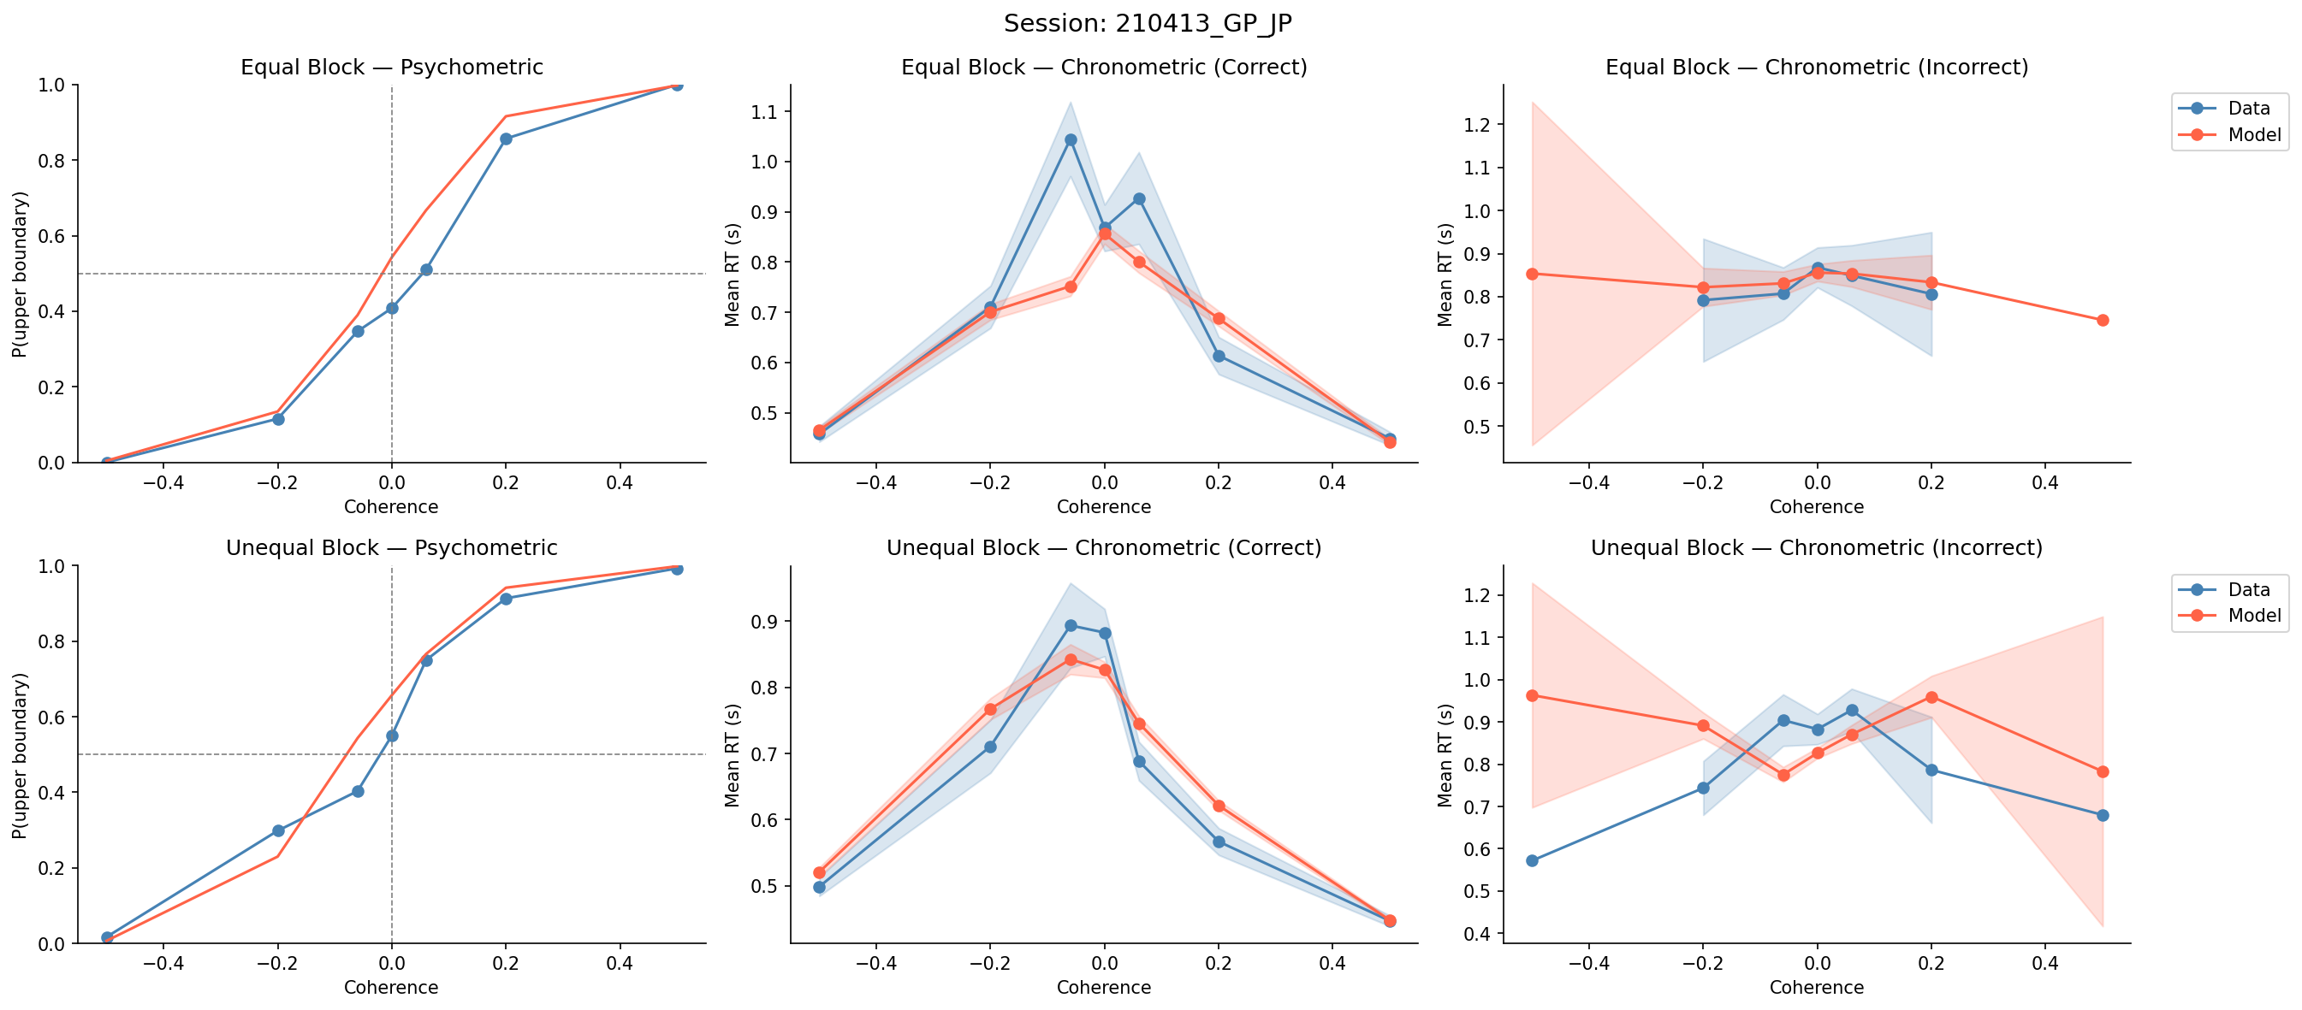
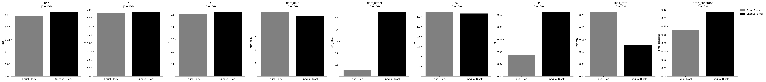
Session: 210413_GP_JP

Slide 20
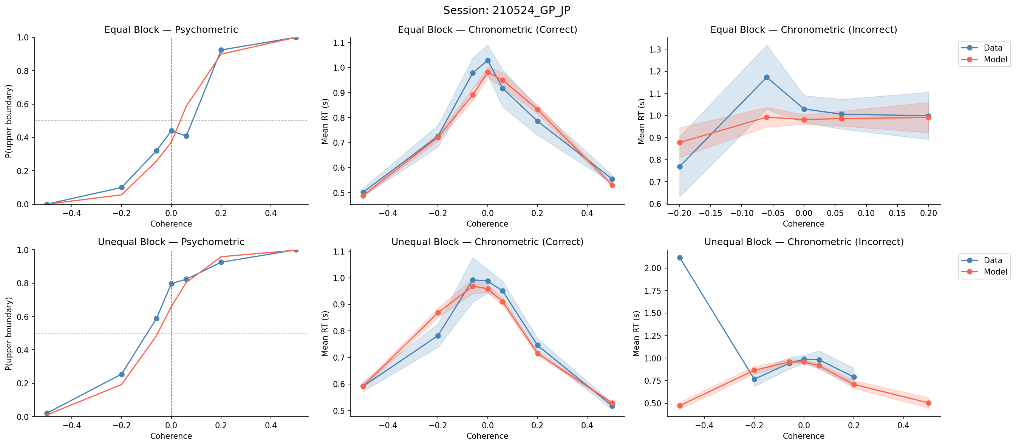
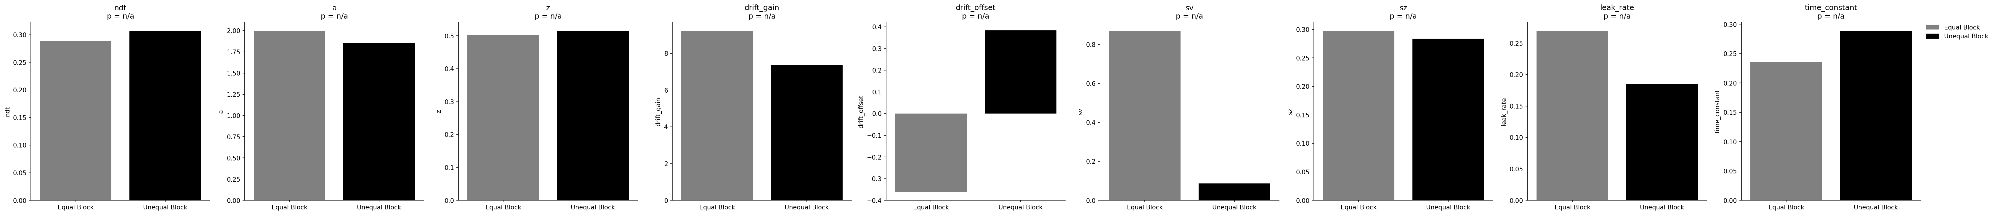
Session: 210524_GP_JP

Slide 21
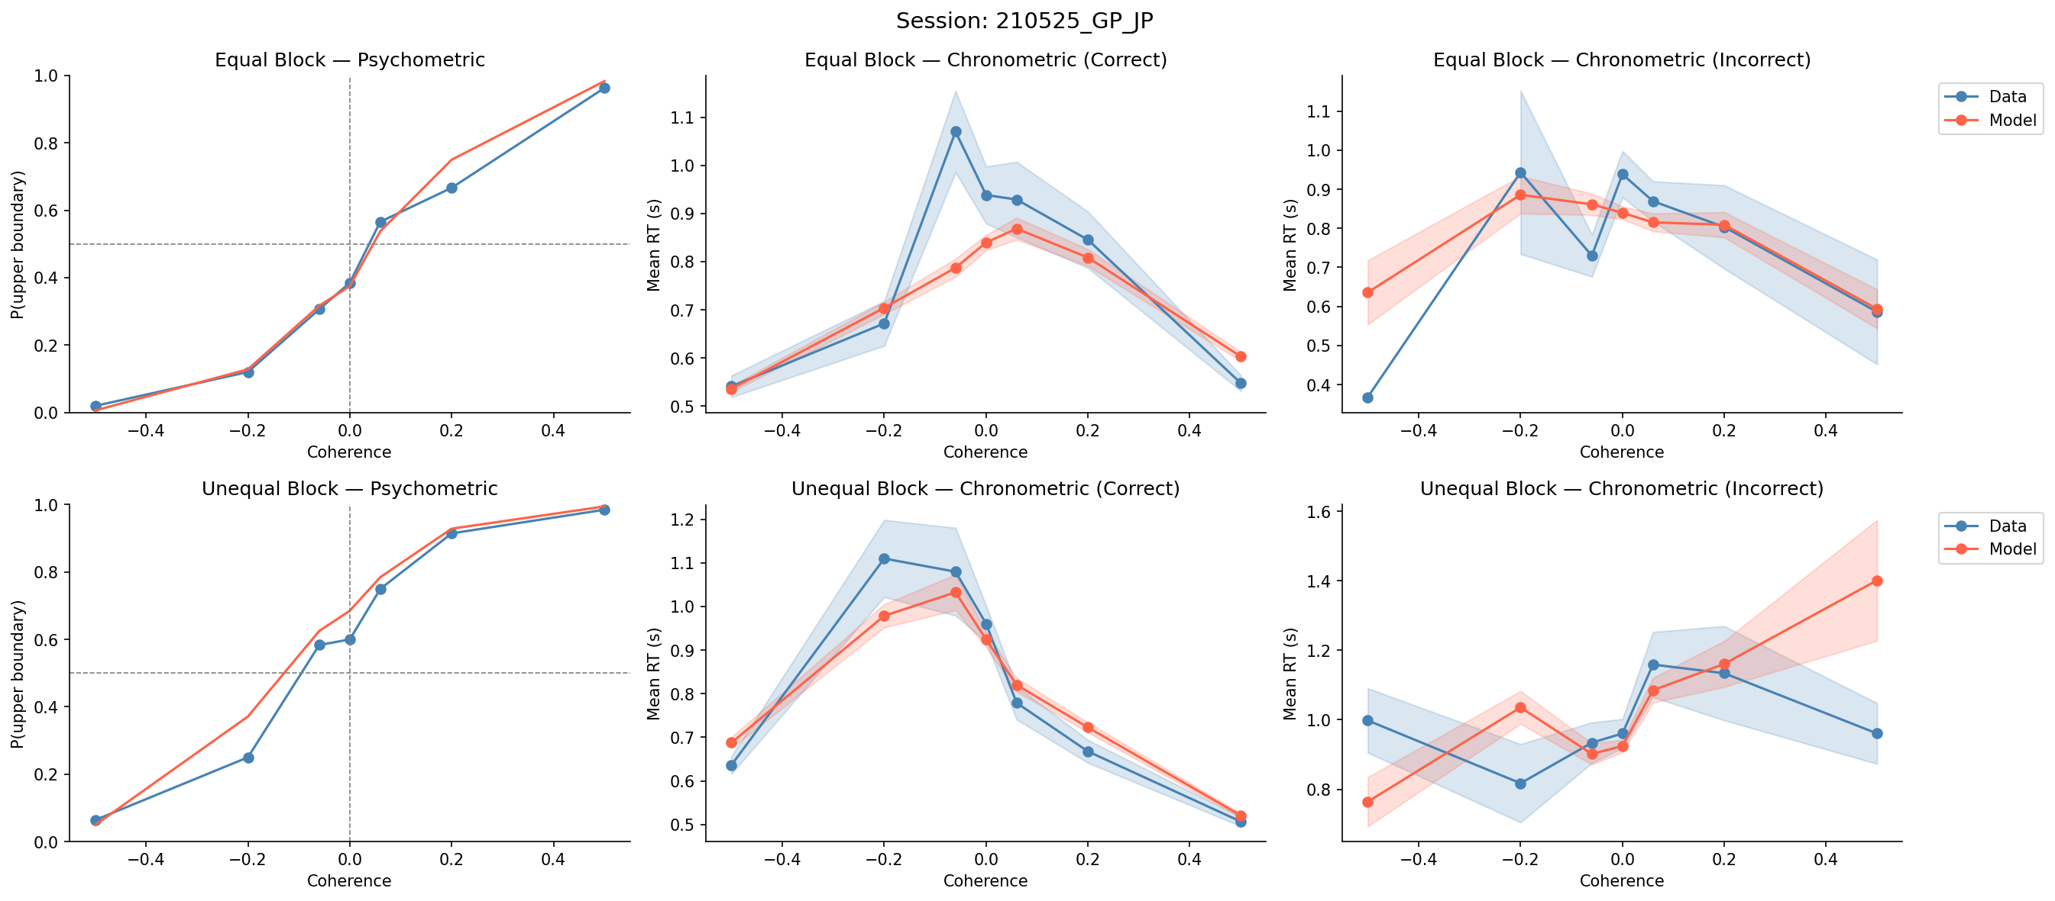
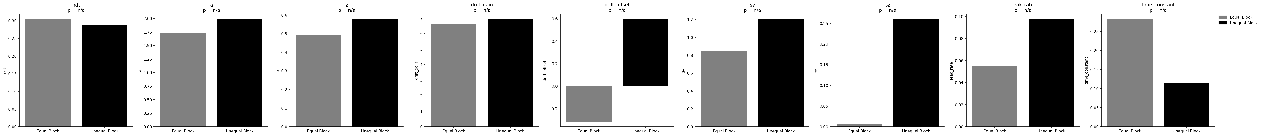
Session: 210525_GP_JP

Slide 22
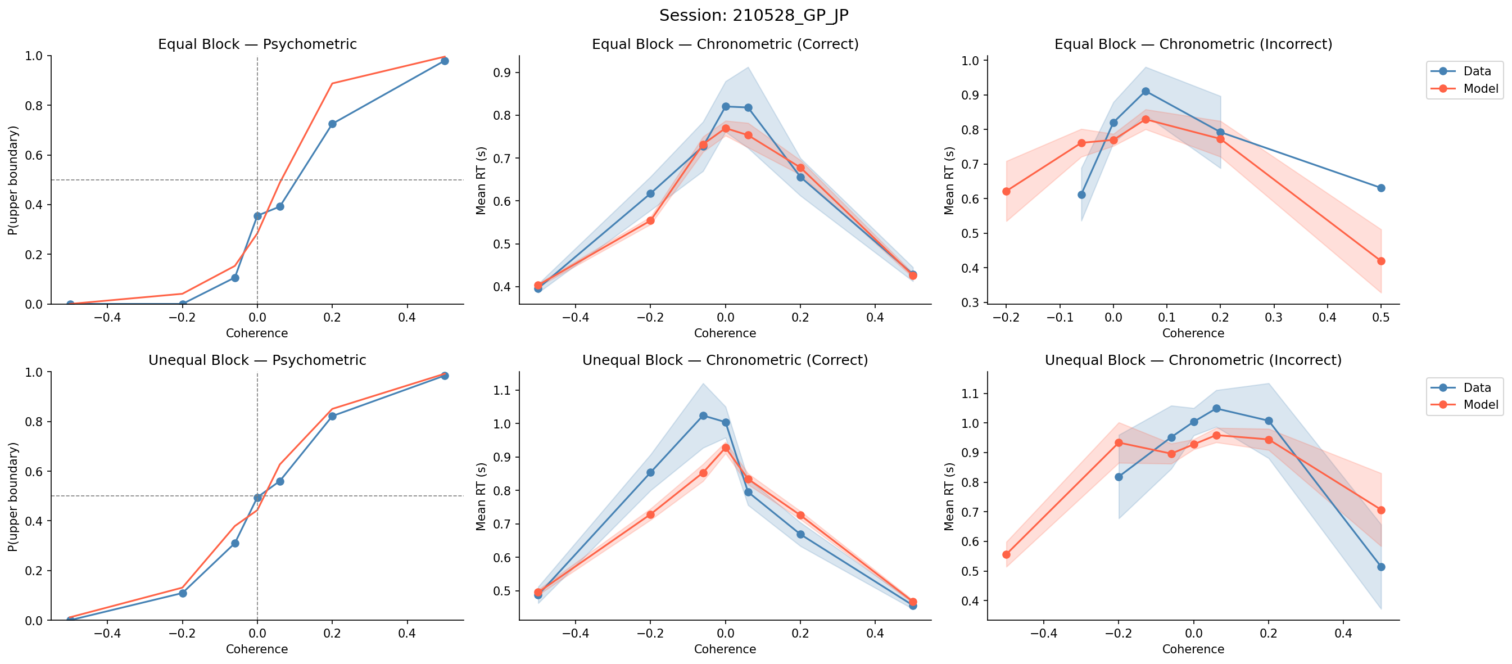
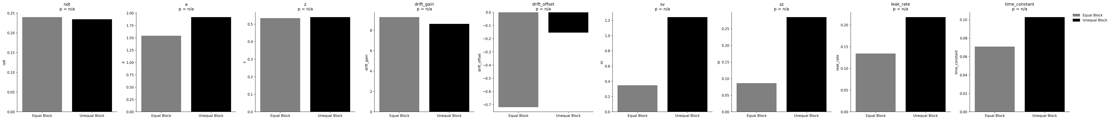
Session: 210528_GP_JP

Slide 23
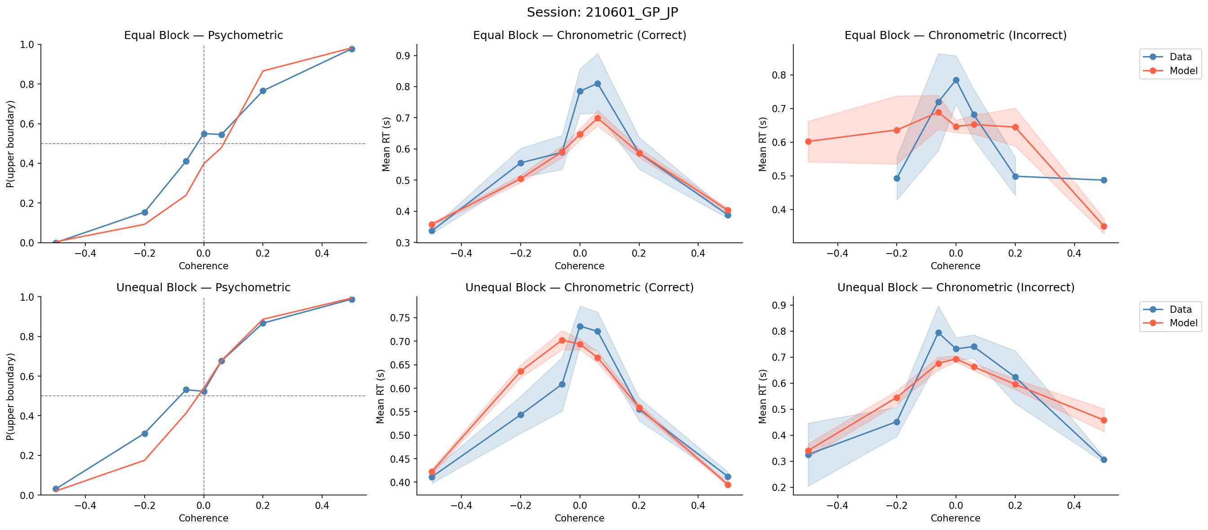
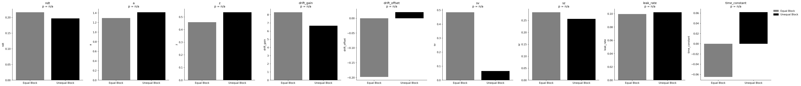
Session: 210601_GP_JP

Slide 24
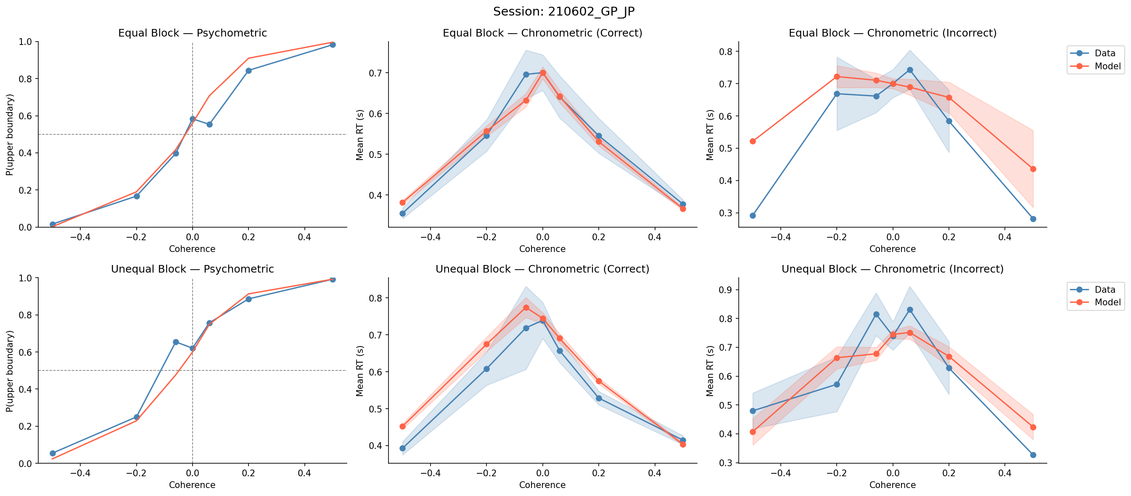
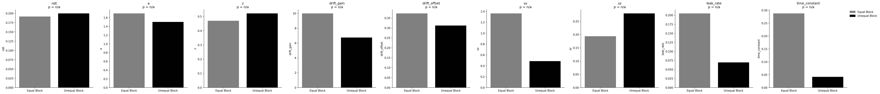
Session: 210602_GP_JP

Slide 25
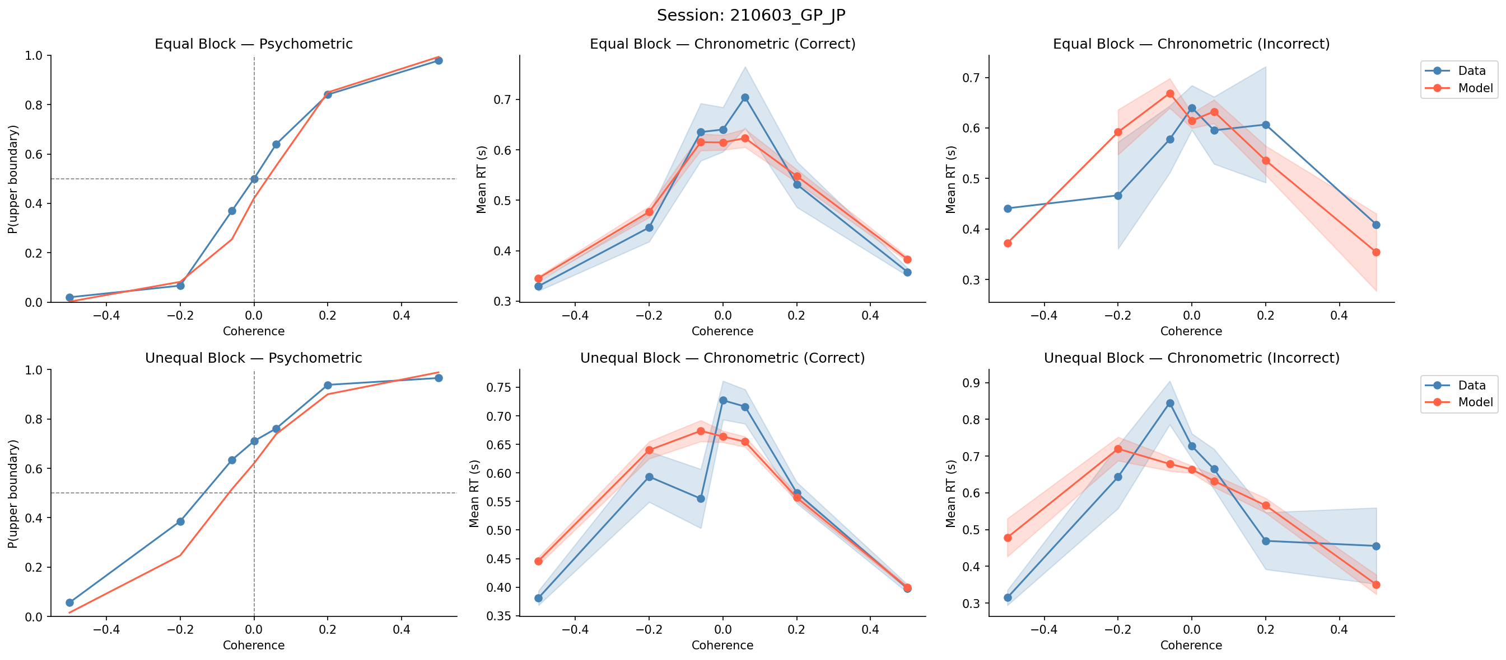
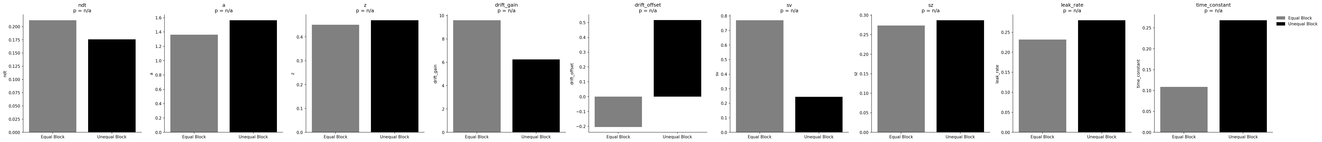
Session: 210603_GP_JP

Slide 26
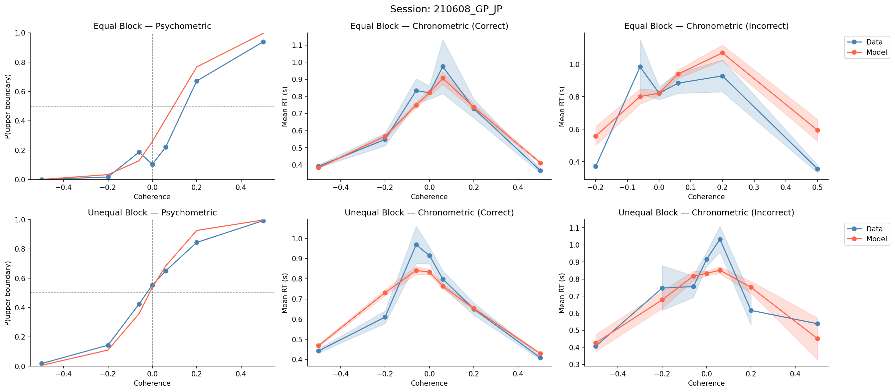
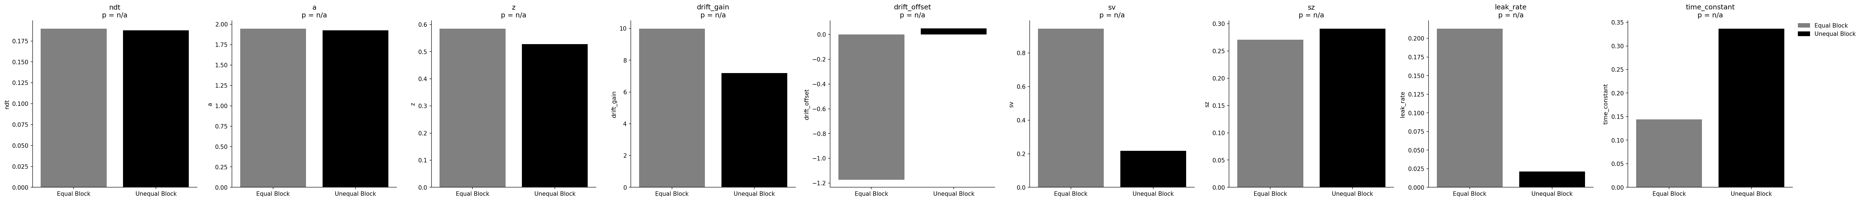
Session: 210608_GP_JP

Slide 27


Session: 210609_GP_JP

Slide 28


Session: 210708_GP_JP

Slide 29


Session: 240625_GP_TZ

Slide 30


Session: 240627_GP_TZ

Slide 31


Session: 240710_GP_TZ

Slide 32


Session: 240805_GP_TZ

Slide 33


Session: 240809_GP_TZ

Slide 34


Session: 240814_GP_TZ

Slide 35


Session: 240828_GP_TZ

Slide 36


Session: 240903_GP_TZ

Slide 37


Session: 241002_GP_TZ

Slide 38


Session: 241129_GP_TZ

Slide 39


Session: 241130_GP_TZ

Slide 40


Session: 241209_GP_TZ

Slide 41


Session: 241211_GP_TZ

Slide 42


Session: 241216_GP_TZ

Slide 43


Session: 241217_GP_TZ

Slide 44


Session: 241223_GP_TZ

Slide 45


Session: 241227_GP_TZ

Slide 46


Session: 241230_GP_TZ

Slide 47


Session: 250108_GP_TZ

Slide 48


Session: 250109_GP_TZ

