Slide 1
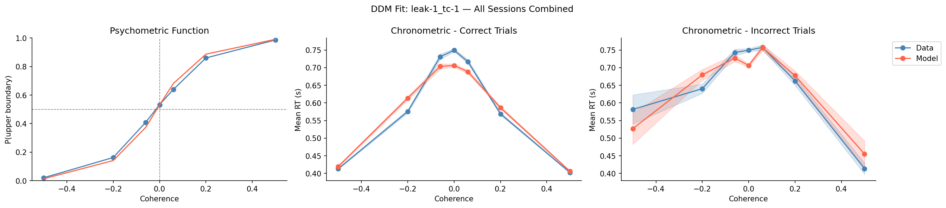
leak-1_tc-1 — All Sessions Combined

Slide 2
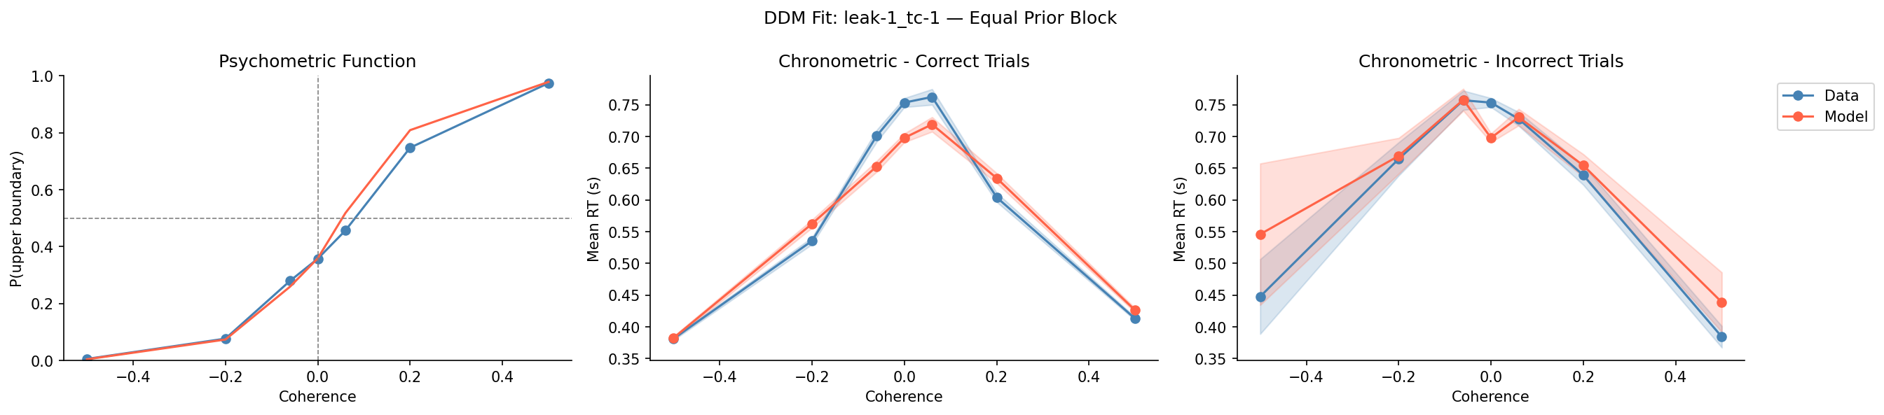
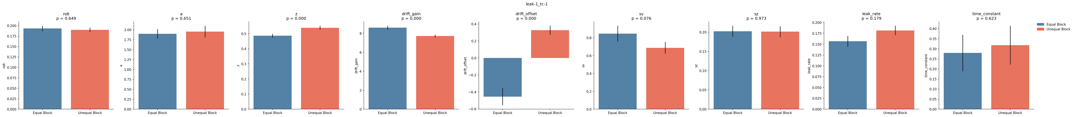
leak-1_tc-1 — Equal Block + Parameters

Slide 3
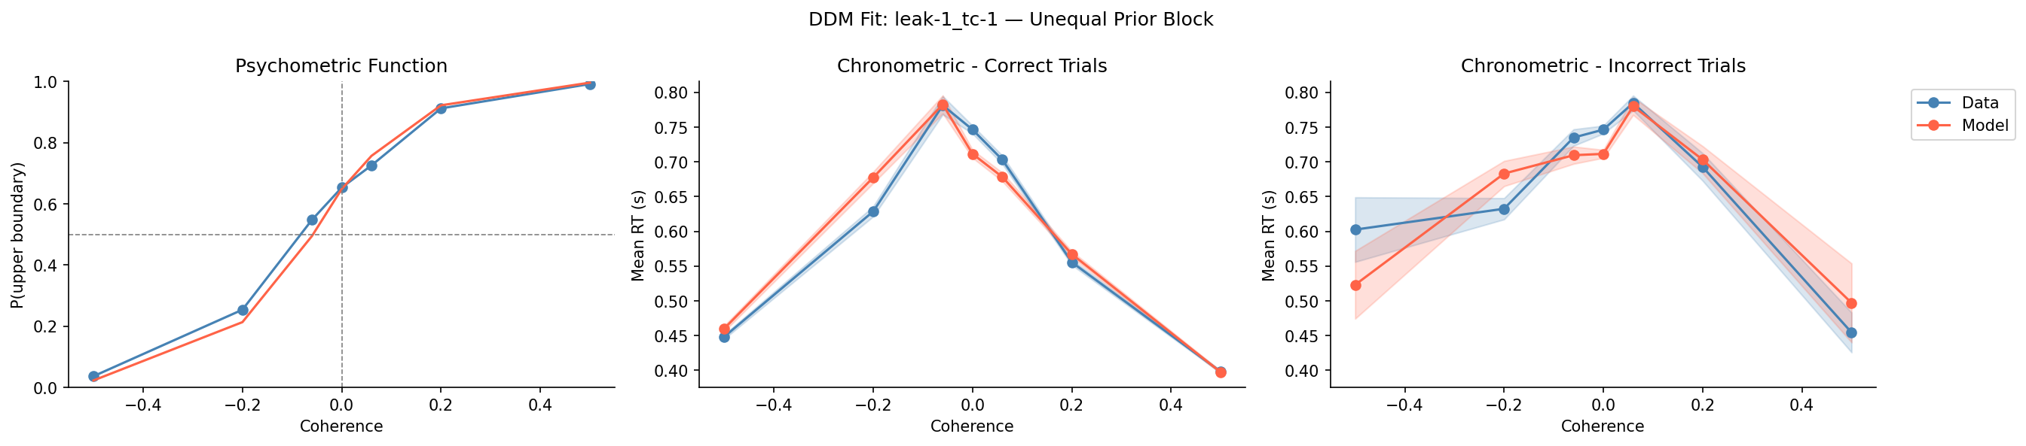
leak-1_tc-1 — Unequal Block + Parameters

Slide 4
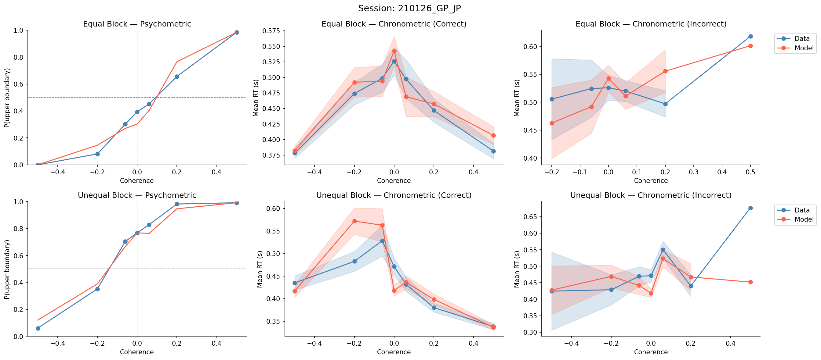
Session: 210126_GP_JP

Slide 5
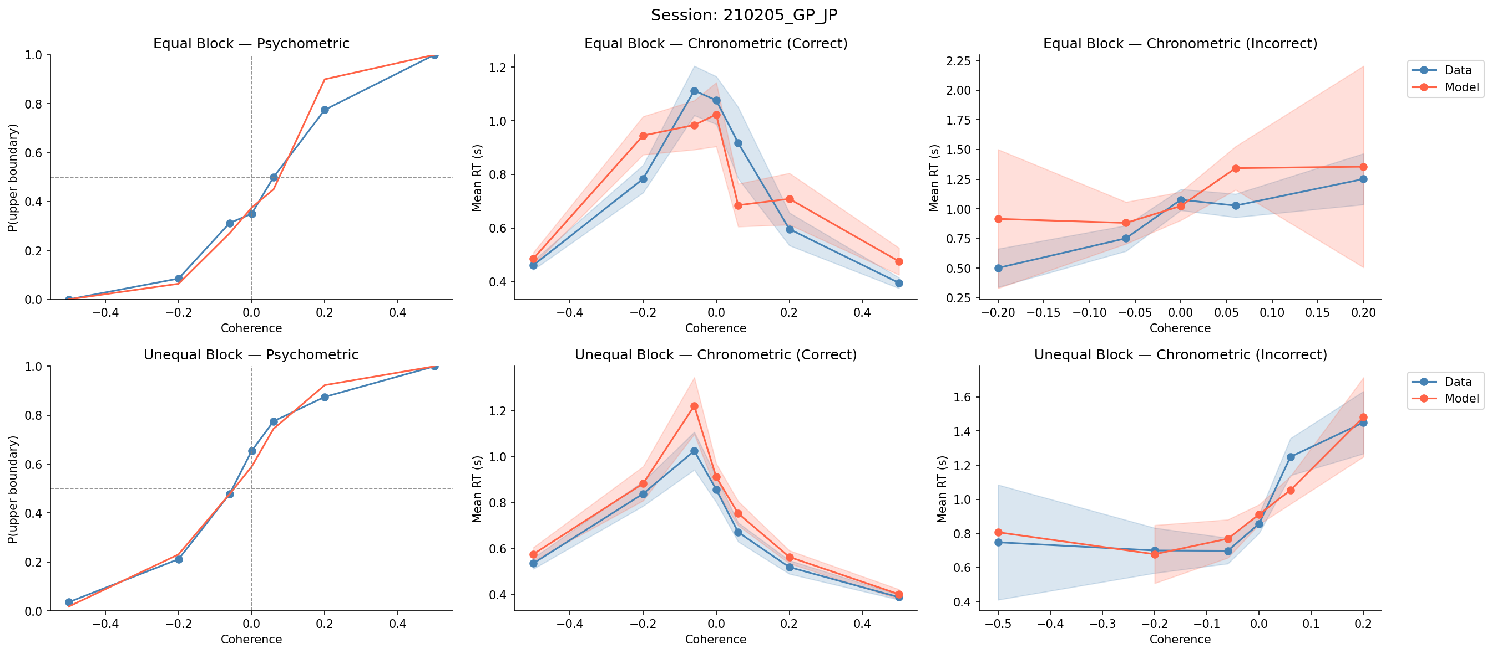
Session: 210205_GP_JP

Slide 6
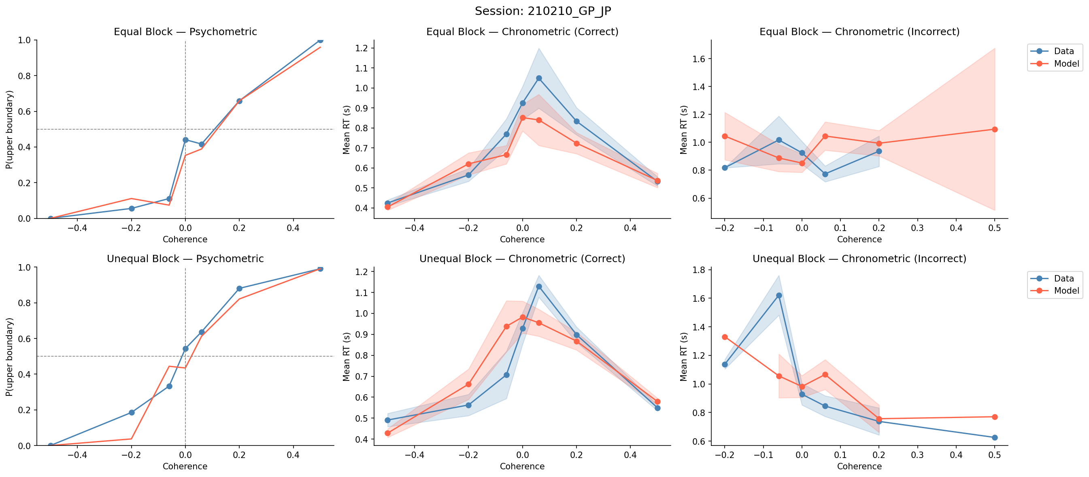
Session: 210210_GP_JP

Slide 7
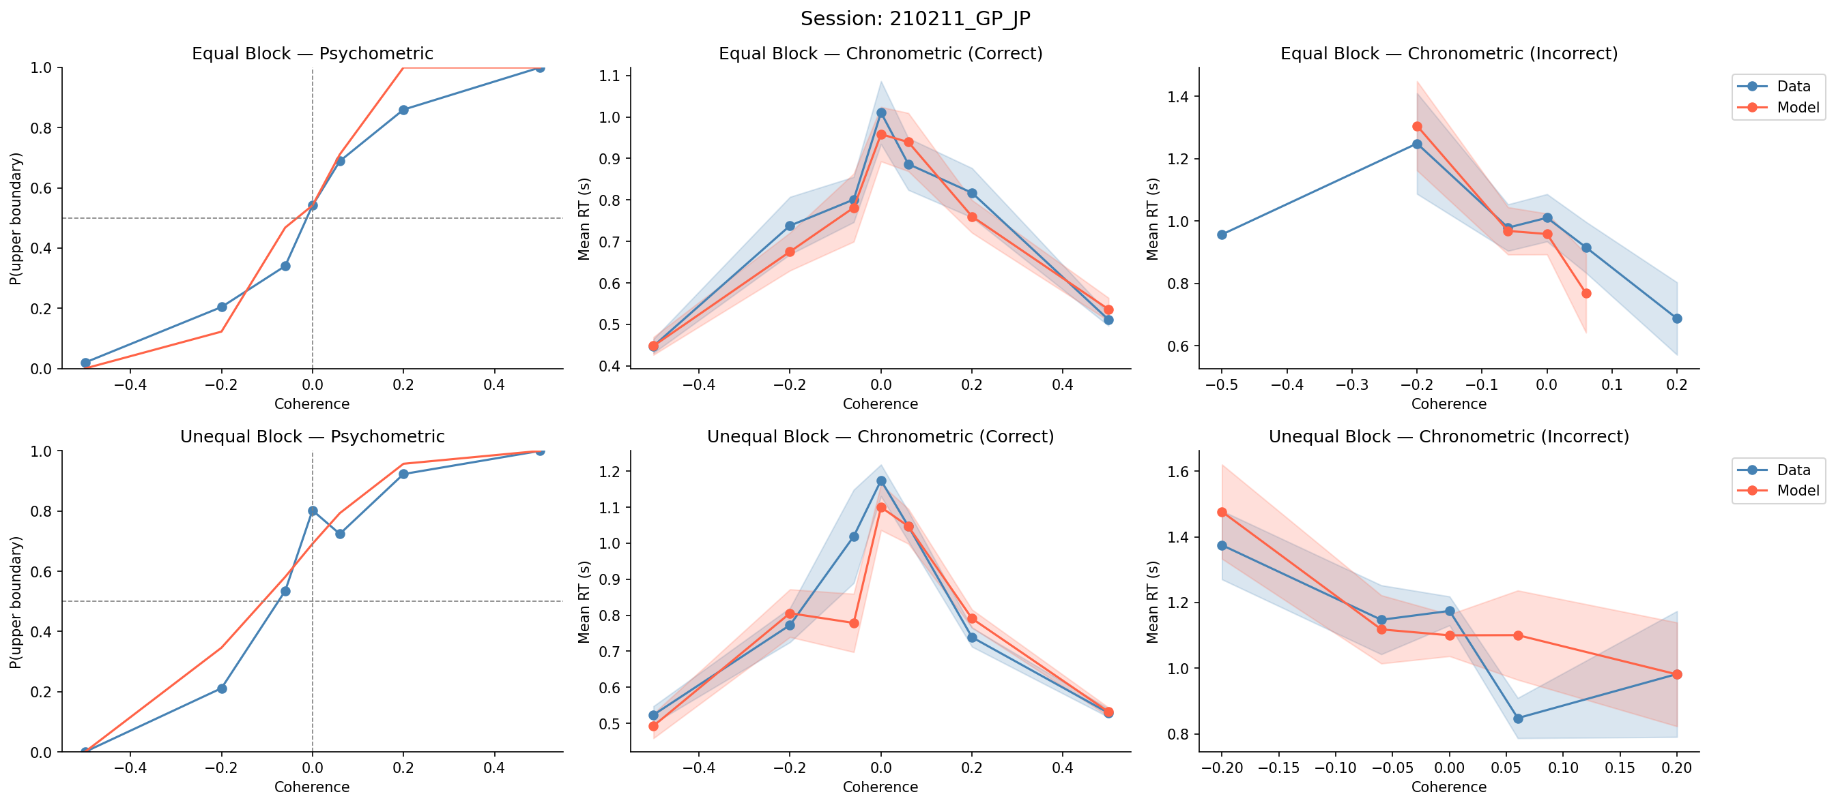
Session: 210211_GP_JP

Slide 8
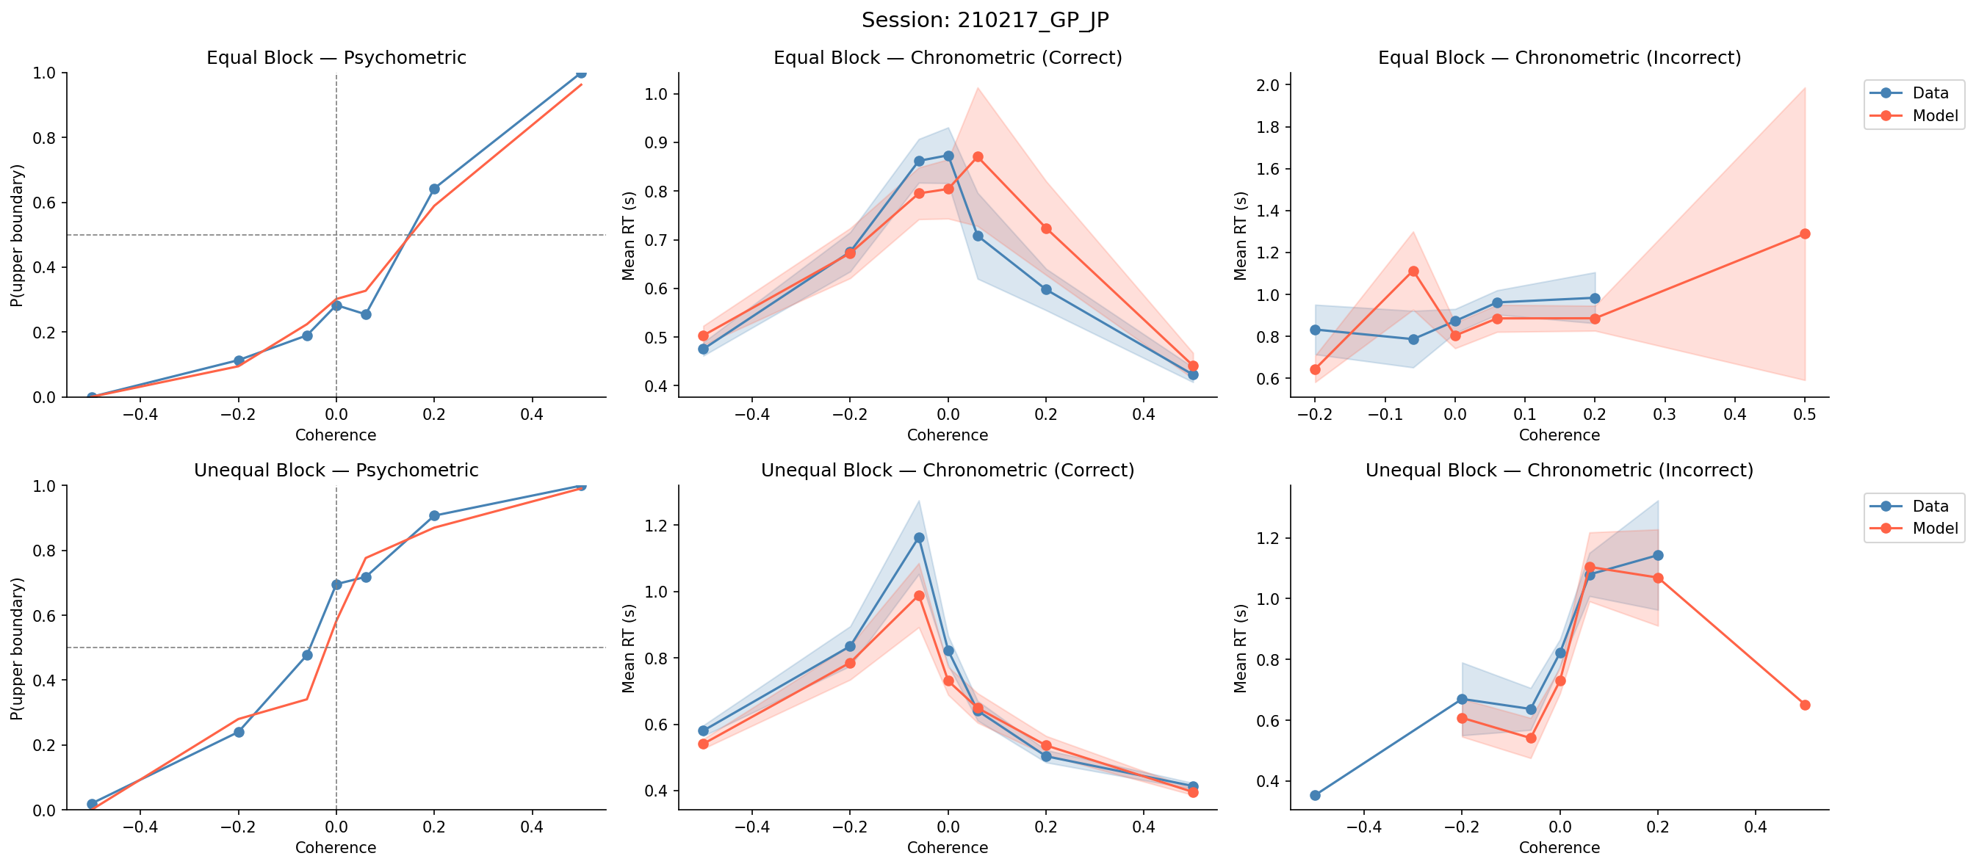
Session: 210217_GP_JP

Slide 9
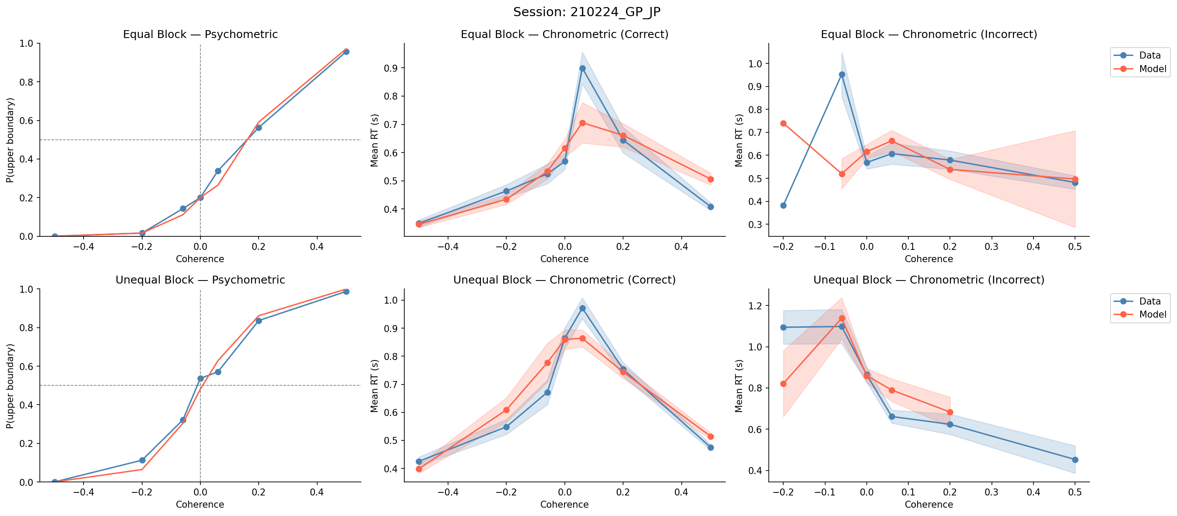
Session: 210224_GP_JP

Slide 10
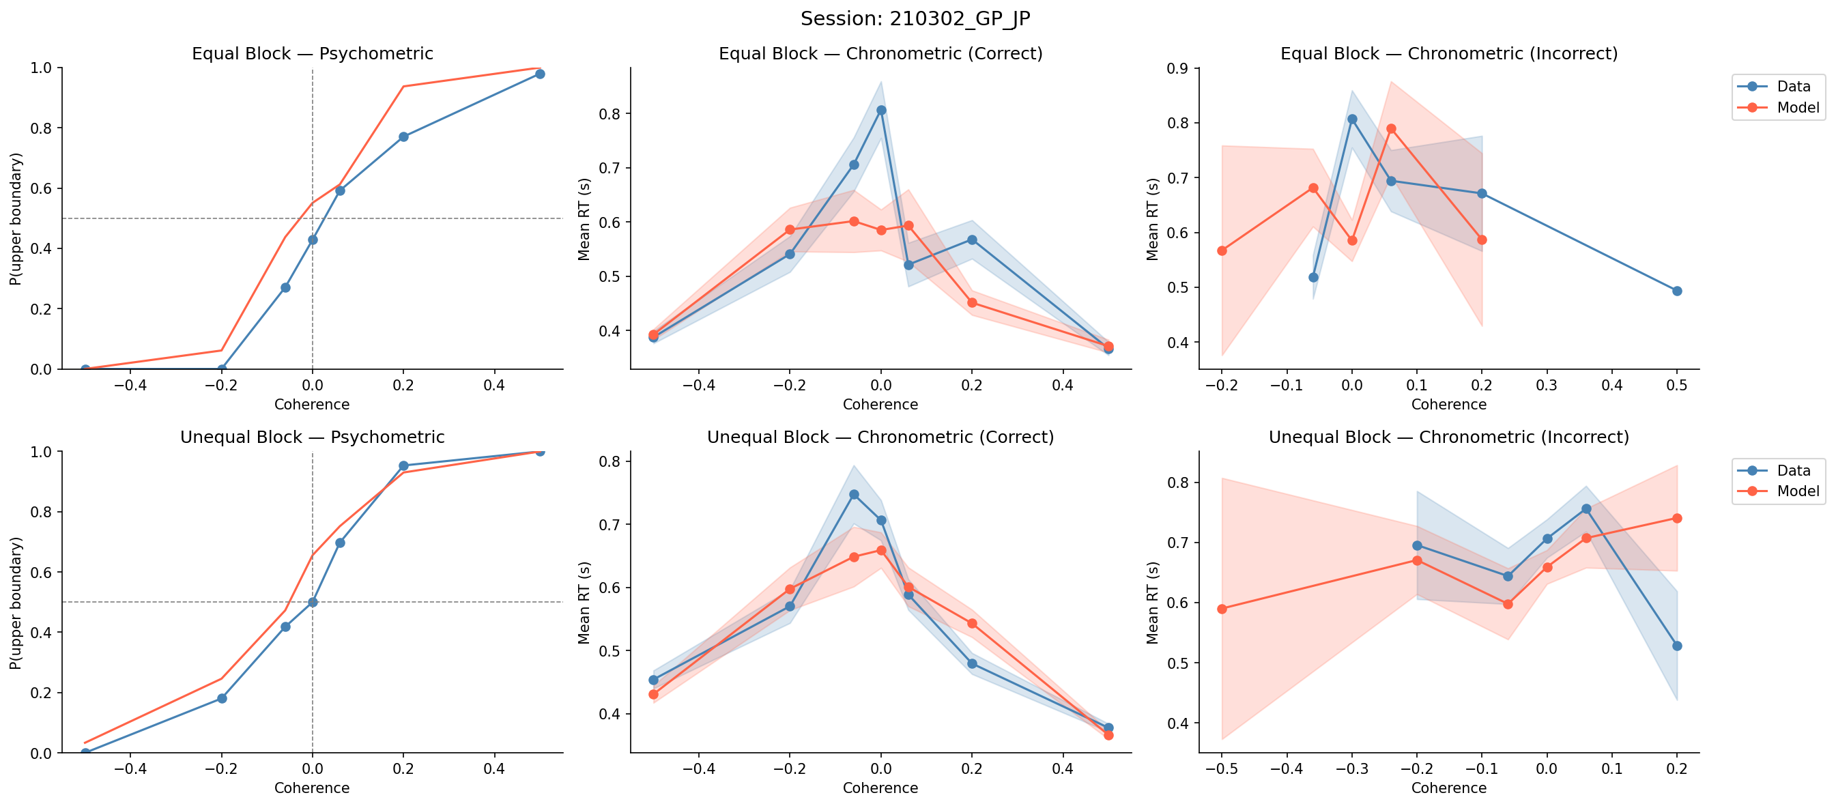
Session: 210302_GP_JP

Slide 11
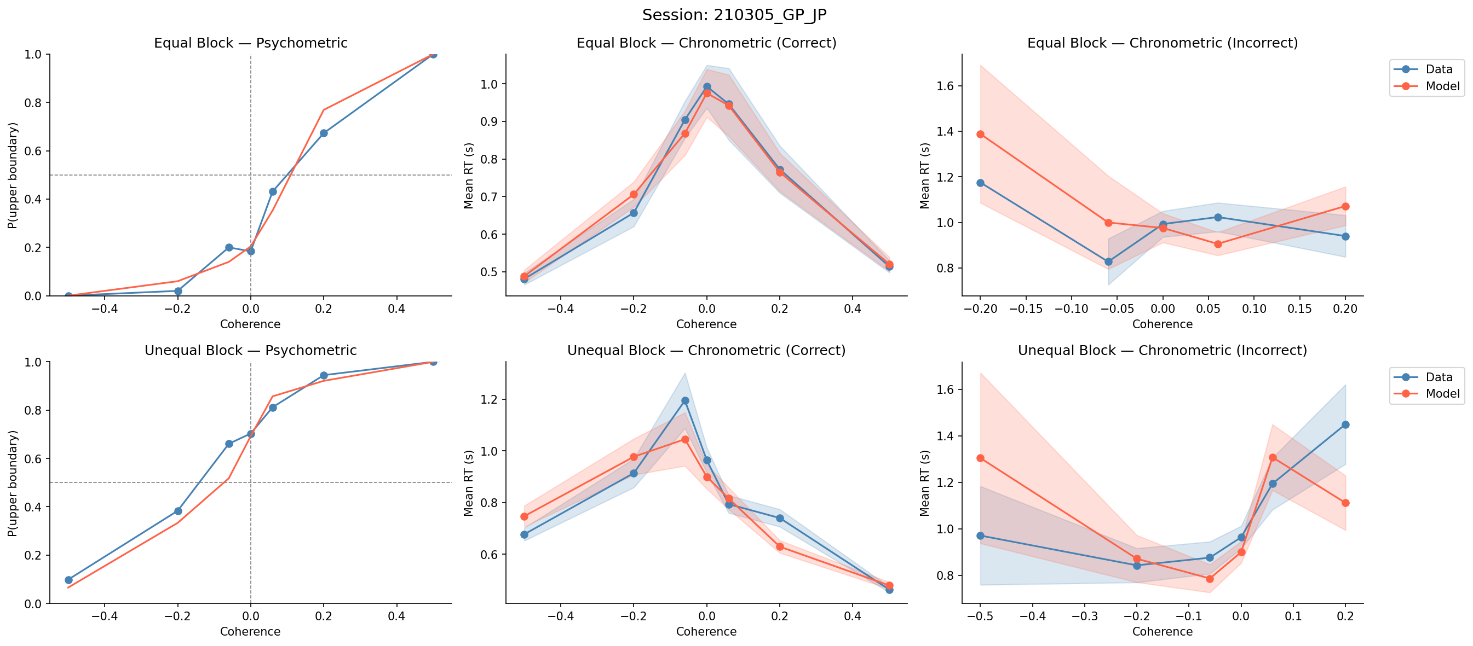
Session: 210305_GP_JP

Slide 12
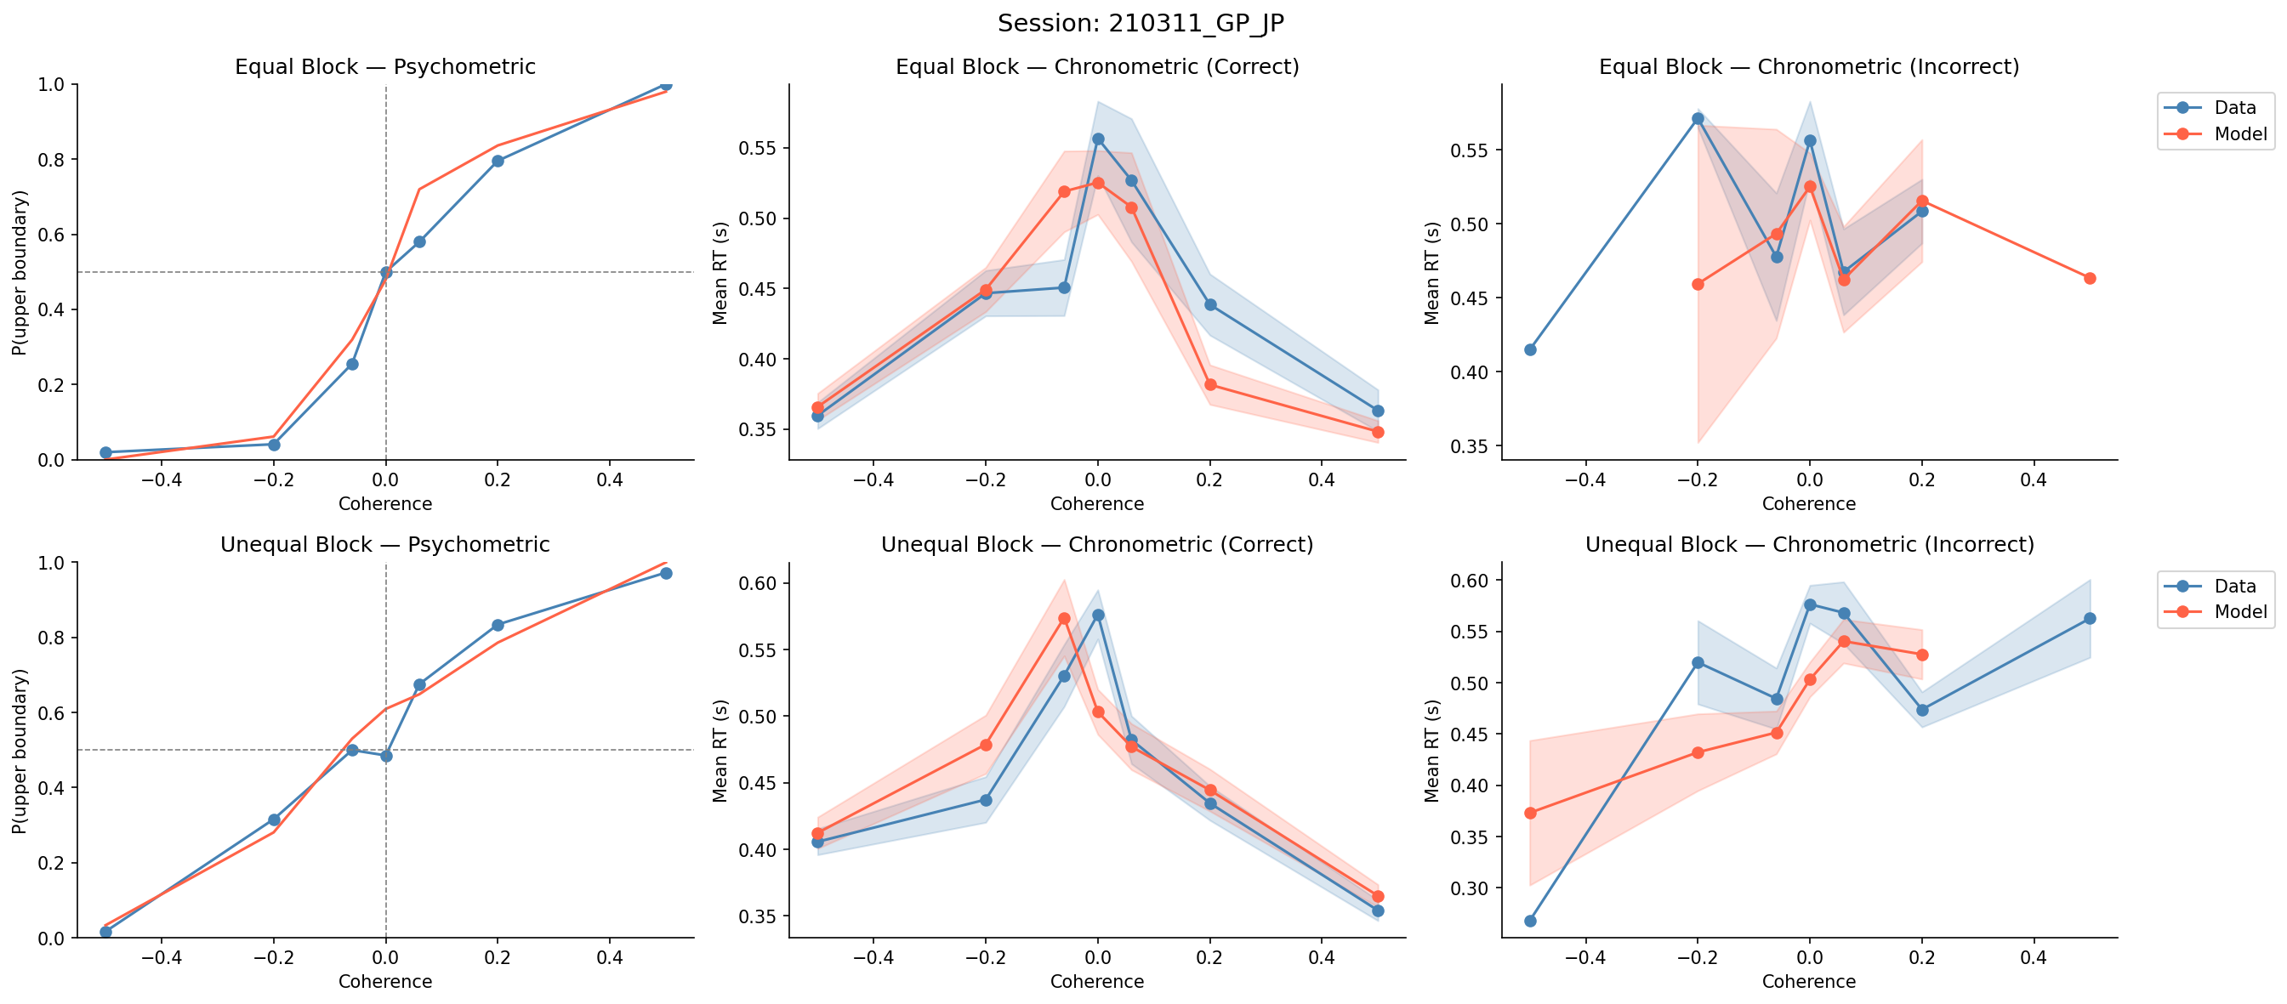
Session: 210311_GP_JP

Slide 13
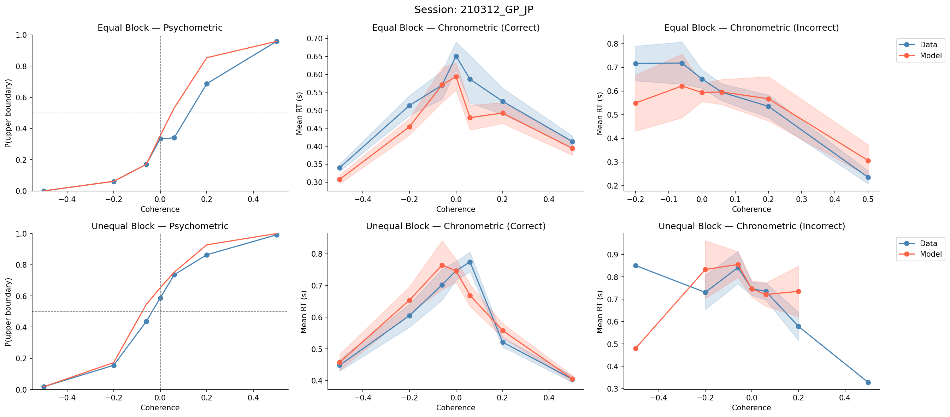
Session: 210312_GP_JP

Slide 14
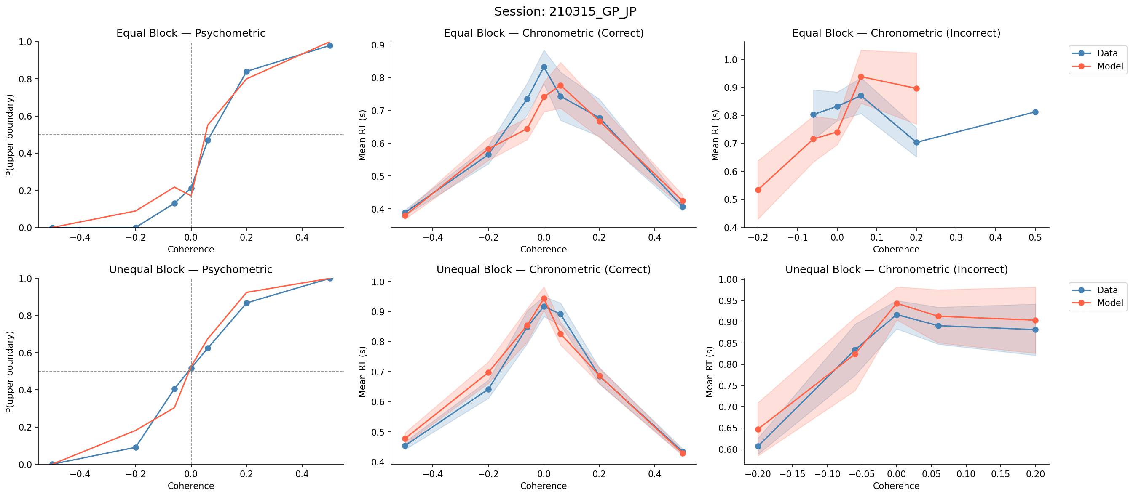
Session: 210315_GP_JP

Slide 15
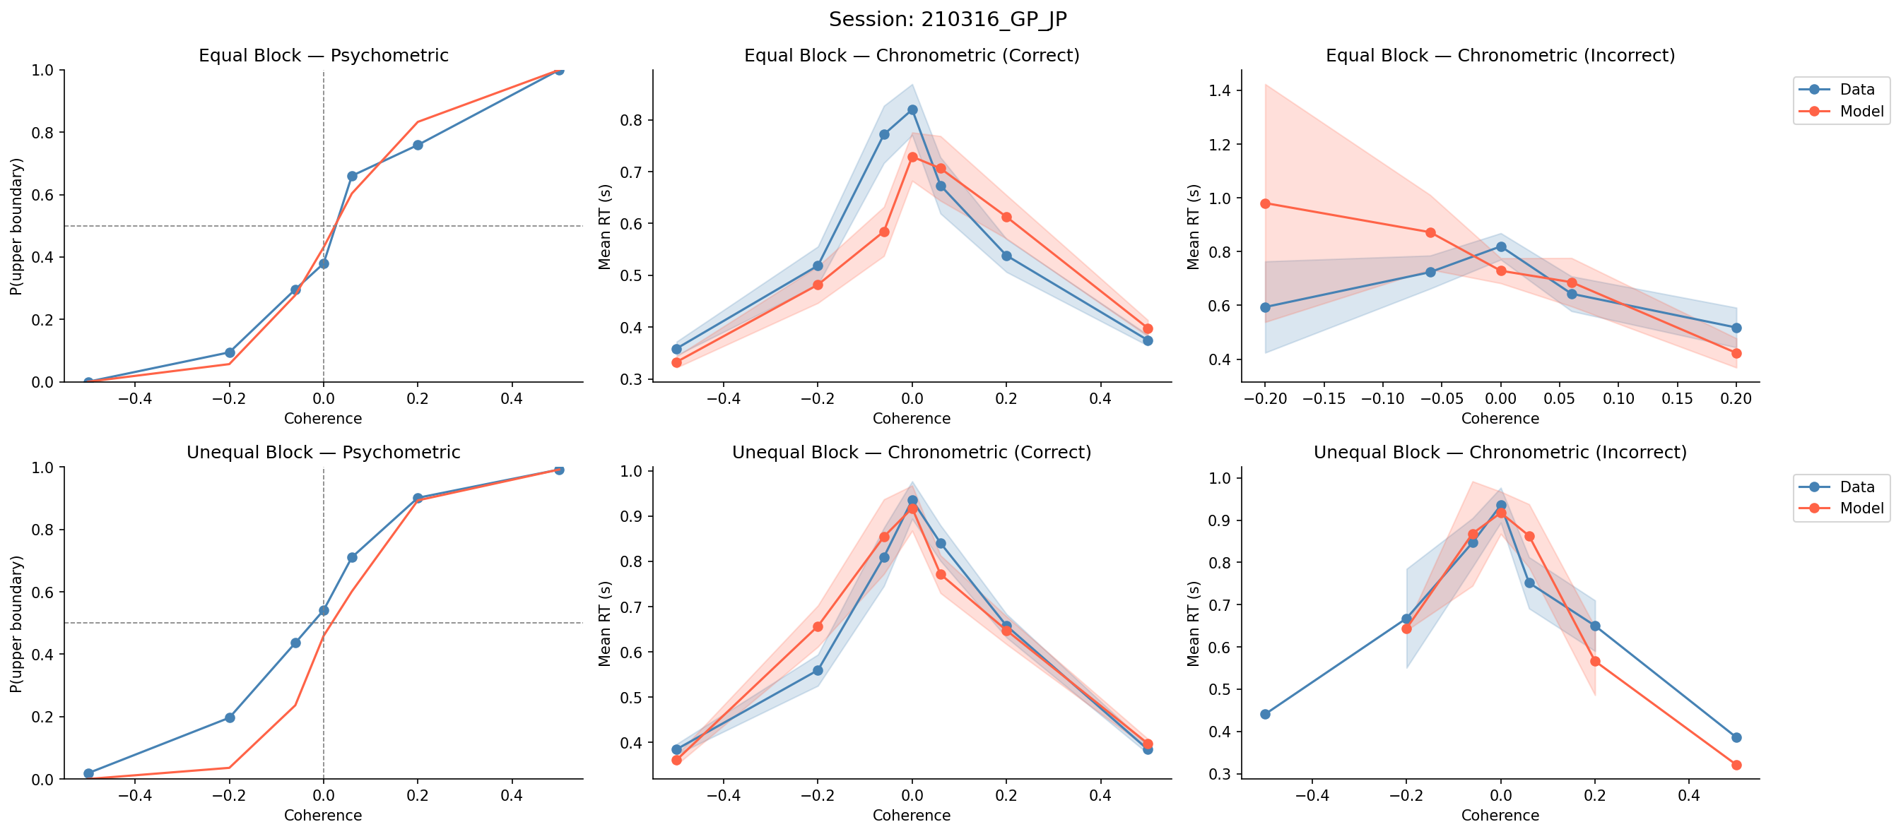
Session: 210316_GP_JP

Slide 16
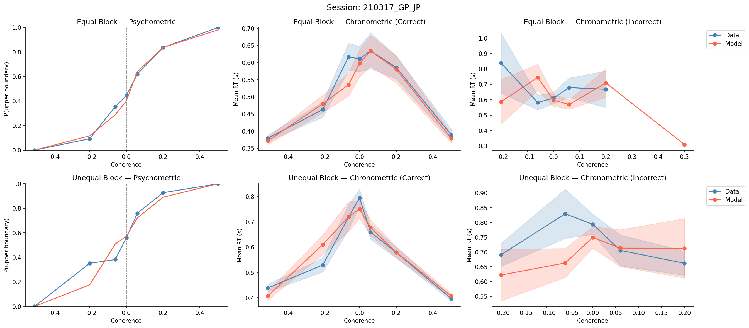
Session: 210317_GP_JP

Slide 17
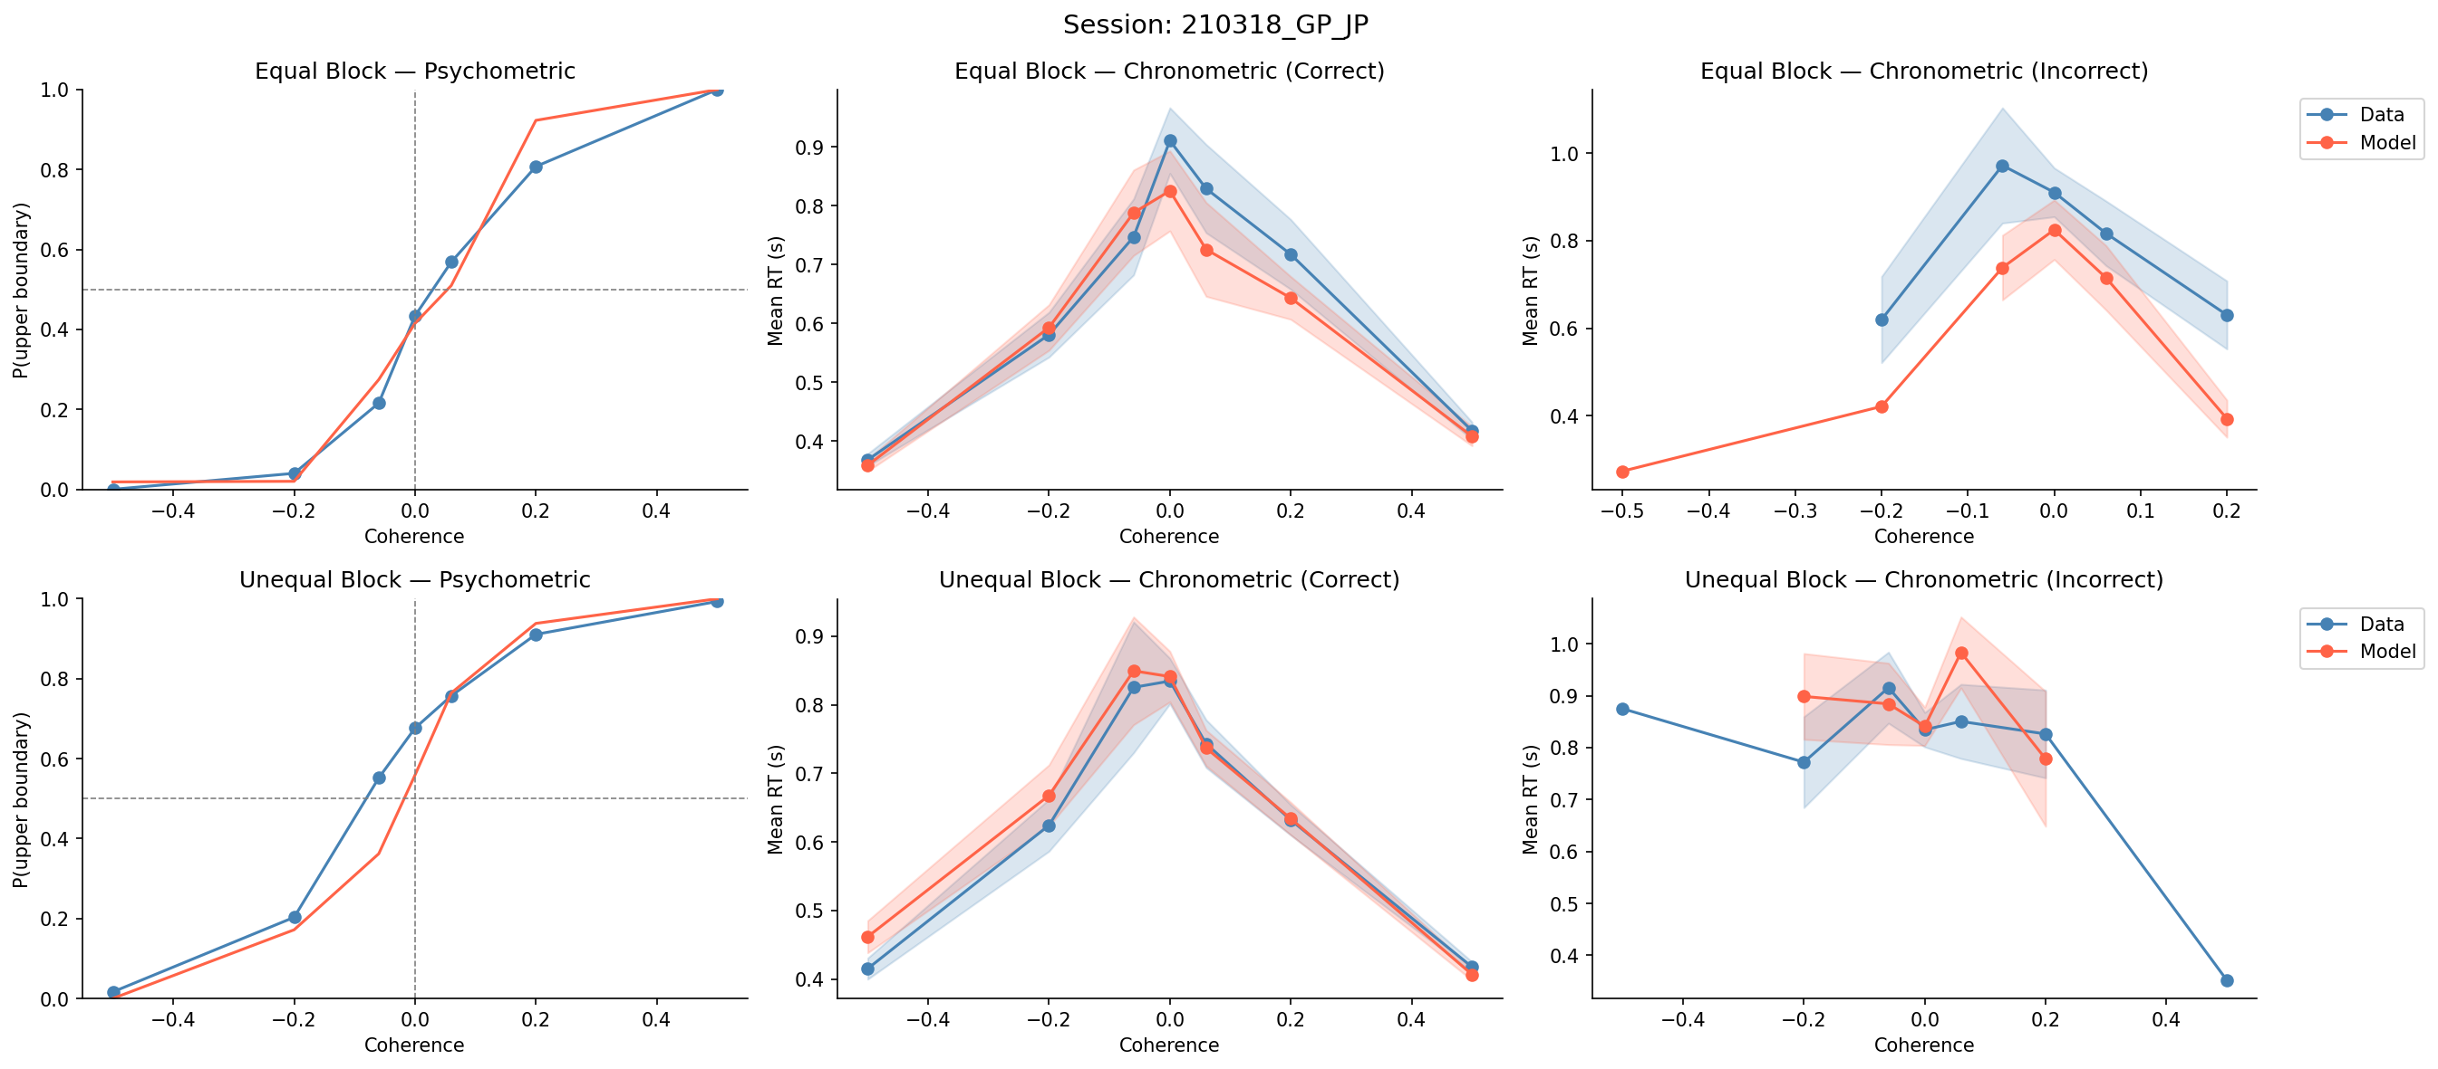
Session: 210318_GP_JP

Slide 18
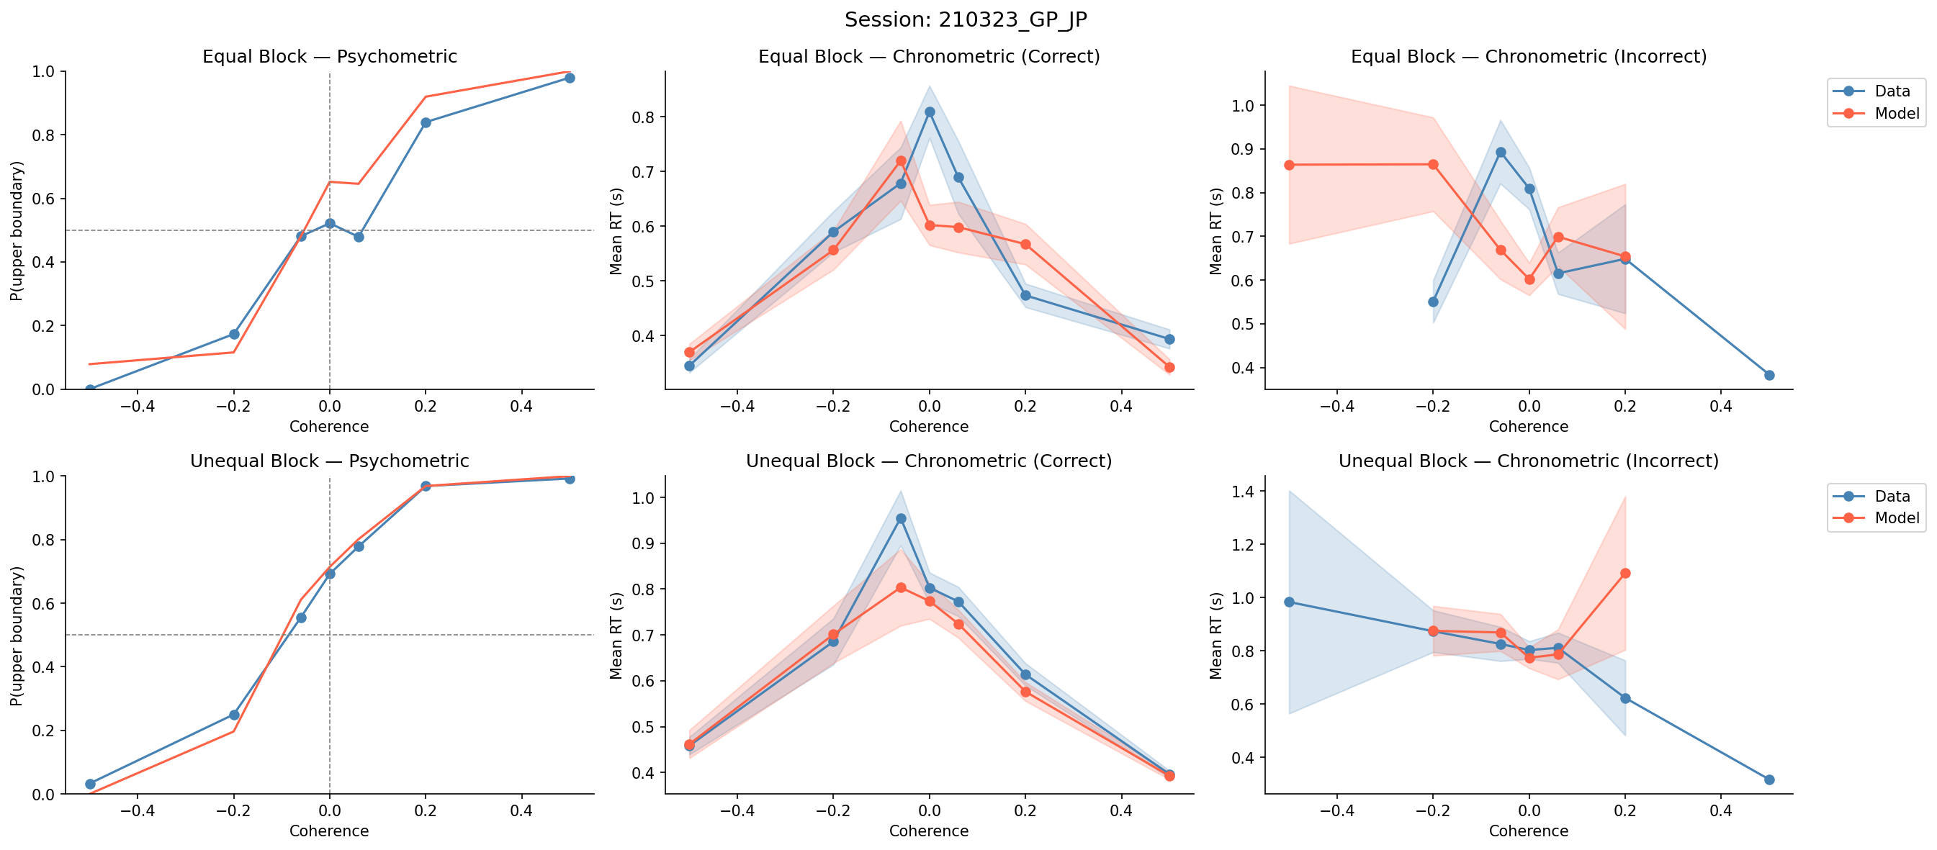
Session: 210323_GP_JP

Slide 19
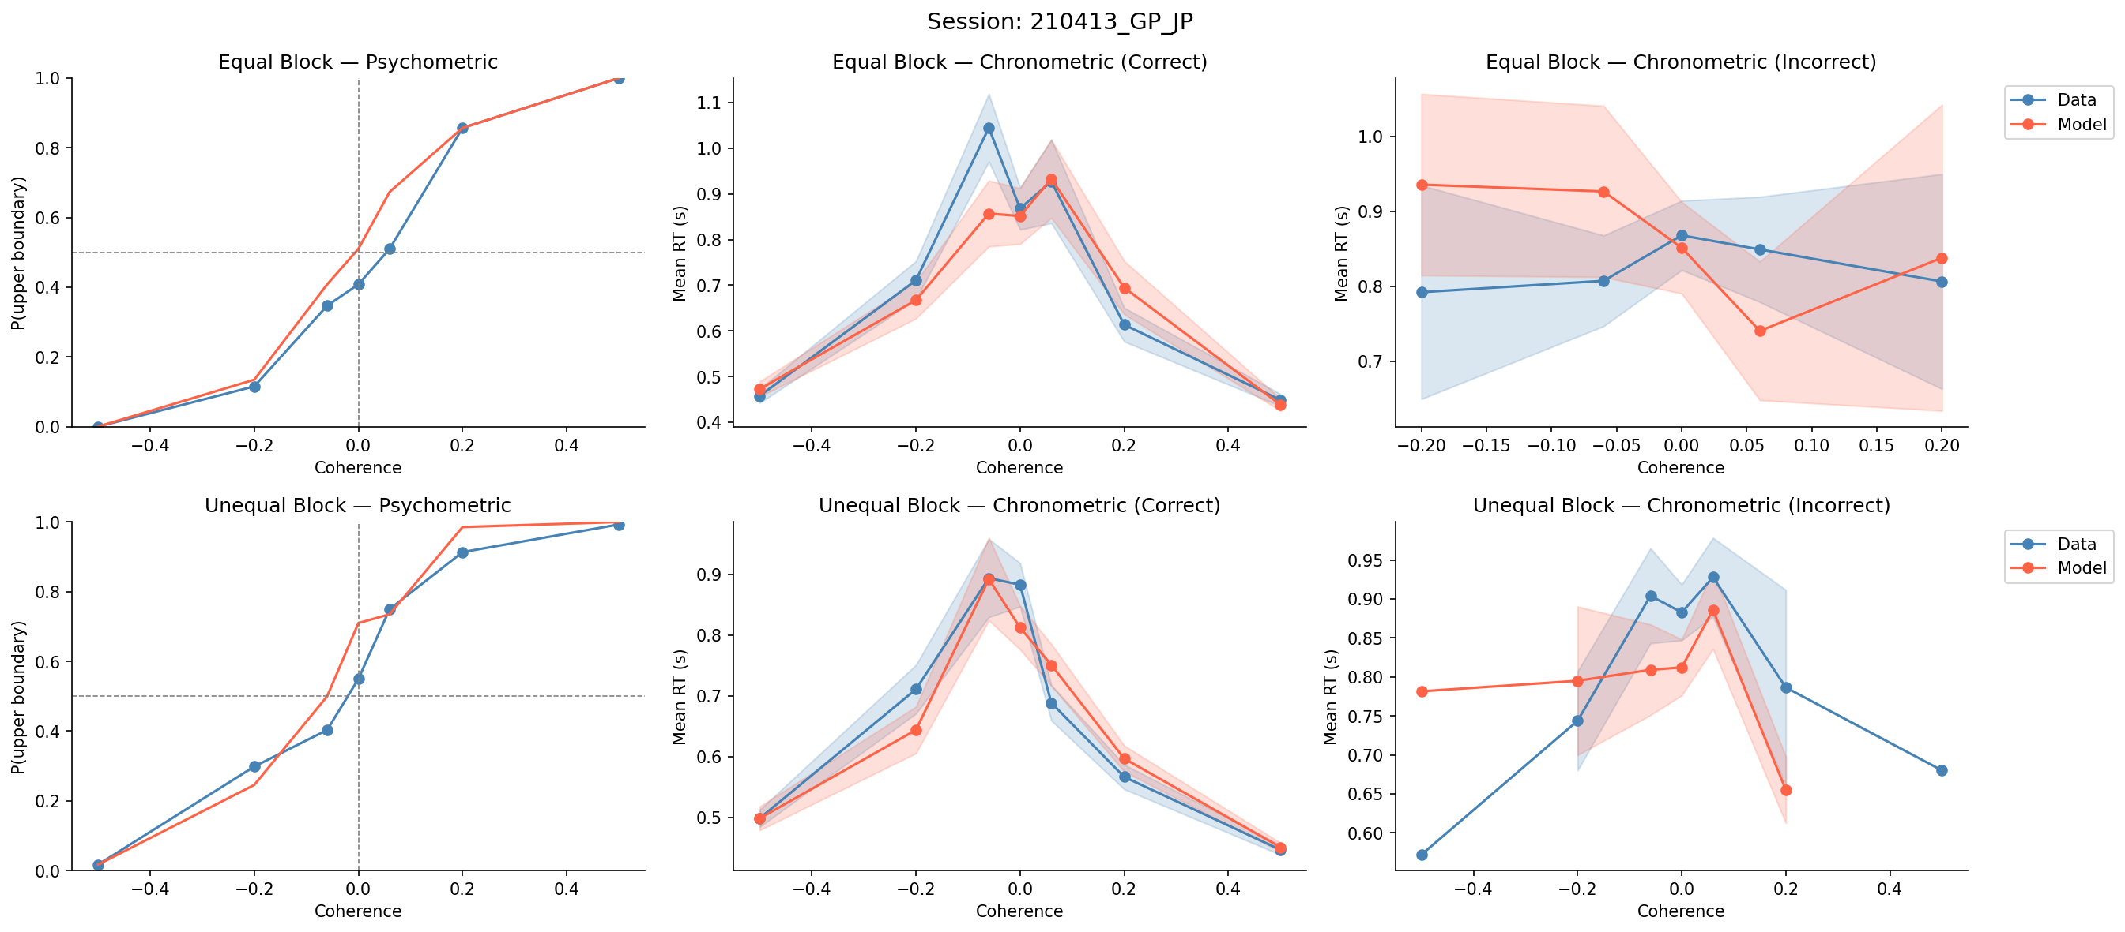
Session: 210413_GP_JP

Slide 20
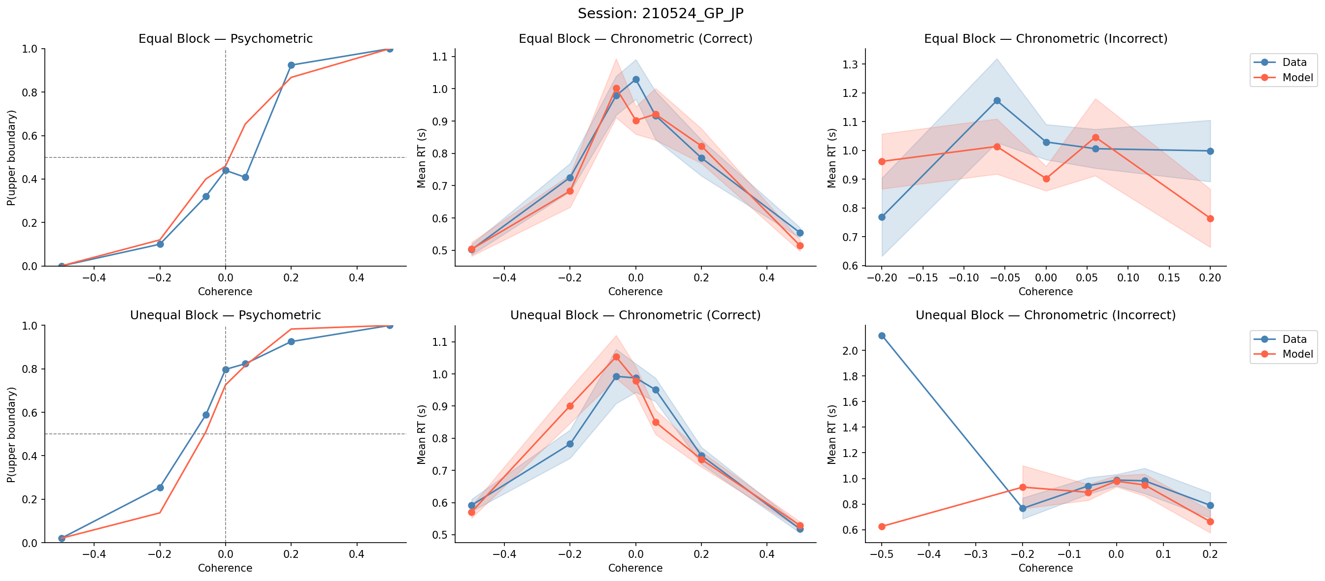
Session: 210524_GP_JP

Slide 21
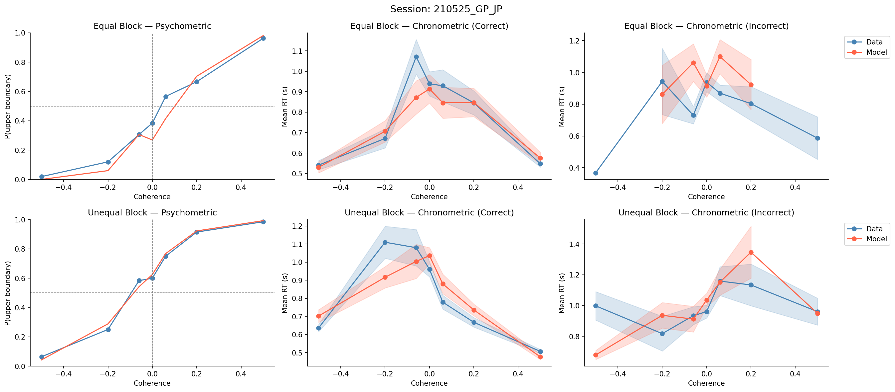
Session: 210525_GP_JP

Slide 22
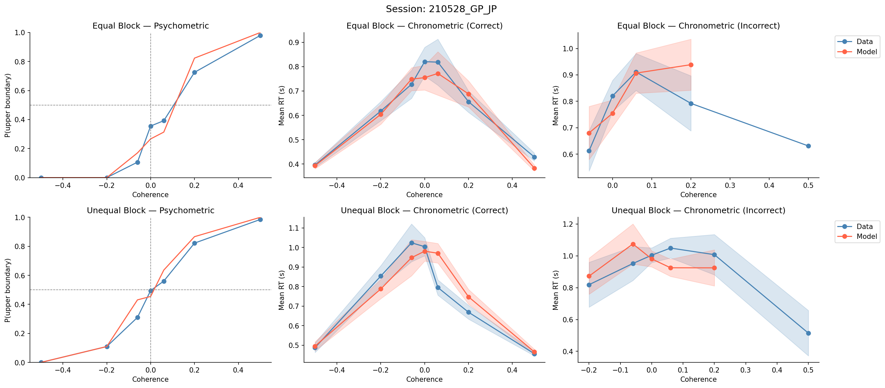
Session: 210528_GP_JP

Slide 23
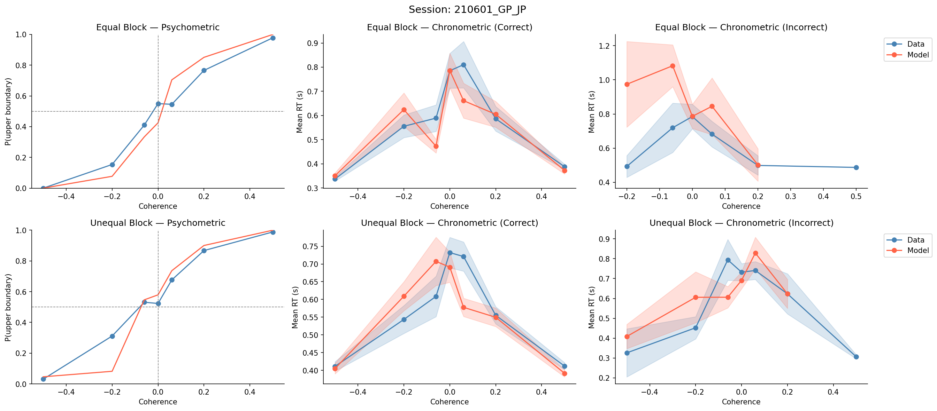
Session: 210601_GP_JP

Slide 24
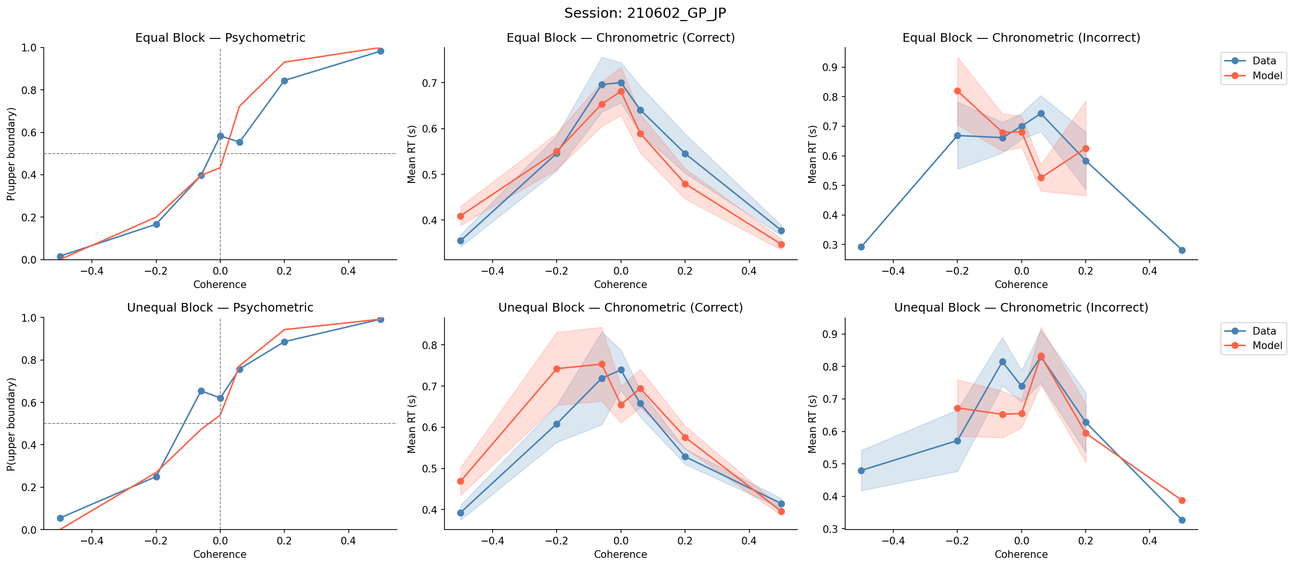
Session: 210602_GP_JP

Slide 25
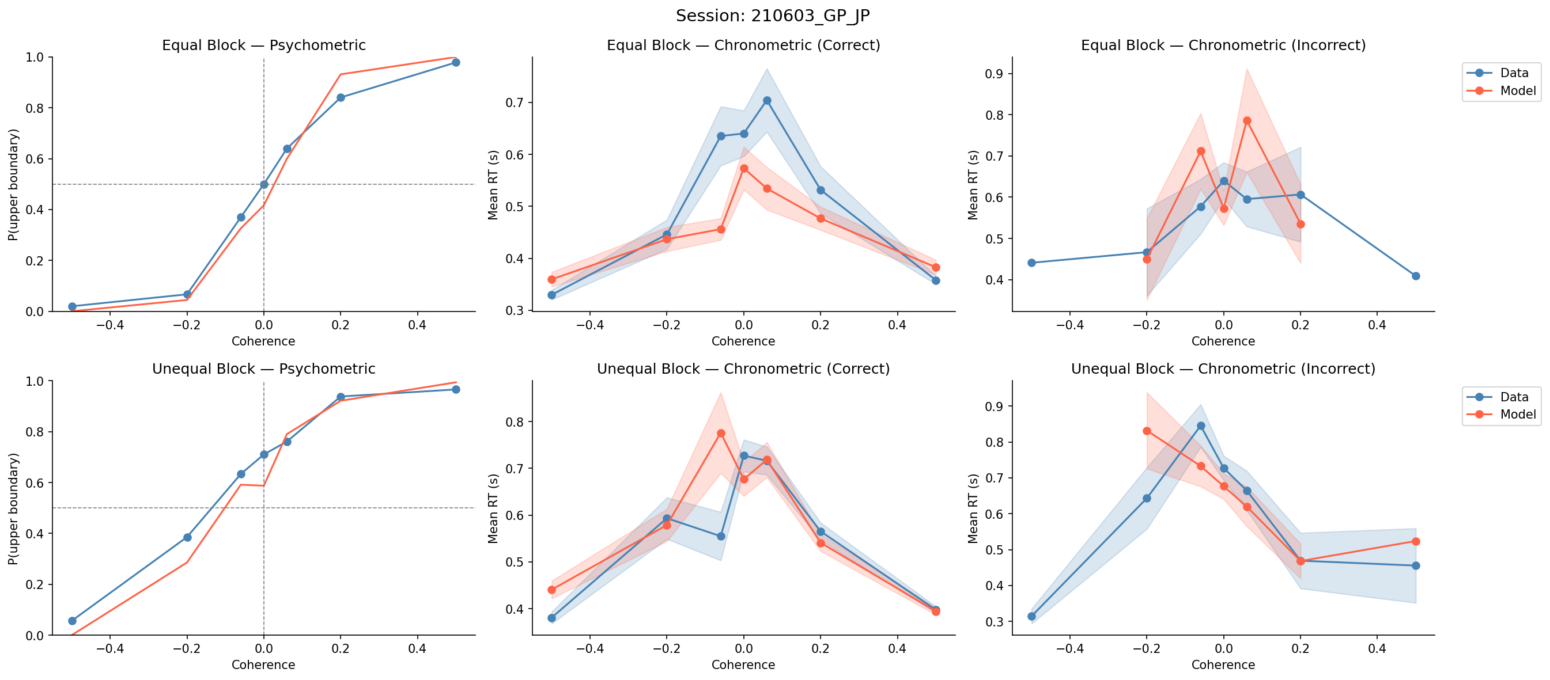
Session: 210603_GP_JP

Slide 26
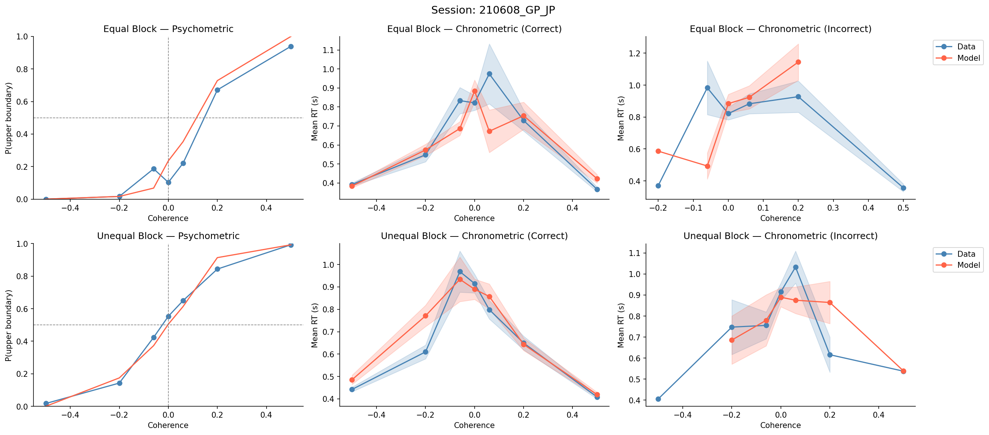
Session: 210608_GP_JP

Slide 27
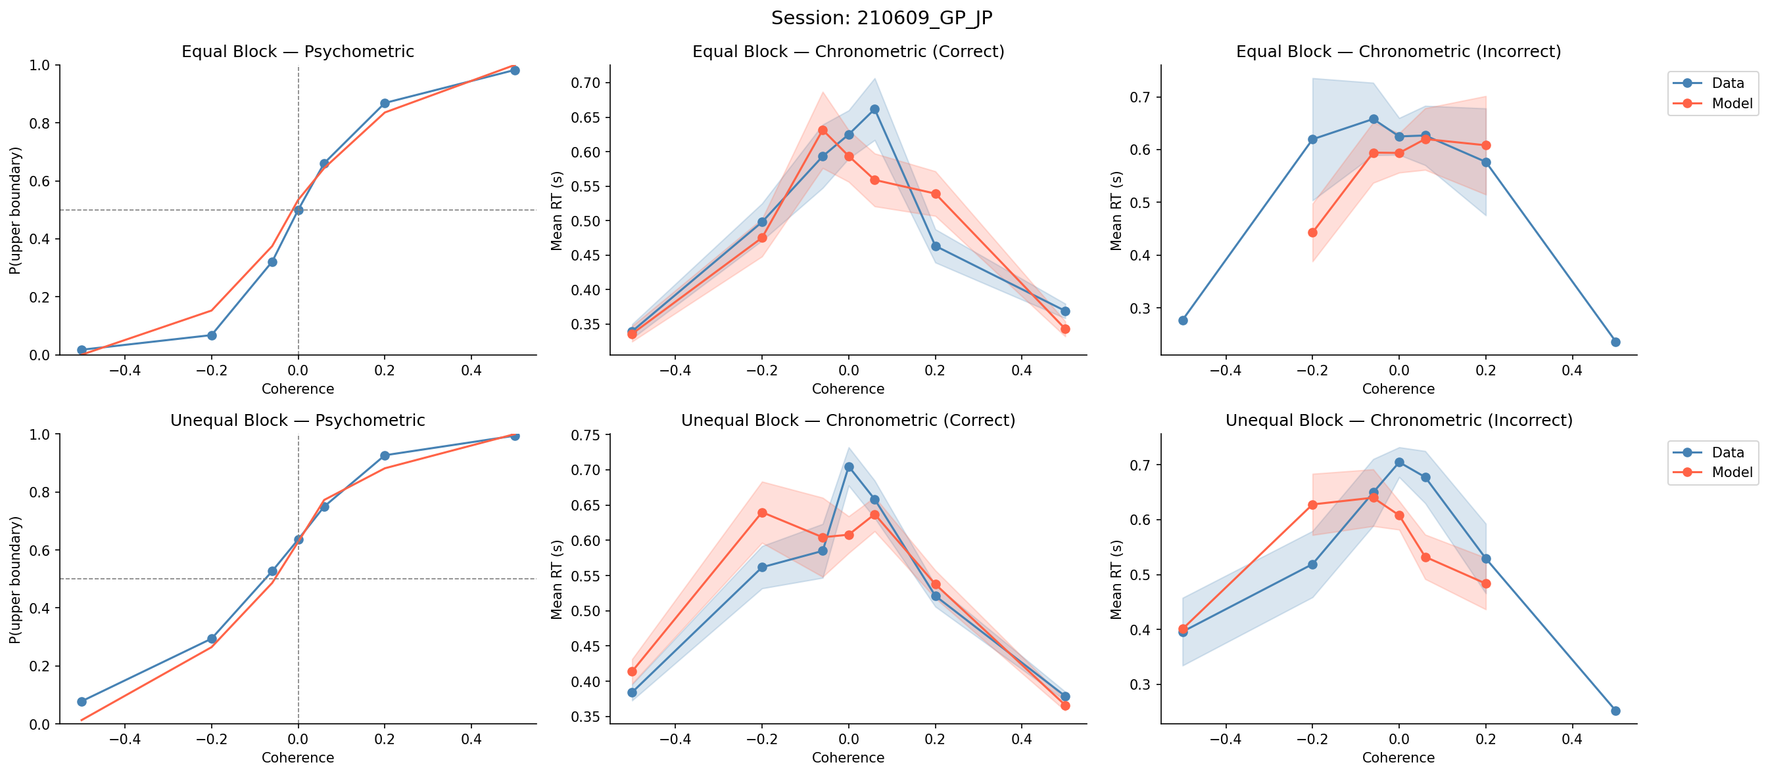
Session: 210609_GP_JP

Slide 28
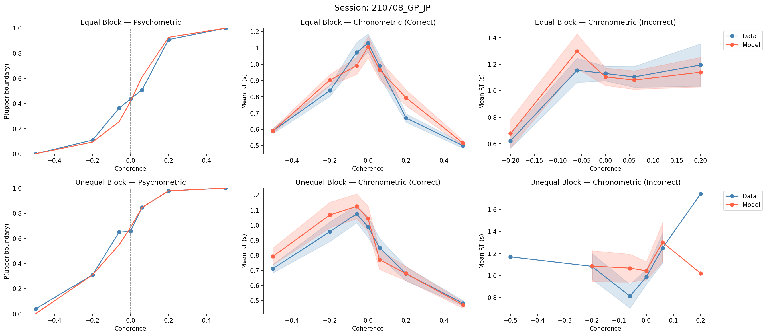
Session: 210708_GP_JP

Slide 29
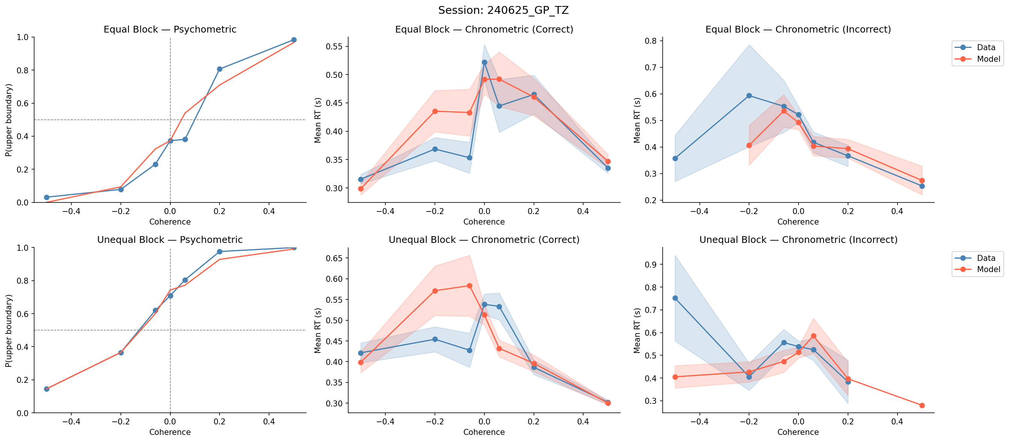
Session: 240625_GP_TZ

Slide 30
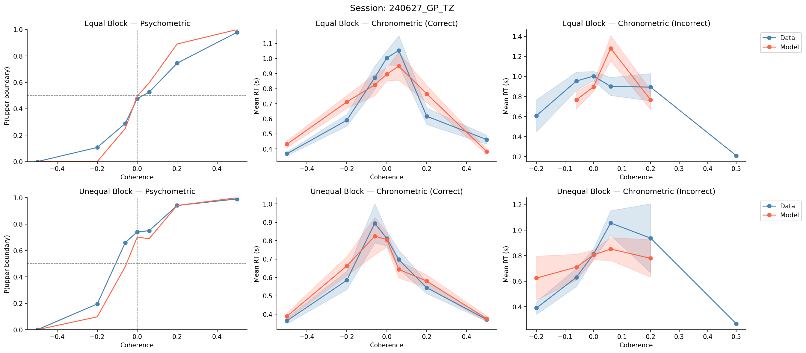
Session: 240627_GP_TZ

Slide 31
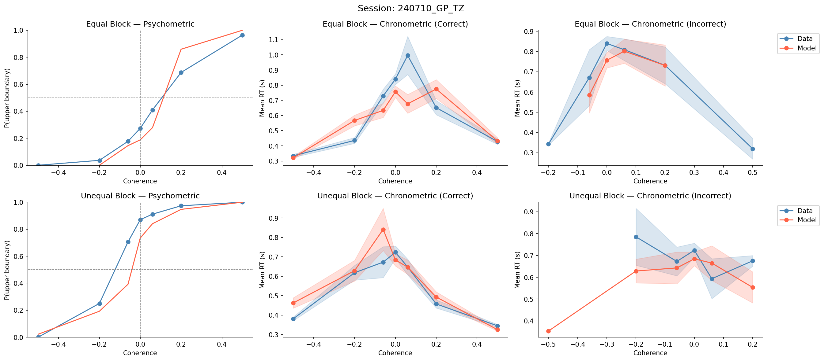
Session: 240710_GP_TZ

Slide 32
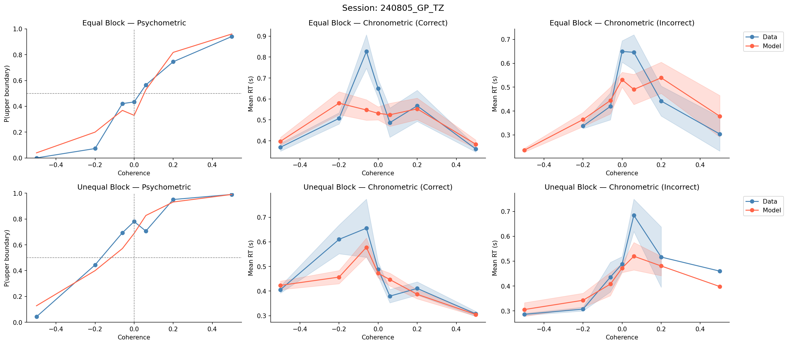
Session: 240805_GP_TZ

Slide 33
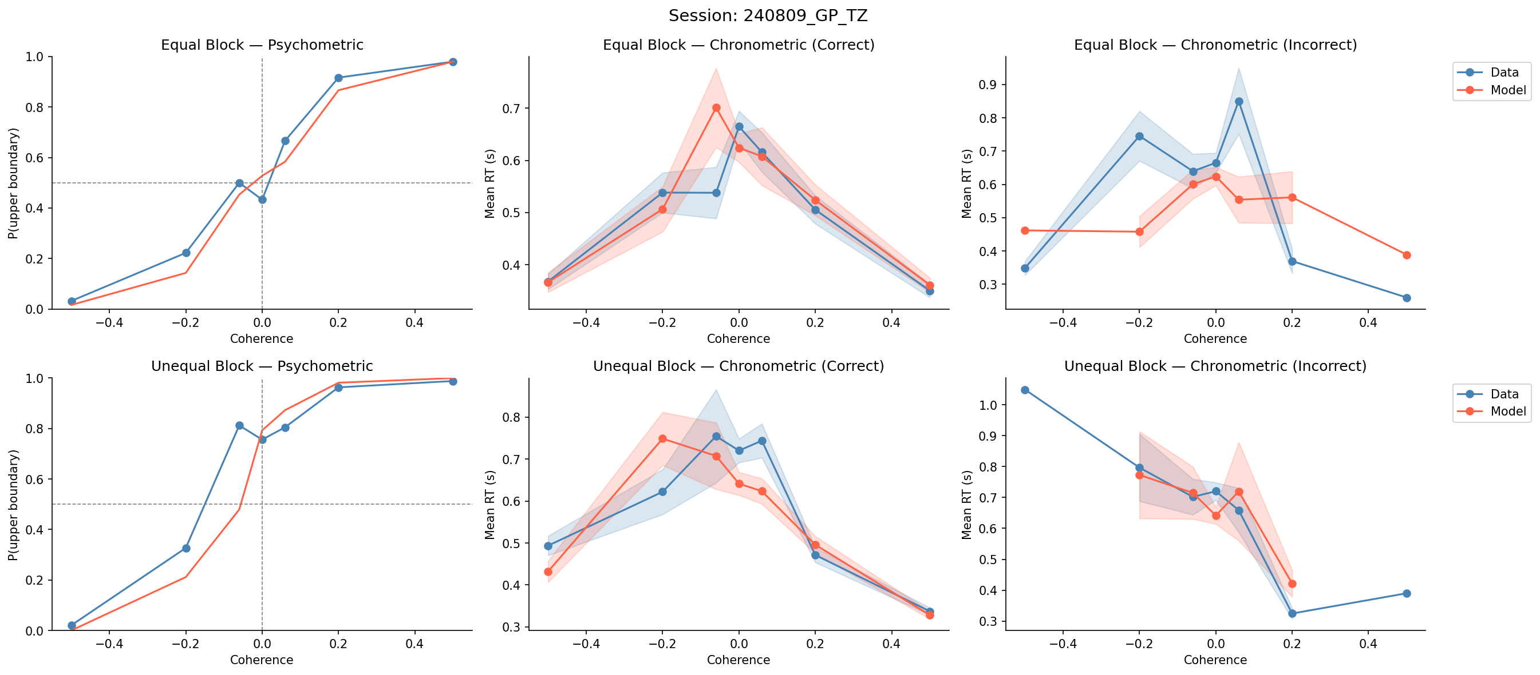
Session: 240809_GP_TZ

Slide 34
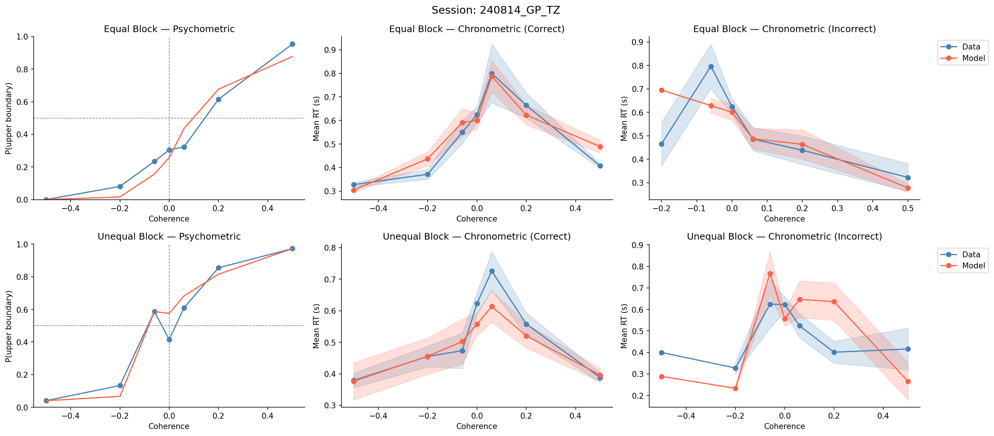
Session: 240814_GP_TZ

Slide 35
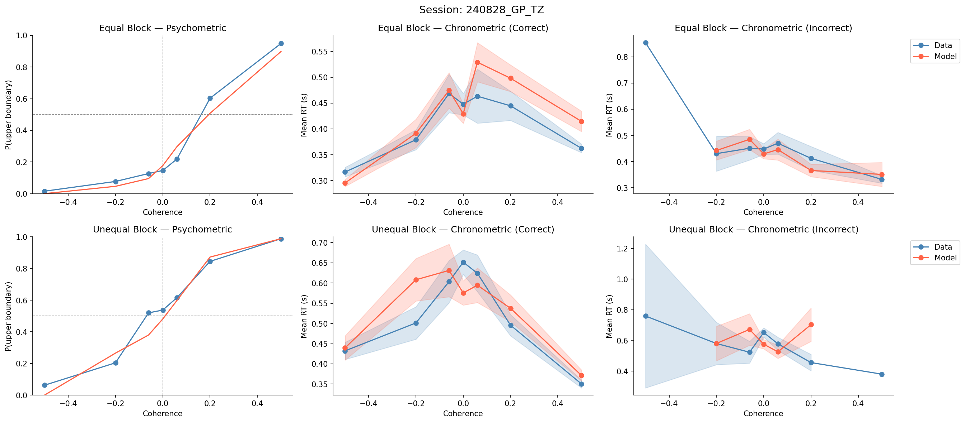
Session: 240828_GP_TZ

Slide 36
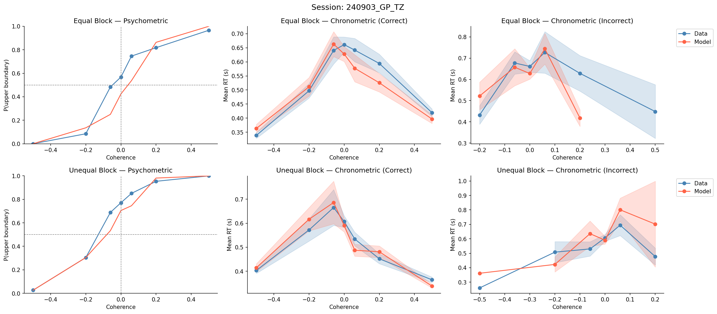
Session: 240903_GP_TZ

Slide 37
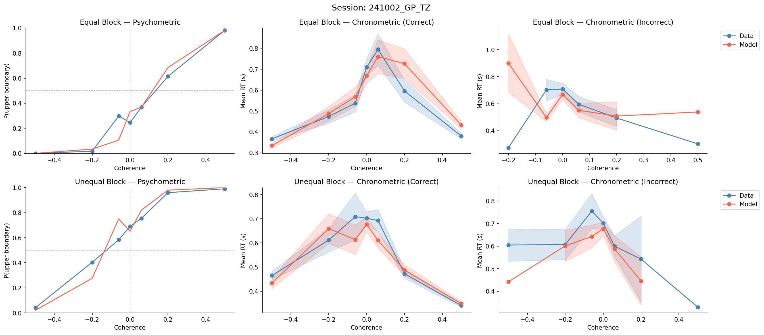
Session: 241002_GP_TZ

Slide 38
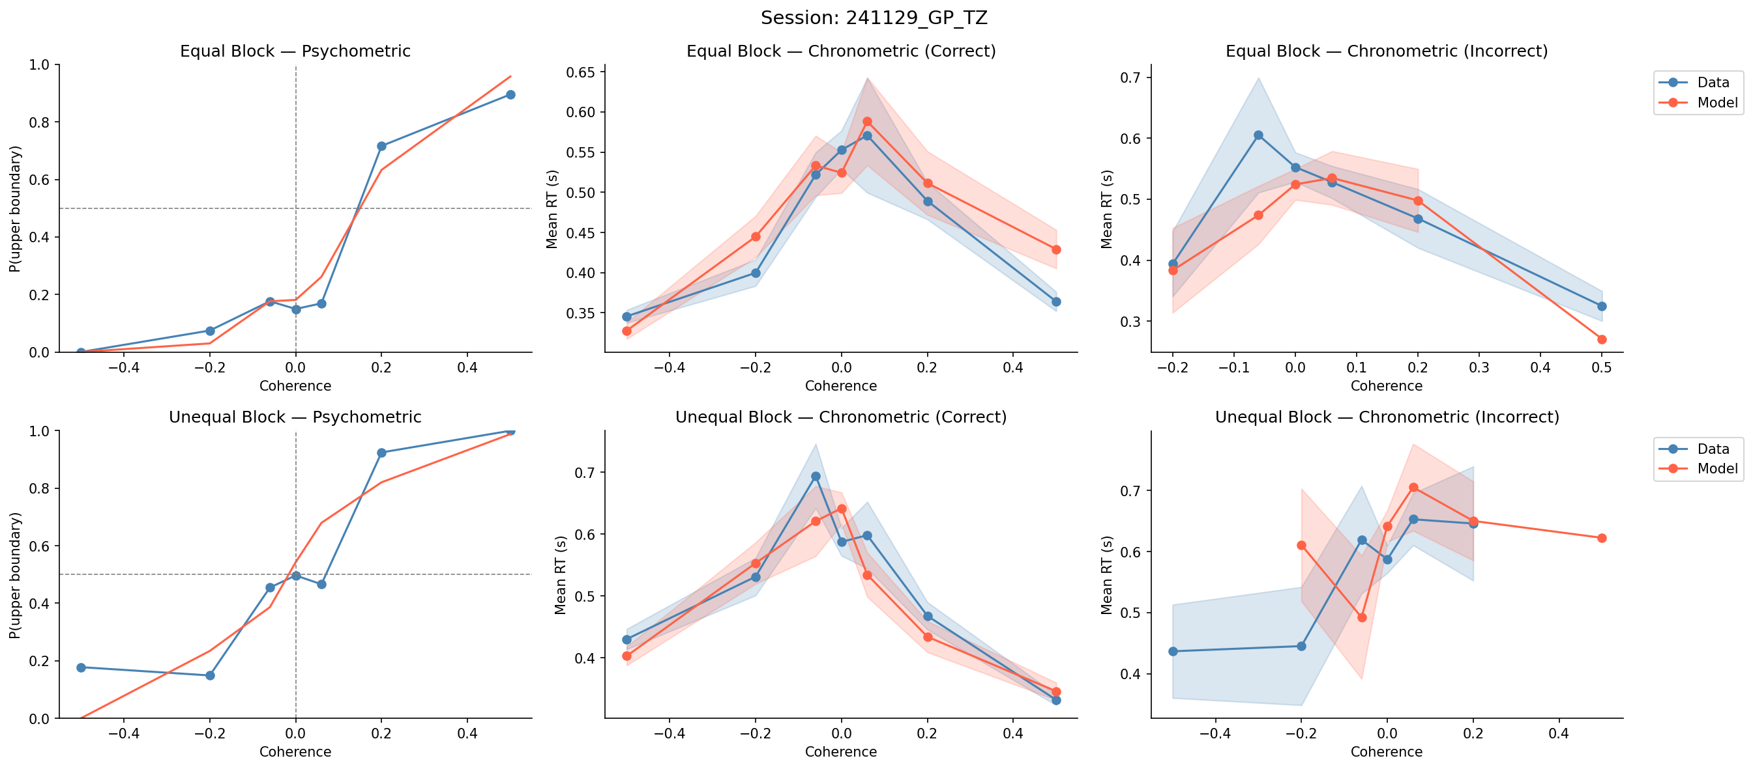
Session: 241129_GP_TZ

Slide 39
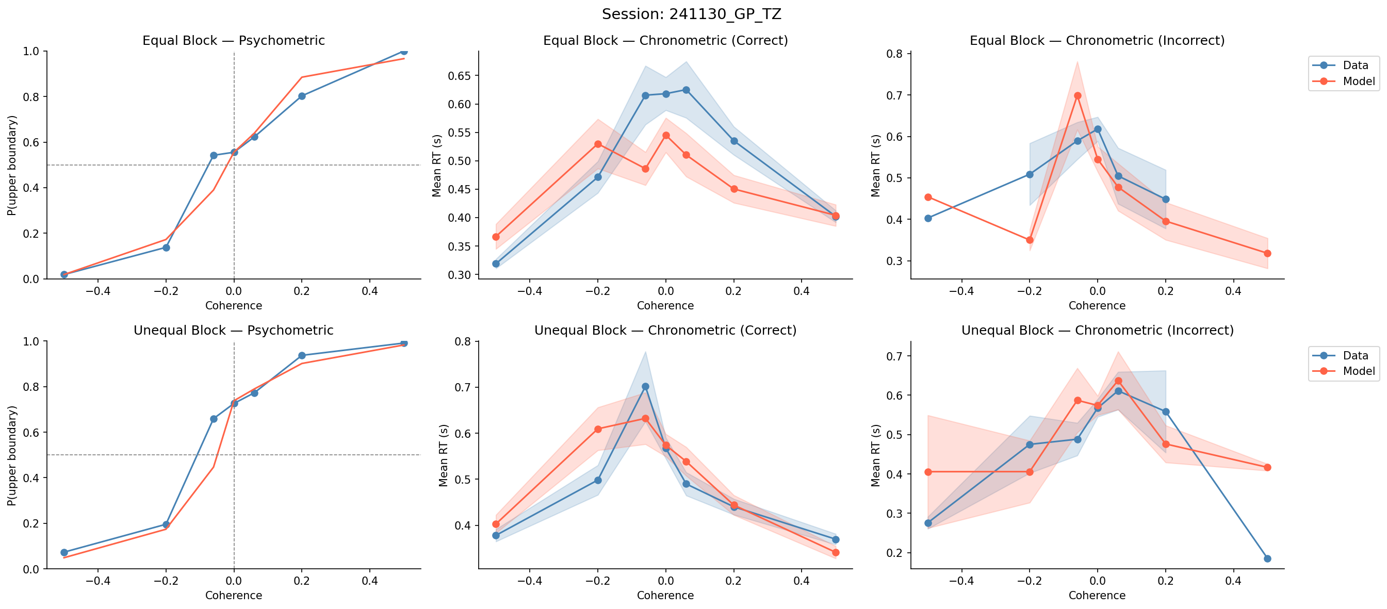
Session: 241130_GP_TZ

Slide 40
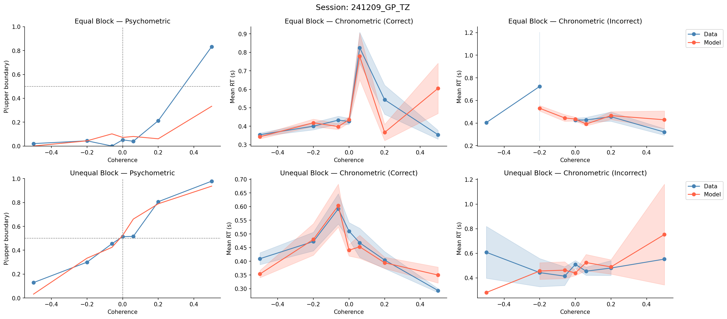
Session: 241209_GP_TZ

Slide 41
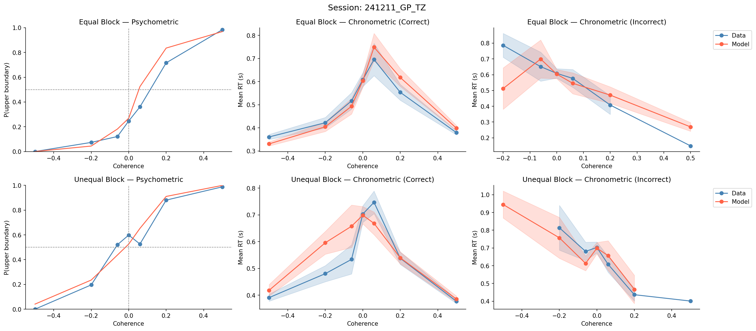
Session: 241211_GP_TZ

Slide 42
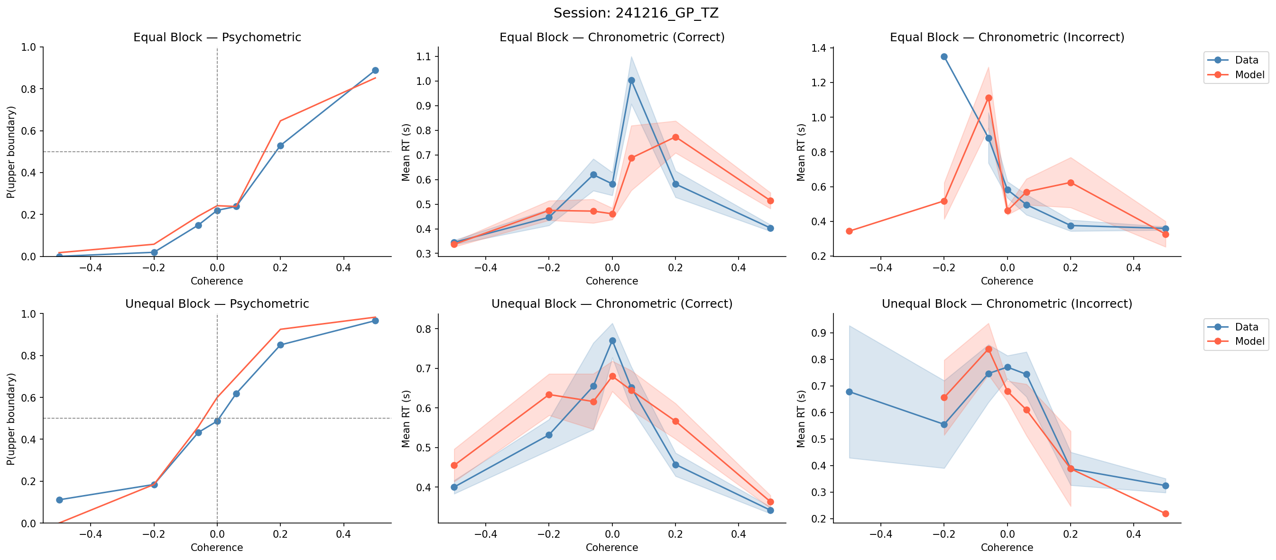
Session: 241216_GP_TZ

Slide 43
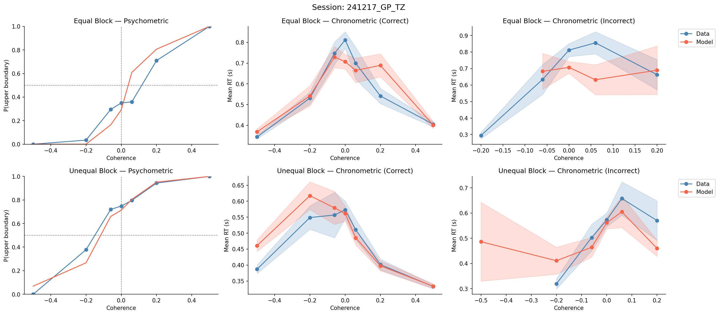
Session: 241217_GP_TZ

Slide 44
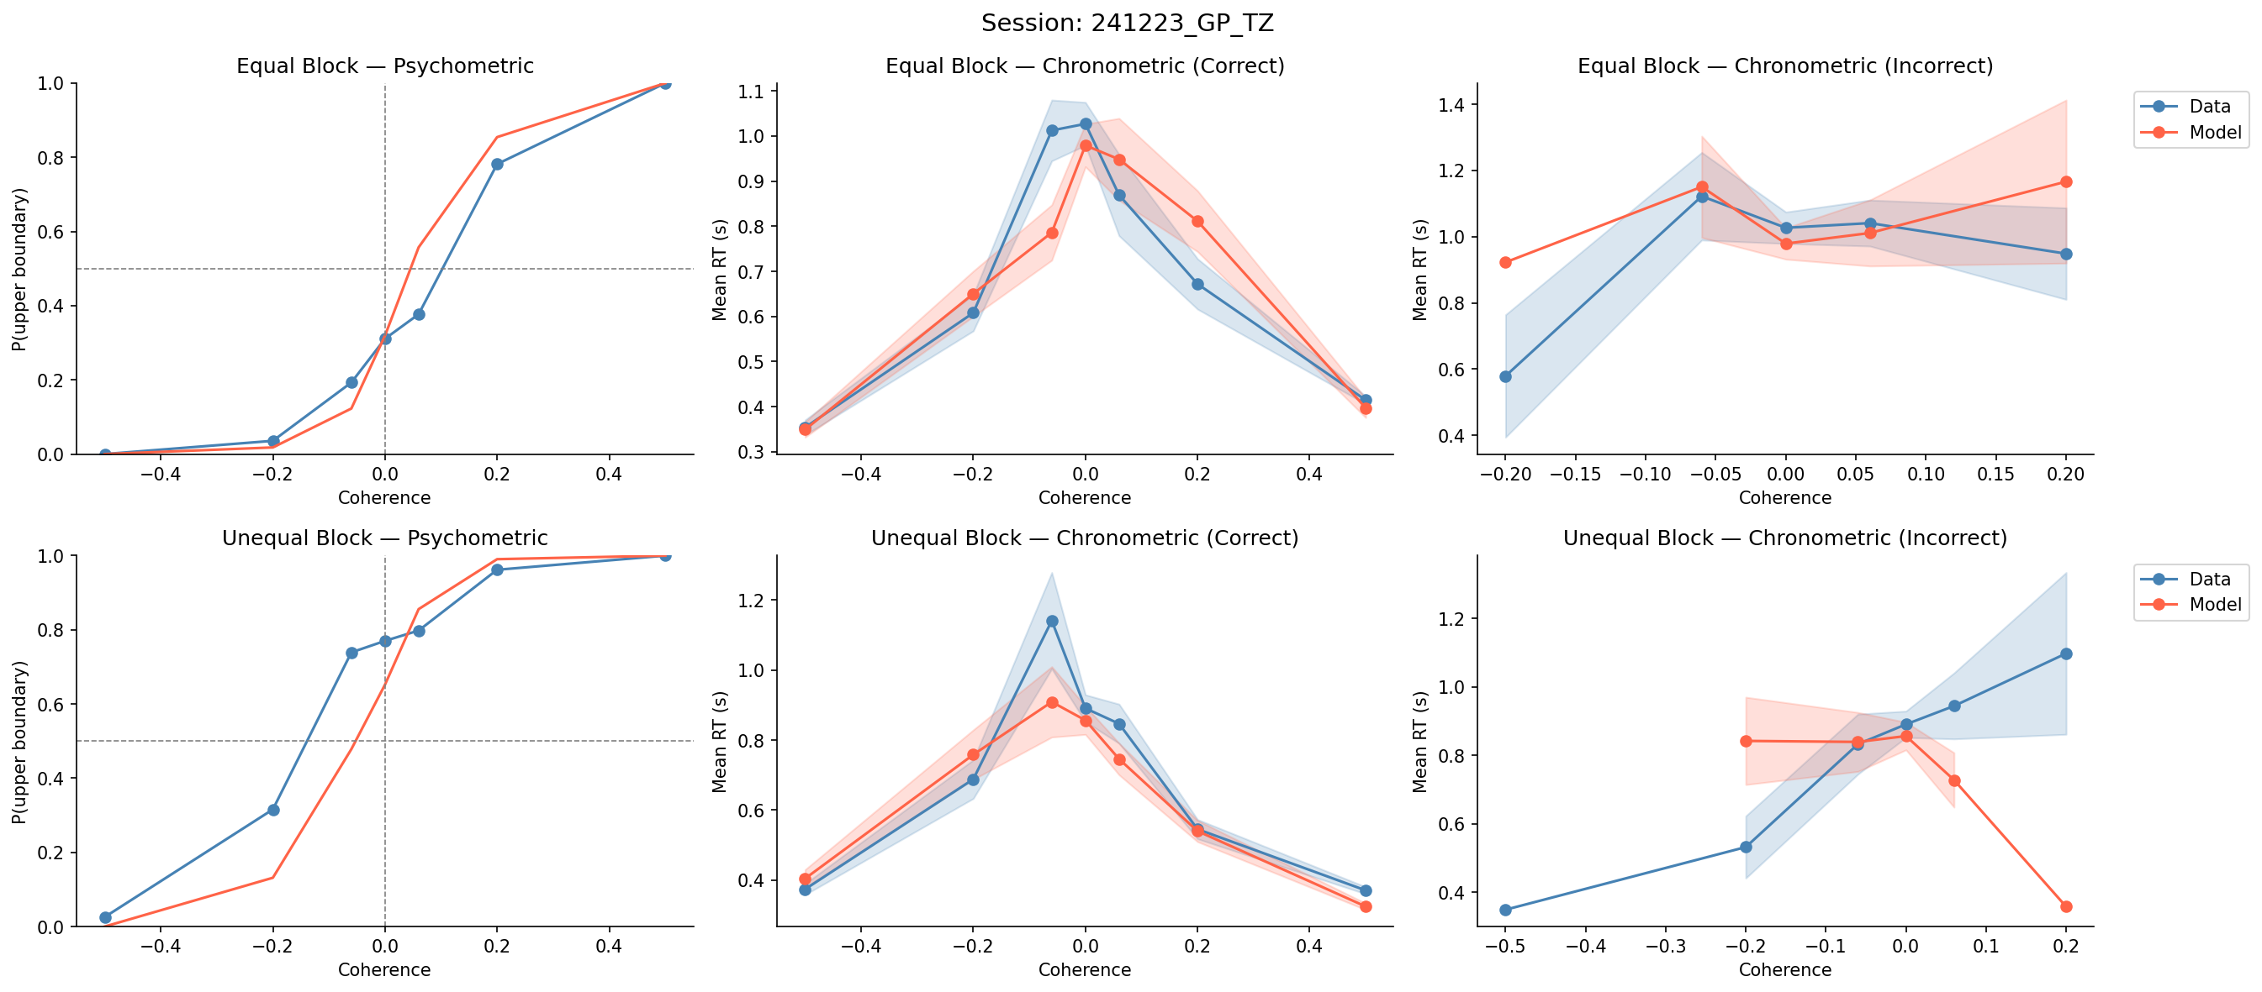
Session: 241223_GP_TZ

Slide 45
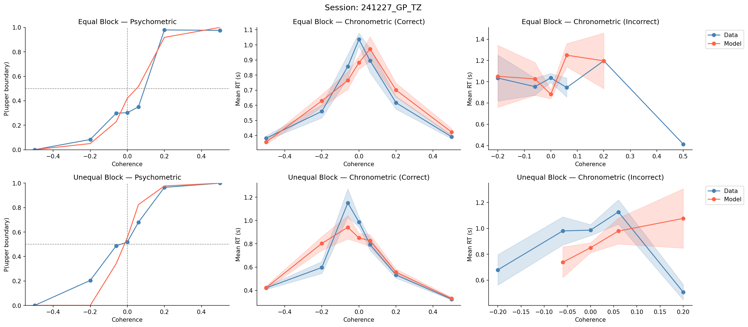
Session: 241227_GP_TZ

Slide 46
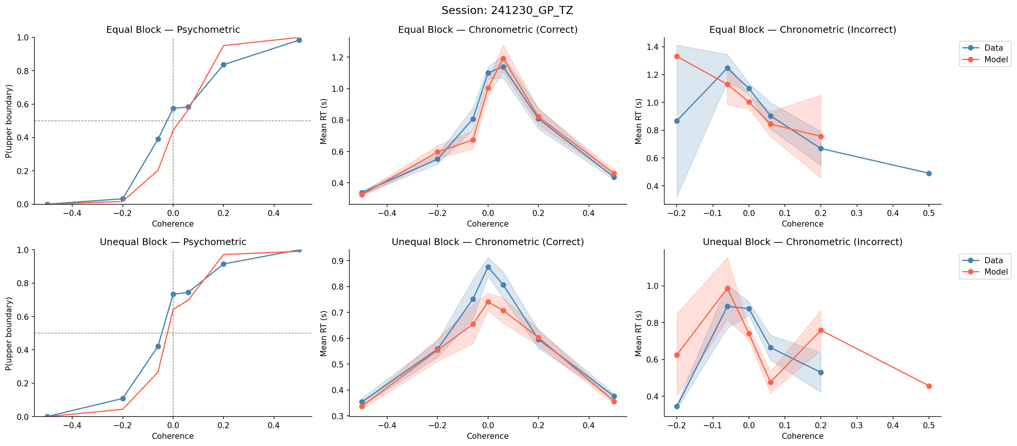
Session: 241230_GP_TZ

Slide 47
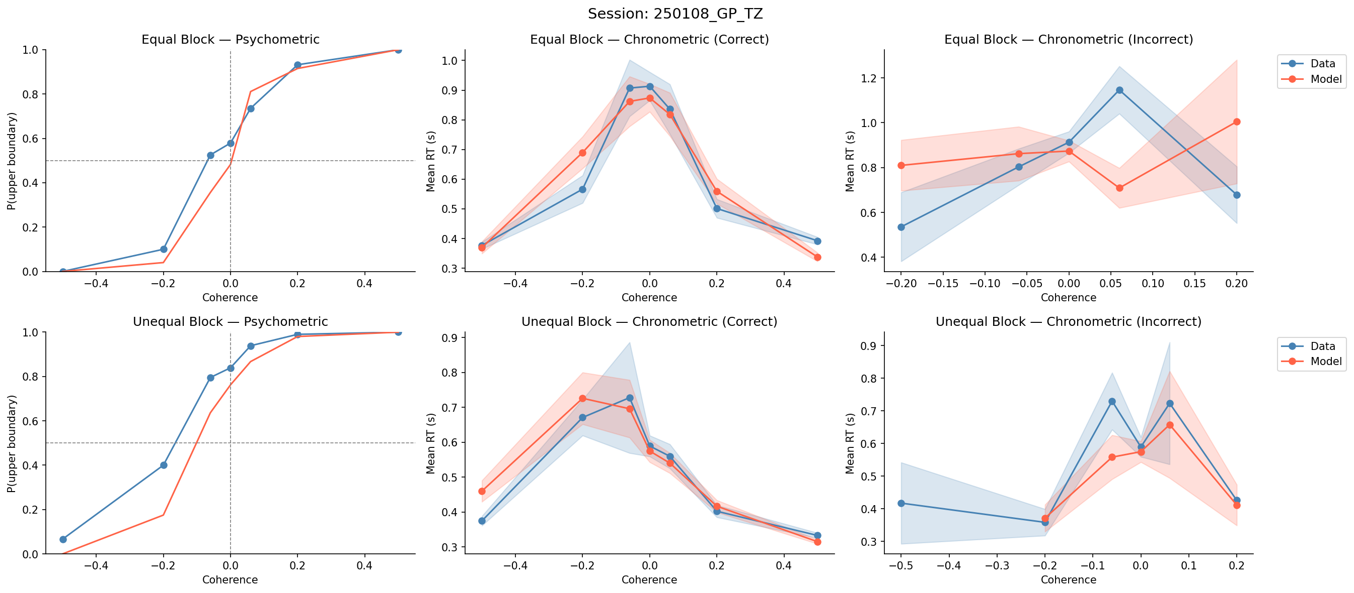
Session: 250108_GP_TZ

Slide 48
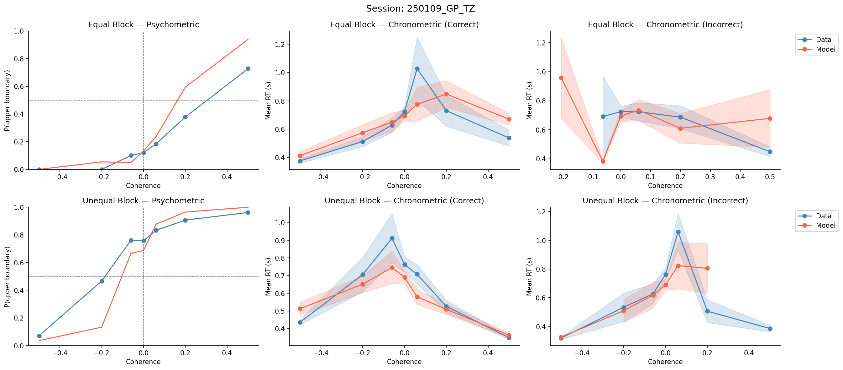
Session: 250109_GP_TZ

