Slide 1
dPCA Updates
07/12/2025

Slide 2
Neuron selectivity
Selectivity criteria: abs(loadings) > 0.3

Slide 3
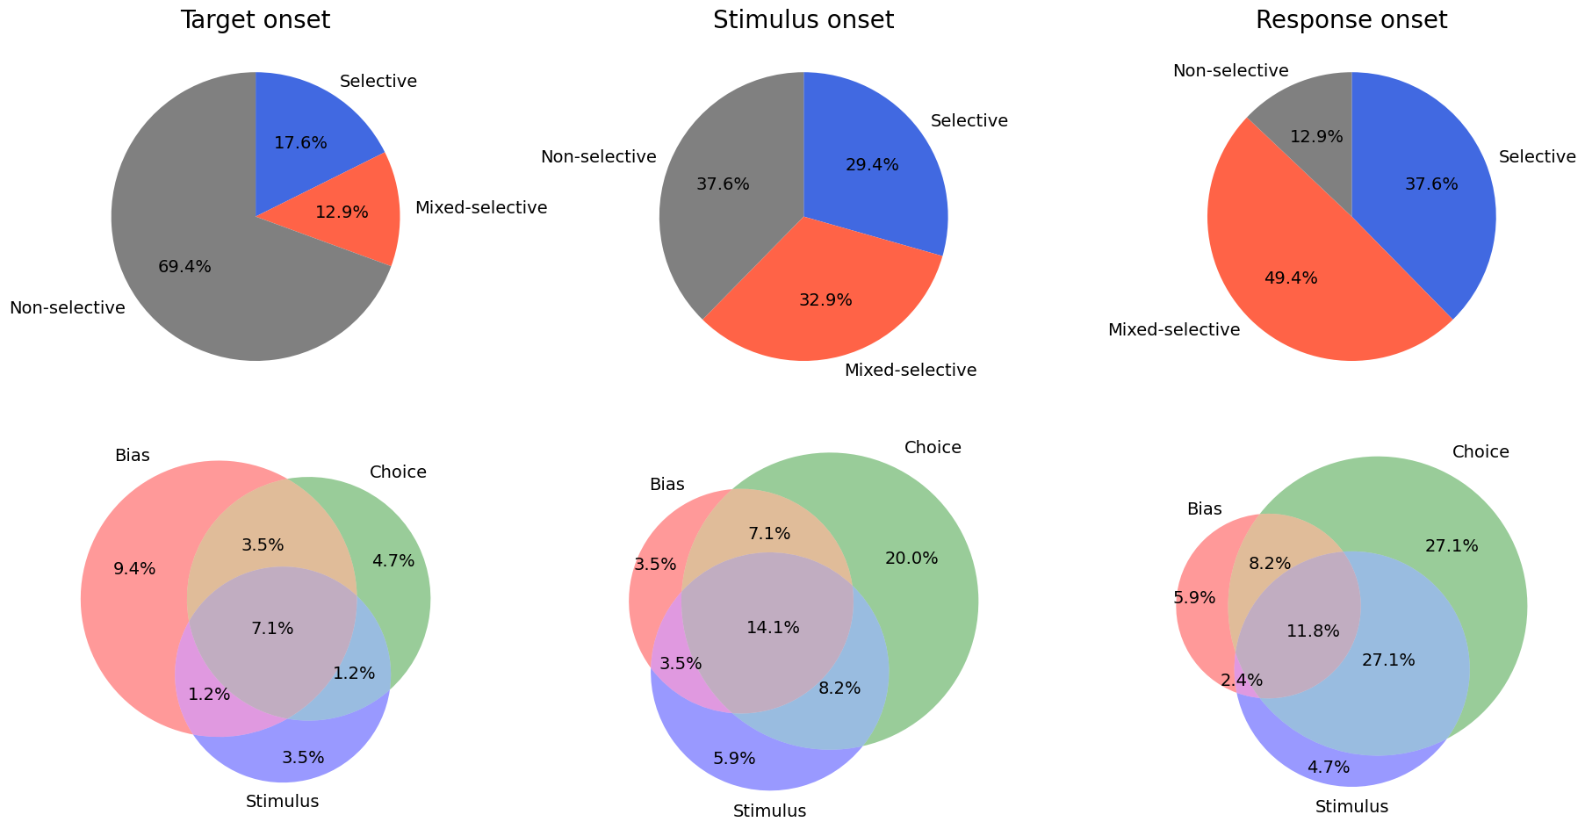
toRF sessions

Slide 4
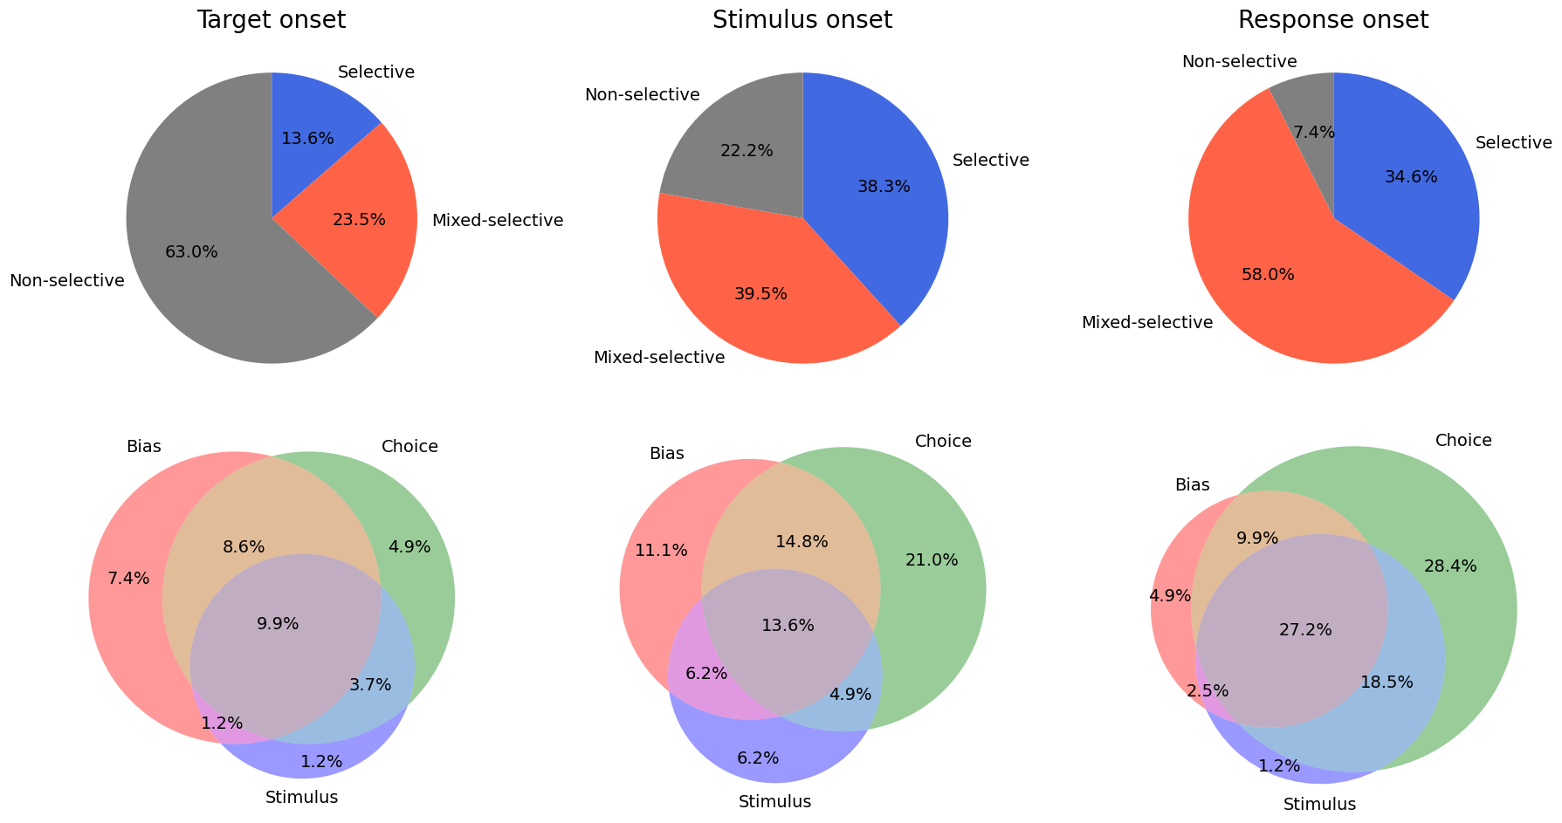
awayRF sessions

Slide 5
Cosine Similarity
Across task epochs
Across feature PCs
Range: -1 to 1
-1: Opposite direction
0: Orthogonal direction
1: Same direction

Slide 6
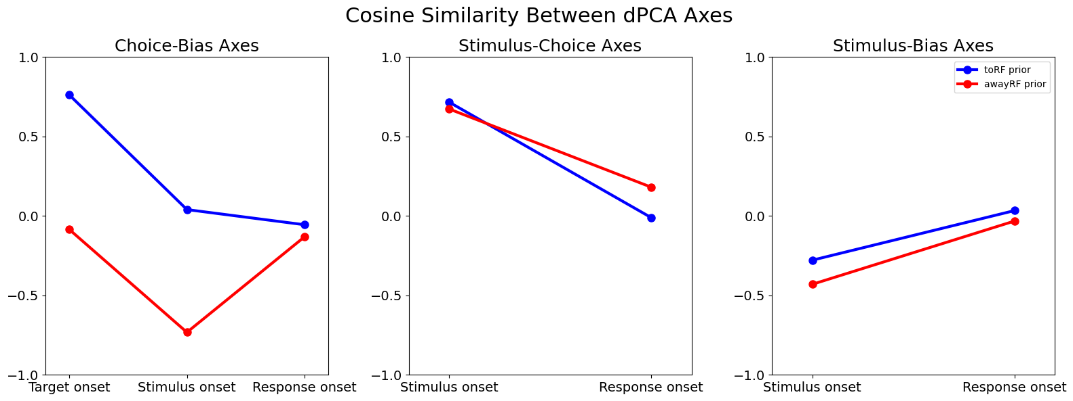

Slide 7
Backup figures for cosine similarity

Slide 8
toRF Prior Sessions

Slide 9
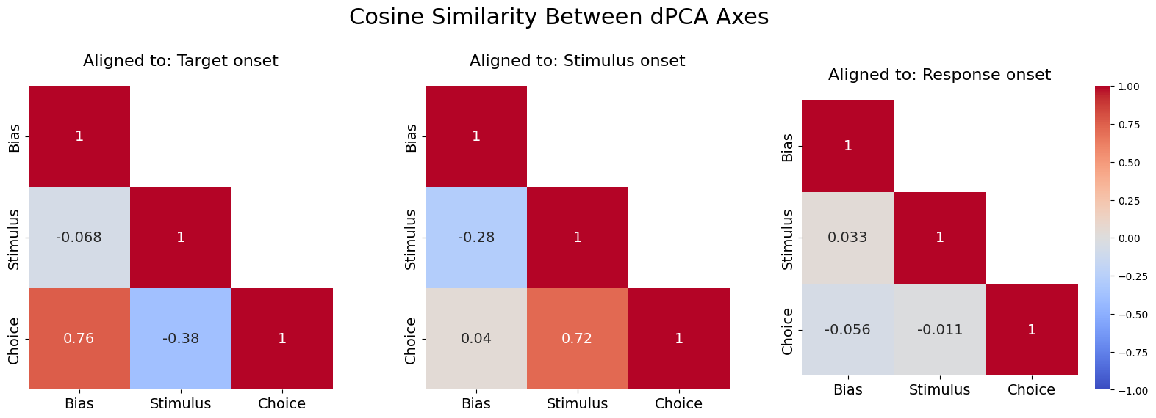

Slide 10
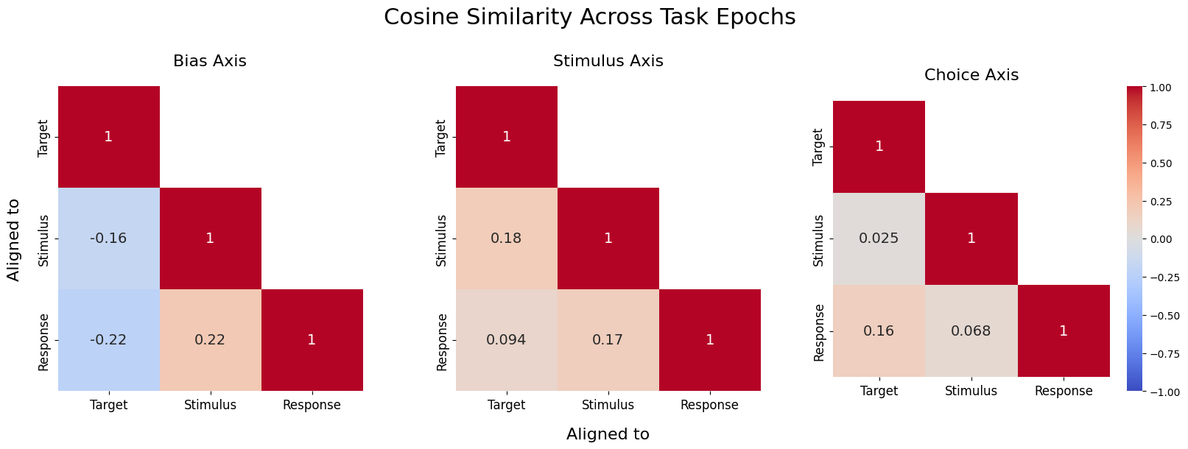

Slide 11
awayRF Prior Sessions

Slide 12
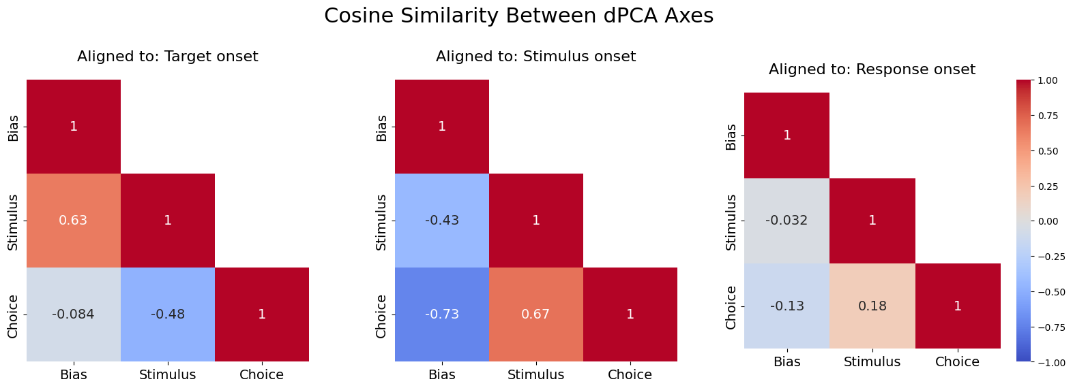

Slide 13
