Slide 1
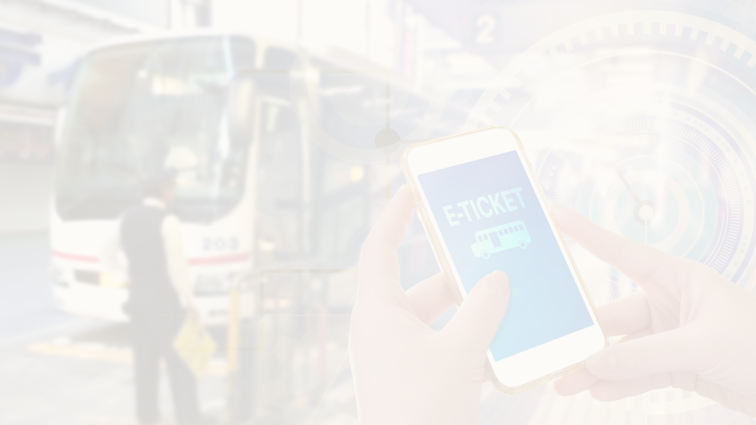
RFID Bus Ticketing: Revolutionizing Public Transportation
Kingston engineering college College code -5113
By S. pavithra - naan mudalvan ID:au511321106019 , Email:pavithrasundervadivel04@gmail.com
R . Vijaya bharathi - naan mudalvan ID:au511321106026 , Email: Vijayabharathi152003@gmail.com
T. Madhu mitha - naan mudalvan ID: autle-06ece , Email: madhumithausha2002@gmail.com
S . vaideeswari - naan mudalvan ID: autle-01ece, Email: vaishusaravanan1315@gmail.com
S.Priya Dharshini - Naan mudalavan Id : autle-05ece, Email: priyadharshinis07092000@gmail.com

Slide 2

RFID Bus Ticketing
1
Efficiency at its Best
2
Real-time Tracking
3
Enhanced Security
Say goodbye to long queues and paper tickets. With RFID technology, passengers can effortlessly tap their cards for a seamless boarding experience.
The built-in GSM module enables real-time communication between the bus and the central database, allowing for accurate tracking of vehicle movements and passenger data.
RFID tags provide a secure and tamper-proof ticketing system, reducing the risk of fraud and ensuring a safe and reliable journey for all passengers.

Slide 3
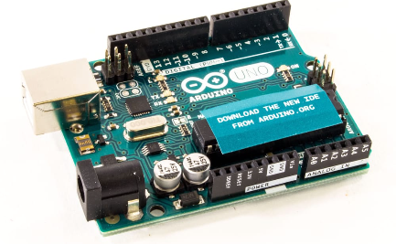
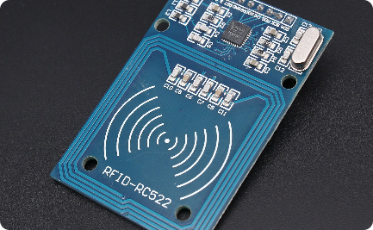
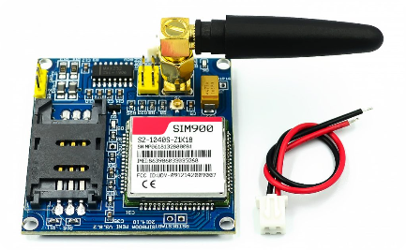
Arduino-Based System
Utilizing Arduino UNO, this innovative system integrates various modules and sensors to create a comprehensive smart ticketing solution.
Arduino UNO
RFID-RC522 Module
GSM800 Module
The heart of the system, Arduino UNO, acts as the control center, processing data from the RFID and GSM modules.
This RFID module allows for quick and reliable identification of passengers by reading their RFID cards or tokens.
The GSM module enables seamless communication between the bus and the central server, ensuring real-time data updates.

Slide 4

The Power of RFID
Explore the capabilities of RFID technology, propelling bus ticketing into a new era of convenience and efficiency.
1
Identification Made Easy
Passengers simply swipe their RFID cards or tokens near the RFID reader, instantly registering their presence and validating their tickets.
Automated Fare Calculation
2
With precise tracking of passenger entry and exit, the system automatically calculates fares, eliminating the need for manual ticketing.
3
Streamlined Data Management
By collecting and analyzing data from each transaction, transit authorities can streamline operations, improve service delivery, and make informed decisions.

Slide 5
future work : the GSM Connection
Unleash the power of real-time communication with the GSM800 module, enabling a seamless connection between the bus and the central server.
Constant Updates
Emergency Alerts
The GSM module ensures that the bus's location, passenger count, and other crucial data are communicated to the server in real-time.
In case of emergencies or schedule changes, the GSM module enables immediate notifications to passengers and authorities.
Efficient Fleet Management
Improved Passenger Experience
Transit authorities can monitor bus performance, schedule maintenance, and optimize routes through the continuous data exchange facilitated by the GSM module.
Real-time updates on bus timings and availability enhance passenger convenience and satisfaction, enabling a reliable and comfortable journey.

Slide 6
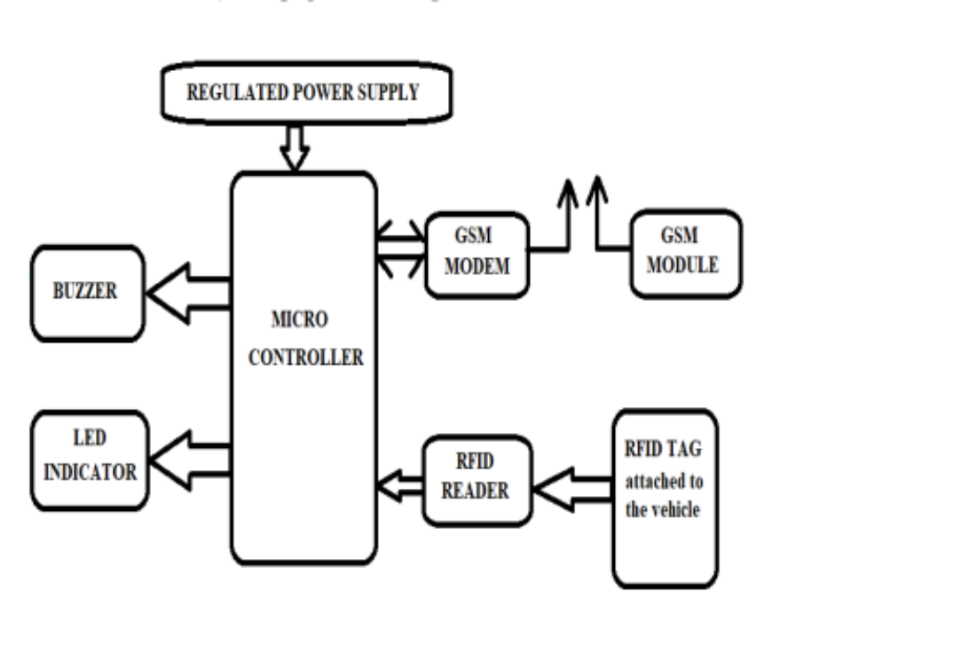
System Architecture

Slide 7
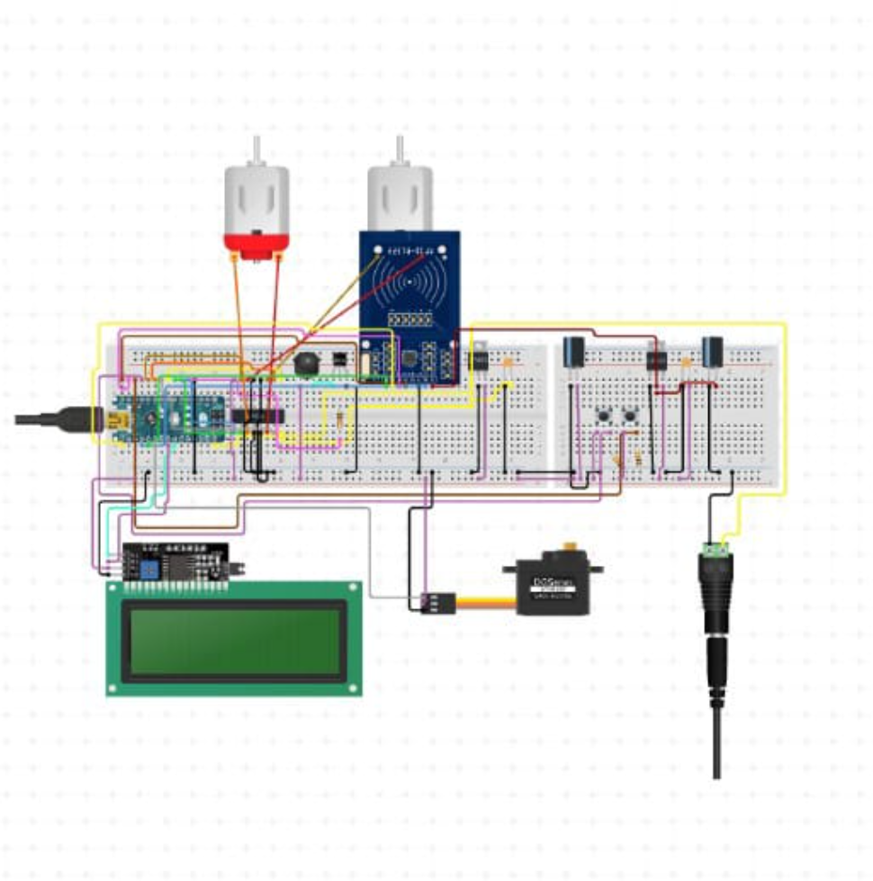
circuit diagram :

Slide 8
coding:
//include the RFID libs
#include <SPI.h>
#include <MFRC522.h>
//include the LCD lib
#include <LiquidCrystal.h>
//declear the reset and SDA pins of RFID
#define SS_PIN 10
#define RST_PIN 9
// Create MFRC522 instance.
MFRC522 mfrc522(SS_PIN, RST_PIN); // Create MFRC522 instance.

Slide 9
//declear what LCD pins u are sending data
LiquidCrystal lcd(3, 2, 6, 4, 7, 5);
String pass1 = "CHIBUEZE";
String acct1 = "6A 2D 67 07";
String pass2 = "SMART";
String acct2 = "77 1F 73 63";
int balance1 = 1000;
int balance2 = 1000;
int rate = 200;
void setup()
{
Serial.begin(9600);

Slide 10
// Initiate SPI bus
SPI.begin();
// Initiate MFRC522
mfrc522.PCD_Init();
//begin the LCD
lcd.begin(16, 4);
//state your actuator pins
pinMode(A0, OUTPUT);
pinMode(A1, OUTPUT);
pinMode(A2, OUTPUT);

Slide 11
//display a welcome note
lcd.setCursor(0, 0);
lcd.print("WELCOME CHIBUEZE ");
delay(4000);
lcd.setCursor(0, 0);
lcd.print(" BUS TICKET ");
lcd.setCursor(0, 1);
lcd.print(" PAYMENT SYSTEM ");
delay(2000);
lcd.clear();
lcd.setCursor(0, 2);
lcd.print(" ");
lcd.setCursor(0, 3);
lcd.print(" ");
}

Slide 12
coding:
void unregisted(){
tone(A0, 1000);
delay(500);
noTone(A0);
delay(500);
tone(A0, 1000);
delay(500);
noTone(A0);
delay(500);
tone(A0, 1000);
delay(500);
noTone(A0);
delay(500);
lcd.setCursor(0, 0);
lcd.print(" UNREGISTERED ");

Slide 13
void loop() {
//turn off the actuators
digitalWrite(A0, LOW);
analogWrite(A1, 0);
analogWrite(A2, 0);
lcd.setCursor(0, 0);
lcd.print("Bus Fare is #");
delay(2000);
lcd.setCursor(0, 1);
lcd.print("PLS GET A VALID CARD");
for (int positionCounter = 0; positionCounter < 43; positionCounter++) {
// scroll one position left:
lcd.scrollDisplayLeft();
// wait a bit:
delay(150);
}
}

Slide 14
//lcd.clear(); }
void loop()
//turn off the actuators
digitalWrite(A0, LOW);
analogWrite(A1, 0);
analogWrite(A2, 0);
lcd.setCursor(0, 0);
lcd.print("Bus Fare is #");
lcd.println(rate);
lcd.println(" ");
lcd.setCursor(0, 1);
lcd.print(" Swipe To Pay ");

Slide 15
coding:
// Select one of the cards
if ( ! mfrc522.PICC_ReadCardSerial()) { return; }
//Show UID on serial monitor Serial.print("UID tag :");
String content= ""; byte letter; for (byte i = 0; i < mfrc522.uid.size; i++) {
Serial.print(mfrc522.uid.uidByte[i] < 0x10 ? " 0" : " "); Serial.print(mfrc522.uid.uidByte[i], HEX); content.concat(String(mfrc522.uid.uidByte[i] < 0x10 ? " 0" : " ")); content.concat(String(mfrc522.uid.uidByte[i], HEX));
} Serial.println(); Serial.print("Message : ");
content.toUpperCase();

Slide 16
//this is where u put the UID of the card that you want to give access
if (content.substring(1) == "6A 2D 67 07")
{ analogWrite(A2, 255) ;
delay(250);
analogWrite(A2, 0);
delay(250);
analogWrite(A2, 255);
if (balance1 >= rate){ balance1 -= rate;
lcd.setCursor(0, 0); lcd.print(" Hi CHIBUEZE "); lcd.setCursor(0, 1); lcd.print("__Payment O.K__ "); } else{ lcd.setCursor(0, 0); lcd.print(" Sorry CHIBUEZE "); lcd.setCursor(0, 1); lcd.print("Insuficient Fund"); } delay(4000); lcd.setCursor(0, 1); lcd.print("_Balance is #"); lcd.println(balance1); lcd.println(". ."); delay(4000); return; }

Slide 17
if (content.substring(1) == "77 1F 73 63") { analogWrite(A2, 255); delay(250); analogWrite(A2, 0); delay(250); analogWrite(A2, 255); if (balance2 >= rate){ balance2 -= rate; lcd.setCursor(0, 0); lcd.print(" Hi SMART "); lcd.setCursor(0, 1); lcd.print("__Payment O.K__ "); } else{ lcd.setCursor(0, 0); lcd.print(" Sorry SMART "); lcd.setCursor(0, 1); lcd.print("Insuficient Fund"); } delay(4000); lcd.setCursor(0, 1); lcd.print("_Balance is #"); lcd.println(balance2); lcd.println(". ."); delay(4000); return; }

Slide 18
else{ lcd.clear();
analogWrite(A1, 255);
delay(250);
analogWrite(A1, 0);
delay(250);
analogWrite(A1, 255);
unregisted();
} lcd.clear();
}

Slide 19
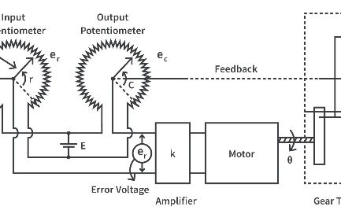
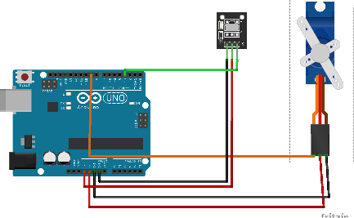
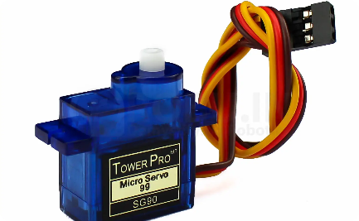
Integration of Servo Motor
Discover the role of the servo motor in the RFID bus ticketing system, ensuring secure and convenient access control.
Access Control
Arduino Integration
Reliability and Durability
The servo motor controls the opening and closing of the bus door, allowing only validated passengers to board.
Through Arduino's precise control, the servo motor operates smoothly, enhancing the overall efficiency of the ticketing system.
Designed for continuous usage, the servo motor ensures long-lasting performance, reducing maintenance requirements.

Slide 20

Conclusion
As we conclude this presentation, let's recap the key points and consider the potential benefits and future applications of RFID bus ticketing.
1
Effortless Travel
RFID technology simplifies the ticketing process, making bus travel more convenient for passengers.
2
Data-Driven Decision Making
Transit authorities can leverage the collected data to optimize operations, improve efficiency, and enhance the overall transportation experience.
3
Scalable Solution
The RFID bus ticketing system can be implemented across various cities, providing a versatile and scalable ticketing solution.

