Slide 1
SAFAR
-Vaidehi Ahir

Slide 2
PID - 492
Public Transport
By- Vaidehi Ahir
​Branch – Cyber Security
Batch- 12
​Enrollment No. – CS 23​

Slide 3
Challenge
To offer citizens/commuters the website that enables them to identify:
Bus availability from Point to A to B
Estimated travel time and cost
Sharing the bus travel information within a group to enable board same bus
More people will use public transport

Slide 4
impact
Reduce traffic and pollution

Slide 5
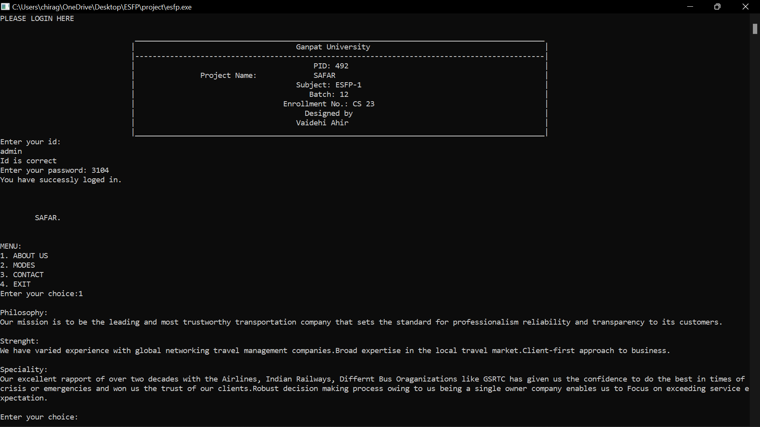
output

Slide 6
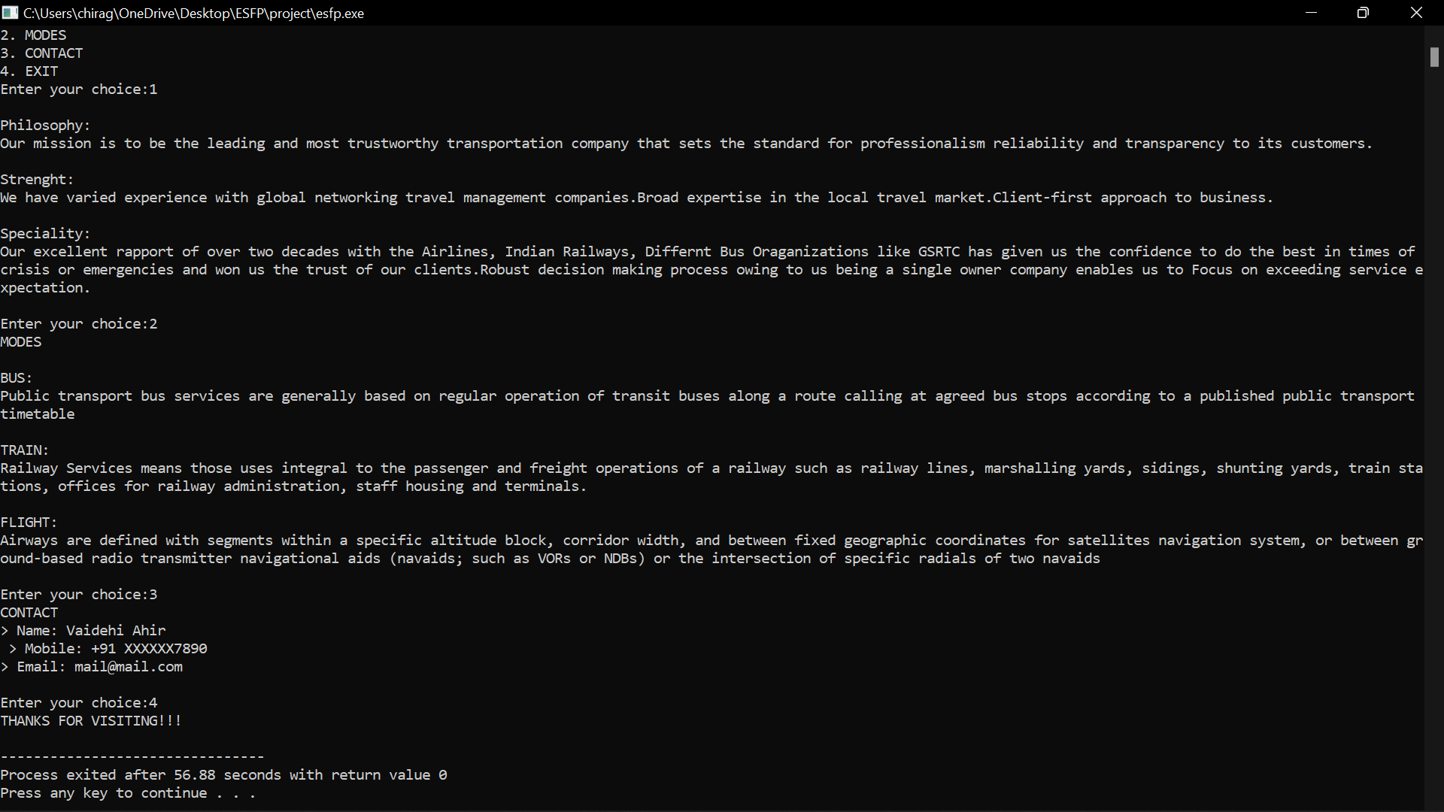

Slide 7
THANK YOU

