Slide 1

Categorization of Property Type in Housing Website
MET CS-699: Data Mining
Term Project
Aditya Maheshwari (U54025068)
Vaidehi Shah (U90080562)

Slide 2
INTRODUCTION
Makaan.com is a renowned real estate portal based in India. The dataset used for this project has been prepared by scraping information off of makaan.com's website. The primary focus of this project is the listings that are stated as “sell” under the “Listing Category” attribute.
The analysis of this project will be based on determining the type of property based on its features and characteristics. To avoid data imbalance, the categorization is done as “Apartments” and “Non-Apartments”. By addressing this, the aim is to enhance the search engine of the Makaan.com website, providing more tailored search results that are in line with customers' preferences and requirements.

Slide 3
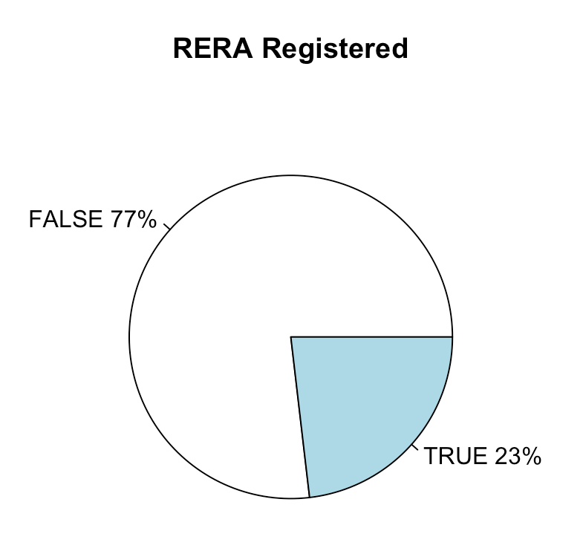
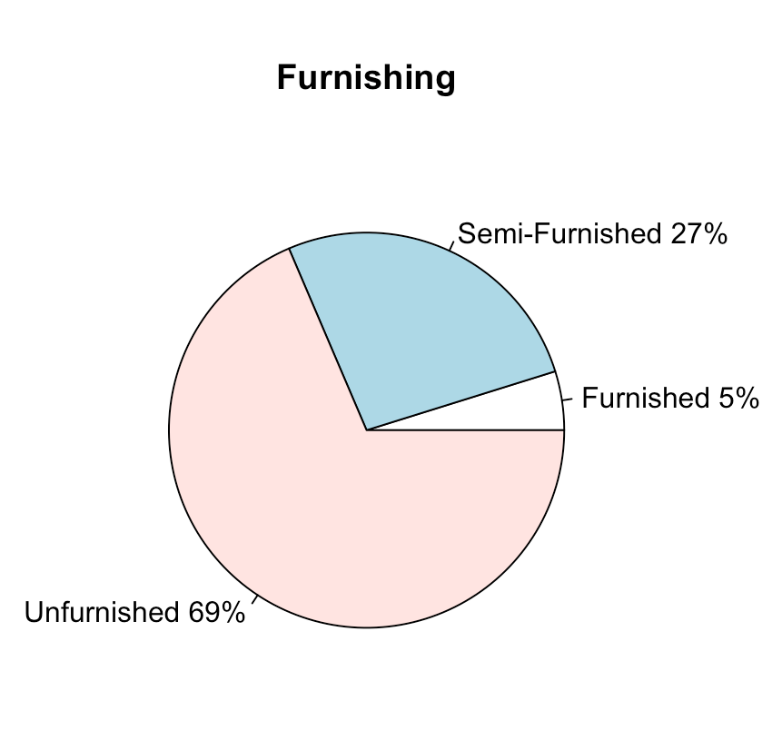
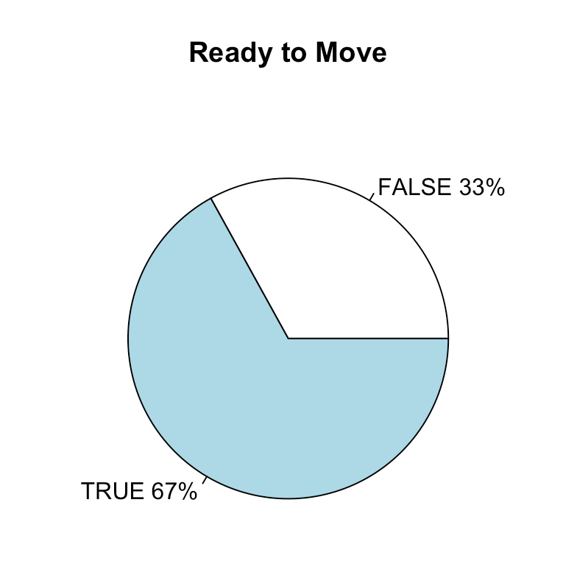
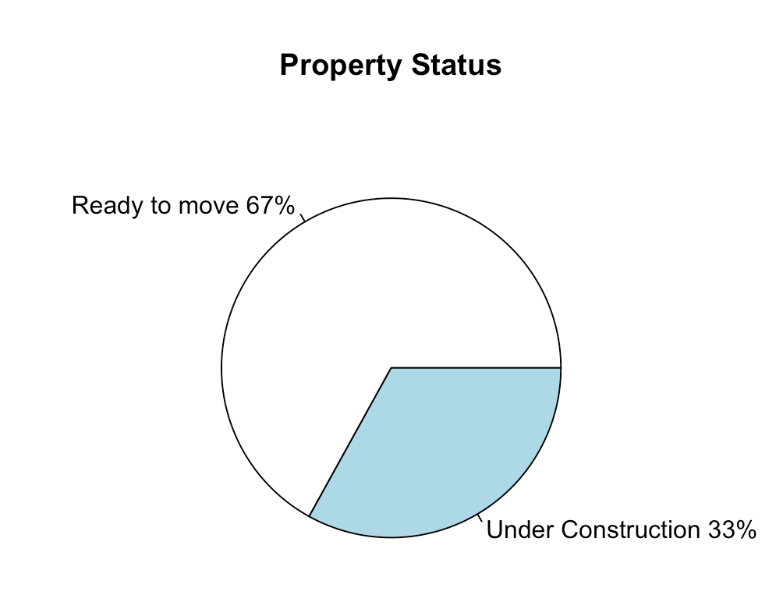
EXPLORATORY DATA ANALYSIS

Slide 4
PROBLEM STATEMENT
Predicting if a property is an apartment or not is crucial for real estate. It helps investors, managers, lenders, and buyers analyze the market, manage properties, and make investment decisions. Analyzing the property's features, location, size, amenities, and demographics using machine learning algorithms can lead to informed decisions and better outcomes.

Slide 5
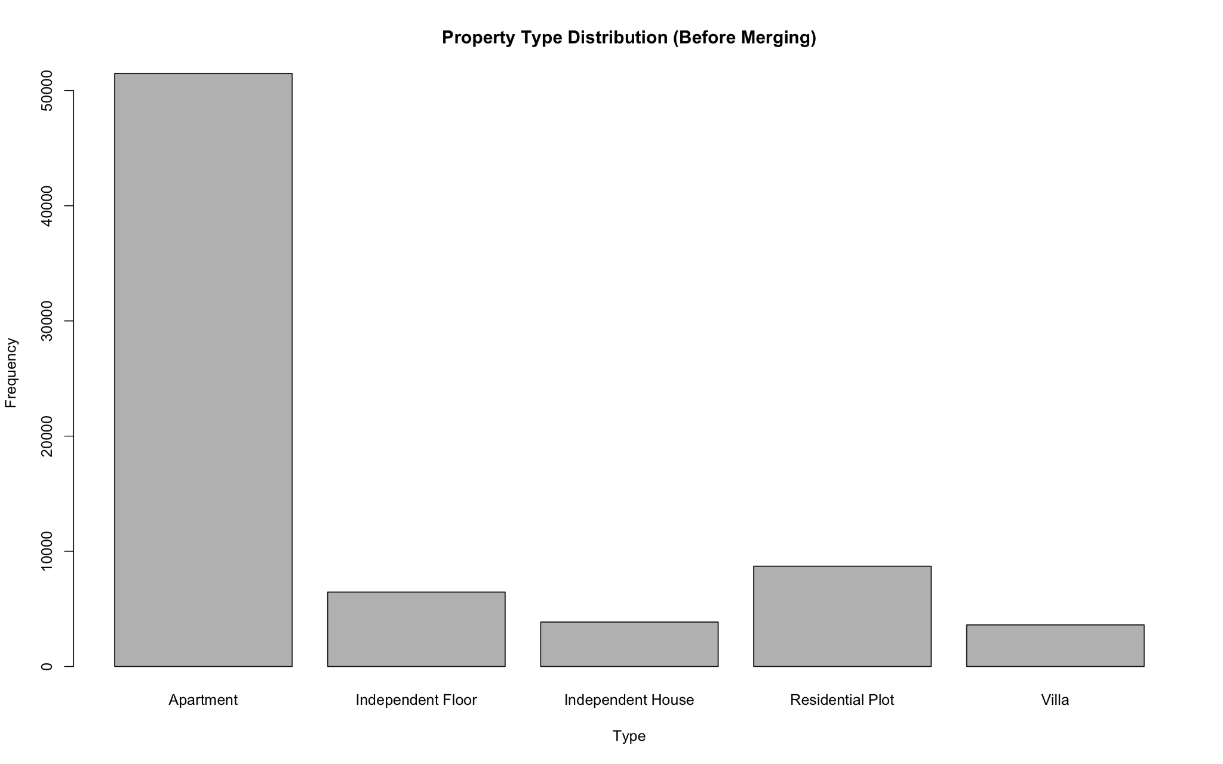
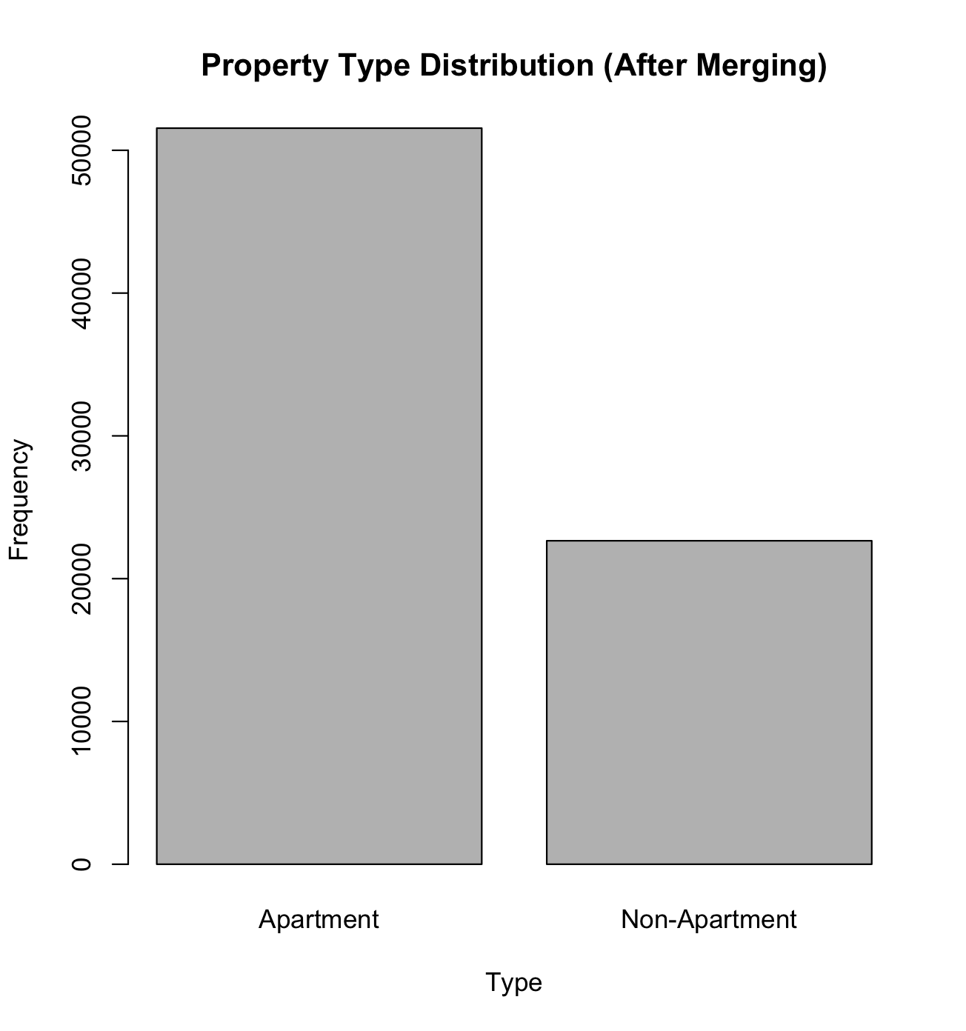
Transforming data according to the Problem Statement:
Before
After
Notes:
Because of the disbalance in the dataset, we decided to combine certain types of housing together. We came up with a binary problem where a property type could either be an apartment or not. This reduced the imbalance in our dataset a lot which is very clearly reflected in the two diagrams.

Slide 6
DATA CLEANING & TRANSFORMATION
Transformations
Data Type Transformation
Min-Max Scaling
Target variable set up
Cleaning
Remove Duplicate or Irrelevant Data
Handle Missing Data
Not Removed Unwanted Outliers
Notes:
Cleaning:
Remove Duplicate or Irrelevant Data: removed columns which were not relevant to the predictions for our target variable
Handle Missing Data: removed the NA values as they were not required and could not be filled out with mean, mode or median because they were categorical variables.
Not Removed Unwanted Outliers: For the analysis we are doing, depending on the size and location of the property, the prices would definitely have an impact on the analysis. We believe these outliers for prices and sizes of the house belong to the distribution and decided to keep the outlier values.
Transformations:
Data Type Transformation: Most of the numerical variables in our dataset were set to data type character, and not integer or double. We converted price, area and size of the property attributes to numeric. This was important to ensure that numeric variable are not used as text variables, but as numeric ones. The factor() function is used to convert categorical variables into factors.
Min-Max Scaling: The minMax() function is defined to implement min-max scaling, which is a normalization technique that scales variables to a range of 0 and 1. This step is important to ensure that variables are on the same scale and to avoid any bias that may arise from variables that are measured on different scales. It is used to normalize the Price_per_unit_area, Price, and Size variables.
Target variable set up: For removing the bias from the data and predicting the target variable correctly, we categorized the target variable to be either Apartment or non-Apartment.

Slide 7
CLASSIFICATION ALGORITHMS
Classification algorithms are used to predict the class or category of a data point based on its features or attributes. We used the following five supervised machine learning classification algorithms
Logistic Regression
k-Nearest Neighbours
Support Machine Vector
Naive-Bayes
Random Forest
Notes:
Logistic Regression: works by calculating the probability of the input variables belonging to one of the two classes, using a logistic function and maps any input value to a value between 0 and 1.
kNN: this classification model categorizes data by calculating the distance between a test instance and all points in the training dataset. Once “k” nearest neighbors are identified, the kNN algorithm calculates the probability of the test instance belonging to each class represented in the k-training data.
SVM: works by constructing an optimal hyperplane by iteration in a multidimensional space to separate the classes. It minimizes the error and maximizes the margin between the support vectors and the dataset.
Naive-Bayes: it is a statistical classifier that uses probability to predict labels. It works by implementing Bayes’ Theorem of conditional probability to calculate the likelihood of each class label, given the data point belongs to a particular class.
Random Forest: it is an ensemble learning algorithm that consists of multiple decision trees. The model operates by randomly selecting a subset of samples from the dataset and constructing a decision tree for each sample.

Slide 8
ATTRIBUTE SELECTION METHODS
Attribute Selection Methods involve selecting the most relevant and useful features (or attributes) from a dataset to use as input for a model. We used the following five classification algorithms:
FEATURES SELECTION METHOD | NUMBER OF SELECTED FEATURES
Random Forest Feature Selection | 4
Boruta Model | 12
Chi-Square | 5
R-Part | 10
Recursive Feature Elimination | 5
Notes:
Chi-Square Test: It employs applying the Chi-Square test individually to each attribute in order to evaluate the degree of independence between two occurrences. When the Chi-Square test shows that the predictor variable and the class variable are independent, then the predictor variable is excluded.
Boruta Model: It operates by using the random forest method to assess the importance of each feature. In the training phase, the Boruta Model generates a set of random shadow features and adds them to the original dataset. Mean Decrease Impurity (MDI) is used to distinguish between the truly important and not important variables by iterating through the random features.
R-part: Recursive partitioning operates by repeatedly partitioning the data into subsets, evaluating all possible feature splits at each node, and selecting the split that optimizes a particular criterion, such as information gain or Gini impurity.
Random Forest Feature Importance: By amalgamating each decision tree created in training phase using a random subset of features selected from the entire feature set, Random Forest estimates the importance of each feature based on its contribution to the model's accuracy.
Recursive Feature Elimination: Works by iteratively eliminating the least important features in a model until a desired number of features is achieved.

Slide 9
PERFORMANCE METRICS - ACCURACY
Model / Method | Random Forest Feature Selection | Boruta Model | Chi Square | R-Part | Recursive Feature Elimination | All Features
Logistic Regression | 83.63% | 83.49% | 83.49% | 87.66% | 84.26% | 89.7%
Naive Bayes | 79.25% | 73.64% | 73.64% | 86.00% | 72.18% | 79.3%
K-Nearest Neighbors | 85.72% | 85.52% | 85.52% | 94.27% | 88.46% | 93.94%
Support Vector Machine | 84.73% | 84.87% | 84.87% | 90.46% | 87.63% | 90.85%
Random Forest | 87.05% | 95.51% | 87.11% | 95.21% | 88.94% | 95.69%
Notes:
Reasons why r-part has higher accuracy than Boruta for most classification models:
Noise in the data: The dataset may contain a lot of noise or irrelevant variables that could negatively impact Boruta's ability to identify the most important variables.
Overfitting: Boruta may select too many variables, leading to overfitting of the model, while Rpart can create a simpler and interpretable model by selecting only the most important variables.
Class imbalance: If the dataset is imbalanced, with one class having significantly fewer samples than the other, Boruta may not perform well, as it relies on random forests to estimate variable importance, which can be biased towards the majority class. Rpart can handle class imbalance by using weighted splits to account for the differences in class frequencies.

Slide 10
PERFORMANCE METRICS - PRECISION
Model / Method | Random Forest Feature Selection | Boruta Model | Chi Square | R-Part | Recursive Feature Elimination
Logistic Regression | 0.8639 | 0.8871 | 0.8607 | 0.8726 | 0.8371
Naive Bayes | 0.7569 | 0.8291 | 0.8170 | 0.8326 | 0.7578
K-Nearest Neighbors | 0.8489 | 0.9324 | 0.8458 | 0.9371 | 0.8786
Support Vector Machine | 0.8699 | 0.8973 | 0.8639 | 0.9046 | 0.8837
Random Forest | 0.8756 | 0.9498 | 0.8765 | 0.9453 | 0.8816

Slide 11
PERFORMANCE METRICS - RECALL
Model / Method | Random Forest Feature Selection | Boruta Model | Chi Square | R-Part | Recursive Feature Elimination
Logistic Regression | 0.7495 | 0.8619 | 0.7473 | 0.8305 | 0.7781
Naive Bayes | 0.7534 | 0.8493 | 0.5753 | 0.8648 | 0.5533
K-Nearest Neighbors | 0.8061 | 0.9235 | 0.8032 | 0.9274 | 0.8429
Support Vector Machine | 0.7687 | 0.8795 | 0.7738 | 0.8677 | 0.8192
Random Forest | 0.8131 | 0.9445 | 0.8138 | 0.9420 | 0.8522

Slide 12
CONCLUSION: BEST MODEL
Looking at the average accuracy, precision, and recall values for each model, we can see that the Random Forest model consistently performs well across all attribute selection methods, followed by the K-Nearest Neighbors and Support Vector Machine models. The Logistic Regression and Naive Bayes models generally have lower average performance across all attribute selection methods. Therefore, we can conclude that the Random Forest model is the best performing model across all classifiers.
Among the attribute selection methods, Boruta Attribute Selection takes the win with Random Forest Classification Model. It is closely competing with r-part attribute selection method which has overall higher statistics for all models except for Random Forest.

Slide 13
THANK YOU

