Slide 1


JSPM’s
Rajarshi Shahu College of Engineering, Tathawade, Pune
(An Autonomous Institute affiliated to Savitribai Phule Pune University)
Department of Computer Science and Business Systems
Academic Year: 2026-27
Project Title: Food Delivery System
Students Name and PRN no: Nirbhay Ane (RBT25CB023), Dhruv Shah (RBT25CB019)
Date: 14 October 2026
Course Name: Database Management System
Course Coordinator: Prof. Rutuja S. Bachhav

Slide 2
Index
Introduction
Problem Definition & Objectives
Literature Survey
Feasibility Study
System Design & Architecture
Database Design & ER Diagram
SQL Implementation & Results
Conclusion
References

Slide 3
Introduction / Background
Definition
A Food Delivery System is a database-driven application that connects customers, restaurants and delivery partners and manages the full order cycle: menu, ordering, payment and delivery.
Overview
This project stores restaurants, menus, customers, orders, payments and delivery partners in a MySQL database. A Flask backend and a web frontend let users place and track orders.
Evolution / Background
Food ordering moved from phone calls and paper bills to app-based platforms such as Zomato and Swiggy, which rely on relational databases to keep orders and payments consistent.
Core Motivation
Online food delivery is a daily-use service in cities like Pune. A well-designed database avoids duplicate data, keeps orders and payments accurate and makes reporting easy.

Slide 4
Problem Definition & Objectives
Problem Statement
Small restaurants often take orders by phone or on paper. This causes:
Order and billing mistakes
No record of customers, payments or deliveries
Delivery partners assigned without tracking
Need: one central database that handles the whole order cycle.
Objectives
Design an ER diagram for restaurants, menu, customers, orders, payments and delivery partners
Convert it into a normalized relational schema in MySQL
Protect data integrity with keys and constraints
Place orders with automatic total calculation and delivery-partner assignment
Provide a web interface and reports (revenue, deliveries)

Slide 5
Literature Survey
Approach / Source | What it offers | Gap
Manual / phone ordering | Simple, needs no technology | Errors, no records, no tracking
Large platforms (Zomato, Swiggy, Uber Eats) | Wide choice, online payment, live tracking | Large and proprietary; not suited for learning or small local use
Relational model [1] and ER model [2] | Tables, keys and normalization keep data consistent | Needs careful schema design for each domain
This project | Open-source MySQL + Flask, normalized schema, full order cycle | Core features only (no GPS or payment gateway)
Theory used: relational model [1], entity-relationship model [2] and standard DBMS textbooks [3], [4].

Slide 6
Feasibility Study
Technical Feasibility
MySQL 8, Python Flask and plain HTML/CSS/JS
Runs on an ordinary laptop
Uses standard SQL: joins, constraints, transactions
Tools are mature and well documented
Financial / Business
All tools are open source, so no licence cost
Only cost is development time
Suits small restaurants and cloud kitchens
Revenue reports support business decisions
Operational Feasibility
Simple screens for ordering and tracking
Delivery partner is assigned automatically
Status updates keep everyone informed
No special training needed

Slide 7
System Design & Architecture
Presentation Layer
HTML, CSS, JavaScript
Order Food, Orders, Customers, Dashboard
Application Layer
Python Flask REST API
Validation, total calculation, delivery assignment
Data Layer
MySQL 8 database
7 tables with keys, constraints, transactions
HTTP + JSON
SQL queries
Order placement flow
1
Select customer, restaurant and items
2
Server calculates total from database prices
3
Delivery partner with fewest active orders is assigned
4
Order, items and payment saved in one transaction
5
Status tracked: Placed to Delivered

Slide 8
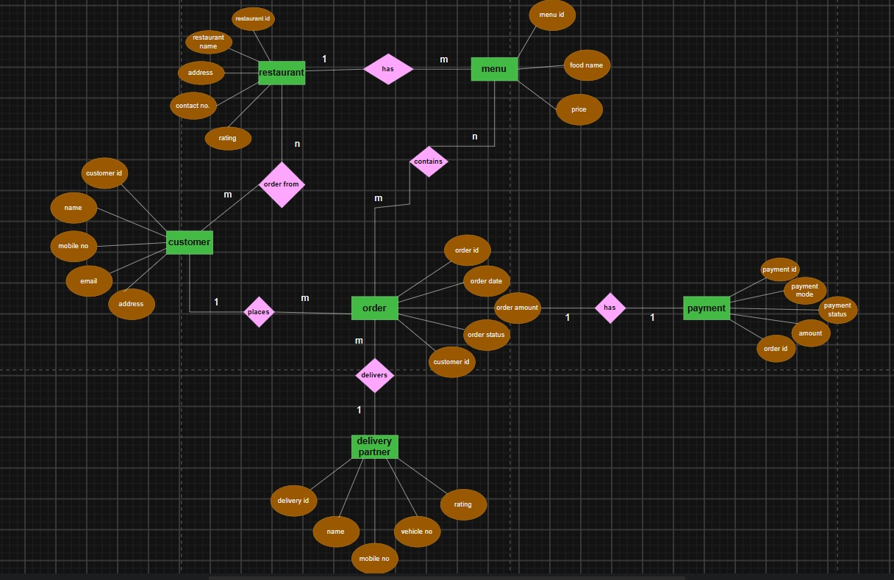
Database Design & ER Diagram
Entities and relationships
Restaurant 1 : M Menu (has)
Customer 1 : M Order (places)
Order 1 : 1 Payment (has)
Delivery Partner 1 : M Order (delivers)
Customer M : N Restaurant (order from)
Order M : N Menu (contains)
The two M : N links become tables in MySQL: orders (order from) and order_items (contains).

Slide 9
Database Design: Relational Schema
Table | Primary Key | Foreign Key(s) | Other attributes
restaurant | restaurant_id | - | name, address, contact_no, rating
menu | menu_id | restaurant_id | food_name, price
customer | customer_id | - | name, mobile_no, email, address
delivery_partner | delivery_id | - | name, mobile_no, vehicle_no, rating
orders | order_id | customer_id, restaurant_id, delivery_id | order_date, order_amount, order_status
order_items | (order_id, menu_id) | order_id, menu_id | quantity
payment | payment_id | order_id (unique) | payment_mode, payment_status, amount
Normalization: tables are in 3NF and the M : N links are resolved with order_items. Totals (order_amount, amount) are stored as derived values for faster reporting.

Slide 10
SQL Implementation & Results (1/3)
Table creation: orders (excerpt)
Constraints used
PRIMARY KEY with AUTO_INCREMENT
FOREIGN KEY with ON DELETE CASCADE / SET NULL
UNIQUE on mobile_no, email, vehicle_no
CHECK: rating 0 to 5, price > 0, quantity > 0
ENUM for order status and payment mode
DEFAULT CURRENT_TIMESTAMP for order date
CREATE TABLE orders (
order_id INT PRIMARY KEY AUTO_INCREMENT,
customer_id INT NOT NULL,
restaurant_id INT NOT NULL,
delivery_id INT NULL,
order_date DATETIME DEFAULT CURRENT_TIMESTAMP,
order_amount DECIMAL(10,2) DEFAULT 0.00,
order_status ENUM('Placed','Preparing',
'Out for Delivery','Delivered','Cancelled'),
FOREIGN KEY (customer_id)
REFERENCES customer(customer_id),
FOREIGN KEY (delivery_id)
REFERENCES delivery_partner(delivery_id)
ON DELETE SET NULL
);

Slide 11
SQL Implementation & Results (2/3)
JOIN: full order details
GROUP BY: revenue per restaurant
SELECT o.order_id, c.name AS customer,
r.restaurant_name,
dp.name AS delivery_partner,
o.order_amount, o.order_status
FROM orders o
JOIN customer c
ON o.customer_id = c.customer_id
JOIN restaurant r
ON o.restaurant_id = r.restaurant_id
LEFT JOIN delivery_partner dp
ON o.delivery_id = dp.delivery_id;
SELECT r.restaurant_name,
SUM(o.order_amount) AS revenue
FROM orders o
JOIN restaurant r
ON o.restaurant_id = r.restaurant_id
GROUP BY r.restaurant_name;
UPDATE: order amount from items
UPDATE orders o SET order_amount = (
SELECT SUM(oi.quantity * m.price)
FROM order_items oi
JOIN menu m ON oi.menu_id = m.menu_id
WHERE oi.order_id = o.order_id)
WHERE o.order_id > 0;
Why LEFT JOIN? Orders that have no delivery partner yet are still listed.

Slide 12
SQL Implementation & Results (3/3)
Order details (sample data)
Revenue per restaurant
ID | Customer | Restaurant | Partner | Amount | Status
1 | Rahul Sharma | Spice Garden | Suresh Kumar | 600.00 | Delivered
2 | Sneha Patil | Pizza Hub | Vikas More | 428.00 | Out for Delivery
3 | Amit Joshi | Biryani House | Suresh Kumar | 610.00 | Preparing
Restaurant | Revenue
Spice Garden | 600.00
Pizza Hub | 428.00
Biryani House | 610.00
3
orders placed
1,638
total revenue (INR)
2
delivery partners used

Slide 13
Conclusion
What we achieved
Designed a complete Food Delivery System, from ER diagram to a working MySQL database
Keys and constraints keep customer, order, payment and delivery data consistent
A Flask backend and web frontend support ordering, status tracking and reports
Applied core DBMS concepts: ER modelling, normalization, joins, aggregation and transactions
Future Scope
Live GPS tracking of delivery partners
Online payment gateway (UPI / cards)
Login with customer, restaurant and admin roles
Ratings, reviews and food recommendations

Slide 14
References
[1] E. F. Codd, "A Relational Model of Data for Large Shared Data Banks," Communications of the ACM, vol. 13, no. 6, pp. 377-387, 1970.
[2] P. P. Chen, "The Entity-Relationship Model: Toward a Unified View of Data," ACM Transactions on Database Systems, vol. 1, no. 1, pp. 9-36, 1976.
[3] R. Elmasri and S. B. Navathe, Fundamentals of Database Systems, Pearson.
[4] A. Silberschatz, H. F. Korth and S. Sudarshan, Database System Concepts, McGraw-Hill.
[5] Oracle Corporation, MySQL 8.0 Reference Manual, https://dev.mysql.com/doc/
[6] Pallets Projects, Flask Documentation, https://flask.palletsprojects.com/
[7] MDN Web Docs: HTML, CSS and JavaScript, https://developer.mozilla.org/

