Slide 1

Flight Ticket Booking Application
RNS INSTITUTE OF TECHNOLOGY
BENGALURU - 98
DEPARTMENT OF INFORMATION SCIENCE & ENGINEERING
Presentation on Internship
Vaidehi VL
USN: 1RN18IS114
ENMAZ Engineering Services Pvt. Ltd.
Internal Guide
Dr. Mamatha G
Prof, Dept of ISE, RNSIT
External Guide
Mr. Akshay DR
Director, JP Nagar, Bangalore

Slide 2
AGENDA
Abstract
About the Company
Introduction
Literature Survey
Requirements
System Design
Implementation
Testing
Conclusion and Future Enhancements
References

Slide 3
ABSTRACT
The flight ticket booking application provides a user friendly, interactive system to book flight tickets over the internet.
The main objective of the application is to allow users to login, book flight tickets and also view the status of their current booking.
This flight booking app has a sound UI design and quality features that render a seamless user experience.
The user gets to book their flight tickets through the app anywhere and everywhere in the comfort of their house.
The users booking status will be displayed in the booking status section, where the details about confirmation or cancellations of booking are displayed.
The project is built using Flutter.

Slide 4
About the Company
Enmaz Engineering Services Private Limited is a Private incorporated on 02 December 2019. It is classified as Non-govt company and is registered at Registrar of Companies, Bangalore.
Enmaz has a simple yet robust solution that helps any Industry / Factory digitise their workfloor in no time. The products offered will help in remote monitoring, controlling and also analysing any machine parameter or process
The directors of this company are Akshay Ramakrishna Davasam and Devasam Siddananjappa Setty Ramakrishna
Registered address is #75, 2nd cross, 6th main, 3rd phase, j.p.nagar, bangalore 560078
The current status of Enmaz Engineering Services Private Limited is ACTIVE.

Slide 5
INTRODUCTION
The project is built using Flutter, which is an open-source framework by Google for building beautiful, natively compiled, multi-platform applications from a single codebase.
The Flutter framework consists of both a software development kit (SDK) and their widget-based UI library. This library consists of various reusable UI elements, such as sliders, buttons, and text inputs.
The main objective of the flight ticket booking application is to allow users to book flight tickets in a convenient manner.
Flight booking is made simple as that of a taps and swipes.
The various features present in the application are login, search flights, view trips, view booking details, one way and round trips.

Slide 6
LITERATURE SURVEY
In paper [1], the author discussed the usability of an flight booking system cannot be predicted without considering the flexible behavior of travelers. However, travelers' flexible behavior is molded by a number of service quality attributes. In this paper, service quality attributes along with external variables were computed to determine their association with flexible behavior of travelers and to also ascertain their individual range and strength of association.
Paper [2] discussed how Integrated Development Environments (IDEs) provide a convenient standalone solution that supports developers during various phases of software development. The focus in this paper is on Visual Studio IDE. The author instrumented the previously unexplored Visual Studio IDE and tracked the interactions of developers at an industry partner’s software-development department
Paper [3] discussed about cross platform development using Flutter. Cross-platform mobile development today is full of compromise .Flutter is an open-source SDK for creating high-performance, high- fidelity mobile apps for iOS and Android.

Slide 7
LITERATURE SURVEY
Paper [4] discussed how smartphones have introduced great easiness in our daily life by mobile applications. Nowadays, it is possible to complete tasks on-the-go, without the need of computer. One of the facilities provided is the mechanism to buy flight tickets via mobile phones. However, in the development phase, often poor consideration of end-users' usability requirements leads to under utilization of such facility, thus decreasing potential profit of companies. The purpose of this work is to investigate usability problems for mobile flight booking applications on touch-screen phones and suggest solutions.
Paper [5] discussed the historical development of airlines reservations systems is traced. Characteristics are defined which are those of any real-time, conversational, highly interactive system. The structure of the system is described--agent terminal area, communications facilities, and central site. Lessons learned in the design, development, testing, implementation, and tuning of two generations of systems are discussed.

Slide 8
Requirements
Hardware Requirements
The processor used is Intel(R) Core (TM) i5-8265U CPU @ 1.60GHz.
The capacity of Random-Access Memory (RAM) is 4GB.
The capacity of the storage element of disk space is 2.99GB.
The monitor used is HDMI monitor.
The keys available in the keyboard is 104 keys.
Software Requirements
Operating System: Windows 10
Tools: Flutter
Platform or IDE: Visual Studio Code
Network: Internet connection required

Slide 9
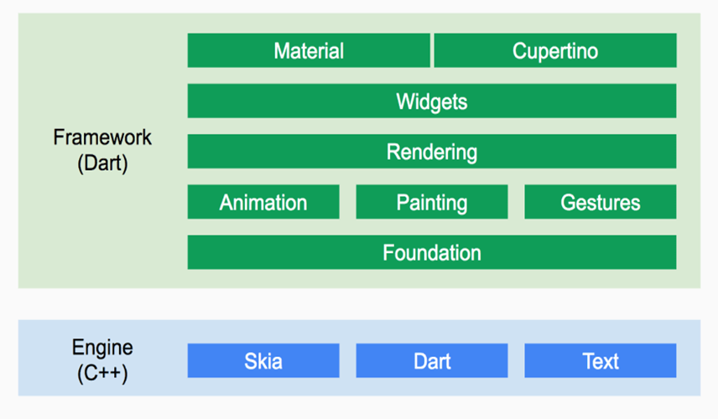
System Design
Flutter Architecture

Slide 10
System Design
Flutter is organized around layers. Each layer is built upon the previous.
From the diagram, we can see the low-level part of Flutter is an Engine built in C++.
It provides libraries to handle animation, gestures, rendering, widgets and more.
With all this layer the developer can do more with less code by using elements on the top or go down to customize some behavior of its app
Basic building block services and foundational classes, such as animation, gestures, and painting, offer commonly used abstractions over the underlying foundation.
The rendering layer brings forth an abstraction for working with layout and building a tree of renderable objects.

Slide 11
System Design
The widgets layer introduces the reactive programming model. Each class in the widgets layer corresponds with a render object in the rendering layer. Besides, the widgets layer allows defining combinations of reusable classes.
The Cupertino and Material libraries provide all-inclusive sets of controls that implement the iOS or Material design languages through the use of the widget layer composition.

Slide 12
System Design
Basic Widgets
In Flutter, everything is a widget nested inside another widget. It comes with beautiful, customizable widgets and we can control the behavior of each widget and also styling becomes easy.
Text
Row
Column
Image
Icon
Scaffold
Button
AppBar
Container

Slide 13
Implementation
About Visual Studio Code
Visual Studio Code is a source-code editor made by Microsoft for Windows, Linux and macOS.
Features include support for debugging, syntax highlighting, intelligent code completion code
refactoring and embedded Git.
About Flutter
Flutter is an open-source UI software development kit created by Google. It is used to develop cross platform applications for Android, iOS, Linux, Mac, Windows, Fuchsia,Web, and the web from a single codebase.

Slide 14
Implementation
Main.dart file
import 'package:challenge_infracea/pages/login/login_page.dart';
import 'package:challenge_infracea/utils/consts.dart';
import 'package:flutter/material.dart';
void main() {
runApp(VeppoApp());}
class VeppoApp extends StatelessWidget {
@override
Widget build(BuildContext context) {
return MaterialApp(
debugShowCheckedModeBanner: false,
theme: ThemeData(
fontFamily:'Montserrat',
scaffoldBackgroundColor: Colors.white,
primarySwatch: white,
hintColor: Colors.transparent,
focusColor: Colors.transparent,
hoverColor: Colors.transparent,
indicatorColor: Colors.transparent,
splashColor: Colors.transparent,
highlightColor: Colors.transparent,),
home: LoginPage(),
);}}

Slide 15
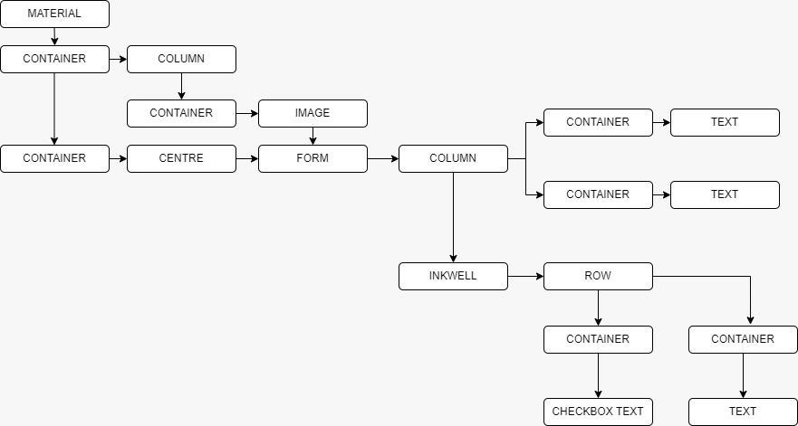
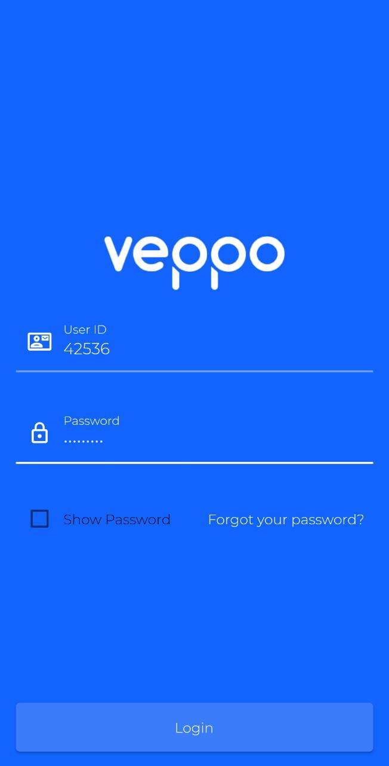
Implementation
Widget tree for login screen

Slide 16
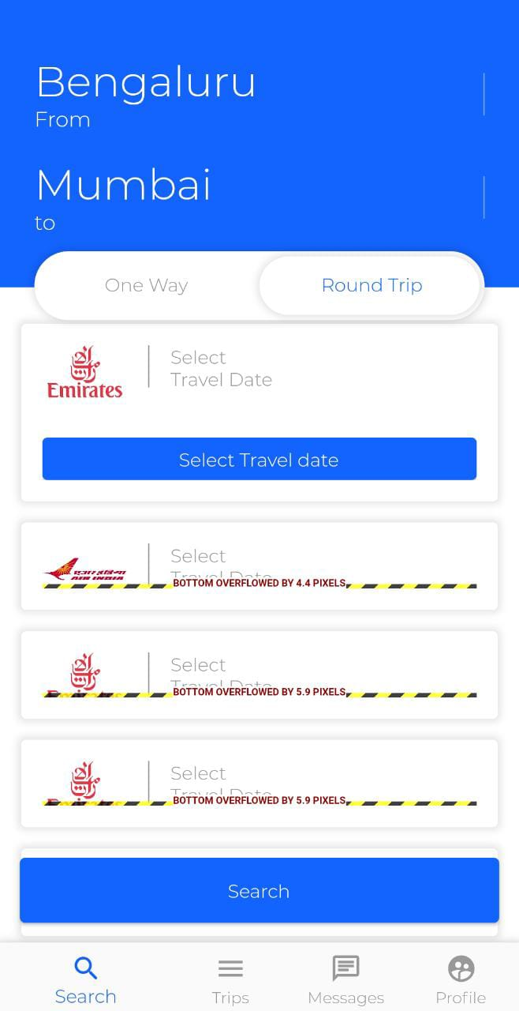
Results
Login screen where the user has to enter the user id along with the password in order to login to the app. Once this is done, the user clicks on the login button to navigate to the app.
The above screen displays one way trip and round trip flights that are available for booking.The user can select the flight they wish to book for the available list.

Slide 17
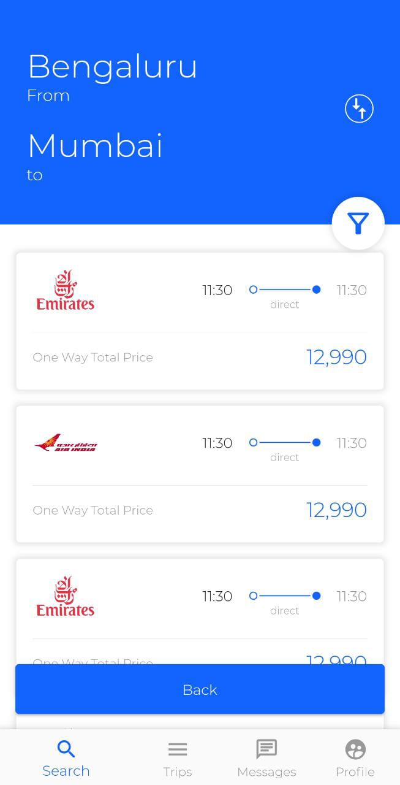
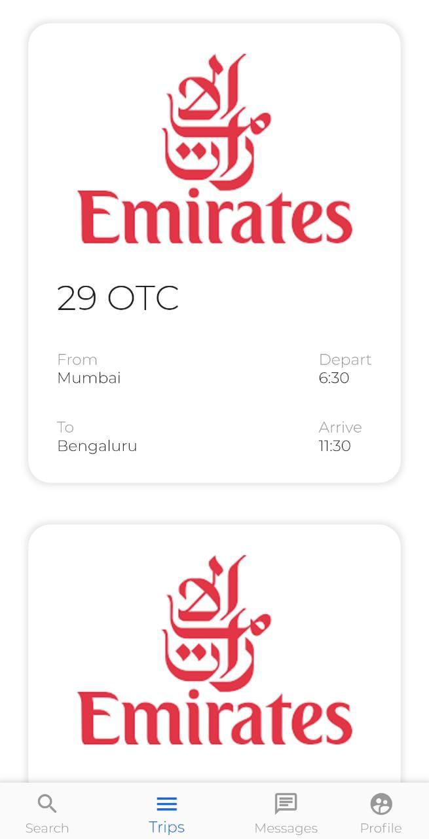
Results
The above screen displays the search option. On clicking the search button, the user is navigated to a list of the flights available from which the user can choose.
The above screen displays the trips option. This option displays the trips taken by the user.It shows the list of journeys of the user. The user can click on these to view the full ticket.

Slide 18
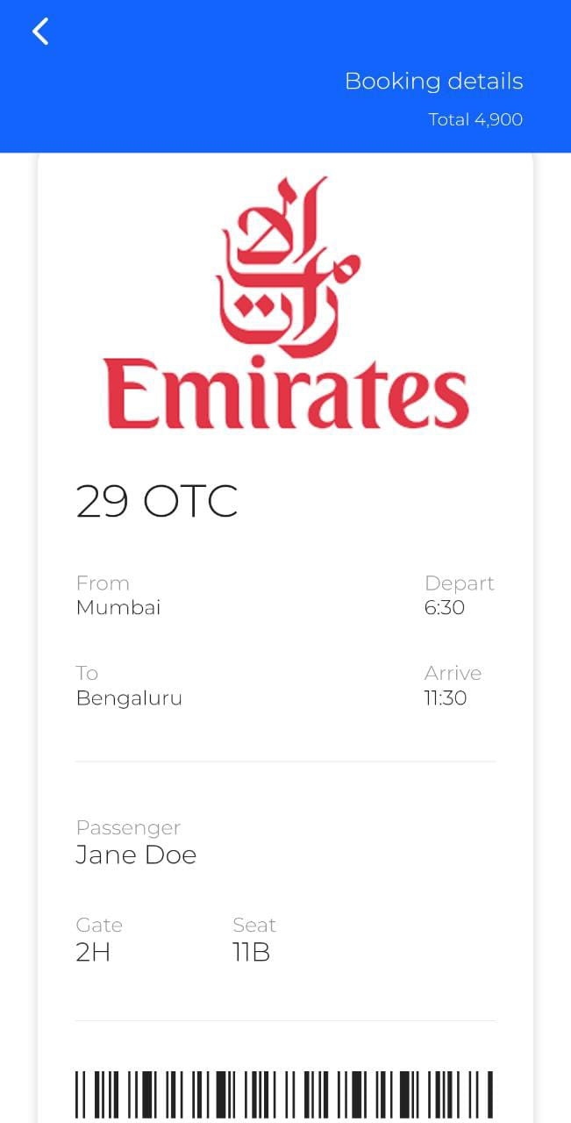
Results
The above screen displays the complete ticket. Upon clicking the option in the trips page, the user is navigated to a page that displays the complete ticket. This includes trip details like departure city and destination city, name, price, barcode, date, flight name and number, etc.

Slide 19
Conclusion
This internship project has been implemented with making appropriate effort to overcome the time consuming problem of manual system.
It has been successfully designed and implemented using Flutter. The system has been developed in a way to make it very user friendly.
This application provides facility to book tickets anywhere and anytime.
It saves time as the user need not wait in long queues to book tickets.

Slide 20
Future Enhancements
In future, the system can be implemented with various sources and destinations.
Discounts and offers can be enabled for users.
It can be possible to make it more user friendly by adding more variety of functions to it.
Allowing users to select their choice of seat.
It can be made fully functional by adding payment options.
The interface can be connected to a database to facilitate data validation and storage.

Slide 21
References
https://flutter.dev/
https://code.visualstudio.com/
Reference Papers:
Paper [1]: https://ieeexplore.ieee.org/document/7845037
Paper [2]: https://ieeexplore.ieee.org/document/7476636
Paper [3]: https://ijesc.org/upload/b3930ac14331fd1b425af8cd1c341d41.Cross%20Platform%20Development%20using%20Flutter%20(1).pdf
Paper [4]: https://ieeexplore.ieee.org/document/6516325
Paper [5]: https://ieeexplore.ieee.org/document/1450843

Slide 22
THANK YOU

